Slide 1
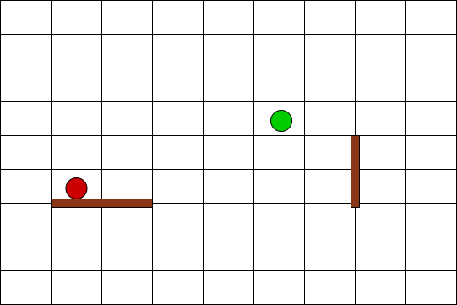
QUORIDOR BOT
INTRODUCTION
Quoridor is a board game invented in 1995. You can read the rules here. The goal is to reach the opposite end of the board before the opponent. You can use walls to interfere with your opponent.
RESULTS
Algorithms were compared in regards to the time it took them to calculate the next move. The results are displayed in the graph below*:
PROBLEM
At first glance, the game doesn’t seem so complicated. However, the number of positions where walls can be placed is large and that increases the game’s complexity. Because there are 128 places on which you can place a wall, and each wall borders 4 fields, and there are 20 walls, the total number of places for walls increases quickly, and with it the game’s tree size complexity. The quoridor’s game tree size is 10¹⁶² [ 1 ], whereas the one of chess is 10¹²³ .
ALGORITHMS
Algorithms used are:
Minimax
Minimax with alpha-beta pruning
Expectimax
Monte Carlo tree search
Quoridor table example
References
RESPALL, Victor Massague; BROWN, Joseph Alexander; ASLAM, Hamna. Monte carlo tree search for quoridor. In: 19th International Conference on Intelligent Games and Simulation, GAME-ON. 2018. p. 5-9.
*Results were acquired by calculating average time needed for next move after one game with each of the bots. Results were acquired by playing on a computer with AMD Ryzen 5 2600X processor.

