Slide 1


Statistical Machine learning: KAGGLE bank telemarketing outcome prediction
Mario cortez, Dimitri Kestenbaum, Fangda fan

Slide 2
Experimental setup
DATA EXPLORATION
DATA PREPROCESSING
HYPERPARAMETER TUNING
EVALUATION METRICS

Slide 3
Data exploration
Initial data exploration

Slide 4
Data exploration I
Variable | Variable Type
Client_ID | Integer
Age | Float
Job | Object
Marital | Object
Education | Object
Default | Object
Housing | Object
Loan | Object
Contact | Object
Month | Object
Day_of_week | Object
Campaign | Float
Number of days passed from previous campaign contact | Float
Number of contacts performed before this campaign | Float
Outcome of previous campaign | Object
Employment variation rate (Quarterly) | Float
Consumer price index (Monthly) | Float
Consumer confidence index (Monthly) | Float
Euribor 3 month rate (Daily) | Float
Number of employees (Quarterly) | Float
Subscribe | Integer
Initial EDA

Slide 5
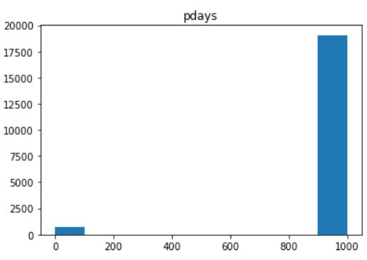
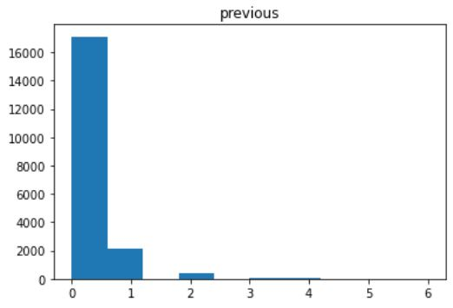
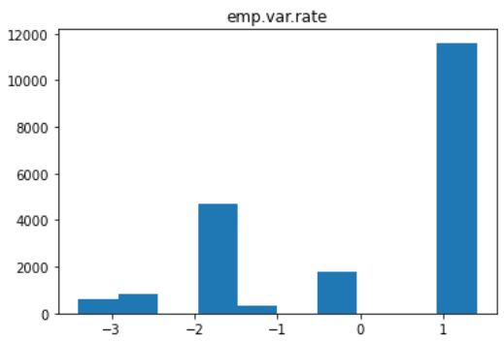
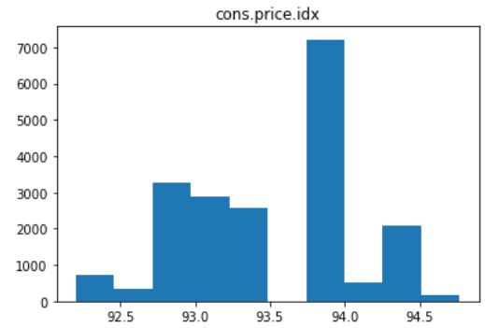
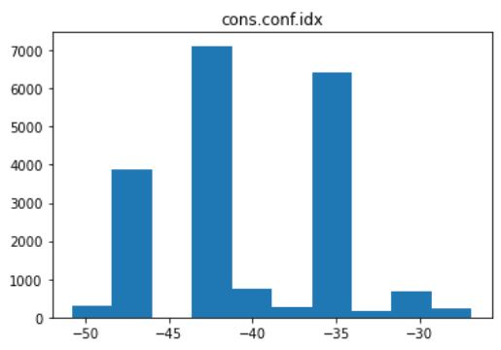
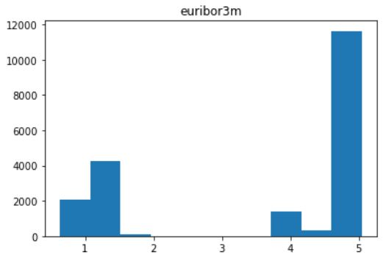
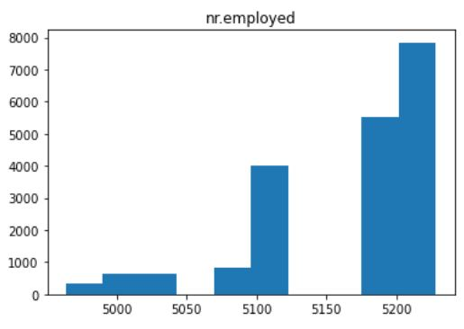
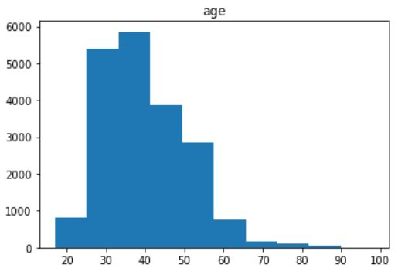
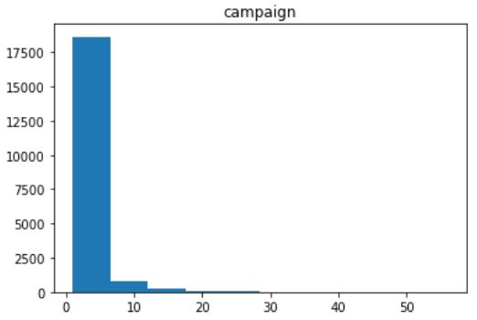
DATA exploration II
Visualize Feature Distributions
Notes:
Exploring the distributions of continuous features. Checking for highly abnormal patterns and wide-ranges in scale.

Slide 6
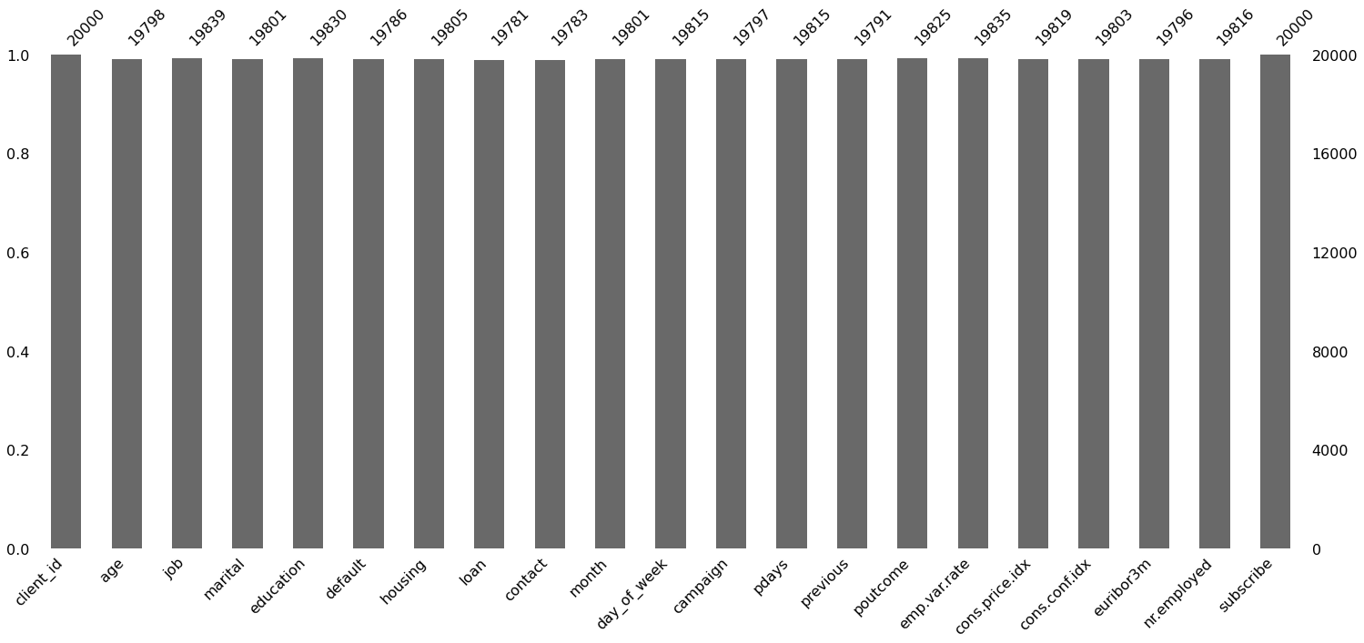
Data exploration III
Visualize Missing Values

Slide 7
Data PROCESSING
Main contributor to improvement on auc

Slide 8
Data preprocessing steps
Error Correction
Impute Missing Values
Value Transformation
Discretize Numerical Variables
Value Representation
Dummy Encode Categorical Variables
Variable Selection
Recursive Feature Elimination with Cross-Validation
Notes:
Dimitri

Slide 9
Data processing Pipeline Control Flow
Iterative Experimentation:
Control flow for toggling methods on or off
Methods applied:
Missing value imputation strategies
Categorical encoding approaches
Feature engineering
Recursive feature elimination
Strategies in Pipeline | Action
Imputation Function | True
Impute “missing” Categorical Variables | False
Label Encoding | True
One-Hot-Encoding | False
Ordinal Encoding for Ordinal Categoricals & Dummy Encoding for High-Cardinality Categoricals | False
Feature Engineering | False
Forward Stepwise Feature Selection | False
Recursive Feature Elimination | True
Notes:
We can create a table here as follows:
Dimitri

Slide 10
Data processing I
Method 1
Numerical Variables Mean
Categorical Variables "Missing" Category
Error Correction:
Impute Missing Values
Method 2
Numerical Variables Mean
Categorical Variables Most Frequent Value
Notes:
Mention this was our most effective approach:
Approach 1:
Numericals -> Mean
Categoricals -> Most Frequent Value
Approach 2
Numericals -> Mean
Categoricals -> New "Missing" Category
Dimitri

Slide 11
Data processing II
Age
Number of days passed from previous campaign contact
Value Transformation:
Discretize Numerical Values
Notes:
Discretize age : Age to 5 quantiles
Convert Pdays to 12 months

Slide 12
Data processing III
Label Encoding
Resulted in best AUC
One-Hot-Encoding
Hybrid Approach
Ordinal Encoding for Ordinal Categorical Features
Dummy Encoding for High-Cardinality Categorical Features
Value Representation:
Dummy Encode Categorical Variables
Notes:
Categorical Encoding Approaches

Slide 13
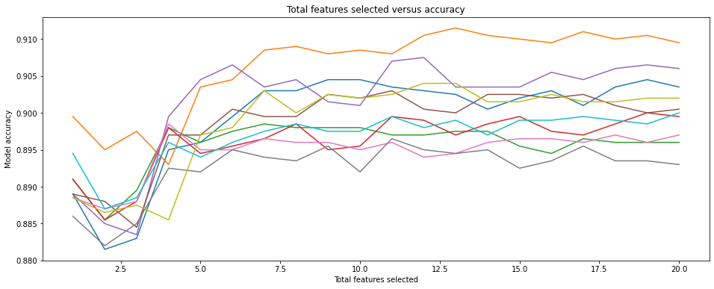
Data processing IV
RFECV package from sklearn
Resulted in overfitting and marginally lower AUC
Number of features selected vs 10-Fold cross-validated accuracy
Variable Selection:
Recursive Feature Elimination with Cross-Validation
Notes:
Optimal number of features?

Slide 14
Hyperparameter tuning
Strategies for 4 models chosen

Slide 15
Models chosen & hyper-parameter tuning strategy
Logistic Regression
Random Forest Classifier
AdaBoost Classifier
Light Gradient Boosting Machine Classifier
GridSearch + fixed parameters
GridSearch + list comprehension & np.linspace()
Randomized Gridsearch

Slide 16
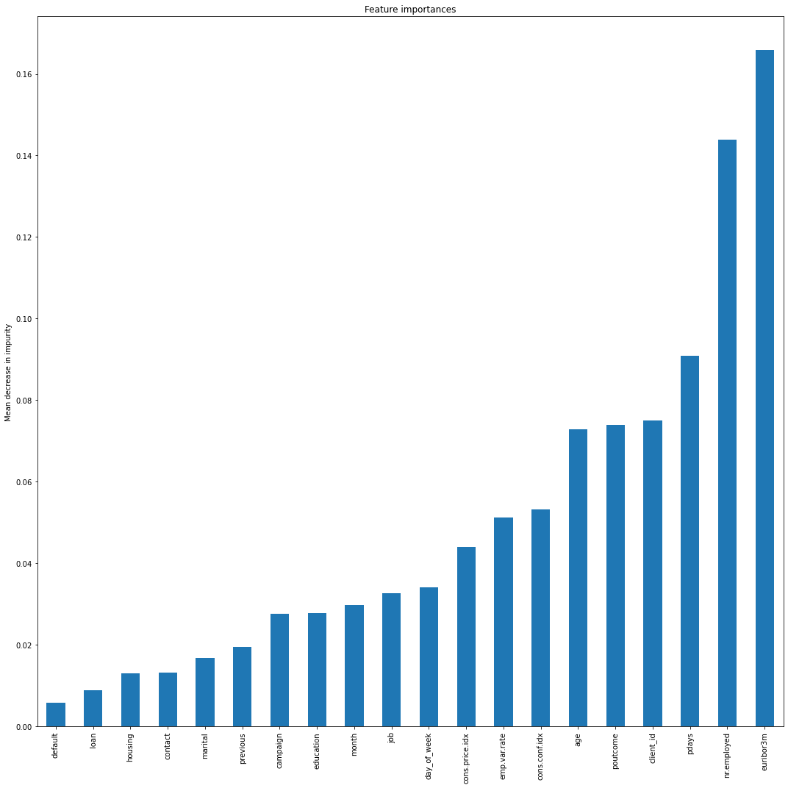
Feature importance
Random Forest Classifier Model

Slide 17
Evaluation metrics
AUC Score + ROC curve

Slide 18
EVALUATION METRICS
 | Logistic Regression | Random Forest | AdaBoost Classifier | Light Gradient Boosting Machine Classifier
Train AUC | 0.77 | 0.78 | 0.79 | 0.79
Test AUC | 0.77 | 0.60 | 0.78 | 0.79
AUC Score Comparison

Slide 19
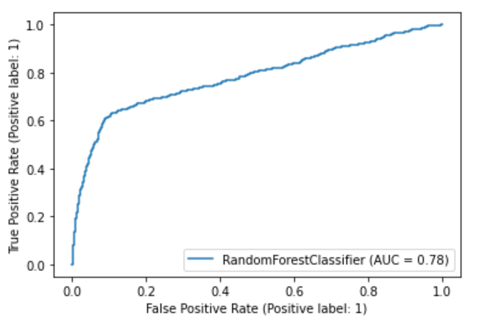
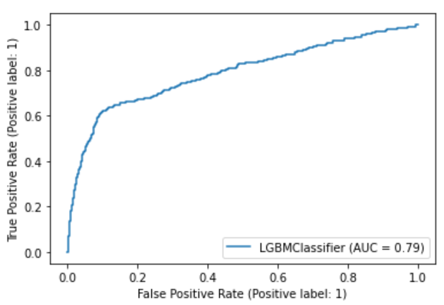
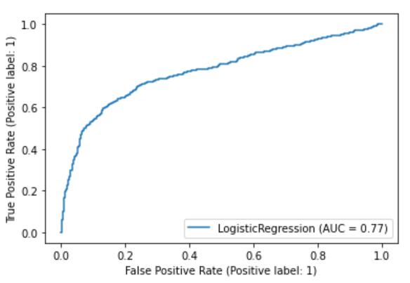
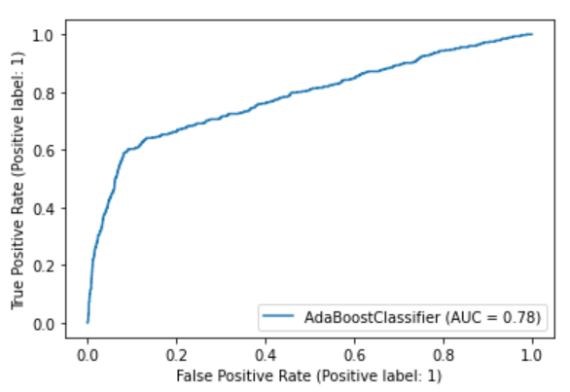
Evaluation metrics
ROC Curve Comparison

Slide 20
Evaluation metrics
Classification Report for Best Model: LGBM Classifier
 | Precision | Recall | F1-Score | Support
Non-Subscribers | 0.90 | 0.98 | 0.94 | 3524
Subscribers | 0.67 | 0.23 | 0.34 | 476
Accuracy |  |  | 0.90 | 4000
Macro Average | 0.79 | 0.61 | 0.64 | 4000
Weighted Average | 0.88 | 0.9 | 0.87 | 4000

Slide 21
Sources https://towardsdatascience.com/logistic-regression-model-tuning-with-scikit-learn-part-1-425142e01af5 https://pandas.pydata.org/docs/user_guide/style.html https://scikit-learn.org/stable/auto_examples/ensemble/plot_forest_importances.html https://towardsdatascience.com/hyperparameter-tuning-the-random-forest-in-python-using-scikit-learn-28d2aa77dd74

