Slide 1


Artificial Intelligence Applications:
Text-based depression detection
Department of Digital Systems
MSc Artificial Intelligence
University of Piraeus-NCSR ’Demokritos’
Dimitris Konstantakopoulos
Evangelia Baou
Hlias Magklogiannis
Athens, 2021

Slide 2
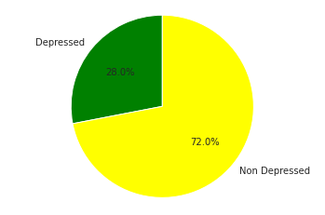
Problem Definition
Detection of patients’ mental health state based on text clinical interviews.
Why?
Depression in a disease that affects millions of individuals around the world
Efficient and effective automatic depression diagnosis can be of substantial benefit
Binary classification problem
The dataset
The dataset used in our study is part of a larger corpus, the Distress Analysis Interview Corpus (DAIC)
This published dataset only includes 107 participants for the training part and 35 participants for the evaluation part.
Type of data: Text

Slide 3
Data Modelling
Sequence modelling only models the patients' responses in succession, without knowledge of the particular question asked.
Our sequential modeling approach treats an entire paragraph spoken by a patient as a single sample.
Data Preprocessing
Tailing blanks removal
Every letter was set to be lowercase
Removal of punctuations
Removal of stopwords
Removal of most common and rare words
Custom preprocessing were applied for replacing the informal speaking with a formal one.
Tokenization
Meta Information
Meta information such as <laughter> or <sigh> are possibly helpful to the model, thus were not removed.

Slide 4
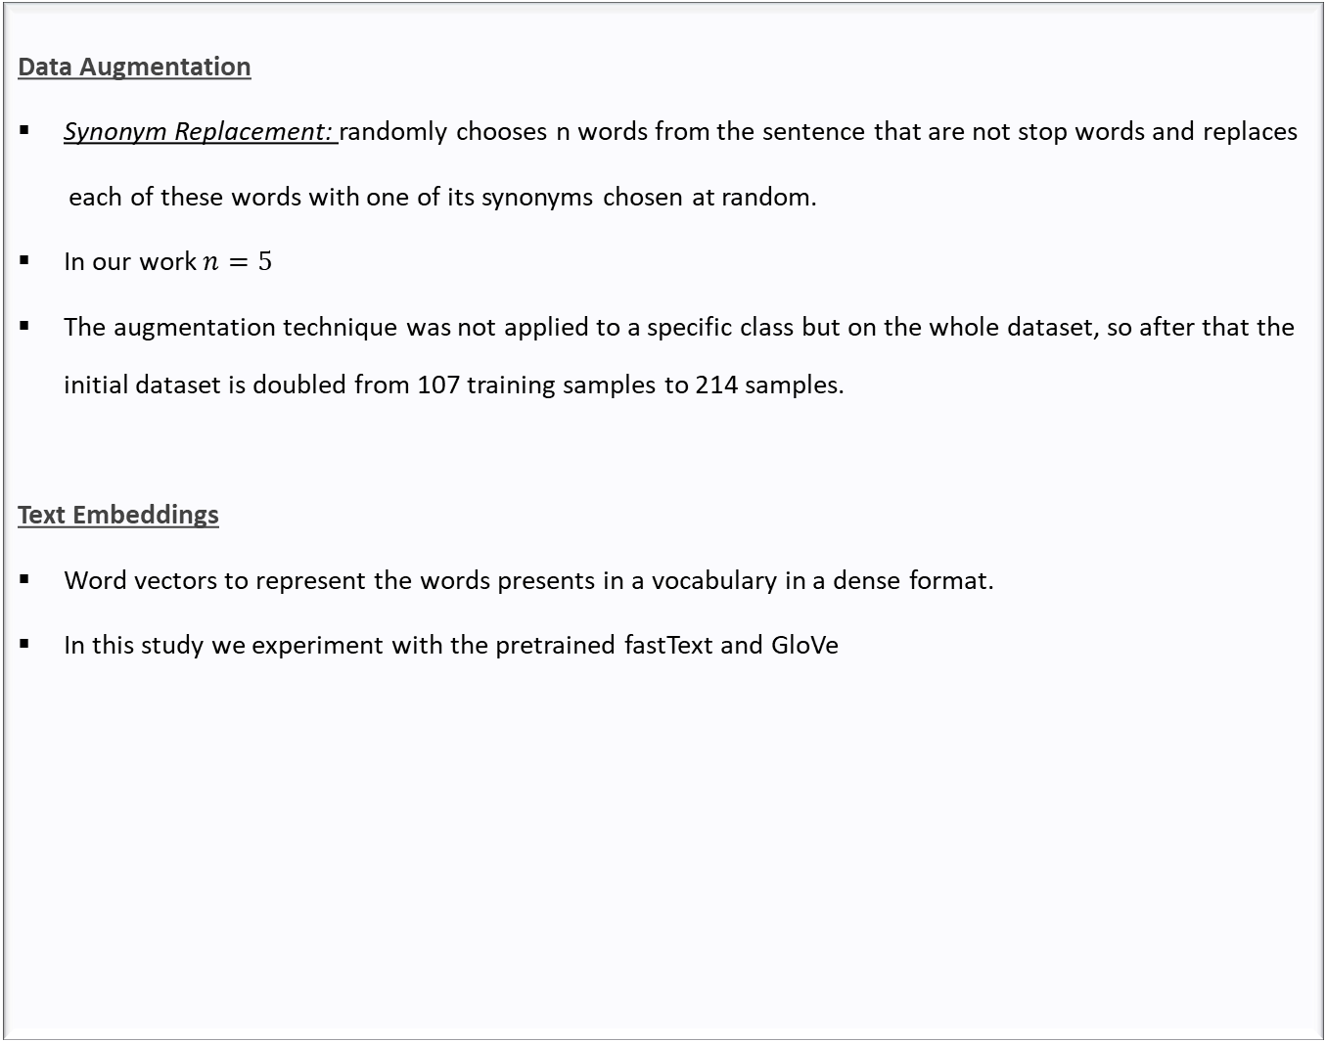

Slide 5
Text Embeddings
fastText
Represents each word as an n-gram of characters
Once the word has been represented using character n-grams, a skip-gram model is trained to learn the embeddings.
The word embedding vector for each word will be the sum of all of its n-grams
GloVe
A count-based, unsupervised learning model that uses co-occurrence (how frequently two words appear together) statistics at a Global level to model the vector representations of words.
For in-stance, given a corpus having V words, the co-occurrence matrix X will be a V x V matrix,where the ith row and jth column of X, Xij denotes how many times word i has co-occurred with word j.

Slide 6
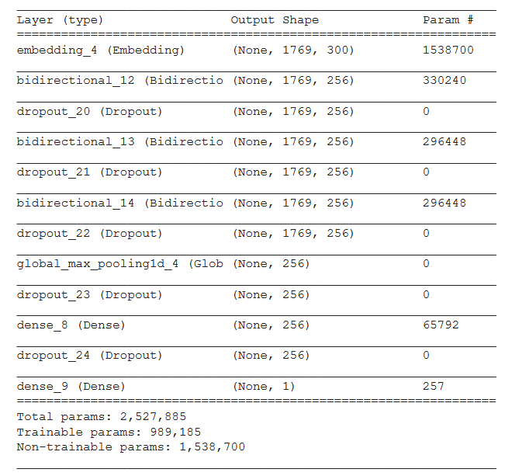
Bidirectional RNN with GRU architecture
Model Architecture

Slide 7
Experiments Set up
Stratified 5-Fold cross-validation
Training was done by running Adam optimizer for at most 10 epochs and a batch size of 15
The initial learning rate was set to be 0.0004 which was reduced by a factor of 10 if the cross-validation loss did not improve for at most 2 epochs.
Our model is initially trained using both fastText and Glove and without using the aforementioned embedders. These two approaches are compared and the one with the lowest validation loss is chosen.

Slide 8
Results
 | Validation Loss | Accuracy
fastText | 51% | 65%
GloVe | 62% | 71%
Table 1. Cross Validation results using fastText and GloVe embedders
 | Depressed | Non Depressed
Depressed | 20 | 3
Non Depressed | 5 | 7
Table 2. Confusion Matrix of BGRU-fastText model

Slide 9
Results
 | F1-score | Precision | Recall
Depressed | 64% | 70% | 58%
Non Depressed | 83% | 80% | 87%
Macro avg | 73% | 75% | 73%
Weighted avg | 77% | 77% | 77%
Table 2. Classification report of BGRU-fastText model

Slide 10


