Slide 1
GitHub: How to Sign Up
Anea Roshyl Santos
BSIT – 404a

Slide 2
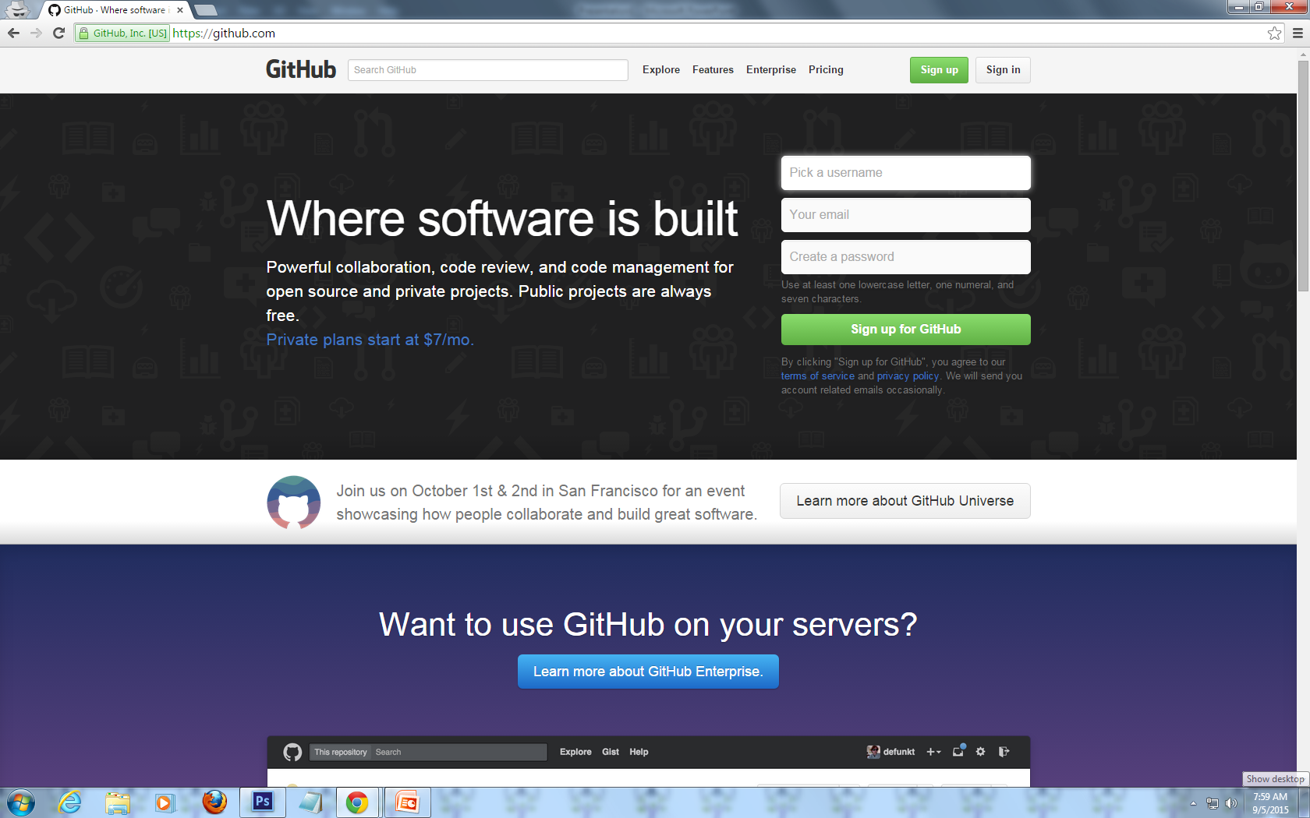
Step 1: Go to http://www.github.com

Slide 3
Step 2: Click the ‘Sign up’ button

Slide 4
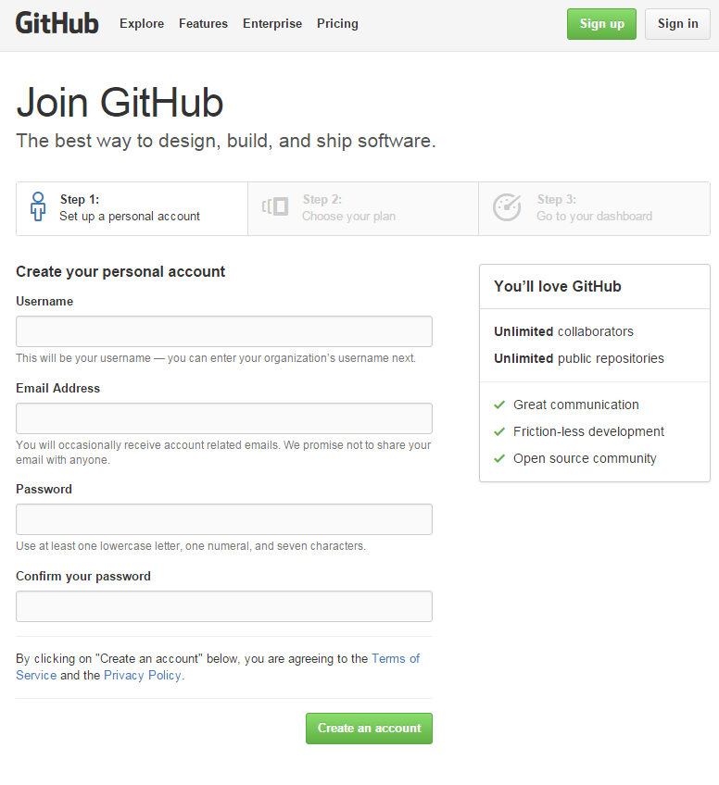
Step 3:
Fill up the form and
click ‘Create an
account’

Slide 5
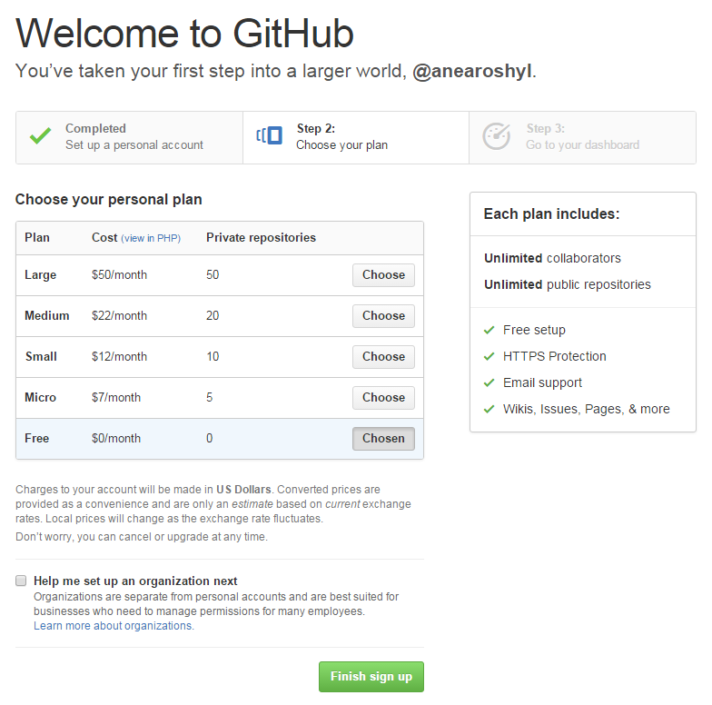
Step 4:
Select the plan that
you want by clicking
the ‘Choose’ button
Click ‘Finish sign up’

Slide 6
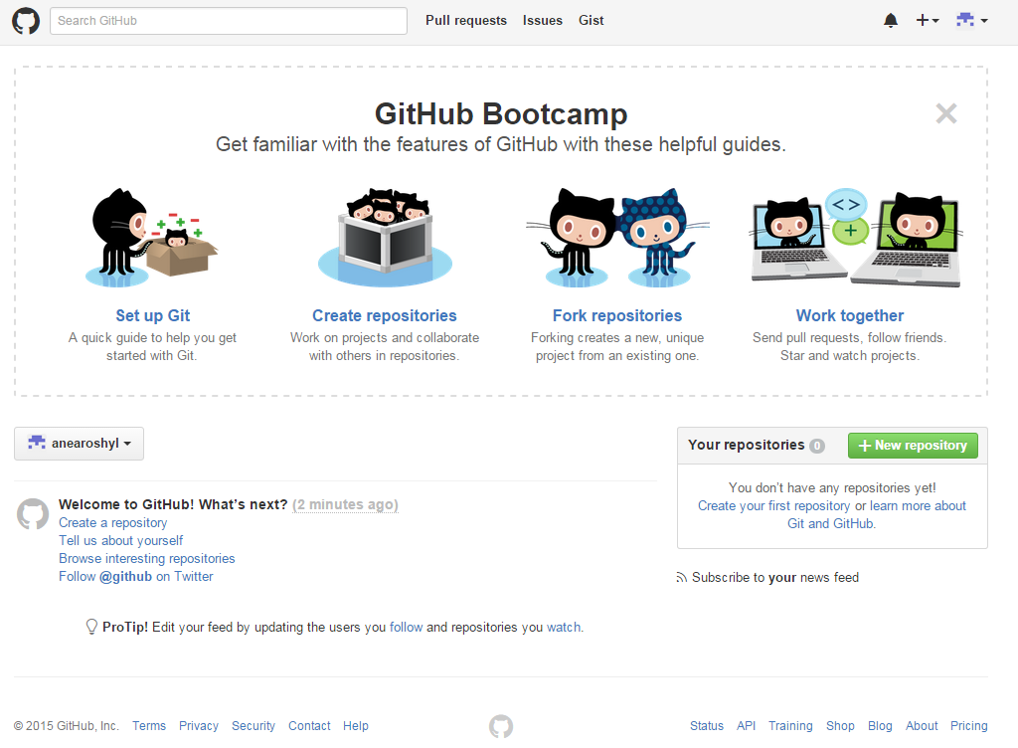
Step 5: This is the page that will appear after you sign up. You can use the guides in order for you to properly use GitHub.

Slide 7
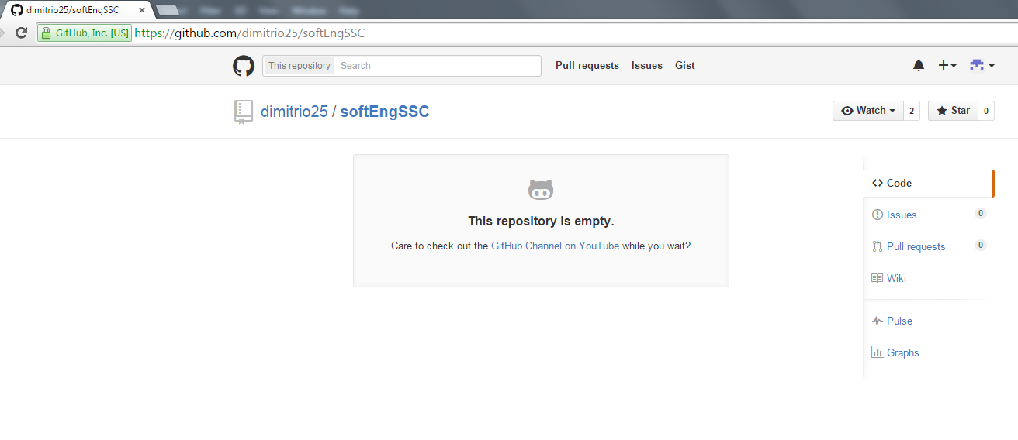
Step 6: If there is a repository that you want to check out, type its URL in your browser’s address bar and you will be directed to its page. In this example, we visited https://github.com/dimitrio25/softEngSSC

Slide 8
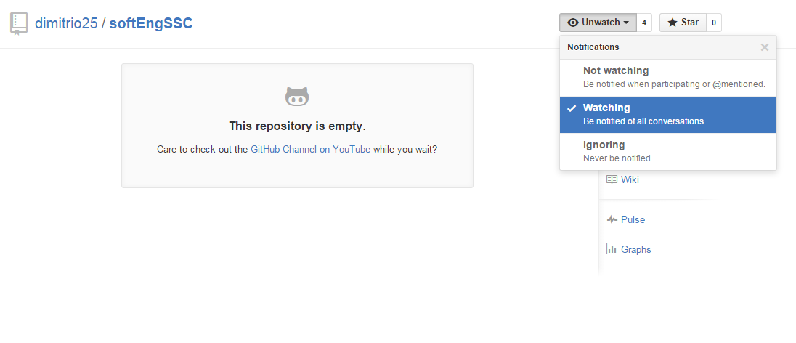
Step 7: Click the ‘Watch’ button. From the Notifications dropdown menu, select the way you want to be notified about the repository’s activities.

