Slide 1
Carza, Jan BS-IT 404 Software Engineering - Midterm

Slide 2
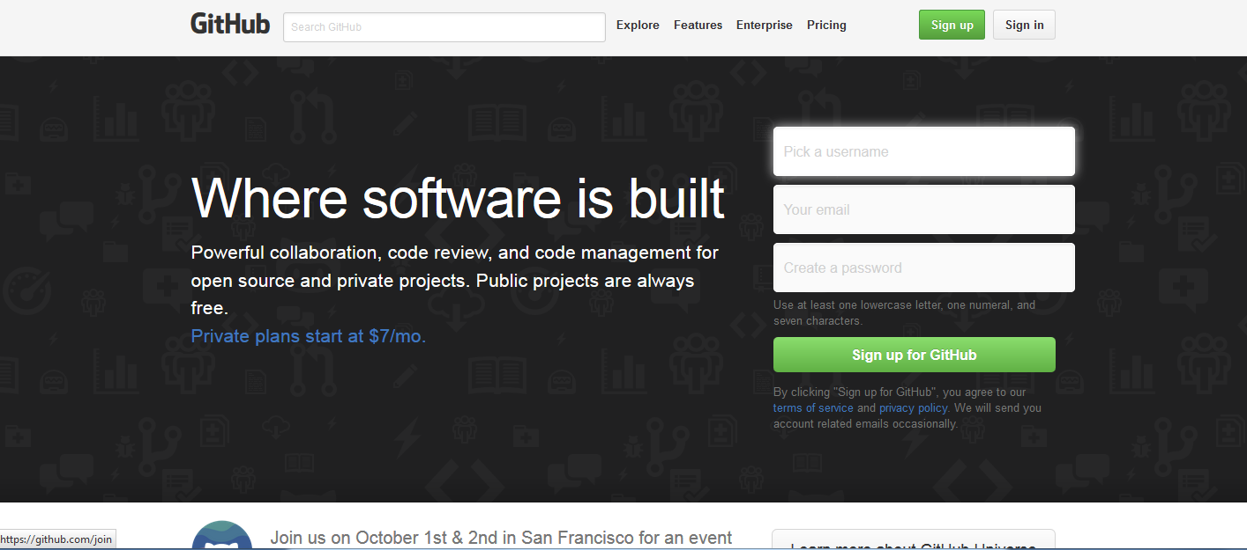
STEP 1:
Go the Github homepage.
STEP 2:
Click Sign Up

Slide 3
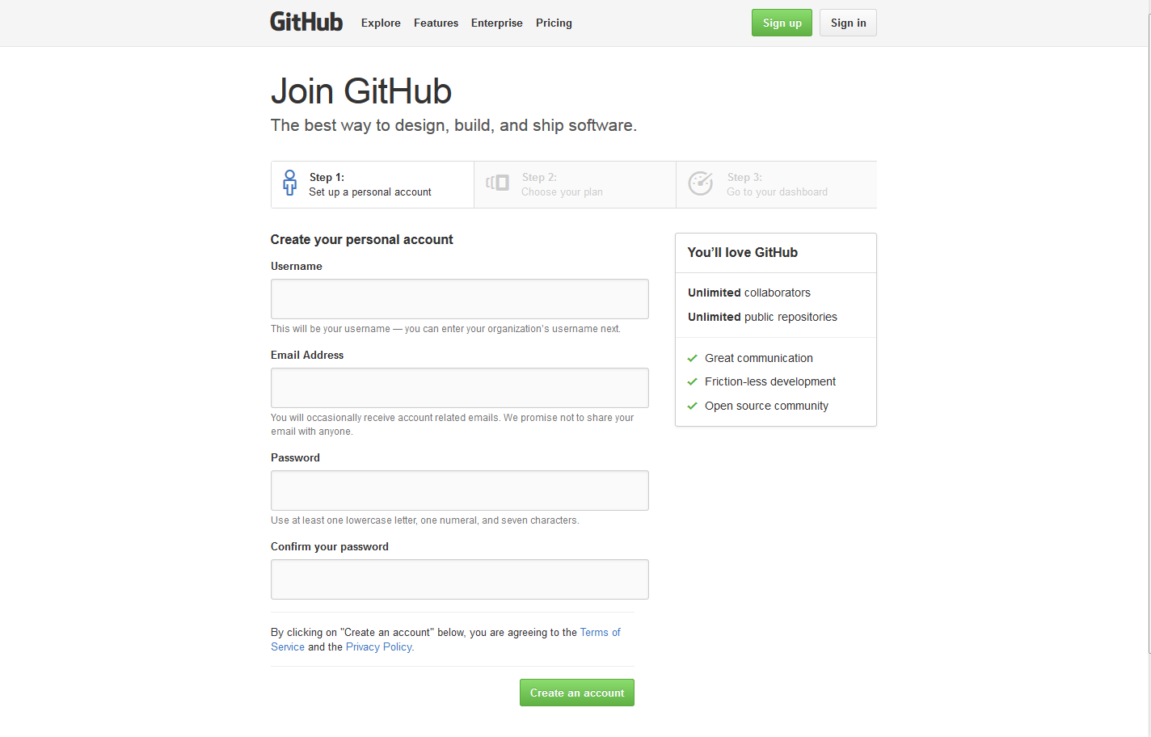
STEP 3:
Fill out the application form.
STEP 4:
Click the confirmation button to create your account.

Slide 4
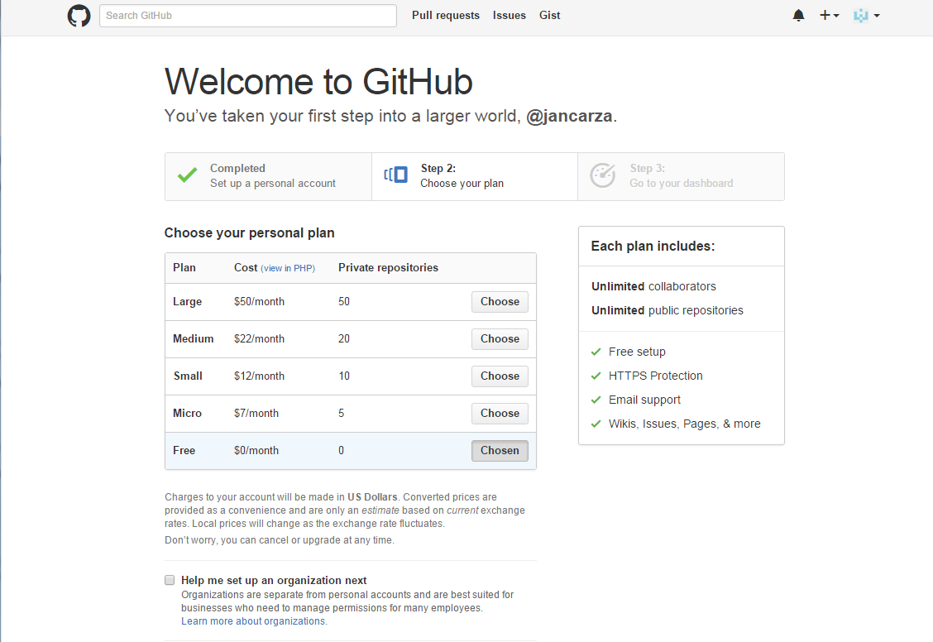
STEP 5:
Once done, you will be prompted to choose a plan. (Choose ‘Free’)

Slide 5
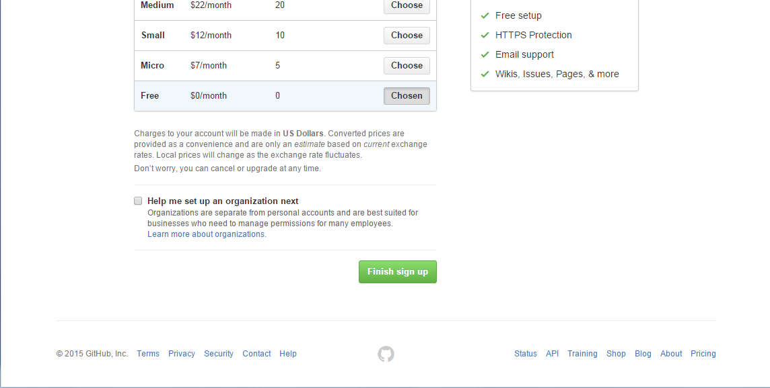
STEP 6:
Click the ‘Finish sign up’ button at the bottom of the page to proceed.

Slide 6
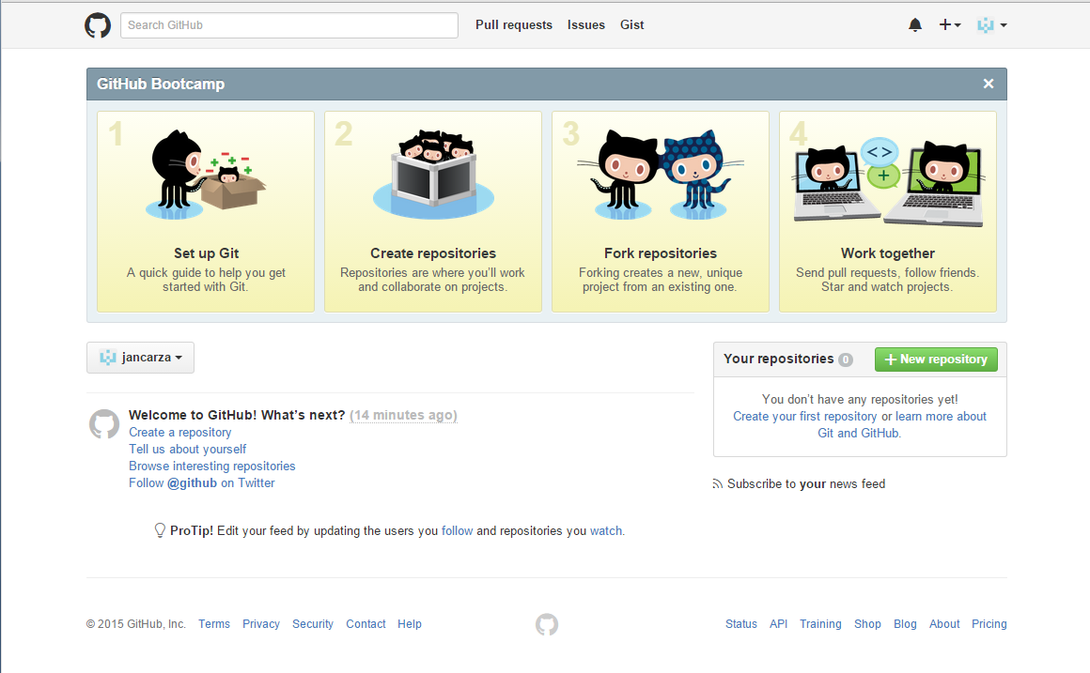
STEP 7:
You will be redirected to your Github news feed.

Slide 7
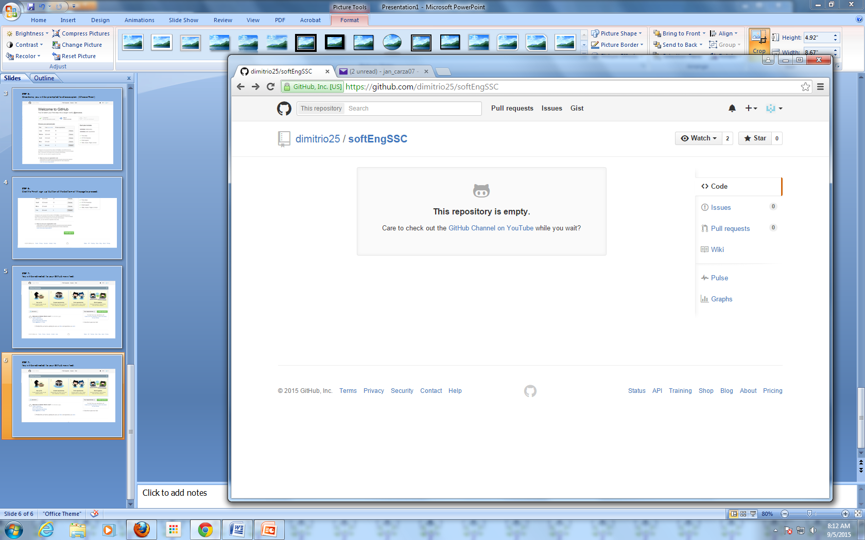
STEP 8:
Now you can look for collaborators.
If you already know your collaborator’s username or url, you can simply type it
in your address bar.
STEP 9:
You will then be redirected to the collaborator’s page.
Click ‘WATCH’ to be notified whenever the collaborator updates his page.

Slide 8
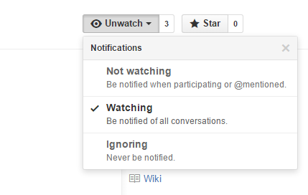
STEP 10:
When you click ‘WATCH’, you will be given three options. Choose the one that
you prefer.

