Slide 1
GitHub
Tolentino, Marielle Aynrand G.
BS – IT 404A

Slide 2
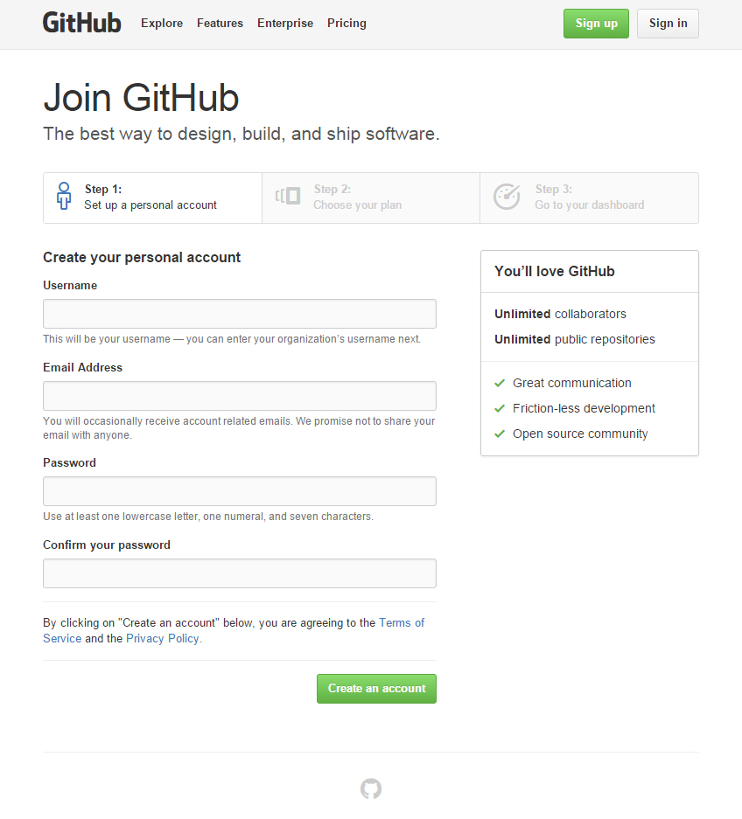
Sign up
Create your account by singing up.
Fill up the information.

Slide 3
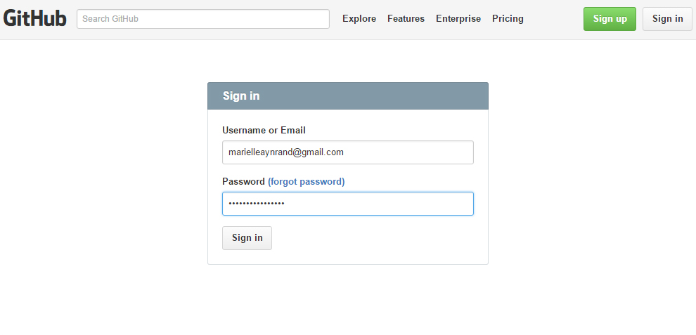
Log in the email or username of your account.

Slide 4
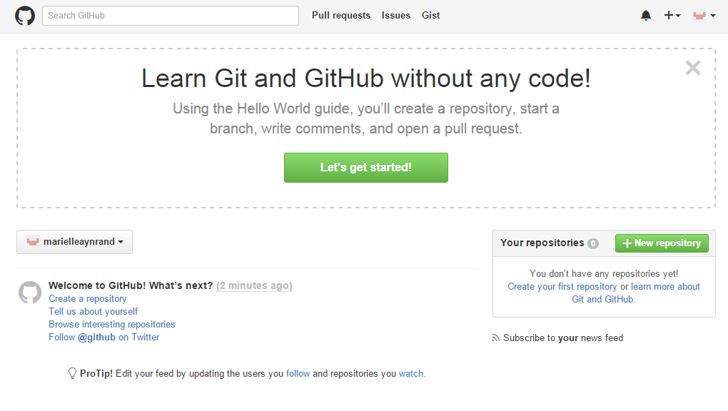
You are now in your GitHub homepage

Slide 5
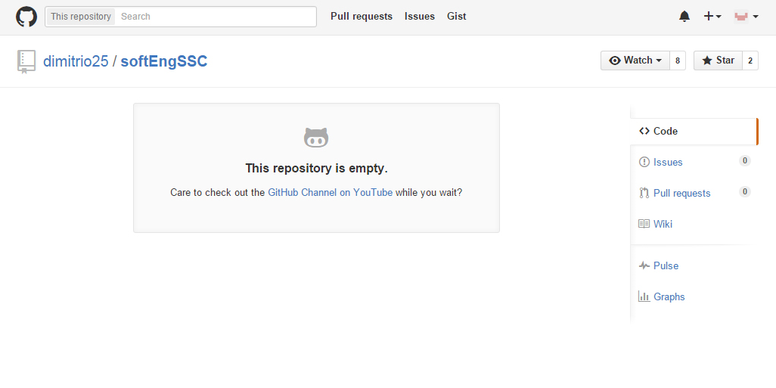
To become a collaborator to a specific repistory, you just need to click the watch button of the repistory.

Slide 6
To add/upload file
Type the following:
git config --global user.name “namehere”
git config --global user.email email@gmail.com
mkdir ~/softEngSSC
cd ~/softEngSSC
git init
git add .
commit -m ‘file added‘
remote add origin https://github.com/dimitrio25/softEngSSC.git
git pull origin master
push -u origin master

