Slide 1
GitHub: How to Sign Up
Anea Roshyl Santos
BSIT – 404a

Slide 2
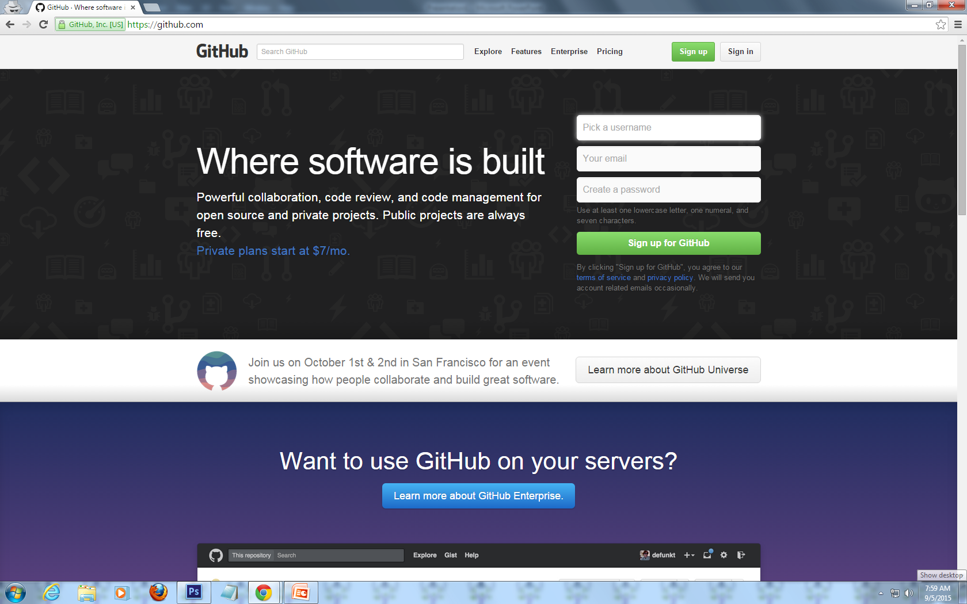
Step 1: Go to http://www.github.com

Slide 3
Step 2: Click the ‘Sign up’ button

Slide 4
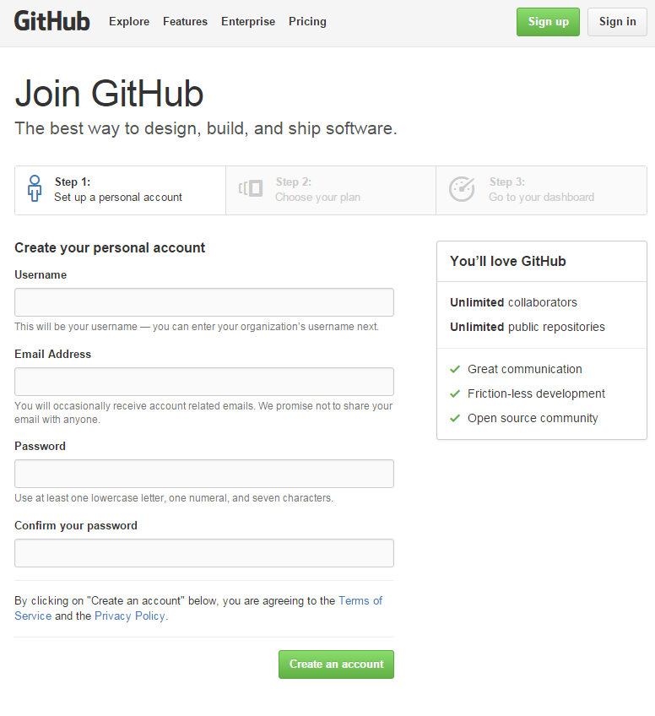
Step 3:
Fill up the form and
click ‘Create an
account’

Slide 5
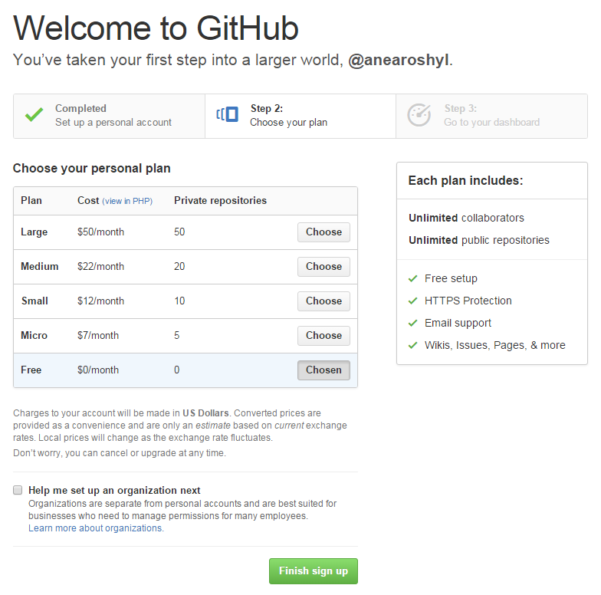
Step 4:
Select the plan that
you want by clicking
the ‘Choose’ button
Click ‘Finish sign up’

Slide 6
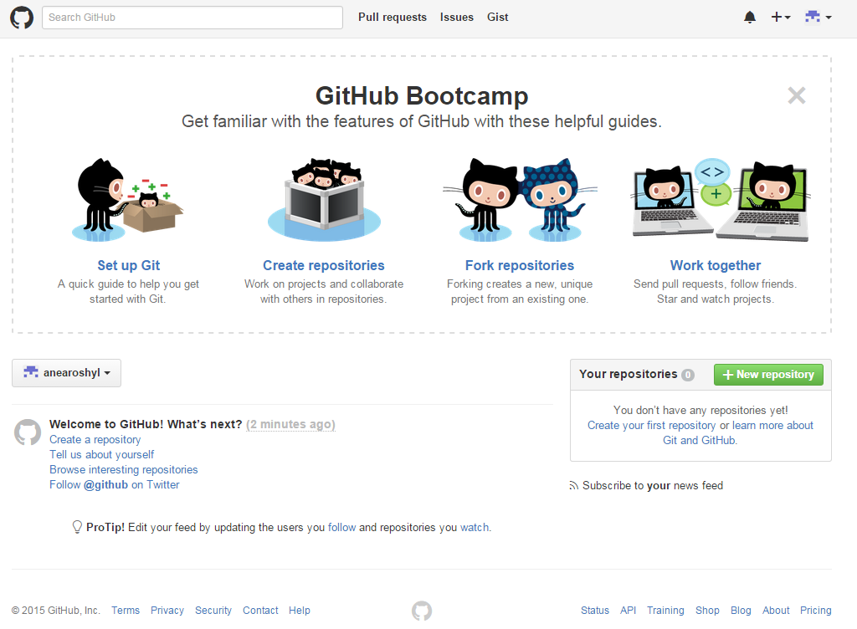
Step 5: This is the page that will appear after you sign up. You can use the guides in order for you to properly use GitHub.

Slide 7
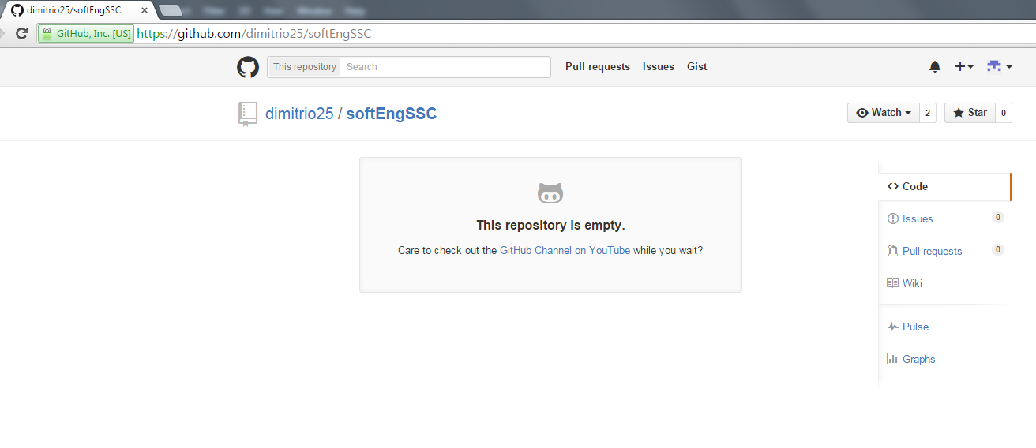
Step 6: If there is a repository that you want to check out, type its URL in your browser’s address bar and you will be directed to its page. In this example, we visited https://github.com/dimitrio25/softEngSSC

Slide 8
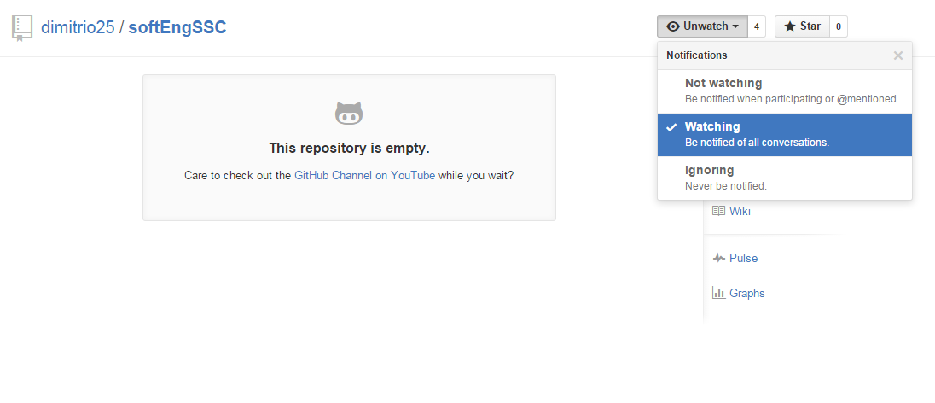
Step 7: Click the ‘Watch’ button. From the Notifications dropdown menu, select the way you want to be notified about the repository’s activities.

Slide 9
GitHub: How to upload a file

Slide 10
Step 1: Download Git Bash.
Step 2: Open the program.
Step 3: Configure your name by typing:
git config --global user.name “[insert name here]“
Step 4: Enter the email that you used to sign up at GitHub by typing:
git config --global user.email “[insert email here]"

Slide 11
Step 5: Make a directory by typing:
mkdir ~/softEngSSC
Step 6: Access the directory by typing:
cd ~/softEngSSC
Step 7: Initialize the repository by typing:
git init
Step 8: Add your file by typing:
git add [filename.fileextension]

Slide 12
Step 9: Type:
git remote add origin https://github.com/dimitrio25/softEngSSC.git
Step 10: Type:
git pull origin master
Step 11: Type:
git commit -m ‘comment’
Step 12: Type:
git push -u origin master

Slide 13
Step 13: Enter your username and password when prompted.
Step 14: Check the online repository to make sure that your file has been uploaded.

