Slide 1
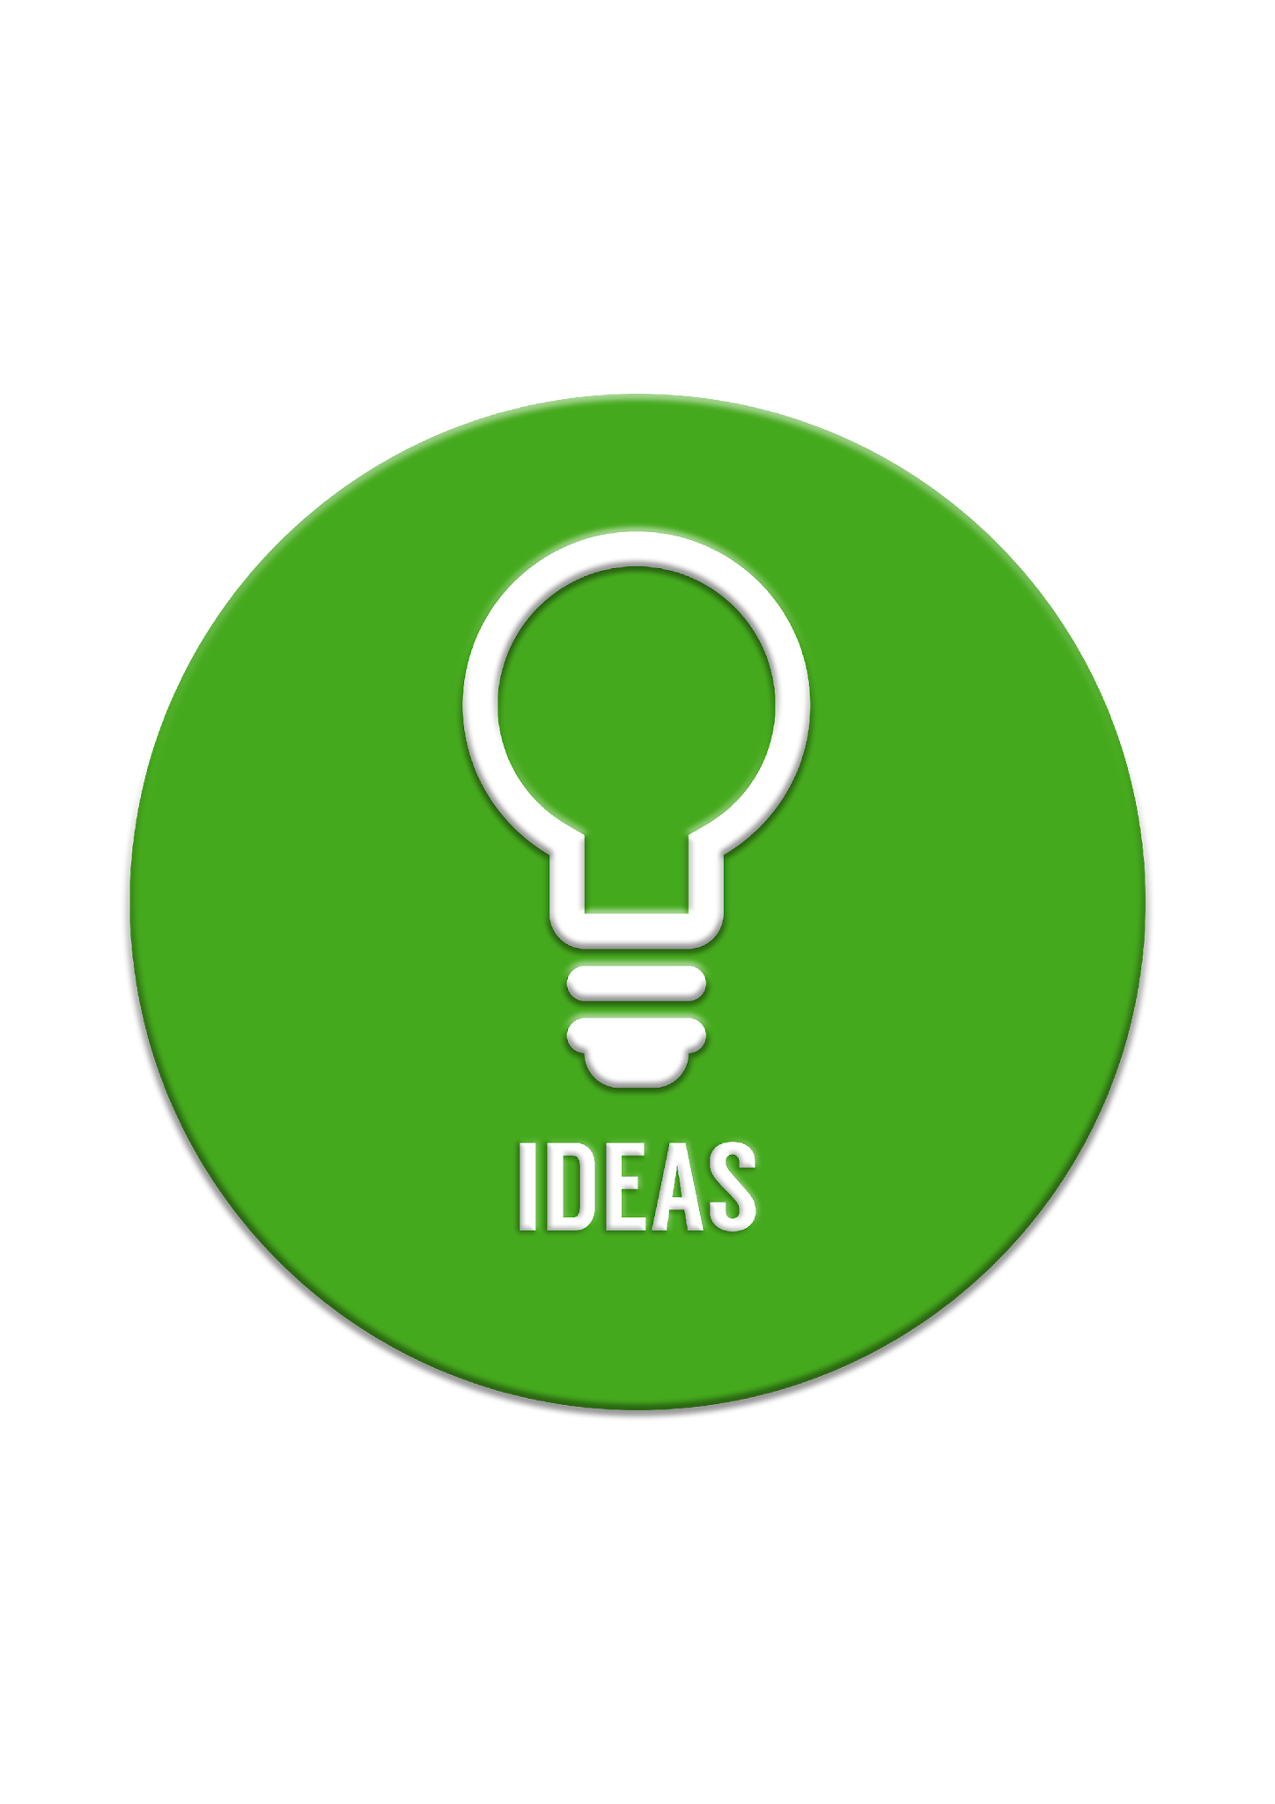


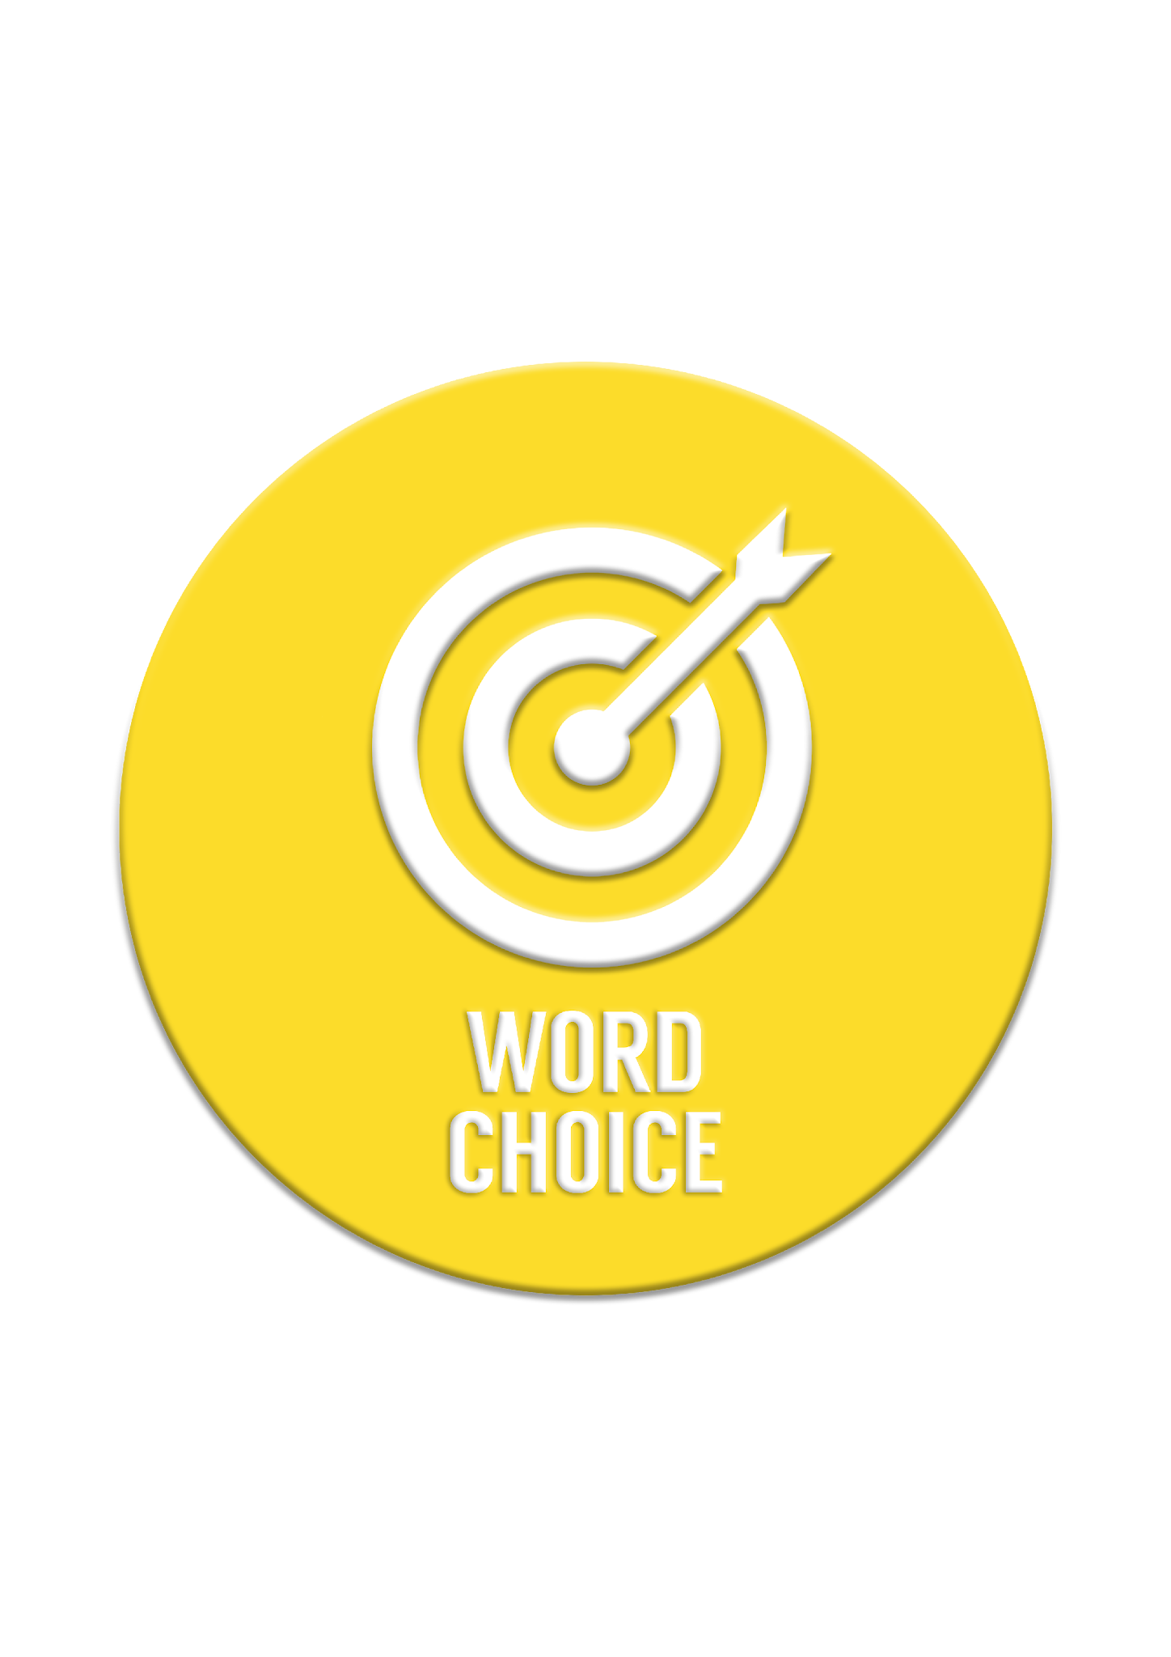
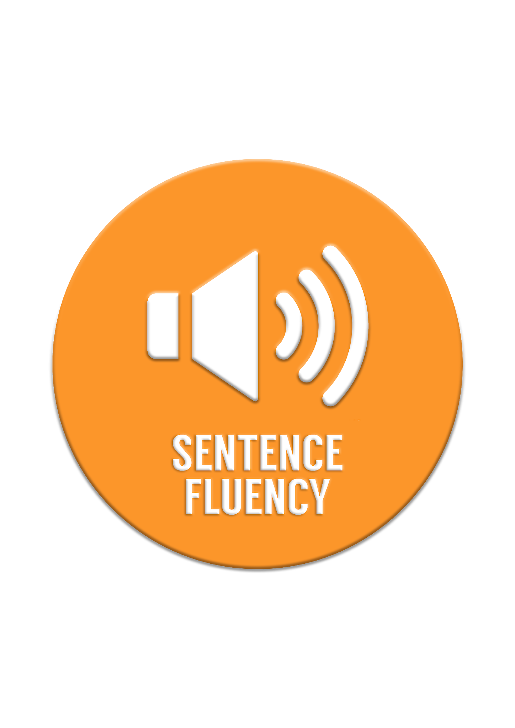
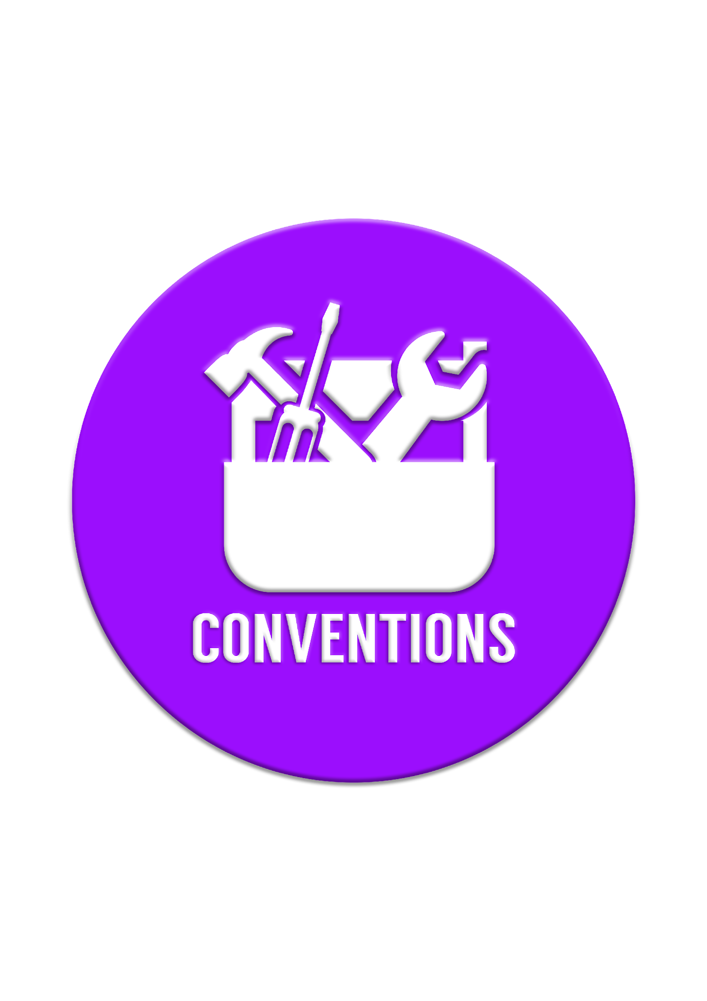
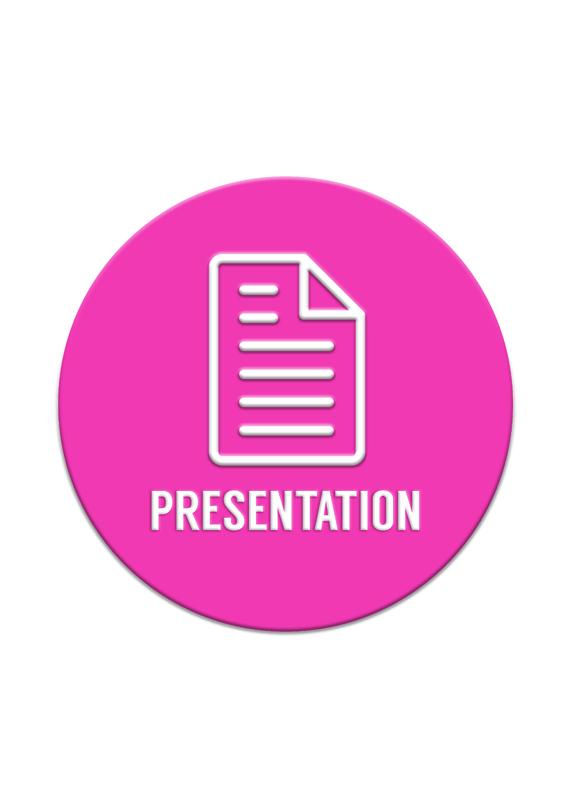

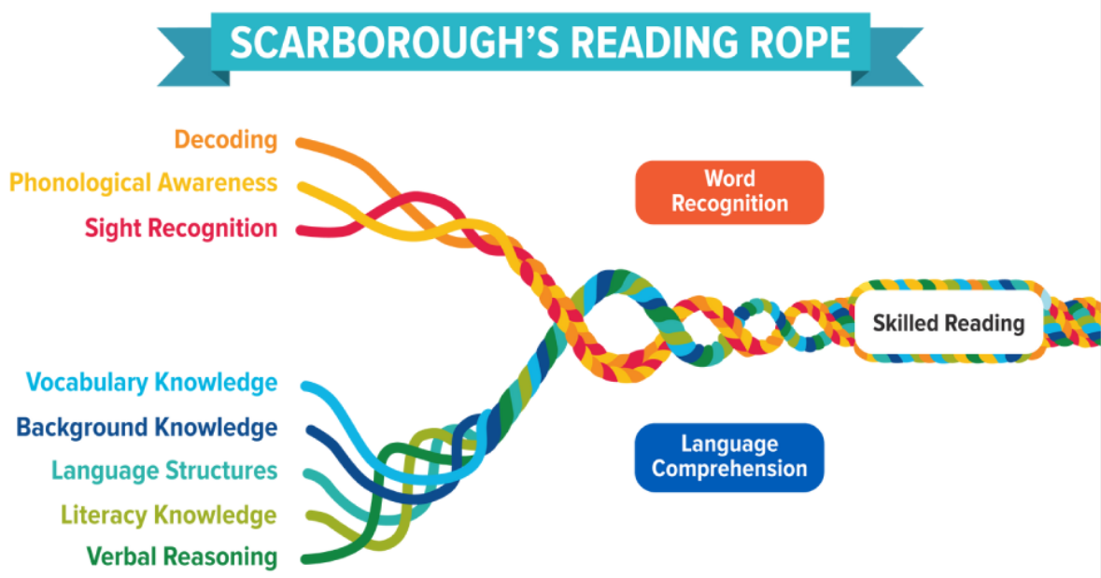
OG
Planner
Enrichment
Term 3 Week XYZ

Slide 2
Weekly Overview
1 hour | Monday | Tuesday | Wednesday | Thursday | Friday
Morphology | New Morphology XYZ | Review Morphology XYZ | New Morphology XYZ | Review Morphology XYZ | Week Review XYZ
Grammar | XYZ | XYZ | XYZ | XYZ | Week Review XYZ
Learned Words | New learned words XYZ | Review learned words XYZ | New learned words XYZ | Review learned words XYZ | Week Review XYZ
Notes:
Monday - New Morphology , Reviewed learned word
Tuesday - Review Morphology, New learned word
Wed - New Morphology , Reviewed learned word
Thursday - Review Morphology, New learned word
Friday - review

Slide 3

Morphology Review
2 mins
Notes:
Sound Deck Drills
Teacher shows card and the class/group says the sound
Teacher shows the card and calls no a student to give the sound; class repeats
Random: teacher shows the sound and calls on a student to give the sound; the teacher calls on another student and asks for the sound, and so on. NOTE: do not do this order or tables or rows because students only pay attention their own word
Kinesthetic: Teacher shows card, the class traces on the table as they say the sound
Working Memory: Teacher hows card and asks for a specific group of student who meet the criteria to give the sound. Examples include:
If you like soccer, give the sound
If your birthday is in January, give the sound
If you are wearing something blue, give the sound etc
Gross Motor: Have students do some gross motor activities:
Stand up and give the sound
Raise your left hand and give the sound
Jump on the spot and give the sound
Touch you right ear and say the sound

Slide 4

XYZ
Notes:
Root - Keyword: Meaning:

Slide 5
XYZ
Notes:
Prefix - Keyword: Meaning:

Slide 6
XYZ
Notes:
Suffix - Keyword: Meaning:

Slide 7
Words to Read Review -
Sounds & Morphology 3 mins
Notes:
WORDS TO READ:
After the student decode, teacher asks students if there are words they do not know and discuss meaning.
Repeat read to increase fluency and automaticity e.g. read row 2 and 5
For older students ask questions regarding: vocabulary, synonym, antonym, parts of speech, words with multiple meanings, analogies, categories etc

Slide 8
Review:
1) XYZ | 2) XYZ | 3) XYZ
4) XYZ | 5) XYZ | 6) XYZ
7) XYZ | 8) XYZ | 9) XYZ
10) XYZ | 11) XYZ | 12) XYZ
13) XYZ | 14) XYZ | 15) XYZ
Notes:
Grammar & Word Study Questions With Answers
Which word is a verb meaning “to control by rules”? Answer: regulate
Which word is an adjective describing something that bends easily? Answer: flexible
Which word is a noun that names a person who helps someone? Answer: assistant
Which word contains the root ped/pod meaning “foot”? Answer: pedestrian or podiatrist
Which word contains the suffix -cy meaning “state or condition”? Answer: literacy
Which word could be used as an adjective in this sentence: The ___ student solved the problem quickly. Answer: ordinary or flexible
Which word contains the root capt/capit meaning “head” or “leader”? Answer: captain
Which word has the root flect/flex meaning “bend”? Answer: flexible
Which word is an example of a compound word? Answer: counterattack
Which word could be turned into an adverb by adding -ly? Answer: ordinary → ordinarily or flexible → flexibly
Extension Questions With Answers
Write a sentence using a verb from the list. Example Answer: The teacher helped regulate the noisy classroom.
Write a sentence using an adjective from the list. Example Answer: The flexible ruler bent without snapping.
Find a word with three syllables. Answer: engineer / literacy / rectangle / captain
Find a word with the prefix counter-. What does the prefix mean? Answer: counterattack Meaning: against or opposite
Explain how the root rect/reg helps you understand the meaning of regulate or rectangle. Answer: The root means “straight” or “rule.” A rectangle has straight sides, and regulate means to control by rules.

Slide 9
Sound Bank 2 mins
Notes:
Students copy sounds into books before spelling words.

Slide 10

Write the sound
XYZ
XYZ
XYZ
XYZ
XYZ
XYZ
XYZ
XYZ
XYZ

Slide 11
Words to Spell Review -
Sounds & Morphology 2 mins

Slide 12
Spell the word
XYZ
Notes:
Word to spell: XYZ
Use word in a sentence.
Click to reveal answer.

Slide 13
New Morphology
2 mins
Notes:
PROCEDURE:
Show prefix/suffix/root word and say sound
Student repeat and traces three times and say.
Teacher gives letter names, keyword and rule/position if there is one.
Student writes three times in book.
Students reads words with the new sound (underline the new sound in each word)
Then, give spelling words.

Slide 14
XYZ
Notes:
Root - Keyword: Meaning:

Slide 15
XYZ
Notes:
Prefix - Keyword: Meaning:

Slide 16
XYZ
Notes:
Suffix - Keyword: Meaning:

Slide 17
Words to Read- New Morphology
2 mins

Slide 18
XYZ
XYZ
XYZ
XYZ
XYZ
XYZ
XYZ
XYZ
XYZ
Notes:
Write meaning here
joint – A joint is a place where two parts join together, such as bones in the body.
enjoin – To enjoin is to join authority with instruction by ordering someone to do or not do something.
conjoin – To conjoin is to join two or more things together into one.
disjointed – Something disjointed seems broken apart, as if its parts no longer join smoothly.
rejoinder – A rejoinder is a reply that joins back into a conversation or argument.
jointly – To act jointly means to join with others in doing something together.
juncture – A juncture is a critical point where events or things join together.
conjunction – A conjunction is a word used to join phrases or clauses in a sentence.

Slide 19
Words to Spell- New Morphology
2 mins

Slide 20
XYZ
XYZ
XYZ
XYZ
Notes:
Once finished, students write a fun sentence with one or more of the words.

Slide 21
Review Learned Words
2 minute
Notes:
PROCEDURE:
Write/Show word on the board
Teacher says word, students repeat
Tell the student the ‘unfair’ part of the word
Say letter names, students repeat
Students copies using far point technique
Students writes 3 times as they say letter names (after each time, say word)
Closes eyes and writes in the air as they say the letter names
Open eyes, covers the learned word and writes from memory and checks using near point technique.
Teacher: Remind students that red words are words you have to STOP and think about.

Slide 22

XYZ
Notes:
👉 /ˈdaːtə/ — sounds like “dah-tuh.”
So:
The first “a” makes a long “ah” sound (like in car).
The second “a” is a schwa sound — that soft uh sound we often hear at the end of words.
🇦🇺 Australian breakdown:
Spelling: d a t a
Pronunciation: DAH-tuh
Tricky part: The first “a” doesn’t say its usual short a (as in cat) or long a (as in day); it’s that ah sound instead.
So you can teach: Tricky part: The first a makes an ah sound in Australian English — “dah-tuh.”

Slide 23
XYZ
Notes:
👉 /ˈdaːtə/ — sounds like “dah-tuh.”
So:
The first “a” makes a long “ah” sound (like in car).
The second “a” is a schwa sound — that soft uh sound we often hear at the end of words.
🇦🇺 Australian breakdown:
Spelling: d a t a
Pronunciation: DAH-tuh
Tricky part: The first “a” doesn’t say its usual short a (as in cat) or long a (as in day); it’s that ah sound instead.
So you can teach: Tricky part: The first a makes an ah sound in Australian English — “dah-tuh.”

Slide 24
New Learned Word
2 minute
Notes:
PROCEDURE:
Write/Show word on the board
Teacher says word, students repeat
Tell the student the ‘unfair’ part of the word
Say letter names, students repeat
Students copies using far point technique
Students writes 3 times as they say letter names (after each time, say word)
Closes eyes and writes in the air as they say the letter names
Open eyes, covers the learned word and writes from memory and checks using near point technique.
Teacher: Remind students that red words are words you have to STOP and think about.

Slide 25
XYZ
Notes:
👉 /ˈdaːtə/ — sounds like “dah-tuh.”
So:
The first “a” makes a long “ah” sound (like in car).
The second “a” is a schwa sound — that soft uh sound we often hear at the end of words.
🇦🇺 Australian breakdown:
Spelling: d a t a
Pronunciation: DAH-tuh
Tricky part: The first “a” doesn’t say its usual short a (as in cat) or long a (as in day); it’s that ah sound instead.
So you can teach: Tricky part: The first a makes an ah sound in Australian English — “dah-tuh.”

Slide 26
Dictation
5 mins
Notes:
PROCEDURE:
Remind or review new sound, rule, new learned words, capitalisation, punctuation rules covered before starting.
Teacher says sentence, student repeat. If the sentence is long, teacher reads 1st phrase, students repeat and write. Teacher reads 2nd phrase, students repeat and write.
CORRECTION:
Learned word- look at student sheet or learned word wall
Phonetic words- fingerspell and stop at error and ask what letter makes the sound
Rules: remind the student about the rule

Slide 27

Write this sentence
At the ceremony, she held a flag with an indigenous symbol.
Notes:
At the ceremony, she held a flag with an indigenous symbol.

Slide 28

Write this sentence
At the ceremony, she held a flag with an indigenous symbol.
Notes:
At the ceremony, she held a flag with an indigenous symbol.

Slide 29
Grammar
5 mins

Slide 30
I do -

Slide 31
We do -

Slide 32
You do -

