Slide 1
Project 5: Covid Death Rate Analysis
Dimitrios Vlahos, Douglas Hundley, Jake Ritmire, Juan Vega

Slide 2
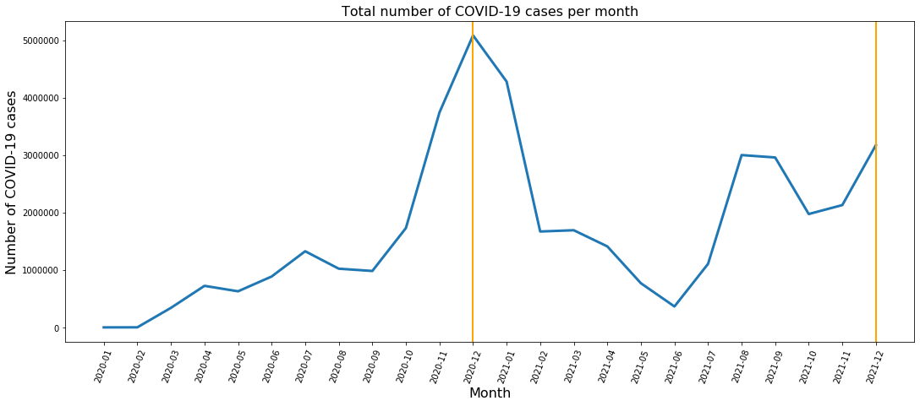
Background
Since the first case of COVID-19 was diagnosed in January 2020, the pandemic has created multiple public health challenges across the U.S. The number of COVID-19 cases has grown very fast between 12/20 and 12/21

Slide 3
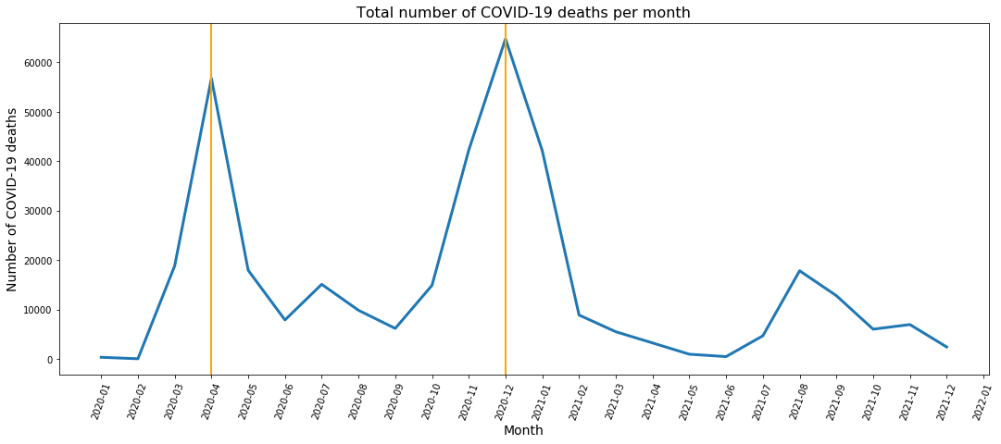
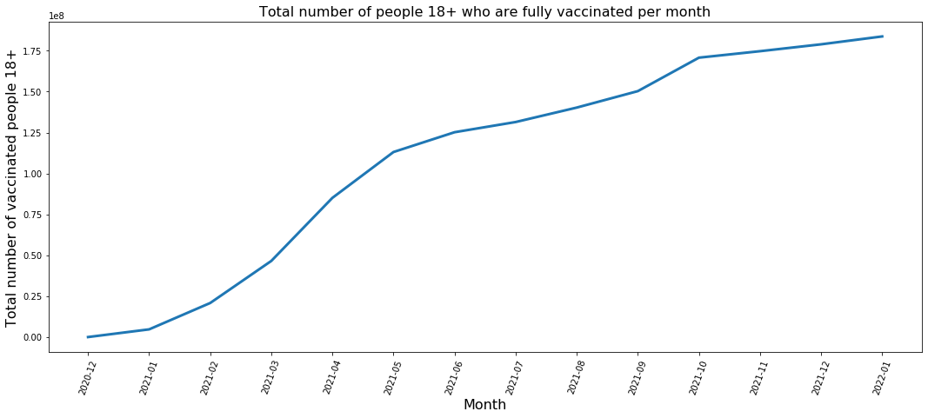
Background
The number of deaths from COVID-19 per capita per 100,000 population also increased significantly in this time period, reaching the highest peak in 12/20 and slowing down as vaccines started become available

Slide 4
Problem Statement
Given the importance of COVID-19 to the overall health of the U.S., the goal of this analysis is to identify counties that have the greatest need for COVID-19 relief as measured by the median number of deaths per capita per 100,000 population between 2020 and 2021
Exploratory data analysis will be used to identify the regions where these counties are located and their characteristics
Logistic and K-nearest neighbors models will be used to predict whether a county has a median death rate above the 75th percentile of all U.S. counties

Slide 5
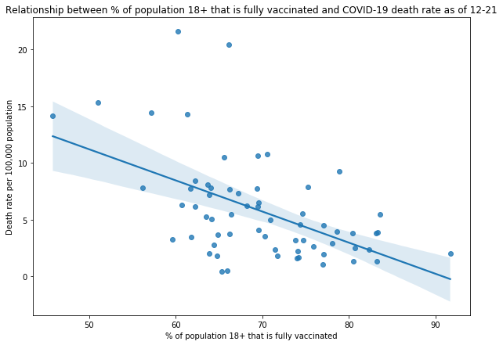
Exploratory Data Analysis
Share of the adult population that is fully vaccinated and death rate
Using the latest data of COVID-19 case surveillance from the CDC from December 2021, there appears to be a moderate negative and linear correlation between the percentage of the adult population (18+) that is fully vaccinated and the death rate

Slide 6
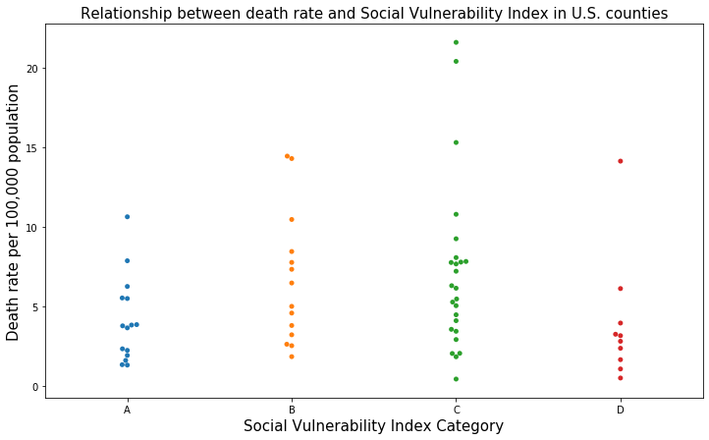
Death rate and social vulnerability
(Based on data from December, 2021)
Social Vulnerability Index (SVI) from the CDC is a measure of a community’s resilience to natural disasters and disease outbreak based on socioeconomic factors such as poverty
SVI category A implies the lowest level of social vulnerability and category D the greatest level of social vulnerability
It appears that counties with greater levels of social vulnerability tends to have higher death rates, pointing to the need to support economically vulnerable communities

Slide 7
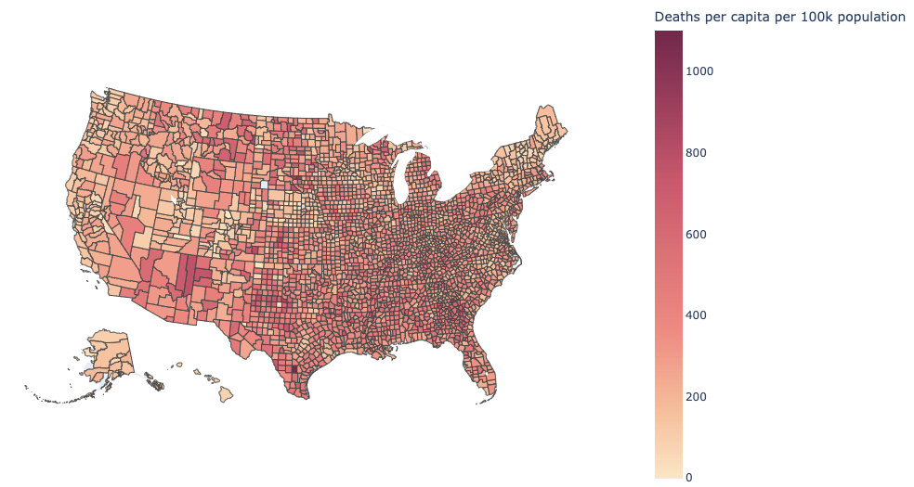
Geographic distribution of the death rate
Some counties have a disproportionately higher median death rate compared to other counties between 2020 and 2021
Counties in states like Arizona, Texas, Georgia, and Florida tend to be among the counties with the highest death rates per capita
Counties with highest death rates are concentrated mostly around the southern United States

Slide 8
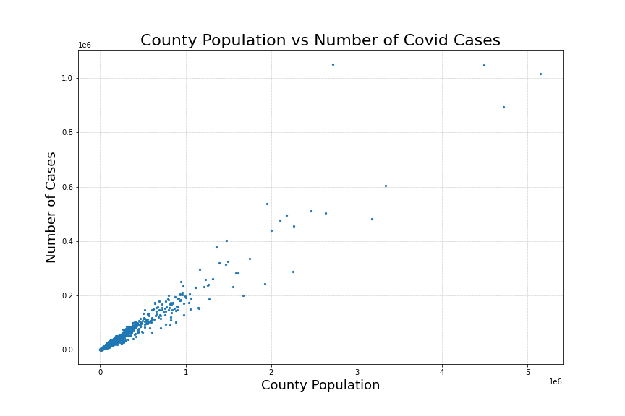
EDA
Strong linear relationship
Indicates that population is a strong predictor of number of cases

Slide 9
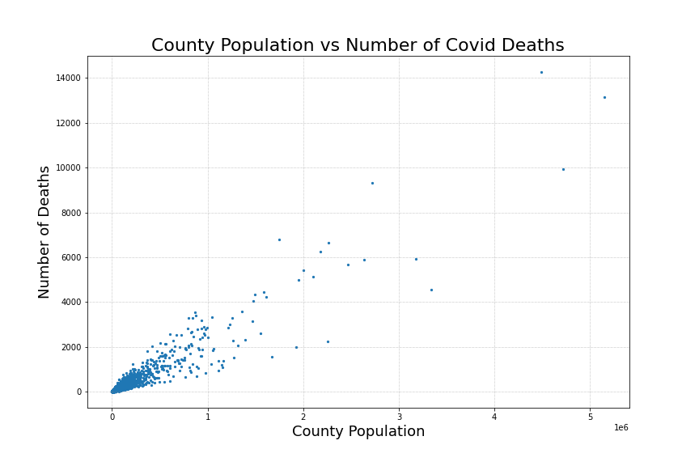
EDA
Strong linear relationship
More variation than there was with number of cases

Slide 10
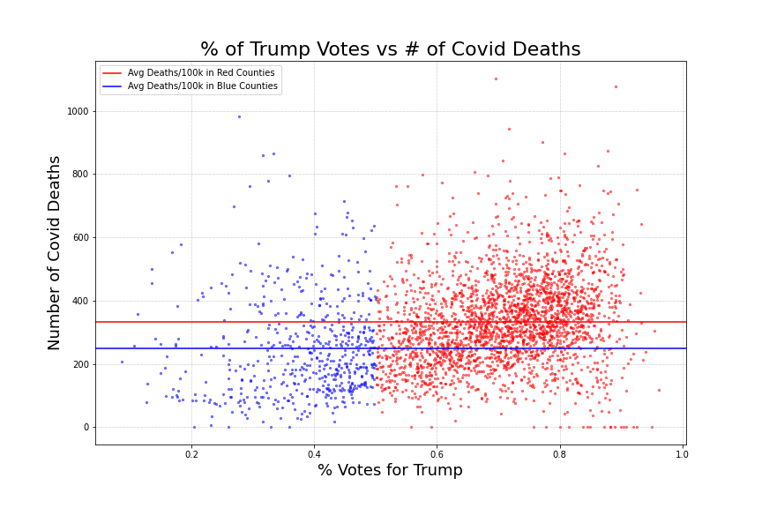
EDA
“Red” Counties >50% of voters voting for Trump
“Blue” Counties >50% of voters voting for Biden
Red county deaths/100k: 333
Blue county deaths/100k: 259

Slide 11
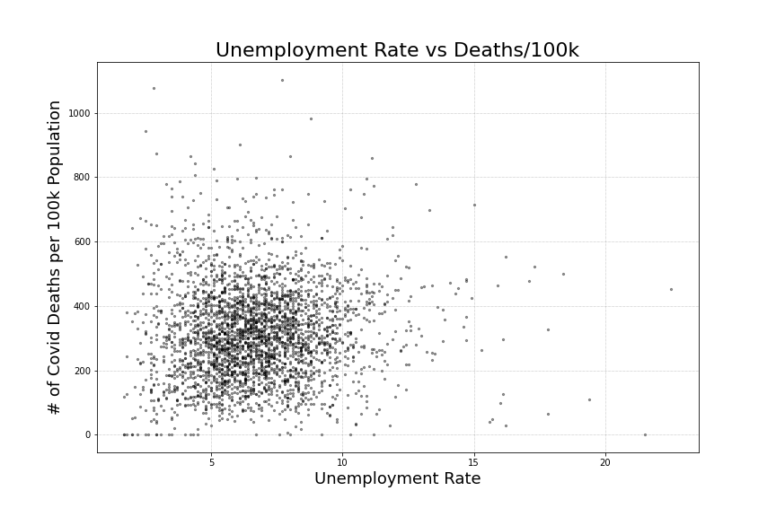
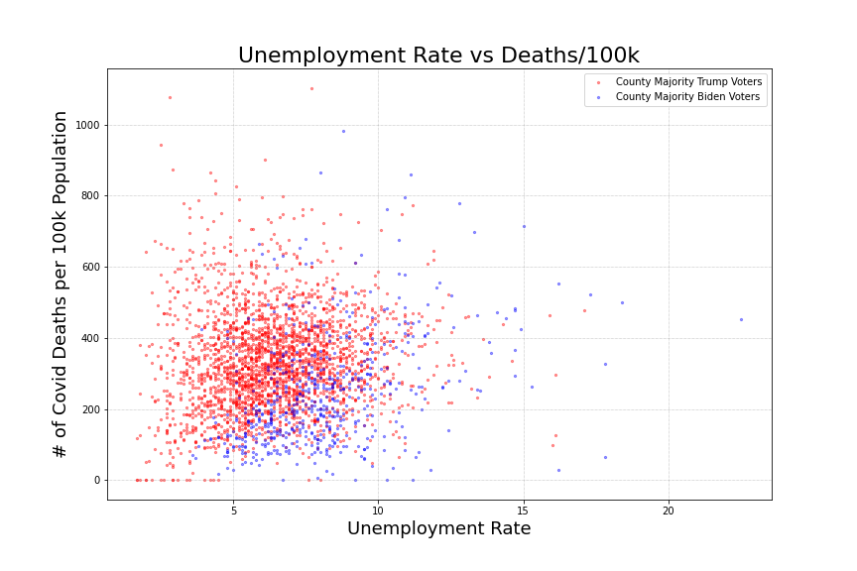
EDA

Slide 12
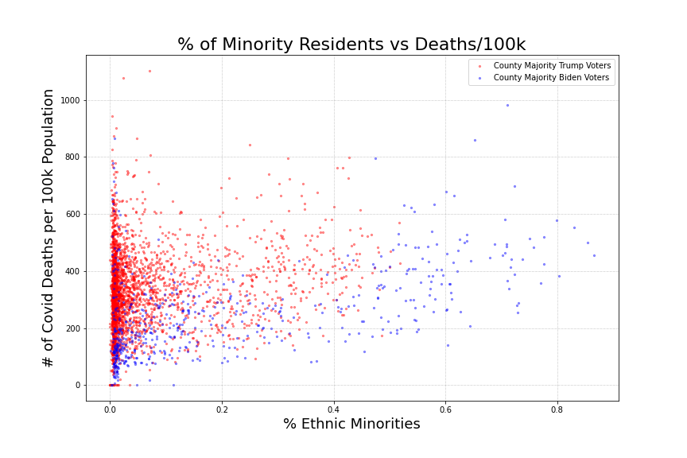
EDA
Counties with more than 50% of population identified as minorities are almost exclusively democrat
As % of minority residents increases, we see number of deaths/100k increase slightly

Slide 13
Data Sources
Covid Data - CDC and New York Times Covid Repository
County Demographic Data - US Census Bureau
Unemployment Data - Bureau of Labor Statistics
Election Data - MIT
Hospital Capacity - Health Data.gov
COVID cases surveillance from the Center for Disease Control
Ultimately compiled a dataset containing 3,133 observations of 54 counties.

Slide 14
Methodology
Target variable made sense
Used PCA to slim down data that we used
Resulted in a precision score measuring how likely the model would be able to predict to the 75th percentile

Slide 15
Logistic Regression
Cursory testing brought better scores than a regression model, stuck with classification
Counties above 75th percentile was the focus, categorized as ‘high need’ for COVID relief
Used Iterative Imputing to fill in missing data; 700+ missing hospital capacity data for counties
5 principle components made up about 70% of the models predictive power
Baseline Score: 74.9%
Modeling Score: 77.5%
Modeling w/ PCA Score: 76% +/- 3%

Slide 16
KNN
Dataset had many nulls
Best scoring model had .783 accuracy
Logistic is the better way to go
Notes:
Because we were merging multiple datasets we had a lot of nulls in the final dataframe we created.Nine of our columns pertaining to hospital beds were each missing 703 values. To avoid adding any extra bias to the data I decided to omit these columns from the knn model. The best performing KNN model had a .783 accuracy . This was achieved by using 37 of our features. I did attempt to further reduce the features used down to 27 but this caused a drop in accuracy. Although the KNN and Logistic model performed similarly we believe the Logistic model is the better choice as it’s more easily interpreted.

Slide 17
Results and Conclusion
Coefficient | Short Desc. | Exponentiated Value
land_area_sqmi | Total land area of county in square miles | 6.883
population_desity | Total pop. / Area Per sq. mile | 3.787
cases_per_10k | # of cases per 10k people | 1.898
biden_votes | # of votes for Biden during election | 1.769
med_cases_per_100k_change | Median of new cases per 100k people in 7 days | 1.533
Decided to move forward with the Logistic Regression model
Concluded model would not be strong enough to predict target
Recommendations:
use visualizations and exploratory analysis from data variables and resulting model coefficients

Slide 18
Proposed Future Analysis/Next Steps
Collection of data needs to be over a greater window of time
Analyze a cross-section data (the most recent month of data)
Use time-series methods to exploit the longitudinal nature of the data
More uniform methods on what data is collected
Compare model performance based on the data provider
New York Times
CDC

