Slide 1
Reinforcement Learning on Markov Decision Processes
By Damianos Dimitris

Slide 2
Table of Contents
Reinforcement Learning
Markov Decision Processes
Algorithms
Q-learning
SARSA
DQN
Environment
Training
References

Slide 3
Reinforcement Learning (RL)
RL focuses on enabling agents to learn optimal decision-making strategies through interaction with an environment.
In RL, agents learn by trial and error, receiving feedback in the form of rewards or penalties based on their actions.
The core challenge in RL is to discover a policy, a mapping from states to actions, that maximizes the cumulative reward over time. This requires a trade-off between exploration, where the agent tries new actions, and exploitation, where the agent leverages its current knowledge to maximize rewards.
Finding the optimal solution requires a mathematical modelling, which in the case of RL is provided by the framework of Markov Decision Processes (MDP)

Slide 4
Markov Decision Processes (MDP)
Mathematical model used to describe decision-making scenarios in which an agent interacts with an environment over a series of discrete time steps.
Key assumption: Markov property (the future depends only on the present and not the past)
Components:
States: All possible situations of the environment
Actions: The available choices of the agent
Rewards: values that the agent receives upon taking an action
Solving MDP (finding optimal policy):
RL algorithms (Q-learning, etc), Gradient Ascent methods

Slide 5
Algorithms: Q-learning - 1
Is model-free (doesn’t require a model of the environment) Is off-policy (produces its own rules to solve the problem)
Components
Agent: the entity that interacts with the environment
States: agent’s possible positions in the environment
Actions: possible action the agent can perform in each state
Rewards: the response provided by the environment
Episodes: : an episode concludes when the agent stops taking new actions
Q-values: Metric used to measure an action for a given state, stored in Q-table

Slide 6
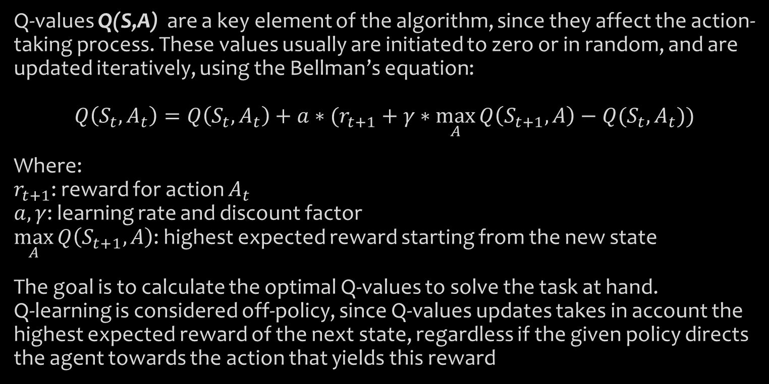
Algorithms: Q-learning - 2
Q-values Q(S,A) are a key element of the algorithm, since they affect the action-taking process. These values usually are initiated to zero or in random, and are updated iteratively, using the Bellman’s equation:
$$Q\left(S_{t},A_{t}\right)=Q\left(S_{t},A_{t}\right)+a∗(r_{t+1}+γ∗\max_{A}{Q\left(S_{t+1},A\right)}−Q(S_{t},A_{t}))$$
Where: $r_{t+1}$: reward for action $A_{t}$ $a,γ$: learning rate and discount factor $\max_{A}{Q\left(S_{t+1},A\right)}$: highest expected reward starting from the new state
The goal is to calculate the optimal Q-values to solve the task at hand. Q-learning is considered off-policy, since Q-values updates takes in account the highest expected reward of the next state, regardless if the given policy directs the agent towards the action that yields this reward

Slide 7
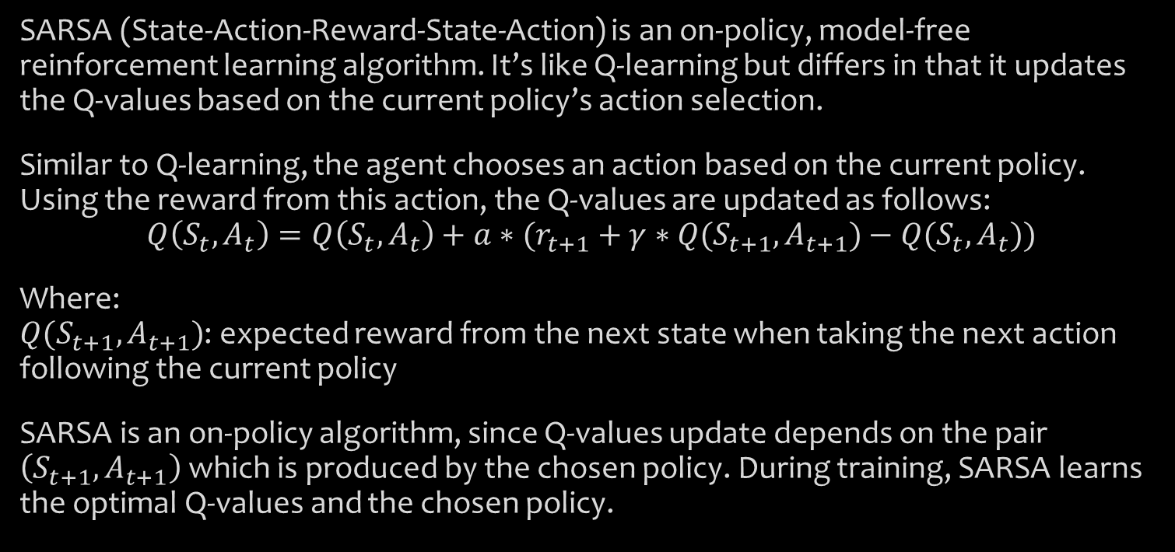
Algorithms – SARSA
SARSA (State-Action-Reward-State-Action) is an on-policy, model-free reinforcement learning algorithm. It’s like Q-learning but differs in that it updates the Q-values based on the current policy’s action selection.
Similar to Q-learning, the agent chooses an action based on the current policy. Using the reward from this action, the Q-values are updated as follows:
$$Q\left(S_{t},A_{t}\right)=Q\left(S_{t},A_{t}\right)+a∗(r_{t+1}+γ∗Q(S_{t+1},A_{t+1})−Q(S_{t},A_{t}))$$
Where: $Q(S_{t+1},A_{t+1})$: expected reward from the next state when taking the next action following the current policy
SARSA is an on-policy algorithm, since Q-values update depends on the pair $\left(S_{t+1},A_{t+1}\right)$ which is produced by the chosen policy. During training, SARSA learns the optimal Q-values and the chosen policy.

Slide 8
Algorithms - Deep Q-Network (DQN)
Proposed by DeepMind in 2013, uses deep neural networks to approximate the Q-values.
It replaces Q-table with a deep neural network (MLP, CNN etc.) which allows the handling of high-dimensional state spaces (like images).
Pros: Scalability, generalization
Cons: Sensitive to hyperparameters tuning

Slide 9
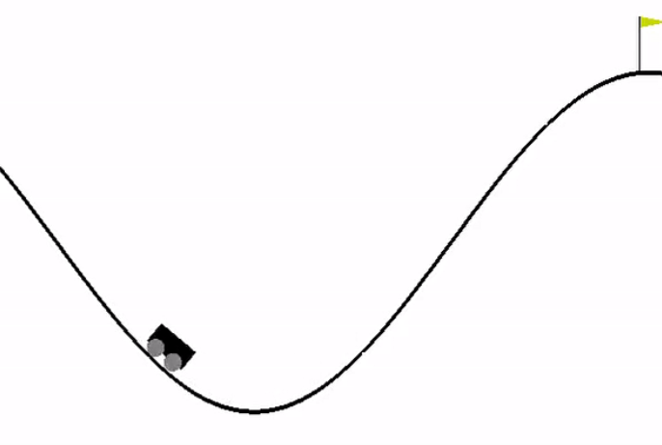
Environment - 1
Provided by OpenAI’s Gym library, we use the Mountain Car environment.
It is a deterministic MDP that consists of a car placed stochastically at the bottom of a sinusoidal valley.
The only possible actions are the accelerations left or right
The goal is to reach the goal state on top of the right hill. The trick is that the car cannot reach the flag by simply accelerating right, but it requires to build momentum by climbing the left hill.

Slide 10
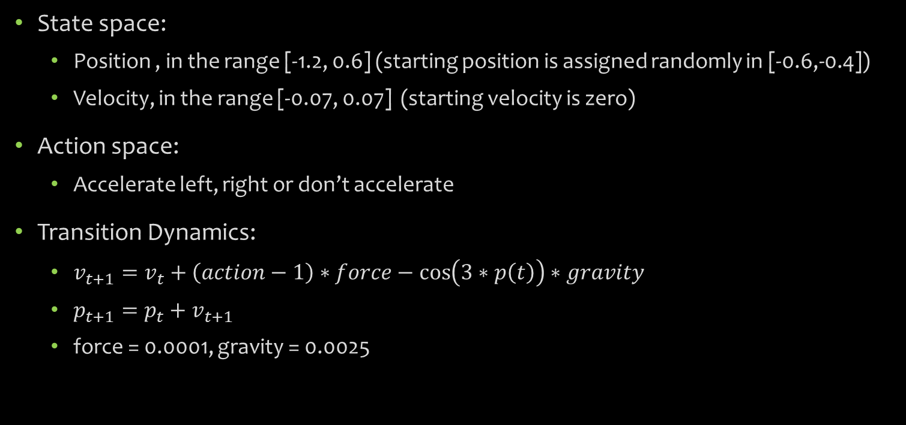
Environment - 2
State space:
Position , in the range [-1.2, 0.6] (starting position is assigned randomly in [-0.6,-0.4])
Velocity, in the range [-0.07, 0.07] (starting velocity is zero)
Action space:
Accelerate left, right or don’t accelerate
Transition Dynamics:
$v_{t+1}=v_{t}+\left(action−1\right)∗force−\cos\left(3∗p\left(t\right)\right)∗gravity$
$p_{t+1}=p_{t}+v_{t+1}$
force = 0.0001, gravity = 0.0025

Slide 11
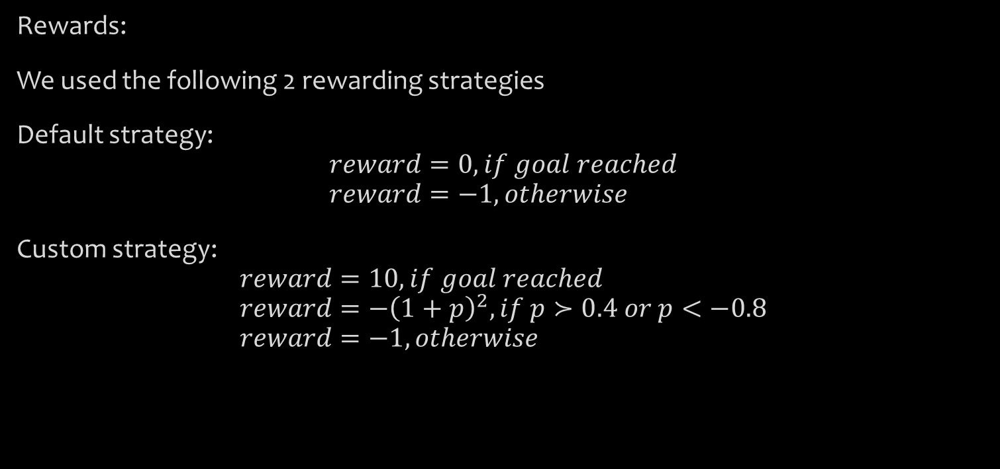
Environment - 3
Rewards:
We used the following 2 rewarding strategies
Default strategy:
$$reward=0, if goal reached \\ reward=−1, otherwise$$
Custom strategy:
$$reward=10, if goal reached \\ reward=−{\left(1+p\right)}^{2}, if p≻0.4 or p<−0.8 \\ reward=−1, otherwise$$

Slide 12
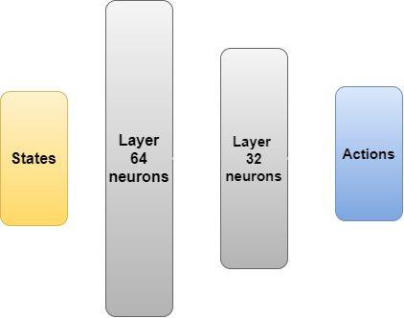
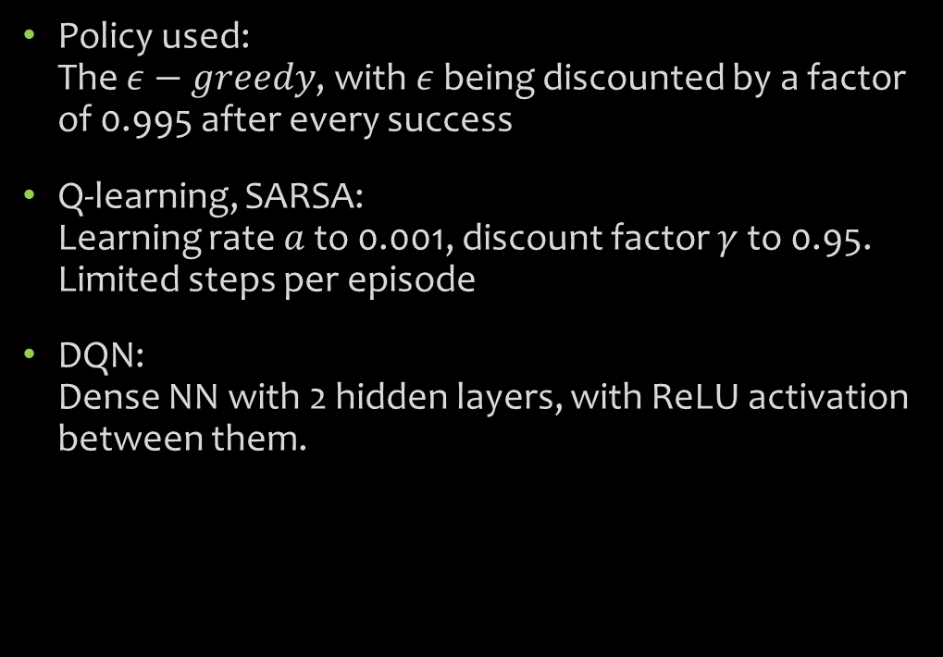
Training - Details
Policy used: The $ε−greedy$, with $ε$ being discounted by a factor of 0.995 after every success
Q-learning, SARSA: Learning rate $a$to 0.001, discount factor $γ$ to 0.95. Limited steps per episode
DQN: Dense NN with 2 hidden layers, with ReLU activation between them.

Slide 13
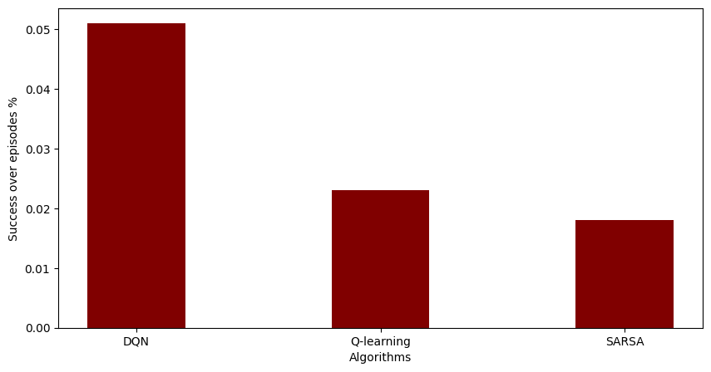
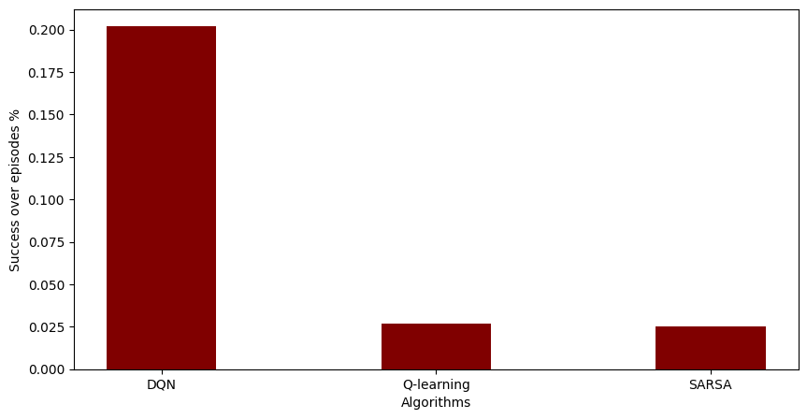
Training – Results - 1
Percentage of success over all episode , using
Default reward strategy (top)
Custom reward strategy (bottom)
DQN was significantly better in both scenarios (5% and 20% success ratio)
Q-learning was slightly better than SARSA in both scenarios (2.3% and 2.5% over 1.8% and 2.3% respectively)

Slide 14
Training – Results – 2
Mean cumulative reward over successful episodes:
DQN achieved significantly better results from the other 2 algorithms with both rewarding strategies.
The custom rewarding strategy improved all algorithms performance
Algorithm | Default Strategy | Custom Strategy
DQN | -654.45 | -449.3
Q-learning | -1451.17 | -1161.31
SARSA | -1495.17 | -1131.87

Slide 15
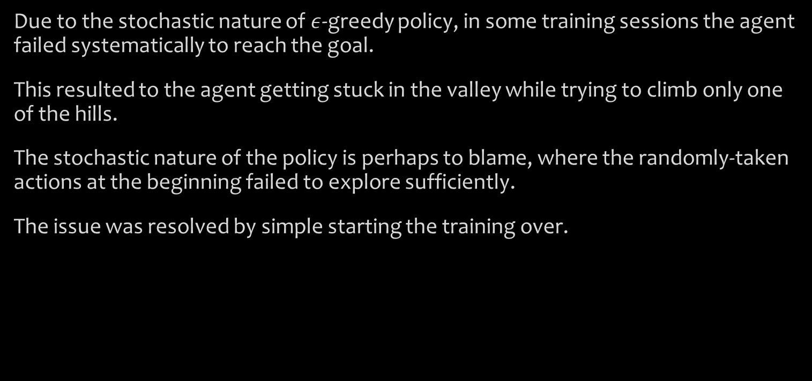
Training – Final Notes
Due to the stochastic nature of $ε$-greedy policy, in some training sessions the agent failed systematically to reach the goal.
This resulted to the agent getting stuck in the valley while trying to climb only one of the hills.
The stochastic nature of the policy is perhaps to blame, where the randomly-taken actions at the beginning failed to explore sufficiently.
The issue was resolved by simple starting the training over.

Slide 16
References
Q-learning (Watkins, 1989)
A Theoretical and Empirical Analysis of Expected Sarsa
Deep Q-Network
OpenAI Gym
Efficient Memory-Based Learning for Robot Control, PhD thesis, University of Cambridge, November 1990.

Slide 17
Thank you
Any questions?

