Slide 1
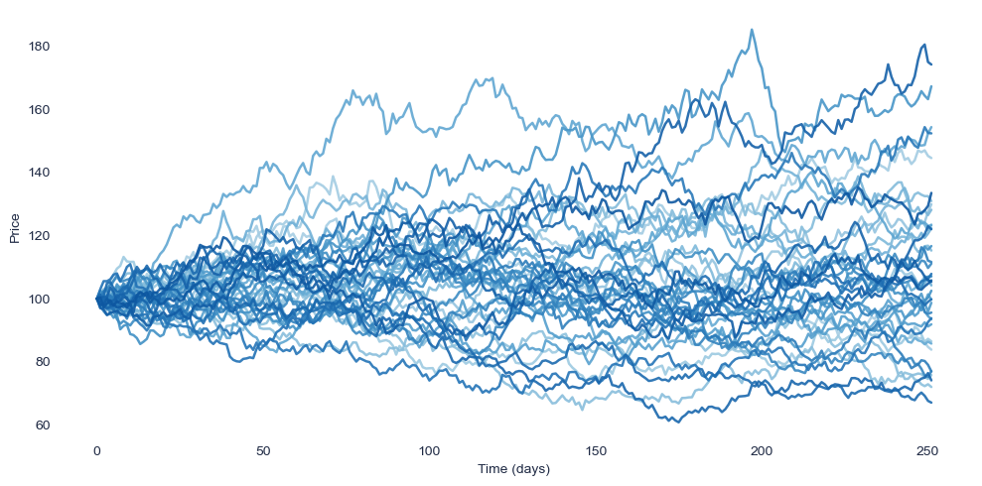
Uncovering Market Regime Structure in Financial Data
STAT 5244: Unsupervised Machine Learning
By Dimitris Markopoulos

Slide 2
Motivations – Why Market Regimes Matter
Markets Change Their Behavior
Models Perform Differently in Each Regime
Early Identification Helps Avoid Surprises
There Are No Labels - We Must Learn Structure
Financial markets switch between calm, volatile, and unstable periods.
These repeating patterns of behavior are called regimes.
A forecasting or risk model that works during calm periods can fail completely during turbulent ones.
Recognizing when markets are shifting into a riskier regime helps investors, policymakers, and analysts prepare.
Markets don’t come with predefined “regime” tags.
Unsupervised learning lets us uncover these hidden structures directly from the data.

Slide 3
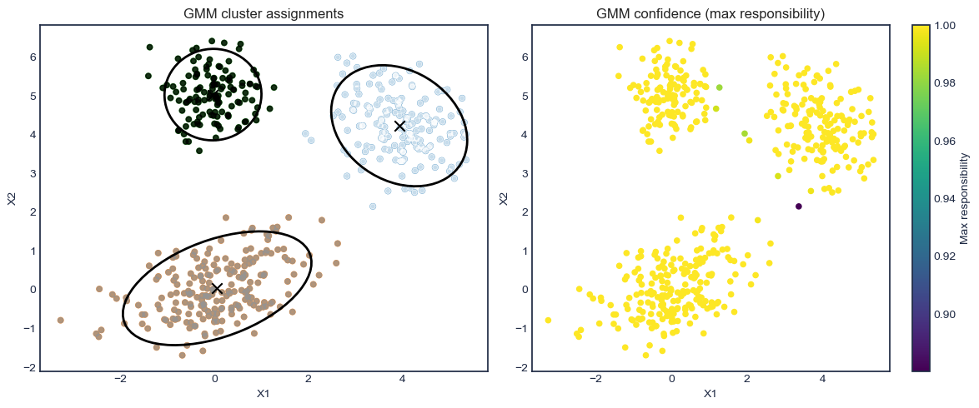
Some Existing Work
Source: Two Sigma (2021). “A Machine Learning Approach to Regime Modeling.”
Deliverables
Applied a Gaussian Mixture Model (GMM) to decades of factor returns
Identified four data-driven market conditions: Crisis, Steady State, Inflation, Walking on Ice
Showed that regimes can be discovered entirely from historical data
Highlighted that regimes shift quickly and non-linearly
Demonstrated GMM as a strong baseline for regime discovery
Limitations
Focused on one specific modeling choice (GMM)
Did not evaluate sensitivity to preprocessing, dimensionality reduction, or clustering alternatives

Slide 4
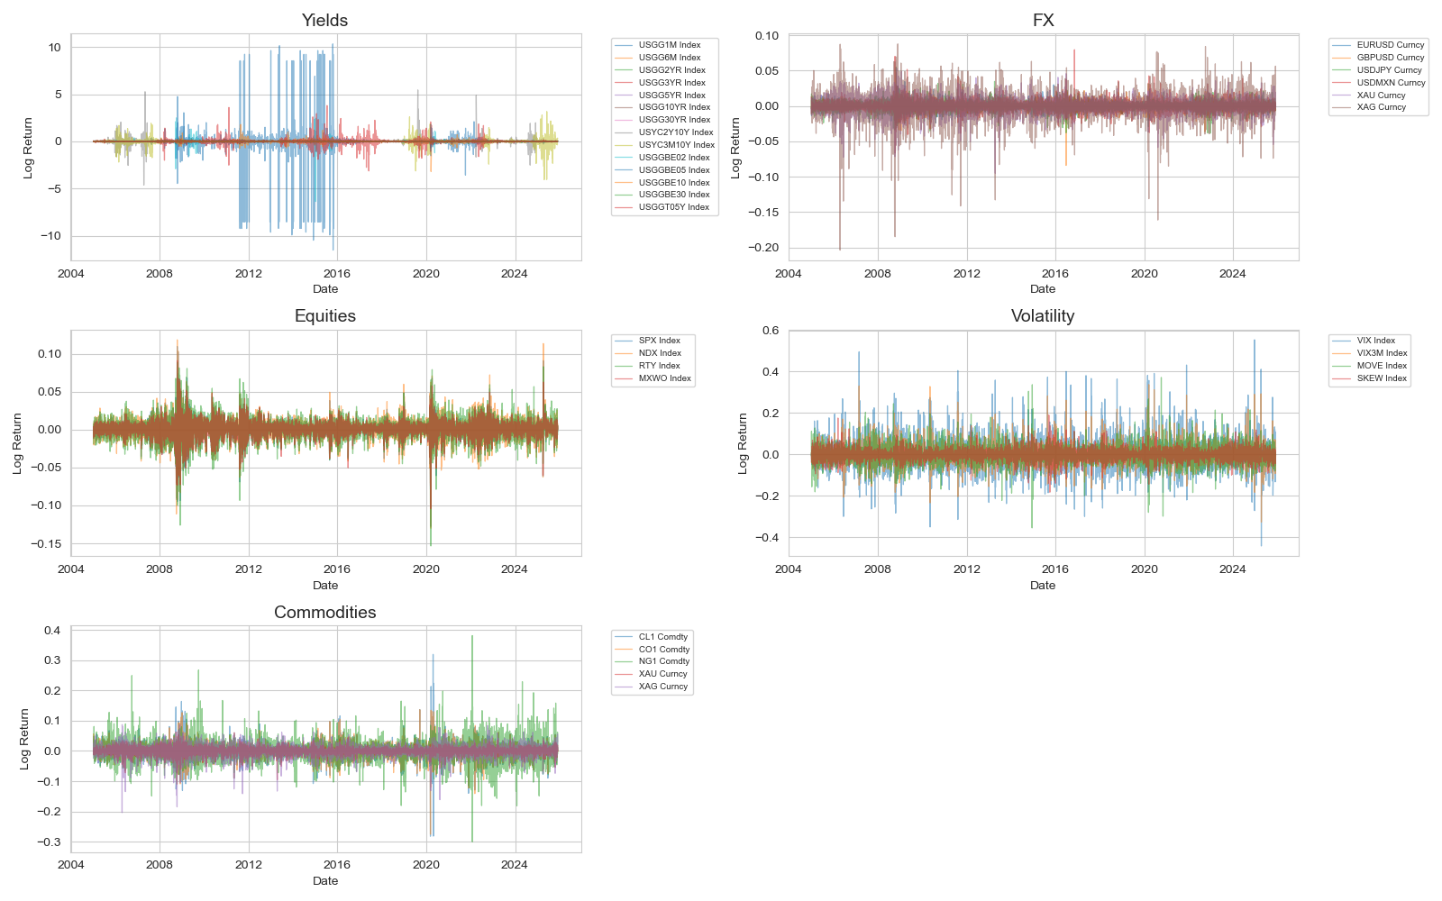
Data
Data Sources Used
Equity returns:
Daily S&P 500 sector + broad index returns
Interest rate/yield data:
U.S. Treasury yield curve (2y, 5y, 10y), term spread
FX (foreign exchange):
Major USD cross rates (EUR/USD, JPY/USD, GBP/USD)
Macro indicators:
Inflation surprises, economic activity indexes
Volatility metrics:
VIX, realized volatility windows

Slide 5
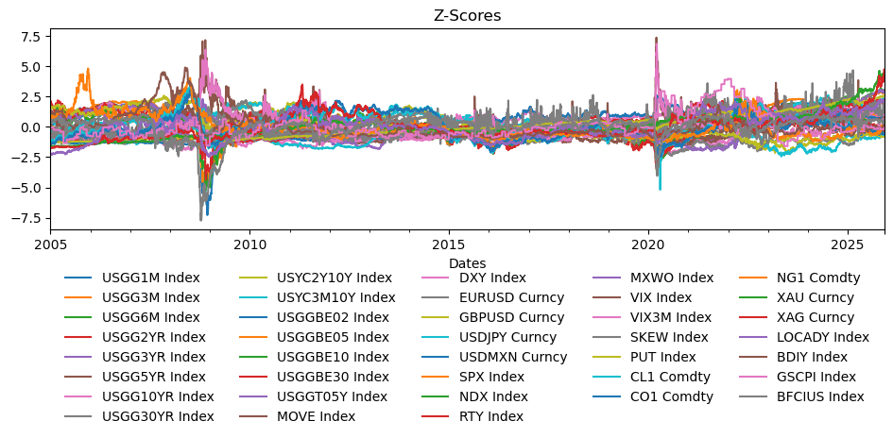
Transformations + Preprocessing
Aligned all series to a common daily date index so every indicator refers to the same timestamp.
Forward-filled missing dates (holidays / non-trading days) to ensure a complete rectangular dataset.
Converted raw levels into daily log returns to remove trends and make macro series stationary.
Replaced zero values in yields with a small epsilon to avoid infinite log-returns.
Standardized all features into z-scores so PCA and clustering are not dominated by high-volatility indicators.

Slide 6
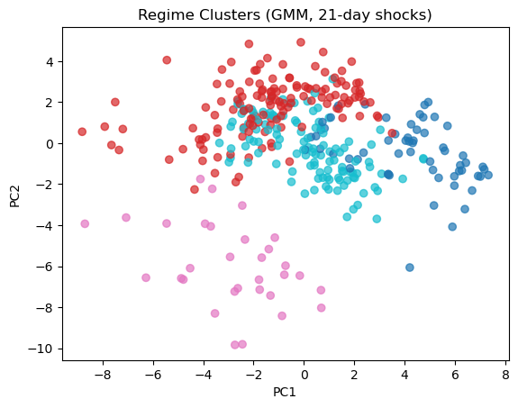
Dimension Reduction + Clustering Techniques
Example of 1 combination:
GMM on PC1 vs PC2
Note the 21-day shock is simply the difference during 1 month of trading days plotted
Can see some regime separation!
PC2 captures separation of regimes (pink)
Dimension Reductions:
PCA
NMF
UMAP
t-SNE
Spectral Embedding
Etc
Clustering Techniques:
GMMs
KMeans++
Spectral Clustering
Hierarchical Clustering
Etc

Slide 7
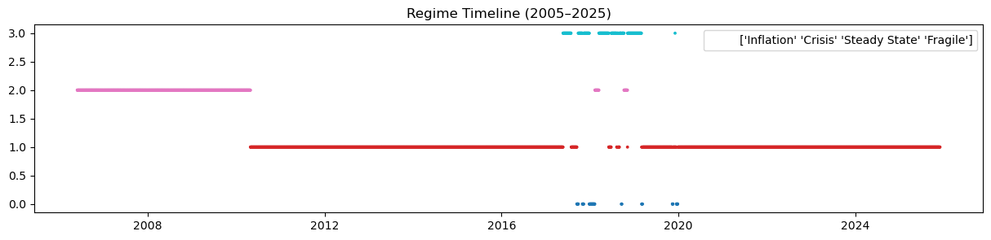
Evaluation of Grid
1. Interpretability
Used mainly to establish grid (what makes sense and is it defendable)
PCA loadings or UMAP neighborhoods must match economic intuition (e.g., crisis = high vol, falling yields)
Regime transitions must align with known macro events
2. Cluster Stability (Most Important)
Adjusted Rand Index (ARI) between rolling windows
→ Measures how consistently a method assigns regimes over time
Consensus Matrix across different runs
→ High agreement = stable, reliable structure
3. Cluster Quality
Silhouette Score
→ Quantifies how well-separated clusters are
Intra-cluster compactness vs. inter-cluster distance
→ Ensures regimes are meaningful, not overlap/noise
Final Selection Criterion
Highest stability + strongest cluster separation + economically interpretable behavior
→ This combination defines the best regime-modeling pipeline.

Slide 8
The End
Thank you for your time!

