Slide 1
Exploring Copula-Based Models for the Stochastic Simulation of Information Retrieval Evaluation Data
by Dimitris Theodorakopoulos
under the supervision of Dr. J. Urbano
Notes:
Hello. My thesis is titled: “Exploring Copula-Based Models for the Stochastic Simulation of Information Retrieval Evaluation Data”, and is supervised by Dr. Urbano.

Slide 2


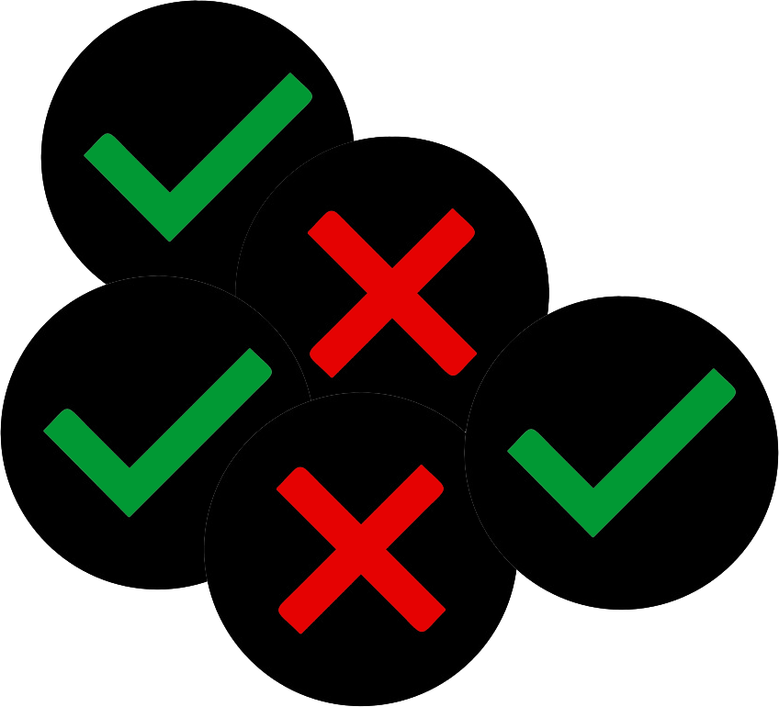
IR System Evaluation
Information Retrieval (IR)
Documents
Test Collection
Topics
Evaluation of systems
Relevance judgments
Offline experiments
Notes:
In the field of Information Retrieval (IR), it is important to evaluate systems reliably, in order to progress the state-of-the-art.
One method of evaluation, is through offline experiments, which involve the use of Test Collections.
Test collections are composed of three main components: a set of documents, a set of topics and a set of relevance judgments, which is also known as the ground truth.

Slide 3

IR System Evaluation
Systems
Information Retrieval (IR)
Documents
Test Collection
Topics
Evaluation of systems
Relevance judgments
Offline experiments
$$X_{A1}$$ | $$X_{B1}$$ | …
$$X_{A2}$$ | $$X_{B2}$$ | …
… | … | …
$$X_{An}$$ | $$X_{Bn}$$ | …
Scores
Notes:
Researchers can evaluate systems on a test collection, and obtain the score of every system on every topic of that test collection.

Slide 4
Why Use Stochastic Simulation?
How to optimize evaluation?
Stochastic simulation can help us…
Limitations of IR data | Advantages of simulation
Small size | Endless generation of data
Lack of control | Generate data under specified conditions
No knowledge of true characteristics | Data come from statistical models (Knowledge of μ, σ, ...)
Notes:
A lot of IR research focuses on finding new ways to optimize the various aspects of evaluation.
One tool that can be used to assist with this kind of research, is stochastic simulation.
This is because it can help us overcome three main limitations that are often associated with IR data.
Firstly, IR data are typically small in size, because it can be expensive to produce them. Simulation can solve this problem because it can generate data endlessly.
Secondly, we typically have no control over IR data. For example, we have no control over the scores of systems on topics. With stochastic simulation, we can generate data under specified conditions.
Thirdly, we typically have no knowledge of the true characteristics of IR data. With stochastic simulation, because we generate data from statistical models, we have knowledge of characteristics such as the true mean, or the true variance of the data.

Slide 5

Examples of Stochastic Simulation
Generate entire test collections
Model user interaction
Formulation of queries
Clicks on results
Generate queries
Generate document scores
Generate scores of systems on topics
We explore:
Urbano & Nagler @SIGIR 2018 “Stochastic Simulation of Test Collections: Evaluation Scores”
Notes:
Simulation has been previously used in IR research, in a few different ways.
In earlier years it was used to generate the entire test collections. Meaning documents, topics, and relevance judgments.
In more recent years, it has been used to model how the users interact with an IR system. For example, how they formulate queries, which results they click on, how they re-formulate queries, and so on.
It has also been used to generate queries, and document scores.
In this thesis we focus on a specific kind of simulation, which is the simulation of evaluation scores of systems on topics.
More specifically, we explore the method proposed in 2018 by the authors Urbano and Nagler

Slide 6
Simulation of System Scores
Scores
$$X_{A1}$$ | $$X_{B1}$$ | $$X_{C1}$$
$$X_{A2}$$ | $$X_{B2}$$ | $$X_{C2}$$
… | … | …
$$X_{An}$$ | $$X_{Bn}$$ | $$X_{Cn}$$
Model
$$X_{A1}^{′}$$ | $$X_{B1}^{′}$$ | $$X_{C1}^{′}$$
$$X_{A2}^{′}$$ | $$X_{B2}^{′}$$ | $$X_{C2}^{′}$$
… | … | …
Simulate
Scores by the same systems,
on random new topics
Notes:
This particular simulation approach, uses existing collections of system scores, to build a model for the joint distribution of system scores on topics, which can then be used to endlessly simulate scores by the same systems, but on random new topics.

Slide 7
Simulation of System Scores
Scores
Research applications:
“How many topics do we need to achieve a certain level of confidence in our evaluation results?”
“Which statistical significance test is optimal for IR evaluation data?”
$$X_{A1}$$ | $$X_{B1}$$ | $$X_{C1}$$
$$X_{A2}$$ | $$X_{B2}$$ | $$X_{C2}$$
… | … | …
$$X_{An}$$ | $$X_{Bn}$$ | $$X_{Cn}$$
Model
$$X_{A1}^{′}$$ | $$X_{B1}^{′}$$ | $$X_{C1}^{′}$$
$$X_{A2}^{′}$$ | $$X_{B2}^{′}$$ | $$X_{C2}^{′}$$
… | … | …
Simulate
Scores by the same systems,
on random new topics
Notes:
This simulation has two main applications in IR research.
It can help researchers answer questions such as ”how many topics do we need to achieve a certain level of confidence in our evaluation results?”, and also the question of, ”which statistical significance test is optimal for IR evaluation data?”

Slide 8
Simulation of System Scores
Scores
Research applications:
“How many topics do we need to achieve a certain level of confidence in our evaluation results?”
“Which statistical significance test is optimal for IR evaluation data?”
$$X_{A1}$$ | $$X_{B1}$$ | $$X_{C1}$$
$$X_{A2}$$ | $$X_{B2}$$ | $$X_{C2}$$
… | … | …
$$X_{An}$$ | $$X_{Bn}$$ | $$X_{Cn}$$
Model
$$X_{A1}^{′}$$ | $$X_{B1}^{′}$$ | $$X_{C1}^{′}$$
$$X_{A2}^{′}$$ | $$X_{B2}^{′}$$ | $$X_{C2}^{′}$$
… | … | …
Simulate
Urbano et al. @SIGIR 2019
“Statistical Significance Testing in Information Retrieval: An Empirical Analysis of Type I, Type II and Type III Errors”
Scores by the same systems,
on random new topics
Findings:
t-test → optimal
Wilcoxon & Sign → unreliable
Notes:
This second question was explored in a recent paper, from 2019, by Urbano and his group, using the aforementioned simulation approach.
The authors concluded that the t-test is optimal for IR data, and that the Wilcoxon and sign tests are unreliable and that they should be discontinued.

Slide 9
Motivation
Another line of work:
_
_
Simulate
Random new retrieval runs, for the same topics
Findings:
Wilcoxon → optimal
Interestingly:
65% of papers use t-test
25% of papers use Wilcoxon
Parapar et al. 2020
“Using Score Distributions to Compare
Statistical Significance Tests for Information Retrieval Evaluation”
Parapar et al. @SAC 2021
“Testing the Tests: Simulation of Rankings to Compare Statistical Significance Tests in Information Retrieval Evaluation”
Notes:
There has also been another recent and parallel line of work, that is lead by Parapar and his group, which also used stochastic simulation, to study the same problem, of finding which statistical significance test is optimal for IR evaluation data.
However, the authors simulate random new retrieval runs, for the same topics.
Surprisingly, despite that they both use stochastic simulation, they reach almost opposite conclusions.
And they find that the Wilcoxon test is optimal, instead of the t-test.
Interestingly these two tests are the most frequently used in IR research, with the t-test being used about 65% of the times and the Wilcoxon about 25%.

Slide 10
Motivation
Another line of work:
_
_
Simulate
Random new retrieval runs, for the same topics
Findings:
Wilcoxon → optimal
Interestingly:
65% of papers use t-test
25% of papers use Wilcoxon
Criticism:
Urbano et. al → Parapar et al.
“one needs to simulate new topics for the same systems”
Parapar et. al → Urbano et al.
“quality of the simulation is unknown”
Parapar et al. 2020
“Using Score Distributions to Compare
Statistical Significance Tests for Information Retrieval Evaluation”
Parapar et al. @SAC 2021
“Testing the Tests: Simulation of Rankings to Compare Statistical Significance Tests in Information Retrieval Evaluation”
Notes:
On the one side, the main criticism of Urbano and his group, aimed at Parapar and his group, is that in order to study the tests ”one needs to simulate new topics for the same systems”.
This is because statistical significance tests deal with errors due to the sampling of topics.
On the other side, the main criticism of Parapar and his group, aimed at Urbano and his group, is that the “quality of the simulation is unknown”.
For example, it could be that the simulation is biased towards specific tests.

Slide 11
Motivation
Another line of work:
_
_
Simulate
Random new retrieval runs, for the same topics
Findings:
Wilcoxon → optimal
Interestingly:
65% of papers use t-test
25% of papers use Wilcoxon
Criticism:
Urbano et. al → Parapar et al.
“one needs to simulate new topics for the same systems”
Parapar et. al → Urbano et al.
“quality of the simulation is unknown”
The objectives of this thesis:
How good is the simulation?
Provide empirical evidence regarding the quality of the simulation
How can we improve it?
Parapar et al. 2020
“Using Score Distributions to Compare
Statistical Significance Tests for Information Retrieval Evaluation”
Parapar et al. @SAC 2021
“Testing the Tests: Simulation of Rankings to Compare Statistical Significance Tests in Information Retrieval Evaluation”
Notes:
This is precisely the objective of this thesis; to provide some empirical evidence regarding the quality of the simulation used by Urbano and his group.
If the simulation is realistic, then the recommendations made regarding the t-test being optimal, should be accurate.
We explore the questions “how good is the simulation?” and “how can we improve it?”

Slide 12

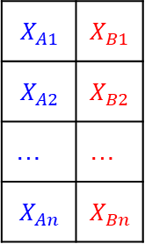
Background (How does the simulation work?)
$$X_{A1}$$ | $$X_{B1}$$
$$X_{A2}$$ | $$X_{B2}$$
… | …
$$X_{An}$$ | $$X_{Bn}$$
scores $X=$
Notes:
As we mentioned, the simulation used by Urbano and his group, uses existing collections of system scores, to fit a model.
In this example, we see the case of only two systems A and B for simplicity.
The model has two separate components.

Slide 13


Background (How does the simulation work?)
Components:
One marginal model for each system (which models the individual distribution of scores)
$$X_{A1}$$ | $$X_{B1}$$
$$X_{A2}$$ | $$X_{B2}$$
… | …
$$X_{An}$$ | $$X_{Bn}$$
scores $X=$
fit
margin $F_{A}^{∗}$
margin $F_{B}^{∗}$
Notes:
Firstly, there is one marginal model for each system, which models the individual, univariate, distribution of scores of the system, regardless of the other systems.

Slide 14
Background (How does the simulation work?)
Components:
One marginal model for each system (which models the individual distribution of scores)
$$X_{A1}$$ | $$X_{B1}$$
$$X_{A2}$$ | $$X_{B2}$$
… | …
$$X_{An}$$ | $$X_{Bn}$$
scores $X=$
Flexibility
Each margin can be modeled by a different distribution family
fit
margin $F_{A}^{∗}$
margin $F_{B}^{∗}$
normal
beta
Notes:
This adds flexibility to the model, because the marginal distribution of each system can be modeled using a different distribution family.
For example, the scores of one system can be modeled using the normal distribution, and the scores of another system can be modeled using the beta distribution.
This is important for IR evaluation data, because systems scores don’t follow any specific distribution family.

Slide 15
Background (How does the simulation work?)
Components:
One marginal model for each system (which models the individual distribution of scores)
A copula that models the dependence among systems
$$X_{A1}$$ | $$X_{B1}$$
$$X_{A2}$$ | $$X_{B2}$$
… | …
$$X_{An}$$ | $$X_{Bn}$$
scores $X=$
copula
Flexibility
Each margin can be modeled by a different distribution family
fit
margin $F_{A}^{∗}$
margin $F_{B}^{∗}$
Notes:
The second component of the simulation, is a copula, that models the dependence among systems, meaning, how they tend to perform on the same topic.

Slide 16

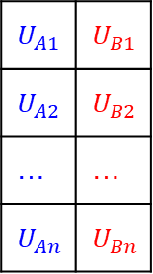
Background (How does the simulation work?)
Components:
One marginal model for each system (which models the individual distribution of scores)
A copula that models the dependence among systems
$$X_{A1}$$ | $$X_{B1}$$
$$X_{A2}$$ | $$X_{B2}$$
… | …
$$X_{An}$$ | $$X_{Bn}$$
$$U_{A1}$$ | $$U_{B1}$$
$$U_{A2}$$ | $$U_{B2}$$
… | …
$$U_{An}$$ | $$U_{Bn}$$
scores $X=$
pseudoscores $U=$
copula
fit
Flexibility
Each margin can be modeled by a different distribution family
fit
margin $F_{A}^{∗}$
margin $F_{B}^{∗}$
Notes:
The copula is actually fitted on the so-called pseudoscores.

Slide 17




Background (How does the simulation work?)
Components:
One marginal model for each system (which models the individual distribution of scores)
A copula that models the dependence among systems
$$F_{A}(X_{A})$$
$$F_{B}(X_{B})$$
define
convert to pseudoscores
empirical $F_{A}$
empirical $F_{B}$
$$X_{A1}$$ | $$X_{B1}$$
$$X_{A2}$$ | $$X_{B2}$$
… | …
$$X_{An}$$ | $$X_{Bn}$$
$$U_{A1}$$ | $$U_{B1}$$
$$U_{A2}$$ | $$U_{B2}$$
… | …
$$U_{An}$$ | $$U_{Bn}$$
scores $X=$
pseudoscores $U=$
fit
Flexibility
Each margin can be modeled by a different distribution family
Copulas and margins can be fitted in any order
Flexibility
Each margin can be modeled by a different distribution family
fit
margin $F_{A}^{∗}$
margin $F_{B}^{∗}$
copula
Notes:
The way scores are converted to pseudoscores is by using the empirical distributions of the data.
One implication of this, is that fitting the copula model, is completely separate from fitting the marginal models.

Slide 18



Background (How does the simulation work?)
Components:
One marginal model for each system (which models the individual distribution of scores)
A copula that models the dependence among systems
$$F_{A}(X_{A})$$
$$F_{B}(X_{B})$$
define
convert to pseudoscores
empirical $F_{A}$
empirical $F_{B}$
$$X_{A1}$$ | $$X_{B1}$$
$$X_{A2}$$ | $$X_{B2}$$
… | …
$$X_{An}$$ | $$X_{Bn}$$
$$U_{A1}$$ | $$U_{B1}$$
$$U_{A2}$$ | $$U_{B2}$$
… | …
$$U_{An}$$ | $$U_{Bn}$$
scores $X=$
pseudoscores $U=$
fit
Flexibility
Each margin can be modeled by a different distribution family
Copulas and margins can be fitted in any order
Flexibility
Each margin can be modeled by a different distribution family
fit
margin $F_{A}^{∗}$
margin $F_{B}^{∗}$
copula
$$R_{A}$$ | $$R_{B}$$
final output
$${{F_{A}^{∗}}^{−1}(R}_{A}^{′})$$ | $${{F_{B}^{∗}}^{−1} (R}_{B}^{′})$$
convert
to scores
$$R_{A}^{′}$$ | $$R_{B}^{′}$$
simulate
Notes:
To simulate, the copula can generate pseudoscores, which can then be converted to scores, using the marginal models.

Slide 19
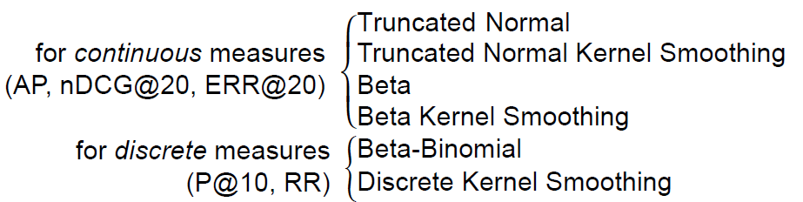
Background (How does the simulation work?)
Candidate distribution families:
Margins
Copulas
12 families (Joe, Clayton, …)
Model selection criterion:
Akaike Information Criterion (AIC)
Notes:
The simulation considers a variety of candidate distribution families, for fitting the marginal models and the copulas.
For the margins, a variety of both parametric, and non-parametric models is considered.
Also, a distinction is made depending on if the scores are continuous or discrete.
For the copulas, 12 different families are considered, including their rotations.
After all candidate models are fitted, the best model is selected according to some criterion, for example, the Akaike information criterion, AIC.

Slide 20
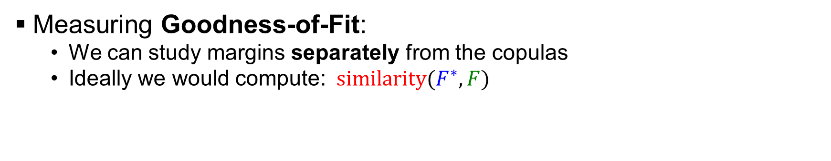
How good is the simulation?
Measuring Goodness-of-Fit:
We can study margins separately from the copulas
Ideally we would compute: ${similarity(F}^{∗}, F)$
true distribution
model
Notes:
Measuring the quality of a stochastic simulation is not a trivial or one dimensional task.
In this thesis, we focus on one, but very important aspect of simulation, which is the goodness-of-fit of the models; meaning, how well do the models describe the data.
Due to the fact that the margins are fitted separately from the copulas, we can study them separately.
Ideally, we would measure goodness-of-fit by calculating some metric of similarity between the model, and the true distribution.

Slide 21
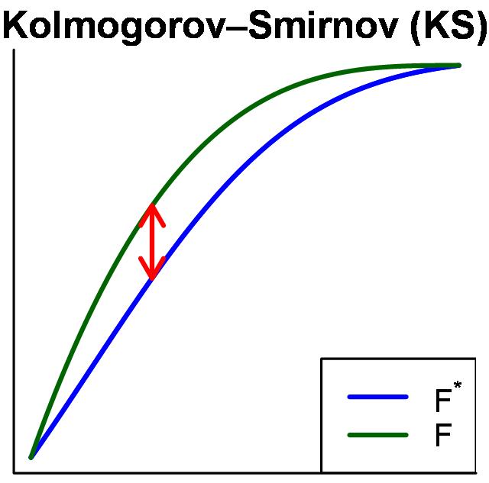
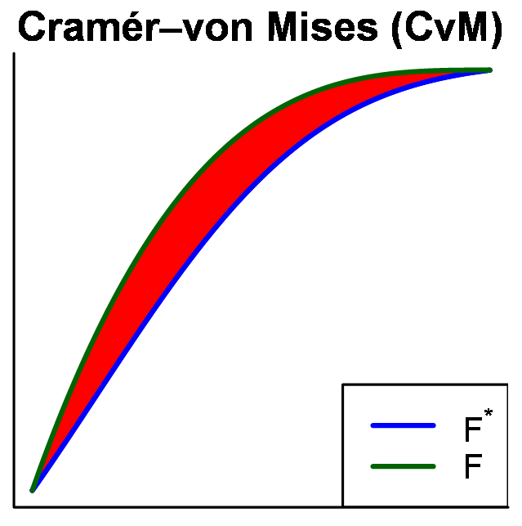

How good is the simulation?
Measuring Goodness-of-Fit:
We can study margins separately from the copulas
Ideally we would compute: ${similarity(F}^{∗}, F)$
In example: or
Goodness-of-Fit = ${−Δ(F}^{∗}, F)$
true distribution
model
Notes:
For example, the Kolmogorov-Smirnov criterion or the Cramér–von Mises criterion.
These metrics actually measure distance, which is the opposite of similarity.
For this reason, we can define goodness-of-fit as the negative of that distance.

Slide 22
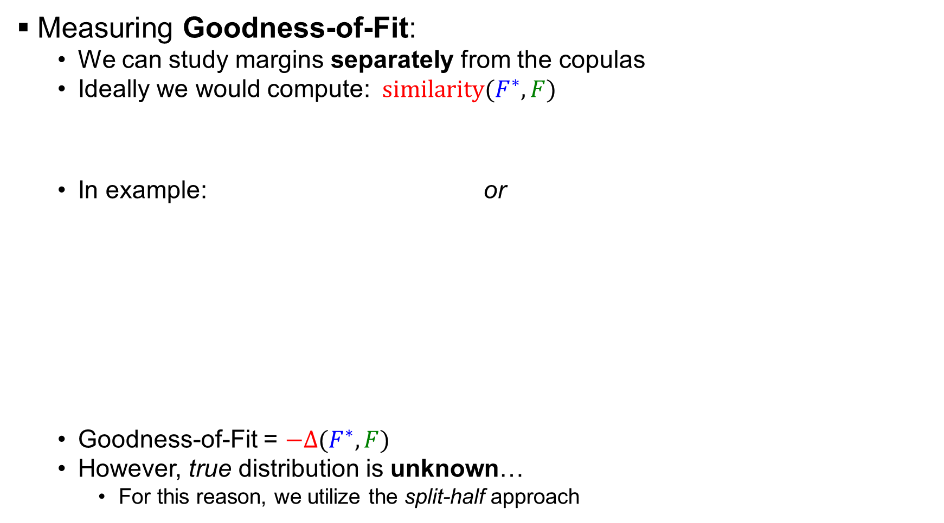
How good is the simulation?
Measuring Goodness-of-Fit:
We can study margins separately from the copulas
Ideally we would compute: ${similarity(F}^{∗}, F)$
In example: or
Goodness-of-Fit = ${−Δ(F}^{∗}, F)$
However, true distribution is unknown…
For this reason, we utilize the split-half approach
true distribution
model
Notes:
But, the problem is that the true distribution is unknown, because it would imply that the systems have been evaluated on the entire, possibly infinitely population of topics.
For this reason, we utilize the split-half approach.

Slide 23



The Split-Half Approach
Treat the:
1st half as the “sample”
2nd half as the “population”
$$S_{19}$$
$$S_{8}$$
$$…$$
$$S_{37}$$
scores
“sample”
$$S_{1}$$
$$S_{2}$$
…
$$S_{50}$$
split-half
$$S_{23}$$
$$S_{41}$$
$$…$$
$$S_{12}$$
“population”
Notes:
The split half approach works by repeatedly splitting the data in half, and treating the first half as the sample, and the second half as the population.

Slide 24



The Split-Half Approach
Treat the:
1st half as the “sample”
2nd half as the “population”
$$S_{19}$$
$$S_{8}$$
$$…$$
$$S_{37}$$
scores
“sample”
$$S_{1}$$
$$S_{2}$$
…
$$S_{50}$$
fit
split-half
compute
$$Δ_{obs}(F_{1}^{∗},F_{2})$$
margin $F_{1}^{∗}$
$$S_{23}$$
$$S_{41}$$
$$…$$
$$S_{12}$$
“population”
define
empirical $F_{2}$
Notes:
Then, we can fit a model on the first half of the data, and use the empirical distribution of the second half, as an estimate of the ground truth.
This way we can now compute a measure of distance “delta” between the model and the estimate of the ground truth.
We call this delta observed.
We compute it as the area between the two curves.

Slide 25
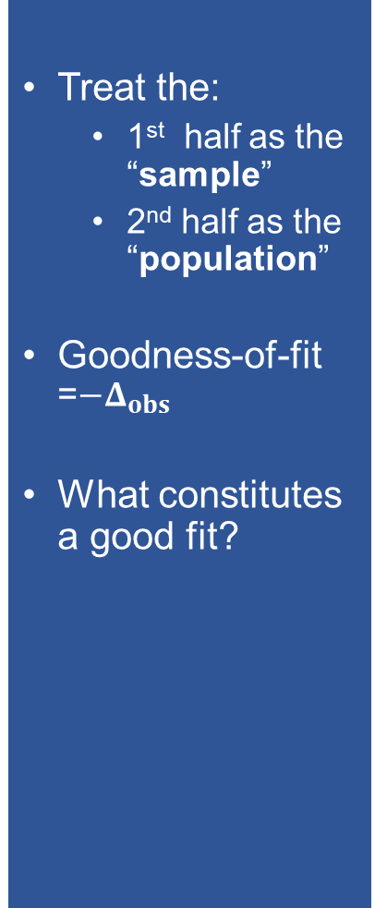
The Split-Half Approach
Treat the:
1st half as the “sample”
2nd half as the “population”
Goodness-of-fit =$−Δ_{obs}$
What constitutes a good fit?
$$S_{19}$$
$$S_{8}$$
$$…$$
$$S_{37}$$
scores
“sample”
$$S_{1}$$
$$S_{2}$$
…
$$S_{50}$$
fit
split-half
compute
$$Δ_{obs}(F_{1}^{∗},F_{2})$$
margin $F_{1}^{∗}$
$$S_{23}$$
$$S_{41}$$
$$…$$
$$S_{12}$$
“population”
define
empirical $F_{2}$
Notes:
The goodness-of-fit of the model can be defined as the negative of this delta.
One limitation is that, it is not entirely obvious how to interpret these delta observed values.
Even though we can compare two models, in relative terms; it is not clear which specific range of values constitute a good fit.
We need a way to calculate which values we should expect from a good fit.

Slide 26



The Split-Half Approach
Treat the:
1st half as the “sample”
2nd half as the “population”
Goodness-of-fit =$−Δ_{obs}$
What constitutes a good fit?
define
$$S_{19}$$
$$S_{8}$$
$$…$$
$$S_{37}$$
compute
$$Δ_{exp}(F_{1},F_{2})$$
empirical $F_{1}$
scores
“sample”
$$S_{1}$$
$$S_{2}$$
…
$$S_{50}$$
fit
split-half
compute
$$Δ_{obs}(F_{1}^{∗},F_{2})$$
margin $F_{1}^{∗}$
$$S_{23}$$
$$S_{41}$$
$$…$$
$$S_{12}$$
“population”
define
empirical $F_{2}$
Notes:
One way to do this is by computing the delta between the two empirical distributions, and use that as a reference.
We call this delta expected, because it is the value we should approximately expect from a good fit.

Slide 27
Results – Margins
250,000 random splits
Notes:
We performed a total of 250,000 random splits for the margins, using a variety of IR data.
The model selection criterion used was AIC.
In this plot, we show the mean delta observed and delta expected values, across all effectiveness measures and candidate distribution families.
The lower the delta observed, the better.
We can see that the models tend to measure a delta that is larger than the expectation.

Slide 28
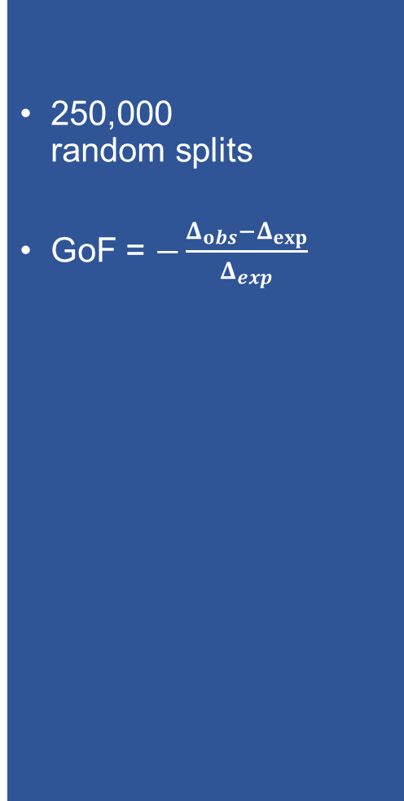
Results – Margins
250,000 random splits
GoF = $−\frac{Δ_{obs}−Δ_{exp}}{Δ_{exp}}$
Notes:
To make it easier to visually interpret the results, we have combined the two deltas, in a single formula, as the negative of the percentage deviation of delta observed from delta expected.
We call this GoF, for goodness-of-fit.
The higher the value, the better.
In general we expect a good fit to give us a value of about 0.
A value of -1, would imply that the delta observed was twice the expectation, which is not good.

Slide 29


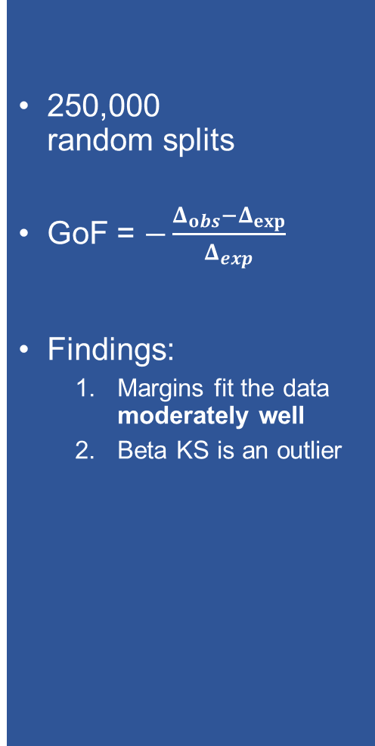

Results – Margins
250,000 random splits
GoF = $−\frac{Δ_{obs}−Δ_{exp}}{Δ_{exp}}$
Findings:
Margins fit the data moderately well
Beta KS is an outlier
Notes:
Our results show that the marginal models fit the data moderately well, with the exception of one obvious outlier, the Beta Kernel Smoothing distribution family.

Slide 30


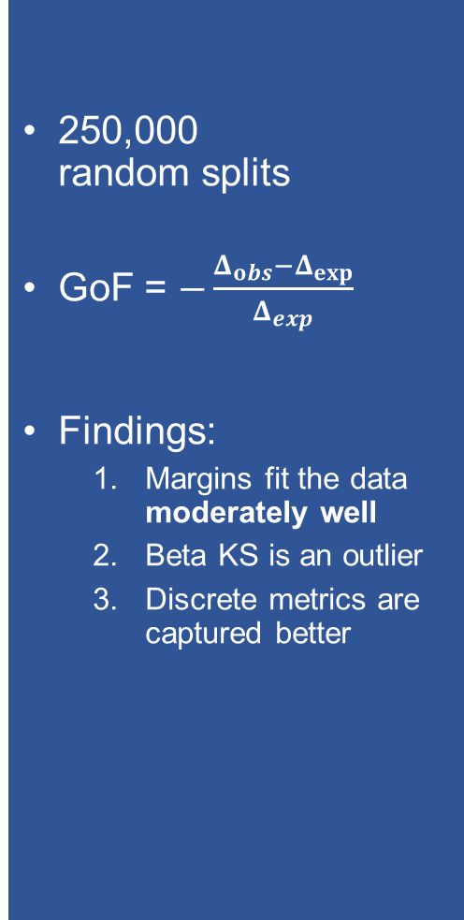
Results – Margins
250,000 random splits
GoF = $−\frac{Δ_{obs}−Δ_{exp}}{Δ_{exp}}$
Findings:
Margins fit the data moderately well
Beta KS is an outlier
Discrete metrics are captured better
Notes:
Also, we can see that the discrete metrics, are captured much better than the continuous metrics.

Slide 31
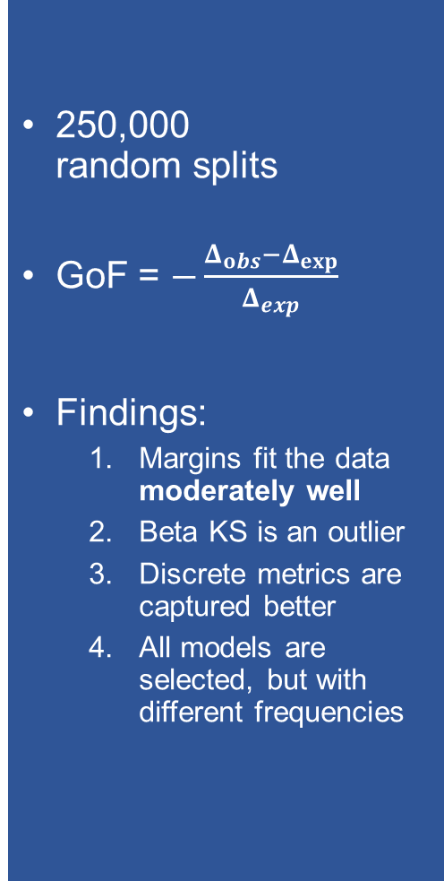
Results – Margins
250,000 random splits
GoF = $−\frac{Δ_{obs}−Δ_{exp}}{Δ_{exp}}$
Findings:
Margins fit the data moderately well
Beta KS is an outlier
Discrete metrics are captured better
All models are selected, but with different frequencies
Notes:
In this plot, we show the frequency with which each candidate model is selected, by AIC.
All models are selected, but with different frequencies.
This implies that IR data are complex, and that a variety of candidates is required.
We show the cases of fitting models on 25, as well as 50 topics.
This is because in a split-half approach, the data are being halved, meaning that models are fitted on only 25 topics.
Whereas, we are truly interested in the quality of models, that are fitted on the entire set of 50 topics.
We see that the differences are small between 25 and 50 topics, in terms of the frequency with which the distribution families are being selected.

Slide 32
Exploring Outlier (Beta KS)
Example:
Good vs bad fit
Bad fit
Good fit
Notes:
Next, we explored the outlier, Beta Kernel Smoothing.
In these two plots, we compare two example Beta KS fits, a bad fit, on the left, and a good fit, on the right.
We selected these two examples to illustrate a pattern that we observed.

Slide 33
Exploring Outlier (Beta KS)
Example:
Good vs bad fit
Bad fit
Too many zero values in the data → bad fit
Was selected due to low complexity
Bad fit
Good fit
Beta KS
zeros
Notes:
Looking at the bad fit example, we see that the model, has trouble fitting the data, due to the high appearance of zero values.
Despite the model being underfitted, it is still selected by AIC, due to its low complexity.

Slide 34
Exploring Outlier (Beta KS)
Example:
Good vs bad fit
Bad fit
Too many zero values in the data → bad fit
Was selected due to low complexity
2nd best model (AIC) would have performed better
Bad fit
Good fit
Beta KS
Tr. Norm KS
zeros
Notes:
In contrast, the 2nd best model according to AIC, which in this case is a Truncated Normal Kernel Smoothing model, would have performed better, if it had been selected.

Slide 35
Exploring Outlier (Beta KS)
Example:
Good vs bad fit
Bad fit
Too many zero values in the data → bad fit
Was selected due to low complexity
2nd best model (AIC) would have performed better
Good fit
Due to chance
Bad fit
Good fit
zeros
zeros
Notes:
Looking at the good fit example, we see that once again, the Beta KS model, has trouble fitting the data, due to the high appearance of zero values.
The reason why we observe a low delta, is simply due to chance.
It just happened that in this particular split, the zero values were present in the first half of the data, but not on the second half of the data.

Slide 36
Exploring Outlier (Beta KS)
Notes:
Next, we compare those specific cases where AIC selected Beta KS, with all other cases.

Slide 37


Exploring Outlier (Beta KS)
When AIC selects Beta KS:
The data contain a large number of zeros
Notes:
We see that when AIC selects Beta KS, the data contain a number of zeros that is larger than usual.

Slide 38

Exploring Outlier (Beta KS)
When AIC selects Beta KS:
The data contain a large number of zeros
None of the models would have performed very well
Notes:
Also, we see that none of the candidate models, would have performed well, even if they had been selected optimally.
We do this by selecting the model with the lowest delta observed.

Slide 39



Exploring Outlier (Beta KS)
When AIC selects Beta KS:
The data contain a large number of zeros
None of the models would have performed very well
Notes:
For example, we see that the GoF values would have been around -0.25, which means that the delta observed would have been 25% larger than the expectation, even if the models were selected optimally.

Slide 40
Exploring Outlier (Beta KS)
When AIC selects Beta KS:
The data contain a large number of zeros
None of the models would have performed very well
Additional models would be required to capture these corner cases
I.e., Mixture model that models the zeros separately
Notes:
This implies that additional models would need to be considered, to significantly improve the goodness-of-fit.
For example, perhaps a better fit would have been achieved, by a mixture model, that models the zero scores separately from non-zeros.
We leave this for future work.

Slide 41



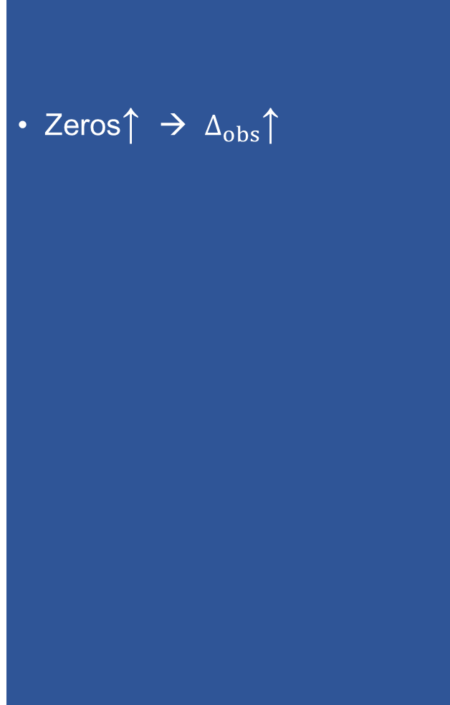
Exploring Outlier (Beta KS)
Zeros↑ → $Δ_{obs}$↑
Notes:
In this plot, we see that when the number of zeros increases, the delta observed increases as well.
This further verifies our hypothesis the large number of zeros in the data, is not modelled properly.

Slide 42
Correcting Outlier (Beta KS)
Simply never select Beta KS?
Notes:
In at attempt to correct for this outlier in our results, we explored if the quality can be improved simply by never selecting Beta KS.
In this plot, we only show the results on those specific random splits, where AIC selected Beta KS.
And we explore, what would have happened, if we had selected the 2nd best model instead.

Slide 43


Correcting Outlier (Beta KS)
Simply never select Beta KS?
Good solution
Notes:
We actually see that, on average, the 2nd best model is much better than Beta KS, which is what AIC had selected.

Slide 44


Correcting Outlier (Beta KS)
Simply never select Beta KS?
Good solution
Notes:
In fact, it is almost as good, as it could have been, if we compare it to the best-case, which is best possible candidate model.

Slide 45



Correcting Outlier (Beta KS)
Simply never select Beta KS?
Good solution
Notes:
In the bottom plot, we visualize the improvement that would have been observed by the removal of Beta KS.
We see that it is mostly noticeable for the case of one particular metric, the normalized discounted gain @ 20.

Slide 46




Correcting Outlier (Beta KS)
Simply never select Beta KS?
Good solution
… but, the margins still have room for improvement
Notes:
But, even with this improvement, the GoF values are still quite low.
A good fit should give us a GoF value of about zero.
For this reason, we look for ways to refine the quality of the margins.

Slide 47
Exploring Alternative Model Selection Criteria
Consider existing criteria
AIC, BIC, LL
Propose a new criterion
Split-Half Criterion (SHC)
Notes:
In this thesis, we specifically focused on exploring alternative ways to select the models that we already have, instead of expanding our list of candidates with additional models.
We considered criteria such as BIC and LL, but also proposed a new method of selecting models, which was inspired by the split-half approach, and we refer to as the Split-Half Criterion (SHC)

Slide 48


Exploring Alternative Model Selection Criteria
Consider existing criteria
AIC, BIC, LL
Propose a new criterion
Split-Half Criterion (SHC)
$$S_{1}$$
$$S_{2}$$
…
$$S_{25}$$
scores
fit
$$…$$
Notes:
We illustrate how our criterion works, through an example.
Starting from a set of 25 scores, we fit all candidate models, and we want to select the best model.

Slide 49







Exploring Alternative Model Selection Criteria
Consider existing criteria
AIC, BIC, LL
Propose a new criterion
Split-Half Criterion (SHC)
$$S_{1}$$
$$S_{2}$$
…
$$S_{25}$$
scores
fit
$$…$$
Split 1
Split n
$$S_{23}$$
$$S_{4}$$
$$…$$
$$S_{7}$$
$$S_{19}$$
$$S_{21}$$
$$…$$
$$S_{5}$$
Split i
$$⋮$$
$$⋮$$
$S_{ 1,1}=$
$S_{ 1, 2}=$
fit
define
$$⋮$$
Notes:
The Split-Half Criterion works, by performing n splits, and in each split, we fit all models and compute their delta observed.

Slide 50
Exploring Alternative Model Selection Criteria
Consider existing criteria
AIC, BIC, LL
Propose a new criterion
Split-Half Criterion (SHC)
$$S_{1}$$
$$S_{2}$$
…
$$S_{25}$$
scores
fit
$$…$$
Split 1
Split n
$$S_{23}$$
$$S_{4}$$
$$…$$
$$S_{7}$$
$$S_{19}$$
$$S_{21}$$
$$…$$
$$S_{5}$$
Split i
$$⋮$$
$$⋮$$
$S_{ 1,1}=$
$S_{ 1, 2}=$
fit
define
$$⋮$$
Notes:
For example, in the first split, we computed a delta observed of 0.21 for Beta KS.

Slide 51





Exploring Alternative Model Selection Criteria
Consider existing criteria
AIC, BIC, LL
Propose a new criterion
Split-Half Criterion (SHC)
$$S_{1}$$
$$S_{2}$$
…
$$S_{25}$$
scores
fit
$$…$$
Split 1
Split n
$$S_{23}$$
$$S_{4}$$
$$…$$
$$S_{7}$$
$$S_{19}$$
$$S_{21}$$
$$…$$
$$S_{5}$$
Split i
$$S_{15}$$
$$S_{10}$$
$$…$$
$$S_{12}$$
$$S_{2}$$
$$S_{7}$$
$$…$$
$$S_{24}$$
$$⋮$$
$S_{ 1,1}=$
$S_{ 1, 2}=$
$S_{ n,1}=$
$S_{ n, 2}=$
fit
define
fit
define
$$⋮$$
$$⋮$$
Notes:
In the end, the Split-Half Criterion value for Beta KS, is simply the average of the delta observed values that we measured for Beta KS, across n splits.

Slide 52
Exploring Alternative Model Selection Criteria
Consider existing criteria
AIC, BIC, LL
Propose a new criterion
Split-Half Criterion (SHC)
$$S_{1}$$
$$S_{2}$$
…
$$S_{25}$$
scores
fit
$$…$$
Split 1
Split n
$$S_{23}$$
$$S_{4}$$
$$…$$
$$S_{7}$$
$$S_{19}$$
$$S_{21}$$
$$…$$
$$S_{5}$$
Split i
$$S_{15}$$
$$S_{10}$$
$$…$$
$$S_{12}$$
$$S_{2}$$
$$S_{7}$$
$$…$$
$$S_{24}$$
$$⋮$$
$S_{ 1,1}=$
$S_{ 1, 2}=$
$S_{ n,1}=$
$S_{ n, 2}=$
fit
define
fit
define
$$⋮$$
$$⋮$$
Notes:
The model that is selected, is the model with the lowest criterion value.
In this case, the Truncated Normal model, with a value of 0.09.

Slide 53
Exploring Alternative Model Selection Criteria
Consider existing criteria
AIC, BIC, LL
Propose a new criterion
Split-Half Criterion (SHC)
Excluding Beta KS
Notes:
Next, we show a comparison of the model criteria, in terms of the overall mean GoF that is measured.

Slide 54




Exploring Alternative Model Selection Criteria
Consider existing criteria
AIC, BIC, LL
Propose a new criterion
Split-Half Criterion (SHC)
Findings:
For discrete metrics, all criteria perform well (except SHC for RR)
Excluding Beta KS
Notes:
For the discrete metrics, we see that they all perform well, with the only exception being our proposed criterion, for the case of Reciprocal Rank.

Slide 55








Exploring Alternative Model Selection Criteria
Consider existing criteria
AIC, BIC, LL
Propose a new criterion
Split-Half Criterion (SHC)
Findings:
For discrete metrics, all criteria perform well (except SHC for RR)
For continuous metrics, SHC performs the best
Excluding Beta KS
Notes:
For the continuous metrics, we see that our criterion is actually the best

Slide 56




Exploring Alternative Model Selection Criteria
Consider existing criteria
AIC, BIC, LL
Propose a new criterion
Split-Half Criterion (SHC)
Findings:
For discrete metrics, all criteria perform well (except SHC for RR)
For continuous metrics, SHC performs the best
However, if we remove Beta KS, all criteria perform very similarly, except LL
Excluding Beta KS
Notes:
However, when we exclude Beta KS, all criteria perform very similarly, except LL.

Slide 57
Extrapolating to 50 Topics
Do we underestimate (or overestimate) goodness-of-fit?
By how much?
Notes:
As we mentioned, one limitation of a split-half approach is that the data are being halved.
For this reason, our goodness-of-fit estimates are based on models fitted on only 25 topics, as opposed to the entire set of 50 topics.
We investigated if we underestimate or overestimate the goodness-of-fit, and by how much.

Slide 58
Extrapolating to 50 Topics
Do we underestimate (or overestimate) goodness-of-fit?
By how much?
“What if we had 25 more topics?”
Using a collection of system scores on 149 topics
Notes:
We essentially ask the question “what if we had 25 more topics?”.
This is explored using a separate dataset, that contains scores of systems on 149 topics, instead of 50.

Slide 59



Extrapolating to 50 Topics
Do we underestimate (or overestimate) goodness-of-fit?
By how much?
“What if we had 25 more topics?”
Using a collection of system scores on 149 topics:
We repeatedly create 3 data splits
$S_{50}$
$S_{149}$
split
$S_{99}$
Notes:
What we do is that, we repeatedly split the data in 3 parts.
The first two parts are created by splitting the data, so that we get a set of 50 scores and a set of the remaining 99 scores.

Slide 60

Extrapolating to 50 Topics
Do we underestimate (or overestimate) goodness-of-fit?
By how much?
“What if we had 25 more topics?”
Using a collection of system scores on 149 topics:
We repeatedly create 3 data splits
$S_{25}$
sub-sample
$S_{50}$
$S_{149}$
split
$S_{99}$
Notes:
Then, we create a smaller set of 25 scores, by sampling from the set of 50.

Slide 61


Extrapolating to 50 Topics
Do we underestimate (or overestimate) goodness-of-fit?
By how much?
“What if we had 25 more topics?”
Using a collection of system scores on 149 topics:
We repeatedly create 3 data splits
$S_{25}$
fit
margin $F_{25}^{∗}$
sub-sample
$S_{50}$
fit
margin $F_{50}^{∗}$
$S_{149}$
split
$S_{99}$
Notes:
This way, we can fit one model one the set of 25 scores, and another model on the set of 50 scores.

Slide 62



Extrapolating to 50 Topics
Do we underestimate (or overestimate) goodness-of-fit?
By how much?
“What if we had 25 more topics?”
Using a collection of system scores on 149 topics:
We repeatedly create 3 data splits
$S_{25}$
fit
margin $F_{25}^{∗}$
sub-sample
$$Δ_{obs}^{25}$$
$S_{50}$
fit
margin $F_{50}^{∗}$
$$Δ_{obs}^{50}$$
$S_{149}$
split
define
$S_{99}$
empirical $F_{99}$
Notes:
Then, using the remaining 99 scores as an estimate of the ground truth, we can compute two deltas, one for each model.

Slide 63
Extrapolating to 50 Topics
Do we underestimate (or overestimate) goodness-of-fit?
By how much?
“What if we had 25 more topics?”
Using a collection of system scores on 149 topics:
We repeatedly create 3 data splits
Findings:
We underestimate quality of the margins, only by a small amount (8% for AP, and 3% for P@10)
$S_{25}$
fit
margin $F_{25}^{∗}$
sub-sample
$$Δ_{obs}^{25}$$
$S_{50}$
fit
margin $F_{50}^{∗}$
$$Δ_{obs}^{50}$$
$S_{149}$
split
define
$S_{99}$
empirical $F_{99}$
Notes:
By comparing these two deltas, we found that we underestimate the quality of the margins, but only by a very small amount.
8% for AP and 3% for P@10.

Slide 64
Copulas
Same approaches as in the case of the margins
Only a few differences
Notes:
We also explored the copula models.
The approaches we used are largely the same with those used in the case of the margins.
However there are a few differences.

Slide 65
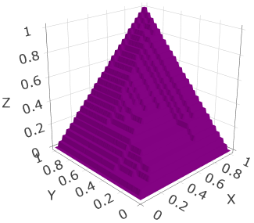
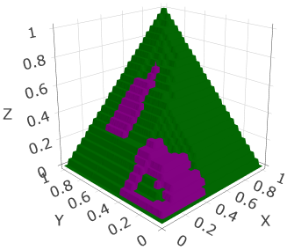
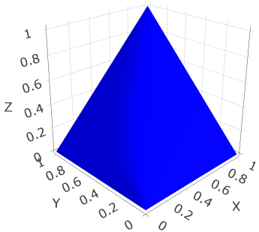
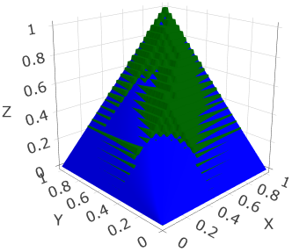
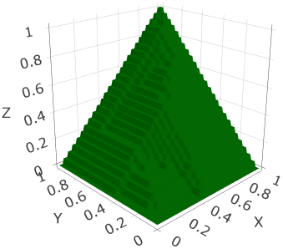

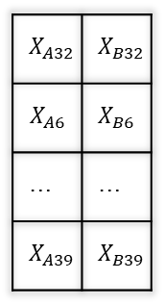


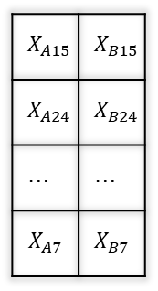


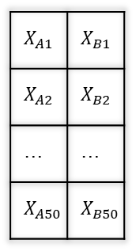





Copulas
Same approaches as in the case of the margins
Only a few differences:
Joint distributions
Δ = volume between 2 curves
Pseudoscores
empirical $F_{1}$
$$X_{split 1}$$
define
$$X_{A15}$$ | $$X_{B15}$$
$$X_{A24}$$ | $$X_{B24}$$
… | …
$$X_{A7}$$ | $$X_{B7}$$
$$U_{split 1}$$
margin $F_{1}^{∗}$
$$Δ_{exp}$$
$$scores X$$
$$X_{A1}$$ | $$X_{B1}$$
$$X_{A2}$$ | $$X_{B2}$$
… | …
$$X_{A50}$$ | $$X_{B50}$$
fit
split
half
convert to pseudoscores
$$X_{split 2}$$
$$Δ_{obs}$$
$$X_{A32}$$ | $$X_{B32}$$
$$X_{A6}$$ | $$X_{B6}$$
… | …
$$X_{A39}$$ | $$X_{B39}$$
empirical $F_{2}$
$$U_{split 2}$$
define
Notes:
In this diagram, we show the split-half approach, for the case of the copulas.
We see that the distributions are now joint, instead of univariate.
Which means that the models are visualized as surfaces instead of curves.
As a consequence, we compute deltas, as the volume between two surfaces.
Also, the scores need to be converted to pseudoscores first, before any model fitting.

Slide 66
Results – Copulas
250,000 random splits
Findings:
Copulas fit the data moderately well (but worse than the margins)
No obvious outliers
Notes:
We ran 250,000 random splits for the copulas as well.
In this plot we report average GoF values.
We see that the models fit the data moderately well, but worse than the margins.
And we see no obvious outliers.

Slide 67
Results – Copulas
250,000 random splits
Findings:
Copulas fit the data moderately well (but worse than the margins)
No obvious outliers
All models are selected, but with different frequencies
Notes:
Looking at the frequency with which each family is selected, we see that all models are selected, but with different frequencies.
Once again, this implies that IR data are complex, and that a variety of models is required.
The differences between 25 and 50 topics are small.

Slide 68
Results – Copulas
250,000 random splits
Findings:
Copulas fit the data moderately well (but worse than the margins)
No obvious outliers
All models are selected, but with different frequencies
Tawn is selected the most
Lack of asymmetric copulas
Notes:
We notice that the most frequently selected copula is the Tawn copula, which is actually the only asymmetric copula that is considered.
We speculate that if more asymmetric copulas were considered, the goodness-of-fit would improve.

Slide 69






Results – Copulas
250,000 random splits
Findings:
Copulas fit the data moderately well (but worse than the margins)
No obvious outliers
All models are selected, but with different frequencies
Tawn is selected the most
Lack of asymmetric copulas
Our criterion selects the copulas more optimally
Notes:
Next, we compare the various model selection criteria, in terms of the overall mean GoF that is measured.
Our proposed criterion actually selects models more optimally, on average, across all effectiveness measures.
Although, the improvement is relatively small.

Slide 70
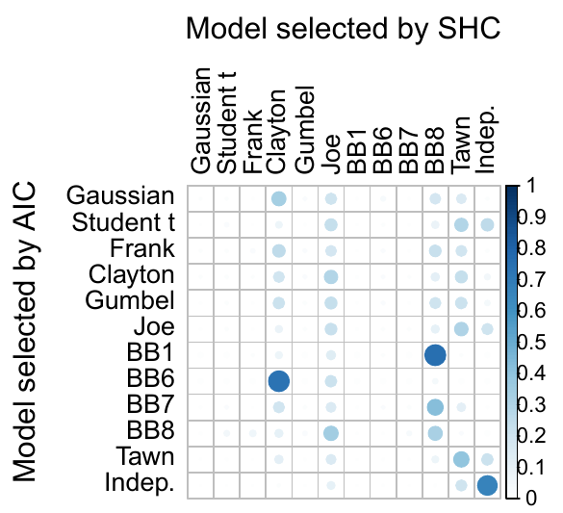
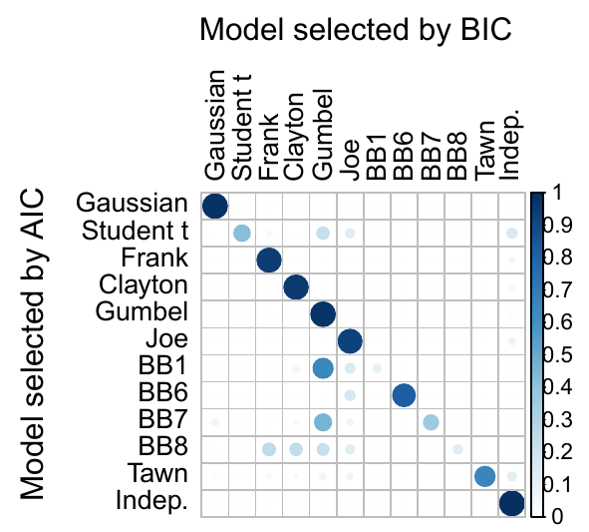
Results – Copulas
250,000 random splits
Findings:
Copulas fit the data moderately well (but worse than the margins)
No obvious outliers
All models are selected, but with different frequencies
Tawn is selected the most
Lack of asymmetric copulas
Our criterion selects the copulas more optimally
Notes:
In this plot, we visualize how different is our criterion, compared to AIC, in terms of model selections.
Our criterion seems to select models very differently compared to AIC.

Slide 71





Results – Copulas
250,000 random splits
Findings:
Copulas fit the data moderately well (but worse than the margins)
No obvious outliers
All models are selected, but with different frequencies
Tawn is selected the most
Lack of asymmetric copulas
Our criterion selects the copulas more optimally
Notes:
It appears to be favoring the Clayton, Joe, BB8 and Tawn copulas.

Slide 72
Results – Copulas
250,000 random splits
Findings:
Copulas fit the data moderately well (but worse than the margins)
No obvious outliers
All models are selected, but with different frequencies
Tawn is selected the most
Lack of asymmetric copulas
Our criterion selects the copulas more optimally
Notes:
In contrast, if we compare AIC with BIC, we can see that the selections are very similar.
This can be seen by looking at the diagonal.

Slide 73

Results – Copulas
250,000 random splits
Findings:
Copulas fit the data moderately well (but worse than the margins)
No obvious outliers
All models are selected, but with different frequencies
Tawn is selected the most
Lack of asymmetric copulas
Our criterion selects the copulas more optimally
Notes:
This suggests that our criterion is not redundant, since it selects models quite differently than other criteria.

Slide 74
Results – Copulas
250,000 random splits
Findings:
Copulas fit the data moderately well (but worse than the margins)
No obvious outliers
All models are selected, but with different frequencies
Tawn is selected the most
Lack of asymmetric copulas
Our criterion selects the copulas more optimally
Underestimating goodness-of-fit by only around 5%
Notes:
Finally, we also found that our goodness-of-fit estimates are slightly underestimated, by only about 5%.

Slide 75
Conclusion
Overall, both the marginal models and the copulas (to a lesser extent) fit the data moderately well
This substantiates the findings of Urbano et al. regarding the t-test being optimal for IR evaluation data
The only obvious outlier is Beta KS. This can be corrected by simply removing it from the list of candidates.
The high appearance of zeros is not properly modeled by the margins
Our criterion selects the copulas more optimally than other criteria
Notes:
In conclusion, our findings show that:
Overall, both the marginal models and the copulas (to a lesser extent) fit the data moderately well
An important implication of this is that it substantiates the findings of Urbano and his group regarding the t-test being optimal for IR evaluation data
The only obvious outlier is Beta KS, which can be corrected by simply removing Beta KS from the list of candidates.
Moreover, the high appearance of zeros is not properly modeled by the margins
And finally, our criterion selects the copulas more optimally than other criteria

Slide 76
Conclusion
Overall, both the marginal models and the copulas (to a lesser extent) fit the data moderately well
This substantiates the findings of Urbano et al. regarding the t-test being optimal for IR evaluation data
The only obvious outlier is Beta KS. This can be corrected by simply removing it from the list of candidates.
The high appearance of zeros is not properly modeled by the margins
Our criterion selects the copulas more optimally than other criteria
Future work:
Further investigate why the results of Urbano et al. and Parapar et al. are not in accordance. This is important, in order to:
Determine which test is optimal
Deepen our knowledge with regards to the properties of IR evaluation data
Notes:
The most important direction for future work is to further investigate why the results of Urbano and his group, and Parapar and his group, are not in accordance.
This is important, in order to:
Not only to determine which test is optimal
But also to deepen our knowledge with regards to the properties of IR evaluation data

