Slide 1






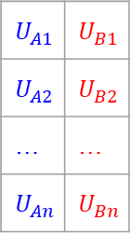




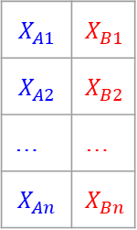

$$F_{A}(X_{A})$$
$$F_{B}(X_{B})$$
define
convert to pseudoscores
empirical $F_{A}$
empirical $F_{B}$
$$X_{A1}$$ | $$X_{B1}$$
$$X_{A2}$$ | $$X_{B2}$$
… | …
$$X_{An}$$ | $$X_{Bn}$$
$$U_{A1}$$ | $$U_{B1}$$
$$U_{A2}$$ | $$U_{B2}$$
… | …
$$U_{An}$$ | $$U_{Bn}$$
scores $X=$
pseudoscores $U=$
fit
fit
margin $F_{A}^{∗}$
margin $F_{B}^{∗}$
copula
simulate
$$R_{A}$$ | $$R_{B}$$
final output
$${{F_{A}^{∗}}^{−1}(R}_{A}^{′})$$ | $${{F_{B}^{∗}}^{−1} (R}_{B}^{′})$$
convert
to scores
$$R_{A}^{′}$$ | $$R_{B}^{′}$$

