Slide 1
Mini Project
By
Ali Faisal Raza,
Dimitri Salavci

Slide 2
Agenda
Methodology
Customer Demography:
Prepared Final Dataset
Determine Optimal Number of Clusters (Elbow Chart)
Radar Chart
PCA Chart
Banking Behavior:
Prepared Final Dataset
Determine Optimal Number of Clusters (Elbow Chart)
Radar Chart
PCA Chart

Slide 3
Methodology
Apply transformations on observations (scaling and adopting dummy variables).
Plot elbow graph to determine the optimal number of clusters.
Apply KMeans algorithm to divide observations into clusters.
Prepare radar chart to show clusters together for comparison
Perform PCA analysis to determine 2 principal components for observations.
Prepare PCA chart to show the two principal components.

Slide 4
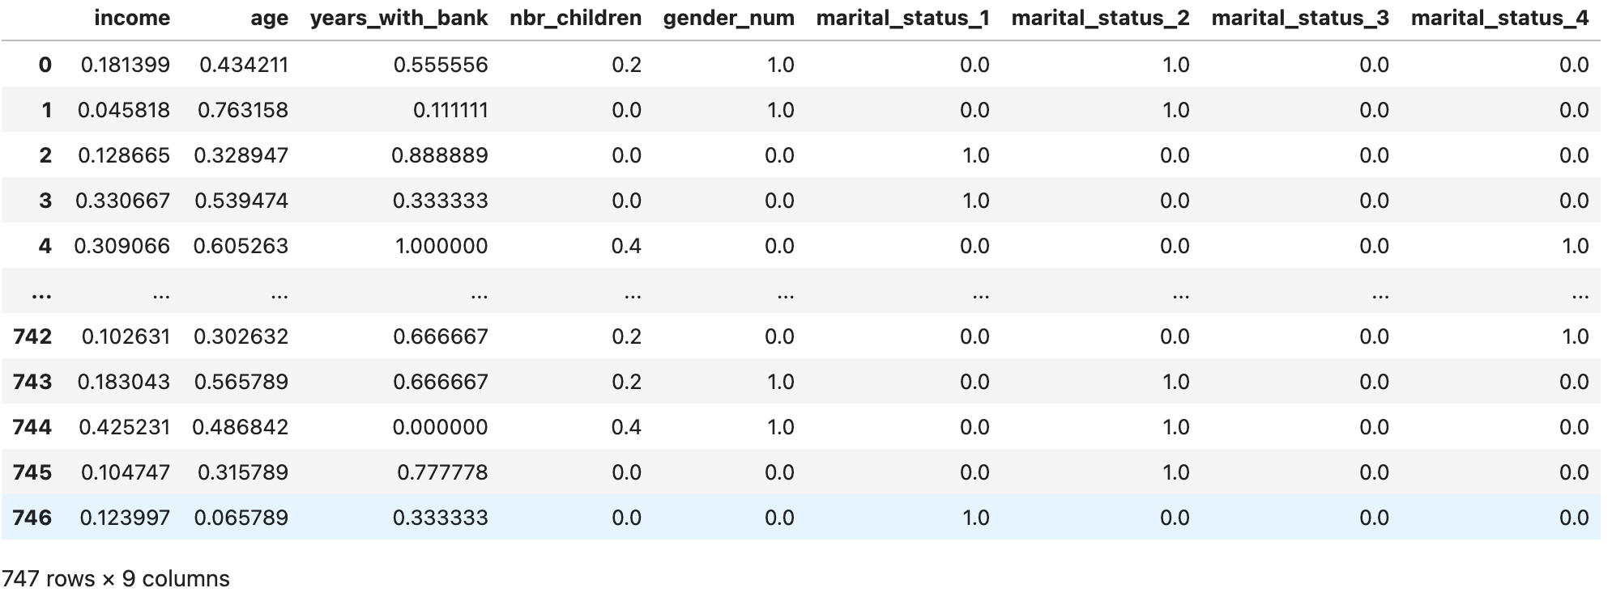
Customer Demography – Final Dataset

Slide 5
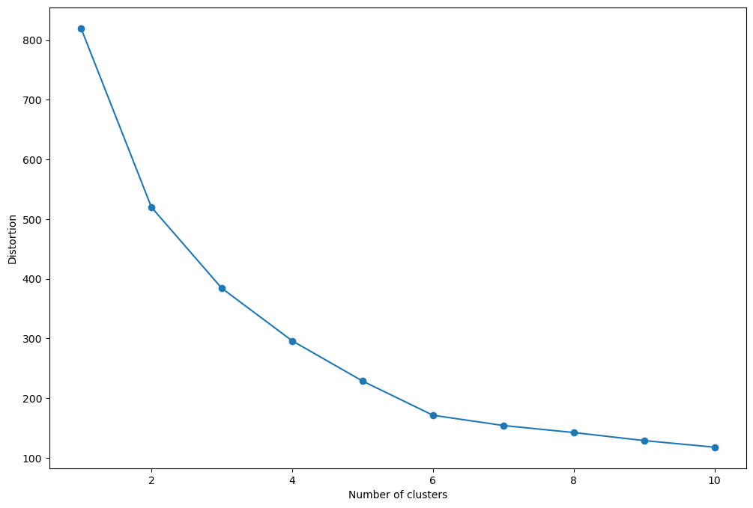

Customer Demography – Elbow Chart

Slide 6
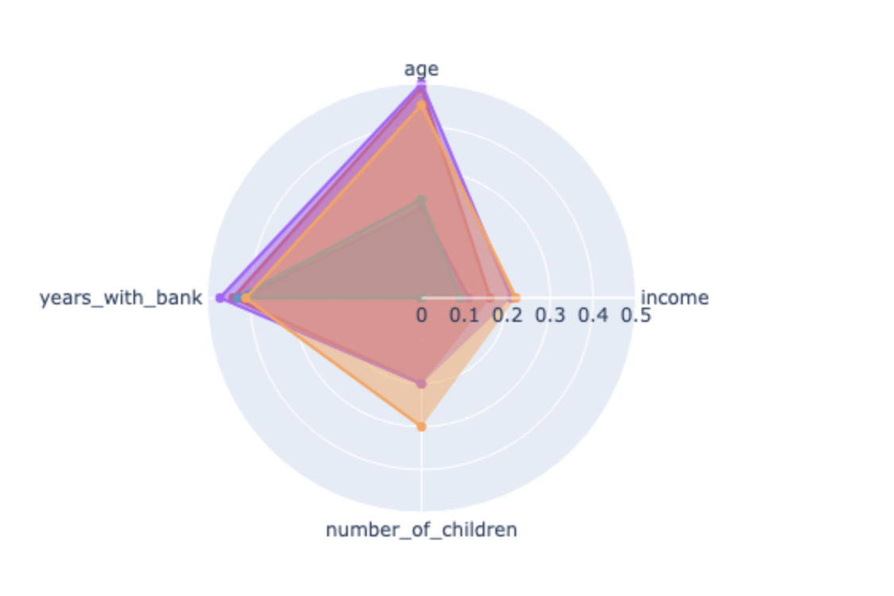
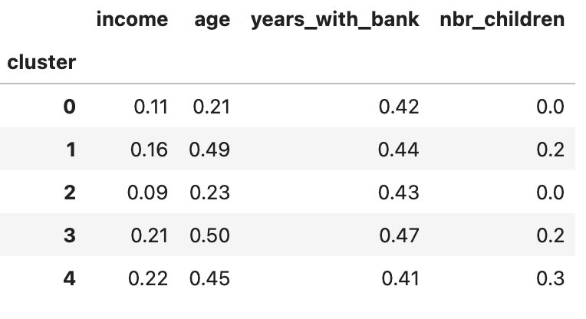
Customer Demography – Radar Chart

Slide 7
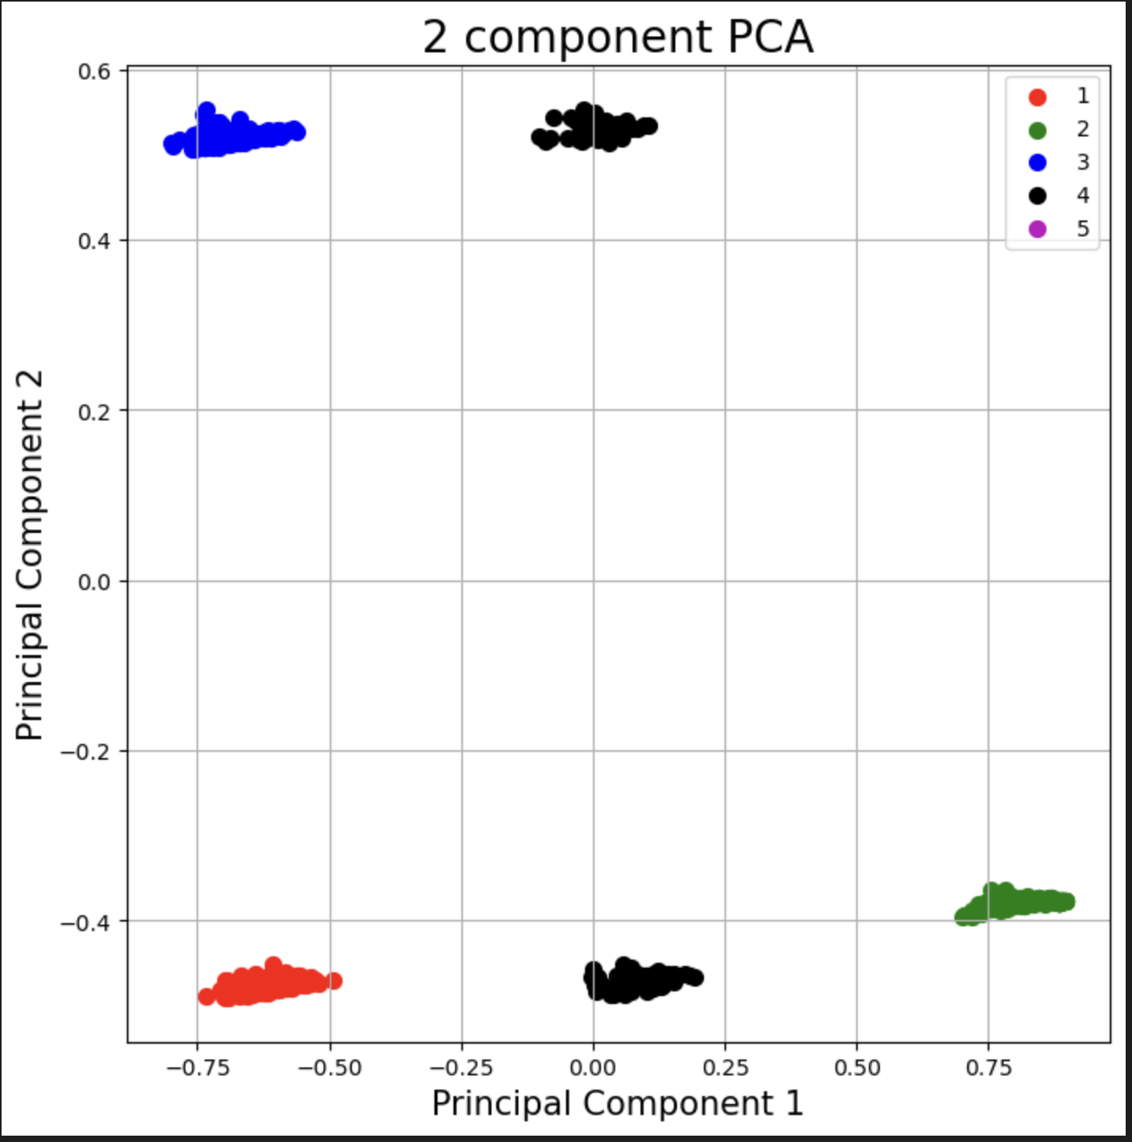
Customer Demography – 2 Component PCA

Slide 8
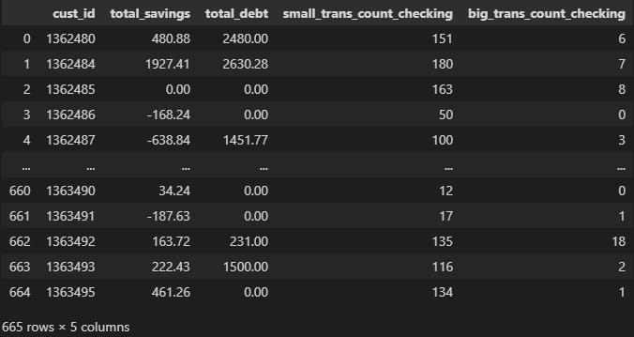
Banking Behavior – Final Dataset

Slide 9
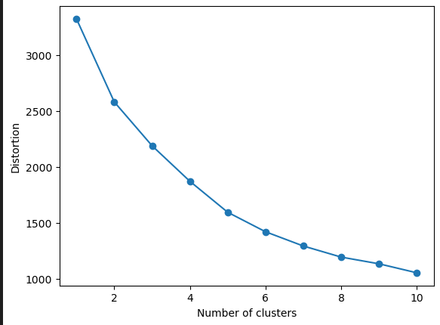

Banking Behavior – Elbow Chart

Slide 10
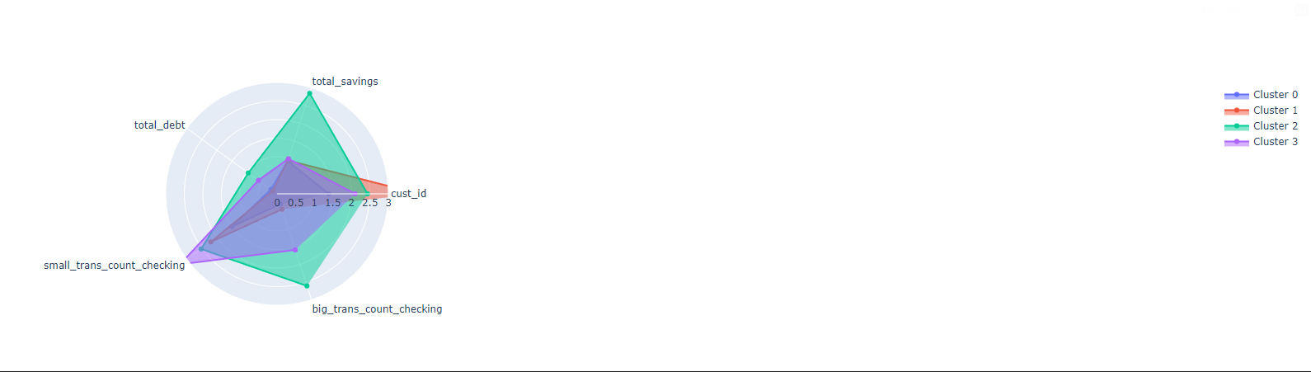
Banking Behavior – Radar Chart

Slide 11
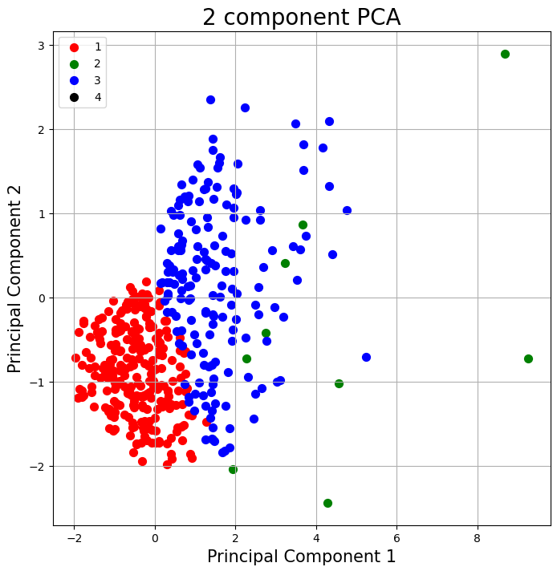
Banking Behavior – 2 Component PCA

Slide 12
Queries?

