Slide 1
Predicting flight delays
Lighthouse Labs Mid-Term Project - Option 1
FeBRUARY 24, 2023
Dimitri Salavaci & Spencer Denton
Data science bootcamp

Slide 2

Project goals
To predict commercial flight delays
To build various machine learning models
To evaluate various machine learning models
To improve presentation skills for final project

Slide 3
Process
Pull data from database via SQLite3
Familiarize ourselves with data
Perform EDA & Cleaning (Including writing functions to clean data)
Conduct Feature Engineering
Build Machine Learning Models
Evaluate Machine Learning Models
Predict Future Flight Delays

Slide 4
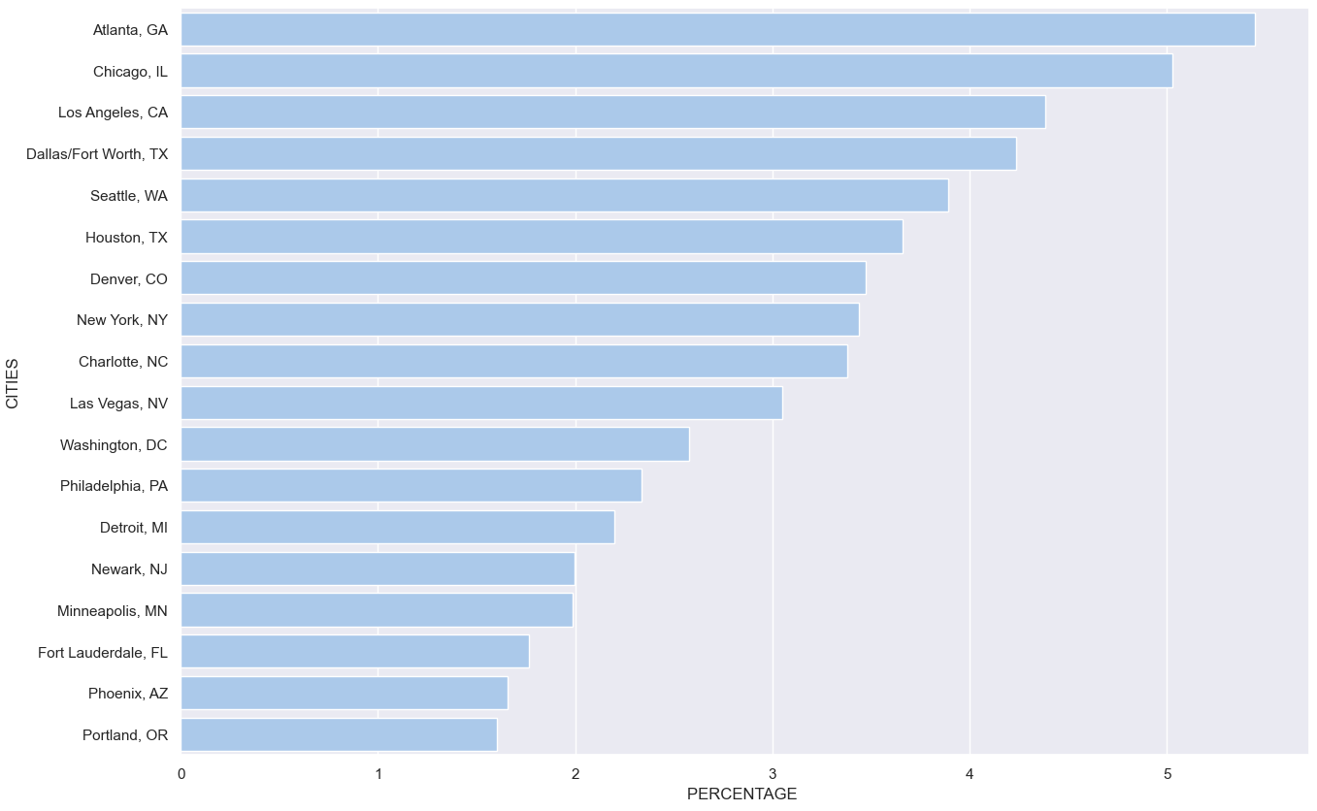
EDA
Percentage of Air Traffic for Different States

Slide 5
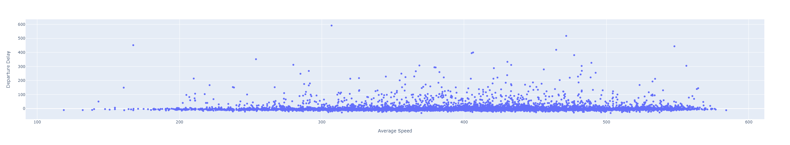
Average speeds based on departure delay

Slide 6
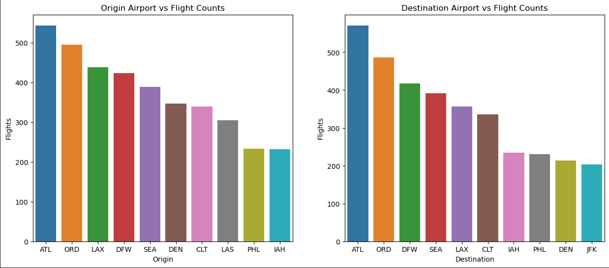
Origin and destination airports & their flight counts

Slide 7
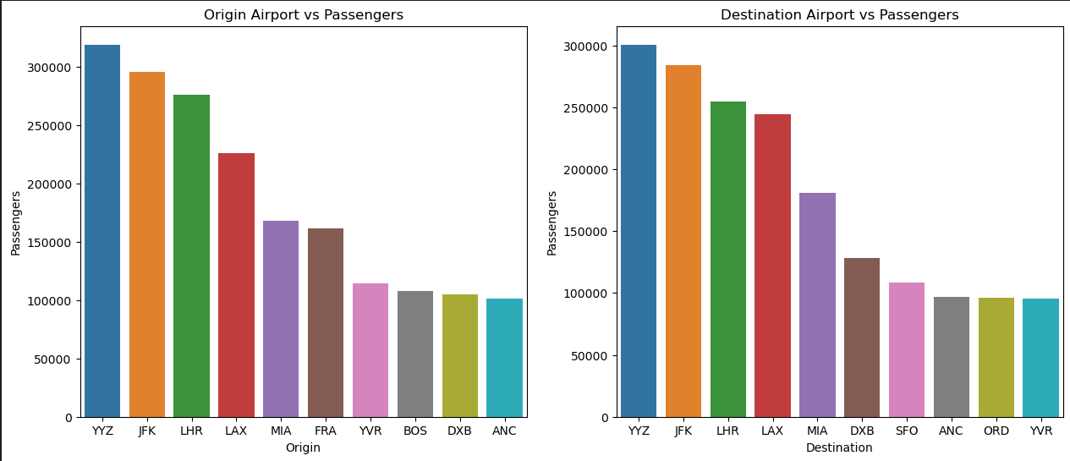
Origin & destination airports & their passengers

Slide 8
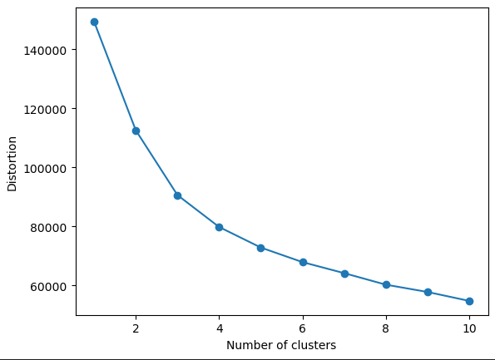
ELBOW CHART

Slide 9
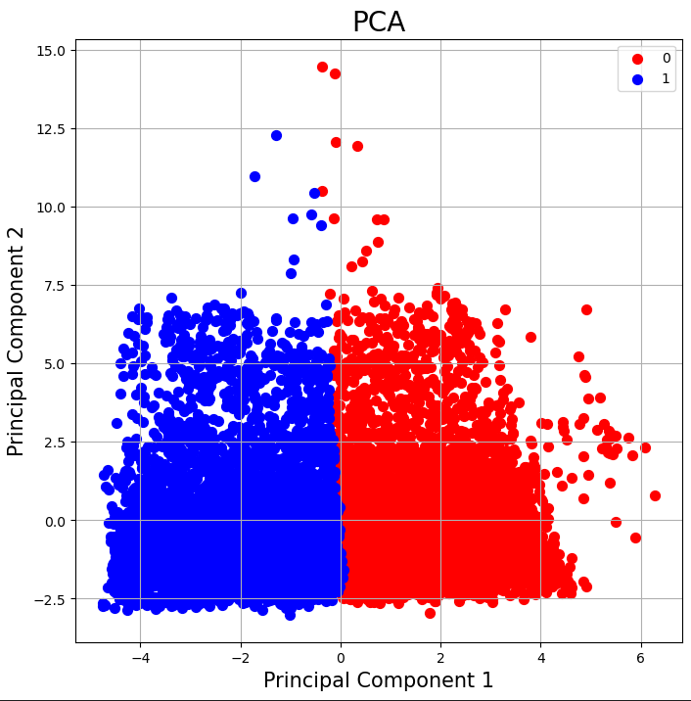
PCA BASED On elbow chart

Slide 10
Feature engineering
Delay caused by carrier
Delay caused by holiday
Delay caused by day of week
Delay cased by departure city
Delay caused by arrival city
Delay caused by hour flight departs
Delay caused by length of flight

Slide 11
Machine learning models
Linear Regression
Naive Bayes
Random Forrest
SVM
XGBoost

Slide 12
Model results
Models did not seem to have high predictive power. We were getting negative values for R Squared and a very high Mean Squared Error
Linear Regression - MSE: 4.98 RSquared: 0.201 P-Value: 0.025 Random Forrest - MSE: 3135.64 RSquared: -0.15 XGBoost - MSE: 3004.65 RSquared: -0.13 SVM - Ran for 8 hours before I killed it. No results.
Was unable to get other metrics such as Accuracy, F1-score and AUC-score

Slide 13
Challenges
GITHUB!!!!! + CHATGPT
Computer speed / time to run models
Running effective models
Trying to run models on too large of datasets
Working with large files (had to install Git Large File Storage)
Team Illness

Slide 14
Insights
A large number of flights are frequently delayed
Many factors impact if a flight will be delayed
We are able to predict flight delays with Machine Learning Models (however we require tweaking and proper feature engineering)
Machine Learning Models can be leveraged by many different industries for various predictive capabilities.

Slide 15
Future goals
Conduct more Feature Engineering to try to improve models
Spend more time tweaking the features so the models perform better
Run different models to see how they compare to the models we have already run
Run models on a supercomputer so I don’t have to spend so much time waiting for (often disappointing) results
Save local files in alternate folder and not in repository connected to GitHub and only move before committing.

