Slide 1

exploreReading
Low-Fi Prototyping
Christos Tsagkaridis, Dimitris Dimitriadis, Chibu Agbanyim, Alyssa Nicole Doria

Slide 2
Chapter 1
Value Proposition

Slide 3
Value Proposition
Explore
Discover
See the wonders

Slide 4
Chapter 2
Designed Interfaces

Slide 5
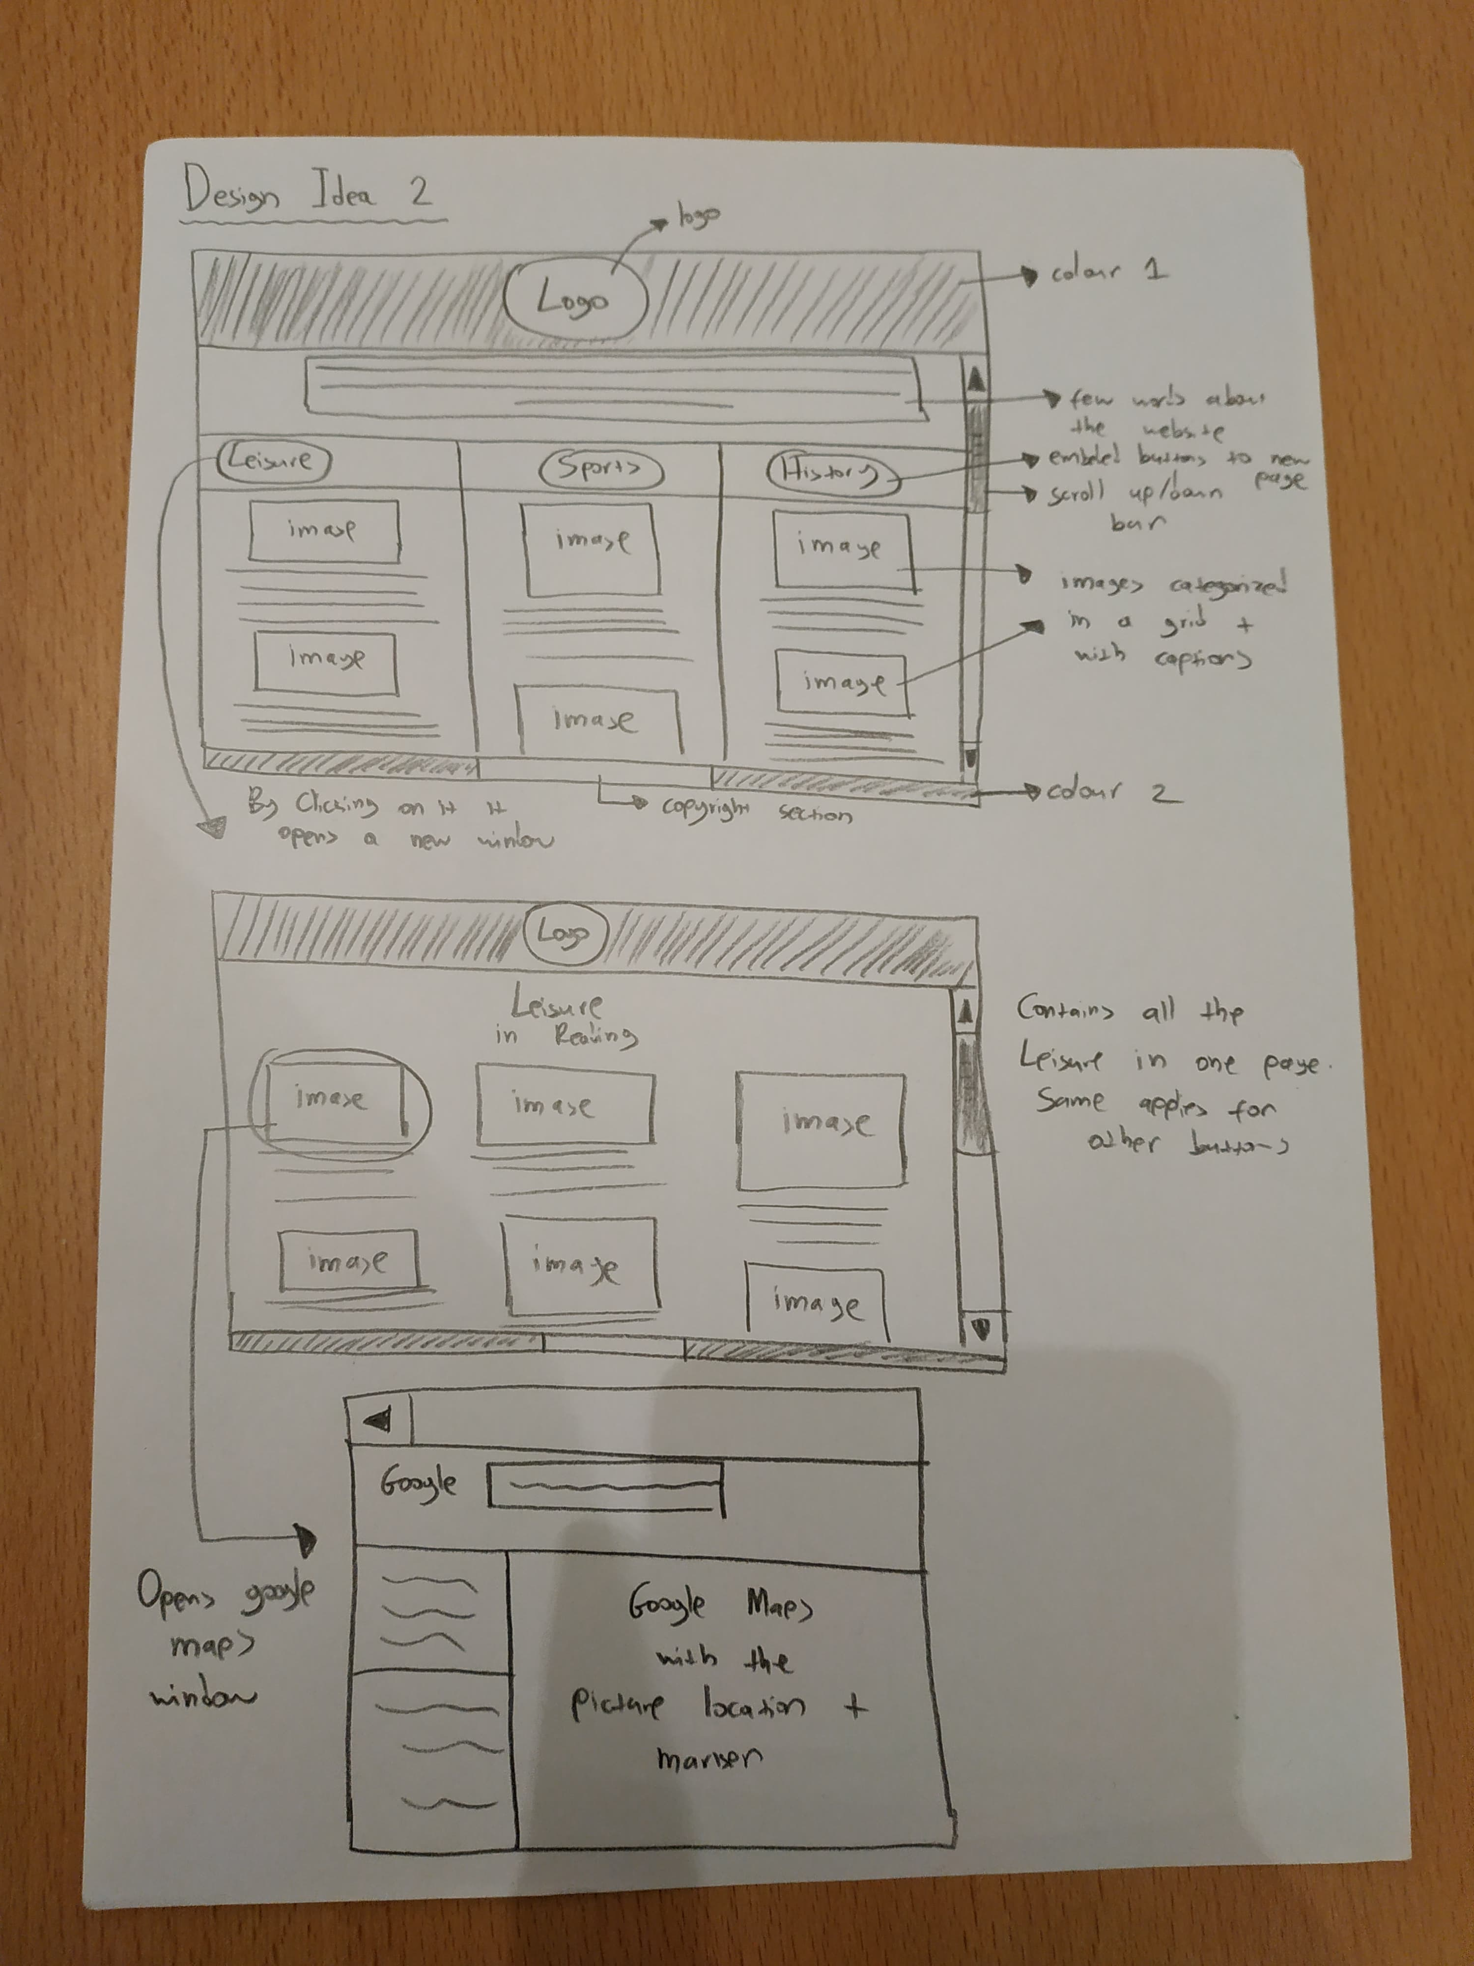
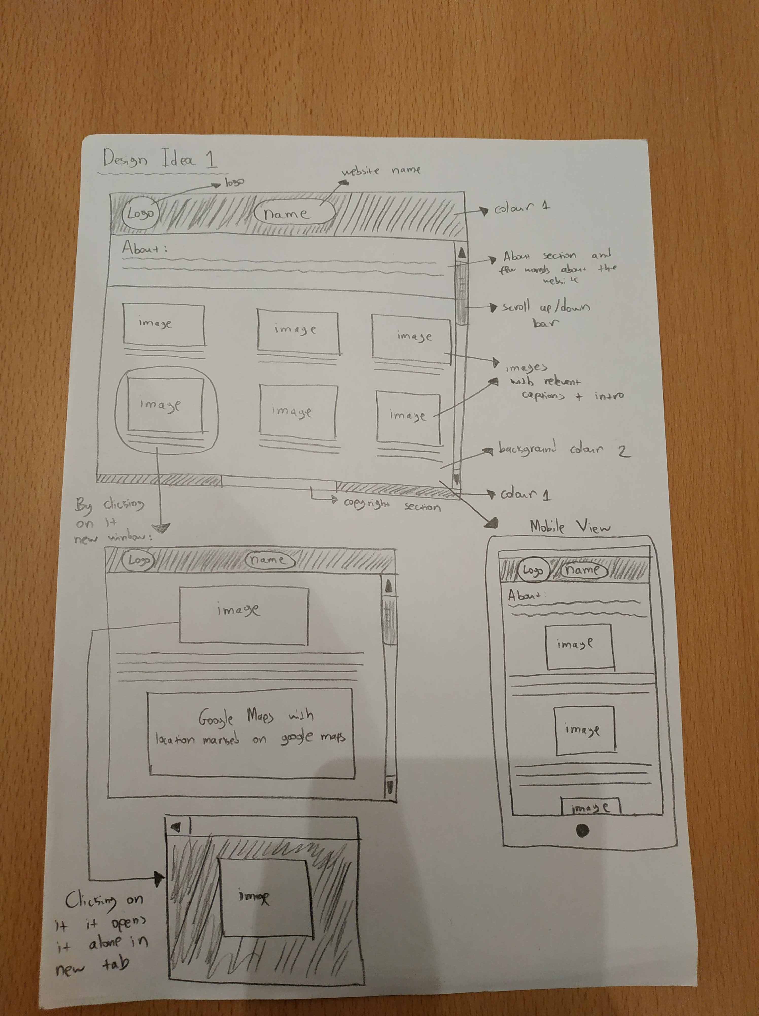
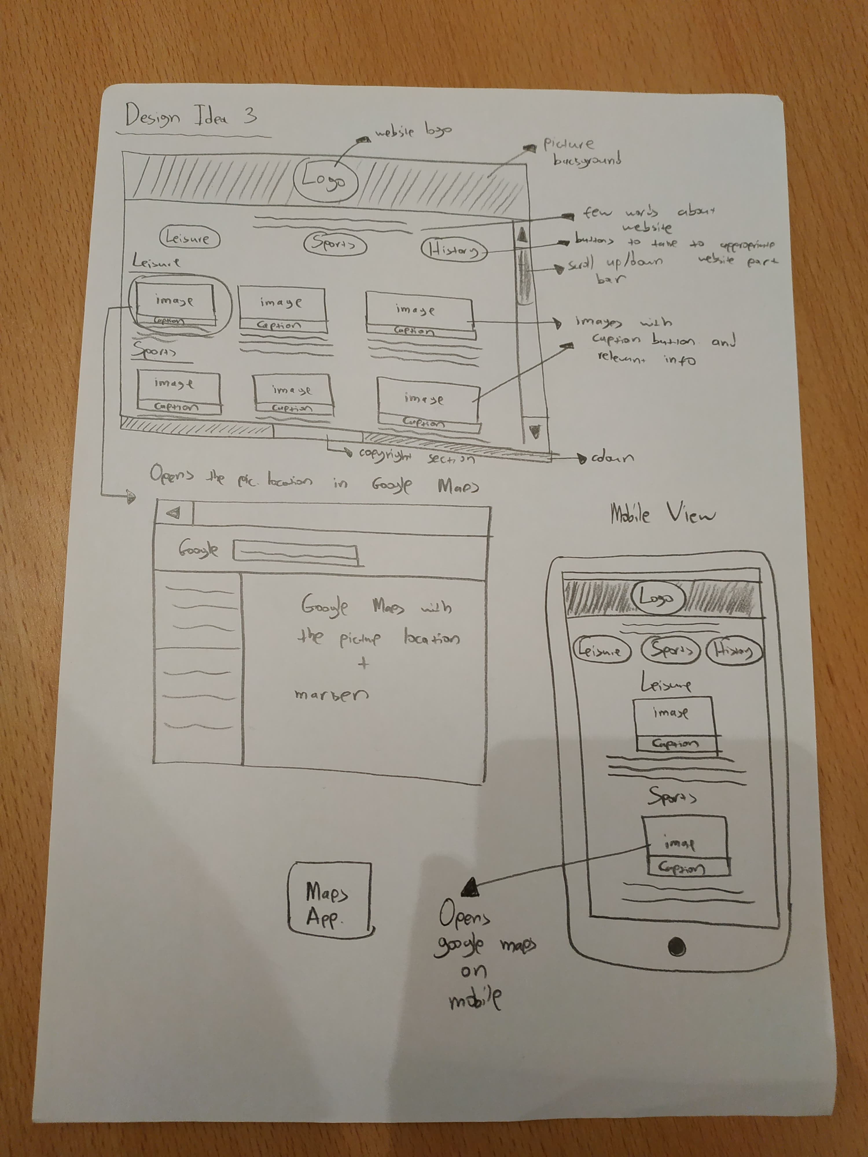
UI Interface

Slide 6
Selected Interface

Slide 7
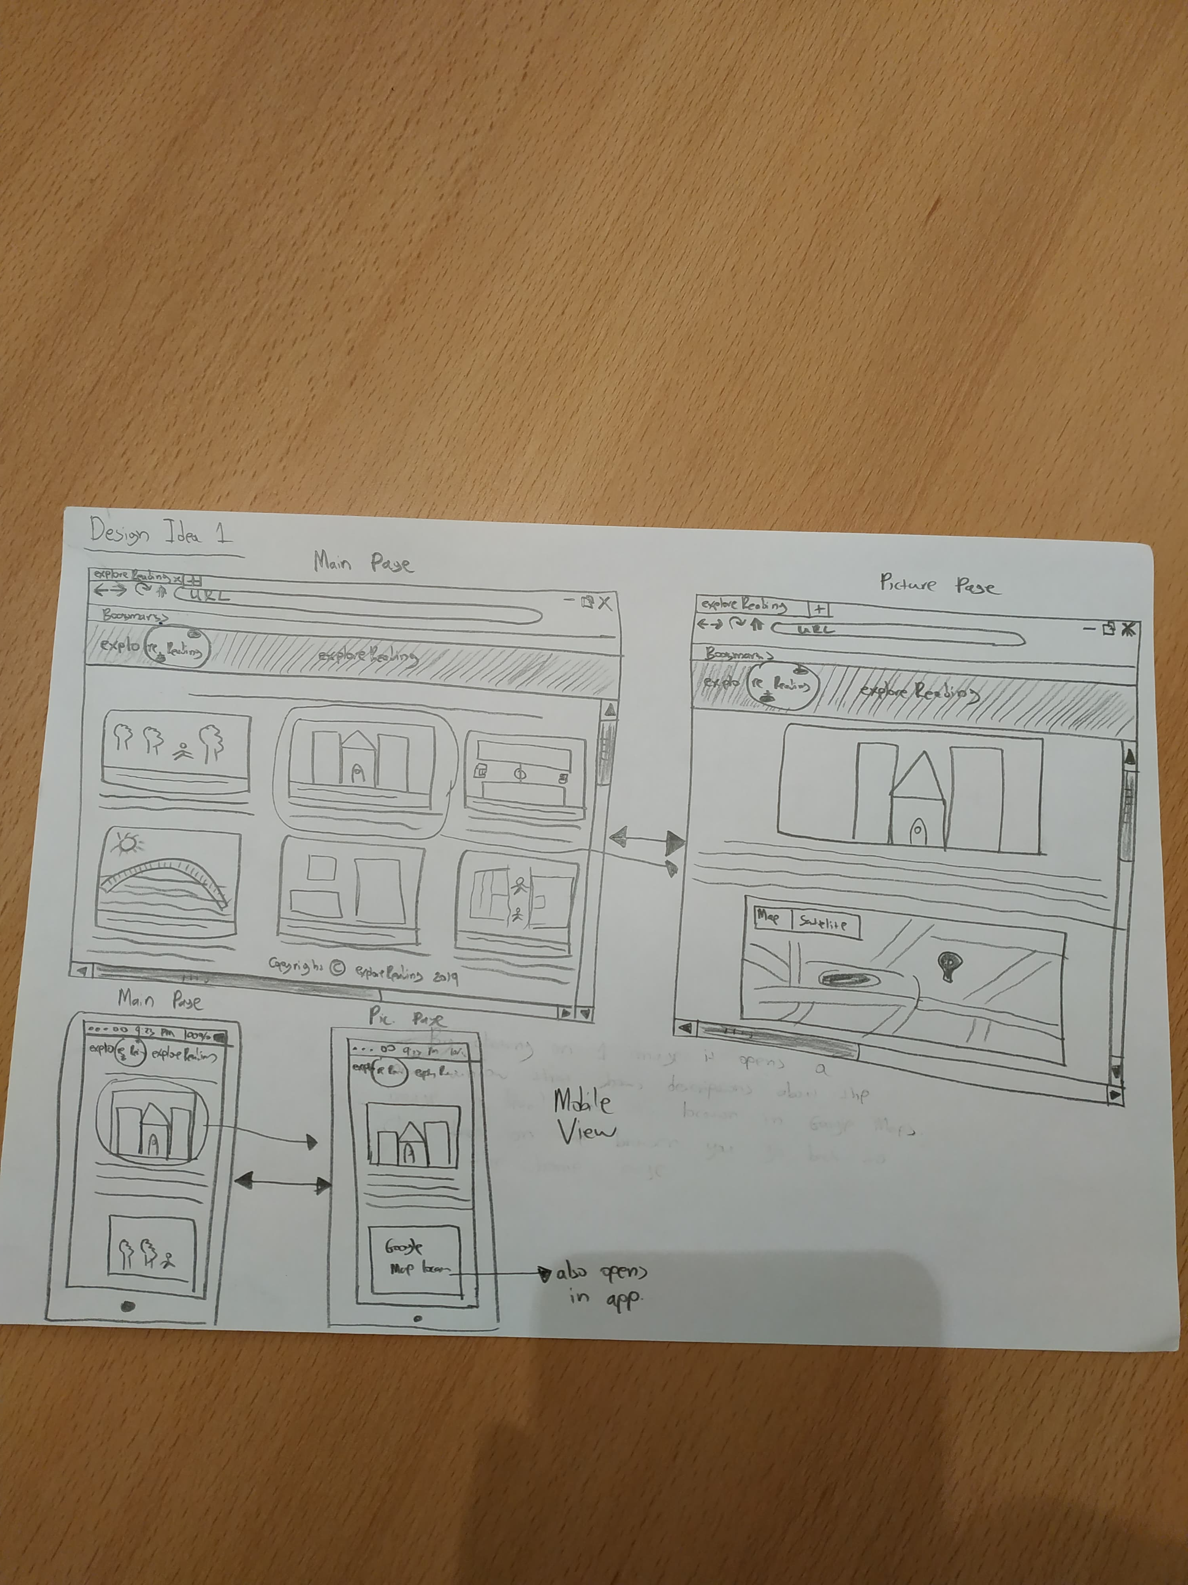
Selected Interface in detail

Slide 8
WHY?
Easy Interface for the user to navigate and explore.
Good and consistent structure of the website.
Is mobile friendly.
Google Maps is embedded inside the website for the user to view the location of each image
Image location of each image is marked down on the map for each one.
The new window that opens when clicking on the image gives us the space to further describe each image and embed google maps, without having everything in 1 page under each image and creating a huge one-page website.

Slide 9
Chapter 3.
Low-fi Prototype Structure
Designed online using proto

Slide 10
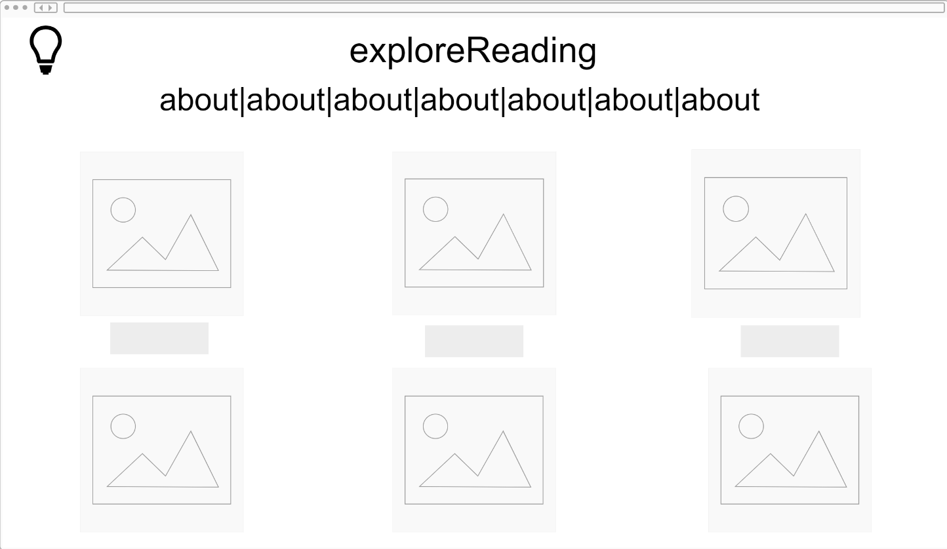
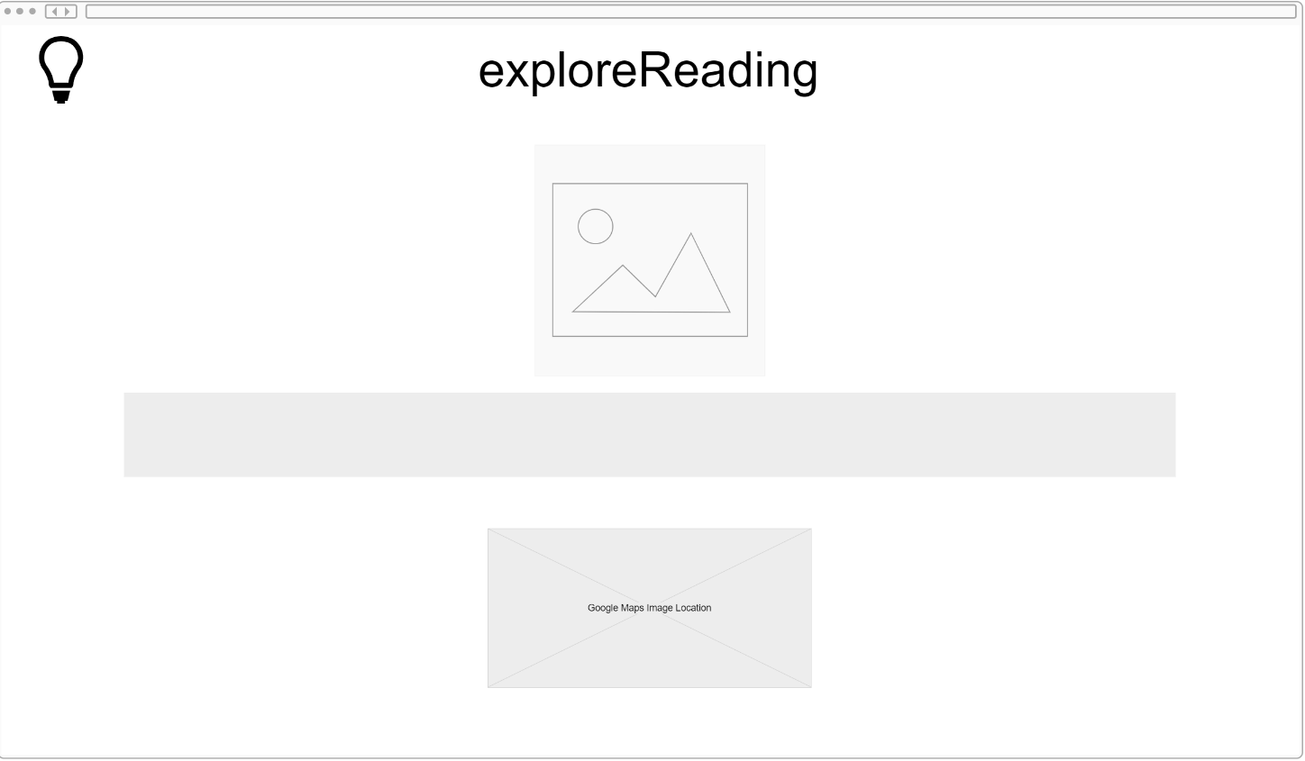
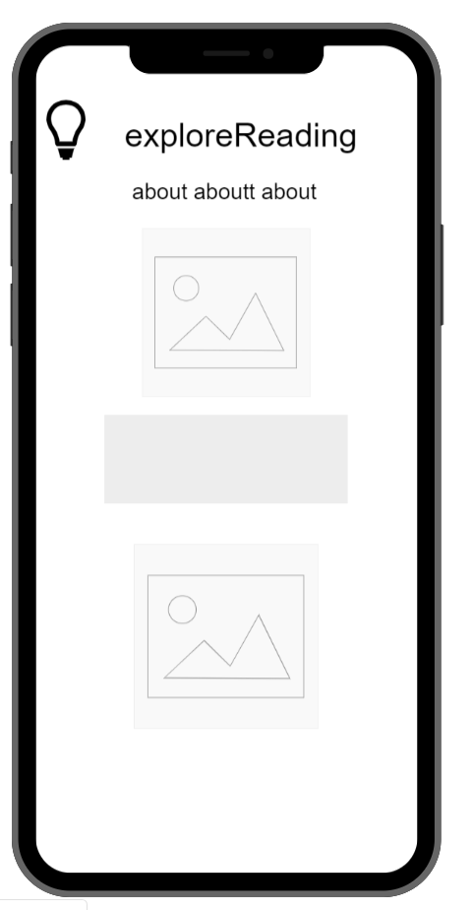
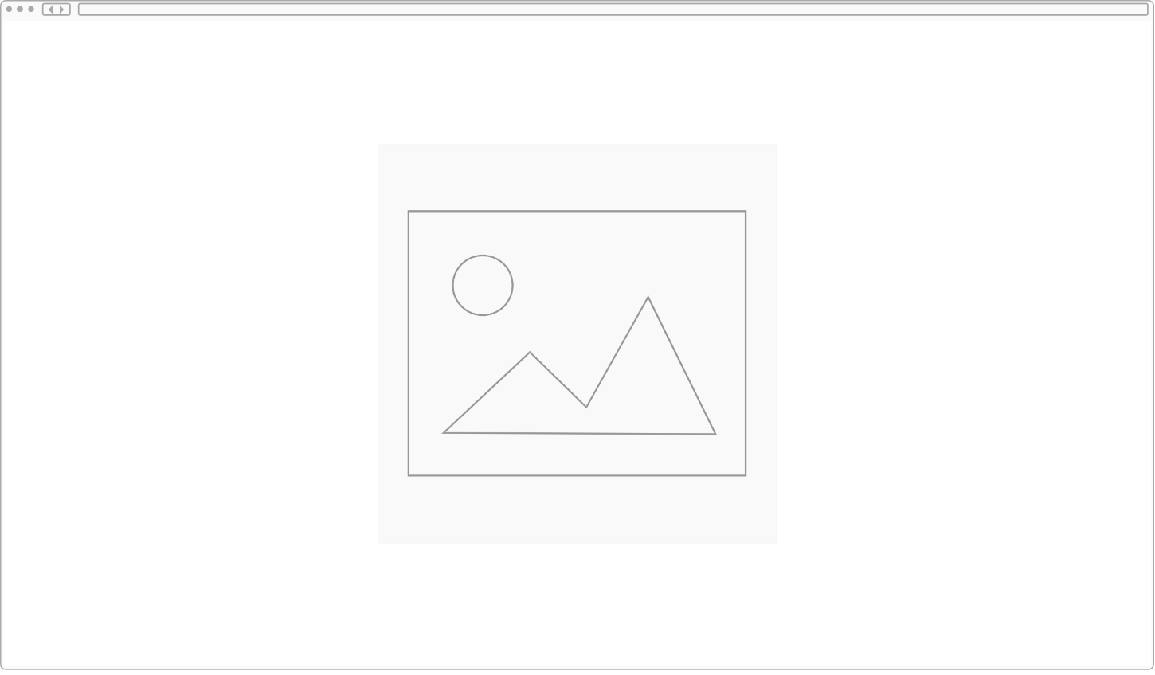

Slide 11
Chapter 4.
Task Flows

Slide 12
TASK #1: Clicking on an image to view more details about it and the Google Map. Navigates to new page

Slide 13
TASK #2: Clicking on an image inside the image window

Slide 14
TASK #3: Going back to the homepage from the image page (click on back)

Slide 15
Chapter 5.
Experimental Methods

Slide 16
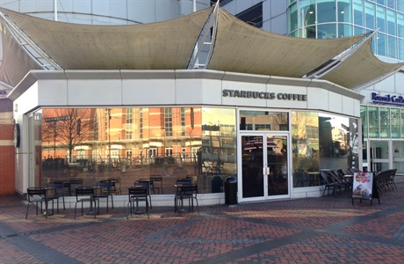
Experimental Methods
Component
Content
Environment
Participants
Procedure & Member
Tasks
Test Measure
Starbucks Riverside

Slide 17
Experimental Methods
Component
Content
Participant #1
3rd year psychology student at the University of Reading
From Cyprus
Likes hanging out with her friends
Uses websites each day for a lots of different uses.
Environment
Participants
Procedure & Member
Tasks
Test Measure

Slide 18
Experimental Methods
Component
Content
Participant #2
2nd^{rd} year law student at the University of Reading
From Cyprus
Likes history and sports
Environment
Participants
Procedure & Member
Tasks
Test Measure

Slide 19
Experimental Methods
Component
Content
Environment
Participants
Procedure & Member
Tasks
Test Measure
Participant #3
22 years old from Wales
Works at Starbucks Riverside
Likes Sports and Video Games

Slide 20
Experimental Methods
Component
Content
Environment
Participants
Procedure & Member
Tasks
Test Measure
Member Role
Christos
Computer
Dimitris
Facilitator
Note taker
Alyssa
Supplement notes and photography
Processing data

Slide 21
Experimental Methods
Component
Content
Environment
Participants
Procedure & Member
Tasks
Test Measure
Step 1
Ask for their time to sign a consent form
Step 2
Read the prepared script for introduction and explain about the tasks
Step 3
Take notes on what the participants do

Slide 22
Experimental Methods
Component
Content
Environment
Participants
Procedure & Member
Tasks
Test Measure
Task 1
Navigate in the home page
Task 2
Navigate in the image page
Task 3
Go back to the home page

Slide 23
Experimental Methods
Component
Content
Environment
Participants
Procedure & Member
Tasks
Test Measure
Test Measure
Point of Confusion
Click something else
Time navigating in the website
How easy the website is
Comment while performing

Slide 24
Chapter 6.
Experimental Results

Slide 25
Experimental Results
Task 1: Navigate in the home page
All 3 Participants found it very easy. Everyone did it in 3-4 seconds.

Slide 26
Experimental Results
Task 1a: Go to the image page
All 3 Participants found it very easy and figured it out based on the layout of the website. Everyone did it in 3-4 seconds.

Slide 27
Experimental Results
Task 2a: Click on the image of the image page and go back
All 3 Participants found it very easy and figured it out based on the layout of the website. Everyone did it in 3-4 seconds.

Slide 28
Experimental Results
Task 2b: Use google maps
All 3 Participants found it very easy but kept clicking on it to open in a new window

Slide 29
Experimental Results
Task 3: Go back to the home page
Participants 1 and 2 were clicking on the logo to go back and then clicked on “Back”. Participant 1 figured it later and Participant 2 asked us why. Participant 3 figured it by himself

Slide 30
Chapter 7.
Suggested UI Change

Slide 31
Suggested UI Change
Make the logo redirect back to the home page as a button on the image page.
Enter a url under the google maps for the actual google maps to open with a marker of the image as the google maps that is embedded in the system is just static and for viewing.

Slide 32
Chapter 8.
Summary

Slide 33
THANKS!
Any questions?

