Slide 1

exploreReading
Med-Fi Prototyping
Christos Tsagkaridis, Dimitris Dimitriadis, Chibu Agbanyim, Alyssa Nicole Doria

Slide 2
Overview
Value Proposition
Explore. Discover. See the wonders
Problem
Many people come to Reading and don’t know exactly what this town has to offer. Moreover, they don’t know the location of many popular sights and attractions, but also the sights and attractions themselves.
Solution
eploreReading hosts everything recommended on what to do and where to go in Reading with a brief statement and google maps showing the locations for the user to use to and navigate to them.

Slide 3
Task 1: Navigate in the home page
Instead of just description under each picture in the home page, we added a caption box that states the image’s name and should dissolve when a mouse button hovers above it, showing the rest of the image.

Slide 4
Task 2 Navigate in the image page
We added the link of the location of the featured image from google maps with a maker, underneath the image, that allows the user to view the location of the image inside google maps and zoom in/out and navigate in it.
This happened because that item does not open in a new link and is just static there. With this way, the user can go directly to google maps and start navigating to that location from his current location without just viewing it statically on the website.

Slide 5
Task 3 Go back to the homepage
We added a link back to the homepage on the logo picture inside the image window by clicking on it.
This happened because most participants in the experiment clicked there to go back instead of the back button.

Slide 6
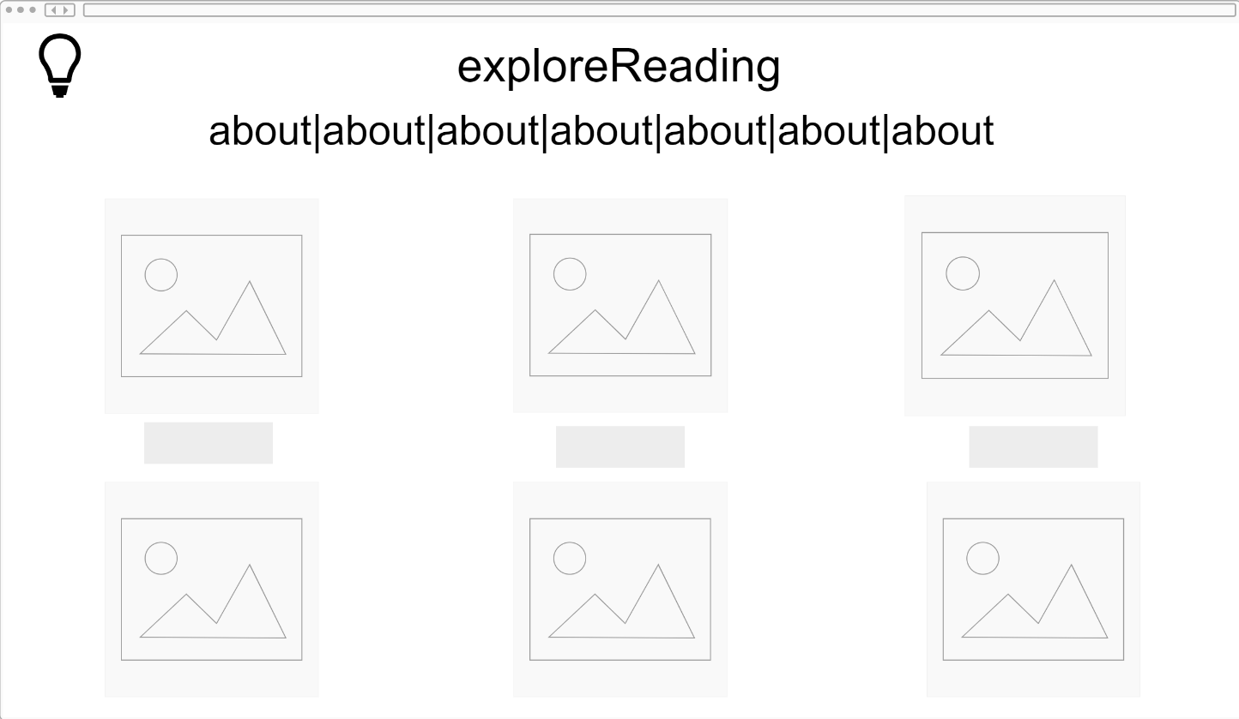
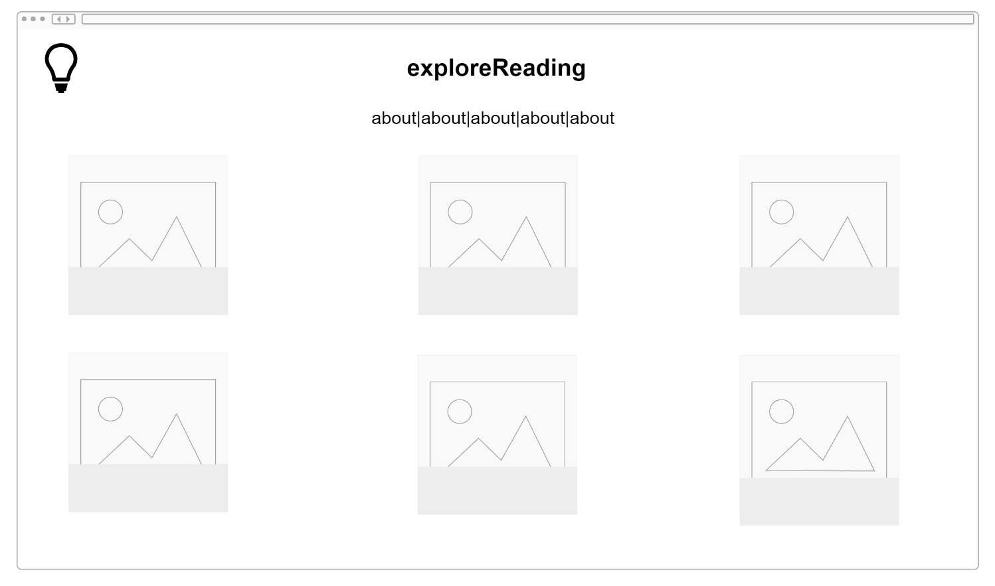
Revised Interface Design
Changed the description under each image to become a caption onto the image, that hides and reveals the rest of the image when the mouse button hovers above it.

Slide 7
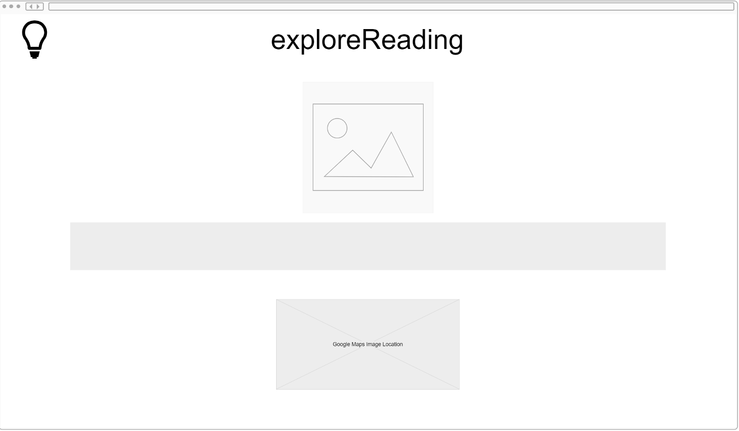
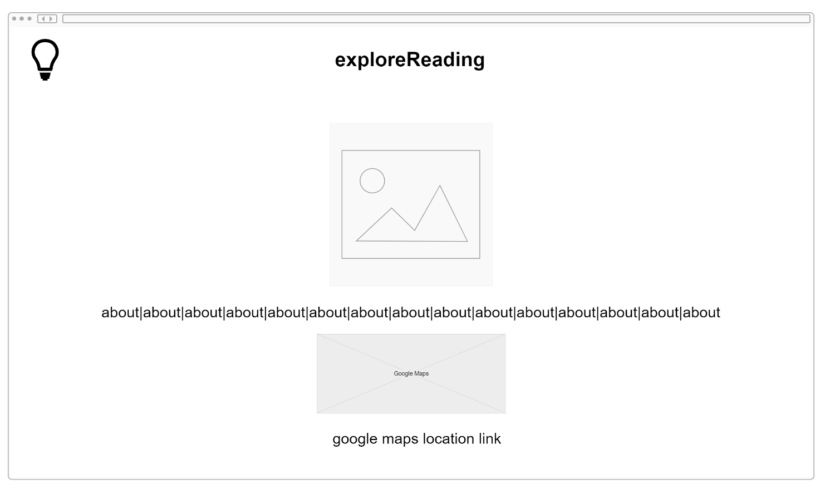
Revised Interface Design
Entered the link of the image location from google maps under the google maps image, for the user to click on it and go to it and start navigating by his current location to go there.

Slide 8
Revised Interface Design
Website logo in the image page links back to the homepage

Slide 9
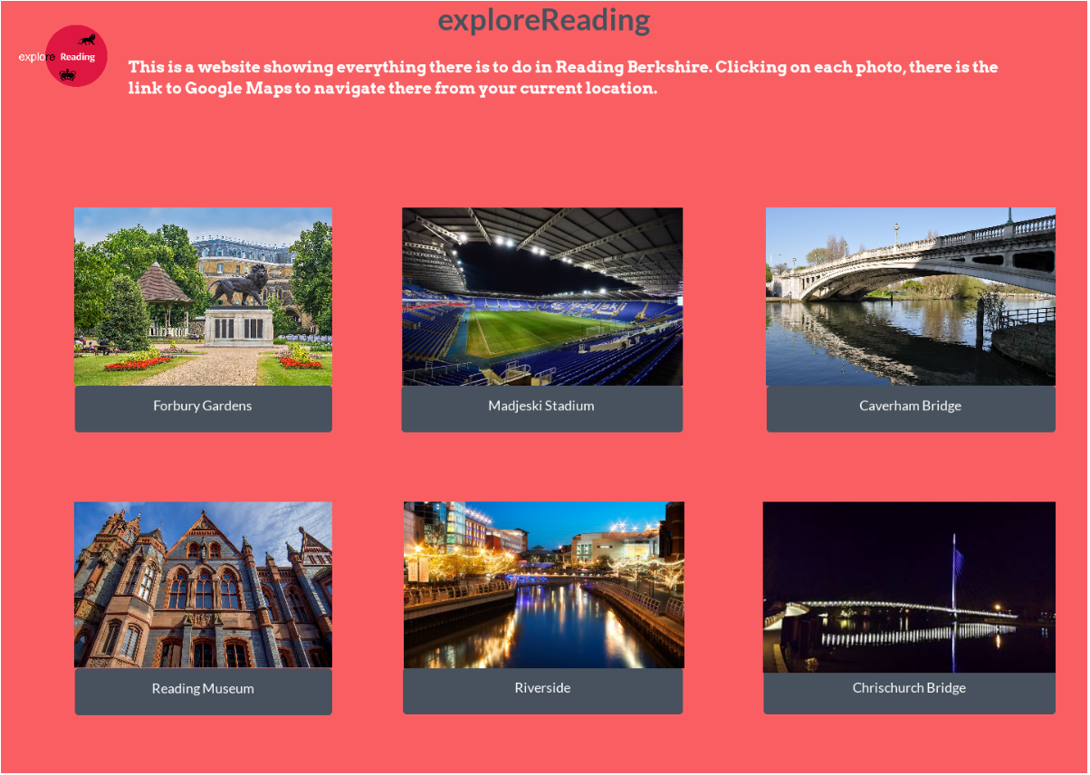
Revised Interface Design (Task 1)

Slide 10
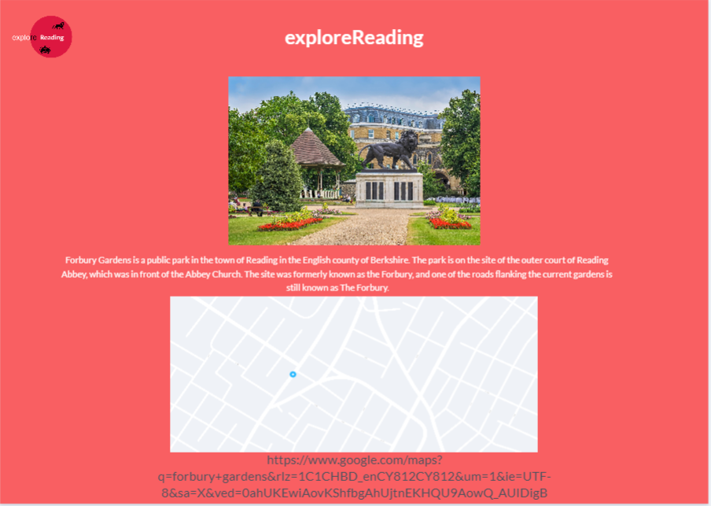
Revised Interface Design (Task 2)

Slide 11
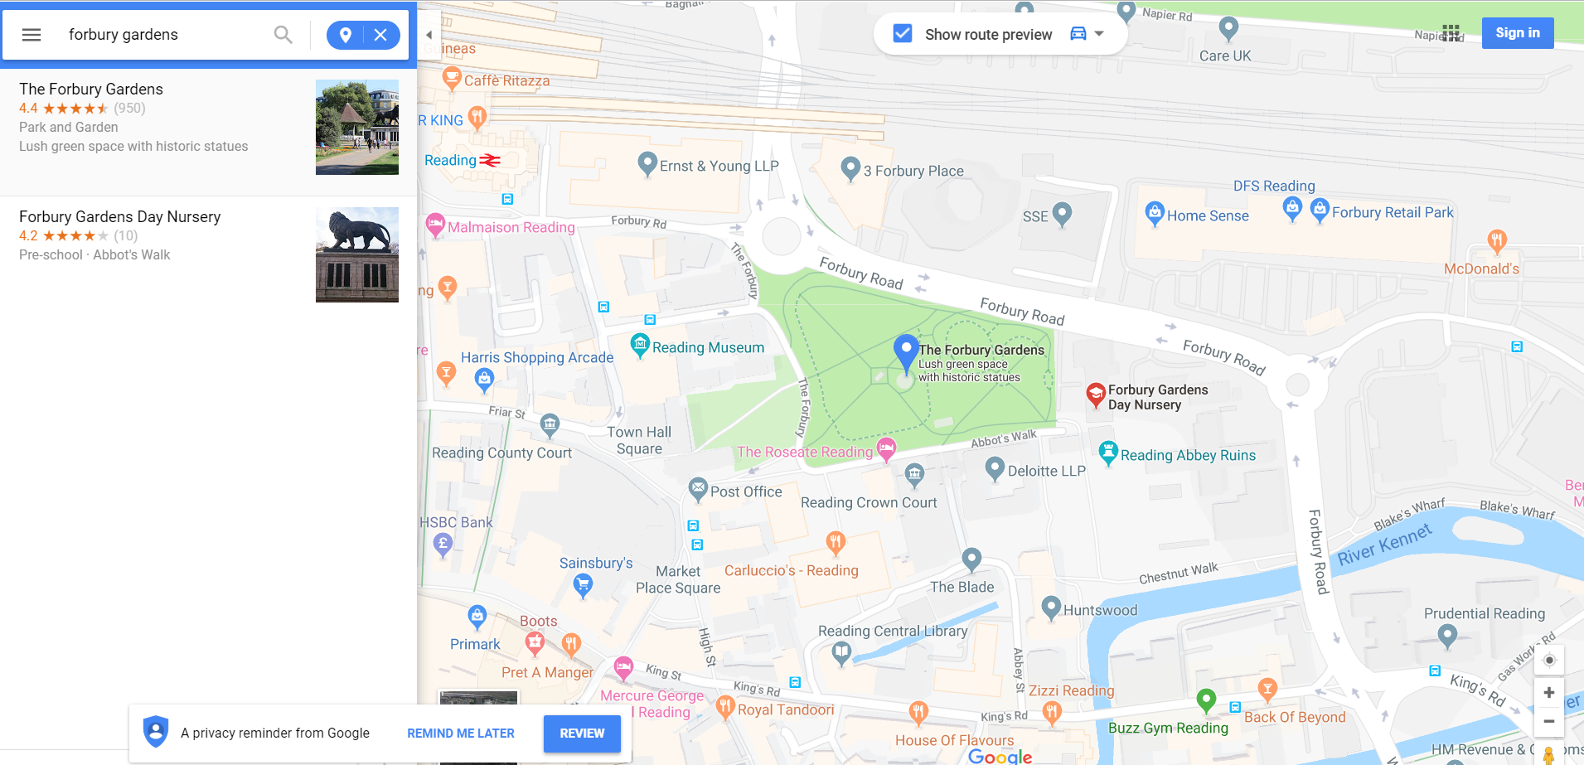
Revised Interface Design (Task 2b)

Slide 12
Revised Interface Design (Task 3)

Slide 13
Prototype Overview - Tools
Used proto.io to design the individual screens of the website .
Based on those designed images, we applied the same concept to design our med-fi prototype
Used Marvel to apply this design concept (med-fi prototype) based on the prototypes designed in proto, the low-fi prototype sketches and the user requirements.

Slide 14
Prototype Overview - Limitations
The captions of the images inside the home page, won’t disappear when the mouse button is hovered over them due to limitations of the Marvel application.
Cannot enter the actual colors that the website will have and the places where they are going to be implemented due to limitations of the Marvel application (only allows one color font as background inside each window).
Cannot embed the actual Google Map function that will show the location of the image with a marker on the map and navigate inside it (zoom in,-zoom out, go places inside the map) due to limitations of the Marvel application (this is JavaScript code and cannot be implemented in this demo).

