Slide 1

Mini-eBank
Intuitive Observability at Scale
Dimitris FINAS
Sr Advisory Solution Consultant
Notes:
Hi, my name is Andrew, and I’m a senior product marketing manager at Lightstep. I’m here today to talk to you about how Lightstep can help your organization accelerate your transition to cloud-native.

Slide 2
future: trading
android
iOS
web
ads
api-gateway
authentication
loan
payment
recommendation
subscription
transfer-internal
productcatalog
transfer-external
accountbalance
pingIdentity
ext-api-gateway
IAM

Slide 3
Login
SERVICE | OPERATION
android, iOS, web | /login
api-gateway | /api/login
authentication | /login
IAM | /getPrivileges

Slide 4
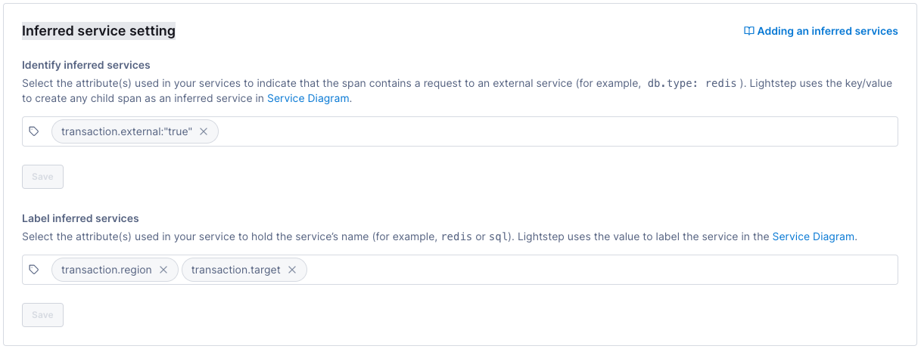
Inferred Service Settings

Slide 5
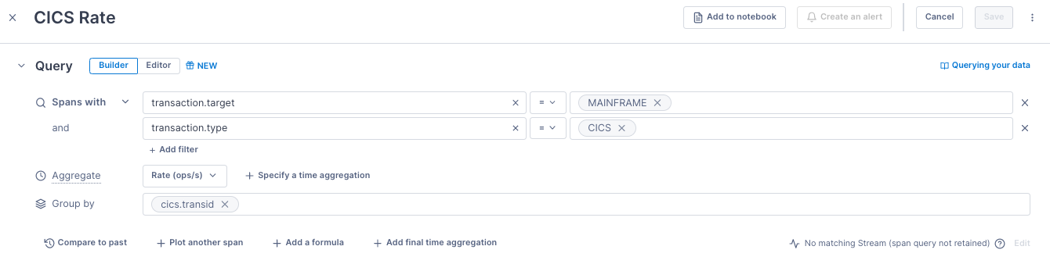
Example of Dashboard

Slide 6
Make Payment
SERVICE | OPERATION
web | /make-payment /submit-payment
api-gateway | /api/getpayment
web | /payment-status
payment | /CardPayment /ChargeRequest /CreditCardInfo
ext-api-gateway | /ext-api/payment

Slide 7
Make Payment
SERVICE | OPERATION
web | /make-payment /submit-payment
api-gateway | /api/getpayment
web | /payment-status
payment | /CardPayment /ChargeRequest /CreditCardInfo
ext-api-gateway | /ext-api/payment

Slide 8

Thank you
Subtitle can go here

