Slide 1

Domain Text Classification

Slide 2
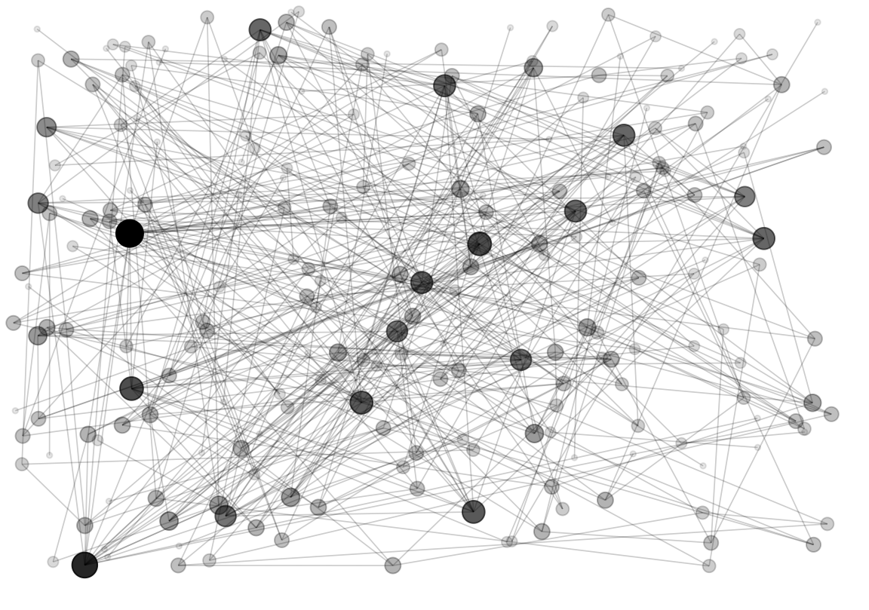

Domain Node Classification | Project Scope
Objective: Use Machine Learning techniques to classify web domains based on textual data and link structures.
Approach: Combine text classification and node classification methods for optimal prediction of domain classes minizing the multiclass log loss

Slide 3
Data Preprocessing & Preparation

Slide 4

Data Sources | Greek web domains
Training data
1812
Samples of Greek domains
Test data
605
Samples of Greek domains
Data Categories
Textual Content
Text data of the domains in scope that have been produced by web scraping
Graph-related data
Graph data represent the connectivity of domains within the Greek web, where nodes are domain names and edges are the hyperlinks between them
Model learning
Model testing
Output predictions into
9 classes

Slide 5
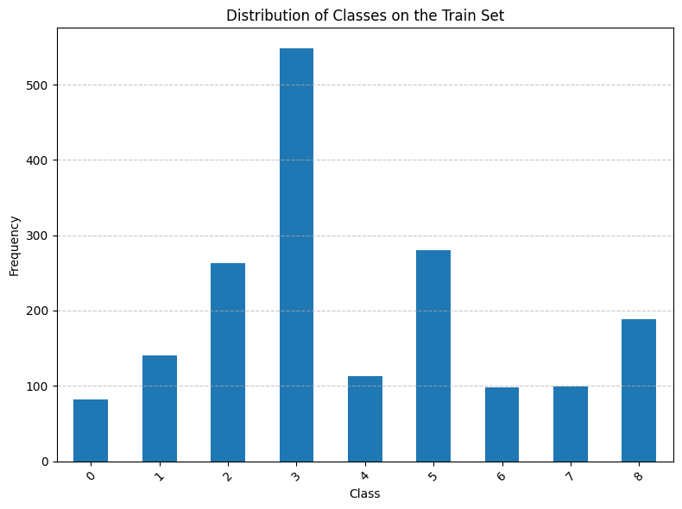
Data Exploration | Class Distribution
Analyzing the Class Distribution in Training Data to Understand Imbalance and Representation
Significant imbalance among the classes.
Class 3 is the most dominant with over 500 instances.
Classes 0, 6, and 7 seem underrepresented with fewer than 100 instances each.

Slide 6
Data Exploration | Domain Node Classification
Deep dive into the Classes
Class | Domains |  | Top words
0 | Autocarnet.gr | Mydirect.gr | Αυτοκινήτου | Παραδόθηκε
1 | Coachbasket.gr | Basketplus.gr | Παιδαγωγικός | Προπονητής
2 | Yourate.gr | Rockandroll.gr | Υπερρεαλιστικά | Μακιαβελικό
3 | Athensgo.gr | Onalert.gr | Κοινοποίηση | Καταλάβετε
4 | Oaed.gr | Education.gr | Πληροφορική | Αναβάθμιση
5 | Queen.gr | Hostplus.gr | Φωτογραφία | Τηλεοπτική
6 | Topgamos.gr | Spitistaleuka.gr | Μοιραστείτε | Επισκέπτες
7 | Holiday.gr | Samothraki.gr | Αεροδρόμιο | Αναμνήσεις
8 | Psychotherapia.net.gr | Sweetandbalance.gr | Γλυκαιμικός | Πανεπιστήμιο
The top words for each class give insights into the key themes and topics covered within each domain.
The average document length varies significantly across classes.

Slide 7
Data Exploration | Graph features
Analysis of Domain Popularity per Class: In-Degrees and Out-Degrees
Class | Highest In-degrees | Highest Out-degrees
0 | Car.gr | Moto.gr
1 | gazzetta.gr | Podilates.gr
2 | sansimera.gr | Slang.gr
3 | tovima.gr | In2life.gr
4 | uoa.gr | Auth.gr
5 | google.gr | Freestuff.gr
6 | mothersblog.gr | Hamomilaki.gr
7 | Oasa.gr | Arttravel.gr
8 | Iatronet.gt | Iator.gr
Domains with high in – degrees are the most popular or influential within each class.
Domains with high out – degrees are potential hubs within each class.
This comprehensive analysis facilitates the identification of core themes and key domains per Class.

Slide 8
Data Exploration | Domains’ Themes
Combination of the above analyses to understand the class thematics
Class | Highest In-degrees
0 | Driving/ Cars
1 | Sports
2 | Art
3 | News
4 | Education
5 | Weather/ Online Transactions
6 | Housing / Home-ware
7 | Travelling
8 | Health
Combining the results of the above analyses, we conclude on specific thematic per Class.
The mapping explains some of the above details e.g., higher document length in “News” domain.

Slide 9
Data Exploration | Communities Detection
Examination of the structural organization and cohesiveness of nodes within each class
Higher Number of Communities (10-11):
Classes 0, 1, 2, 5, and 8 exhibit more communities.
Complex structure with diverse subgroups.
This indicates varied content or areas of interest within these classes.
Fewer Communities (7-9):
Classes 3, 4, 6, and 7 show fewer communities.
More cohesive structure with stronger interconnections among nodes.
This suggests more homogenous content.

Slide 10
Data Preprocessing| Cleaning up
Utilize SpaCy to preprocess the textual representation of the domains and reduce the noise
Text Truncation
Text Normalization
Tokens Lemmatization
Tokens Filtering
Cut sentences up to a max length
Use the average length of documents as upper limit
Max 10,095 tokens
Remove accents
Lower the tokens
Reduce tokens in their base form
Reduce noise
Remove Stop Words
Remove small tokens (≤3 characters)
Filter non-alphabetic tokens
Remove symbols & URLs

Slide 11
Feature Engineering

Slide 12
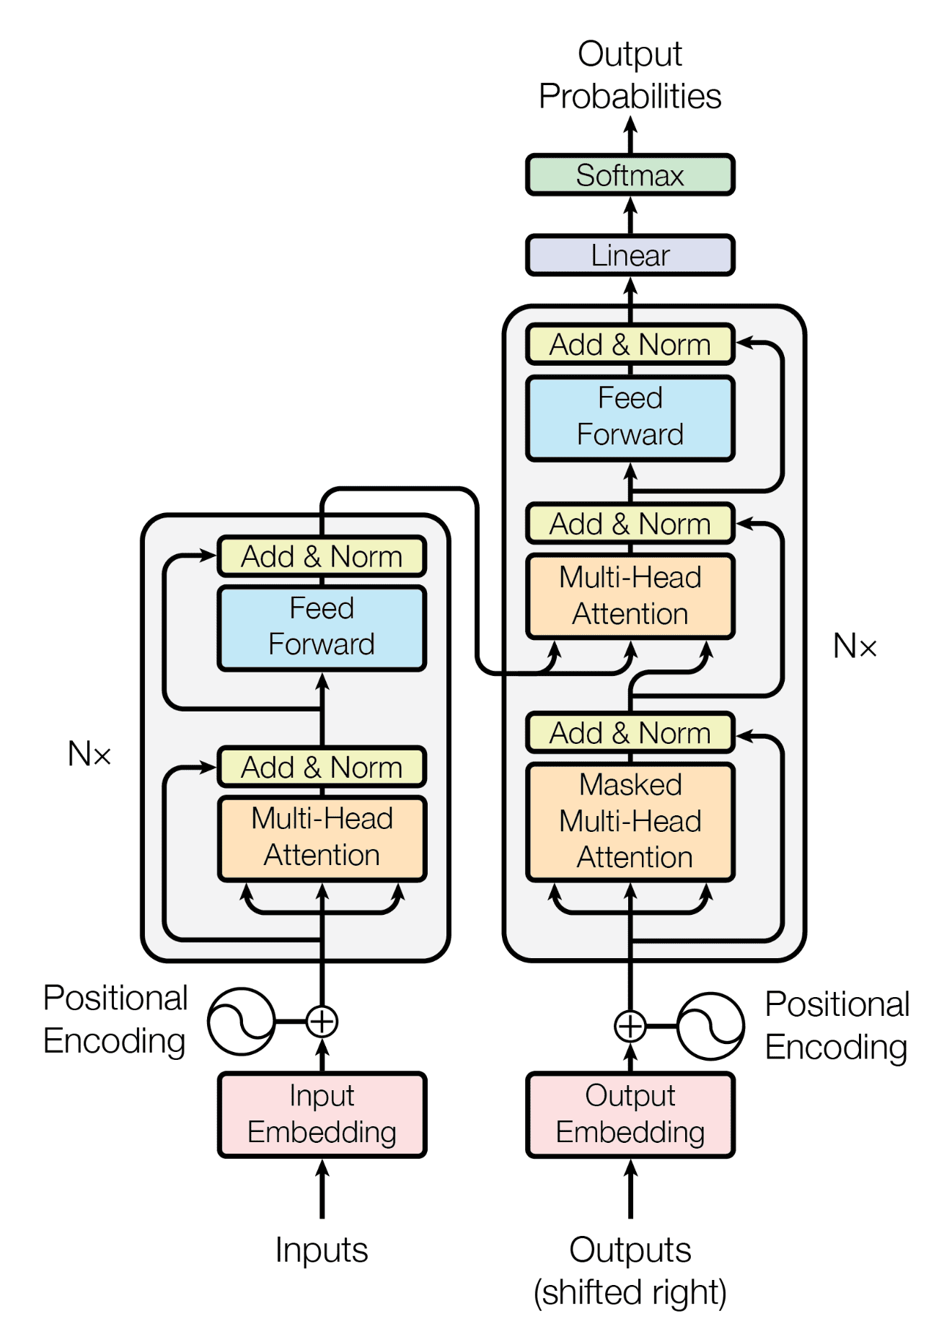
Feature Engineering | Text Representations
Creating a suitable representation for the textual information, using Greek Bert k-Sentence Transformer.
We produced our embeddings using
Greek Bert k-Sentence Transformer*
where k was the mean length of the Sentences.
Alternatively, we obtained the embeddings from a different BERT model** of the tokens of each sentence and produced the sentence embedding by averaging the tokens’ embeddings.
*Bert-based Greek uncased v1
**st Greek media Bert-based Greek uncased

Slide 13
Feature Engineering | Graph Representations
Finding Suitable and Useful Representations for the Information Contained Inside the Graph Structure.
-In Degree
-Out Degree
-Average Neighbor
Deep walk + Word2Vec
Louvain Partition
Concatenate
Concatenate
We calculate some basic features for each node of the graph and we create first features matrix.
We create 20 Random Walks for each node and then we transform the lists returned from Deep Walk to embeddings, using Word2Vev (trained for all nodes).
We create clusters to classify our nodes to. We use the Louvain Method to create for each node the information of the community.

Slide 14
Modeling & Evaluation

Slide 15
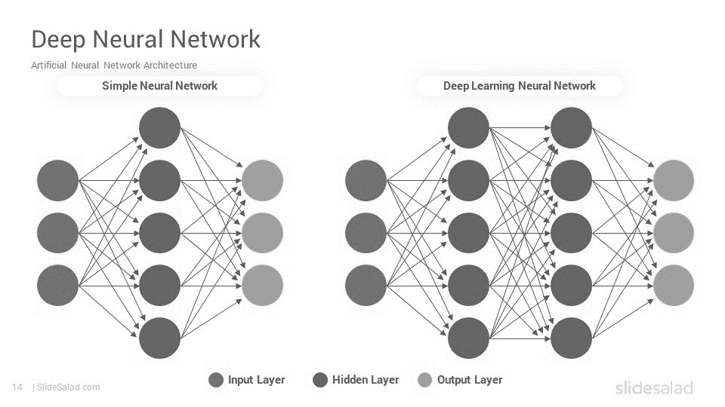
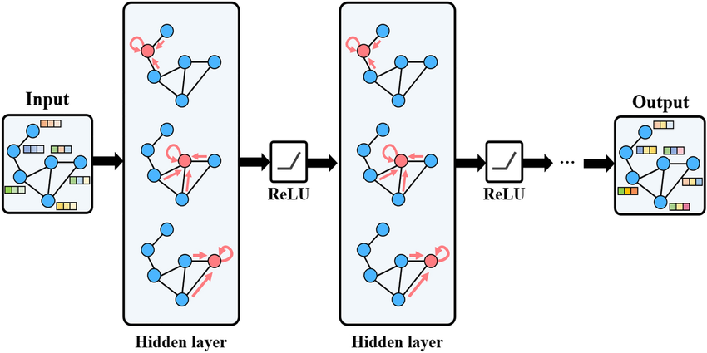
Modeling | An integrated pipeline
The following model architecture was developed that effectively integrates both the text and the graph data, capturing the interplay between textual content and network structure
MLP 1
MLP 2
GCN
Text embeddings
(768,)
Prob dist
(9,)
Prob dist
(9,)
Deep walk feature vectors (128,)
+
Connectivity metrics
(4,)
* Standard scaling performed
Deep walk feature vectors (128,)

Slide 16
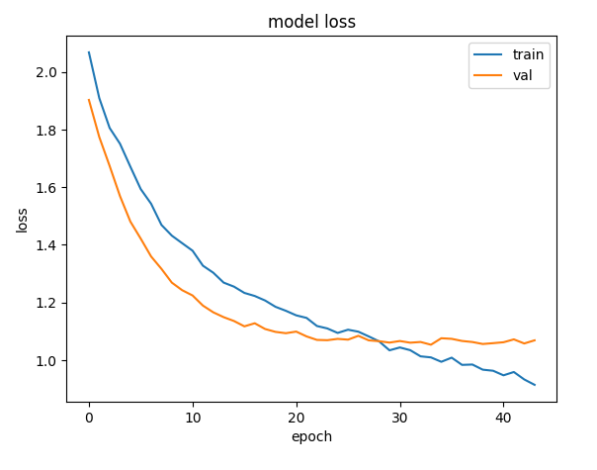
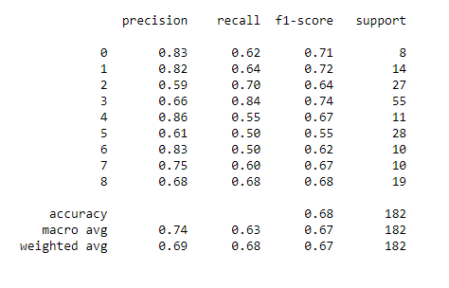
Modeling | An MLP model for textual information representation
Architecture
Evaluation on Validation data (90%-10%)
MLP 1
Number of layers: 2
Hidden layer 1: 896
Dropout: 0.2
Hidden layer 1 : 384
Dropout: 0.4
* Hyper-parameter tuning performed using Optuna
* Early stopping mechanism added
Results
Train loss=0.8964 and validation loss=1.0685
Signs of overfitting
Better performance than the baseline logistic regression model

Slide 17
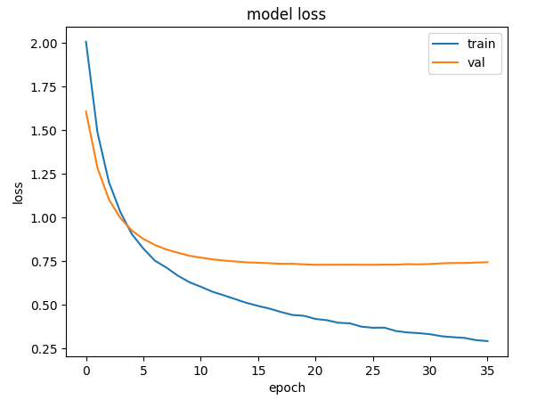
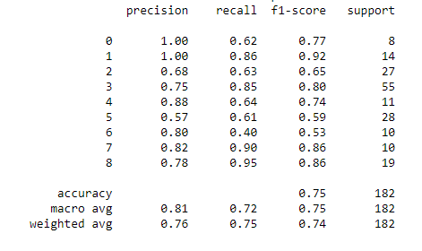
Modeling | An MLP model for graph-related information representation
Architecture
Evaluation on Validation data (90%-10%)
MLP 2
Number of layers: 1
Hidden layer 1: 896
Dropout: 0.3
* Hyper-parameter tuning performed using Optuna
* Early stopping mechanism added
Results
Train loss=0.2842 and validation loss=0.7445
Overfitting – huge gap between training and validation loss
Improved performance than the first MLP model on the validation data
Do not generalize well on unseen test data

Slide 18
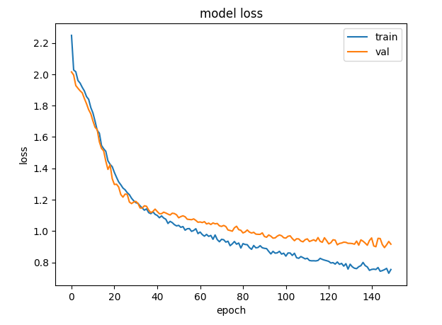
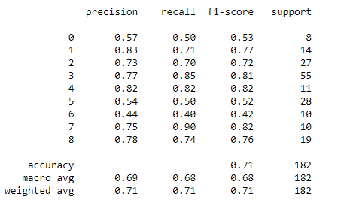
Modeling | A GCN to leverage more graph information
Architecture
Evaluation on Validation data (90%-10%)
GCN
2 GCN layers
Hidden layer 1: 64
Hidden layer 2: 128
1 fully connected layer
Dropout: 0.4
Results
Train loss=0.7550 and validation loss=0.9162
Overfitting issue is less than the previous model
Did not perform better than the previous model on the validation data, but it achieved better results on the test data (Private loss of 0.9196 and a Public loss of 0.8620)

Slide 19
Modeling | A GCN to leverage more graph information
Architecture
Evaluation on Validation data (90%-10%)
GCN
2 GCN layers
Hidden layer 1: 64
Hidden layer 2: 128
1 fully connected layer
Dropout: 0.4
General Information:
Even Thought We Had Already Leveraged The Topological Information, When Creating Our Embeddings, We Thought that The GCN Might Reveal a More Complex Pattern, to Increase our Accuracy.
Because of the Topological Nature of Our Embeddings, our GCN Both Converged and Overfitted Incredibly Early.
There Was no Reason to Continue the Training Because it is Very Rare, Because of the GCN Architecture to Fall to a Local Instead of Local Minimal, for an extensive Period of Time.

Slide 20
Other trials | Different combinations of features and models tested
Modeling trials
Training and Testing models using different feature sets independently:
MLP model using the text embeddings alone
MLP model using graph-based features alone, both with and without Louvain community labels
Combined Feature Models
Experimentation with text embeddings and graph-based features combined:
MLP model using the full text embeddings (768,) combined with graph-based features (132,)
MLP model using the truncated text embeddings (100,) combined with graph-based features
Feature Engineering
Evaluation of the results for every feature set combination:
Scaling for improved convergence
Dimensionality reduction to remove noise and keep the important information
Various text representation techniques (e.g. fast-text Greek model, bert embeddings, bert sentence transformers)

Slide 21
Conclusions & Future Work

Slide 22
Conclusions | Challenges & Limitations
Graph-based features enhanced domain representations and boosted classification accuracy by capturing local domain connectivity
Simpler models, such as MLPs with 1-2 layers, performed better due to their simpler architecture
The small dataset with limited training samples created issues such as model overfitting
GCN did not significantly improve performance, indicating that MLPs might suffice with better features
Improved feature engineering is needed, as modeling attempts did not significantly enhance accuracy

Slide 23
Further Improvements | What we could do better?
Address discrepancies in validation and test losses, performing cross validation for fine tuning
Handle overfitting issues using regularization techniques such as batch normalization layers
Handle the imbalance dataset performing techniques such as data augmentation or random sampling to produce more data samples
Explore advanced feature engineering methods such as topic modeling to extract topic distributions from texts and leverage the information for modeling
Improve and boost graph-related features incorporating additional measures that could provide even richer representation

