Slide 1
Jif:
Java + Information Flow
Steve Zdancewic
University of Pennsylvania
Andrew Myers, Lantian Zheng, Nate Nystrom
Cornell University

Slide 2
Confidential Data
Networked information systems:
  PCs store passwords, e-mail, finances,...
  Businesses build computing infrastructure
  Military & government communications
Security of data and infrastructure is critical [Trust in Cyberspace, Schneider et al. '99]

Slide 3
Technical Challenges
Software is large and complex
  HotMail bugs: read anyone's mail, steal passwords
Security policies are complex
  Requires tools & automation
Existing mechanisms are crucial, but
  OS: Coarse granularity of access control
  Cryptography must be applied appropriately

Slide 4
Jif: Java+Information Flow
[Myers, Nystrom, Zdancewic, Zheng]
Java
  With some restrictions
Information Flow Policy Language
  Principals and Labels
  Principal Hierarchy (delegation)
  Confidentiality & Integrity constraints
  Robust Declassification & Endorsement
  Language features (i.e. polymorphism)

Slide 5
Benefits
Explicit, fine-grained policies
Program abstractions
Regulate end-to-end behavior
  Information Flow vs. Access Control
Tools: increased confidence in security

Slide 6

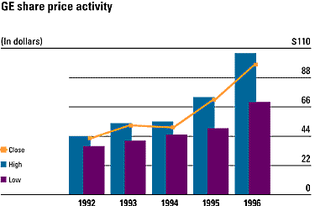

Information-flow Policy
Downloadable financial planner:
Disk
Network
Accounting
Software
Access control insufficient

Slide 7
Noninterference
[Goguen&Meseguer '82,'84]
Disk
Network
Accounting
Software
Private data does not interfere with network
communication
Baseline confidentiality policy

Slide 8
Principals
Principals: users, groups, etc.
  Express constraints on data usage
  Distinct from hosts
  Alice, Bob, etc. are principals
  Jif runtime represents principals as Java classes

Slide 9
Decentralized Labels
[Myers & Liskov '97, '00]
Simple Component {owner: readers}
  {Alice: Bob, Eve}
Compound Labels
  {Alice: Charles; Bob: Charles}
  “Alice owns this data and she
  permits Bob & Eve to read it.”
  “Alice & Bob own this data
  but only Charles can read it.”

Slide 10
Label Lattice
T
❖ Order
…
…
…
…
⧫ Join
{Alice:}
Labels higher in
the lattice are more
restrictive.
…
{Alice:Bob}
…
⧫
…
{Alice:Bob,Charles}
{Alice: Bob,Eve}
…
{}

Slide 11
Integrity Constraints
Specify who can write to a piece of data
  {Alice? Bob}
Both kinds of constraints
  {Alice: Bob; Alice?}
  “Alice owns this data and
  she permits Bob to change it.”

Slide 12
Extended Types
Jif augments Java’s types with labels
  int{Alice:Bob} x;
  Object{L} o;
Subtyping
  Inherited from the  lattice order
Inference
  All Jif expressions have labeled types
  Programmers may elide types

Slide 13
Implicit Flows
int{Alice:} a;
int{Bob:} b;
...
PC Label
{}
{}{Alice:}={Alice:}
{}
if (a > 0) then {
b = 4;
}
{Alice:; Bob:}
Assignment leaks information contained in the program counter.
{Alice:}
{Bob:}
{}

Slide 14
Implicit Flows
int{Alice} a;
int{Bob} b;
...
PC Label
{}
{}{Alice:}={Alice:}
{}
if (a > 0) then {
b = 4;
}
{Alice:; Bob:}
To assign to variable with
label X, must have
PC  X.
{Alice:}
{Bob:}
{}

Slide 15
Function Calls
int{Alice} a;
int{Bob} b;
...
PC Label
{}
{}{Alice:}={Alice:}
{}
if (a > 0) then {
f(4);
}
{}
Effects inside the function can leak information about the program counter.
{Alice}
{Bob}
{Alice,Bob}

Slide 16
Function Calls
int{Alice} a;
int{Bob} b;
...
PC Label
{Alice,Bob}
{Alice,Bob}{Alice}={Alice}
{Alice,Bob}
if (a > 0) then {
f(4);
}
{}
To call a function with
effects bounded by X
must have PC  X.
{Alice}
{Bob}
{Alice,Bob}

Slide 17
Method Types
int{L₁} method{B} (int{L₂} arg) : {E}
where authority(Alice)
{
…
}
Constrain begin and end PC labels
  To call PC  B
  On return PC  E
May include where clauses to specify
  Authority (set of principals)
  Caller’s Authority

Slide 18
Richer Security Policies
More complex policies:
"Alice will release her data to Bob, but only after he has paid $10."
Noninterference too restrictive
  In practice programs do leak some information
  Justification lies outside the model
  (i.e. cryptography)

Slide 19
Declassification
int{Alice:} a;
int Paid;
... // compute Paid
if (Paid==10) {
int{Alice:Bob} b = declassify(a, {Alice:Bob});
...
}
“down-cast" int{Alice:} to int{Alice:Bob}

Slide 20
Robust Declassification
[Zdancewic & Myers CSFW'01]
int{Alice:} a;
int{Alice?} Paid;
... // compute Paid
if (Paid==10) {
int{Alice:Bob} b = declassify(a, {Alice:Bob});
...
}
Alice needs to trust the contents of paid.
Introduces constraint
PC  {Alice?}

Slide 21
First Class Labels & Principals
Two new primitive datatypes:
principal
  Can be bound to different users at run time
  Programmer can ask whether p actsfor q
label
  A value that can be used as a dynamic tag
  If x is a label value then {*x} is the type
  Can use switchlabel(l) to examine run-time labels

Slide 22
Parameterized Classes
Jif allows classes to be parameterized by labels and principals
  Code reuse
  e.g. Containers parameterized by labels
class MyClass[label L] {
int{L} x;
}

Slide 23
Demo

Slide 24
Unix cat in Jif
public static void main{}(String{}[]{} args) {
String filename = args[0];
final principal p = Runtime.user();
final label lb;
lb = new label{p:};
Runtime[p] runtime = Runtime.getRuntime(p);
FileInputStream{*lb} fis = runtime.openFileRead(filename, lb);
InputStreamReader{*lb} reader = new InputStreamReader{*lb}(fis);
BufferedReader{*lb} br = new BufferedReader{*lb}(reader);
PrintStream{*lb} out = runtime.out();
String line = br.readLine();
while (line != null) {
out.println(line);
line = br.readLine();
}
}

Slide 25
Caveats
No threads
  Information flow hard to control
  Active area of research (still preliminary)
Timing channels not controlled
  Explicit choice for practicality
  See Agat ’01 for alternatives
Differences from Java
  Some exceptions are fatal
  Restricted access to some System calls

Slide 26
Language-based Security
Denning ’75, ’77
Smith & Volpano ’96—’01
Abadi, Banerjee, Heintz, and Riecke ’99
Sabelfeld & Sands
Honda & Yoshida ’01, ’02
Pottier et al. ’01, ’02

Slide 27
Jif Project Status
Complete implementation of Jif.
Implemented several thousand LOC
  Mostly small test cases
  Port of Java’s io package
  Hashtable implementation
  Tax simulation (~300 LOC)
  Battleship program (~300 LOC)

Slide 28
Ongoing Jif Research
Using this programming model in distributed settings [SOSP ’01]
Replication of code & data to improve integrity guarantees [submitted for publication]

Slide 29
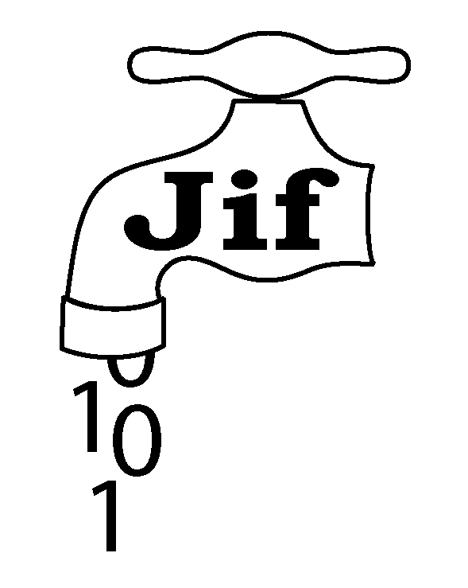
Jif Project Home
www.cs.cornell.edu/jif

