Slide 1

SECURE GPT
Your Guardian Guide: Navigating Online Safety with Secure GPT
Students:
Vasilis Drouzas
Rafail Mpalis
Dimitris Tsirmpas
Dimitris Stathopoulos
MSc in Data Science
Prof. John Pavlopoulos
Ass. Prof. Konstantina Liagkou

Slide 2
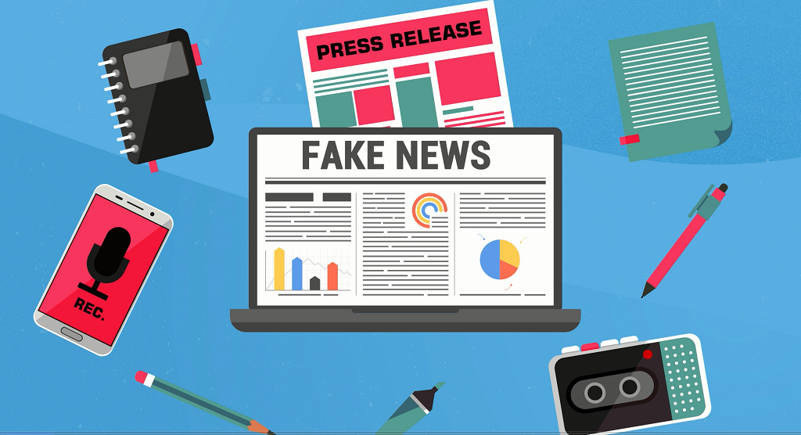
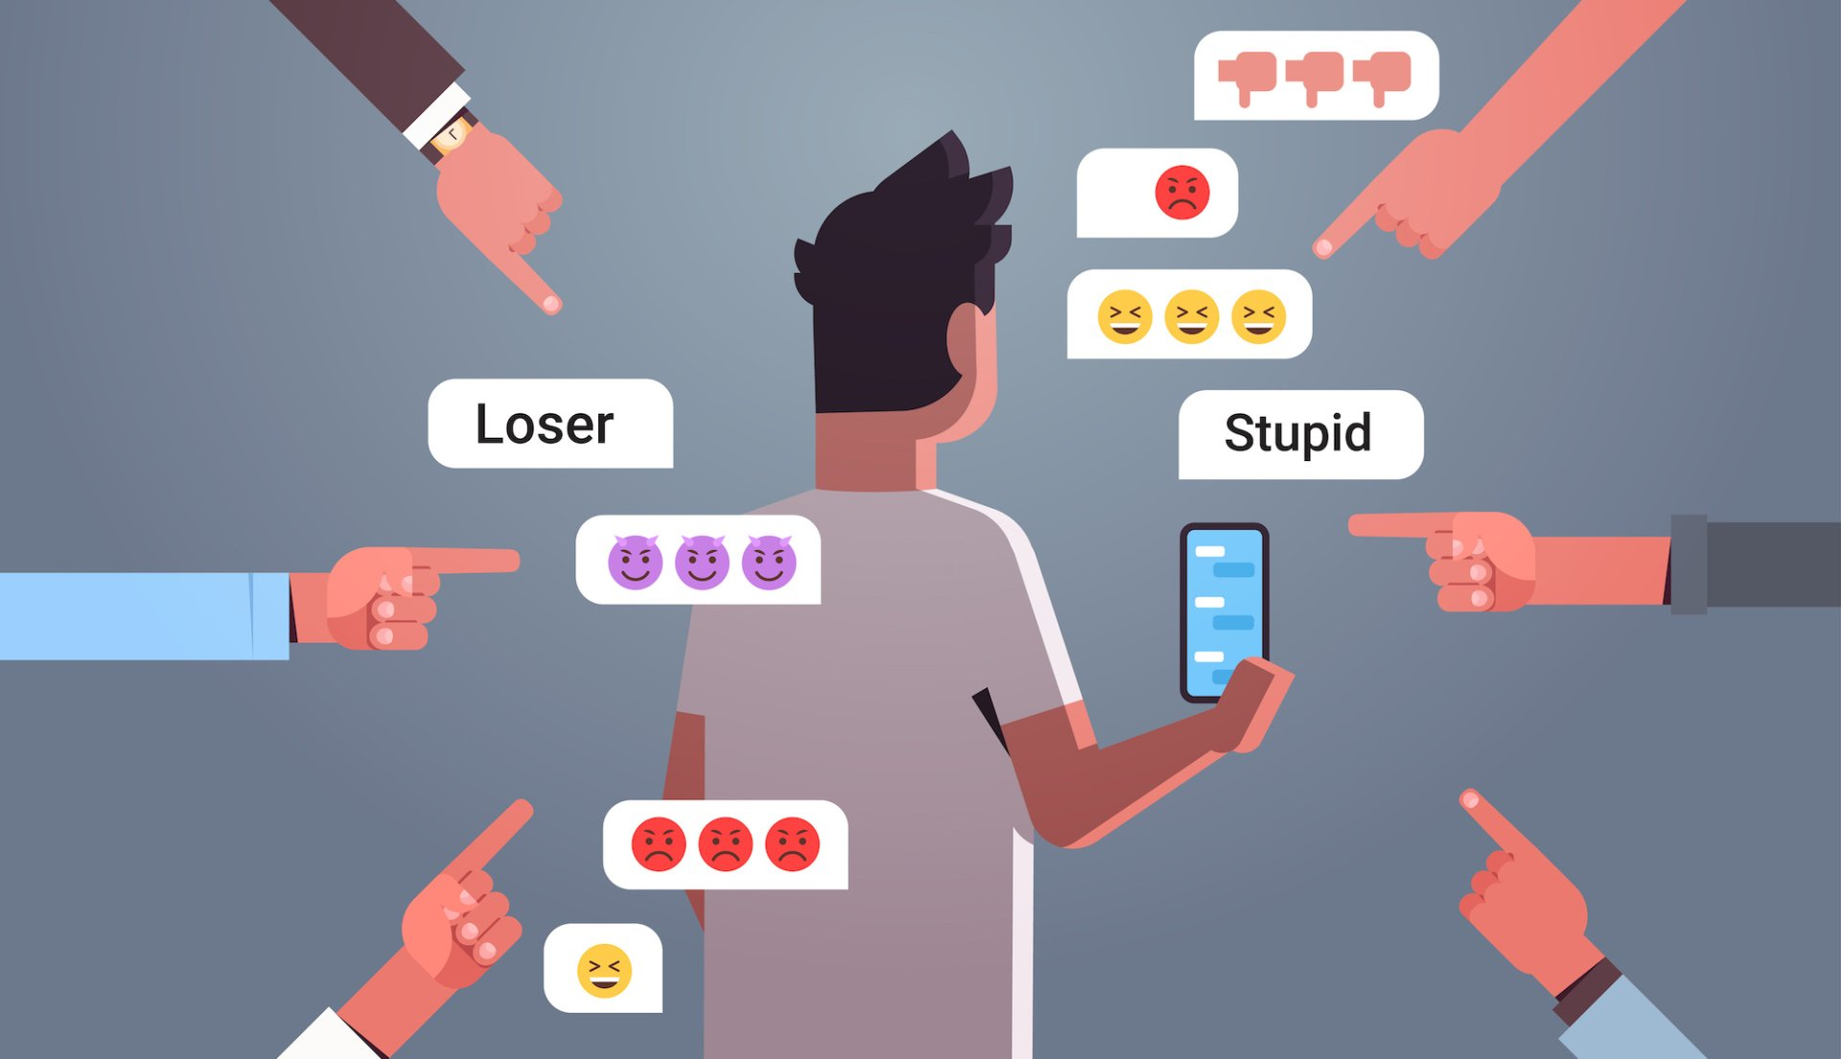

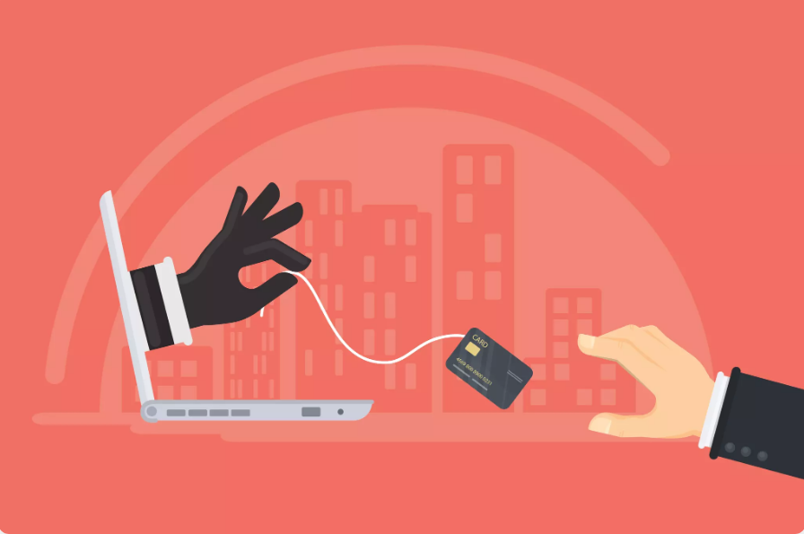
Digital Safety Gap - Web Dangers
FAKE NEWS
CYBERBULLYING
PRIVACY CONCERNS
ONLINE SCAM

Slide 3
How big is the problem?
Fake News: A threat to public opinion. We need to balance between free speech and responsible sharing.
Cyber Bullying: A form of harassment with emotional & psychological consequences for the victims. Our LLM can identify relative keywords and thus warn the user in advance.
Privacy concerns: Secure GPT traces occasions where personal data could be exposed and notifies the user.
Online Scam: Many users receive phishing messages in social media. Our aim is to block relative content before reaching the user.

Slide 4
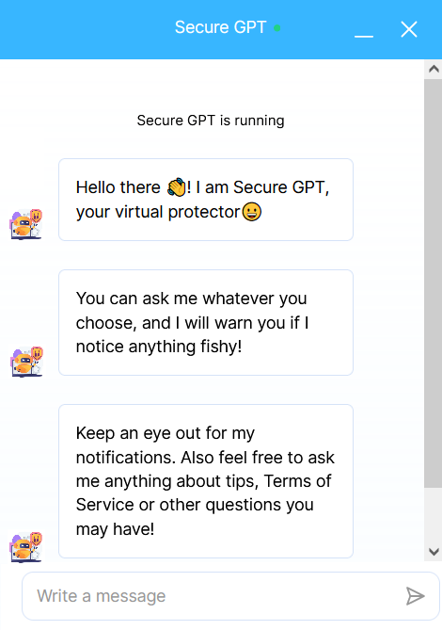
Secure GPT – Reliable advisor for Trust and Safety
Scam Shield: No more victims to online scams! Secure GPT identifies and blocks potential scams.
Privacy Sentinel: Secure GPT keeps personal information safe and secure.
Cyberbullying Guardian: Defends against online harassment, cyberbullying, and trolling.
Fake News Buster: Secure GPT discern fact from fiction, preserving trust and reducing societal polarization.

Slide 5
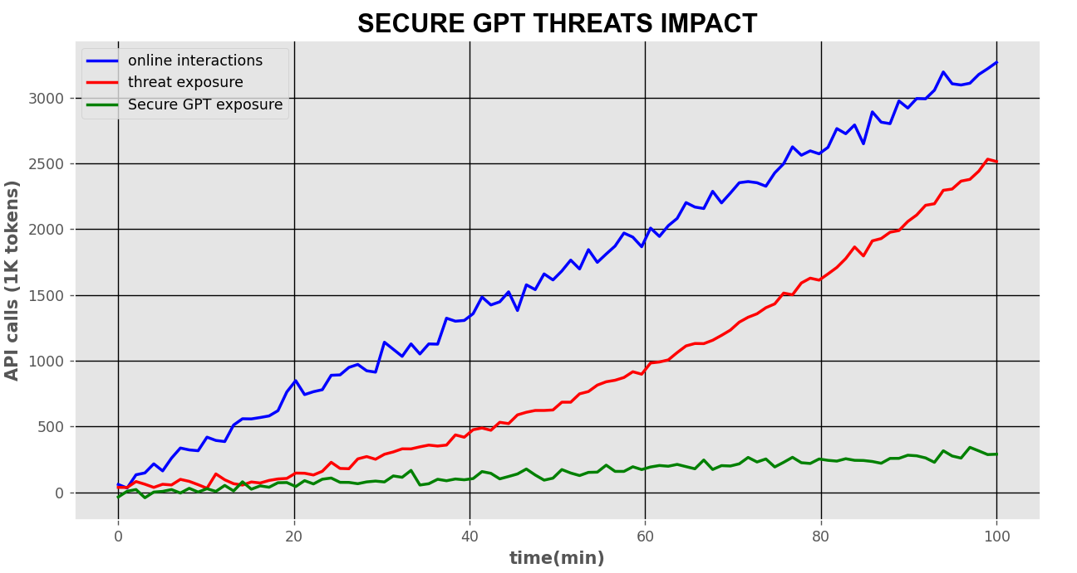
Figure 1: Our AI models predict that by using Secure GPT, the impact of threat exposure per user will be decreased exponentially.

Slide 6
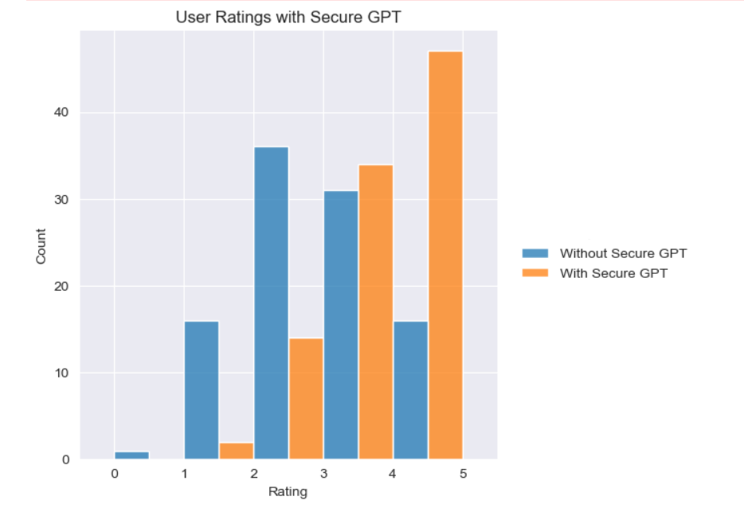
Secure GPT Reliably Enhances UX
Figure 2: Ratings of 100 users on their experience after 2 hours of online browsing (Orange: With Secure GPT, Blue: Control Group). Note the significant 4 and 5 star ratings while using Secure GPT.

Slide 7
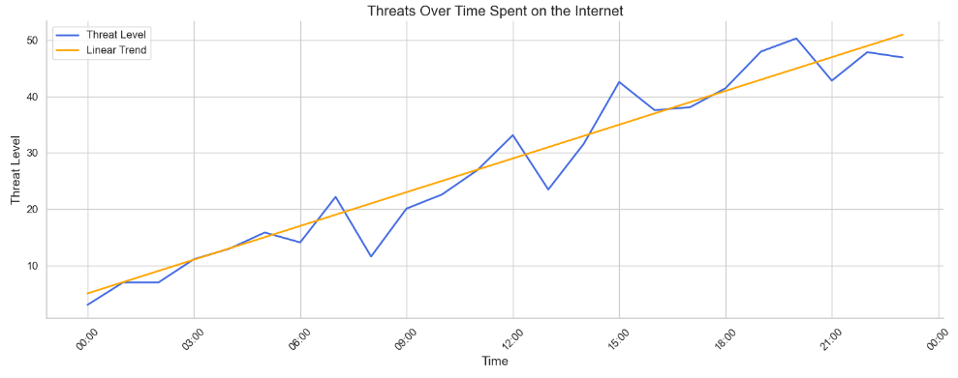
Figure 3: User Threat Level based on time of day. Note the linear trend towards night-time hours, which correspond with increased online activity.

Slide 8
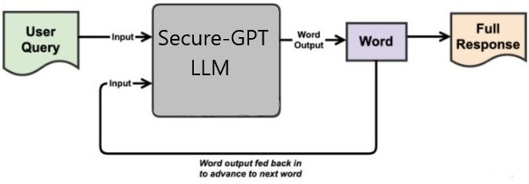
Secure GPT - Is it adequate?
Secure GPT can work under massive workloads. Just an add-on on the web browser, without compromising on the performance. (Scalability)
Secure GPT is a viable idea. No need to access the users’ private data, but performing only web scraping, thus it eliminates any law implications. (Viability)
Νο company with a relative application in production. Idea of secure surfing on top platforms, is still in progress. (Innovation)

Slide 9

QUESTIONS??

