Slide 1
Investigating Pseudo-labeling Without Supporting Algorithms and Models
Tsirmpas Dimitris
MSc in Data Science
Athens University of Economics and Business

Slide 2
What we will be talking about
Domain-adaptation task
Pseudo-labeling across different domains
Strengths and weaknesses of pseudo-labeling
Our incremental learning algorithm
Results
Conclusion

Slide 3
Pseudo-labeling for the Domain Adaptation Task

Slide 4
What is Domain Adaptation?
Domain adaptation aims to improve model performance on a target domain using knowledge from a source domain
Key Components:
  Source Domain: Domain with abundant labeled data
  Target Domain: Domain with limited or no labeled data
  Source and Target domains have same dimensionality and label-space (homogeneous domain adaptation)
  Source and Target domains have different feature distributions

Slide 5
What is Pseudo-labeling?
Pseudo-labeling is a semi-supervised learning technique where the model generates labels for unlabeled data
Originally used for dataset augmentation
Can be adapted for domain adaptation
  Train model on source domain
  Use trained model to predict labels on target domain's unlabeled data
  Select high-confidence predictions as pseudo-labels
  Retrain model with both source and pseudo-labeled target data

Slide 6
Pseudo-labeling: Strengths
Compared to other DA algorithms pseudo-labeling:
  Intuitive
  Can be applied to any black-box model (theoretically…)
  Cheap (no additional models, layers, gradient computations e.t.c.)
  Very easy to implement

Slide 7
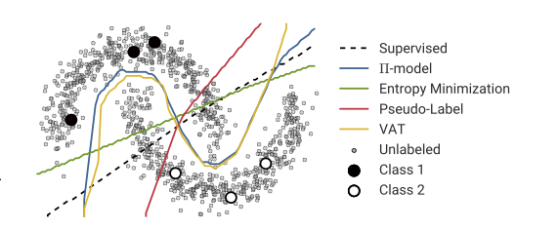
Pseudo-labeling: Weaknesses (1)
Wrong high-confidence predictions lead to more wrong predictions
Model collapse likely
Sensitivity to noisy data and low-quality pseudo-labels
The model on the left fails to properly identify clusters due to few starting samples
Figure from Oliver et al (2019)

Slide 8
Pseudo-labeling: Weaknesses (2)
More hyperparameters need bigger validation set (Oliver et al. 2019)
May only use a subset of the target domain dataset
Dependence on the initial model's accuracy
Defining the threshold to pseudo-label target data as the model changes is tricky

Slide 9
Experiments

Slide 10
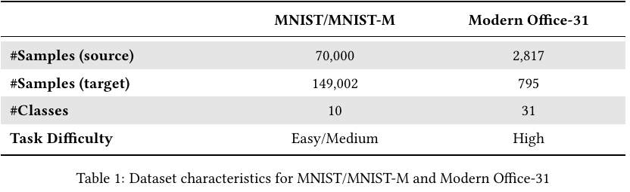
Datasets used

Slide 11
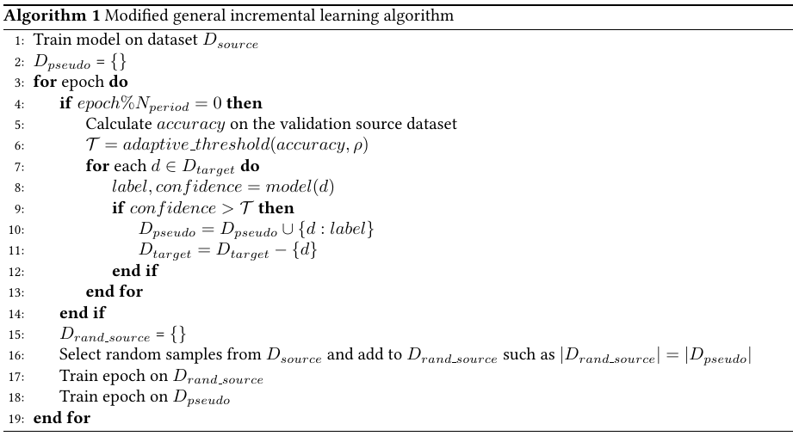
The training algorithm

Slide 12
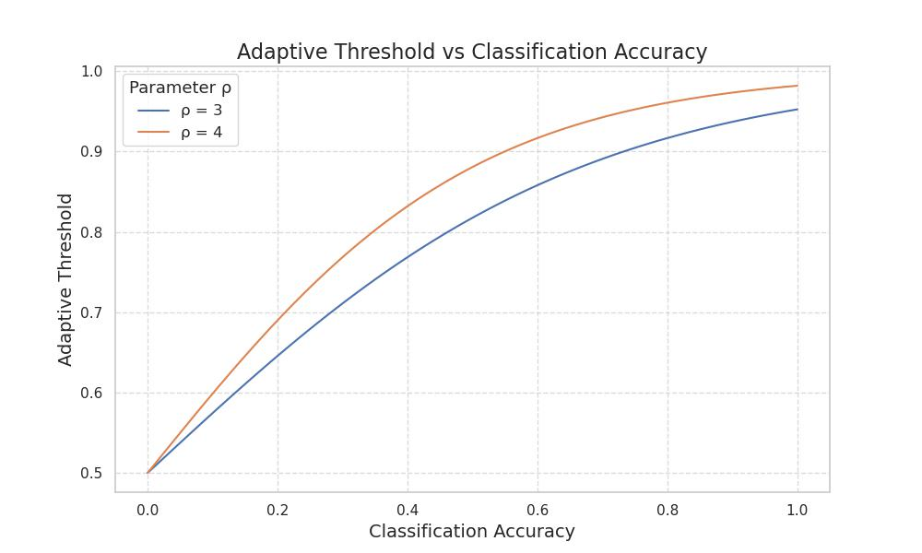

The adaptive threshold function
Sigmoid function
Changes dynamically according to source dataset validation accuracy

Slide 13
Experimental Setup
Base model: ResNet-18
  Pretrained on ImageNet for the Modern Office-31 dataset
Three baseline models:
  Model trained on source dataset - lower performance bound
  Model trained on (fully labelled) target dataset - upper performance bound
  Model using Deep CORAL (Correlation Alignment) – comparison with basic DA method

Slide 14
Experimental Setup
For each domain we run the incremental learning algorithm on:
  The fine-tuned (source) model
  The model additionally fine-tuned on a small labelled sample from the target domain
  The model additionally fine-tuned on a larger labelled sample from the target domain
We compare performance of these unsupervised and semi-supervised approaches, as well as the rate of pseudo-labelled misclassifications

Slide 15
Results

Slide 16
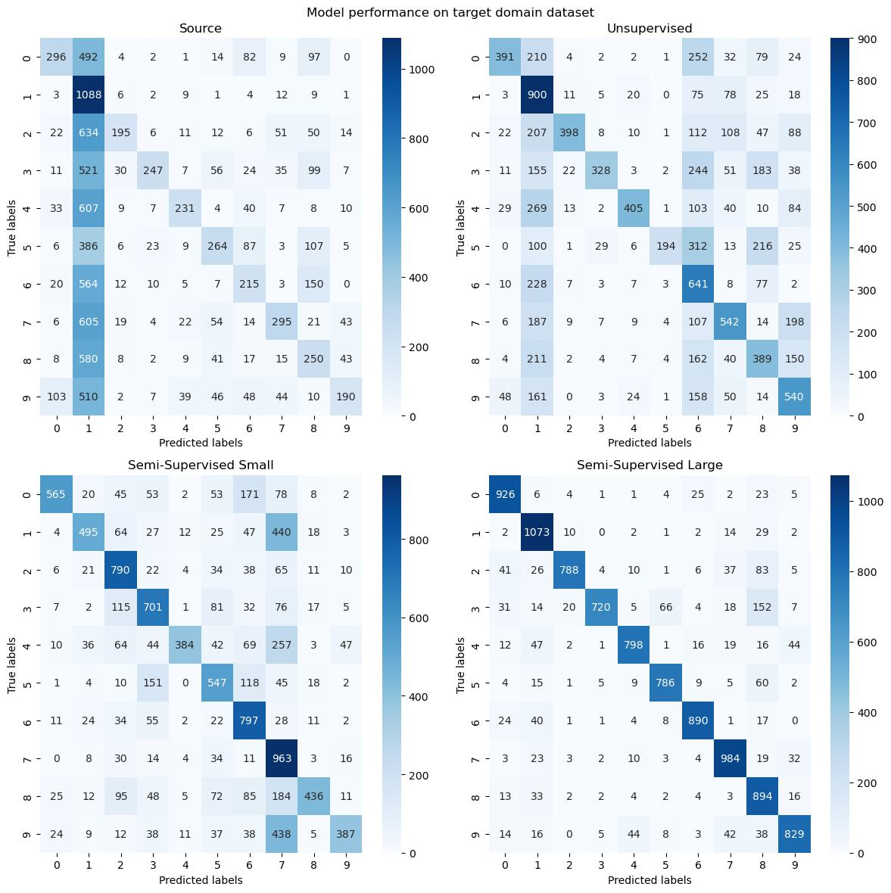
Accuracy: MNIST/MNIST-M

Slide 17
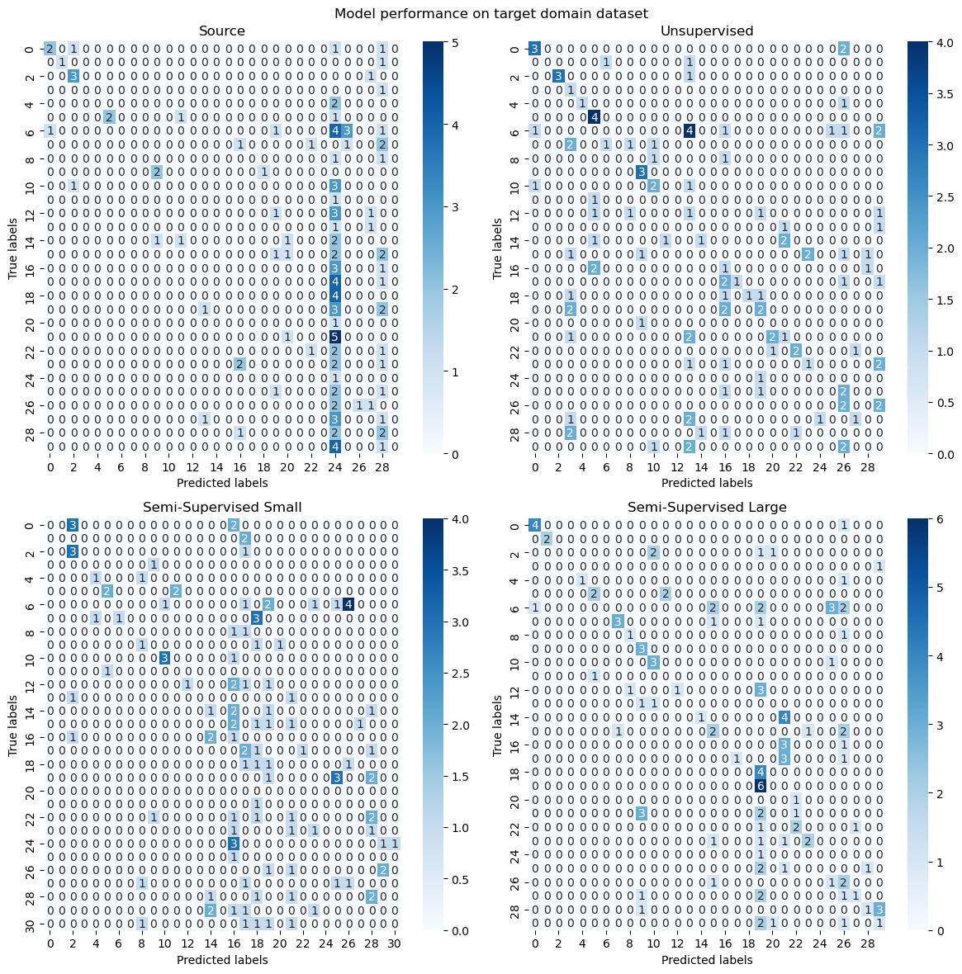
Accuracy: Modern Office-31

Slide 18
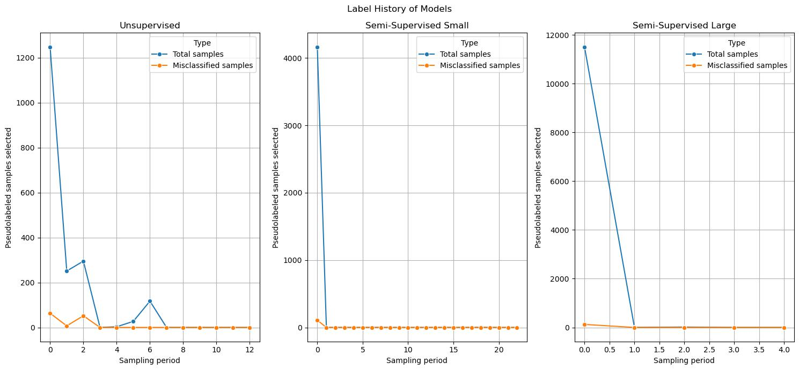
Misclassifications: MNIST/MNIST-M

Slide 19
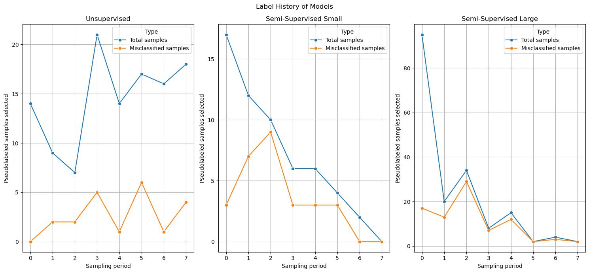
Misclassifications: Modern Office-31

Slide 20
Conclusions (1)
Unsupervised pseudo-labeling improves performance when source and target distributions are similar (MNIST/MNIST-M)
    Incorporating limited labeled target data enhances performance for significant distribution shifts (Modern Office-31)
    Adding more labeled target data doesn't always lead to better efficiency
    Domain-invariant features may sometimes be learned by labelling few target domain data to training dataset

Slide 21
Conclusions (2)
  Importance of adaptive threshold ρ:
    Crucial for selecting high-confidence samples, avoiding incorrect pseudo-labeling
    Adaptive threshold function may fail in case of model overconfidence

Slide 22
Questions?

