Slide 1
Mitigating Polarization in Online Discussions Through Adaptive Moderation Techniques
Dimitris Tsirmpas
Master Thesis – CAPSTONE Project
Athens University of Economics and Business
MSc in Data Science
Notes:
Name
Title
Quickly explain: LLM facilitation on online discussions

Slide 2
Thesis Outline
Introduction
System Concept
Implementation
Experimental Setup
Results
Outcomes
Notes:
Briefly explain sections

Slide 3
Thesis Outline
Introduction
System Concept
Implementation
Experimental Setup
Results
Outcomes
Notes:
-

Slide 4
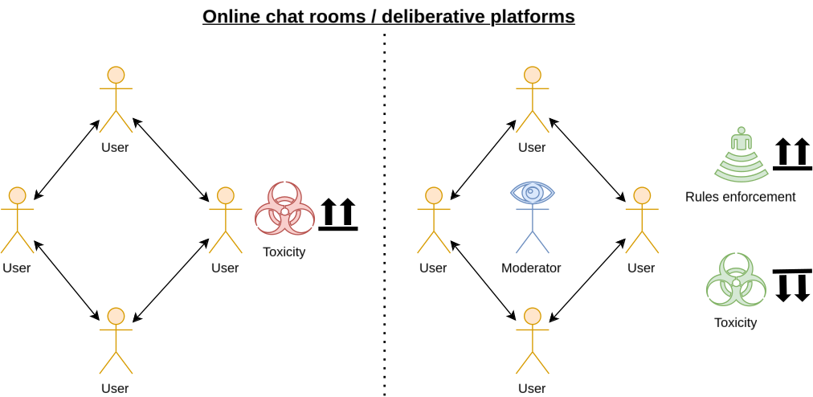
Traditional chat room discourse

Slide 5
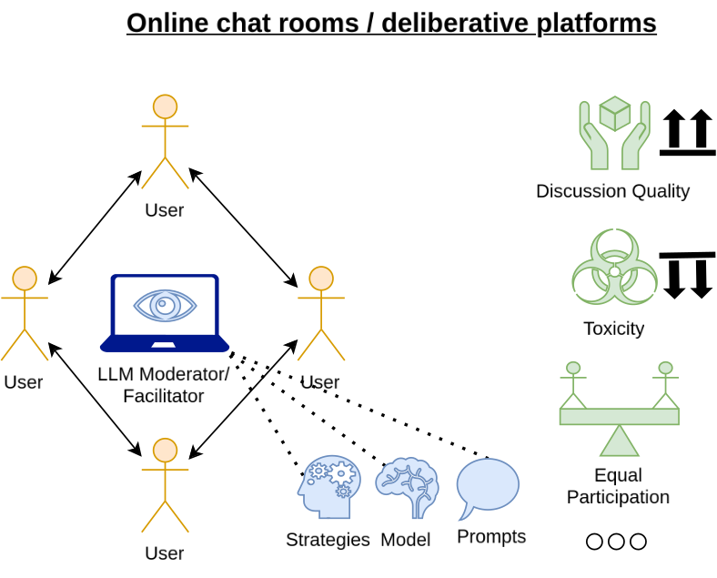
Wider research goal

Slide 6
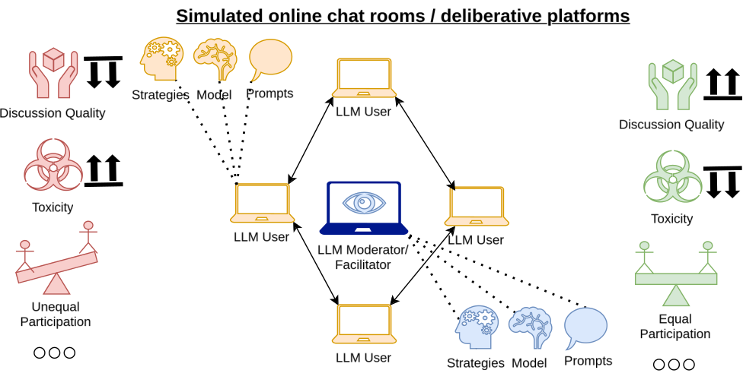
Thesis goal

Slide 7
Why simulate discussions? (2/2)
1st Solution: Use existing conversation datasets
  We are unable to dynamically gauge how the conversation would change because of changes in our LLM facilitator
  Datasets including moderators very limited
2nd Solution: Prototype the LLM facilitators on synthetic discussions (with LLM users) instead!
  Cheaper, easier → A/B testing
  Enables bulk generation of data → Data Analysis

Slide 8
Why LLMs as synthetic users?
LLMs excellent at mimicking humans
Can leverage latent knowledge within their parameters to convincingly mimic human discussions
  Large part of training dataset often includes forums such as Reddit, where discussions are common and diverse
Are known to exhibit offensive language, toxic behavior and problematic statements (e.g. hate speech) unless painstakingly finetuned not to
  In our case this is a feature, not a bug!

Slide 9
Challenges
LLMs often produce low-quality conversations
  Unrealistic dialogue, stereotype-heavy language, conversational collapses are common
LLMs very sensitive to prompting
  As of now, no template in literature which guarantees good results
Bulk generation of data means heavy data loads
  Need automated filtering and classification procedures (for example, automated toxicity classification)

Slide 10
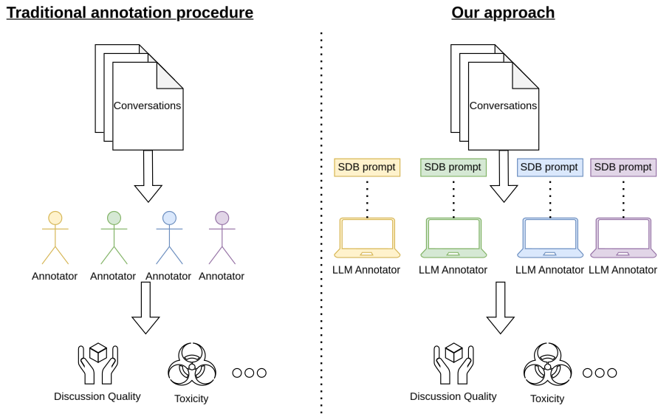
The case for LLM annotation

Slide 11
Research Questions
RQ1: Can LLM-based user-agents convincingly argue against each other when supplied with only a controversial topic and differing SDBs?
RQ2: Do LLM-based annotator-agents change their behavior according to different SDBs?

Slide 12
Thesis Outline
Introduction
System Concept
Implementation
Experimental Setup
Results
Outcomes
Notes:
Now we will be going over how to apply these ideas into a synthetic discussion creation system

Slide 13
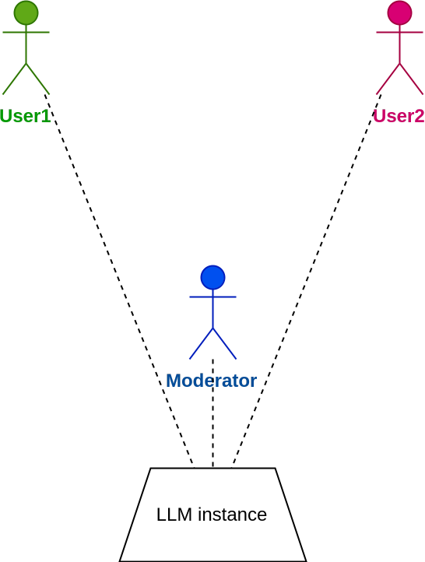
Synthetic Discussion Generation (1/4)
Single LLM for all actors in the discussion
  N users, one facilitator
Notes:
Very basic stuff DO NOT mention SDBs and BAN

Slide 14
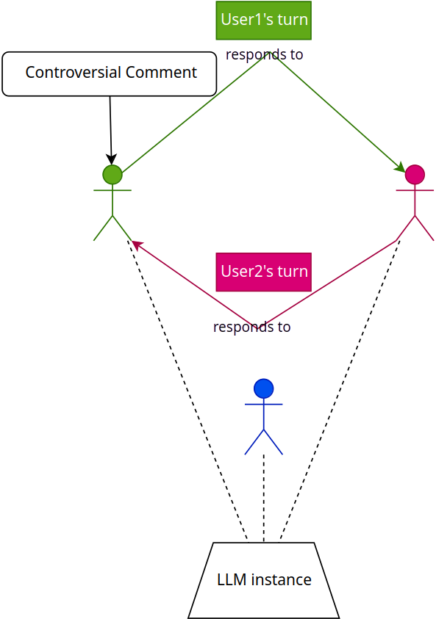
Synthetic Discussion Generation (2/4)
Single LLM for all actors in the discussion
  N users, one facilitator
Start the discussion with a given controversial topic
Users respond to each other
Notes:
Very basic stuff DO NOT mention SDBs and BAN

Slide 15
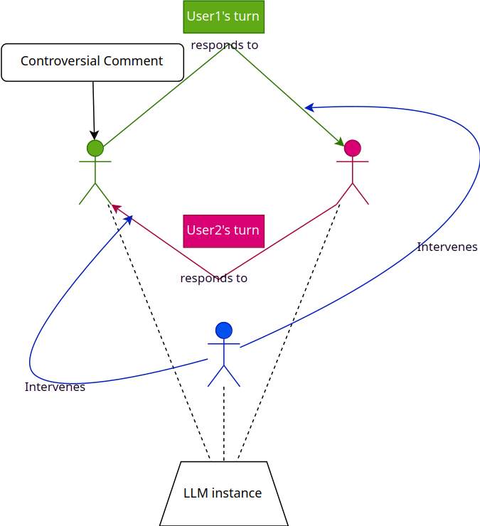
Synthetic Discussion Generation (3/4)
Single LLM for all actors in the discussion
  N users, one facilitator
Start the discussion with a given controversial topic
Users respond to each other,
The facilitator jumps in when necessary
Notes:
Very basic stuff DO NOT mention SDBs and BAN

Slide 16
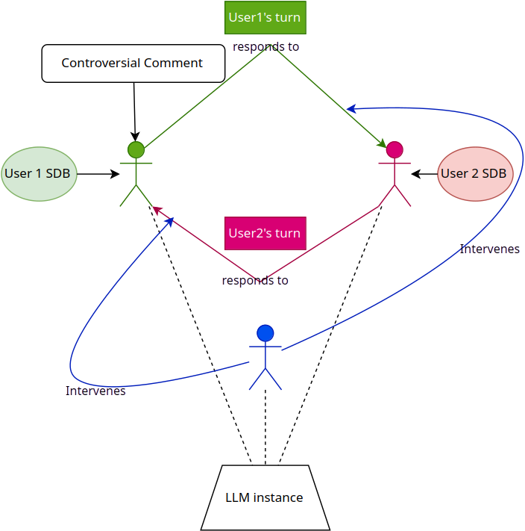
Synthetic Discussion Generation (4/4)
Each actor is given a socio-demographic prompt
  For example, user1 is an African American, user2 is LGBT
The facilitator has the power to ban a participant
  Ends the discussion
Notes:
Do it now :)
SDBs and BAN

Slide 17
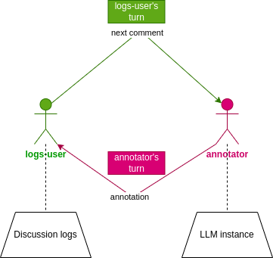
Synthetic Discussion Annotation
Automated annotation: use LLMs again!
Can annotate for almost any metric
  Toxicity, relevance, clarity, consensus
Task the same LLM instance to go through each post in the conversation and decide on a classification score
Many LLM annotator-agents with different SDBs
  Enables us to analyze inter-annotator agreement
Notes:
Same as conversation
One “real” user; the other one is just the system

Slide 18
Thesis Outline
Introduction
System Concept
Implementation
Experimental Setup
Results
Outcomes
Notes:
Now we talk about how the system was implemented based on the concept we analyzed

Slide 19
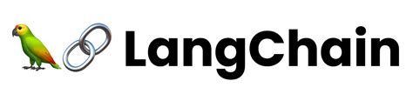

Why not use something that exists?
Ready-to-use frameworks for conversational LLMs do exist
  Concordia, LangChain, e.t.c.
However complex API, strict hardware requirements
Notes:
Examples: transformer layers on GPU, dedicated RAM and VRAM for caching

Slide 20
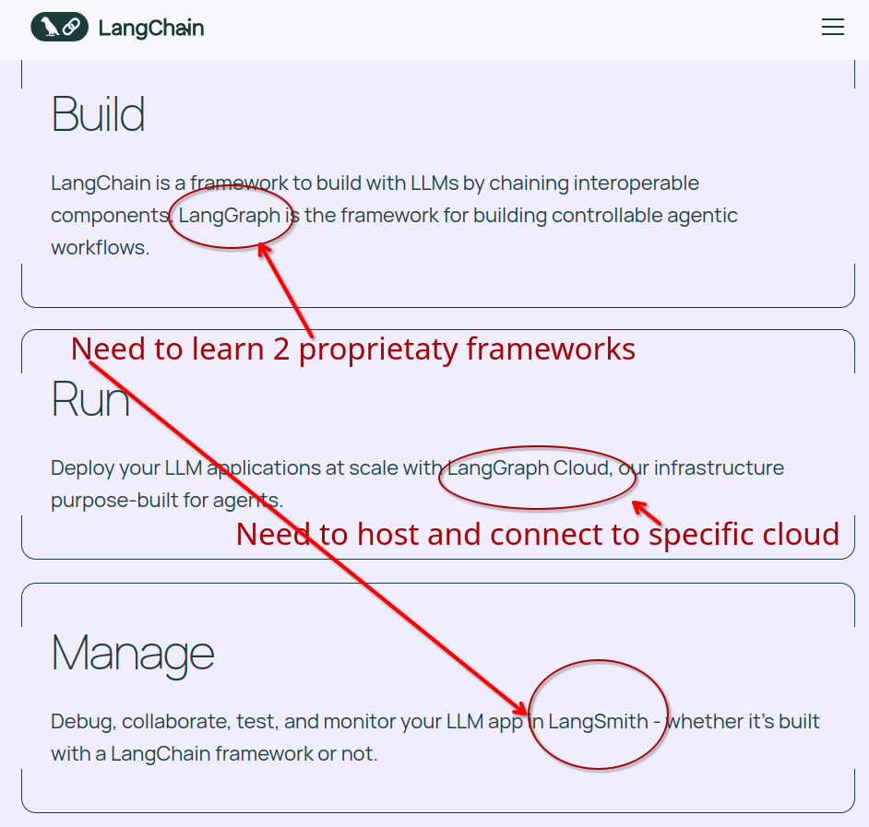
Why not use something that exists? - LangChain
Notes:
Examples: transformer layers on GPU, dedicated RAM and VRAM for caching

Slide 21
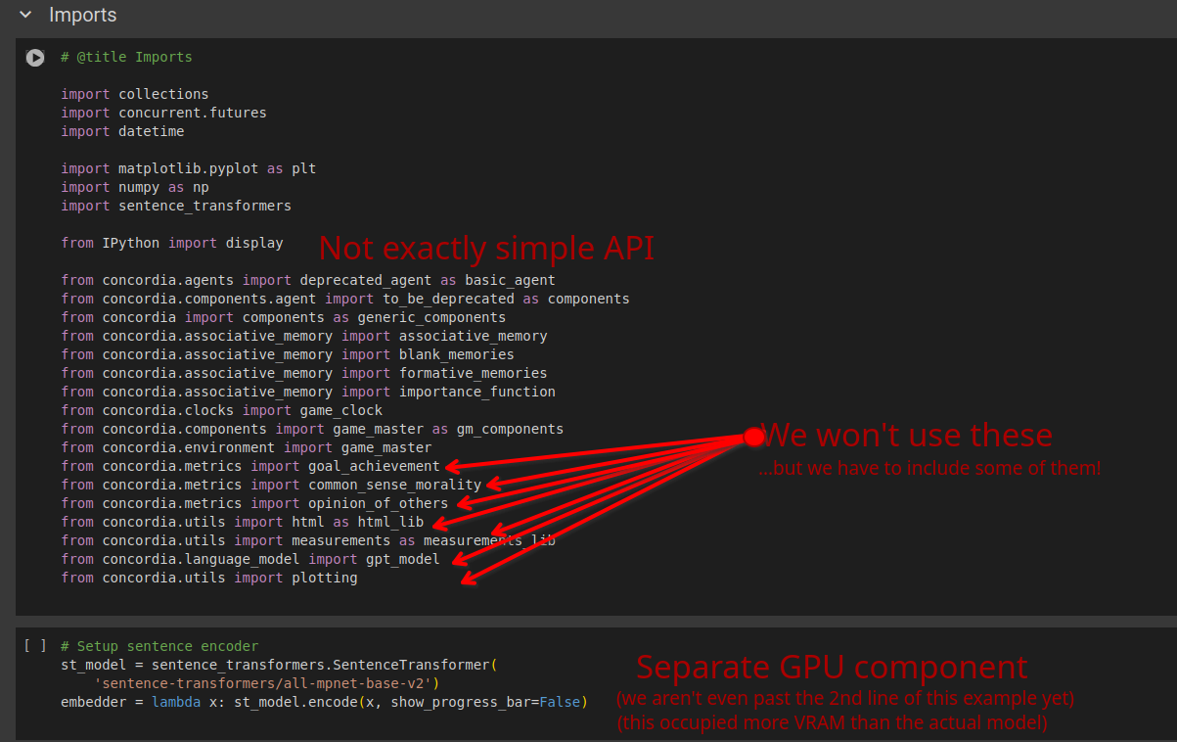
Why not use something that exists? - Concordia
Notes:
Examples: transformer layers on GPU, dedicated RAM and VRAM for caching

Slide 22
Why not use something that exists?
Create our own discussion framework
  Simple API
  Lightweight
  Focused on our use-case (research)
Notes:
Examples: transformer layers on GPU, dedicated RAM and VRAM for caching

Slide 23
Our framework: Features
Arbitrary amount of synthetic users with different personas
Custom JSON schema supporting:
  Automated conversation creation
  Data analysis on finished conversations
Multiple entry-points
  Called by provided notebook, as automated script (only interacting through JSON) or directly through Python
Notes:
0 to N with SDBs
JSON as input, JSON as output
Explain entry points in next slide

Slide 24
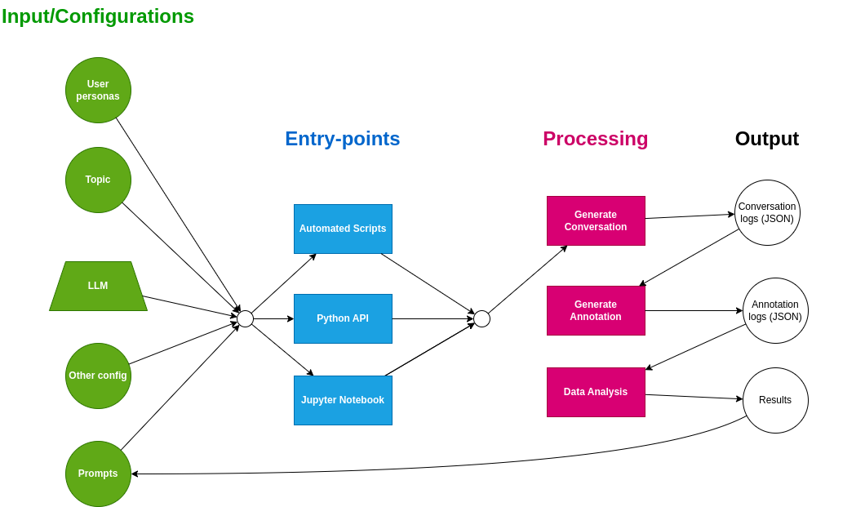
High level overview
Notes:
Left to right
Pink is SDL

Slide 25
Thesis Outline
Introduction
System Concept
Implementation
Experimental Setup
Results
Outcomes

Slide 26
Setup
Two users, 0-1 facilitators
Controversial topics selected from Pavlopoulos & Likas 2024
Use toxicity as a proxy for discussion quality
  No widespread, computational metric for discussion quality
  Already established that toxicity prime cause for online conversation failure
3 different user SDBs
8 different annotator SDBs

Slide 27
Defining policy - facilitator prompts
Facilitator prompts ← discussion rules ← policy ← ideal discussion properties
How would the ideal online/deliberative discussion look like?
  We want the most opinions to be heard from the most people
    Non toxic – toxicity leads to user distrust (Avalle et al 2024)
    Polarization is the devil
Keep interventions to a minimum
Combine the above with guidelines from actual human moderation manuals (Cornell eRulemaking 2017)

Slide 28
Breaching the policy – User prompts
Why do online discussions fail in the real world?
  Anonymity makes people less likely to consider the other side (Avalle et al 2024)
  Personal attacks common and significantly increase the chance of the conversation collapsing (Kock & Stafford & Vlachos 2022)
People resist changing their beliefs
These are all aspects that our LLM user-agents should follow while talking with each other

Slide 29
Prompt templates
Vanilla template
  Model guidelines via standard instruction prompt
  E.g. “You are a human chat user. You are in a chat room discussing <topic> and you see <controversial comment> [...]”
Moderation Game template
  Model discussion as a non-zero-sum, scorable game
  Guidelines → scorable rules
  Rule weights as parameters, can be adjusted / learned

Slide 30
The Moderation Game
Facilitator
  Intervene: -1 points
  Threatened ban: -1 points
  Intervention led to better behavior: +3 points
  Banned a participant: -5 points
Users
  Defend your position: +1 point
  Concede to an opponent's view: -0.5 points
  Provoke a toxic answer: +2 points
  Get away with attacking your opponent: +1 point
  Get banned from the discussion: -20 points

Slide 31
Thesis Outline
Introduction
System Concept
Implementation
Experimental Setup
Results
Outcomes

Slide 32
How do SDBs influence the LLM user-agents?

Slide 33
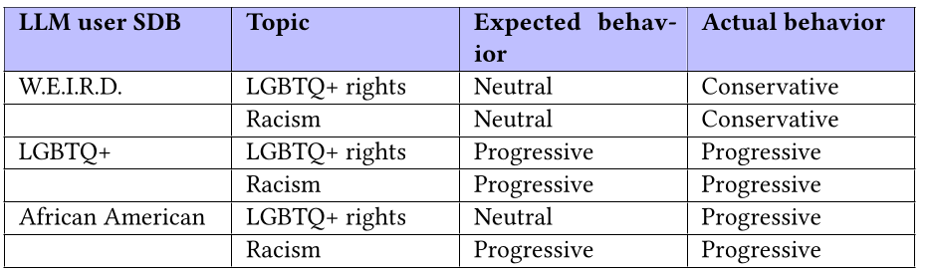
Impact of SDBs on synthetic users
W.E.I.R.D. = Western, Educated, Industrialized, Rich and Democratic
African American LLM users progressive in both issues
  Distortion caused likely by model biases
W.E.I.R.D. LLM users more conservative in all issues
  Distortion likely caused by our prompts encouraging polarization

Slide 34
How do instruction prompts influence the LLM users?

Slide 35
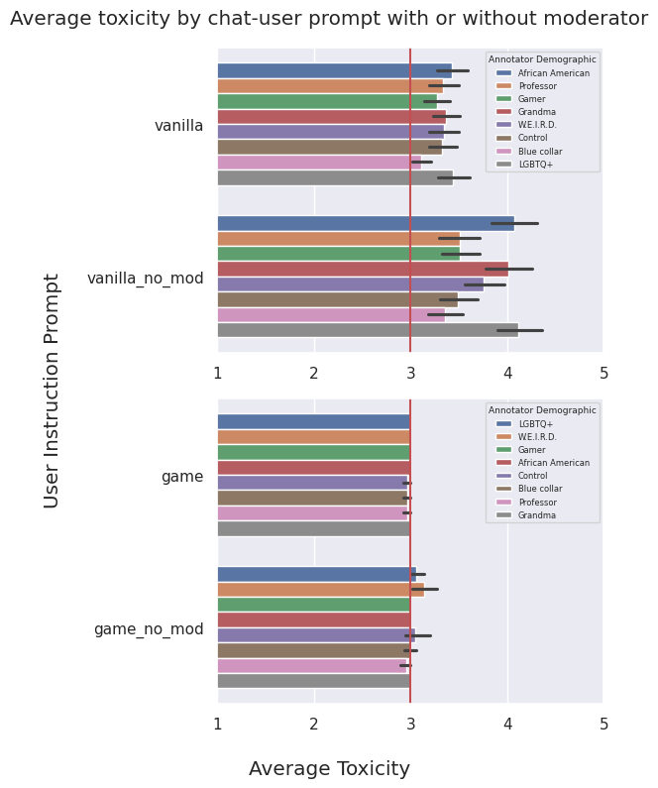
Impact of facilitator/instruction template
Annotations generally
consistent between SDBs,
with some variance
“Moderation Game” template much less toxic than vanilla prompting
Facilitator presence
reduces toxicity

Slide 36
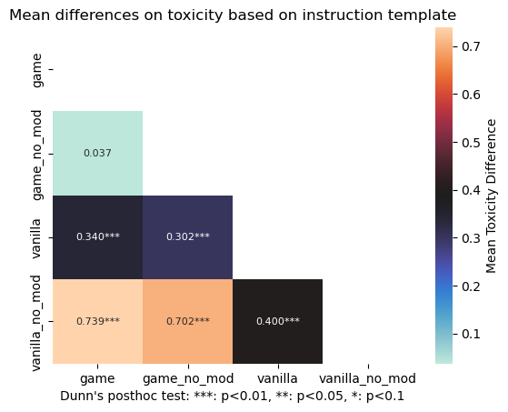
Impact of facilitator/instruction template
Facilitator presence in the “Moderation Game” prompt shows no statistically significant difference in toxicity
Significant differences between all instruction templates

Slide 37
How do SDBs influence the LLM annotators?

Slide 38
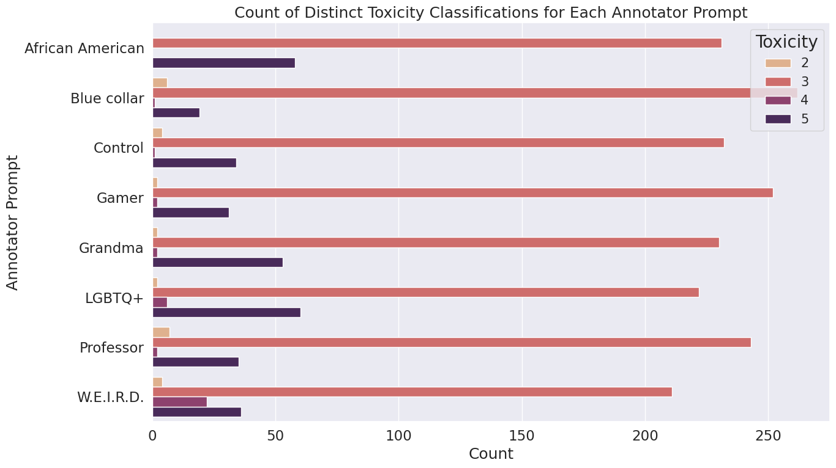
Impact of annotator SDB on toxicity
Most comments moderately toxic
  May be caused by our user instructions
Differences mostly in what is considered “very” or “extremely” toxic

Slide 39
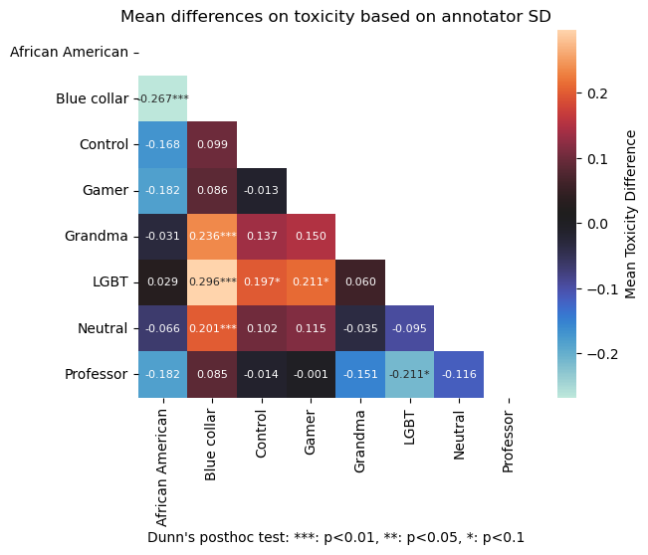
Impact of annotator SDB on toxicity
Annotator SDB influences toxicity classification (Kruskall Test p<2e-8)
… but influence relatively muted in qualitative terms (at most ±0.3 toxicity on average)

Slide 40
Are annotator SDBs faithful to human annotations?

Slide 41
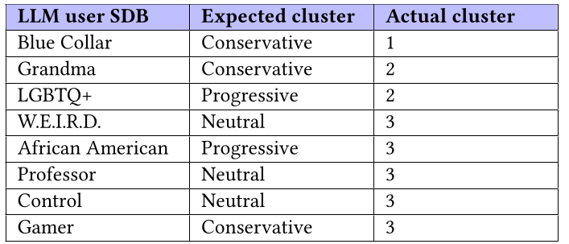
Impact of annotator SDB on toxicity
Annotators clustered according to previous Figure (small deviations between two SDBs → same cluster)
LLM annotator behavior does not match expected human behavior

Slide 42
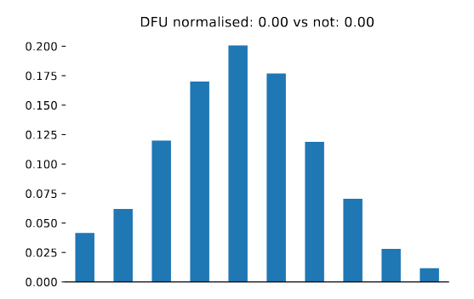
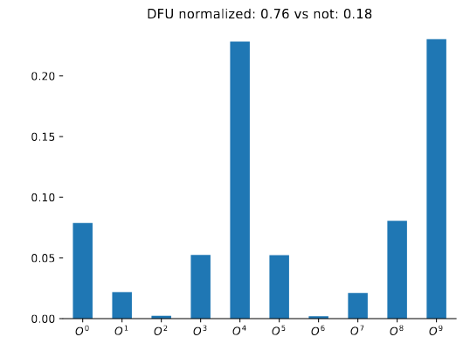
Background: The nDFU measure
Pictures from Pavlopoulos & Likas 2024
normalized Distance From Unimodality (Pavlopoulos & Likas 2024)
  nDFU=0: No polarization in annotations
  nDFU=1: Very polarized annotations

Slide 43
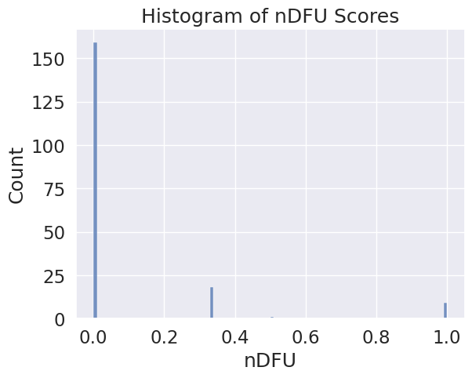
Impact of annotator SDB on toxicity
Most annotators agree with each
other irrespective of SDB
However some comments exhibit maximum polarization

Slide 44
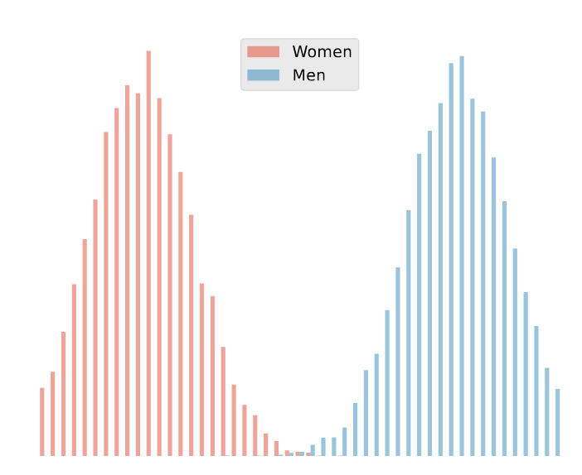
Background: Aposteriori unimodality measure
Picture from Pavlopoulos & Likas 2024
Does a feature (e.g. gender) explain the observed polarization?
It does if:
  The annotations are polarized, but
  Not polarized when divided between the individual factors (e.g. annotations of men and women)

Slide 45
The Aposteriori Unimodality Test
Aposteriori unimodality has no threshold
It also does not take into account variance in the data (almost, but not quite unimodal distributions)
We propose a new statistical test
  Leverage Wilcoxon one-way test to check whether the individual factors have unimodal distributions (nDFU=0)
Interpretable, more objective, easy to reason about

Slide 46
Results: Aposteriori Unimodality Test
We can not claim that SDBs are the cause of the polarization between the annotators (p = 0.996)
We can not claim that instruction prompts/facilitator presence not cause polarization either (p = 0.9375)
  Toxicity still differs, but annotators perceive that difference in the same way, irrespective of SDB

Slide 47
Thesis Outline
Introduction
System Concept
Implementation
Experimental Setup
Results
Outcomes

Slide 48
Research Questions
RQ1: Can LLMs convincingly argue against each other when supplied with only a controversial topic and differing SDBs?
  Yes, but care must be taken to make sure the model’s and our own biases don’t influence their behavior

Slide 49
Research Questions
RQ2: Do LLM annotators change their behavior according to different SDBs?
  Not significantly, and not in a manner consistent with humans
  Different experimental setups may produce more meaningful results

Slide 50
The Synthetic Discourse Framework (SDF)
We publish a new lightweight, open-source, and easy-to-use framework for creating and annotating synthetic discussions
Include the source code for the Synthetic Discussion Library (SDL)
  Configurable and extendable for more models, experiments

Slide 51
Synthetic Datasets
We release 3 synthetic datasets
  Synthetic Dialogues Dataset
    Contains logs of the synthetic Conversations with metadata
    244 rows, 12 columns
  Automated Annotation Dataset
    Contains annotations for each comment in the Synthetic Dialogues Dataset
    Contains annotator SDBs
  Controversial Comments Dataset
    Contains comments which the LLM annotators disagreed on

Slide 52
Sources

Slide 53
Sources (1/2)
Introduction
  Polis: Christopher Small, Michael Bjorkegren, Timo Erkkilä, Lynette Shaw, and Colin Megill. “Polis: Scaling deliberation by mapping high dimensional opinion spaces”. In: Recerca: revista de pensament i anàlisi 26.2 (2021).
  Polis LLMs: Christopher T. Small, Ivan Vendrov, Esin Durmus, et al. “Opportunities and Risks of LLMs for Scalable Deliberation with Polis”. In: (2023). arXiv: 2306.11932.

Slide 54
Sources (2/2)
Experimental Setup
  Polarized Discussions: John Pavlopoulos and Aristidis Likas. “Polarized Opinion Detection Improves the Detection of Toxic Language”. In: Proceedings of the 18th Conference of the European Chapter of the Association for Computational Linguistics (Volume 1: Long Papers).
  Anonymity in online spaces: Michele Avalle, Niccolò Di Marco, Gabriele Etta, et al. “Persistent interaction patterns across social media platforms and over time”. In: Nature 628 (2024), pp. 582–589.
  Effects of toxicity in discussions: Christine de Kock, Tom Stafford, and Andreas Vlachos. “How to disagree well: Investigating the dispute tactics used on Wikipedia”. In: (2022). arXiv: 2212.08353
  Human facilitation guidelines: Cornell eRulemaking Initiative. CeRI (Cornell e-Rulemaking) facilitator Protocol. Cornell e-Rulemaking Initiative Publications, 21. 2017.

Slide 55
Thank you

Slide 56
Questions?

Slide 57
Addendum

Slide 58
Why LLM facilitators?

Slide 59
Why LLM facilitators?
Human discourse facilitation expensive, non-scalable, training-intensive
LLMs can achieve many functions of human facilitators very well (Small et al 2023)
  Iteratively summarizing points from each group
  Can start the dialogue by providing “seed opinions”
  Can moderate the discussion by warning/banning troublesome users

Slide 60
Why moderate discussions?
We focus on both online and deliberative discussions
  Focus is not on “winning” arguments or necessarily reaching a consensus
Humans have been shown consistently to make better judgments when allowed to deliberate
However, human psychology often leads to discussions getting derailed, often by a single offending remark

Slide 61
Why LLM facilitators?

Slide 62
Defining policy - facilitator prompts
Remain neutral; do not take a position or form unconscious biases.
Ask purposeful questions, understand the comment fully.
Use short sentences and common words. Avoid technical terms.
Threaten or exercise bans only as last resort.

Slide 63
Algorithms

Slide 64
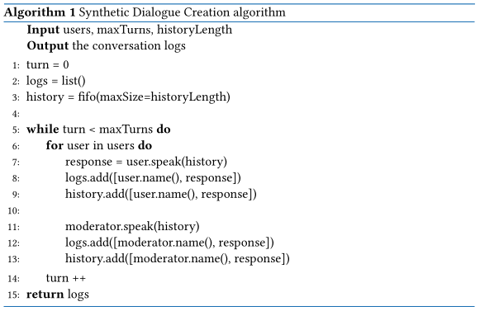
Synthetic Dialogue Creation algorithm

Slide 65
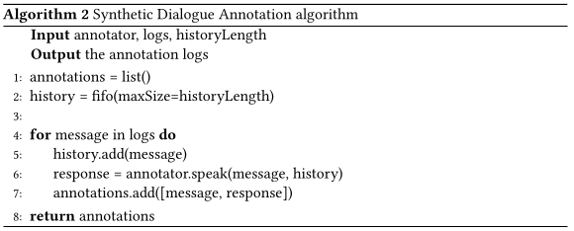
Synthetic Dialogue Annotation algorithm

Slide 66
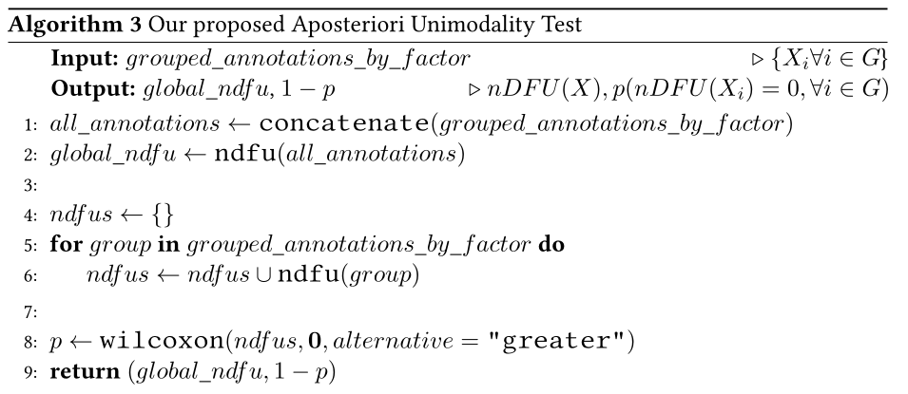
The Aposteriori Unimodality Test

Slide 67
Theoretical Base

Slide 68
Self-talking LLMs
Self-play in Reinforcement Learning
  An agent learns by playing against itself
Ulmer et al. 2024: Why not apply the same method to LLMs?
  Most conversations are low-quality; they are repetitive, off-topic, the client goes on long rants, ...
  Careful selection and rigorous tuning yields some high-quality conversations
Notes:
Very briefly

Slide 69
SimReddit
Sung et al 2022: “social simulacra”
  Simulated discussions between many users, with many topics, by LLMs
One LLM instance is used to generate a top-level post, as well as subsequent comments made by different users
  Prompt includes personality characteristics, user intent (e.g. helpful, troll, …) as well as community rules and guidelines

Slide 70
Discourse as a game
Abdelnabie et al 2023: Transform negotiation as scorable negotiation games involving multiple parties
  Non-zero-sum games encouraging cooperation and competition.
  Games can be compromising, greedy, adversarial e.t.c.
Roles with different powers and agendas
  Proposer: Manages and invests in the project.
  Resource Manager: Provides budget, holds veto power.
  Others: Beneficiaries, constraint-imposers, opposers, e.t.c.
Notes:
Very briefly
Resource Manager = facilitator: veto
Others=users: different intents

Slide 71
Conclusions
Synthetic dialogues between LLMs tested and can work
  Many difficulties and challenges
Emphasis on prompting and evaluating the discussions
Setups simple and intuitive
No specialized models necessary – Finetuning optional and usually reserved for specific needs
Modeling discussions as games, and users as players with motivations, may produce more authentic dialogues

Slide 72
Sources (2/3)
Theoretical Base
  Social Simulacra: Park, J.S., Popowski, L., Cai, C.J., Morris, M.R., Liang, P., & Bernstein, M.S. (2022). Social Simulacra: Creating Populated Prototypes for Social Computing Systems. Proceedings of the 35th Annual ACM Symposium on User Interface Software and Technology.
  Self-Talking LLMs: Jack Urbanek, Angela Fan, Siddharth Karamcheti, et al. “Learning to Speak and Act in a Fantasy Text Adventure Game”. In: Proceedings of the 2019 Conference on Empirical Methods in Natural Language Processing and the 9th International Joint Conference on Natural Language Processing (EMNLP-IJCNLP).
  Socio-demographic prompting: Tilman Beck, Hendrik Schuff, Anne Lauscher, and Iryna Gurevych. “Sensitivity, Performance, Robustness: Deconstructing the Effect of Sociodemographic Prompting”. In: Proceedings of the 18th Conference of the European Chapter of the Association for Computational Linguistics
  Negotiations as games: Abdelnabi, S., Gomaa, A., Sivaprasad, S., Schonherr, L., & Fritz, M. (2023). Cooperation, Competition, and Maliciousness: LLM-Stakeholders Interactive Negotiation.

