Slide 1
THE MODERATION GAME: PRELIMINARY RESULTS
Dimitris Tsirmpas 2024
AUEB CAPSTONE & AthenaRC

Slide 2
Research goals
Create synthetic discussions with LLMs
  “Online” discussions on controversial topics
  Include a LLM moderator (facilitator)
Investigate prompts useful for:
  The LLM users: realistic, convincing LLM interactions
  The LLM moderator: efficiently facilitate the discussion
Use LLM annotation to quantify conversation quality
  Use toxicity for these experiments
Dimitris Tsirmpas 2024
AUEB CAPSTONE & AthenaRC

Slide 3
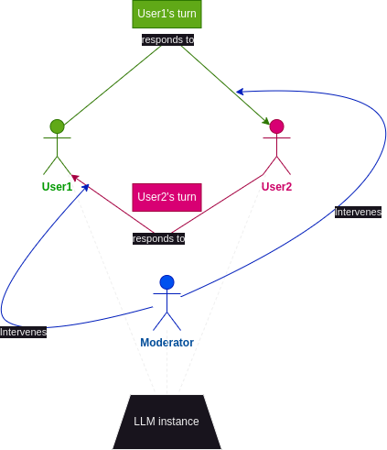
Experimental Setup: Conversation
Single LLM for all 3 actors in the discussion
Users respond to each other; the moderator jumps in when necessary
Encourage users to be contentious
Each actor is given a socio-demographic background (SDB)
  For example, user1 is an African American, user2 is LGBTQ+
Dimitris Tsirmpas 2024
AUEB CAPSTONE & AthenaRC

Slide 4
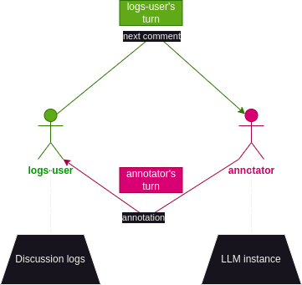
Experimental Setup: Annotation
Task the same LLM instance to go through each post in the conversation and decide on a classification score for any conversation-quality metric
Use SDB prompts for the annotators as well
Dimitris Tsirmpas 2024
AUEB CAPSTONE & AthenaRC

Slide 5
Experimental SETUP: USER PROMPTS
“Moderation game” prompt
“VANILLA” PROMPT
Defend your position
May attack the other participants’ views
Must heed the moderator’s warnings when in risk of getting banned
Point system (LLM with most points “wins”)
Being stubborn and provoking the other user yields positive points
Getting banned drastically reduces points
Dimitris Tsirmpas 2024
AUEB CAPSTONE & AthenaRC

Slide 6
Preliminary results
Dimitris Tsirmpas 2024
AUEB CAPSTONE & AthenaRC

Slide 7
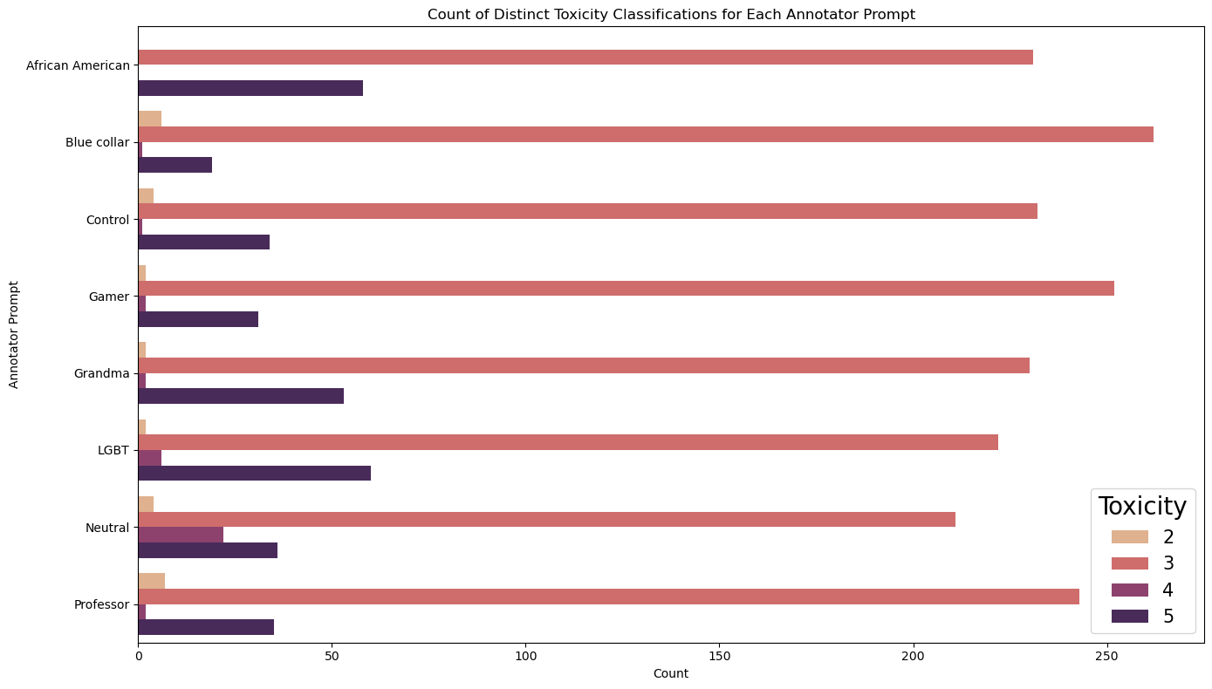
Results: Annotator SDB
Most comments moderately toxic (may be caused by our user instructions)
Differences mostly in what is considered “very” or “extremely” toxic
Dimitris Tsirmpas 2024
AUEB CAPSTONE & AthenaRC

Slide 8
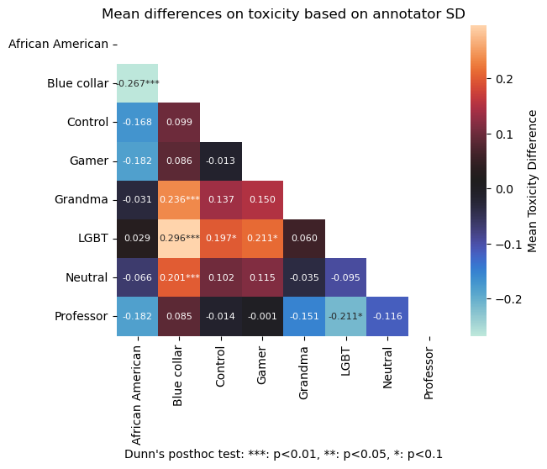
Results: Annotator SDB
Annotator SDB influences toxicity classification (Kruskall Test p<2e-8)
Influence relatively muted in qualitative terms (at most ±0.3 toxicity on average)
Dimitris Tsirmpas 2024
AUEB CAPSTONE & AthenaRC

Slide 9
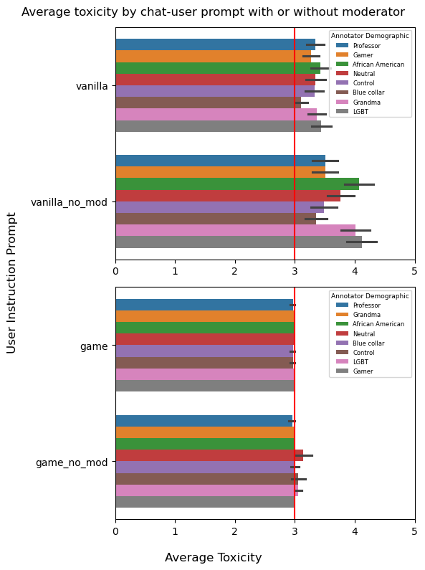
Results: User Instructions
User-instruction prompt templates used with, and without LLM moderator
LLM annotator ratings by SDB
Dimitris Tsirmpas 2024
AUEB CAPSTONE & AthenaRC

Slide 10
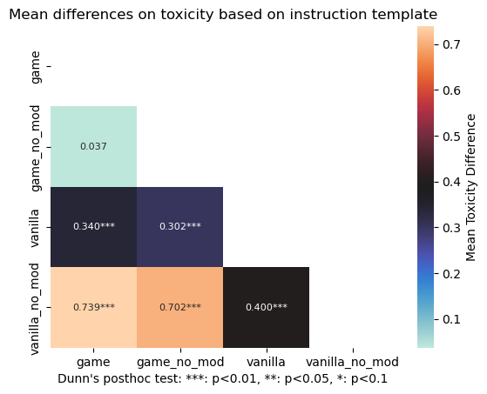
Results: User Instructions
Moderator presence in the “Moderation Game” prompt shows no statistically significant difference in toxicity
Significant differences between all instruction templates
Dimitris Tsirmpas 2024
AUEB CAPSTONE & AthenaRC

Slide 11
Conclusions
Moderator presence can significantly change the toxicity level in LLM-executed conversations
The Moderation Game in its current form fosters below-average toxicity, with or without a moderator
Annotations are relatively objective across different SDBs; differences between annotators are statistically significant, but qualitatively marginal
Dimitris Tsirmpas 2024
AUEB CAPSTONE & AthenaRC

Slide 12
Questions?
Dimitris Tsirmpas 2024
AUEB CAPSTONE & AthenaRC

