Slide 1
Simulating online discussions & moderation using LLMs
Dimitris Tsirmpas
Athens University of Economics and Business

Slide 2
Why simulate discussions?
Goal: Research ways to make LLM moderators effective
Plan: Monitor “online” discussions with different LLM moderators
Problem: Human involvement is costly and time consuming
Solution: Prototype the LLM moderators on synthetic discussions instead
  Cheaper, easier, allows easy A/B testing
  Enables bulk generation of data => enables data analysis

Slide 3
Simulating the discussions

Slide 4
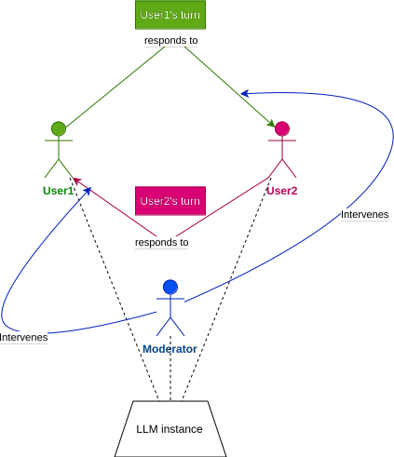
Experimental Setup (1/2)
Single LLM for all 3 actors in the discussion
  Two users, one moderator
Start the discussion with a given controversial topic
Users respond to each other, the moderator jumps in when necessary

Slide 5
Experimental Setup (2/2)
Each actor is given a socio-demographic prompt
  For example, user1 is an African American, user2 is LGBT
The moderator has the power to ban a participant
  Ends the discussion

Slide 6
Challenges
LLMs often produce low-quality conversations
  Unrealistic dialogue, stereotype-heavy language, conversational collapses are common
LLMs very sensitive to prompting
  As of now, no template in literature which guarantees good results
Bulk generation of data means heavy data loads
  Need automated filtering and classification procedures (for example, automated toxicity classification)

Slide 7
Analyzing discussion quality

Slide 8
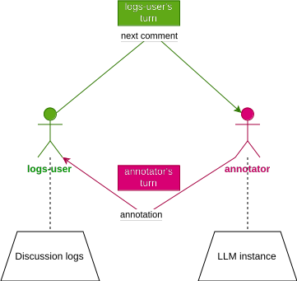
Annotating the discussions (1/2)
Automated annotation: use LLMs again!
Can annotate for almost any metric
  Toxicity, relevance, clarity, consensus
Task the same LLM instance to go through each post in the conversation and decide on a classification score

Slide 9
Annotating the discussions (2/2)
Why not use socio-demographic prompts for the annotators as well?
  e.g. African American / LGBT annotators may perceive comments as more toxic than white Americans
Enables us to analyze inter-annotator agreement
Re-use conversational framework

Slide 10
Possibilities for analysis

Slide 11
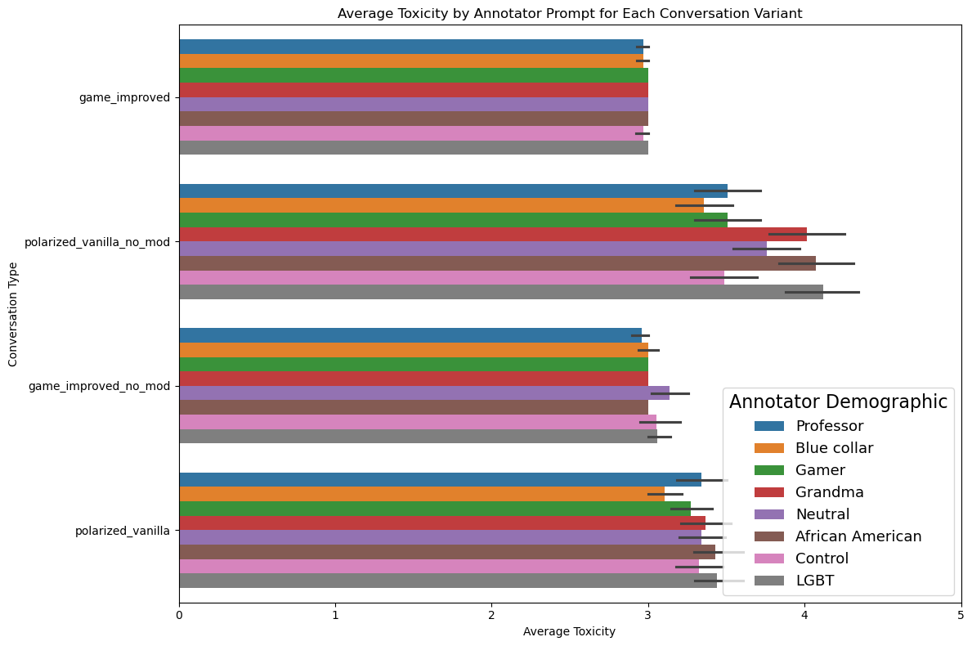
Possibilities for analysis (1/2)
Analyze the impact of moderator / prompt templates...

Slide 12
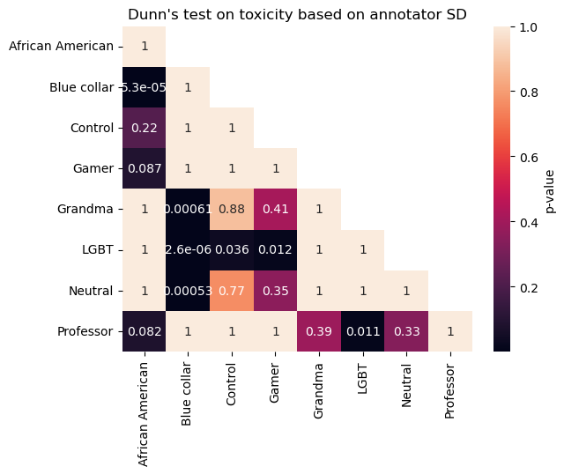
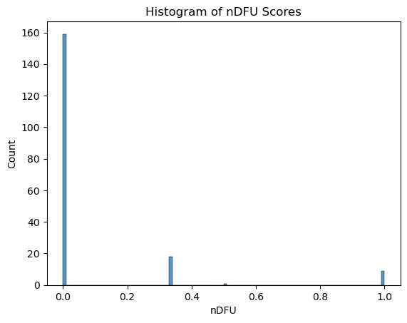
Possibilities for analysis (2/2)
… or even the consistency of LLM annotators and effects of different annotation personas.

Slide 13
Implementation

Slide 14


Implementation
Ready-to-use frameworks for conversational LLMs
  Concordia, LangChain, e.t.c.
  Complex API, strict hardware requirements
Instead develop custom library
  Simple API, can be extended for any LLM
  Efficient hardware and computational needs

Slide 15
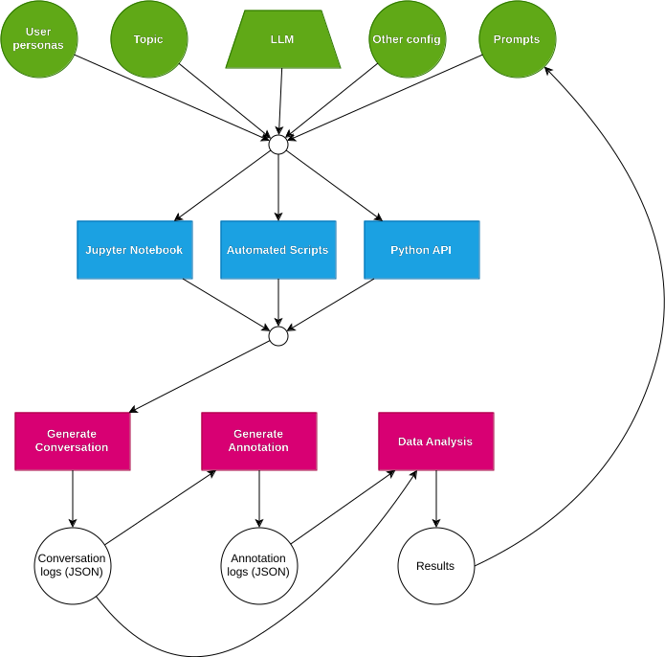
Features
Arbitrary amount of “users” with different personas
Custom JSON schema supporting:
  automated conversation creation
  data analysis on finished conversations
Called by provided notebook, as automated script (defining parameters in JSON) or directly through Python

Slide 16
Questions?

