Slide 1
Pisa 2018: Gender Disparities and Analysis of Greek Scores
Dimitrios Tsirmpas
Data visualization and communication
MSc in Data Science
Athens University of Economics and Business

Slide 2
What are we talking about?
Data from “Programme for International Student Assessment” (PISA) 2018
Global survey conducted by the Organisation for Economic Co-operation and Development (OECD)
Compares the academic performance of 15-year-old students in mathematics, science, and reading literacy across countries.
We analyze the standing of Greece compared to other countries and the existence of “gender” gaps between scores

Slide 3
What are we talking about?
Greek vs global scores
How do Greek students compare:
  to other countries?
  to European countries?
In which subjects did they do better/worse compared to their international peers?
Gender gaps
Is there a gap between female and male scores?
  If so, in which countries?
  Does population/economic prosperity/geography influence that gap?
In which subjects do female/male students outperform the other gender?

Slide 4
Caveats
The data is comprised of 80 countries with significant geographical biases
  Only one country is represented in Africa (Morocco)
The GLCM test is conducted on much fewer countries (notably none in Oceania)

Slide 5
Comparing Greek and international scores

Slide 6
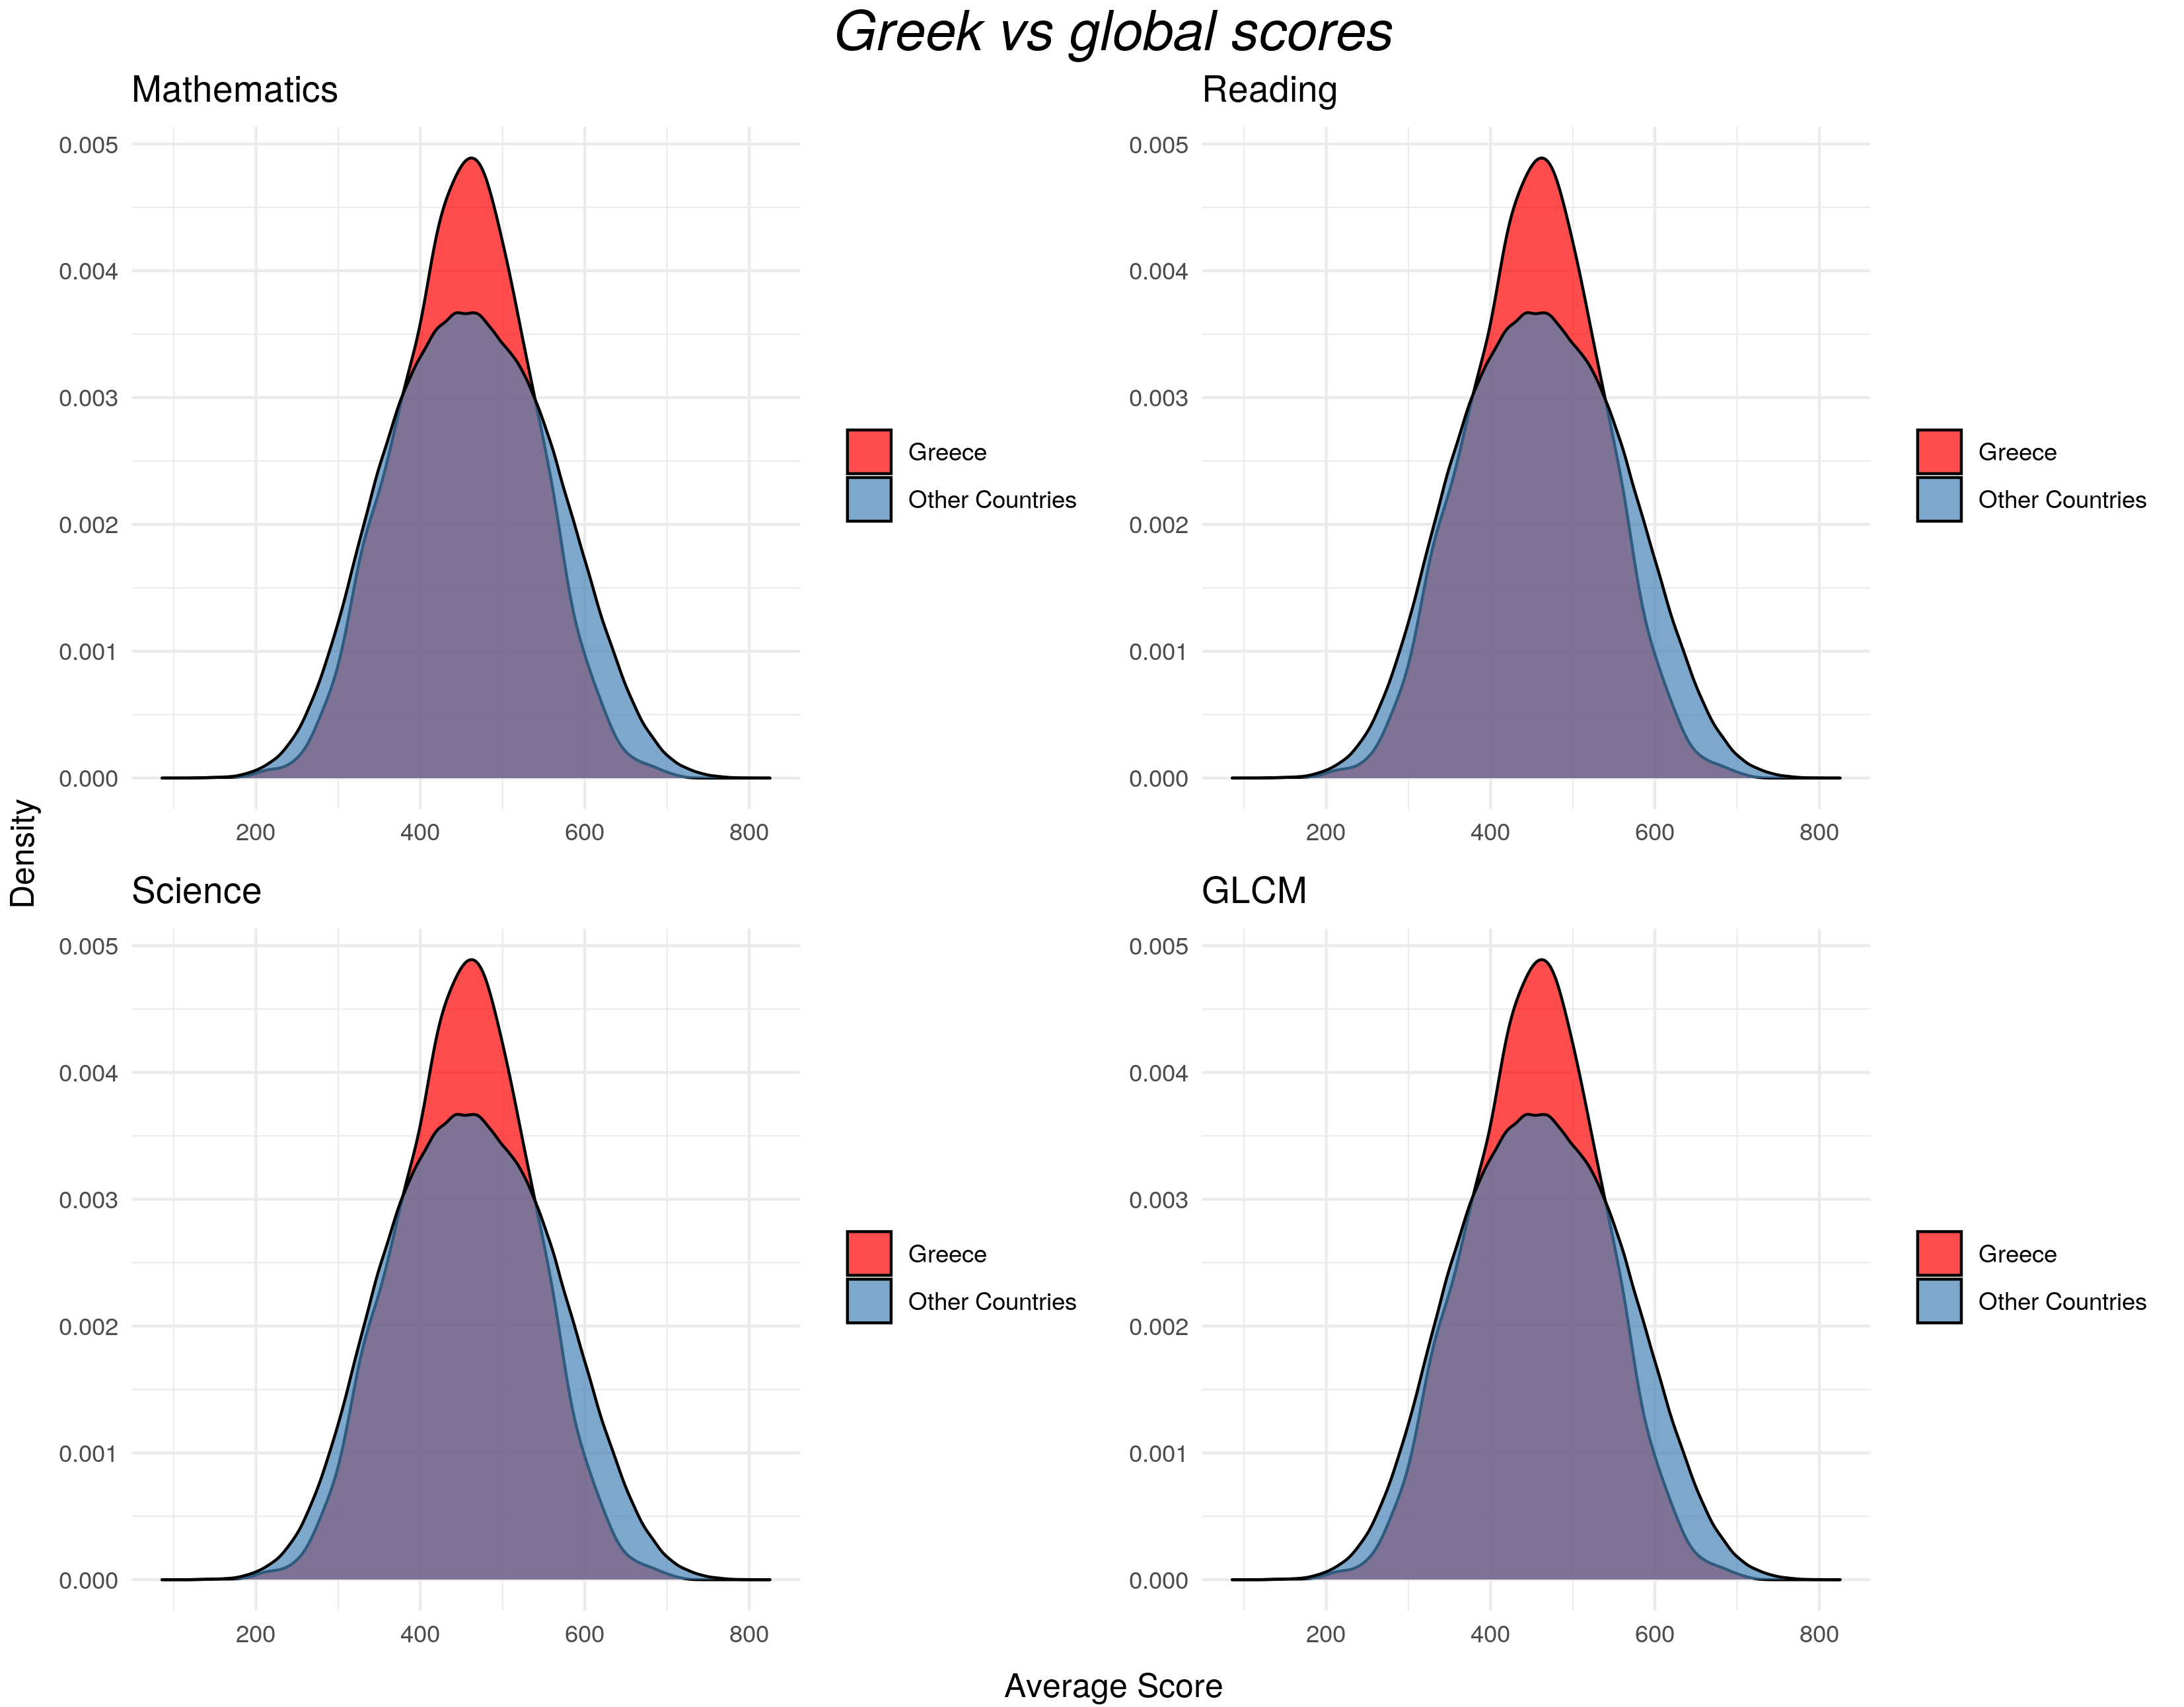
Comparing Greek and international scores
Greek scores in general are comparable to international scores
  They feature roughly the same mean score on all subjects
  The smaller variance is expected (one sample population vs multiple)

Slide 7
Comparing Greek and international scores
The international score distribution is not symmetric, unlike the Greek one
  There is a substantial “right tail”, indicating a higher percentage of international students who scored higher than Greek students

Slide 8
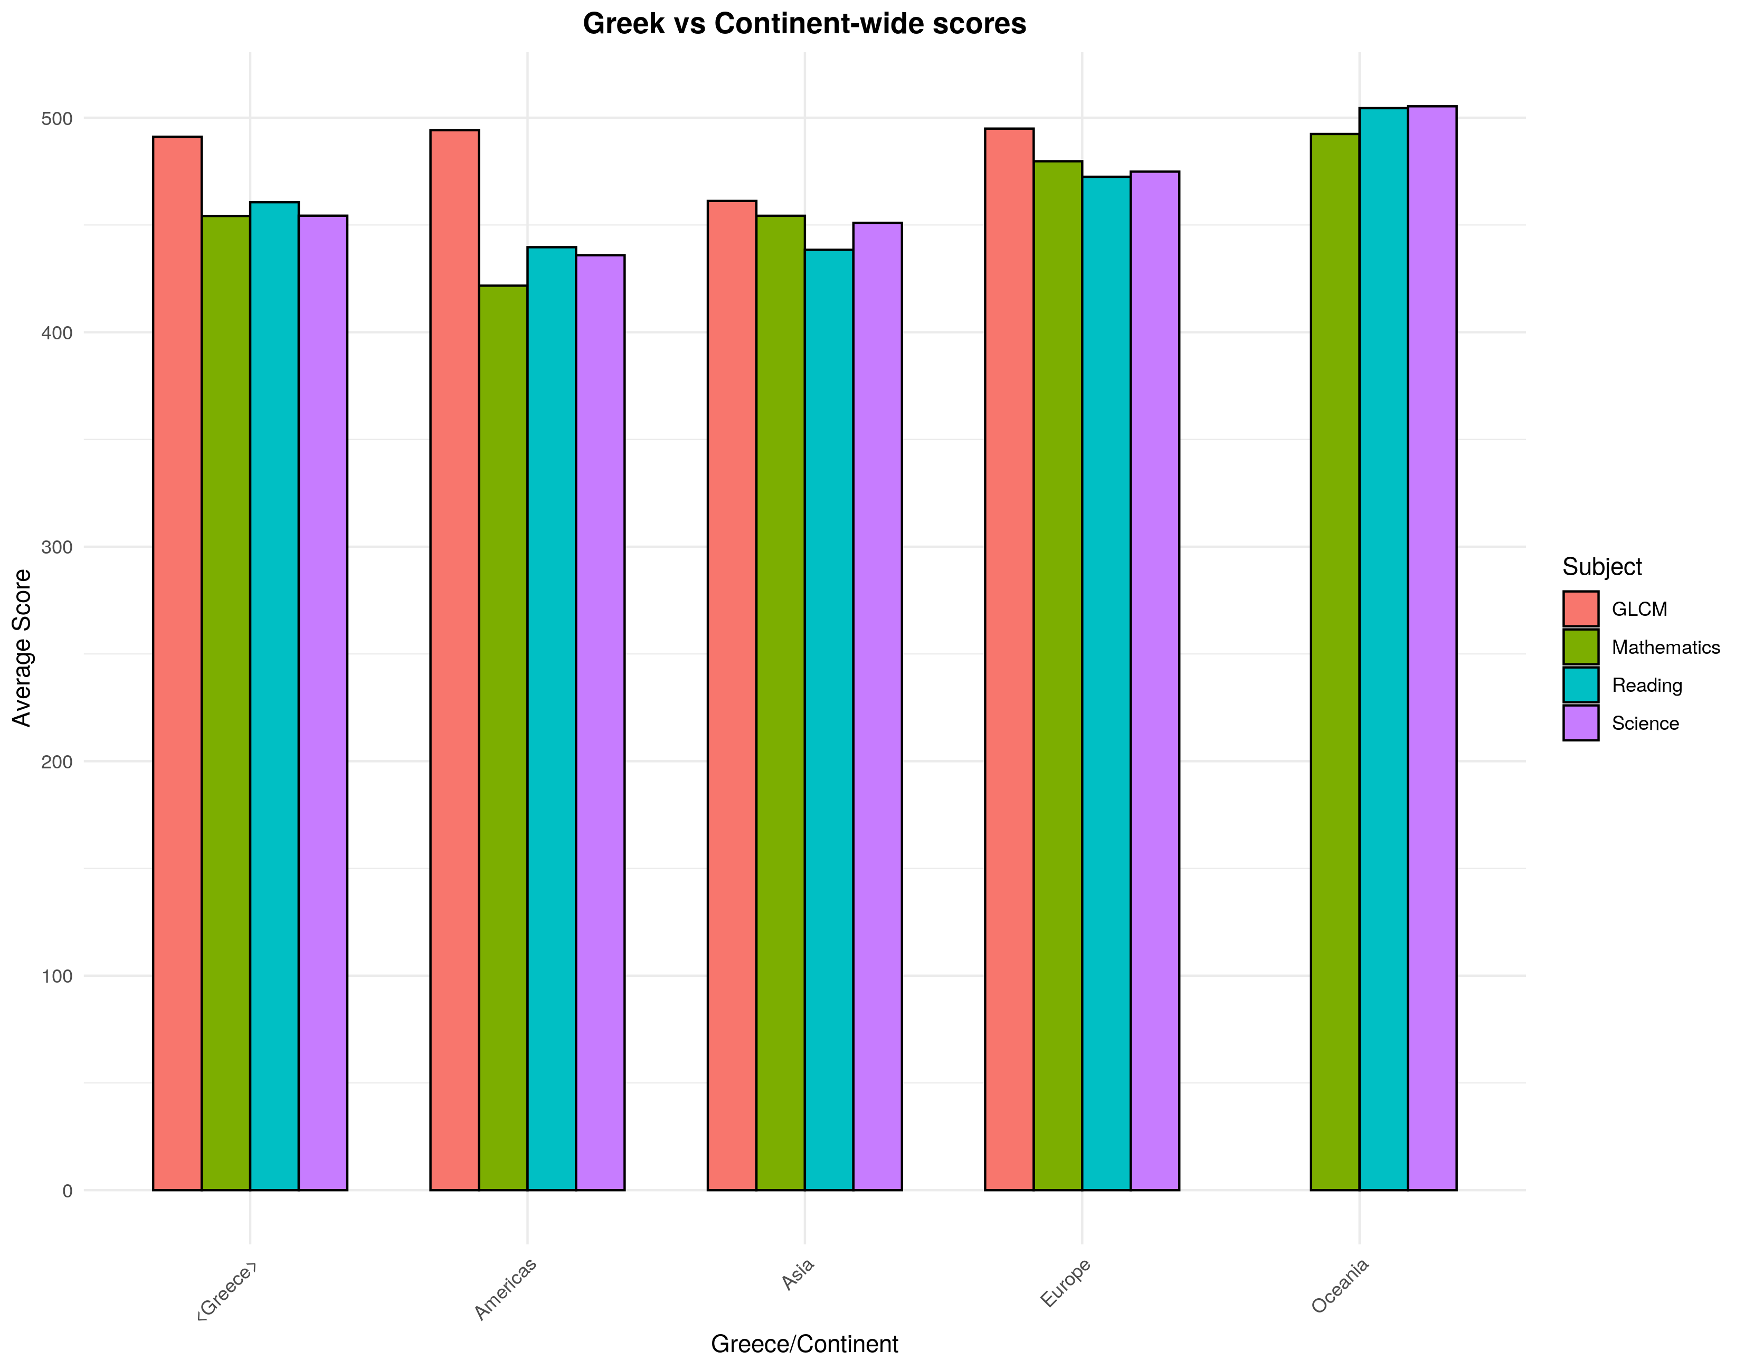
Comparing Greek and international scores
Greece (1st bar) seems to, on average, outperform countries from Africa and the Americas.
Greece also beats Asia on GLCM scores.
European, Asian and Oceanic countries generally outperform Greek students however.

Slide 9
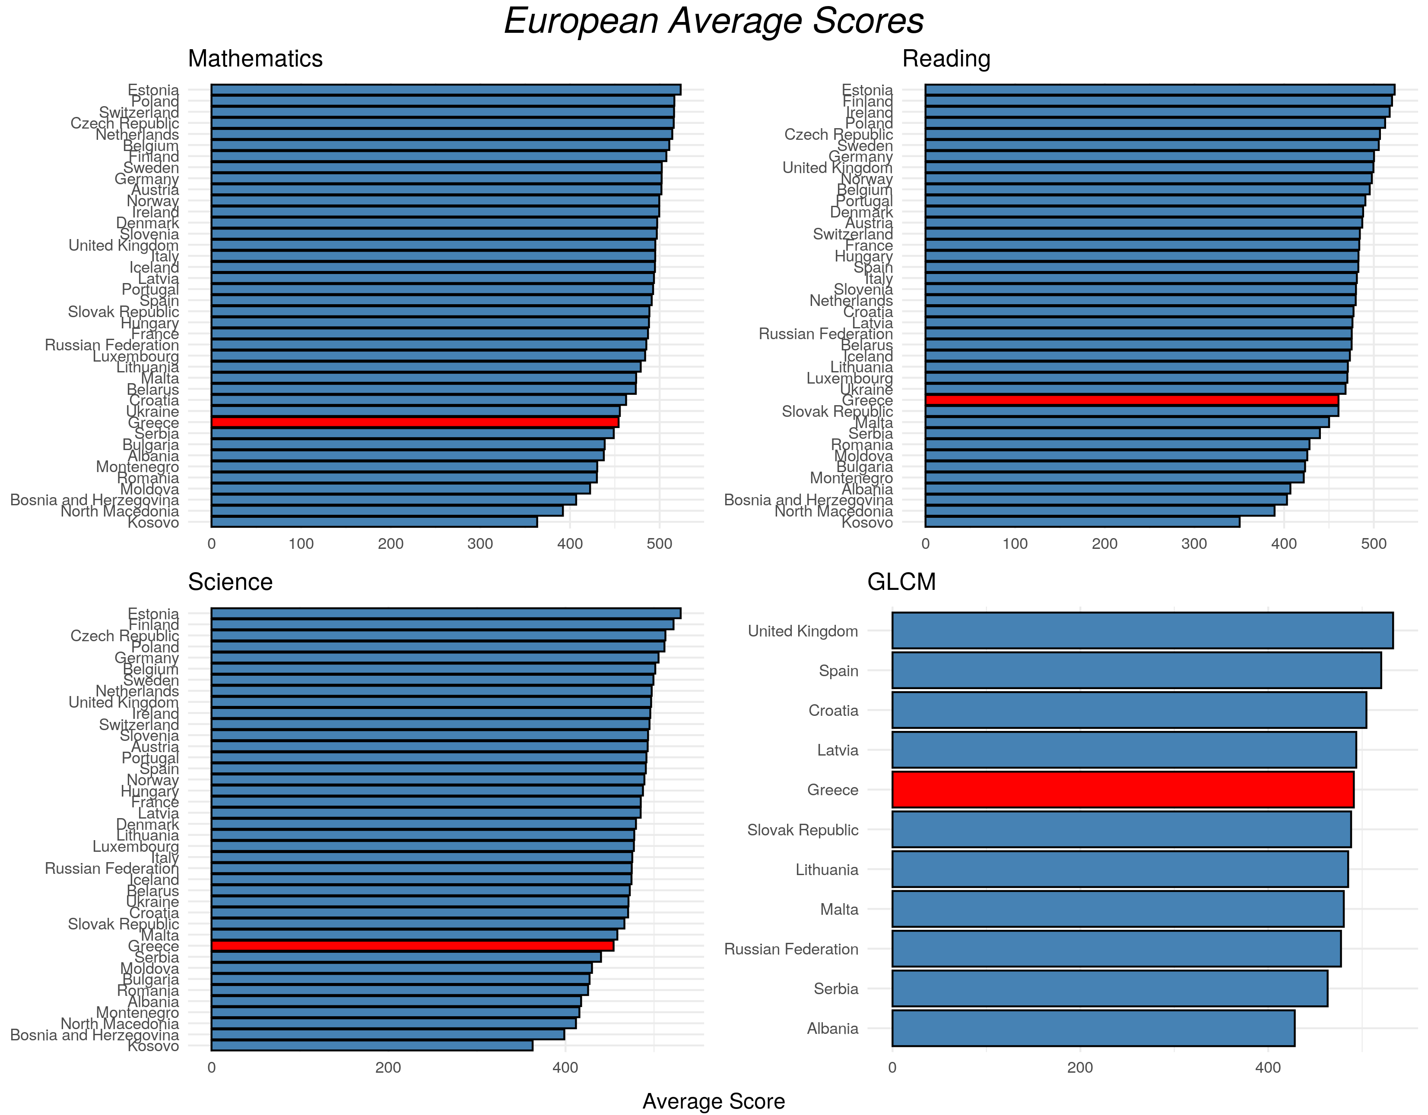
Comparing Greek and international scores
Greece scores worse than most European countries in mathematics, reading and science
While surpassed by Central and Northern European countries, it eclipses most Balkan countries
Greece scores higher than average in the GLCM test

Slide 10
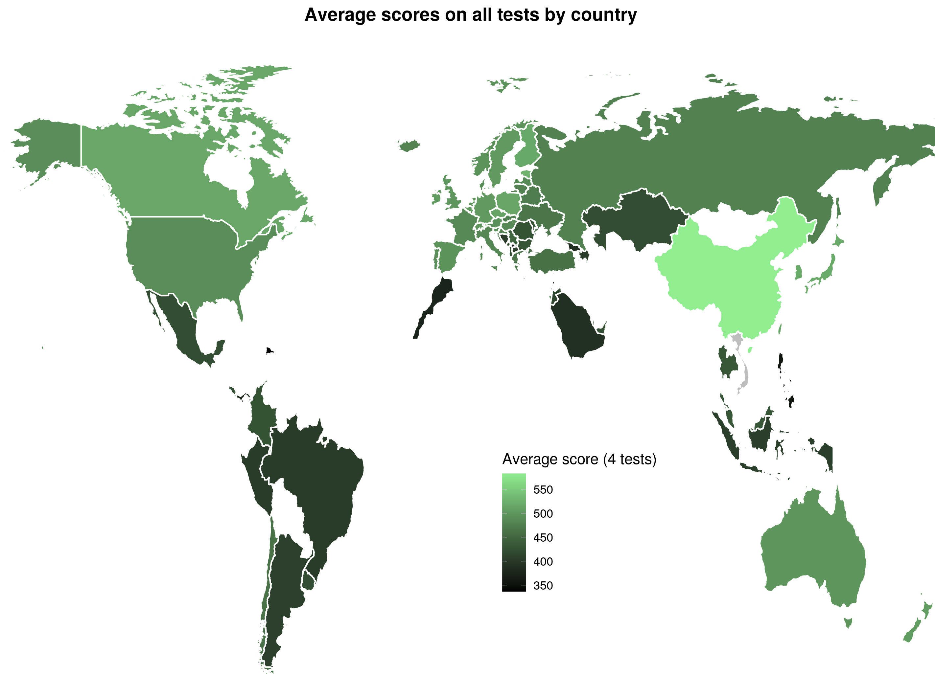
Comparing Greek and international scores
Geographical location is correlated to average test scores
Greece scores better than comparatively less developed nations in Latin America, the Balkans and Asia
...but is surpassed by comparatively wealthy countries

Slide 11
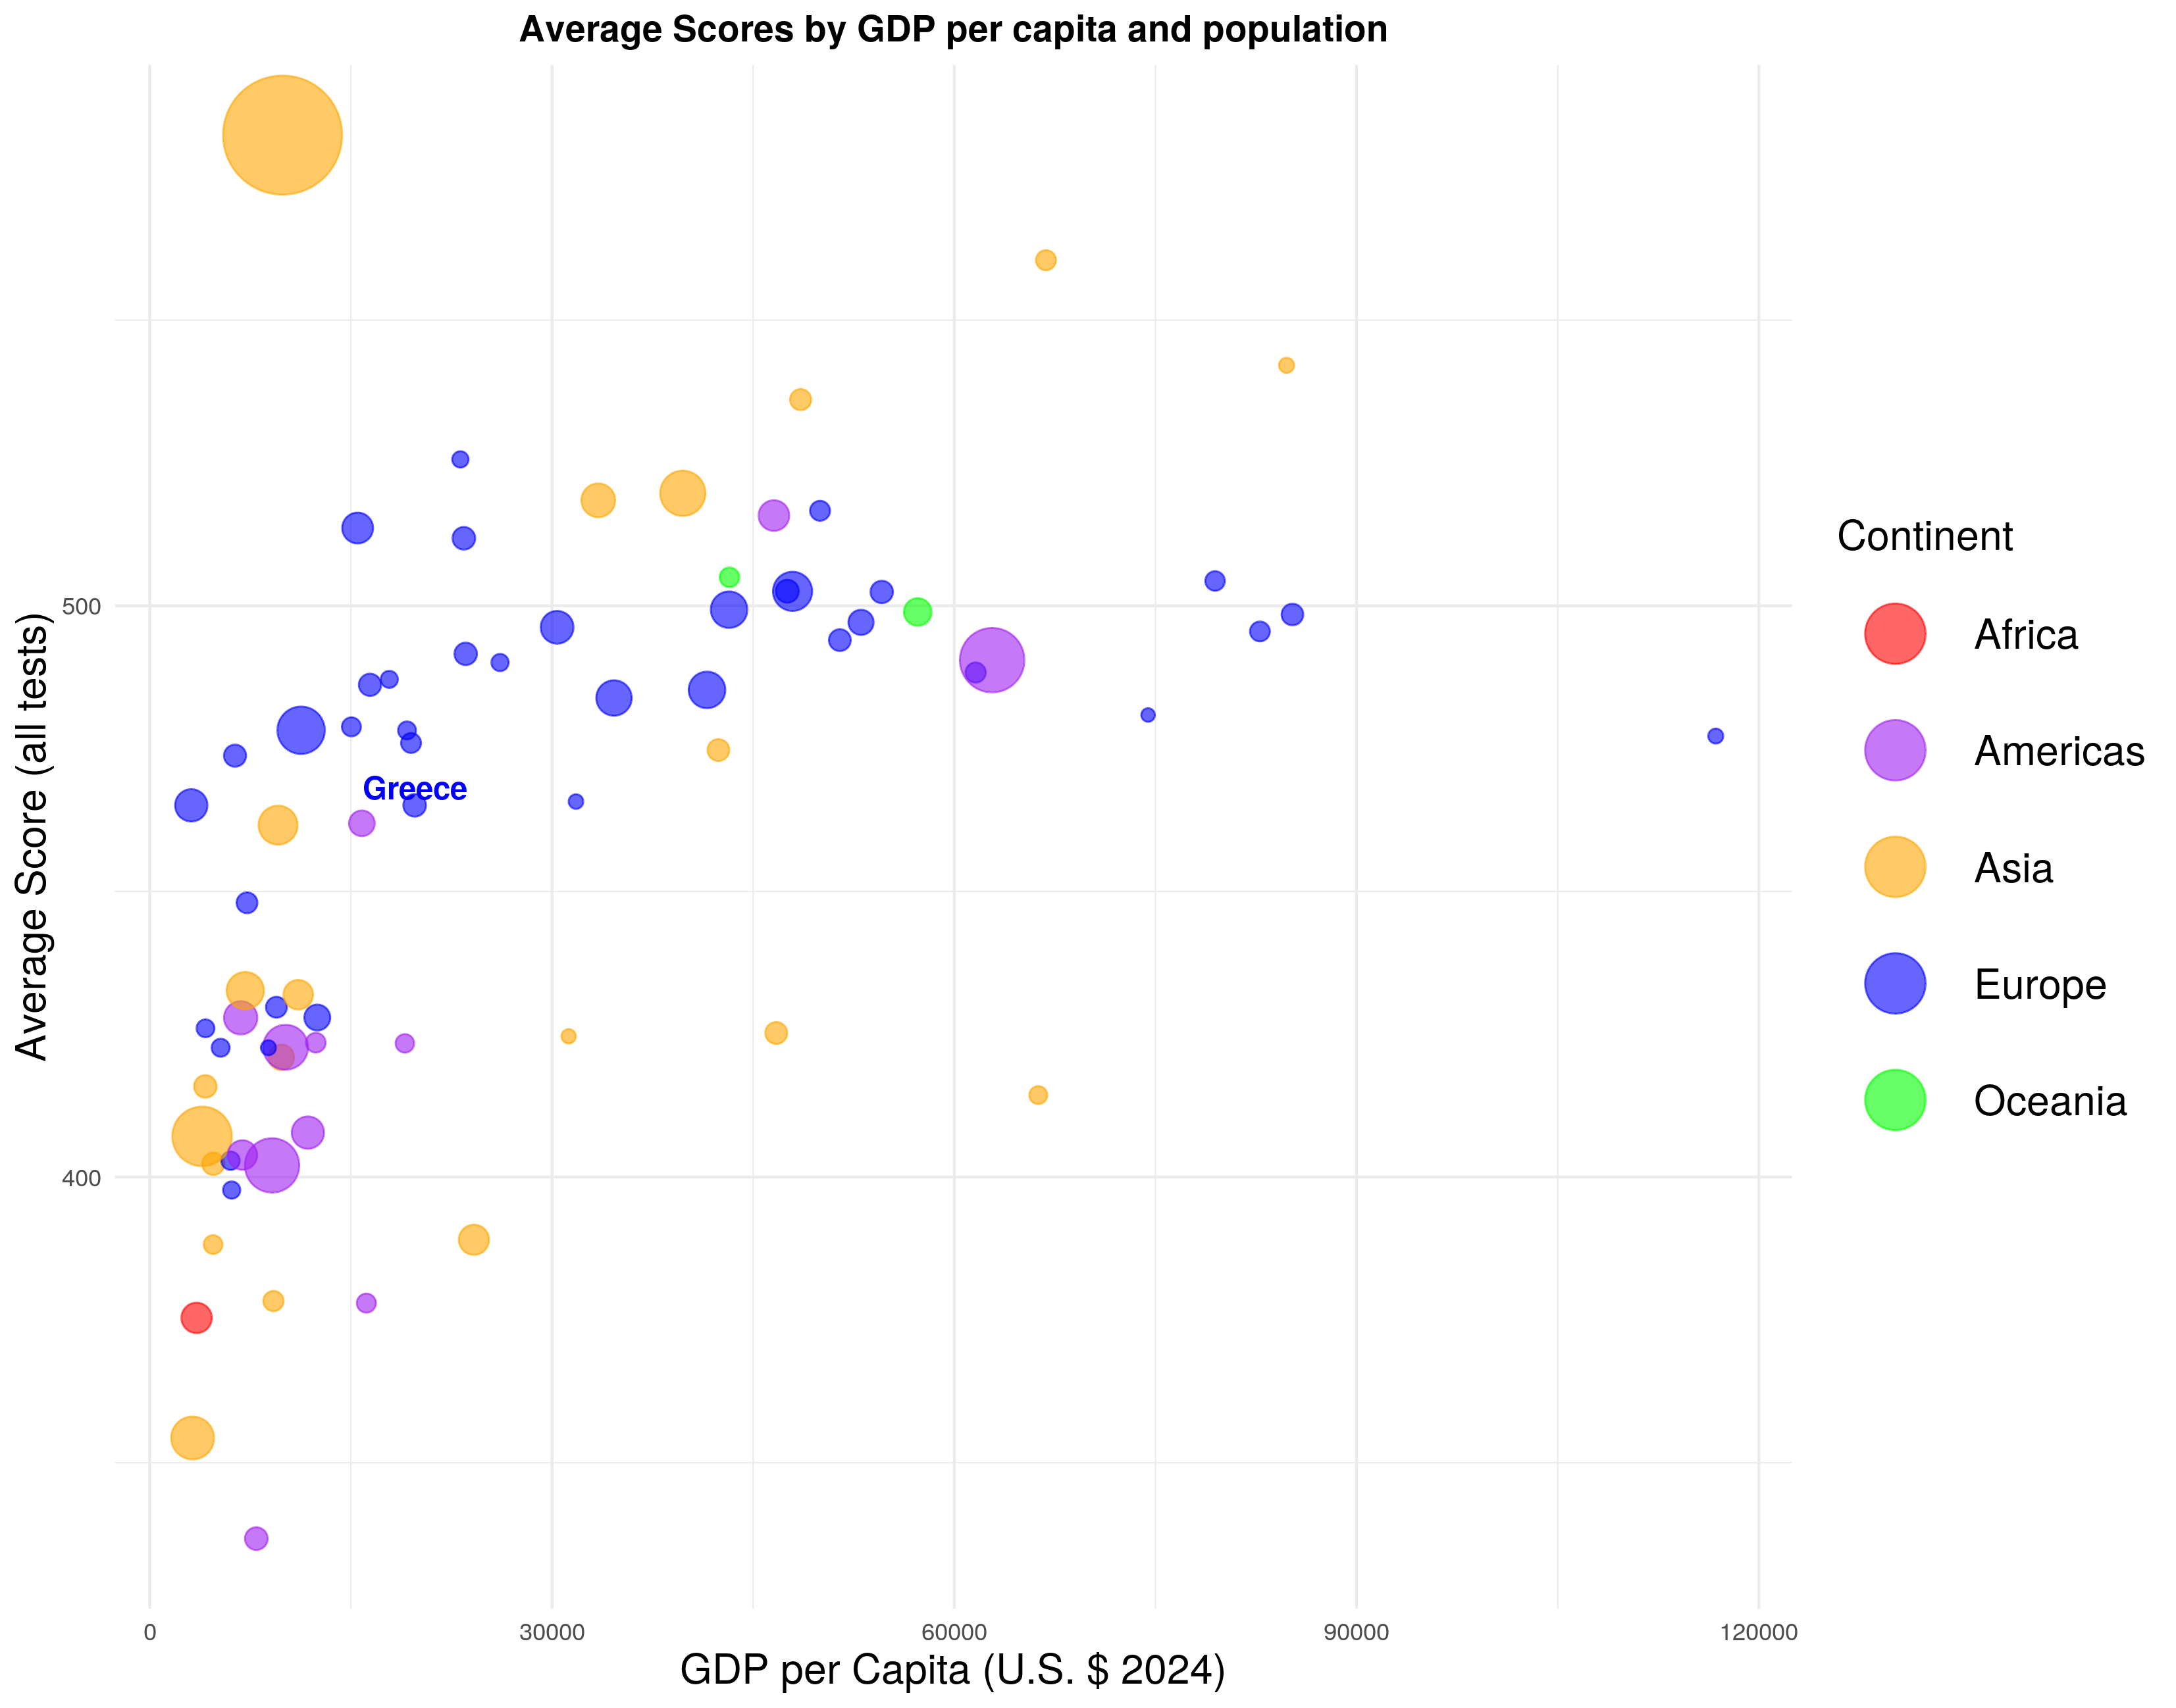
Comparing Greek and international scores
Average test scores seem to be correlated with GDP per capita and continent
  Not so much with population
Greece performs worse on average compared to most countries with similar economic status

Slide 12
Analyzing the gender gap

Slide 13
Defining the gender gap
We define the gap between female and male grades as follows:
Diff = avg(female_grades) – avg(male_grades)
Where avg() is the mean of all 4 subjects for a specific country
If Diff > 0, then female grades are higher on average
If Diff < 0, then male grades are higher on average
If Diff = 0, then male and female grades are the same on average

Slide 14
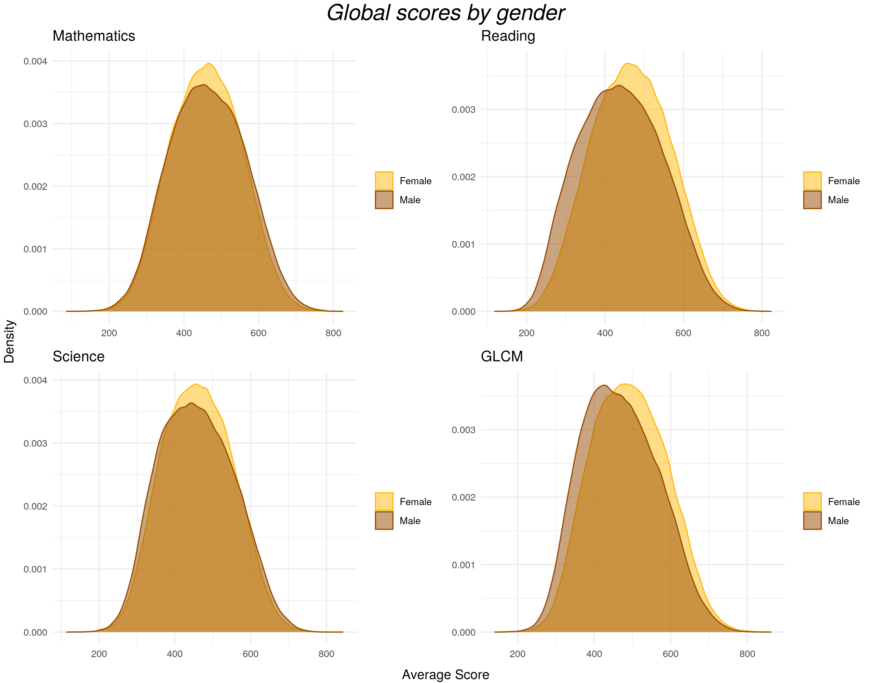
Analyzing the gender gap
In general, female and male students feature similar scores
Female students perform slightly better on the Reading and GLCM tests
This difference is less apparent, or even reversed, on the Math and Science tests

Slide 15
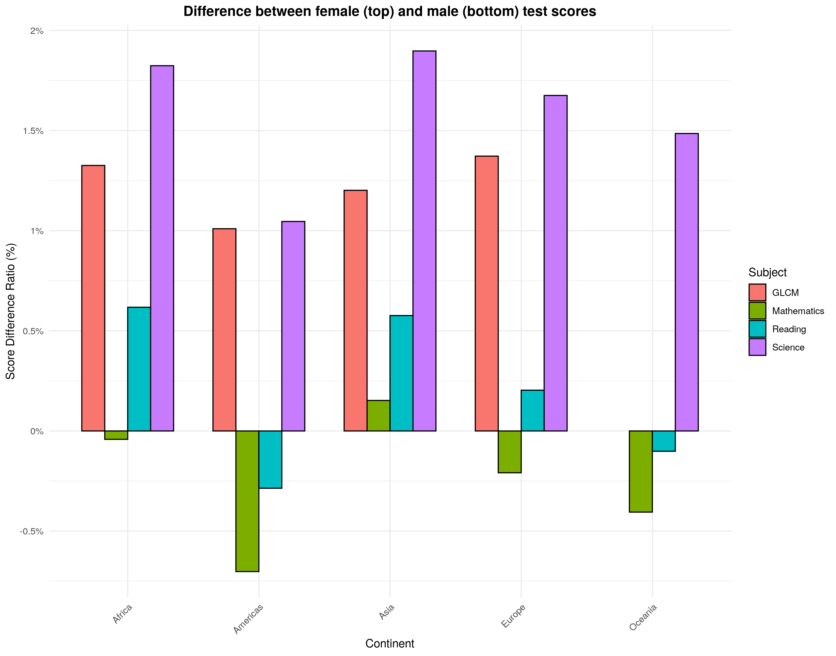
Analyzing the gender gap
On all continents, we notice a substantial (1.5%-2%) difference of female scores over male ones on Science tests, as well as a similar (1%-1.5%) consistent GLCM difference
Male students on all continents but Asia, slightly outperform female students on Math tests
Reading scores are the most balanced, with interesting geographic variations

Slide 16
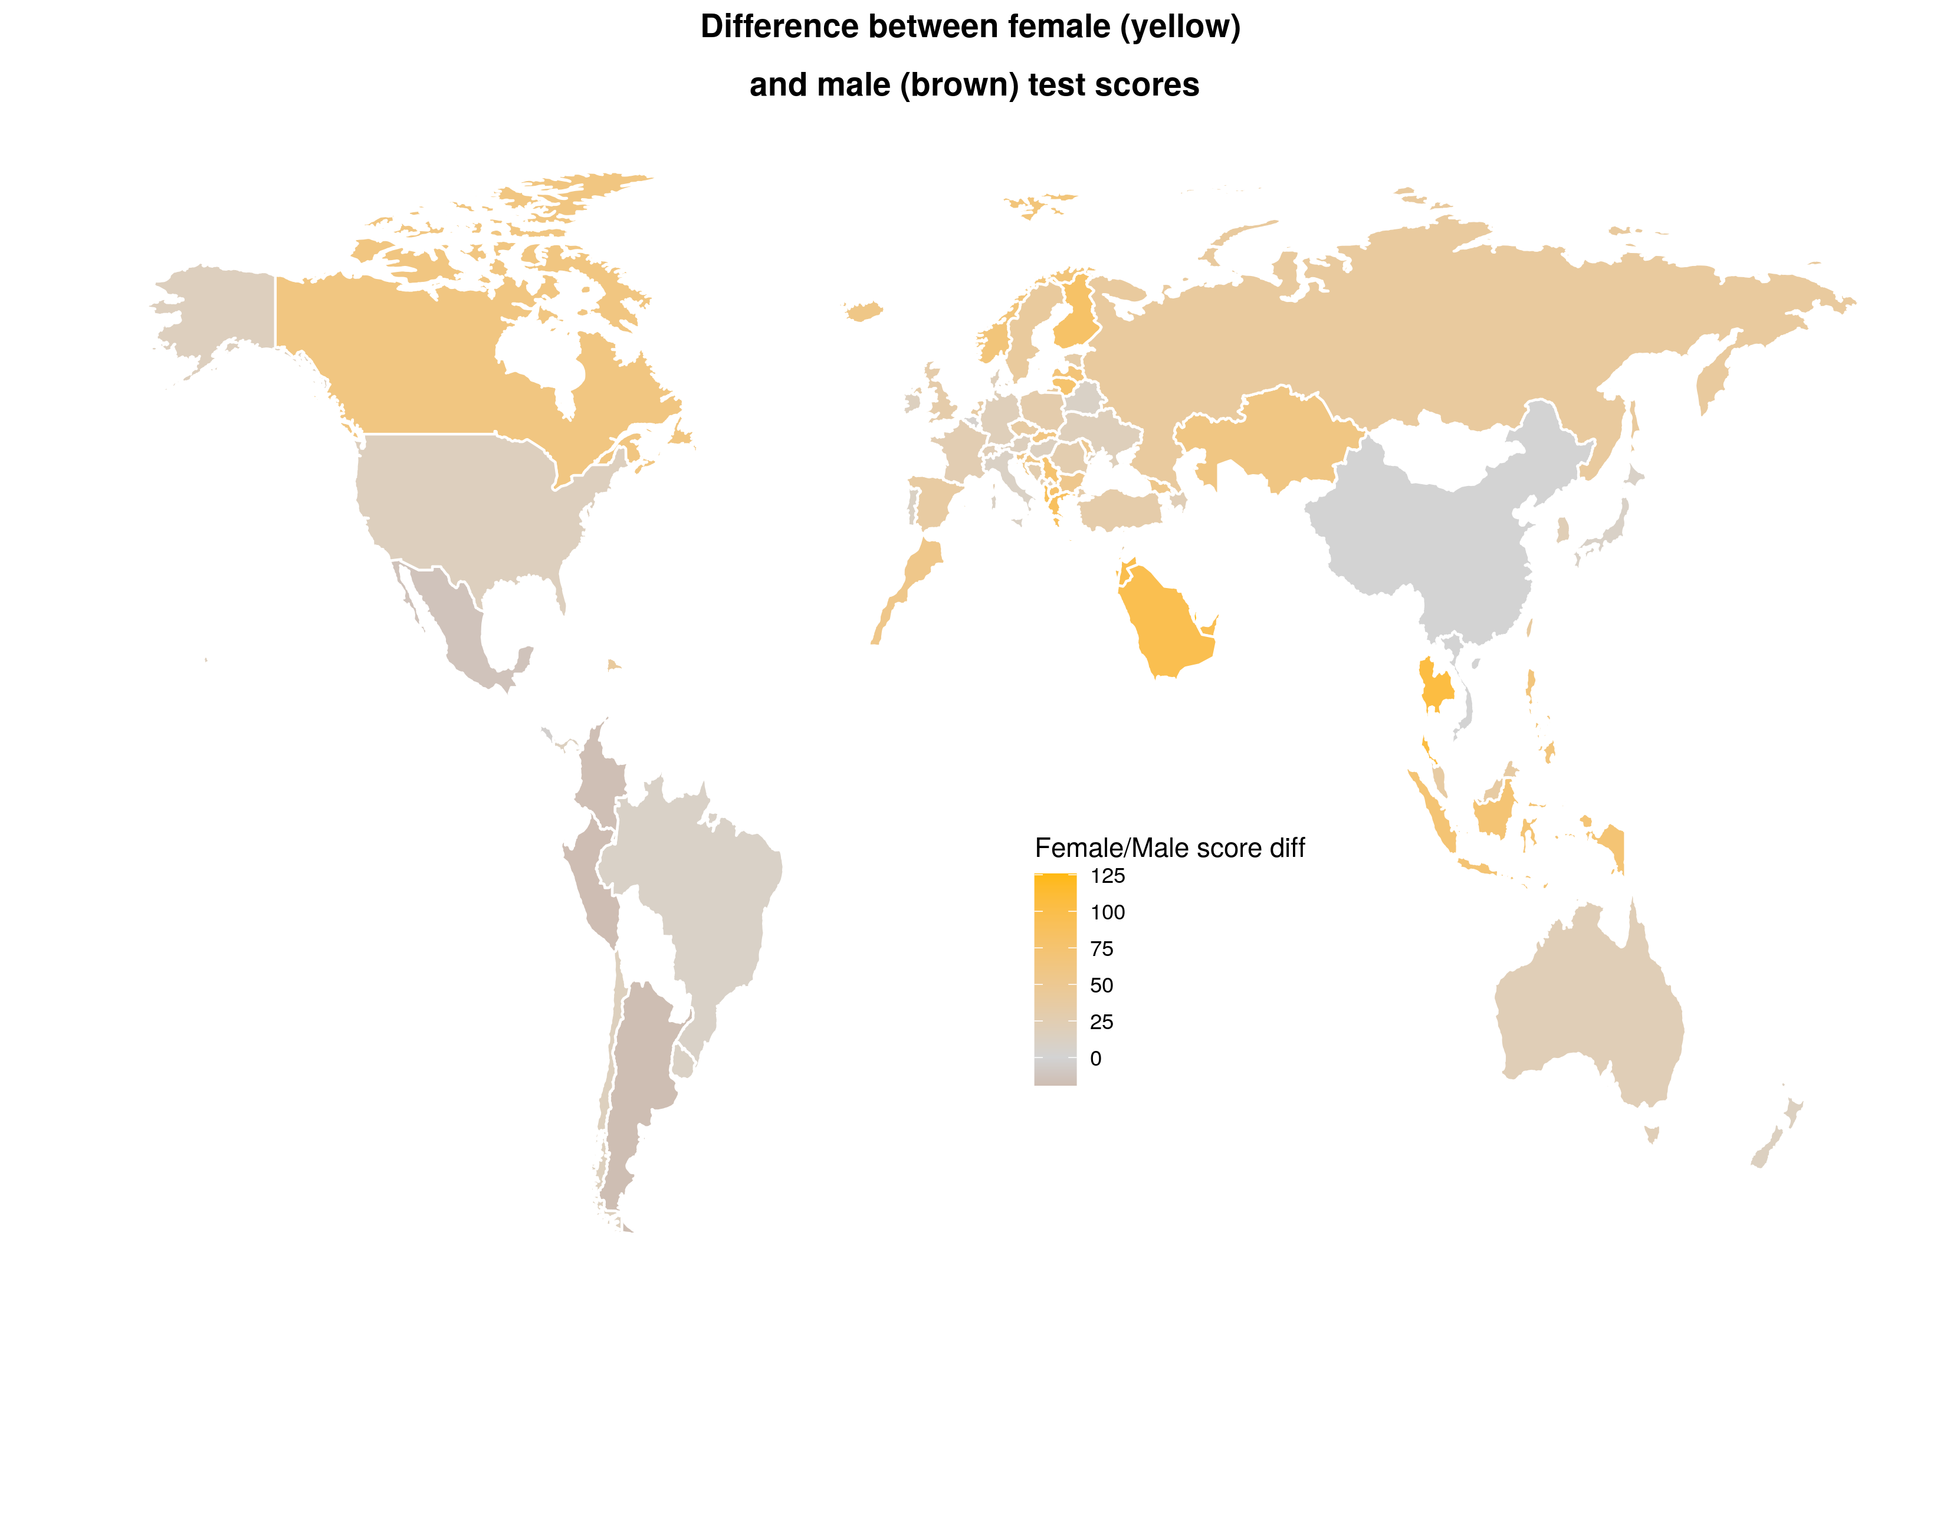
Analyzing the gender gap
Female-dominated scores are common across the board
  The difference is more notable in Europe, the Indo-Pacific and, strangely, Saudi Arabia
  It is negligible or even reversed in South America and East Asia

Slide 17
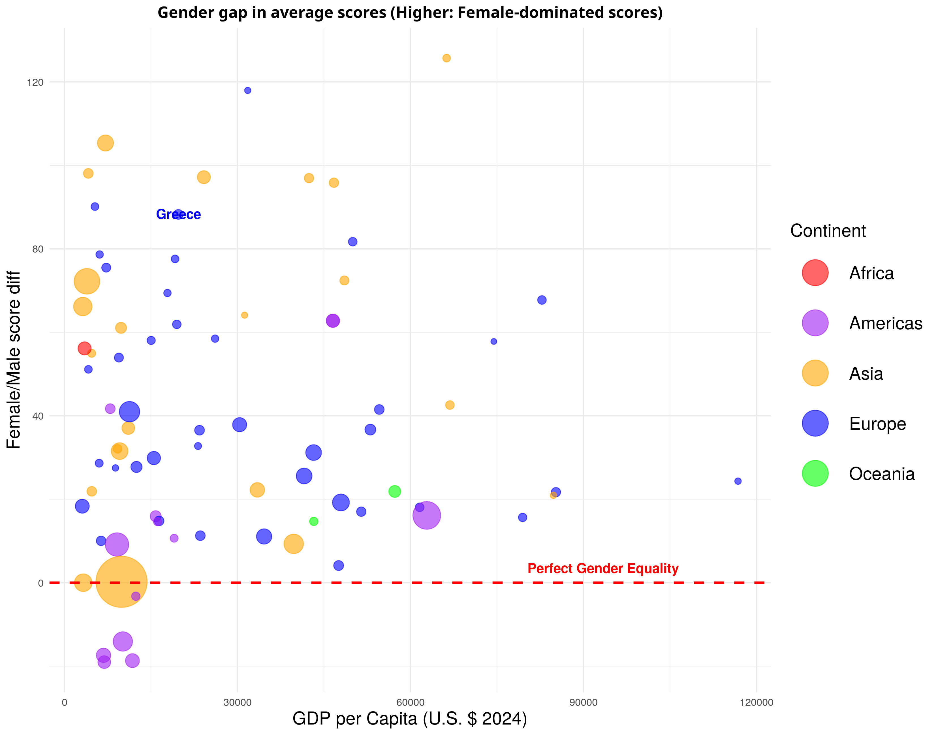
Analyzing the gender gap
The following graph depicts gender inequality in scores by population size (bubble size), GDP per capita (x-axis) and continent (color)

Slide 18
Analyzing the gender gap
We confirm that in most countries, on average, female students score higher than male ones.
  Unlike South American nations where this is mostly reversed
It is not clear whether wealthy countries tend to suffer less from gender inequality in general

Slide 19
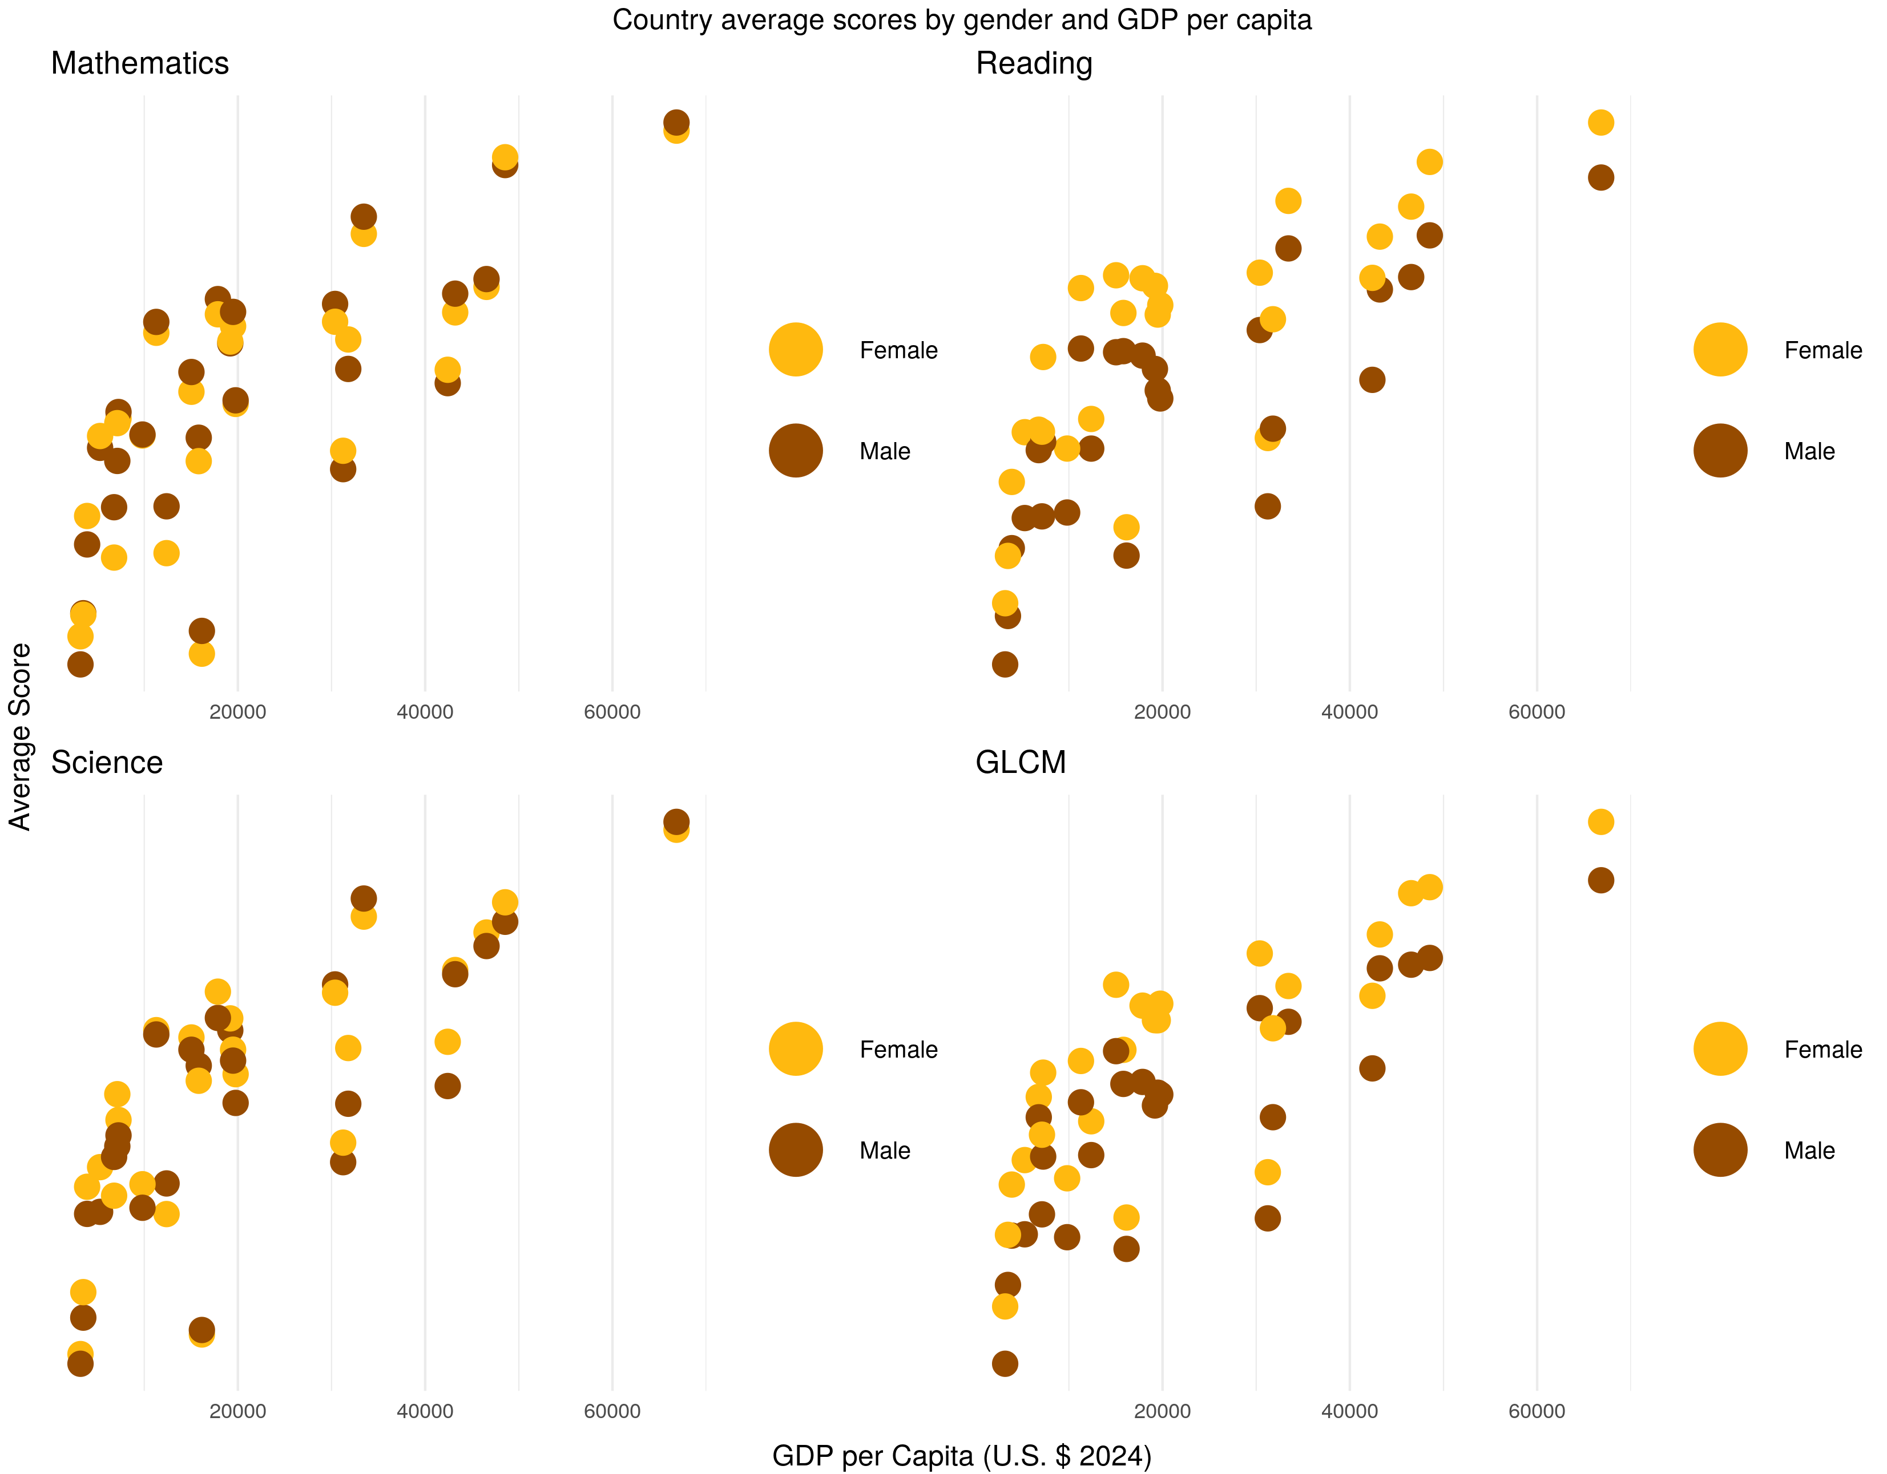
Analyzing the gender gap
There is no clear correlation between the gender gap and country wealth in the Maths and Science tests
Although female students seem to benefit more in the Reading and GLCM tests in countries with increased GDP per capita

Slide 20
Analyzing the gender gap
This does not necessarily mean that an increase in wealth causes disproportional increase in female students’ Reading/GLCM scores
It could be caused by another latent variable influencing both GDP and female-over-male performance (such as geography, as previously hypothesized)

Slide 21
Sources
Pisa 2018 data (OECD)
  https://www.oecd.org/pisa/data/2018database/
Economic and population data 2018 (World Bank)
  https://data.worldbank.org/indicator/NY.GDP.PCAP.CD?end=2018&start=2018
  https://data.worldbank.org/indicator/SP.POP.TOTL?end=

Slide 22
Questions?

