Slide 1

CpSc 8430: Deep Learning
Homework 1

Slide 2
Copy Right Notice
Most slides in this presentation are adopted from slides of text book and various sources. The Copyright belong to the original authors. Thanks!

Slide 3
Three Parts in HW1
(1-1) Deep vs Shallow:
Simulate a function.
Train on actual task using shallow and deep models.
(1-2) Optimization
(1-3) Generalization

Slide 4
HW1-1: Deep vs Shallow
Simulate a function:
function need to be single-input, single-output
function need to be non-linear
Train on actual task:
MNIST or CIFAR-10

Slide 5
HW1-1 Simulate a Function
Requirements:
train at least two different DNN models with the same amount of parameters until convergence
compare the training process of models by showing the loss in each epoch in a chart
visualize the ground-truth and predictions by models in a graph
Tips:
constrain the input domain
hyper-parameters are important (i.e. tune all models to the best)

Slide 6
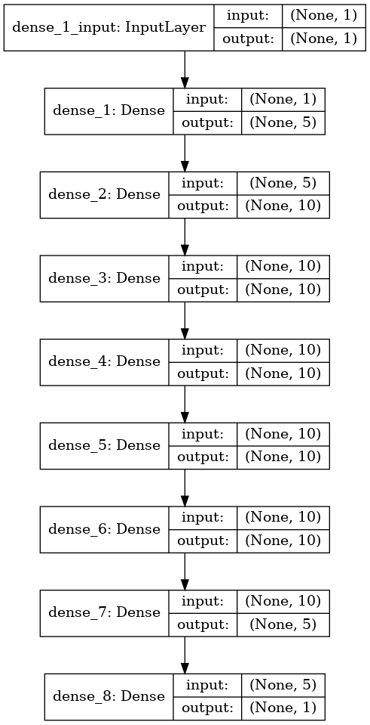
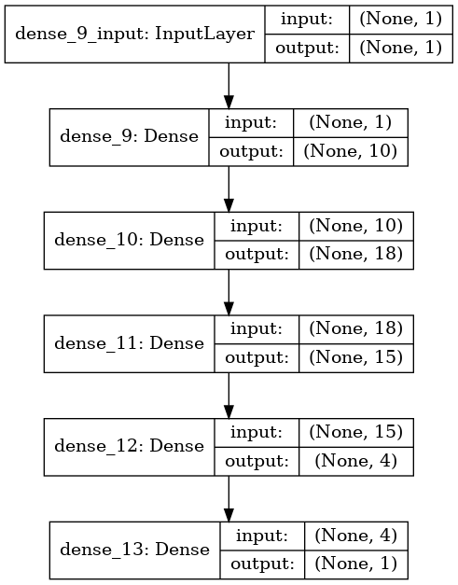
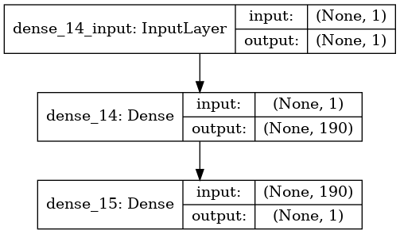
HW1-1 Simulate a Function
Example models:
model2 parameters：571
model1 parameters：572
model0 parameters：571

Slide 7
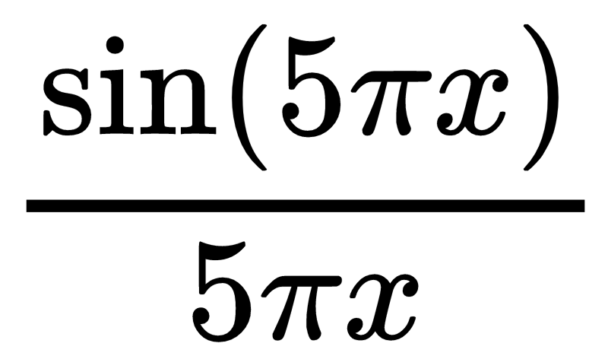
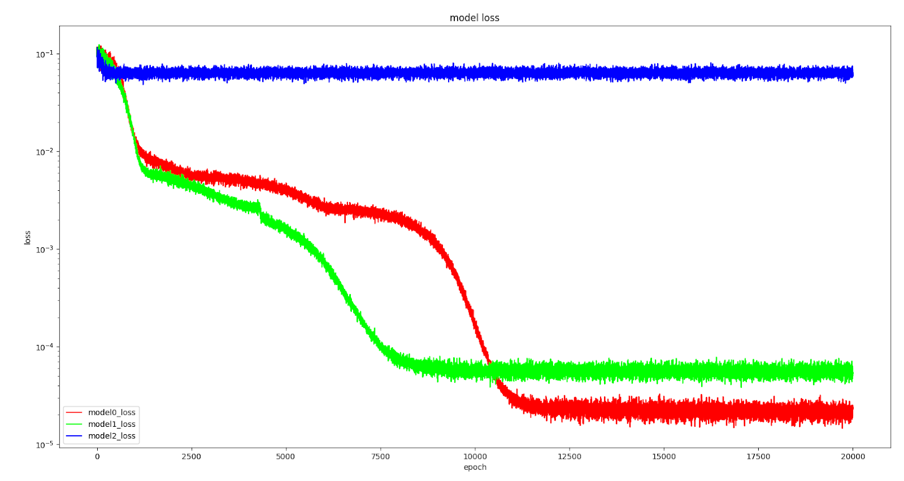
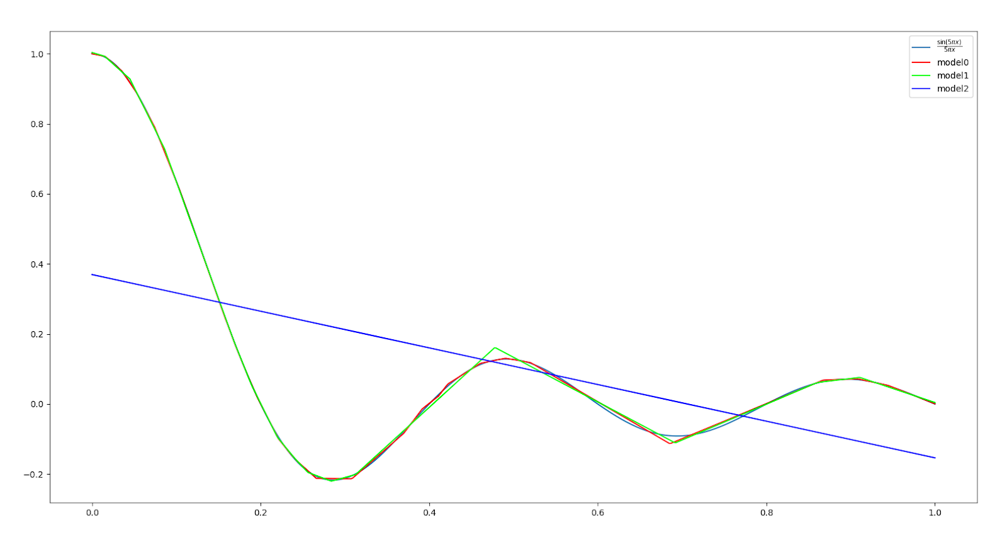
HW1-1 Simulate a Function
20000 epochs

Slide 8
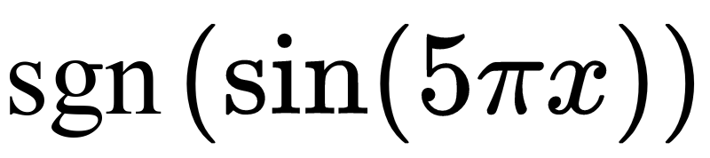
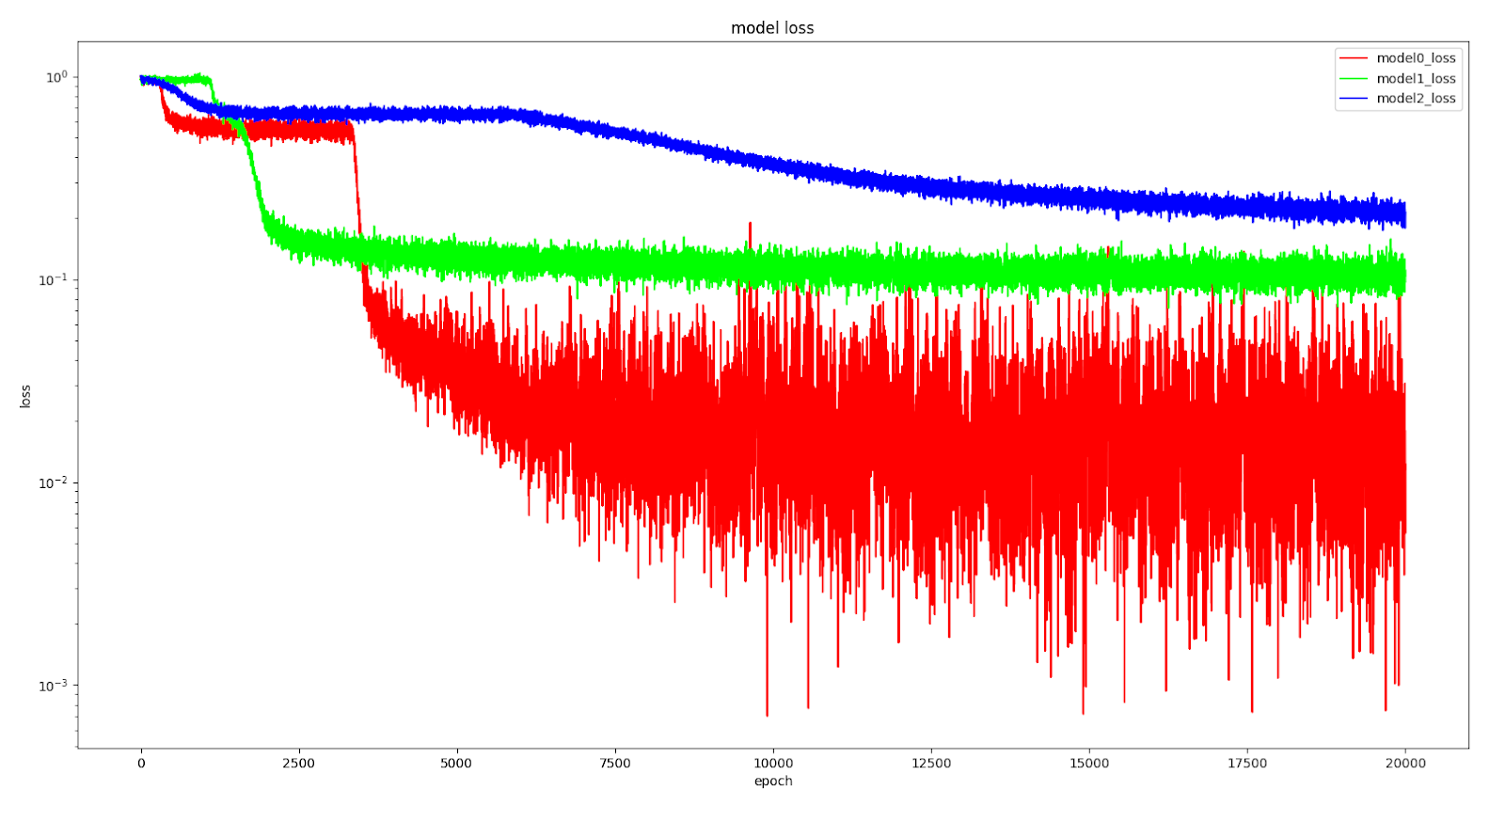
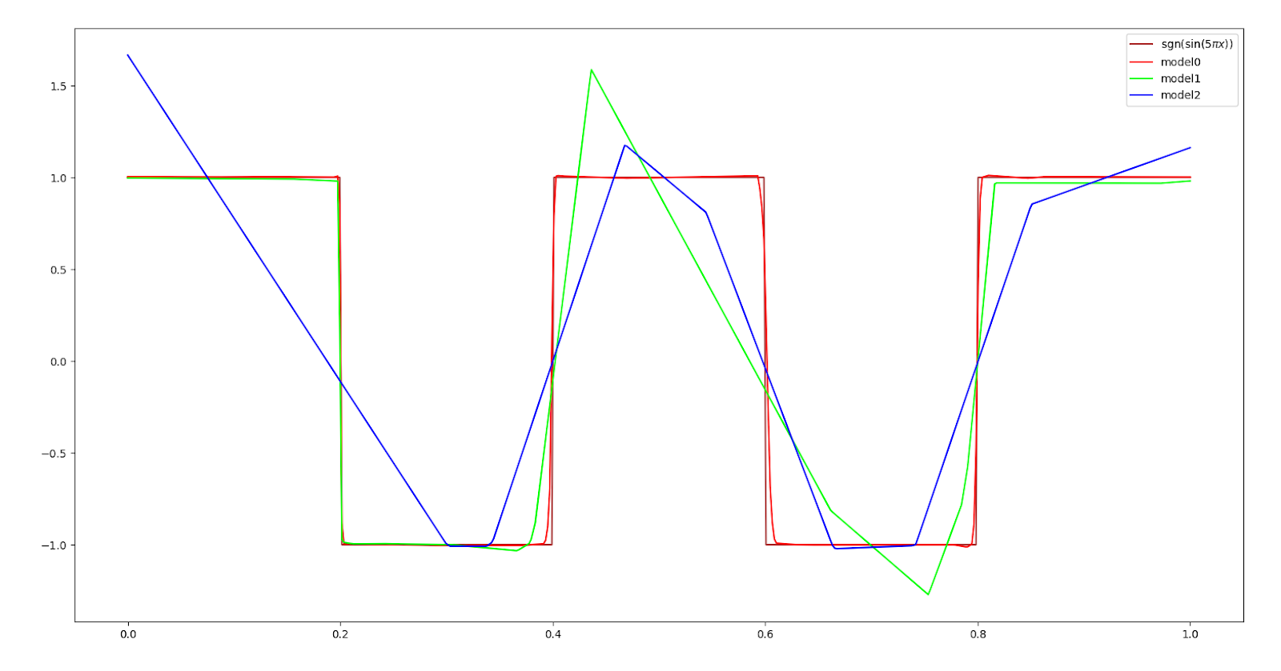
HW1-1 Simulate a Function
20000 epochs

Slide 9
HW1-1 Train on Actual Tasks
Requirements:
use MNIST or CIFAR-10
use CNN or DNN
visualize the training process by showing both loss and accuracy on two charts
Tips:
CNN is easier to see the difference

Slide 10
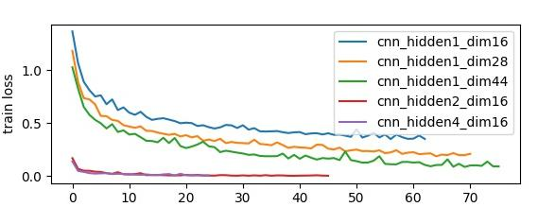
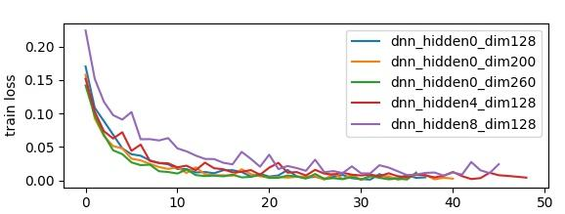
HW1-1 Train on Actual Tasks
MNIST：
CNN
MNIST：
DNN

Slide 11
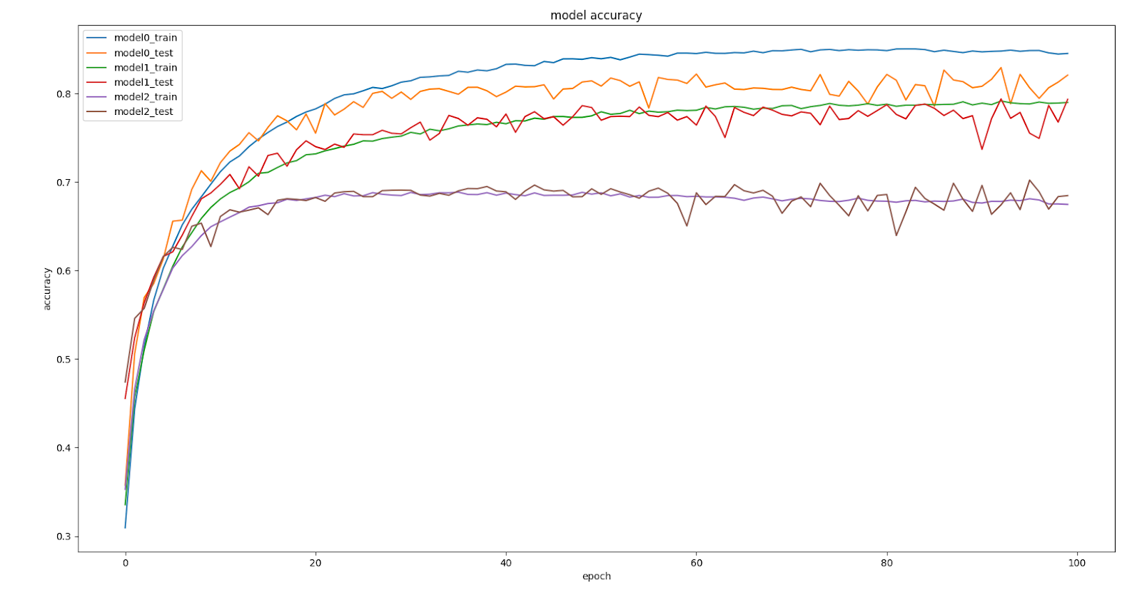
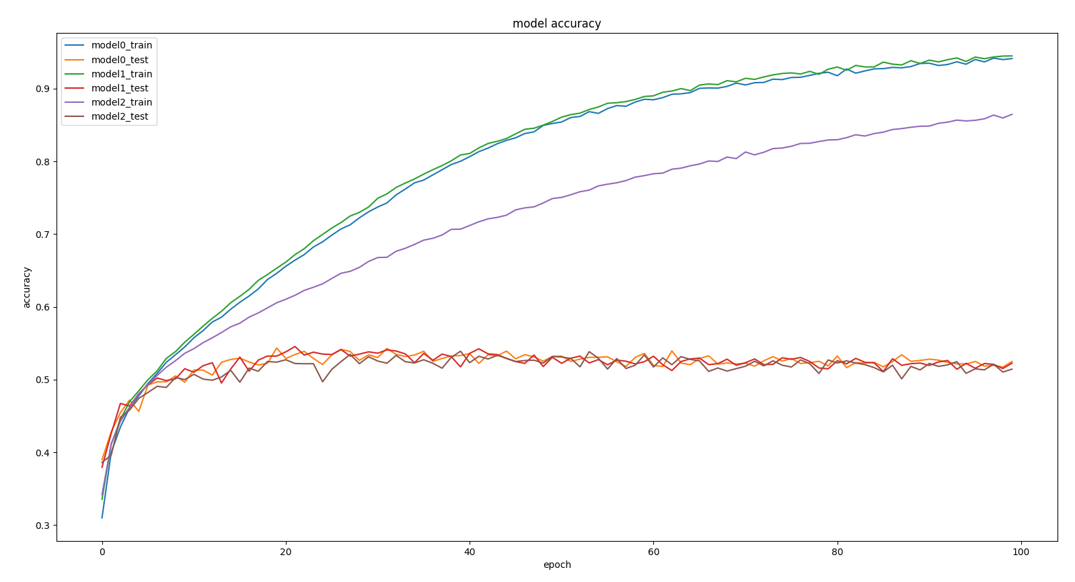
HW1-1 Train on Actual Tasks
CIFAR-10：
CNN
CIFAR-10：
DNN

Slide 12
HW1-1 Report Questions
Simulate a Function:
Describe the models you use, including the number of parameters (at least two models) and the function you use.
In one chart, plot the training loss of all models.
In one graph, plot the predicted function curve of all models and the ground-truth function curve.
Comment on your results.
Use more than two models in all previous questions. (bonus)
Use more than one function. (bonus)
Train on Actual Tasks:
Describe the models you use and the task you chose.
In one chart, plot the training loss of all models.
In one chart, plot the training accuracy.
Comment on your results.
Use more than two models in all previous questions. (bonus )
Train on more than one task. (bonus )

Slide 13
HW1-2: Optimization
Three subtask
Visualize the optimization process.
Observe gradient norm during training.
What happens when gradient is almost zero?
Train on designed function, MNIST or CIFAR-10

Slide 14
Visualize the Optimization Process
Requirement
Collect weights of the model every n epochs.
Also collect the weights of the model of different training events.
Record the accuracy (loss) corresponding to the collected parameters.
Plot the above results on a figure.

Slide 15
Visualize the Optimization Process
Collect parameters of the model:
n1
n2
nk
l1
l2
lk
m1n1
m2n2
mknk
Model
m1
m2
.....
mk
.....
l1
l2
lk
Reduce the dimension
m1n1 + m2n2 + ...... + mknk
1st event epoch 0
.....
1st event epoch 3
.....
1st event epoch 6
dimension
reduction
.
.
.
.
.
.
.
.
.
.
.
.
ith event epoch 0
ith event epoch 3
ith event epoch 6

Slide 16
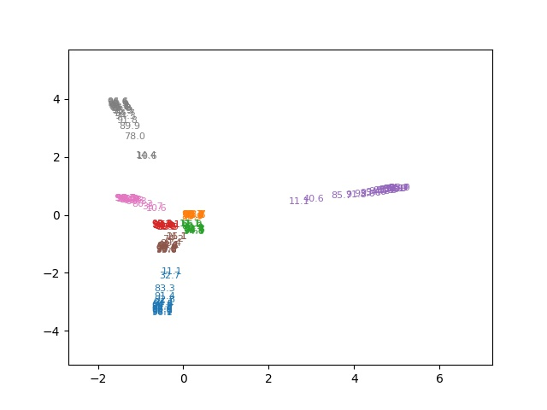
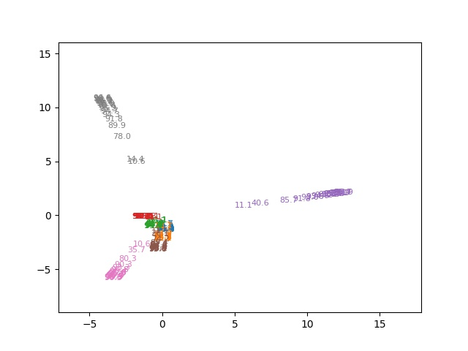
Visualize the Optimization Process
DNN train on MNIST
Collect the weights every 3 epochs, and train 8 times. Reduce the dimension of weights to 2 by PCA.
layer 1 whole model

Slide 17

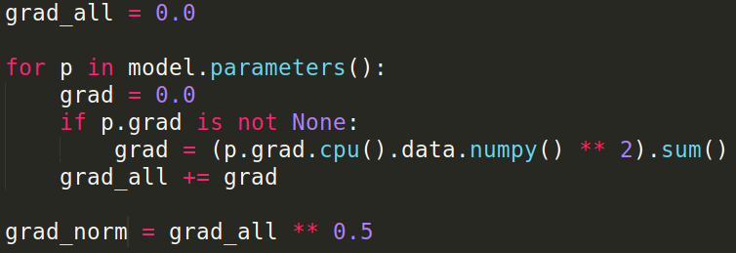
Observe Gradient Norm During Training
Requirement
Record the gradient norm and the loss during training.
Plot them on one figure.
p-norm
In PyTorch:
Other packages: The similar code can be applied.

Slide 18
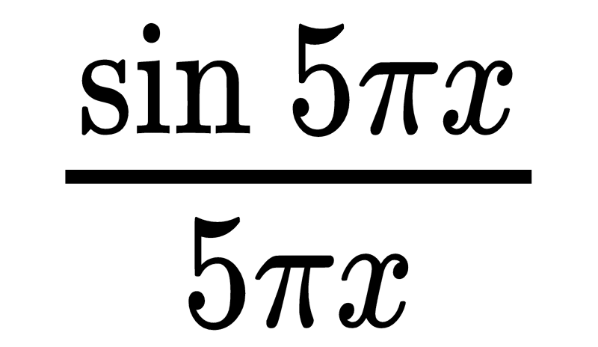
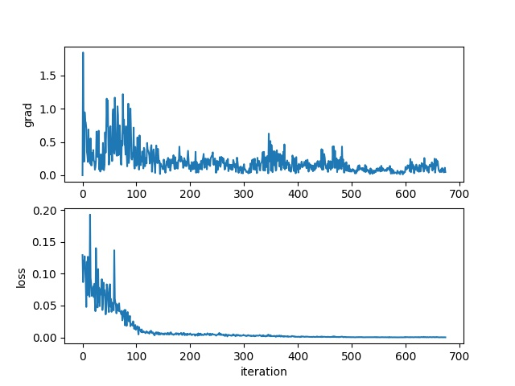
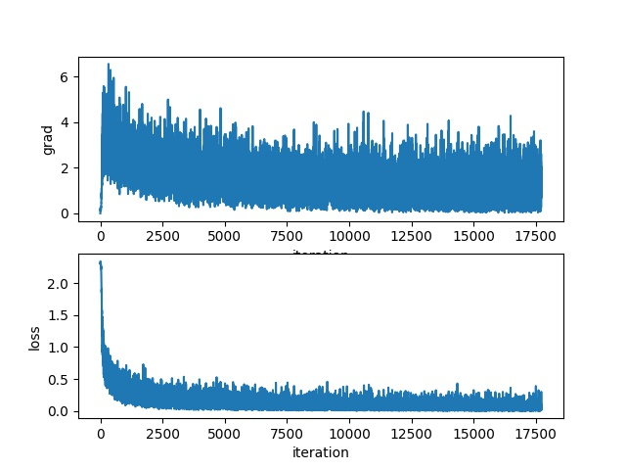
Observe Gradient Norm During Training
MNIST

Slide 19
What Happened When Gradient is Almost Zero
Requirement
Try to find the weights of the model when the gradient norm is zero (as small as possible).
Compute the "minimal ratio" of the weights: how likely the weights to be a minima.
Plot the figure between minimal ratio and the loss when the gradient is almost zero.
Tips
Train on a small network.

Slide 20



What Happened When Gradient is Almost Zero
How to reach the point where the gradient norm is zero?
First, train the network with original loss function.
Change the objective(loss) function to gradient norm and keep training.()
Or use second order optimization method, such as Newton’s method or Levenberg-Marquardt algorithm (more stable)
How to compute minimal ratio?
Compute () (hessian matrix), and then find its eigenvalues. The proportion of the eigenvalues which are greater than zero is the minimal ratio.
Sample lots of weights around , and compute . The minimal ratio is the proportion that .
torch.autograd.functional.hessian
https://pytorch.org/docs/stable/generated/torch.autograd.functional.hessian.html

Slide 21
For the Hessian matrix, I found this on the forum, autograd_lib.backward_hessian(output, loss='LeastSquares').
And you may consider using h_eig = torch.symeig(h).eigenvalues to calculate the eigenvalues of the Hessian matrix.
For the minimal ratio, try to get the number of elements in h_eig that is greater than 0, say A; and the total number of elements in h_eig, say B. The minimal ratio then is A/B.

Slide 22
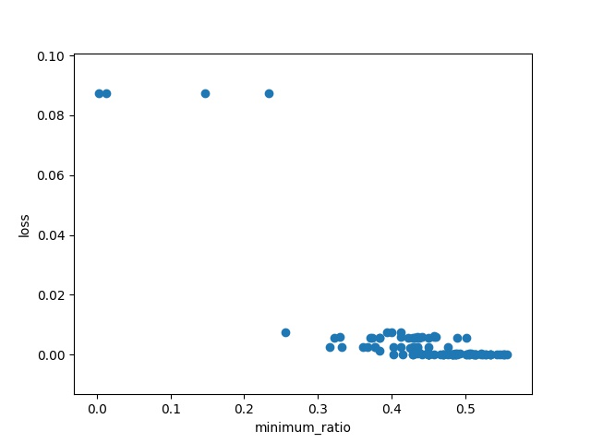

What Happened When Gradient is Almost Zero
Train 100 times.
Find gradient norm equal to zero by change objective function.
Minimal ratio is defined as the proportion of eigenvalues greater than zero.

Slide 23
HW1-2 Report Questions
Visualize the optimization process.
Describe your experiment settings. (The cycle you record the model parameters, optimizer, dimension reduction method, etc)
Train the model for 8 times, selecting the parameters of any one layer and whole model and plot them on the figures separately.
Comment on your result.
Observe gradient norm during training.
Plot one figure which contain gradient norm to iterations and the loss to iterations.
Comment your result.
What happens when gradient is almost zero?
State how you get the weight which gradient norm is zero and how you define the minimal ratio.
Train the model for 100 times. Plot the figure of minimal ratio to the loss.
Comment your result.
Bonus
Use any method to visualize the error surface.
Concretely describe your method and comment your result.

Slide 24
HW1-3: Generalization
Three subtask
Can network fit random labels?
Number of parameters v.s. Generalization
Flatness v.s. Generalization
Train on MNIST or CIFAR-10

Slide 25
Can network fit random labels?
Requirement
Train on MNIST or CIFAR-10
Randomly shuffle the label before training.
Try to fit the network with these random labels.

Slide 26
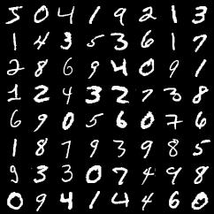
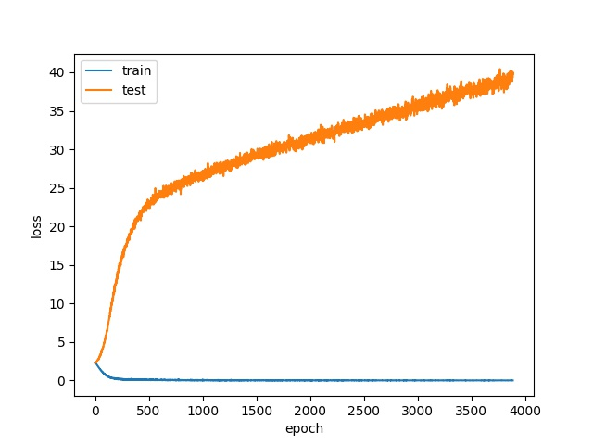
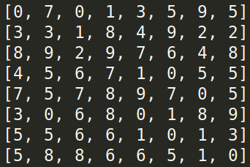
Can network fit random labels?
MNIST
3 hidden layers with 256 nodes.

Slide 27
Number of parameters v.s. Generalization
Requirement
Train on MNIST or CIFAR-10
At least 10 similar-structured models with different amount of parameters
Record both training and testing, loss and accuracy

Slide 28
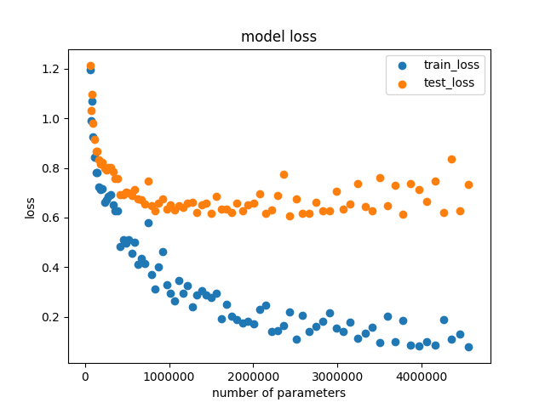
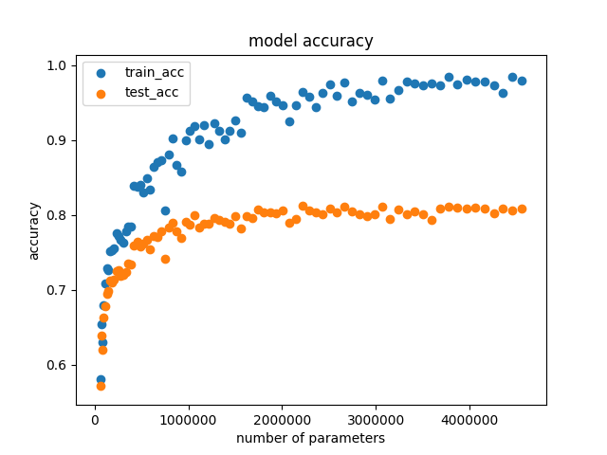
Number of parameters v.s. Generalization
CIFAR-10

Slide 29

Flatness v.s. Generalization - part1
Visualize the line between two trained models
Requirement:
Train two models (m1 and m2) with different training approach. (e.g. batch size 64 and 1024)
Record the loss and accuracy of the model which is linear interpolation between m1 and m2.
, where is the interpolation ratio, is the parameter of the model.

Slide 30
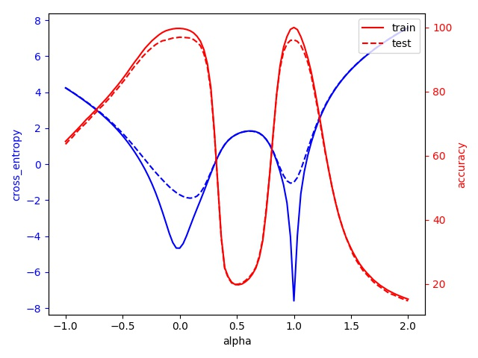
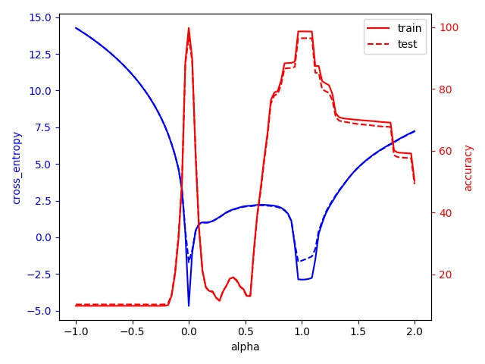
Flatness v.s. Generalization - part1
MNIST (The cross_entropy is log scale)
batch size 64 vs. batch size 1024
learning rate 1e-3 vs. 1e-2

Slide 31
Flatness v.s. Generalization - part2
Requirement:
Train at least 5 models with different training approach.
Record the loss and accuracy of all models.
Record the sensitivity of all models.

Slide 32
Flatness v.s. Generalization - part2
What is sensitivity:
Reference: https://arxiv.org/pdf/1802.08760.pdf
Original definition:
Frobenius norm of Jacobian matrix of model output (class probability) to input
Computationally expensive for us
Our definition:
Frobenius norm of gradients of loss to input

Slide 33
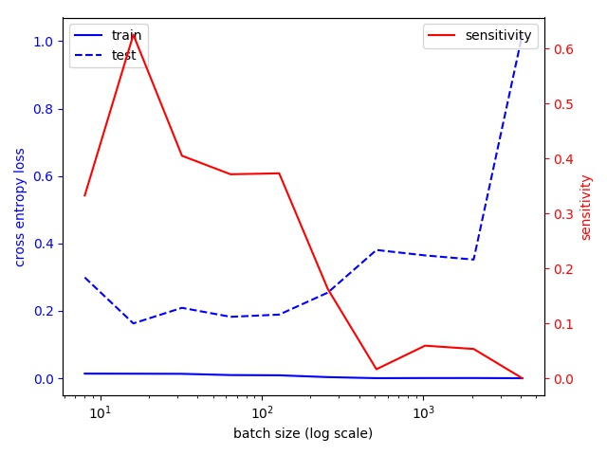
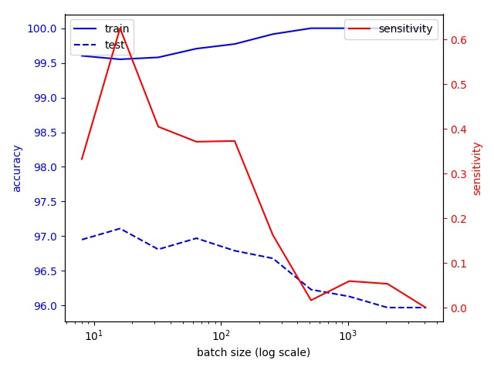
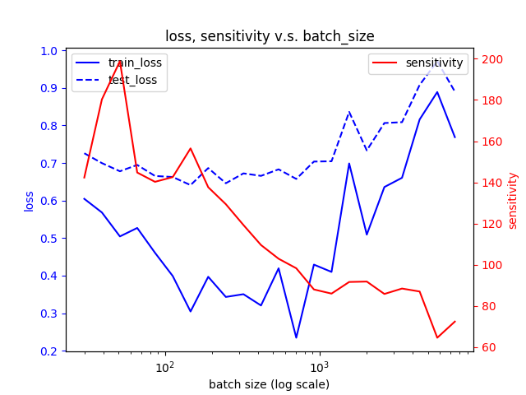
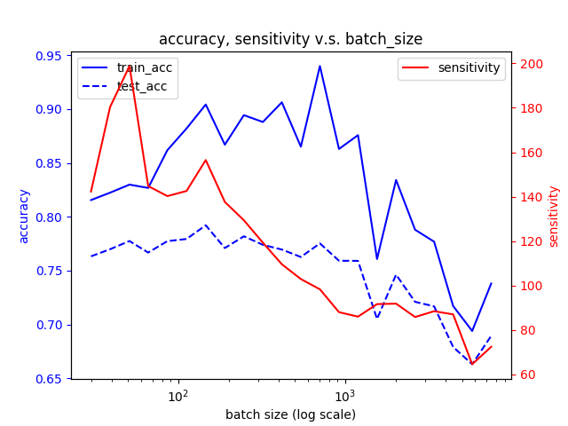
Flatness v.s. Generalization - part2
MNIST :
CIFAR10 :

Slide 34
HW1-3 Report Questions
Can network fit random labels?
Describe your settings of the experiments. (e.g. which task, learning rate, optimizer)
Plot the figure of the relationship between training and testing, loss and epochs.
Number of parameters v.s. Generalization
Describe your settings of the experiments. (e.g. which task, the 10 or more structures you choose)
Plot the figures of both training and testing, loss and accuracy to the number of parameters.
Comment your result.
Flatness v.s. Generalization
Part 1:
Describe the settings of the experiments (e.g. which task, what training approaches)
Plot the figures of both training and testing, loss and accuracy to the number of interpolation ratio.
Comment your result.
Part 2 :
Describe the settings of the experiments (e.g. which task, what training approaches)
Plot the figures of both training and testing, loss and accuracy, sensitivity to your chosen variable.
Comment your result.
Bonus : Use other metrics or methods to evaluate a model's ability to generalize and concretely describe it and comment your results.

Slide 35
Submission
Deadline: Feb. 11th 23:59
Allow package：
python 3
TensorFlow/pytorch ONLY for CS and ECE student
For non-CS/ECE students, Keras is allowed.
Write one report
Share your github with TA
Code
In your Readme, state clearly how to run your program to generate the results in your report.
Files for training is required.

Slide 36
Flatness v.s. Generalization - bonus example
Reference : https://arxiv.org/pdf/1609.04836.pdf
Requirement
Train on MNIST or CIFAR-10
Use at least ten different approaches to train the same model
Calculate the sharpness of trained models
Tips
Train on MNIST
Train with different batch size

Slide 37
Flatness v.s. Generalization - bonus example
There is a generalization gap when using large-batch (LB) methods (instead of small-batch (SB) methods) for training deep learning models.
The reasons (maybe more than these):
LB methods lack the explorative properties of SB methods and tend to zoom-in on the minimizer closest to the initial point.
SB and LB methods converge to qualitatively different minimizers with differing generalization properties (i.e. SB converges to flat minimizer, LB converges to sharp minimizer)
We will focus on the second reason.

Slide 38
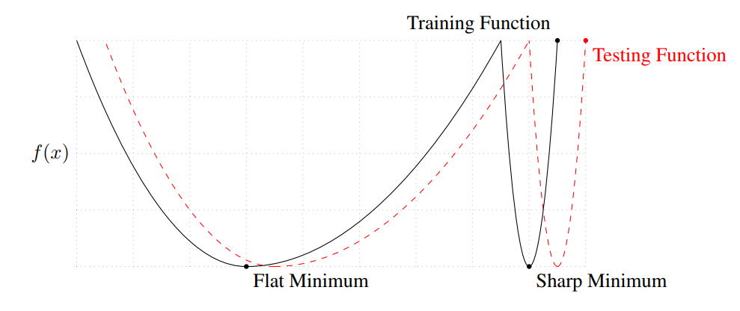
Flatness v.s. Generalization - bonus example
Visually, it means that :
How to measure sharpness (or flatness) ?

Slide 39
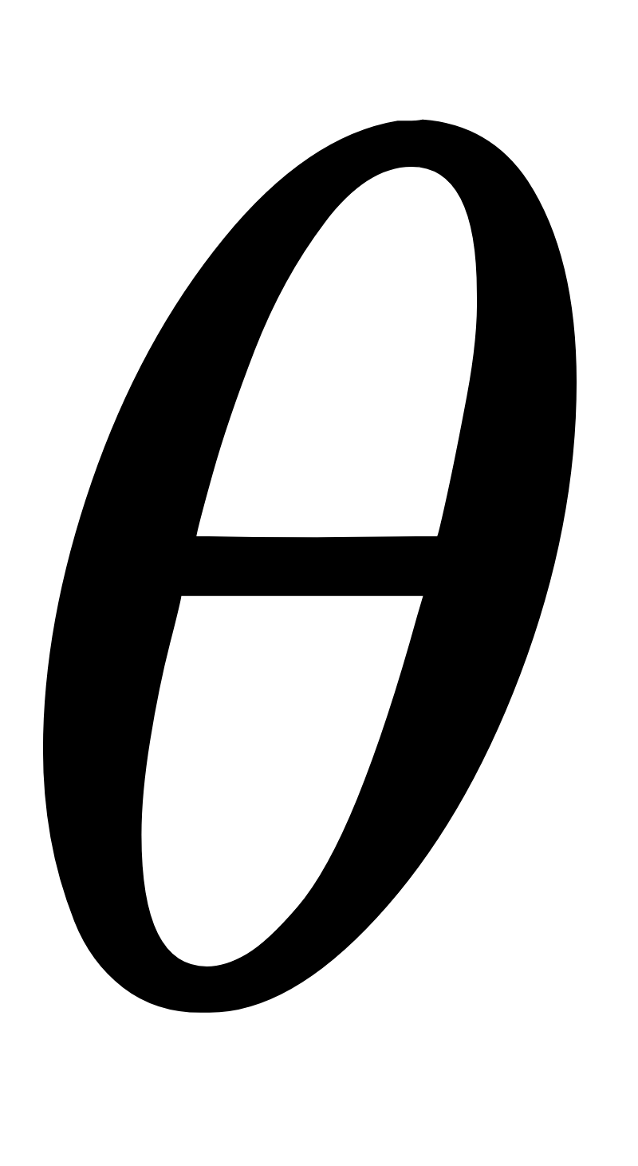
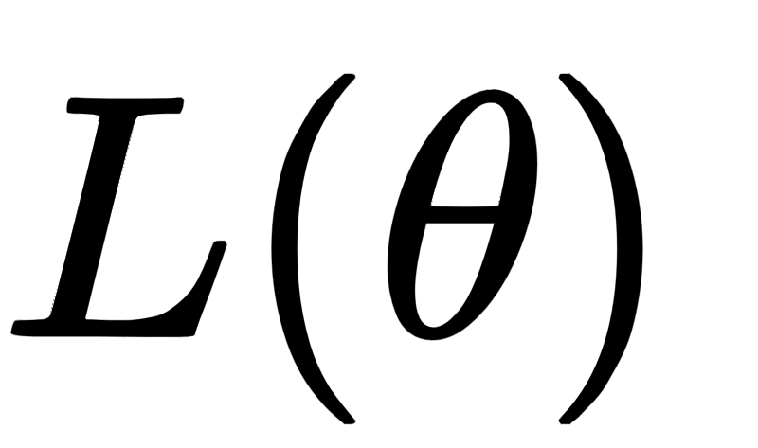
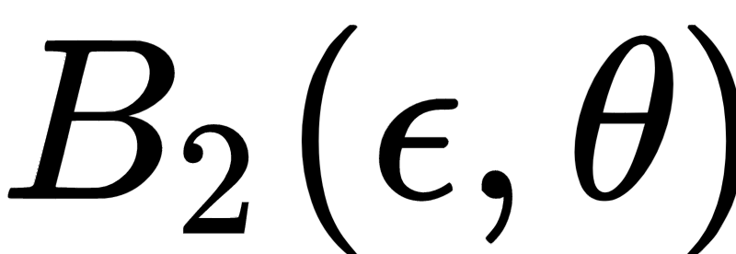
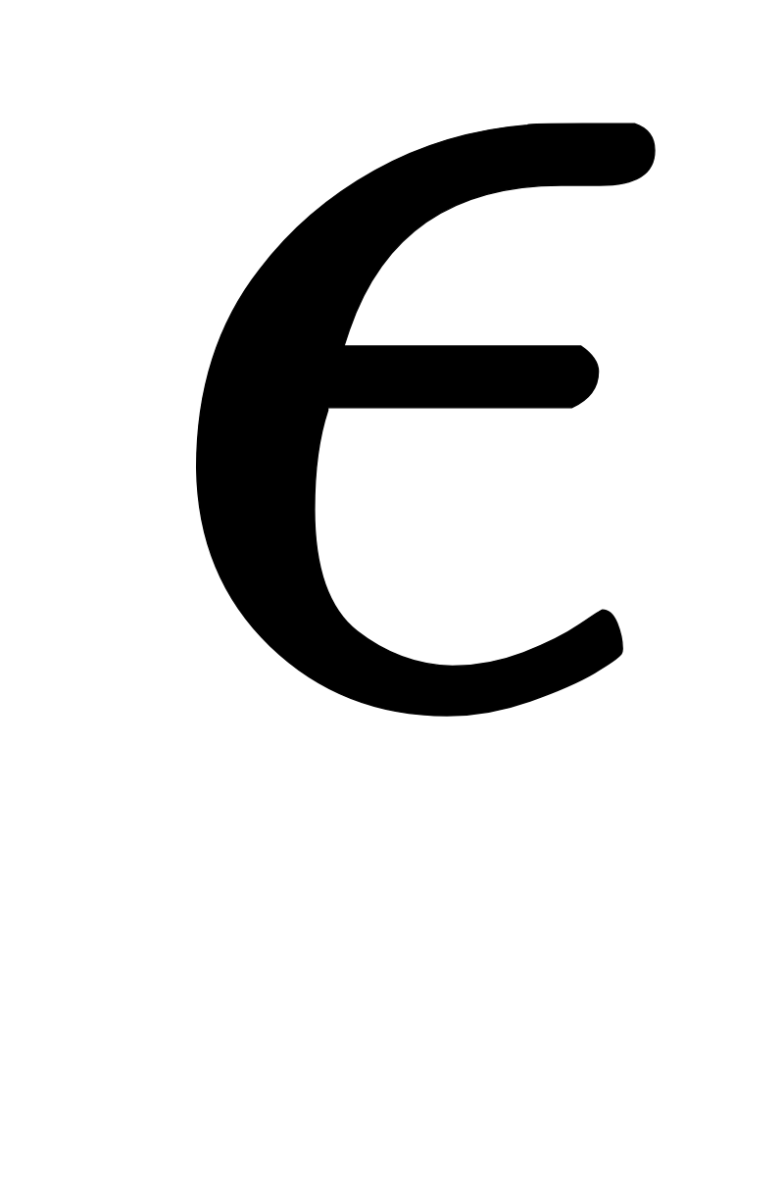
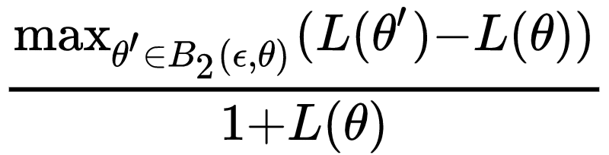
Flatness v.s. Generalization - bonus example
Many methods can measure sharpness, but we will only utilize one in this assignment.
Notations:
: vector of all parameters
: loss of the model given the paramters
: a Euclidean ball centers at with radius
Sharpness:

Slide 40
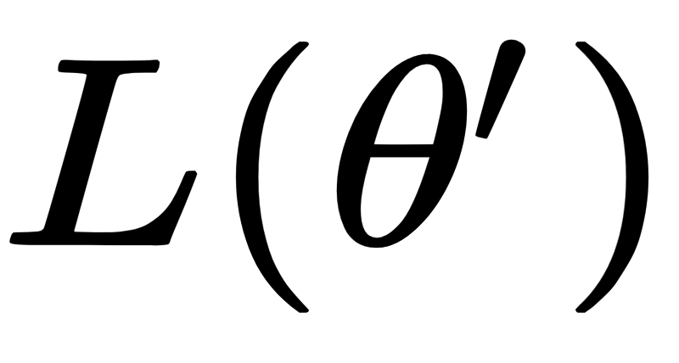
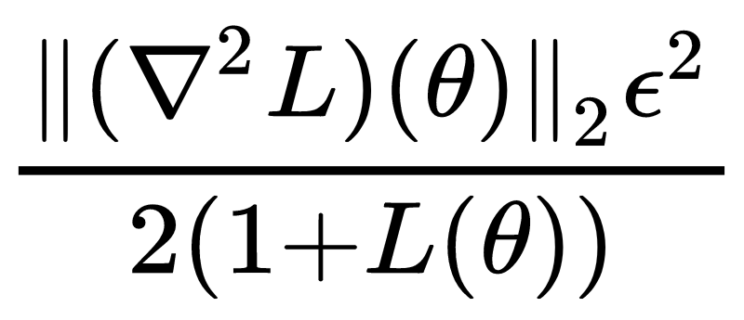
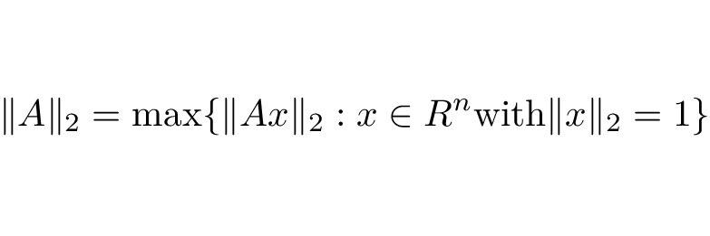

Flatness v.s. Generalization - bonus example
How to calculate this :
Original paper : Use L-BFGS-B to maximize
Around a critical point :
Then :
Since 2-norm of a matrix is defined as :

Slide 41
Flatness v.s. Generalization - bonus example
How to calculate Hessian matrices efficiently:
Use GPU : tf.hessians
Calculate only 500 out of 60000 examples in MNIST
But tf.hessians only return block-diagonal part:
vector of all paramters :
Hessian matrix :
W1
W2
h0 = tf.hessians(loss, [w1, w2])[0]
h1= tf.hessians(loss, [w1, w2])[1]

Slide 42
Flatness v.s. Generalization - bonus example
If we assume off-block-diagonal elements is negligable:
Square of block-diagonal matrix is also block-diagonal.
Eigenvalues of a block-diagonal matrix is the list of all eigenvalues of each block submatrix.
Since we only want the largest eigenvalue, we can conclude that the 2-norm of a block-diagonal matrix is the 2-norm of block submatrix that contains the largest eigenvalue itself.
2-norm of matrix A in tensorflow : tf.norm(A, 2)
2-norm of matrix A in numpy : np.linalg.norm(A, 2)

Slide 43
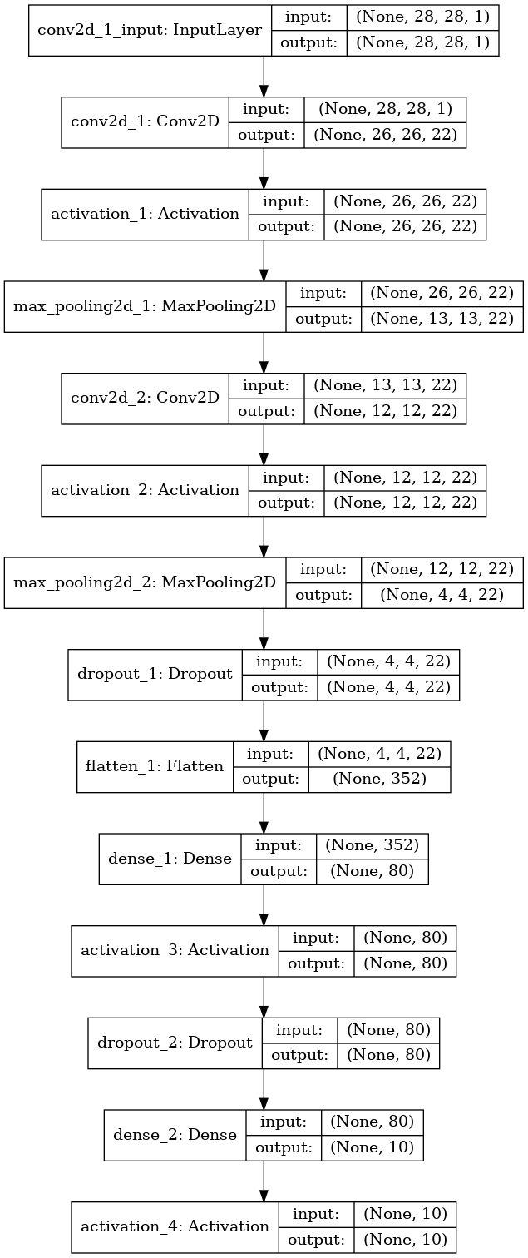
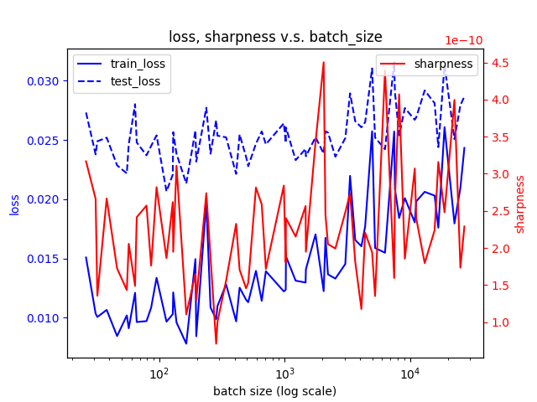
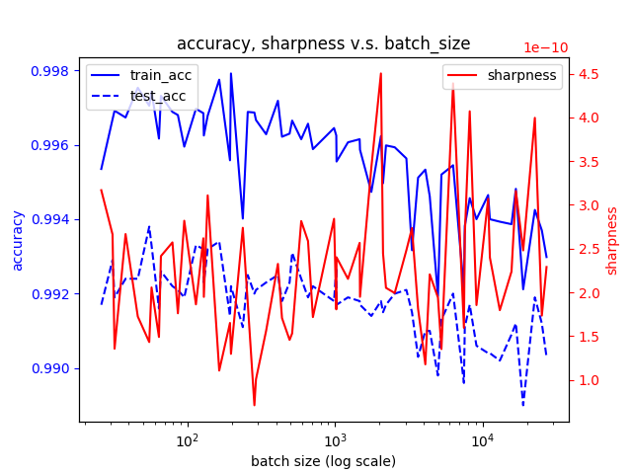
Flatness v.s. Generalization - bonus example
MNIST :
20000~30000 parameters (in order to calculate hessian matrices while maintaining enough model capacity)
Calculate hessian matrices as mentioned in previous slide
epsilon : 1e-4

Slide 44
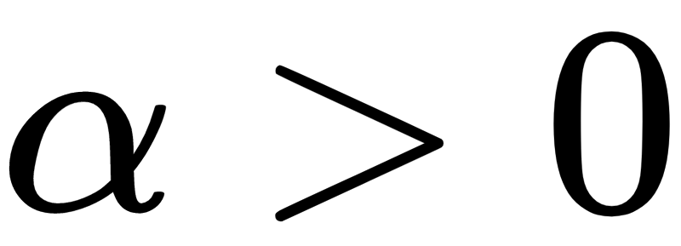
Flatness v.s. Generalization - more possible bonus
Reference: https://arxiv.org/pdf/1703.04933.pdf
This paper shows that several metrics (including sharpness) do not indicates ability of generalization for any RELU-based deep models.
Reparametrize:
if

