Slide 1
GDPR Intelligence Platform
AI-Powered Legal Document Retrieval at Scale
Retrieval-Augmented Generation · Azure · Databricks · GDPR Compliance
Team 6 | Accenture 2026 | June 2026
1 / 12

Slide 2
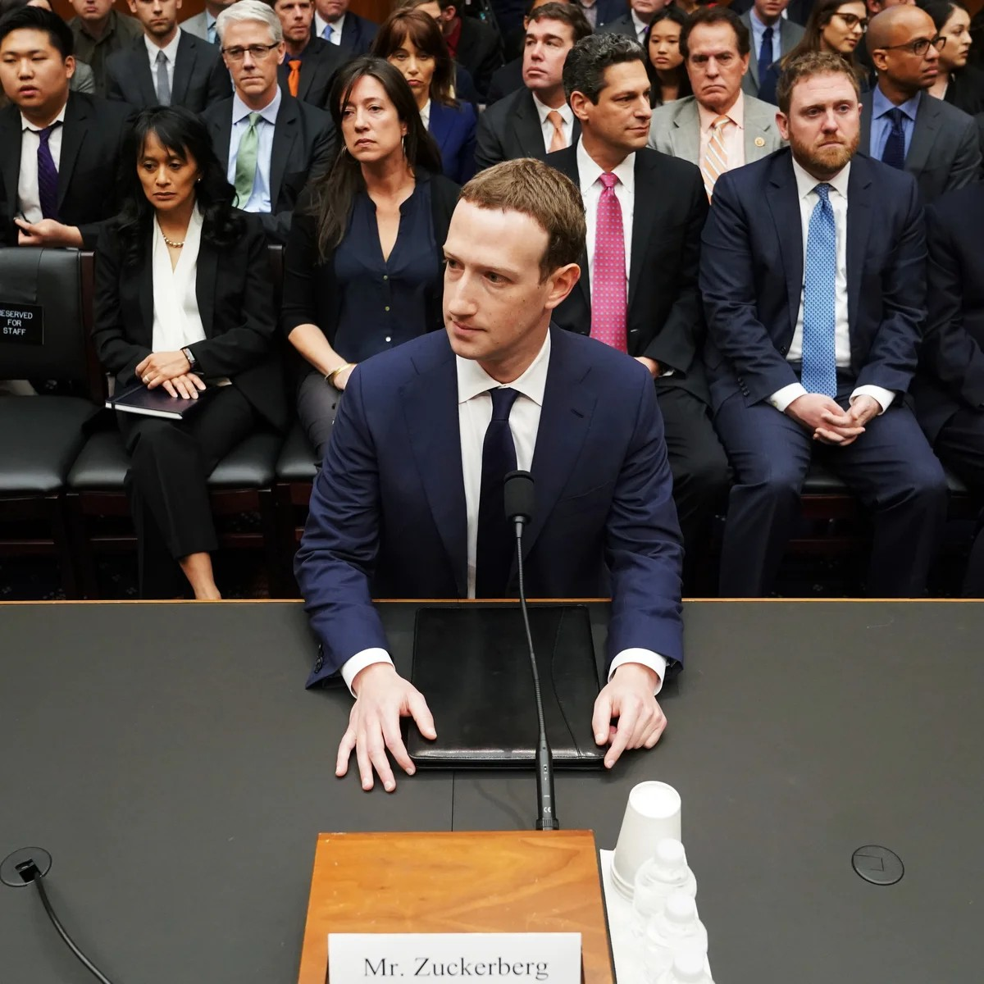
€1,200,000,000 FINE
"He got it wrong."
Meta was fined €1.2B by the Irish DPC in 2023 — the largest GDPR penalty ever issued. The violation? Transferring EU user data to US servers without adequate safeguards.
GDPR compliance is not optional. It is existential.
Our platform makes regulatory intelligence instant and auditable.
2 / 12

Slide 3
ABOUT THE TEAM
Who We Are
Team 6
Domain
Context
Mission
Accenture Data & AI Practice
Regulatory Intelligence & Compliance Tech
Built during the Accenture 2026 AI Bootcamp
Reduce compliance risk through AI-powered document retrieval
3 / 12

Slide 4
PROBLEM STATEMENT
The Compliance Challenge
99 Articles + 173 Recitals
Manual Search Fails
GDPR alone is 88 pages of dense legal text. Add NIS2, DORA, AI Act...
Legal teams spend hours searching documents for a single clause reference.
Fines Are Escalating
No Audit Trail
Over €4.5B in GDPR fines issued since 2018. Ignorance is no defence.
When regulators ask how you interpreted an article, you need to show your work.
4 / 12

Slide 5
SOLUTION
GDPR Intelligence Platform
Ask any GDPR question in plain English. Get a grounded, source-cited answer in seconds.
Natural Language Q&A
Source-Cited Answers
Enterprise-Grade Pipeline
Type any regulatory question — no legal jargon required.
Every answer links back to the exact article and page.
Azure AI Search + Databricks Vector Search at scale.
Full Audit Logging
Multi-Format Ingestion
Smart Article Chunking
Every query and answer is logged to Delta Lake for compliance review.
PDF, DOCX, TXT, CSV, HTML — all ingested automatically.
GDPR articles are segmented by structure, not arbitrary character counts.
5 / 12

Slide 6
ARCHITECTURE
Project Architecture
SOURCES
INGESTION
BRONZE
SILVER
GOLD
VECTOR SEARCH
RAG API
FRONTEND
EUR-Lex Official PDFs Databricks Volume
Auto-Ingestion Pipeline (EUR-Lex API)
Delta Table Raw Chunks Metadata preserved
Delta Table Enriched + Embedded chunks
Delta Table Index-ready records
Databricks Vector Search Index
FastAPI /query /query-databricks
Browser UI Audit Logs Delta Lake
Local / Azure path: Azure AI Search Index → FastAPI /query (parallel retrieval backend)
6 / 12

Slide 7
TECH STACK
Technologies Used
AI & LLM
Storage & Search
Data Platform
Application
• Azure OpenAI — GPT-4 for answer generation
• Azure AI Search — primary vector index
• Databricks Unity Catalog — governance layer
• FastAPI — REST API (Python)
• Azure OpenAI Embeddings — text-embedding-3-large
• Databricks Vector Search — enterprise retrieval
• Delta Lake — Bronze / Silver / Gold pipeline
• Docker — containerised deployment
• SentenceTransformers — local fallback (all-MiniLM-L6-v2)
• ChromaDB — local development fallback
• Apache Spark — distributed ingestion jobs
• EUR-Lex API — automated regulatory ingestion
7 / 12

Slide 8
HOW IT WORKS
Query Flow — Step by Step
1
2
3
4
5
6
User asks a natural-language GDPR question
Question is embedded into a vector
Vector Search finds top-5 relevant chunks
Chunks are formatted as LLM context
Azure OpenAI generates a grounded answer
Answer + sources returned + query logged
8 / 12

Slide 9
BUSINESS VALUE
Why This Matters
< 3 sec
€4.5B+
99
100%
Answer latency for any GDPR question
Total GDPR fines issued since 2018
GDPR articles indexed and searchable
Answers grounded in source documents
✓ Hours of manual legal research → seconds
✓ Every answer is traceable to a source article and page
✓ Query audit log satisfies internal compliance review requirements
✓ Scales to any EU regulation: NIS2 · DORA · AI Act · ePrivacy
9 / 12

Slide 10
ROADMAP
Feature Improvements
Short-term
Medium-term
Long-term
Automated EUR-Lex ingestion
Multi-regulation support
Compliance gap analyser
Daily sync of new regulations via EUR-Lex API — zero manual uploads.
Extend beyond GDPR → NIS2, DORA, AI Act in a single unified index.
Upload a policy document; the system highlights GDPR conflicts.
Multi-language support
Fine-tracker feed
Agent-based regulatory assistant
Query in Greek, German, French; answers in the user's language.
Live feed of GDPR enforcement decisions; link chunks to real cases.
Multi-step reasoning over cross-regulation questions.
Evaluation dashboard
Role-based access
On-prem / air-gapped deployment
Automated retrieval quality scoring (precision@k, MRR) in the UI.
Per-team document permissions via Databricks Unity Catalog groups.
Run entirely within enterprise perimeter with local models.
10 / 12

Slide 11
DEMO
See It In Action
POST /query
// Request
{ "question": "What are the rights of data subjects under GDPR?" }
// Response 200 OK
{
"answer": "Under GDPR, data subjects have: the right to access (Art.15),
the right to erasure (Art.17), the right to portability (Art.20)...
Sources: 32016R0679_EN (pages 42, 44, 47)",
"retrieved_chunks": [ { "chunk_id": "a3f9...", "distance": 0.187, ... } ]
}
Interactive docs: http://127.0.0.1:8080/docs | Frontend UI: GET /
11 / 12

Slide 12
Thank You
GDPR Intelligence Platform · Team 6 · Accenture 2026
Questions?
GitHub · FastAPI /docs · Databricks Unity Catalog
12 / 12

