Slide 1



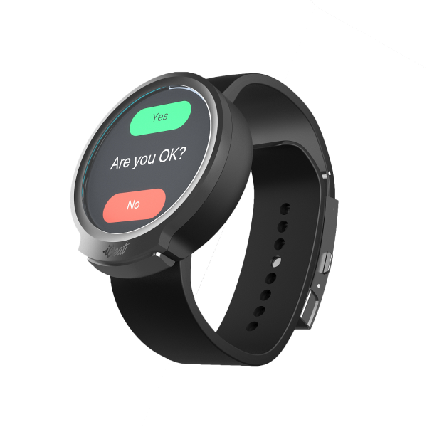
Automated bullying reporting system
Team 3
Midterm presentation: Seokwon Choi, Dereje Regassa, Jaeyoung Kim, Thanh Dung Ho

Slide 2

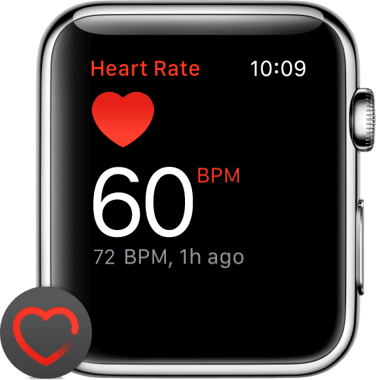
Agenda
Refined project idea
Use cases
Demo of prototype
System architecture
Technical challenges & Our solutions
Revision of project schedule
Conclusion
Notes:
Prototype to show key functionalities and the successful communication between the watch and the server for transmission of victim(student) data

Slide 3
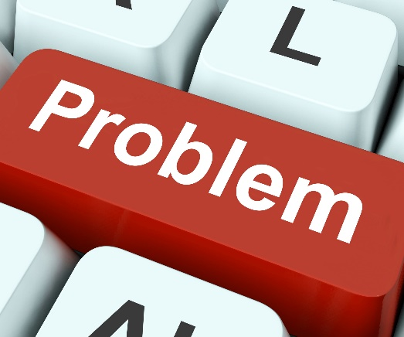
Refined project idea
Recap:
Bullying → severe social issue worldwide
Students (victims) higher risks for behavioral and social problems & affect students negatively in the long term (e.g. school drop out or committing suicide)
Schools‘ interest effective prevention & control of bullying situations
Problems: difficulty for victim to report, not all classmates driven by altruism, undetected bullying situations within school and outside of school
Different point of view (new):
Victim not always the weakest person → can become attacker & dangerous for classmates and teacher
Even though teacher present, not always fast prevention action guaranteed
Piled up wrath, thoughts, and increased heartrate not visible to teachers
Necessity for fast detection
Bullying situations cannot be detected at early stage → makes effective addressing and approaching
of bullying issue more difficult
Notes:
Thoughts of student not visible and not clear whether he is piled up with wrath → teacher cannot see
학생들은 분노가 점점 쌓여 스스로를 전혀 조절할 수 없을 정도에 이르렀고, 공격자가 될 수 있다

Slide 4
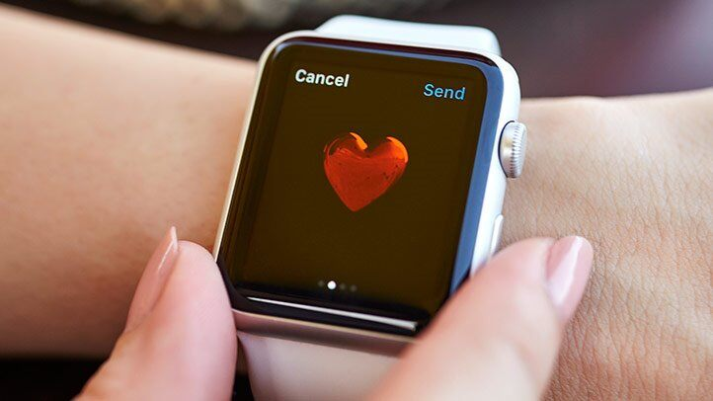
Refined project idea
Our vision
Improvement of process of identifying bullying incidents
If detection system sophisticated and automated enough → Detection of bullying tendencies at early stage, faster reaction, and better prevention interventions
Leveraging apple smartwatch‘ sensors → realization of automatized detection of bullying situations
Potential of contributing to public good & reasonable usage of modern technology
Application: offline bullying/physical bullying & monitoring suspicious behaviors (dangerous for victim & class and teacher)
Target group: Students (Primary – high school) & schools
Notes:
우리 비전: 괴롭힘따돌림을 인식과정을 automatization을 통해서 향상시킨다

Slide 5
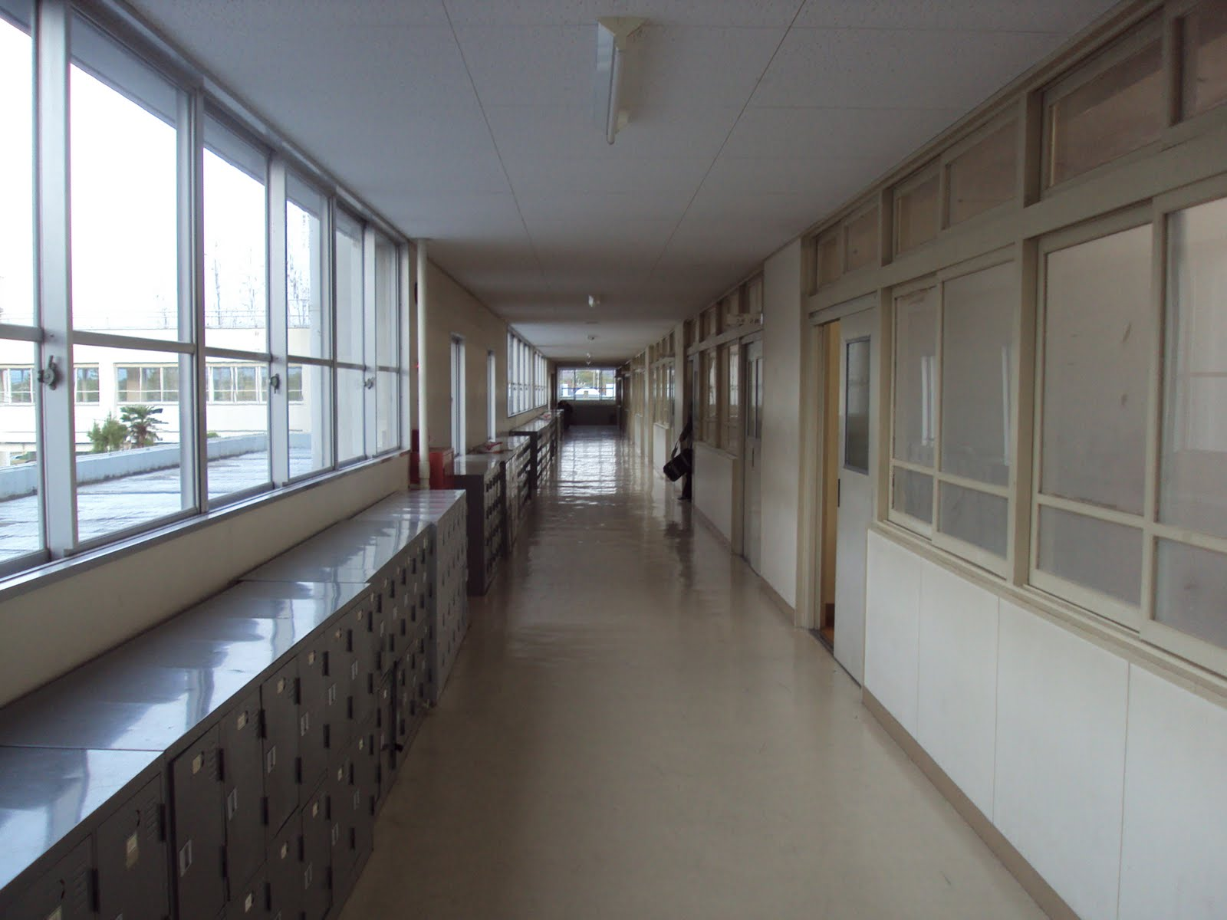
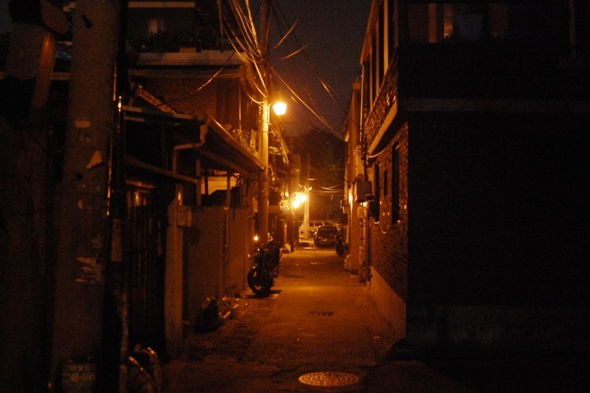
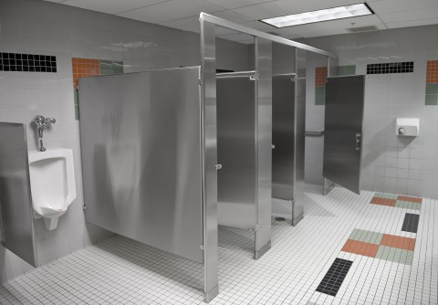
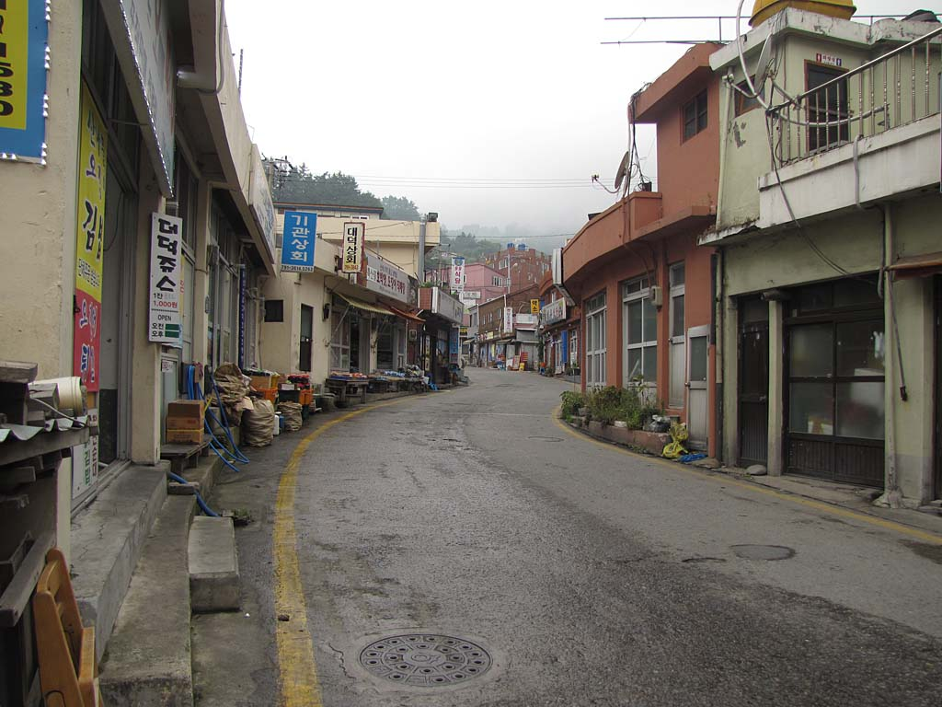
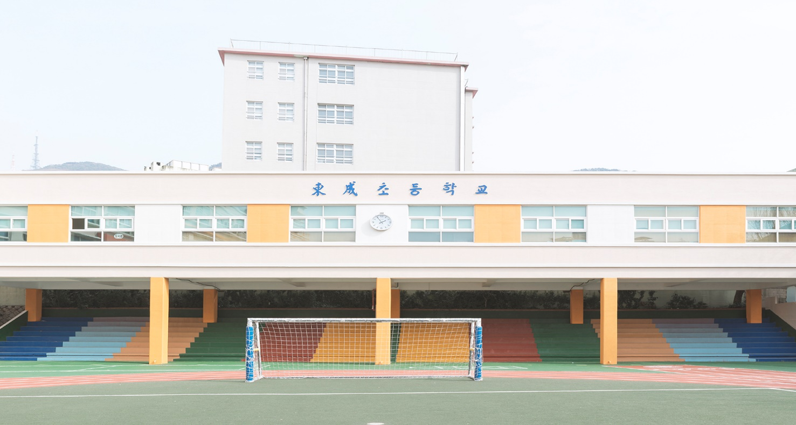
Use Cases
Within school facility →
partial control from teacher side
Outside of school→ not any control (!!)

Slide 6
Use Cases
Use Case 1
Use Case 2
Use Case 3
Automated reporting
Manual reporting (through victim)
Manual reporting (through classmate)
Actors
Actors
Actors
Student (victim) (main),
Teachers, parents, school counselors (receiver),
other classmates (indirect actors)
Student (victim) (main),
Teachers, parents, school counselors (receiver),
other classmates (indirect actors)
Classmates (observers) (main),
Teachers, parents, school counselors (receiver),
other classmates (indirect actors)
Flow
Flow
Flow
Automated capturing process of heartrate (primary), sound, location, motion, time (additional signals)
Analysis of signals to detect bullying situation
Notifications and reports to receiver (teachers, parents, school counselors)
Student (victim) report bullying situation by himself by sending description (text or (picture)) about bullying situation
Directly transferring to the teachers, parents, school counselors
Classmates (observers) report bullying situation by sending information (text+picture) about observed bullying incident
Direct transmission of information to receiver side (teachers, parents, school counselors)
Main focus (!)
Refinement
Refinement

Slide 7
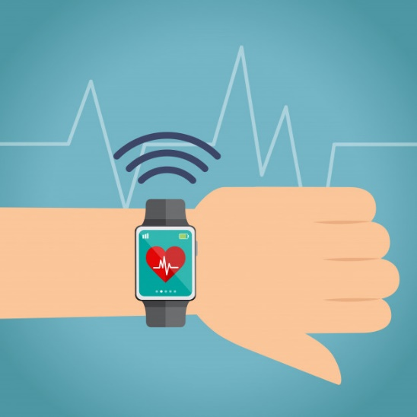
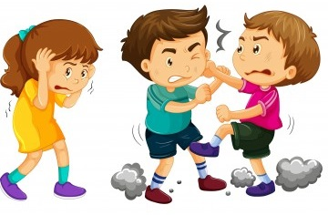


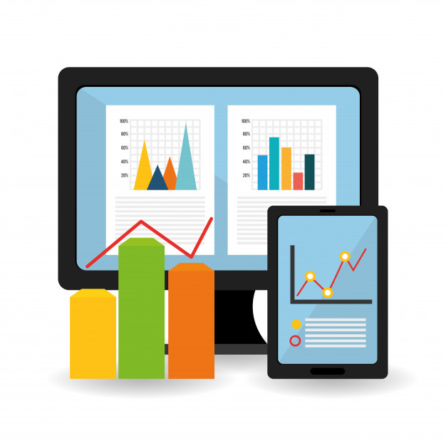
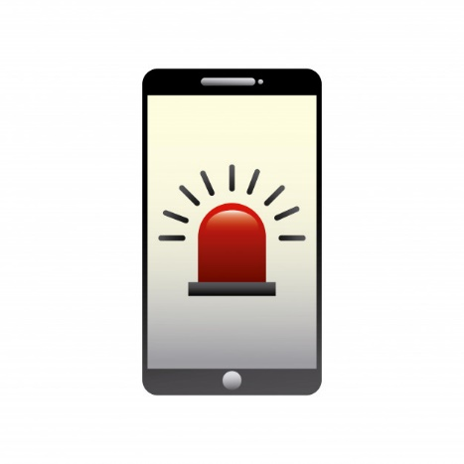
Use Cases (Automated reporting)
Automatized detection of (high heart rate (primary) & basing on increased heart rate consideration signals (sound, location, motion, time)
Analysis via server
Bullying situation
Notify teachers, parents, or mentors & investigation of bullying incidents & (frequencies)
Credits to freepik

Slide 8
DE
MO

Slide 9



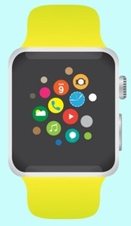
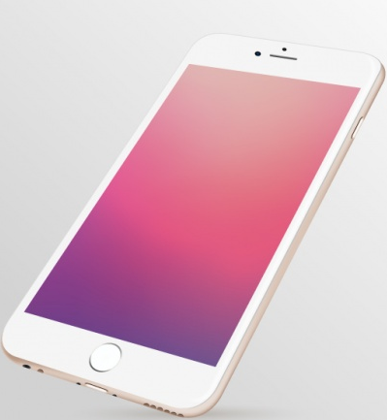
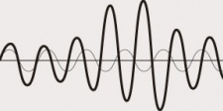
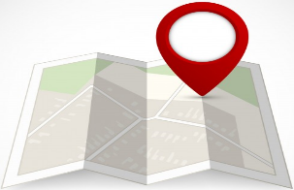
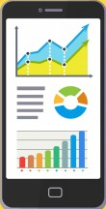

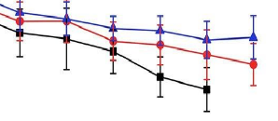
System architecture view
Primary signal
Locations of audio files
Student
Actual audio files
Communication between
Watchkit Extension and IOS app
Processing
Filtering & Analysis
Server
Visualization of bullying signals
Additional signals
Teacher
Notes:
모든 신호들이 한꺼번에 보내진다 → 나중에 구별함

Slide 10
Technical challenges & solutions
Availability of all ios devices (macbook, iphone, smartwatch) to develop for development
Smartwatch 4 series just work with iphone from iphone 5s upwards
No direct access to sensors → access through different frameworks (e. g. using variables in Healthkit to access heartrate) → near real time data
Access to frameworks → developer account required (costs)
Implementation of authorization component necessary → otherwise impossible to read data
High power consumption, since LED lights continously on→ pushing to background or tracking within some time interval (discussion point)
Storage issue due to saving audio files
Just saving critical audio snippets through distinction of dB level
Storing locations/paths of audio files in data base to reduce processing overhead
Server configuration with required settings for access
Web service setup and opening the services for the coming signal from the smart watch
Further analysis of data
IOS side
Server side

Slide 11
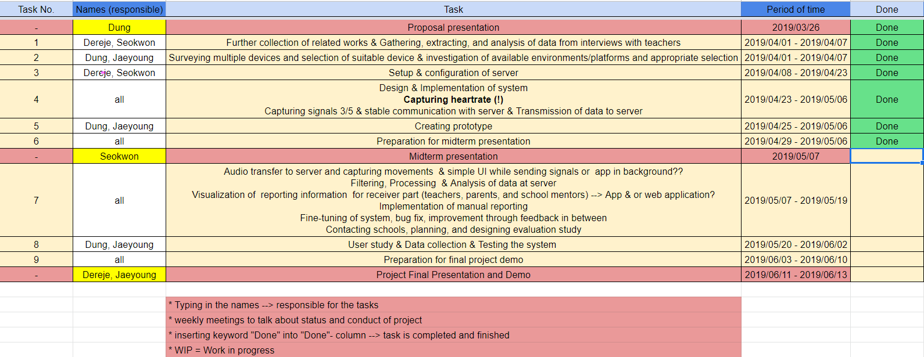
Revised project schedule
Where are we now?

Slide 12
Success criteria & final deliverable
Milestone reached → satisfied
capturing signals 4/5, even though alternative ways had to be taken
GPS data
Hearbeat bpm
Audio recording
Time
Solid communication between smartwatch/app and server
Successful transmission of heartrate and location data
Can our system calculate and conduct the analysis fast enough?
Punctual and early reporting to teachers feasible?
Application of our system useful and helpful?
Finding subjects to test and schools willing to participate
Application of our system useful and helpful?
Notes:
Access of frameworks instead of direct access to sensors
Solid communication between smartwatch/app and server could be established
We get manually victim report and automatically process it
We should finish fast,the victim could be in dangerous situation.
Expected (technical challenges) & solution ideas
Set of distinct relevant data, however full elimination of false positives not ensured
Set still indicates ordinary situations (e.g. active playing in schoolyard)
Not every student possesses smartwatch yet (!) → smartwatch becomes affordable soon → accessible for great group of people
Data cleansing cumbersome & tedious
Utilized device supports intended functionalities?? → alternative ways

Slide 13

Conclusion
Full control of bullying & suspicious situations extremely difficult for teachers
Early & fast recognition of bullying signs → huge step towards efficient prevention & exacerbation of problem impossible
Automatization of detecting & reporting bullying signals → great assistance
Increased heartrate → consideration of further signals (sound, location, motion, and time)
Manual reporting through victim or classmate, just supportive functionalities → main focus on automatization
Milestone:
capturing 4/5 signals (heartrate!!), stable communication between watch/app & server, and successful data transmission
Notes:
Preventing bullying situation to happen, since trying tackling root of problem
Alternative paths have to be taken
But, necessity of our system to be very fast

Slide 14


What comes next?
Next: Capturing movements, audio files transfer, analysis of signals, visualization for receiver (app or web page??) → advices and suggestions appreciated
Pending challenges:
Necessity of our system to be very fast (feasible?)
Storage problem → storing audio files
Finding test subjects & schools
Notes:
Preventing bullying situation to happen, since trying tackling root of problem
Alternative paths have to be taken
But, necessity of our system to be very fast

Slide 15


Automated bullying reporting system: Midterm presentation
Team 3: Seokwon Choi, Dereje Regassa, Jaeyoung Kim, Thanh Dung Ho
Thank you for
your attention!

Slide 16

Automated bullying reporting system: Midterm presentation
Team 3: Seokwon Choi, Dereje Regassa, Jaeyoung Kim, Thanh Dung Ho
Questions?
Comments?
Suggestions?

