Slide 1



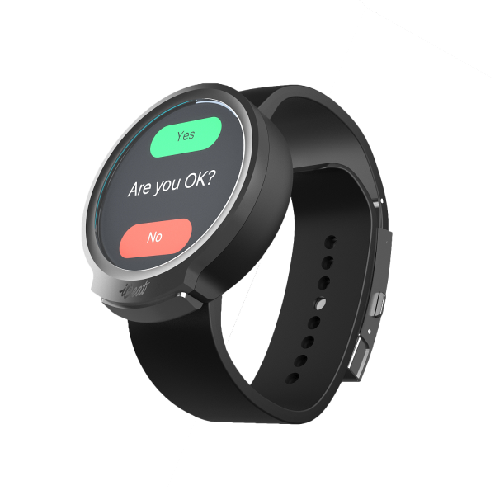
Automated bullying reporting system
Team 3
Proposal presentation: Seokwon Choi, Dereje Regassa, Jaeyoung Kim, Thanh Dung Ho

Slide 2
Agenda
Motivation → idea
System
Project procedure
Conclusion

Slide 3
Motivation
Bullying → a pervasive social issue worldwide (incl. South Korea)
Involved adolescents and children
Behavioral, emotional, social problems, suicidal/self-injurious behaviors
Poor performance in school
Emergence of cyberbullying (Daejeon primary school, Manjeong primary school, Seoil middle school, Ganggyeong-eup High school)
Effective addressing & prevention of bullying situations → high priority for schools
Problems:
Teachers not in full control of every bullying situation → situations outside of school (Seoil middle school, SongPa middle school, Bubal primary school)
Difficulty to communicate bullying situation → victims & witnesses (classmates)
No quick intervention possible
Notes:
Constitutes also serious concern in S. Korea
Point out importance of cyberbullying to pay attention
Cannot grasp every bully situations → unknown bullying situations for teachers
Scared to become victim
Long-term consequences for victim

Slide 4
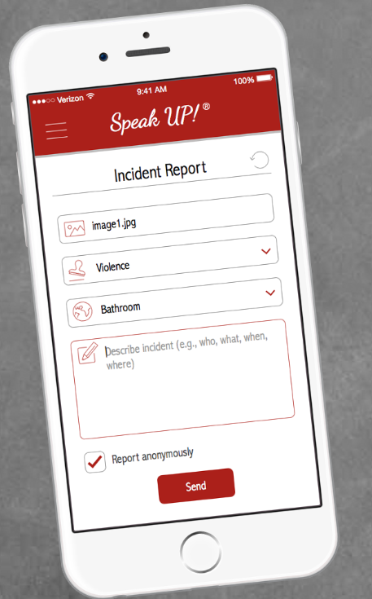

Existing solutions & limitations
Recognition of affective states from physiological data (Wagner, Kim & Andre, 2005)
Utilization of four-channel biosensors
Strong connection between physiological reaction & affective states
Algorithms difficulties to separate some emotions
Speak Up!, Bully Button
Anonymous way to report bullying incident
Witness must be present & willing to report
Exclamo
Facilitation → anonymous communication of bullying incident
→ No automation provided
Notes:
- Through app or web

Slide 5
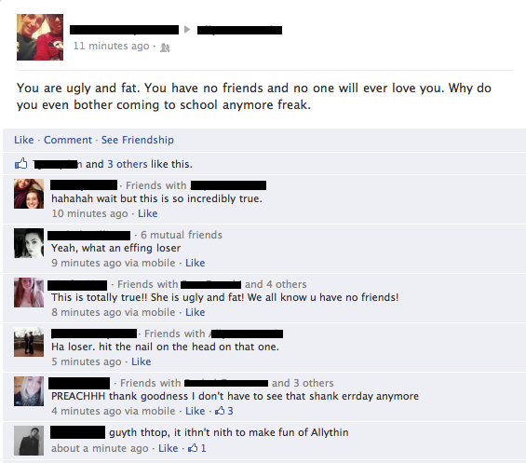
Our vision/idea
Enhancing the process of detection of bullying situations
Offering self-acting and automatic mechanism to identify bullying signals
System sufficient automated → Tendencies and trends of bullying discovered at early stage, enhancement of fast reaction, better adjustments for interventions, and better prevention conducted
Support for victims → difficulties to express their problem
Not absolutely dependent on action of witness
Provide huge benefit to society
Strong focus on physical bullying, but problem of cyberbullying recognized
Target users: Students (Primary - High school)
Notes:
Solutions can be offered at a faster pace
Meet students‘ need at a faster level
Improve public good by effective usage of technology

Slide 6




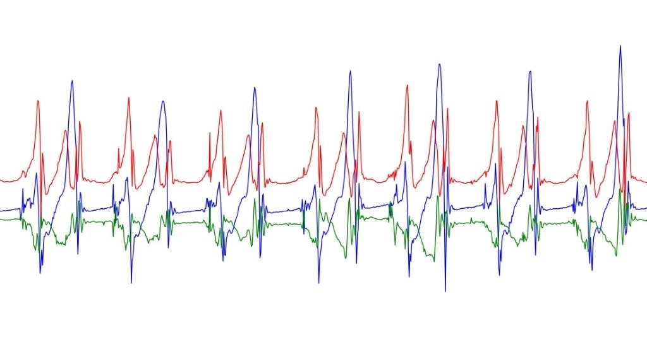
Data sources to detect
Heart rate → high heart rate!!
Sound (through microphone)
Location (GPS)
Time (Time stamp)
Hand motions (accelerometer)
Notes:
-heart rate most distinct data source/factor

Slide 7
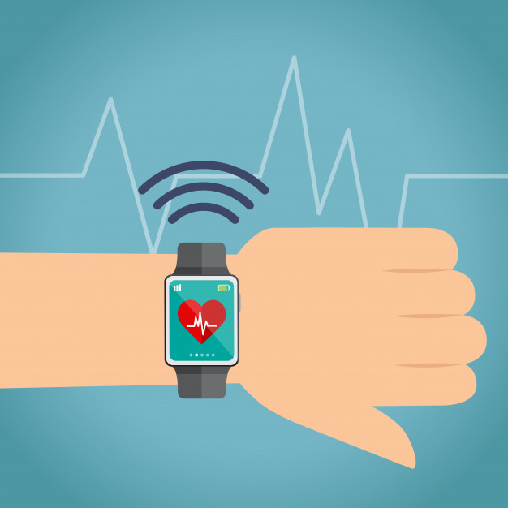
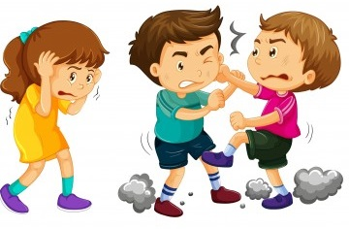




System overview (1)
Detection of (high heart rate, sound, location, time, hand motions)
Processing the data
Bullying situation
Notify teachers, parents, or mentors & investigation of bullying incidents & frequencies
Credits to freepik

Slide 8

System overview (2)
Witness among classmates
Processing the data
Bullying situation
Notify teachers, parents, or mentors & investigation of bullying incidents & frequencies
Credits to freepik

Slide 9

System overview (3)
Self-report through victim
Processing the data
Bullying situation
Notify teachers, parents, or mentors & investigation of bullying incidents & frequencies
Credits to freepik

Slide 10
Expected (technical challenges) & solution ideas
Set of distinct relevant data, however full elimination of false positives not ensured
Set still indicates ordinary situations (e.g. active playing in schoolyard)
Not every student possesses smartwatch yet (!) → smartwatch becomes affordable soon → accessible for great group of people
Data cleansing cumbersome & tedious
Utilized device supports intended functionalities?? → alternative ways

Slide 11
Usage scenarios
Within school facility (classroom, hallway, schoolyard, sports field, etc.)
Outside of school facility
Getting to and from school
Outward and return path (to/from academy, leisure clubs)
Notes:
For teachers → not able to overview and have control about every bullying situations and moments → outside of classroom
Determination of relevant scenarios → focus on

Slide 12
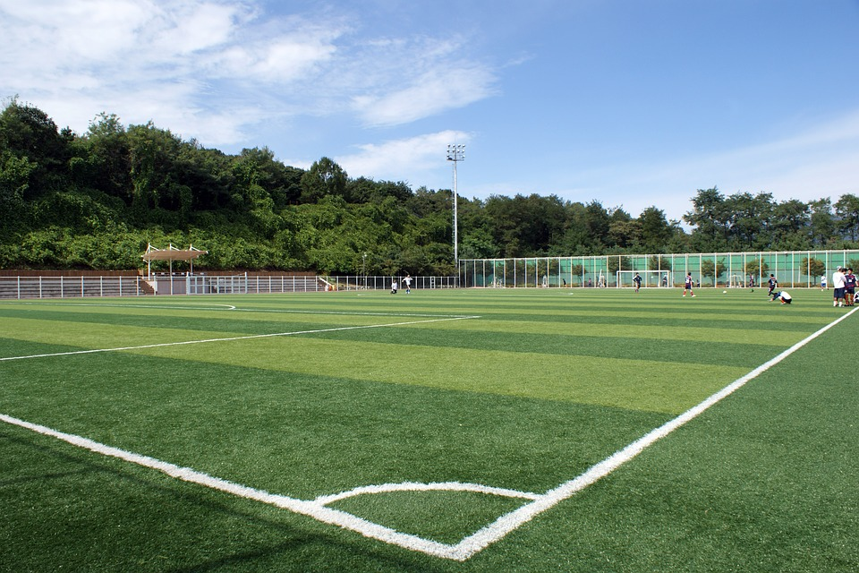

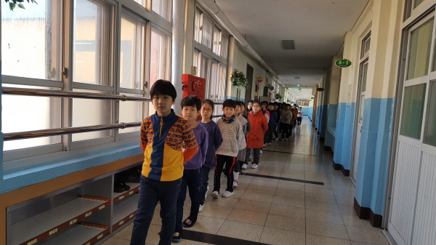
Usage scenarios
Within school facility (classroom, hallway, schoolyard, sports field, etc.)

Slide 13
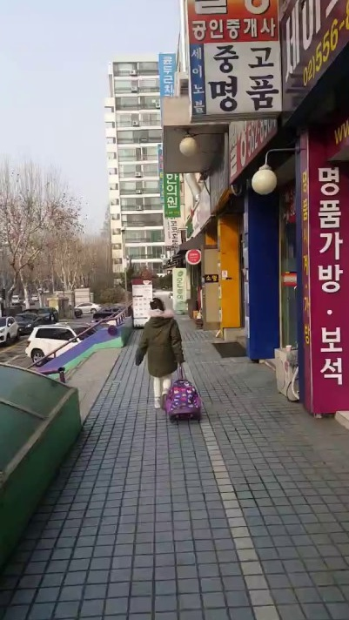
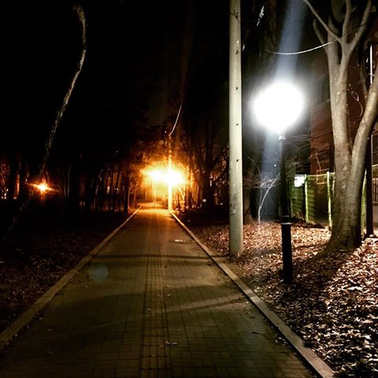
Usage scenarios
Outside of school facility

Slide 14
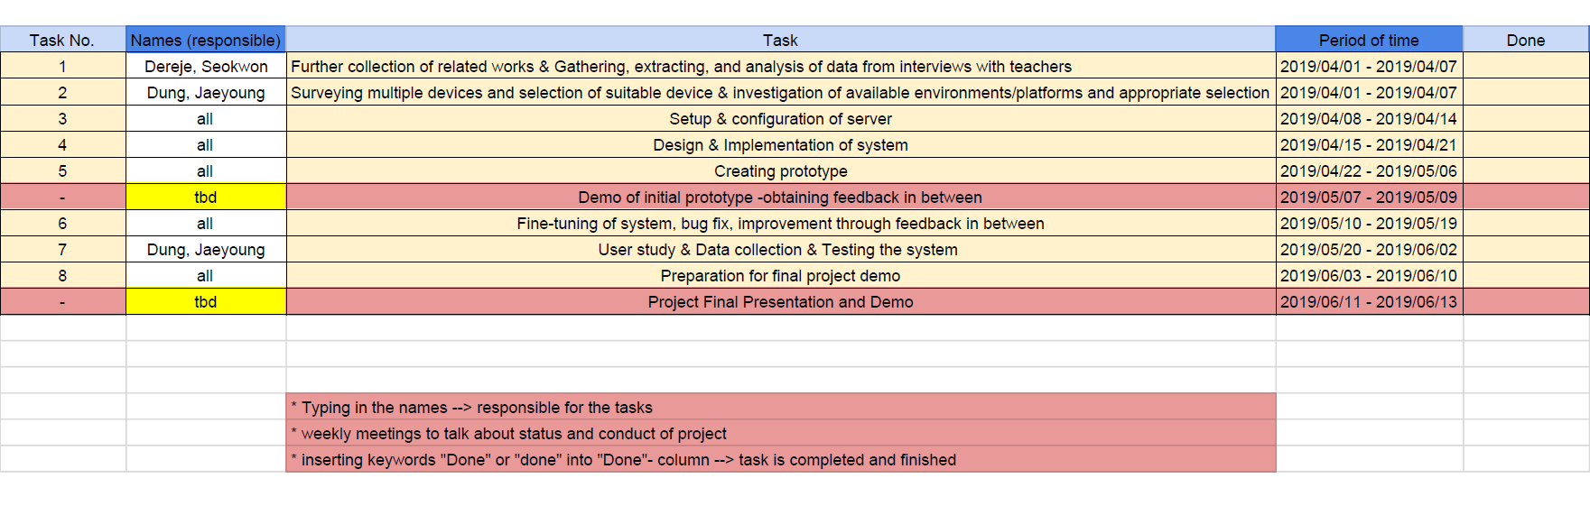
Overall project plan

Slide 15
Success criteria of final deliverable
Our work, whether efficient to automate the process of reporting bullying situations → speeding up the process??
Useful to solve problem to some extent?
Evaluation of system required through user study
Results from user study confirm our assumptions?
Notes:
What are the measurements to judge successs of system?
Laying a foundation possible
Positive resonance available

Slide 16
Conclusion (initial)
Outside classroom especially difficult → overview & control about bullying situations
Automatization of detection and reporting signs of bullying
Identifying sets of indicator data (heart rate, sound, location, time, hand motions) → bullying situation distinguishable
Increasing importance of cyberbullying, focus largely on physical bullying (offline bullying) → spare time → realizing feature for cyberbullying
Bullying and cyberbullying strongly go hand-in-hand (continuation in complementary environment & bully locally close to victim)
Great potential
Opportunity of automatic defense → help for weak ones
Detection of signs of bullying as quickly as possible → act in time & develop countermeasures (teachers, parents, or mentors)
Leveraging modern technology to combat social issue

Slide 17

Automated bullying reporting system
Team 3: Seokwon Choi, Dereje Regassa, Jaeyoung Kim, Thanh Dung Ho
Thank you for
your attention!

Slide 18
Automated bullying reporting system
Team 3: Seokwon Choi, Dereje Regassa, Jaeyoung Kim, Thanh Dung Ho
Questions?
Comments?
Suggestions?

