Slide 1

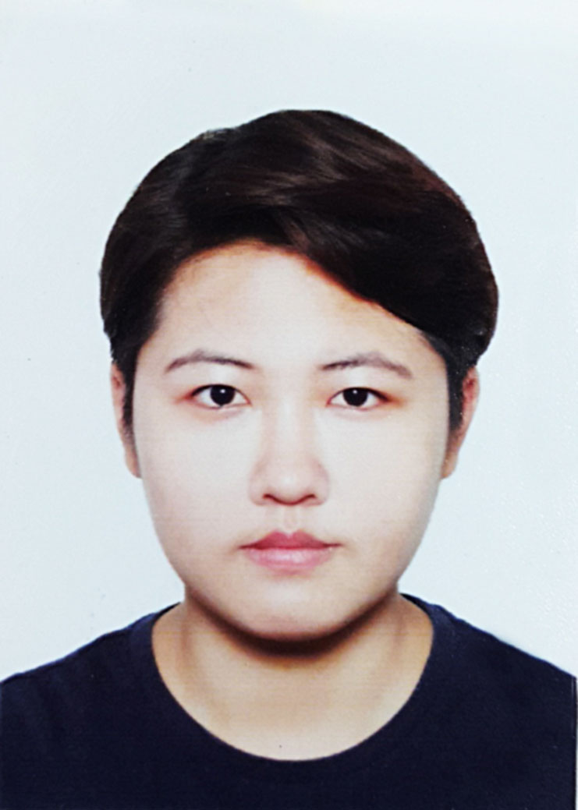

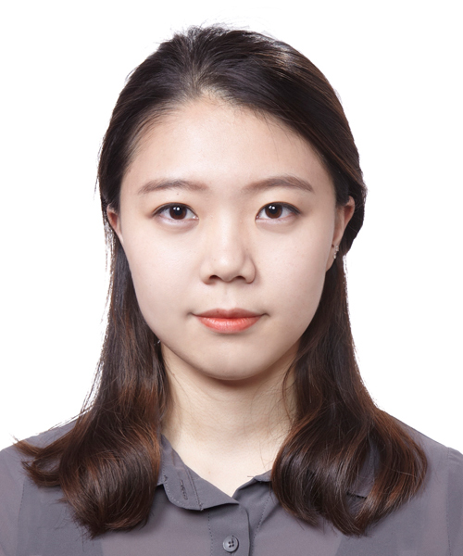
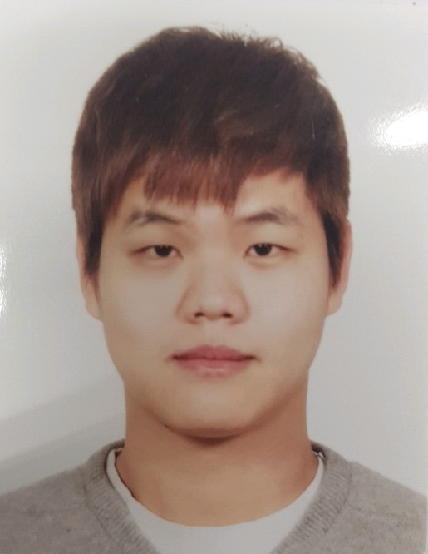
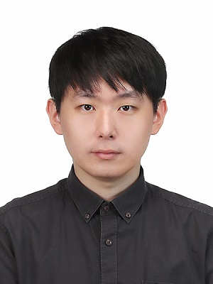


손광훈 교수 연구팀 IEEE/CVF Conference on Computer Vision and Pattern Recognition (CVPR) 2021
5편 논문 발표 승인
손광훈 교수 연구팀이 세계 최상위 컴퓨터비전 학술대회 IEEE/CVF Conference on Computer Vision and Pattern Recognition (CVPR) 2021 (Google Scholar h5-index 299, Computer Vision & Pattern Recognition 분야 Rank 1)에 5편 발표 승인되었다.
본 연구들은 박사과정 이지영, 전상률, 정소미, 박정인, 김한재 학생들이 1저자, 손광훈 교수가 교신저자로 주도하였다.

Slide 2
Prof. Sohn’s Team Published 5 Papers
on IEEE/CVF Conference on Computer Vision and
Pattern Recognition (CVPR) 2021
5 papers has been accepted on IEEE/CVF Conference on Computer Vision and Pattern Recognition (Google Scholar h5-index 299, Rank 1st in Computer Vision & Pattern Recognition category).
This work was done by Jiyoung Lee, Sangryul Jeon, Somi Jeong, Jungin Park, Hanjae Kim Ph.D. Candidate, as the 1st authors and Prof. Kwanghoon Sohn as the corresponding author.

