Slide 1
The Convenience Factor: Residential Valuation Using Machine Learning
A Haystacks.ai Project

Slide 2
Introduction
Haystacks.ai has conducted extensive analysis on internal amenities (in-complex daycare, gyms) and their effect on rental prices.
Now, we want to find out how external amenities, such as grocery stores and schools, directly influence rental price.
These external amenities will be referred to as “Points of Interests” or POIs

Slide 3
How do external amenities impact rental prices on Build-to-Rent and Single/Multi Family Rental Homes?
Which external amenities significantly influence rental price the most?
To what extent does distance affect rental prices in regards to selected external amenities?
The Business Questions

Slide 4
Convenience (As a Feature)
Grocery stores are divided into traditional and non-traditional types, are dependent on their regions, and are occasionally divided between their size, price of goods, or even year-end sales.
Supermarket | A large shop for groceries. It's a full service grocery store that often sells a variety of non-food products as well. Almost always part of a chain (Publix, Harris Teeter, Piggly Wiggly, BiLo, Ingles, Bells, Earthfare).
Variety Store | A variety store or price-point retailer is a retail shop that sells inexpensive items, usually with a single price point for all items in the store (Dollar Tree, Family Dollar, Dollar General).
Warehouse Club | A non-traditional membership-retailer hybrid that sells bulk products in a warehouse environment. At least 40% of products devoted to grocery (Costco, Sam’s Club, BJ’s).
Supercenter | A non-traditional food and drug store combination that sells mass merchandise. At least 40% of products devoted to grocery (Target, Walmart).
Convenience Store | A non-traditional, limited store that sells variety of general merchandise, including packaged food products (7-Eleven, Quick Trip.)

Slide 5
What Does the Literature Say?
Distance is Statistically Significant
Type of Store Matters
It was consistently shown that, the closer a home was to selected amenities, there was an increase in rental prices. This both applied to higher income households and low income households.
Higher income households are able to change grocery stores more easily, are more able to travel, and are more interested in service availability (EG parking).
Development Trends Spark Rental Price Increase
Considered “revitalization”, even in poor neighborhoods, the development of new grocery stores shows a positive increase in rental prices. This applies most to those houses closest to the new lots.

Slide 6
Features as a Measurement
Because of the variety and quality of features, we will vary whether we use distance, density, or both based on the type of feature being used.
Distance-Based
Density-Based
Using sources like Google.api, Foursquare, and OpenStreetMap, we will join geospatial dataset with the rental dataset to find most influential feature influences. As a base, it would be closest *feature* to location given.
However, we also have a previous data that gave us set limits of: 0-199.9, 200-399.9, 400-599.9, and 500-800 meters. 400-599.9 was considered not statistically significant. This should be kept in mind.
Essentially the same as the distance-based, except using quantity within a 1 mile radius. We will keep ideally keep the same radius throughout of 1 mile throughout the analysis to ensure features are measured on comparable scales. See previous comments on distance about significance.

Slide 7
OUR GUIDING PRINCIPLES
Random Forest
XGBoost
1.
2.
Capture non-linear relationships and interactions between amenities and rental prices.
Like Random Forest, but typically more powerful and faster, especially with large datasets. It also handles missing values and scales well.
Multiple Linear Regression
Kernel Ridge Regression
3.
4.
Seek to understand the linear relationship between rental price and external amenities along with other features.
Useful for capturing complex non-linear effects without requiring explicit interaction terms or feature engineering.

Slide 8
ROADMAP
WEEK | OBJECTIVE
ONE: Design and Data Gathering | Finalize project proposal based on Week Zero’s discussions; begin data collection.
TWO: Extract, Transform, and Load | Finalize a geospatial data set that can be merged for machine learning; begin creating models.
THREE: Modeling | Begin Modeling, present initial findings or ”Minimum Viable Product”
FOUR: Refine | Refine MVP based on feedback and draft summary paper
FIVE: Finalize Findings | Summarize findings in Capstone paper
SIX: *Buffer* | Unknown if needed for more time with modeling and/or Capstone paper

Slide 9
Table 1: Score Comparison for Distance, Validation
Model | R-Squared | Mean Squared Error | Root Mean Squared Error | Mean Absolute Percentage Error
XGBoost | 0.6288 | 309641.3048 | 556.4542 | 0.1379
Random Forest | 0.5817 | 348921.4715 | 590.6958 | 0.1449
MLR Regression | 0.3291 | 559709.7060 | 748.1375 | 19.830
MLR, Ridge | 0.3292 | 559639.9084 | 748.0908 | 0.1981
Table 2: Score Comparison for Distance, Test
Model | R-Squared | Mean Squared Error | Root Mean Squared Error | Mean Absolute Percentage Error
XGBoost | 0.6291 | 316769.3253 | 562.8226 | 0.1394
Random Forest | 0.5911 | 349255.2903 | 590.9782 | 0.1492
MLR Regression | 0.2574 | 634274.5192 | 796.4135 | 20.403
MLR, Ridge | 0.2582 | 633533.7671 | 795.9483 | 0.2038
Notes:
Mean squared error (MSE) measures error in statistical models by using the average squared difference between observed and predicted values. Smaller value represents better predictive accuracy. MAPE of 0% represents perfect accuracy. ***Bolded means it’s the superior version compared between the validation and test, bolded model means it’s best model in the set.
Summary: When it came to distance, the validation set had the tendency to be the superior set, however, XGBoost was the best model overall for both validation and test sets.

Slide 10
Table 3: Score Comparison for Density One, Validation
Model | R-Squared | Mean Squared Error | Root Mean Squared Error | Mean Absolute Percentage Error
XGBoost | 0.5085 | 410352.3351 | 640.5875 | 0.1605
Random Forest | 0.5116 | 407739.4850 | 638.5448 | 0.1571
MLR | 0.3511 | 541733.20434 | 736.0253 | 19.5409
MLR, Ridge | 0.3508 | 542014.0598 | 736.2160 | 0.1938
Table 4: Score Comparison for Density One, Test
Model | R-Squared | Mean Squared Error | Root Mean Squared Error | Mean Absolute Percentage Error
XGBoost | 0.5163 | 412909.7081 | 642.5805 | 0.1616
Random Forest | 0.5351 | 396812.5157 | 629.9306 | 0.1595
MLR | 0.3162 | 583738.0604 | 764.0275 | 20.0027
MLR, Ridge | 0.2864 | 609193.5542 | 780.5085 | 0.1997
Notes:
The Random forest was the best model for both test and validation set when it came to density one mile. However, random forest was the only model that stood out as superior for the test set in comparison to the validation set when it came to higher score in more than on category.

Slide 11
Table 5: Score Comparison for Density Five, Validation
Model | R-Squared | Mean Squared Error | Root Mean Squared Error | Mean Absolute Percentage Error
XGBoost | 0.6673 | 277804.1720 | 527.0713 | 0.1325
Random Forest | 0.6578 | 285663.4849 | 534.4750 | 0.1317
MLR | 0.4425 | 465456.8132 | 682.2440 | 18.1823
MLR, Ridge | 0.4423 | 465595.5883 | 682.3457 | 0.1816
Table 6: Score Comparison for Density Five, Test
Model | R-Squared | Mean Squared Error | Root Mean Squared Error | Mean Absolute Percentage Error
XGBoost | 0.6413 | 306218.4166 | 553.3701 | 0.1341
Random Forest | 0.6387 | 308414.5352 | 555.3508 | 0.1328
MLR | 0.3635 | 543307.2766 | 737.0938 | 18.6553
MLR, Ridge | 0.3640 | 542902.2563 | 736.8190 | 0.1863
Notes:
Like with distance, XGBoost was the best model for both the validation and the test sets. Unlike with either the density one mile and the distance models, the test models were not superior in any category compared to the validation sets.
Use lassoregression instead of ridge

Slide 12
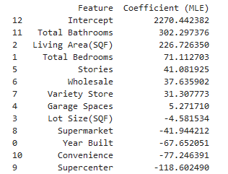
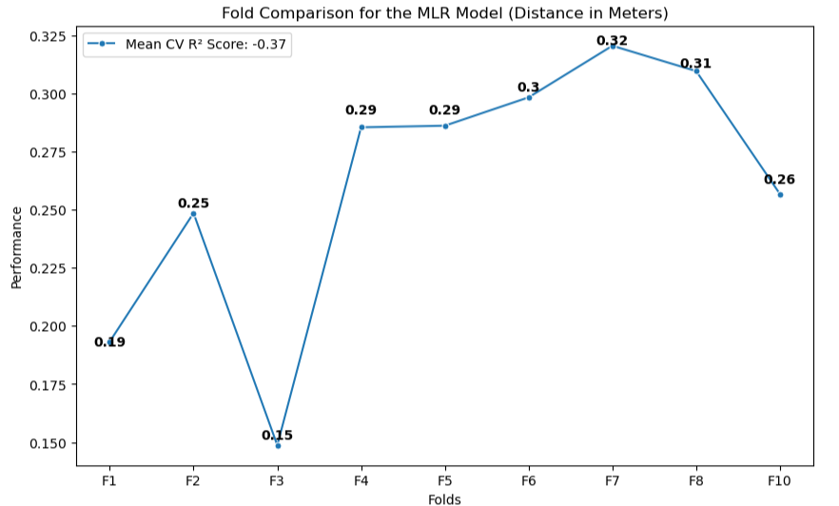
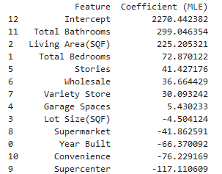
MLR: Distance
*Note: F9 was -5, which distorted the scale, so it was excluded.
Notes:
Mean likelihood estimation for coefficients. Try using lasso. SHAP values for sensitivity analysis, creates a fake coefficient. Log transform target variable. Transform features for interpretability purposes (every % increase, then % increase in target)

Slide 13
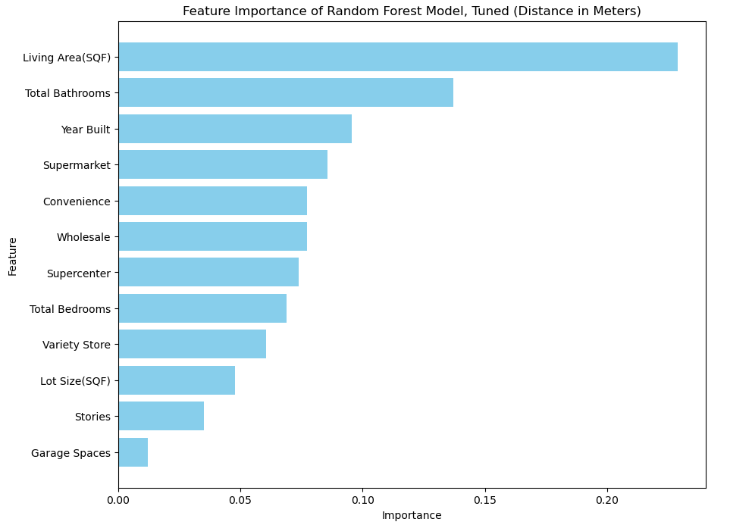
Random Forest: Distance
Notes:
Greatest importance to supermarket and convenience.

Slide 14
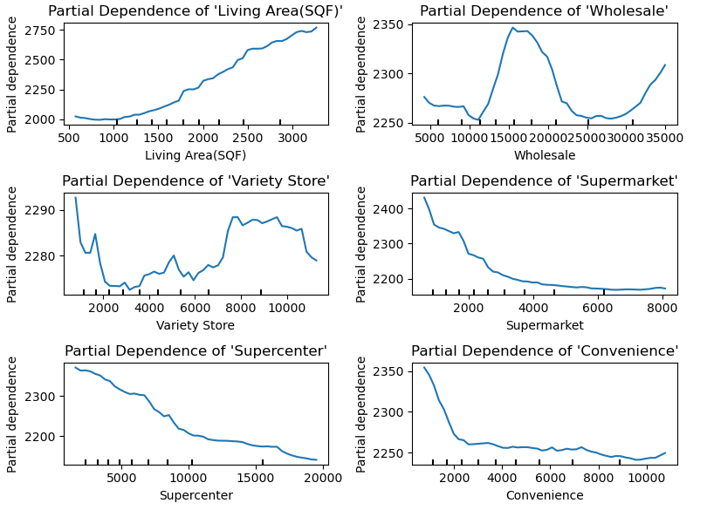
Random Forest: Distance, Partial Dependency Display
Notes:
Measured in meters, implies no particular trend in variety store. High degree of INITIAL dependence for SC, C, and SM, sudden rise for wholesale at around 9 miles.

Slide 15
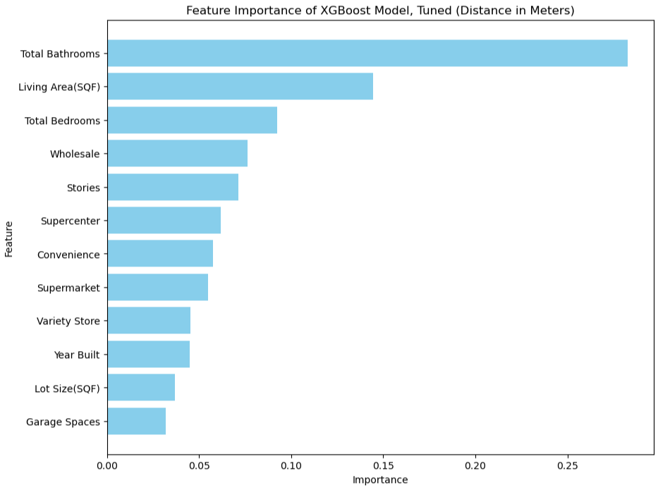
XGBoost: Distance
Best Score (R2): 0.63539347883034
Notes:
Unlike RF, greatest importance to wholesale and SC with convenience and SM trailing behind.

Slide 16
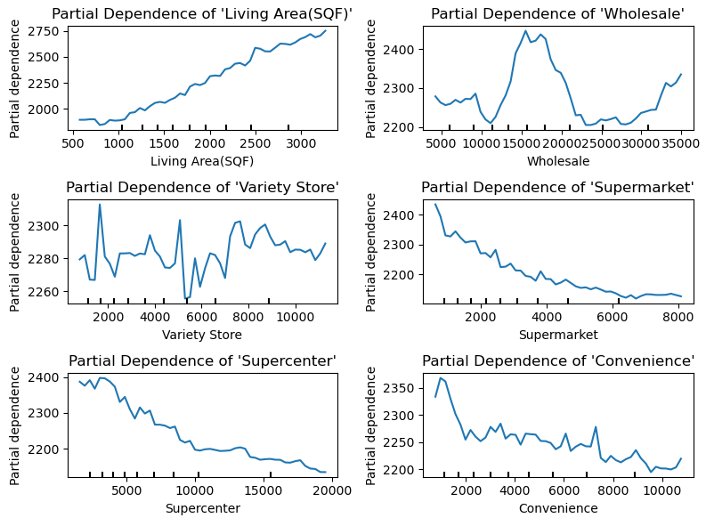
XGBoost: Distance, Partial Dependency Display
Notes:
Same as RF, mostly.

Slide 17
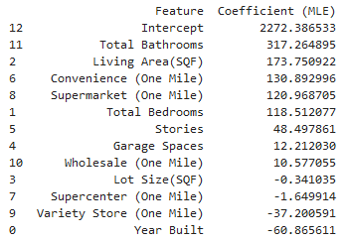
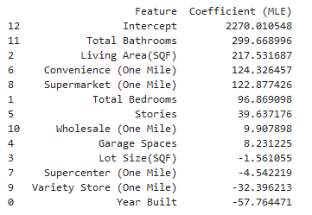
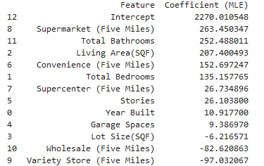
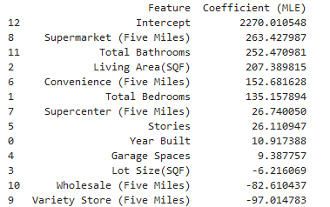
MLR: Density
MLR Density (One Mile)
MLR, Ridge Density (One Mile)
MLR: Density
MLR Density (Five Mile)
MLR, Ridge Density (Five Mile)
Notes:
One mile demonstrates a positive correlation with convenience and supermarket, but only a minor influence with wholesale. It then asserts a very, very slight negative correlation with supercenters and a negative correlation with variety stores. Five miles says a bit differently, asserting a positive influence of supercenters and a very negative influence of wholesale.

Slide 18
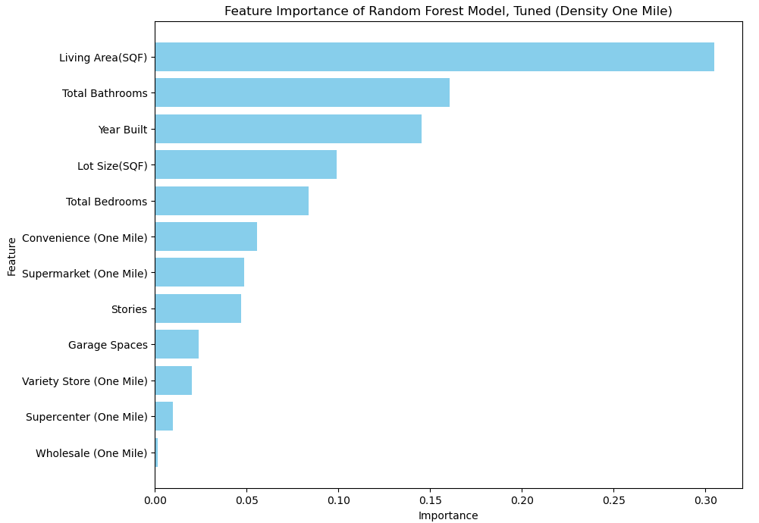
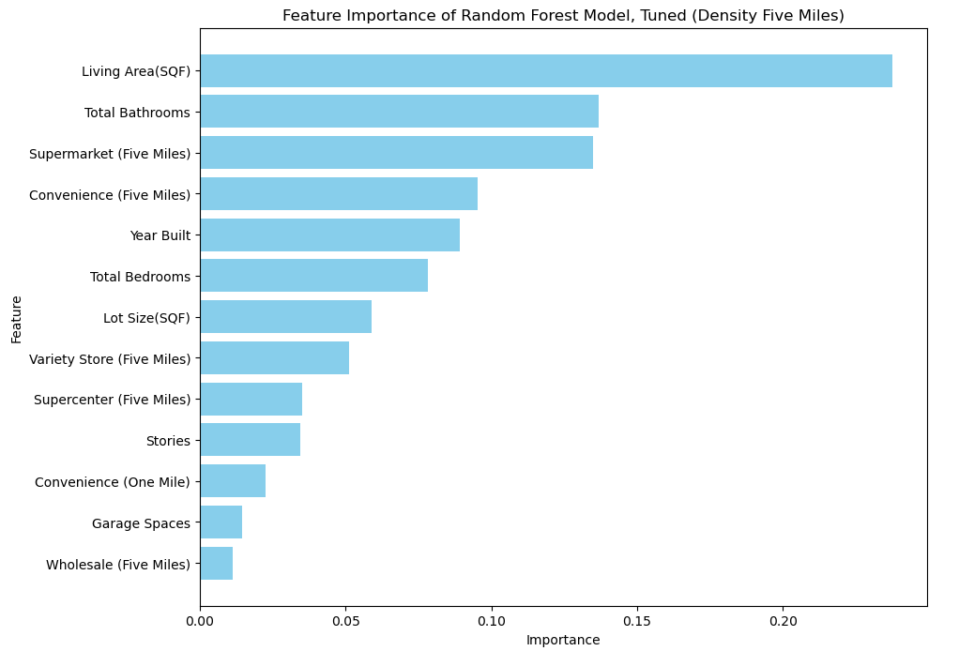
Random Forest: Density
Notes:
Supermarket and convenience stores are consistently rated as the most important, while wholesale drags behind as the least important. VS and SC are somewhere in the middle.
Do density 3 miles. Explain process, visuals that can be shared. SHAP is recommended. Remove stories, garage spaces, and lot size.

Slide 19
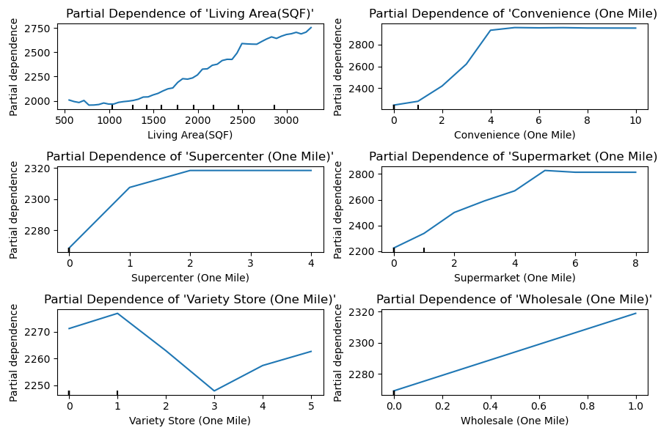
Random Forest: Density, Partial Dependency Display (One Mile)
Notes:
Implies that, as the number of stores increases, the dependency increases, with the exception of variety stores and at some point it levels out to not having a meaning.

Slide 20
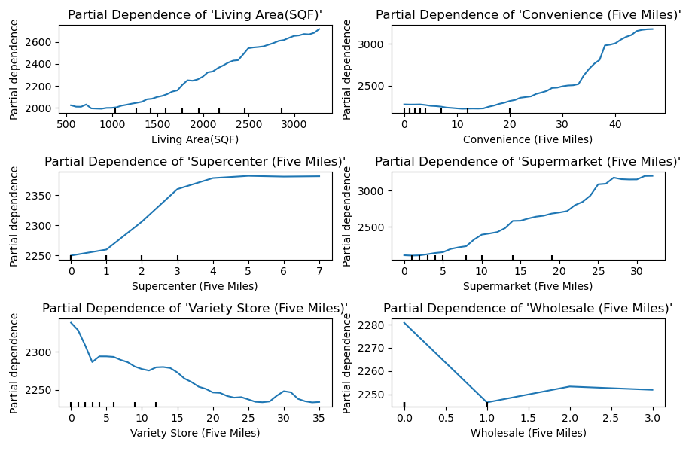
Random Forest: Density, Partial Dependency Display (Five Miles)
Notes:
This graph clarifies that it does not level out for any of the store types. However, variety store only seems to be effective with a few stores in the nearby area.

Slide 21
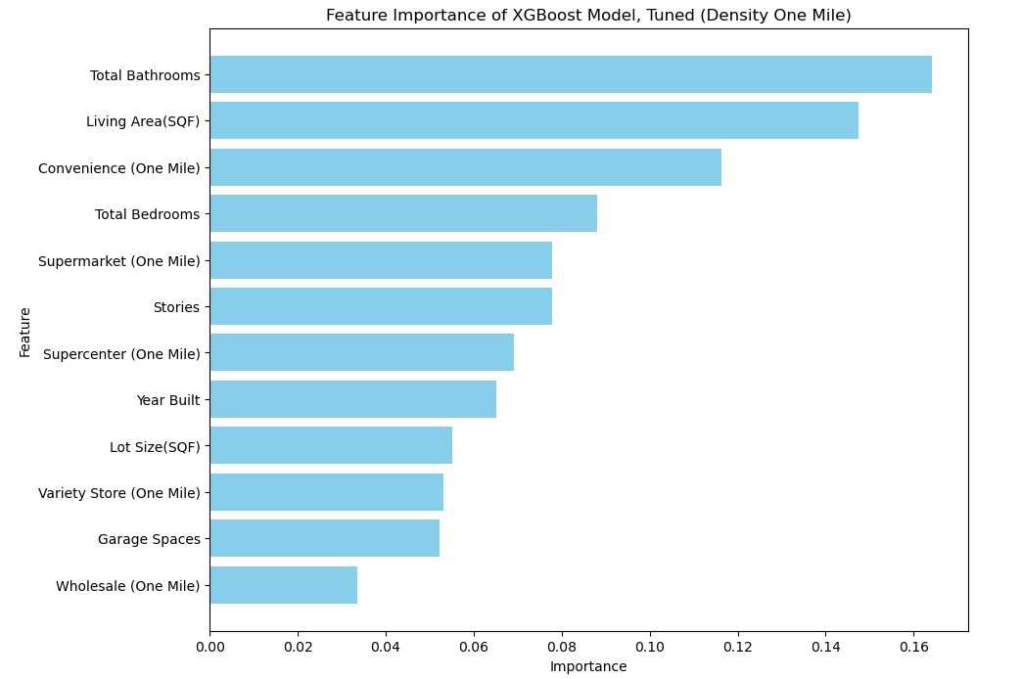
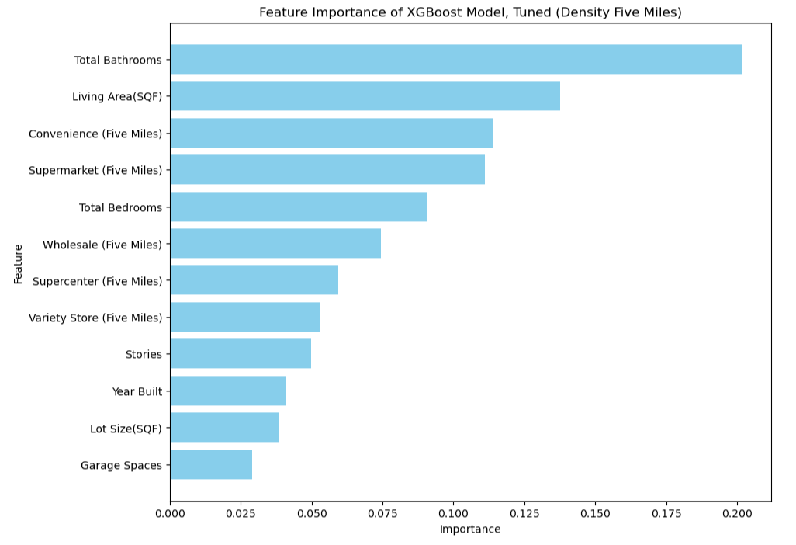
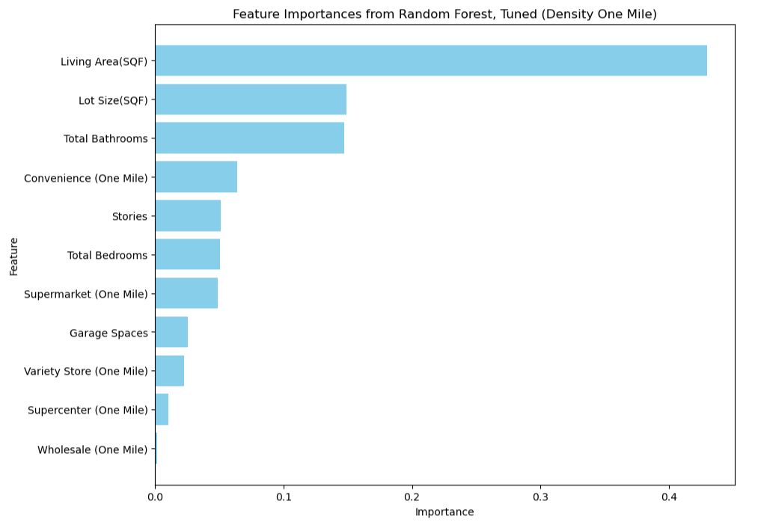
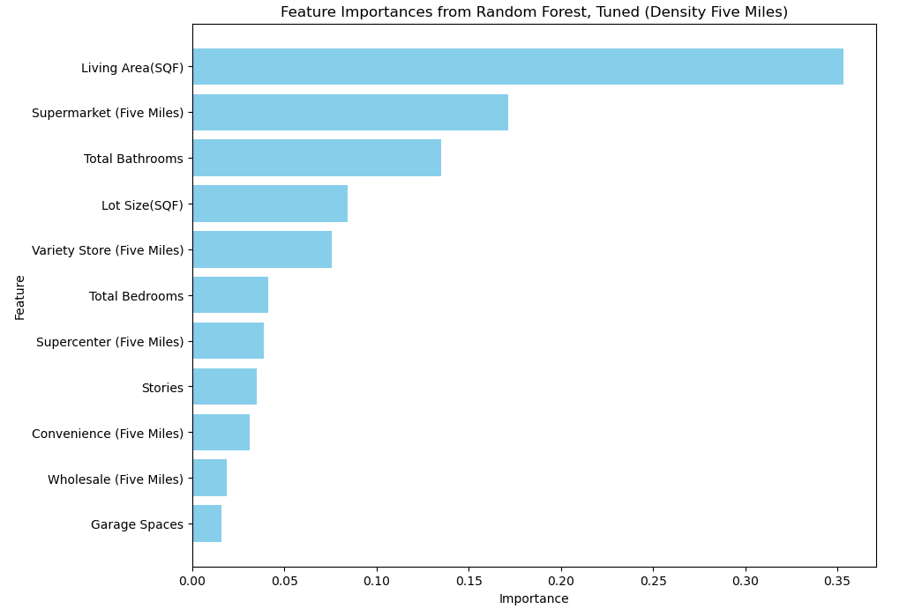
XGBoost: Density
Best Score One Mile (R2): 0.4730635911108848
Best Score Five Miles (R2): 0.6065610562120323
Notes:
Unlike Random forest plot, the five miles implies a larger importance to wholesale.

Slide 22
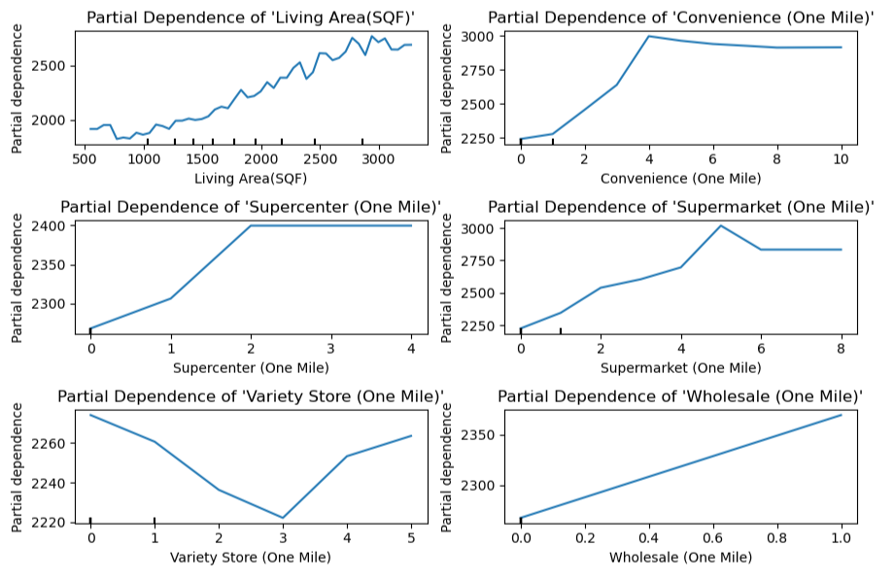
XGBoost: Density, Partial Dependency Display (One Mile)
Notes:
Mostly same as RF.

Slide 23
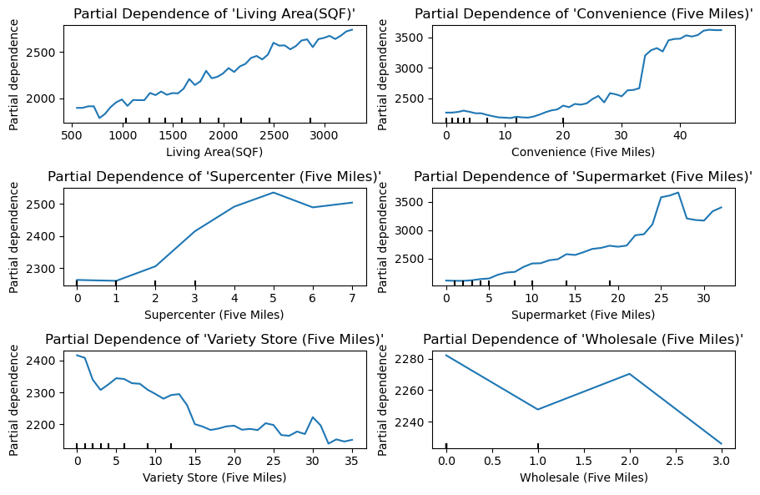
XGBoost: Density, Partial Dependency Display (Five Miles)
Notes:
Wholesale has a larger dependency compared to the RF plot 5 mile plot, spiking at 2, as do supermarkets, spiking at 25. Otherwise it’s mostly the same

