Slide 1
Democratic Backsliding: The Rise of Autocratization
By Daniel Immediato
NYC Data Science Academy

Slide 2
A Changing World
Democracy
Electoral Autocracy
Closed Autocracy
Since 1828, there were three “waves of democracy”, each of which caused a surge in democratic regimes, replacing the previous autocratic ones. But what is a “democracy”?
Those regimes that embody a "negative" view of political power, where civil liberties are protected, there is a strong rule of law, and limits are placed on executive power.
A regime that lacks in several components that make up a liberal democracy, but the rulers are still responsive to the citizens enough to not be complete dictatorships.
A regime where the liberal rule of law no longer applies and the rulers are no longer responsible to their citizens.

Slide 3
What Is Democratic Backsliding?
Put Simply:
A Peak?
It is the decay from one regime type to another (EG a democracy to an electoral autocracy).
This can come about both gradually or quickly, such as through a coup.
Each of the three waves hit a “peak”, where the number of countries autocratizing now outpaces the number of countries democratizing.

Slide 4

Democracy is Not a Permanent Fixture
It was once believed that stable, wealthy democracies would remain so. However, the mid-2000s have shown that even seemingly-stable democracies have recently shown a trend of democratic backsliding.
Perhaps the most notorious of this was the rise of right-wing populism since the Great Recession, with numerous populist political parties imbedding themselves in democratic institutions despite advocating for or using undemocratic methods.
Right-wing populists Viktor Orbán (left) of Hungary’s Fidesz and Santiago Abascal (right) of Spain’s Vox (Img. credit VOX España)

Slide 5
Measuring Democracy: the V-Dem Project
The Varieties of Democracy Project is a data collection effort in an attempt to provide an “overview of the state of democracy in the world”. They use five indices for what a democracy actually is, and then also collect data for numerous factors that may affect these indices. The V-Dem Project also analyzes political parties in much the same way, except this time having only two indices. It was already decided which factors most influenced the democracy level.
Polarization
Populism
Wealth Inequality
-Whether or not political camps interact in a friendly manner.
-The use of anti-establishment and anti-elite rhetoric, along with talks of reducing political corruption.
-The dispersion of income across the entire income distribution

Slide 6
Designing an App
The point was not to find the results of what the V-Dem already did, rather to visualize it in a way that was interactive an accessable.
This is a visualization of three different datasets hoping to tell a story that convey the same end-goal.
R-Shiny used multiple methods that introduced trends and both linear and non-linear models to answer the question if democracy is dissappearing lately.
The hope, then, is to match the base assumption of the key factors that V-Dem assumed.

Slide 7
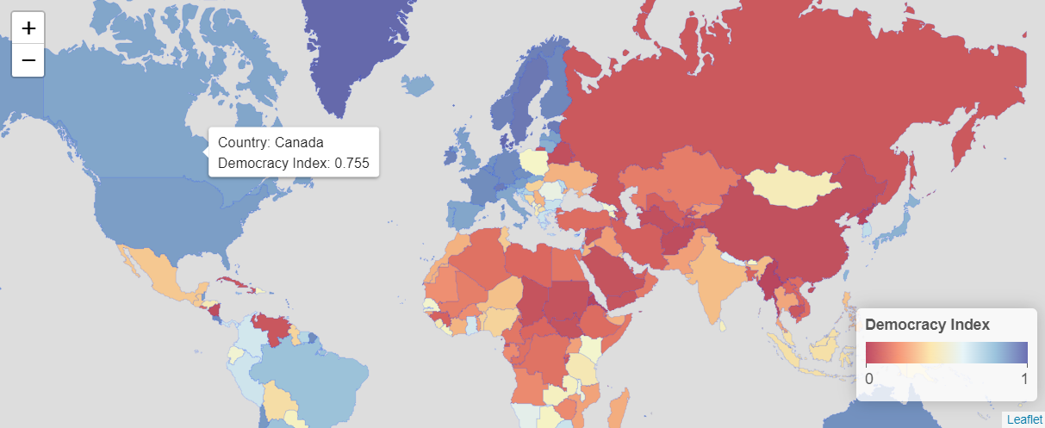


A Glimpse at the World
Canada
Poland
China
Classified as a Liberal Democracy
Classified as an Electoral Autocracy
Classified as a Closed Autocracy

Slide 8
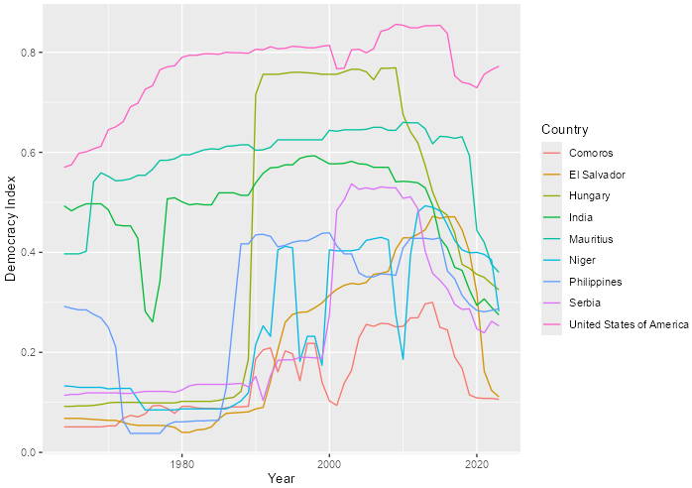
A Worrying Trend
Liberal Democracy Levels By Year
According to the V-Dem Index, global liberal democracy levels have been on the decline. This means that the rise of autocracies have surpassed countries becoming democracies.
This graph in particular shows the worrying trend of already at-risk countries slipping further into autocracy, with the countries selected being the worst offenders.

Slide 9
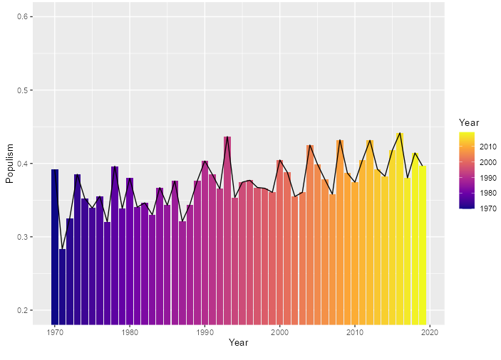
Populism as a Factor
Populist Rhetoric in Political Parties By Year
Populism is a separate index from the others, taking into account party behavior within the government. While the democracy index chosen was narrowed down to one (liberal democracy), the populism index was still kept as two: level of anti-pluralism and populist rhetoric.
Pluralism is how “agreeable” said political party is with other political factions.
On the right shows the general increase in populism over the years, especially since the 2000’s.

Slide 10
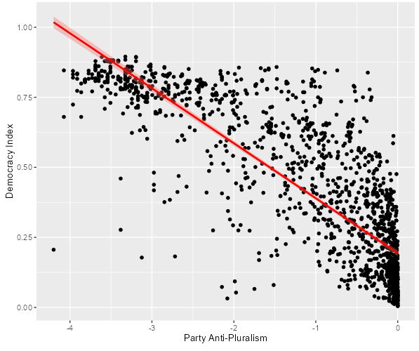
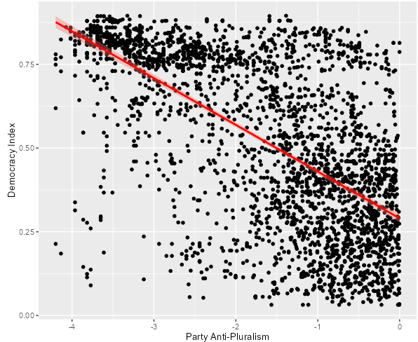
A New Order: The Populist Rhetoric
Analysis shows that populism is a significant factor when it comes to the liberal democracy index, almost across the board. Both in and out of government, the results are statistically significant, when the Senior Partner having the strongest relationship. Only for populism’s “in government but not represented” is it not statistically significant, but that can easily be blamed on the lack of data.
Senior Partner: T:-62.04, <2e-16***
In Opposition: T:-44.62, <2e-16***

Slide 11

A New Type of Wave: Political Polarization
Political polarization is the extent to which political differences affect social relationships beyond political discussions. A highly polarized society has supporters of opposing camps reluctant to engage with each other, perhaps even violently so.
There is a statistically significant relationship between polarization and populism. Therefore, the question is if populist, anti-pluralist parties cause political polarization, or if it’s the other way around.
Societal polarization could not be used due to the lack of data.
President Recep Tayyip Erdogan (left) of Turkey and former President Donald Trump of the USA both, at the time, represented two of the most highly polarized countries in the world (Img. credit to White House Archive)

Slide 12
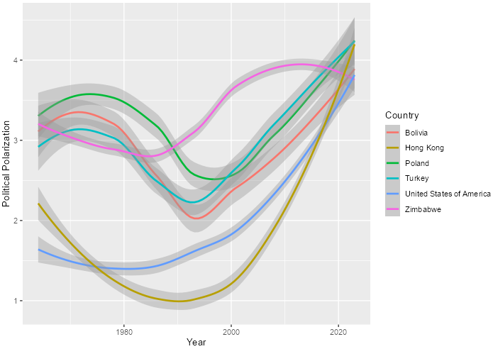
The Inescapable Trend
Political Polarization By Year
Polarization is shown to be a universal trend, shown to be on the rise across the world as a whole. It is correlated with populism and especially anti-pluralism.
Therefore, it is to be expected that polarization is also on the rise, yet oddly it is uniquely so. Rising faster than the other trends, even still increasing when anti-pluralism was noticeably decreasing in the most recent years.

Slide 13
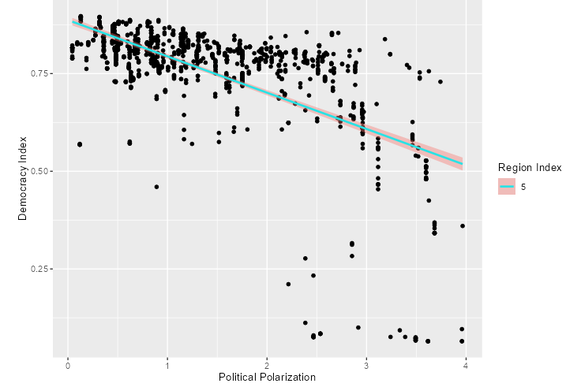
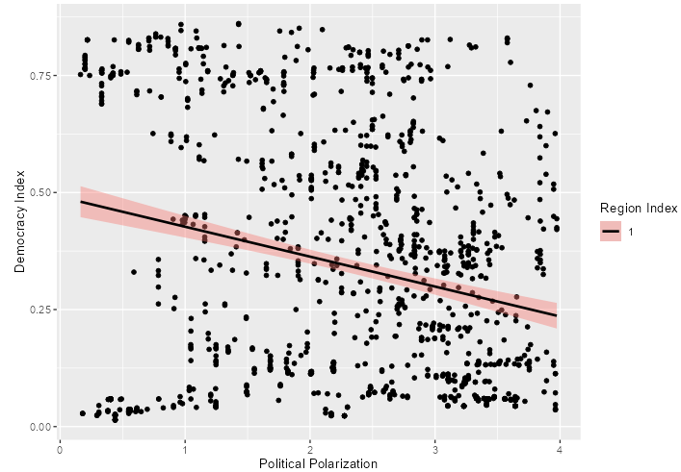
Unique Threat to Democracy
From polarization we see a regression where, as the country increases in polarization, the liberal democracy level decreases. However, this seems to mainly only apply to countries that are already established as democracies, having a much less of an effect on an already autocrat regime. Note Eastern Europe has a .06 R-Squared, so it barely explains any of the variance in the data.
Western Countries: T:-30.53, <2e-16***
Eastern Europe: T:-9.006, <2e-16***

Slide 14
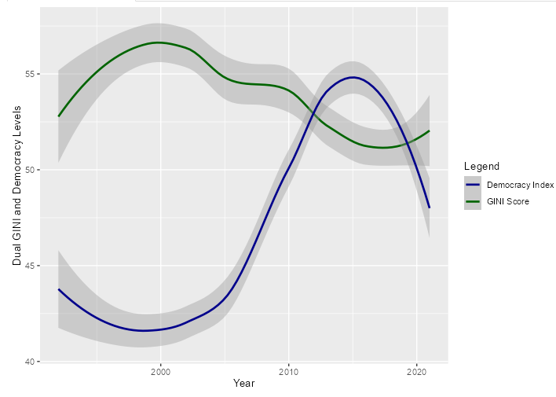
Inequality Begetting Autocracy?
The Gini coefficient is a measure of inequality, where the idea is that higher levels of inequality means lower levels of democracy. The V-Dem Project, however, classifies inequality as a “background” factor, in the same category as geography. However, it’s still classified as one of the most significant contributors to democratic backsliding.
Colombia’s Gini Trend
The trends are mixed at best. Most countries have a stable Gini, but those that don’t may or may not have a fluctuating democracy index. When they do fluctuate together, like with Colombia, though, it does reflect.

Slide 15
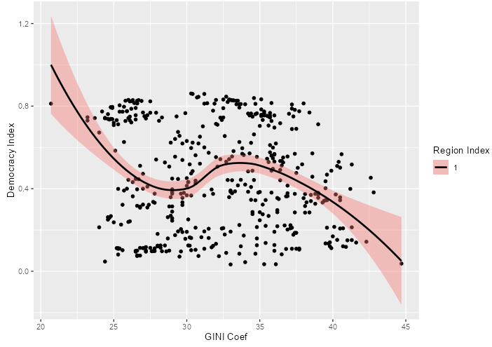
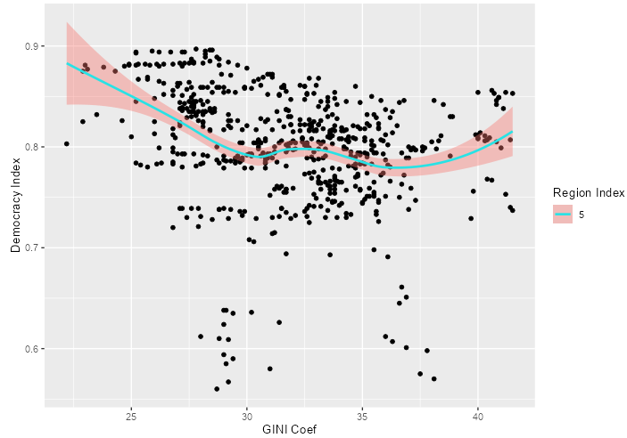
A Faltering Assumption
Whether it be a failed type of measurement for wealth inequality, or possibility it just not making up enough of the variance, it would seem that the Gini coef. is not a strong factor in explaining the decline of democracy in any of the regions. In fact, using a weighted regression, we can see no consistency across the regions, with some being negative and others being positive, yet all having minimal variance.
Eastern Europe: T:-2.96, 0.00369**
Western Europe: T:-6.469, 2.05e-10 ***

Slide 16
Conclusion: Is Democracy At Risk?
01
04
02
05
03
Liberal Democracy Index
Polarization
Since 2010, the number of countries autocratizing has outpaced the number of countries democratizing
Uniquely increasing regardless of the other trends, polarization shares only a strong correlation with backsliding when polarization can exist.
Populism
Pluralism has been steadily increasing, but offers low variance even though it is mostly statistically significant.
Wealth Inequality
The lameduck, wealth inequality, when measured as the Gini, had low variance in all rregions and had very odd strengths in the relationships.
Anti-Pluralism
Although the trend mostly remained the same in recent years, anti-pluralism shows a strong correlation with democratic backsliding

Slide 17
Future Works and Revisions
Analytical Aspect
Technical Aspect
Only the Liberal Democracy Index was used to measure democratic backsliding, when there are actually five indices. These should be incorporated in order to get a more accurate look at how the factors are affecting democratic change.
Wealth inequality is considered a major factor contributing to democratic backsliding. The Great Recession is also considered a factor in the rise of populist parties. A different factor should be used to measure the change of wealth over time.
Only the most significant factors were chosen, yet the actual number of factors rank in the thousands. Analyses could be focused, such as on elections and their qualities, the executive itself, corruption, and/or the legislature.
Grouping the factors by “political region” was also done arbitrarily. Any other grouping can be done and should be attempted to see where and how these factors most apply.
Instead of having a selectinput panel, the map should have a slider for year.
The layout should have a theme, or even having a dropdown menu instead of having tabs upon tabs.
Instead of having the “clickinput” for the points, simply have a mouse-hover only for the lines, including for regression.
Have it so the summary of the linear model can be done on the line instead of the model itself, allowing for a groupcheckbox
Have a dual “mouse hover” for the Gini-dem index graph.
Make the descriptions reactive instead of having them actually be tabs, which is distracting.

