Slide 1
Democratic Backsliding: The Rise of Autocratization
By Daniel Immediato
3/37/2024
NYC Data Science Academy
Notes:
For my R-Project, I decided to create an app based on democratic backsliding. Mainly because I graduated as a political science major, and democratic backsliding in developed countries is a recent trend, now countering the waves of democracy.

Slide 2
A Changing World
Democracy
Electoral Autocracy
Closed Autocracy
Since 1828, there were three “waves of democracy”, each of which caused a surge in democratic regimes, replacing the previous autocratic ones. But what is a “democracy”?
Those regimes that embody a "negative" view of political power, where civil liberties are protected, there is a strong rule of law, and limits are placed on executive power.
A regime that lacks in several components that make up a liberal democracy, but the rulers are still responsive to the citizens enough to not be complete dictatorships.
A regime where the liberal rule of law no longer applies and the rulers are no longer responsible to their citizens.
Notes:
First, what is a democracy? A democracy in itself has a negative view of political power, with an elected government and strong rule of law. On the other end are autocracies, where liberties are no longer protected and the government is not responsible to its citizens. There were three waves of democracy, one that came from suffrage, another from the end of WWII, and the final with the transition from socialist regimes to democratic ones.

Slide 3
What Is Democratic Backsliding?
Put Simply:
A Peak?
It is the decay from one regime type to another (EG a democracy to an electoral autocracy).
This can come about both gradually or quickly, such as through a coup.
Each of the three waves hit a “peak”, where even now the number of countries autocratizing now outpaces the number of countries democratizing.
Notes:
Democratic backsliding is where a regime’s democracy score lowers, possibly changing regime type from a democracy to an autocracy. The “waves” each had peaks, where the number of countries stops democratizing. In our third wave, it would seem that the number of countries has autocratizing have now outpaced the number of countries democratizing.

Slide 4

Democracy is Not a Permanent Fixture
It was once believed that stable, wealthy democracies would remain so. However, the mid-2000s have shown that even seemingly-stable democracies have recently shown a trend of democratic backsliding.
Perhaps the most notorious of this was the rise of right-wing populism since the Great Recession, with numerous populist political parties imbedding themselves in democratic institutions despite advocating for or using undemocratic methods.
Right-wing populists Viktor Orbán (left) of Hungary’s Fidesz and Santiago Abascal (right) of Spain’s Vox (Img. credit VOX España)
Notes:
Unexpectedly, democracies once believed “strong”, that is the democracies that were well-established, wealthy, and stable, began to show signs of backsliding since the mid-2000s. In fact, some third wave democracies have even become stronger democracies than their longer-standing counterparts.

Slide 5
Measuring Democracy: the V-Dem Project
The Varieties of Democracy Project is a data collection effort in an attempt to provide an “overview of the state of democracy in the world”. They use five indices for what a democracy actually is, and then also collect data for numerous factors that may affect these indices. The V-Dem Project also analyzes political parties in much the same way, except this time having only two indices. It was already decided which factors most influenced the democracy level.
Polarization
Populism
Wealth Inequality
-Whether or not political camps interact in a friendly manner.
-The use of anti-establishment and anti-elite rhetoric, along with talks of reducing political corruption.
-The dispersion of income across the entire income distribution
Notes:
This trend was picked up by the Varieties of Democracy Project, an international effort to measure the state of democracy in the world. It uses indices to measure democracy itself, splitting it into five similar measurements, and also analyzes political parties in much the same way. The V—Dem Project concluded that the most significant factors influencing democratic backsliding were: political polarization, populistic rhetoric and anti-pluralism, and wealth inequality.

Slide 6
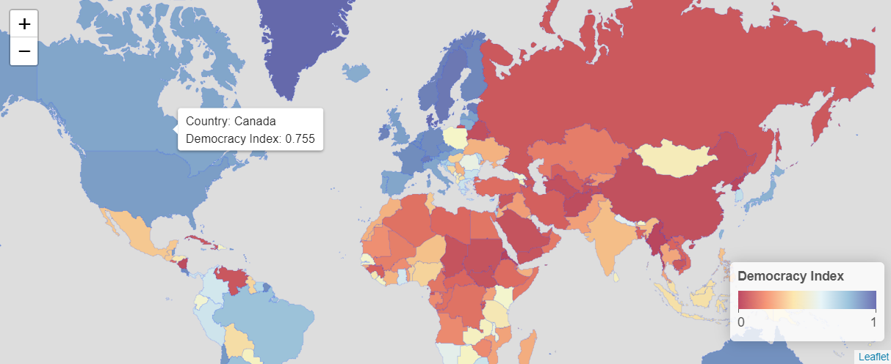


A Glimpse at the World
Canada
Poland
China
Classified as a Liberal Democracy
Classified as an Electoral Autocracy
Classified as a Closed Autocracy
Notes:
Here, we have the actual trends displayed on a world map in a Shiny App made to represent the V-Dem Projects findings. This first “tab” was designed to create a world map based on the liberal democracy index, judging the democracy based on the “limits placed on the government” and its ability to protect individual and minority rights. Since the V-Dem dataset wasn’t a geojson, I had to make it into one myself, including adding the values for the countries. The years are a selectinput based on columns with the years as variables, along with a mouse-hover that provides a textbox.

Slide 7
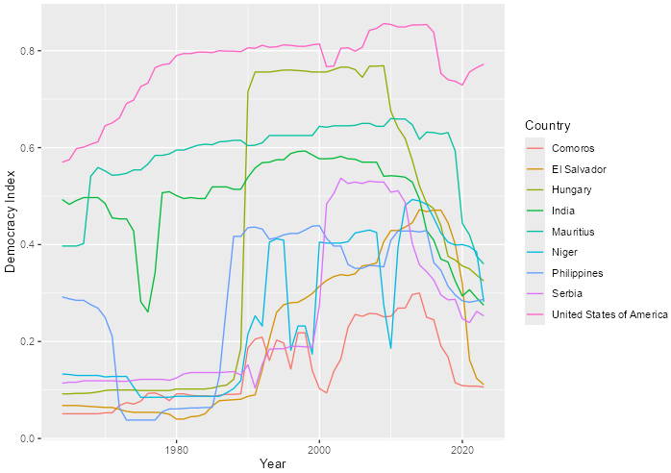
A Worrying Trend
Liberal Democracy Levels By Year
According to the V-Dem Index, global liberal democracy levels have been on the decline. This means that the rise of autocracies have surpassed countries becoming democracies.
This graph in particular shows the worrying trend of already at-risk countries slipping further into autocracy, with the countries selected being the worst offenders.
Notes:
The second panel is a line graph of what was just shown, although highlighted shows the more egregious examples of what the V-Dem Project is trying to convey. Separated by regime type using fluidRow’s columns, one can also click to see the value of x,y itself. The US was included to show a “strong liberal democracy” that recently went through backsliding and compare it to the countries undergoing severe downward trends.

Slide 8
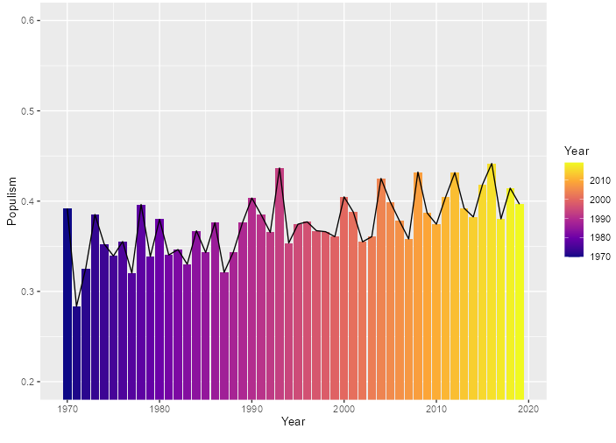
Populism as a Factor
Populist Rhetoric in Political Parties By Year
Populism is a separate index from the others, taking into account party behavior within the government. While the democracy index chosen was narrowed down to one (liberal democracy), the populism index was still kept as two: level of anti-pluralism and populist rhetoric.
Pluralism is how “agreeable” said political party is with other political factions.
On the right shows the general increase in populism over the years, especially since the 2000’s.
Notes:
The V-Dem used a different dataset for political parties, measuring their impact by populism and anti-pluralism. Populism is a rhetoric strategy, using anti-elite and anti-establishment voice in speeches. A bar chart was used to show the gradual increase in populism, although anti-pluralism generally stayed the same since 1970.

Slide 9
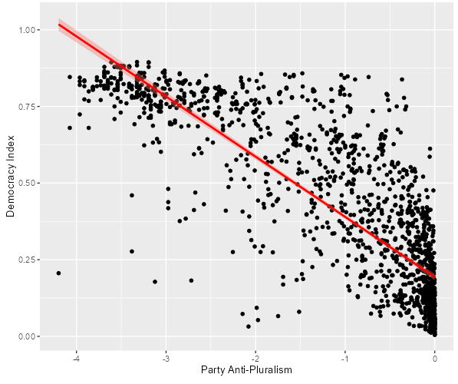
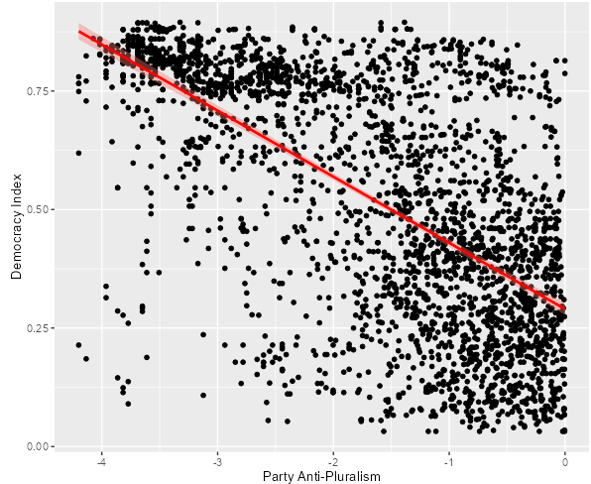
A New Order: The Populist Rhetoric
Analysis shows that populism is a significant factor when it comes to the liberal democracy index, almost across the board. Both in and out of government, the results are statistically significant, when the Senior Partner having the strongest relationship. Only for populism’s “in government but not represented” is it not statistically significant, but that can easily be blamed on the lack of data.
Senior Partner: T:-62.04, <2e-16***
In Opposition: T:-44.62, <2e-16***
Notes:
Anti-pluralism is when the political parties lack a commitment to democratic norms, usually involving demonizing political opponents, favoring the will of the majority over the minority, and even accepting violence as a necessary method of action. Anti-pluralism is shown in populist parties, and the impact of populism’s effect against democracy is amplified when anti-pluralism is used. Although populism by itself was statistically significant, the strength of the relationships were weak. When anti-pluralism was also used, the strength of the relationships were much more impactful, and the variance was much higher. In fact, both when in government and when in opposition, an anti-pluralist, populist party still maintained a strong negative impact on democracy.

Slide 10

A New Type of Wave: Political Polarization
Political polarization is the extent to which political differences affect social relationships beyond political discussions. A highly polarized society has supporters of opposing camps reluctant to engage with each other, perhaps even violently so.
There is a statistically significant relationship between polarization and populism. Therefore, the question is if populist, anti-pluralist parties cause political polarization, or if it’s the other way around.
Societal polarization (differences of opinions) could not be used due to the lack of data.
President Recep Tayyip Erdogan (left) of Turkey and former President Donald Trump of the USA both, at the time, represented two of the most highly polarized countries in the world (Img. credit to White House Archive)
Notes:
Political polarization is when society is polarized into separate, antagonistic political camps. It is essentially an extension of anti-pluralism, where opponents can interact in a friendly manner or interact in a violent manner. It has been shown to increase alongside the increasing trend of populism, in a statistically significant way.

Slide 11
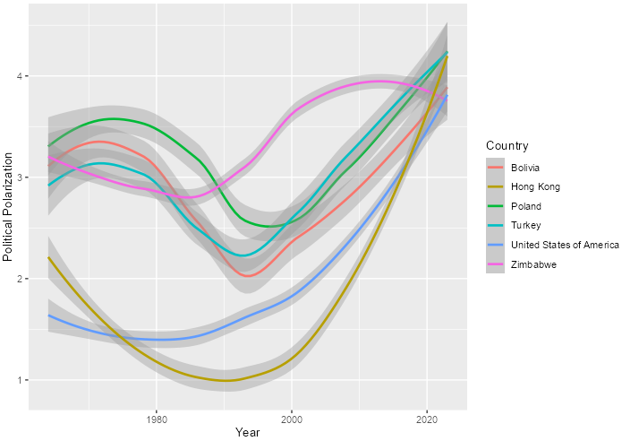
The Inescapable Trend
Political Polarization By Year
Polarization is shown to be a universal trend, shown to be on the rise across the world as a whole. It is correlated with populism and especially anti-pluralism.
Therefore, it is to be expected that polarization is also on the rise, yet oddly it is uniquely so. Rising faster than the other trends, even still increasing when anti-pluralism was noticeably decreasing in the most recent years.
Notes:
Political polarization is unique in that it has been increasing since the 2000s, so much so that it is increasing regardless of the decrease occasionally in anti-pluralism. Also, unlike anti-pluralism, it is on a clear rise across the world.

Slide 12
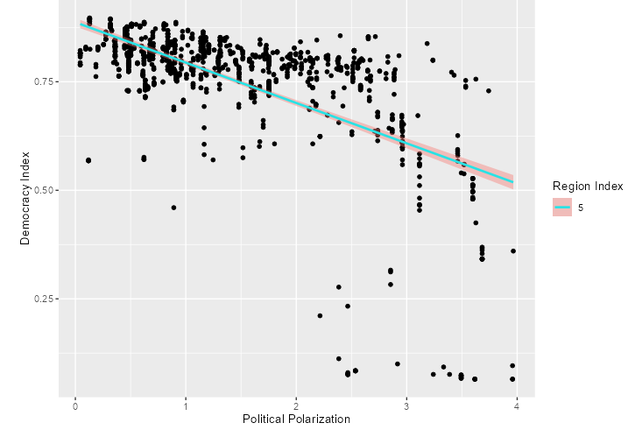
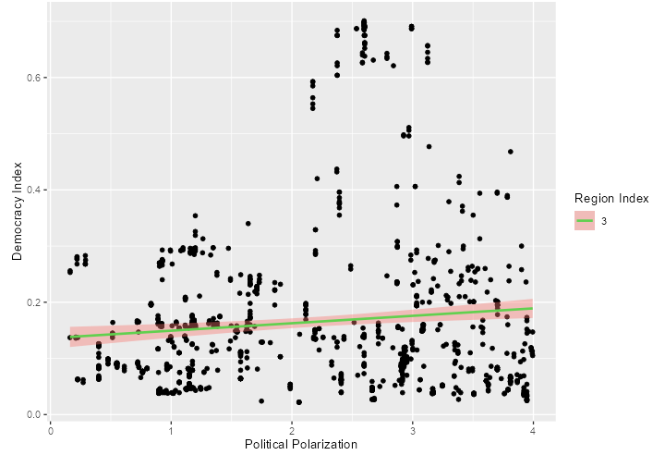
Unique Threat to Democracy
From polarization we see a regression where, as the country increases in polarization, the liberal democracy level decreases. However, this seems to mainly only apply to countries that are already established as democracies, having a much less of an effect on an already autocratic regime. Note how the Middle East actually REVERSES the trend, if only slightly. This can be blamed on the monarchies in the region and other authoritarian governments that don’t allow for political expression, as well as the abysmal variance of .008.
Western Countries: T:-30.53, <2e-16***
Arab Nations: T:3.268, 0.00112 **
Notes:
Unlike anti-pluralism and populism, polarization was statistically significant in all regions of the world. However, it should be noted that its “strength”, along with its variance, was only high in regions that actually had a high amount of electoral democracies. This means that polarization seems to require the ability to be politically expressive, along with having political variation, in order to have an impact. In fact, the Middle Eastern regions, which still have monarchies, even had a very slight increasing trend, although next to no variance.

Slide 13
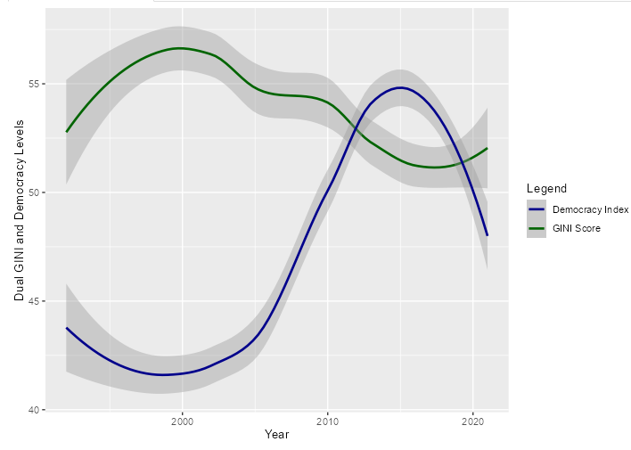
Inequality Begetting Autocracy?
The Gini coefficient is a measure of inequality, where the idea is that higher levels of inequality means lower levels of democracy. The V-Dem Project, however, classifies inequality as a “background” factor, in the same category as geography. However, it’s still classified as one of the most significant contributors to democratic backsliding.
Colombia’s Gini Trend
The trends are mixed at best. Most countries have a stable Gini, but those that don’t may or may not have a fluctuating democracy index. When they do fluctuate together, like with Colombia, though, it does reflect.
Notes:
Wealth inequality is used as a background factor in the V-Dem codebook, but is still blamed as one of the most significant factors in causing democratic backsliding. It was removed as a factor in the most recent codebook, therefore the data had to be taken from somewhere else and the trends are mixed. Most countries have a stable Gini coef., so it can’t be compared against the democracy index. However, when it doesn’t like with Colombia, they do reflect off each other. When every country in the world is taken into account, a reflection trend is also shown as well.

Slide 14
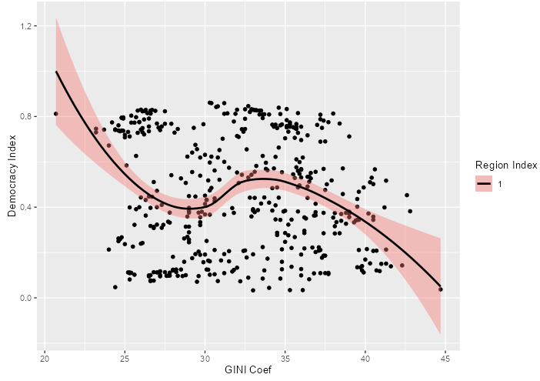
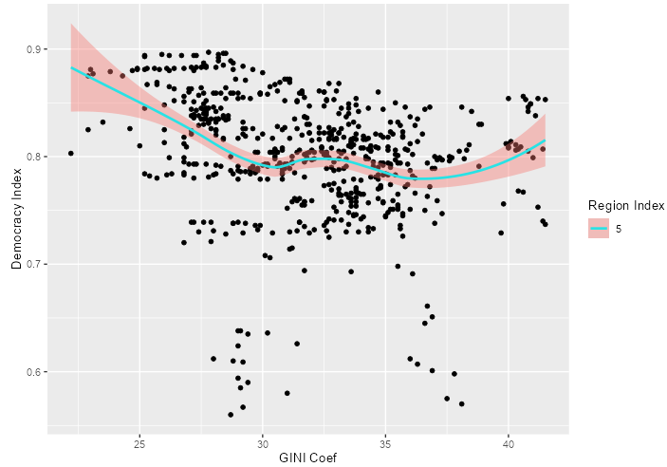
A Faltering Assumption
Whether it be a failed type of measurement for wealth inequality, or possibility it just not making up enough of the variance, it would seem that the Gini coef. is not a strong factor in explaining the decline of democracy in any of the regions. In fact, using a weighted regression, we can see no consistency across the regions, with some being negative and others being positive, yet all having minimal variance.
Eastern Europe: T:-2.96, 0.00369**
Western Europe: T:-6.469, 2.05e-10 ***
Notes:
Even still, this factor was the weakest of all the models in terms of variance, yet only had Asia being statistically insignificant. When a weighted regression was used for the regions, the direction of the strength of the relationship also seemed to have no consistency, likely due to that lack of variance. Western Europe had the strongest t value, but was offset by outliers that caused it to diverge into the positive as Gini raised into further inequality, which suggests that Gini only matters if it is already fluctuating.

Slide 15
Designing an App
The point was not to find the results of what the V-Dem already did, rather to visualize it in a way that was interactive an accessable.
This is a visualization of three different datasets hoping to tell a story that convey the same end-goal.
R-Shiny used multiple methods that introduced trends and both linear and non-linear models to answer the question if democracy is dissappearing lately.
The hope, then, was to match the base assumption of the key factors that V-Dem assumed.
Notes:
As mentioned, to put these measurements into perspective, an R-Shiny app was created, which was the point of the project. It is a combination of technically four datasets, one of which was created by hand, with the goal of matching the results of the V-Dem Project and creating an interactive and reactive app.

Slide 16
Conclusion: Is Democracy At Risk?
01
04
02
05
03
Liberal Democracy Index
Polarization
Since 2010, the number of countries autocratizing has outpaced the number of countries democratizing
Uniquely increasing regardless of the other trends, polarization shares only a strong correlation with backsliding when polarization can exist.
Populism
Pluralism has been steadily increasing, but offers low variance even though it is mostly statistically significant.
Wealth Inequality
The lameduck, wealth inequality, when measured as the Gini, had low variance in all rregions and had very odd strengths in the relationships.
Anti-Pluralism
Although the trend mostly remained the same in recent years, anti-pluralism shows a strong correlation with democratic backsliding
Notes:
With the exception of wealth inequality, most of the factors confirm the V-Dem Project’s conclusions, with a few notable deviations like populism by itself having overall low variance, the Arab regions having a positive correlation in regards to polarization and the democracy index, and how anti-pluralism has a stronger relationship when the parties are in government, while pluralism is strongest when in opposition.

Slide 17
Future Works and Revisions
Analytical Aspect
Technical Aspect
Only the Liberal Democracy Index was used to measure democratic backsliding, when there are actually five indices. These should be incorporated in order to get a more accurate look at how the factors are affecting democratic change.
Wealth inequality is considered a major factor contributing to democratic backsliding. The Great Recession is also considered a factor in the rise of populist parties. A different factor should be used to measure the change of wealth over time.
Only the most significant factors were chosen, yet the actual number of factors rank in the thousands. Analyses could be focused, such as on elections and their qualities, the executive itself, corruption, and/or the legislature.
Grouping the factors by “political region” was also done arbitrarily. Any other grouping can be done and should be attempted to see where and how these factors most apply.
Instead of having a selectinput panel, the map should have a slider for year.
The layout should have a theme, or even having a dropdown menu instead of having tabs upon tabs.
Instead of having the “clickinput” for the points, simply have a mouse-hover only for the lines, including for regression.
Have it so the summary of the linear model can be done on the line instead of the model itself, allowing for a groupcheckbox
Have a dual “mouse hover” for the Gini-dem index graph.
Make the descriptions reactive instead of having them actually be tabs, which is distracting.
Notes:
Suggestions for future works are numerous. First of all, an arbitrary cut-off point was used based on the data from the Gini coef. for the year 1964. The V-Dem data actually goes back to the 1700s. More significantly, an alternative index could be used instead of the liberal democracy index, or all of them could even be combined using a mean. Wealth inequality could be measured differently instead of using the Gini coef. The V-Dem Project also breaks down factors into subsections, such as elections, the executive, and the legislature, and these could all be looked at individually instead to see significant factors and their impact on democracy instead of what we already know. Also, the grouping can be done differently, allowing for more or less data points in each group, since I just chose “political region”.
Obviously there are suggestions for the technical aspect, including having a slider for whenever years are mentioned, having themes and a dropdown menu instead of a tab, having clicknearby instead of just a clickinput, have the linear model summary be based on the line and not the graph, and have the descriptions be “somewhere else” instead of in a separate tab.

Slide 18
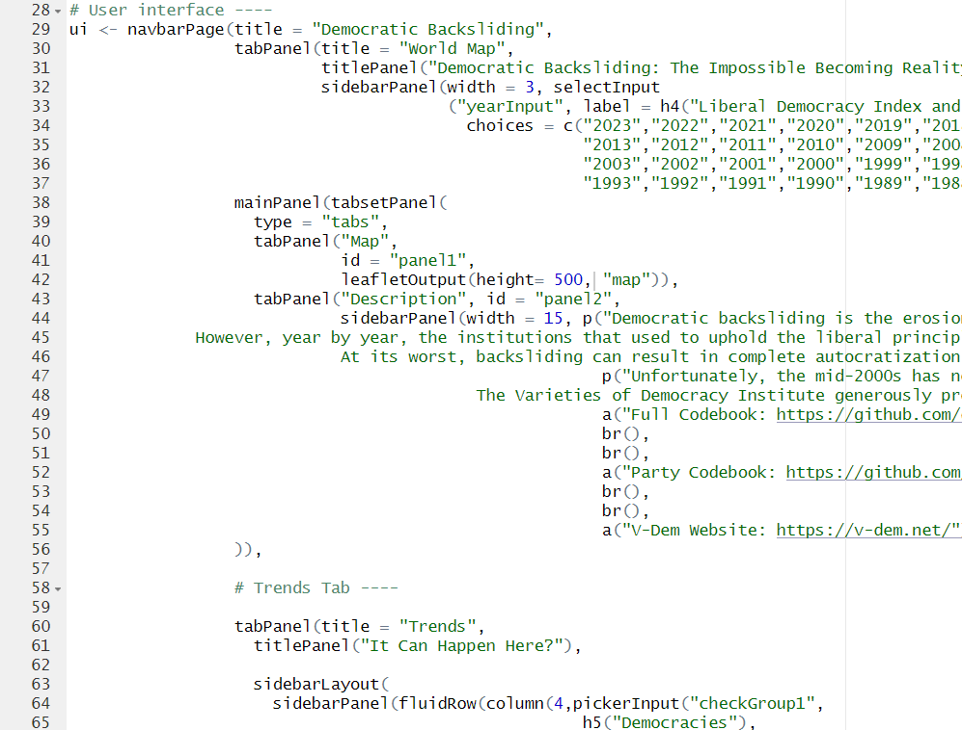
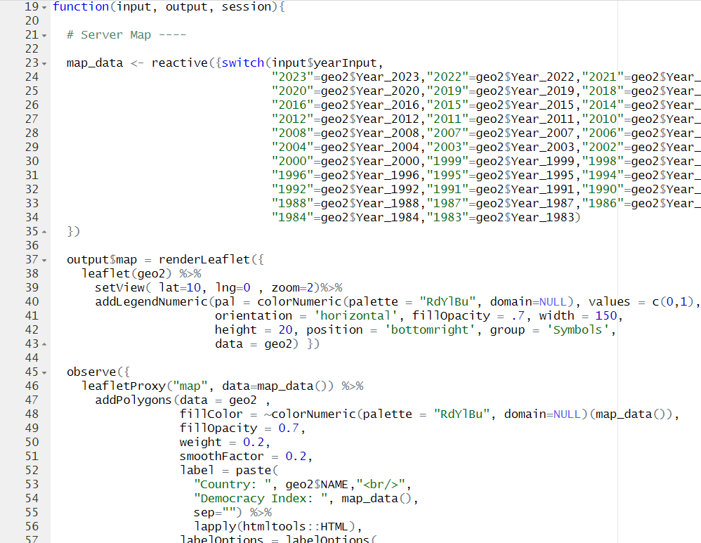
Questions?
Comments?
Suggestions?

