Slide 1
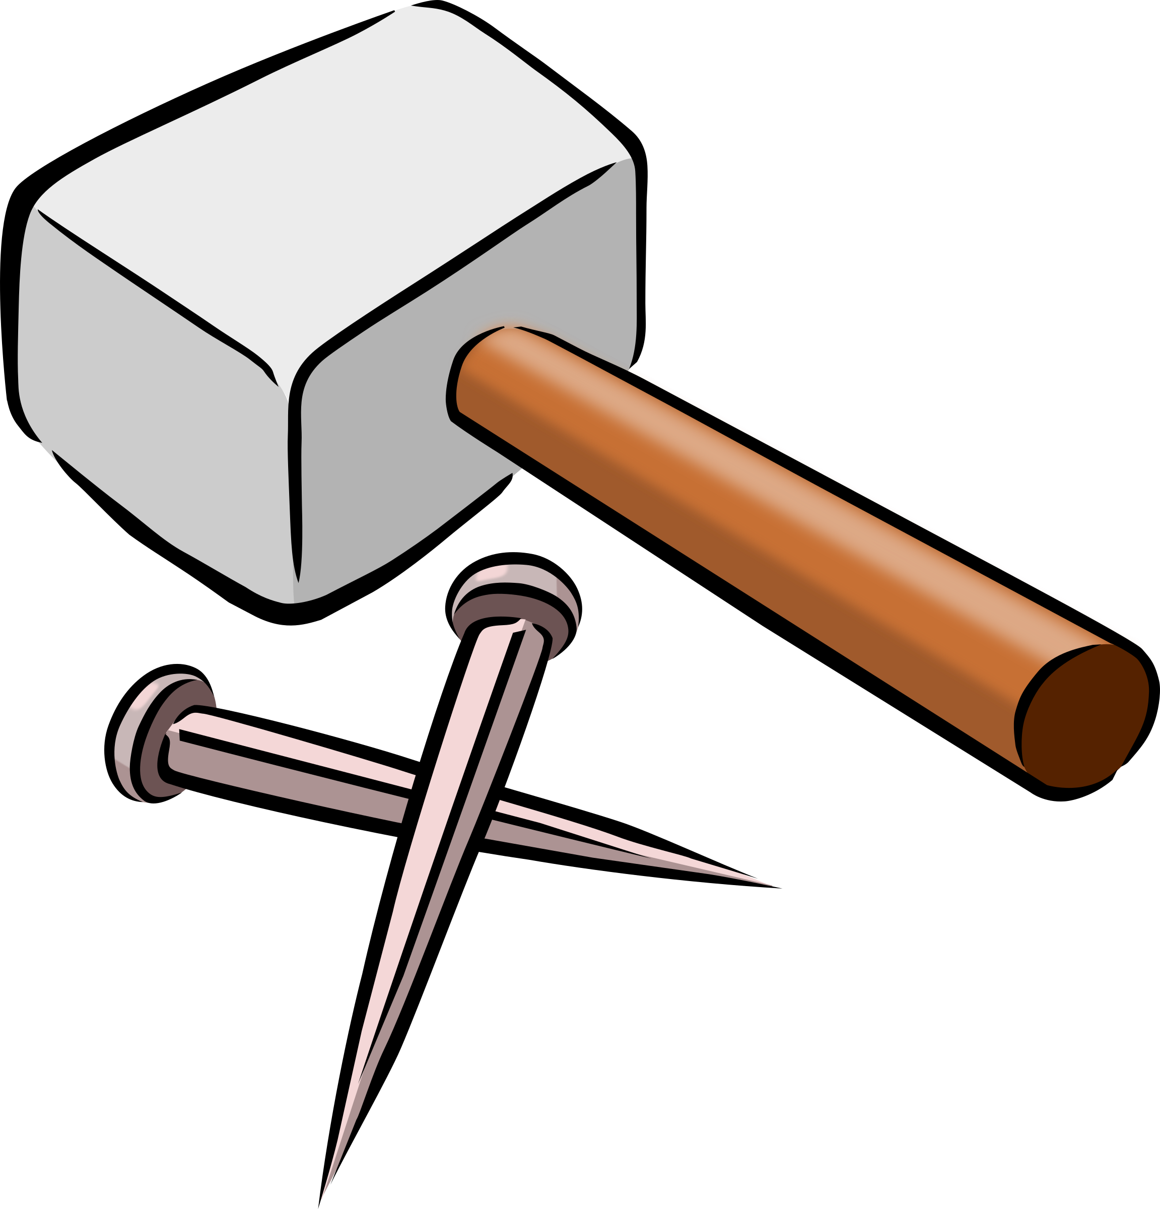
If all you have is a hammer, everything looks like a nail
Pros:
Simplicity
Reliability: no point of failure
Quickly learning curve
Uniformity
Cons:
Narrow area of application

Slide 2
If you only have a Workflow everything looks like a Task
Is it something new or we are doing every day?
Mindlessly passing emails down an invisible chain?
You might have a workflow.
Printing the same form over and over again?
You might have a workflow.
Getting frustrated that one person’s lack of initiative seems to prevent you from doing your job?
You might have a workflow.

Slide 3
Workflow - It’s not that hard!
Establish the purpose
Write out the steps one-by-one
Assign roles to each step – each step needs to have someone’s name by it or it won’t get done.
Identify exceptions and conditions
Attach to Accountability process (KPI: Key Performance Indicator) (That part comes later, when workflow has a physical implementation)

Slide 4
And Smack!!! Every step in workflow becomes a task
Once we defined a workflow dedicated to a particular ‘activity’ - we actually assigned a set of well defined tasks to specific (group of) people.
The only ‘thing’ left to do is to create a ‘process’ that ensures task executions in an expected time and quality.

Slide 5
Challenge
How do we create a Workflow “Hammer” with all the “Pros” of a real Hammer, but without the “Cons”?
Simplicity
Reliability
Uniformity – one size fits all

Slide 6
Way To Simplicity
Use Loose Coupled Familiar Technologies already used throughout the company.
JIRA – Workflow
MS SQL Server – Data, Metadata
MS .NET Framework - Business Logic Domain
MS Access – User Interface
MS ASP.NET, REST
HTTP-based access to BL functionality
User Interface
We already have in-house expert in all those technologies.
For those experts they are “Simple”

Slide 7


Way To Reliability
We don’t have to worry about it.
We are dealing with well established products supported by reliable companies with optimistic projections for their future.
Yes! Only two! Very Simple!

Slide 8







Way To Uniformity
All above mentioned technology are not targeting any specific area.
They used for creating solutions in broad a range of business ‘needs’.

Slide 9
Missing Link
Now we need an environment that will integrate those seemingly unrelated technologies to participate in a common goals:
Model
Implement
Execute

Slide 10

Enter ICE

Slide 11
ICE - T
(I)dentify the problem
(C)reate Solution
(E)xecute
(T)est

Slide 12
(I)dentify Problem
Clients with missing or inactive RM
Expired W8 form
Missing documentation
Create New User
Missing Link IIS
Order pizza every Thursday for IT

Slide 13
(C)reate Lists Dedicated To Each Problem
[MIS] –> Clients With Missing RM
[Olympic] –> Expired W8 Forms
[Edocs] –> Missing Documentation
[ADP] –> List of new employees from
[Pershing] –> List Of Orphaned JT1, JT2, JTU, JT9
[Papa Johns] -> List of Early Bird Specials

Slide 14
(E)xecute JIRA Ticket For All Items in All Lists
Accounts without cost account
Account | Reference Date | Account Status | Ticket
5000015 | 2016-09-25 | Open
5000016 | 2016-09-25 | Blocked
Process
Account | Reference Date | Account Status | Ticket
5000015 | 2016-09-25 | Open | DIT-151
5000016 | 2016-09-25 | Blocked | DIT-152
Execute
fixed
Execute
fixed

Slide 15
ICE Is Not Just A Concept
It is a materialized implementation
of a concept outlined above.

Slide 16
ICE Architecture
JIRA Integration Library
Foundation Library
Configuring, Logging, Testing
JIRA
Web
Service
Web Client
Block Account
Send Wire
Action Handlers
SMS
Provider
SQL Server
JIRA Event Handling Framework

Slide 17

PART TWO
IS IT NEW?

Slide 18
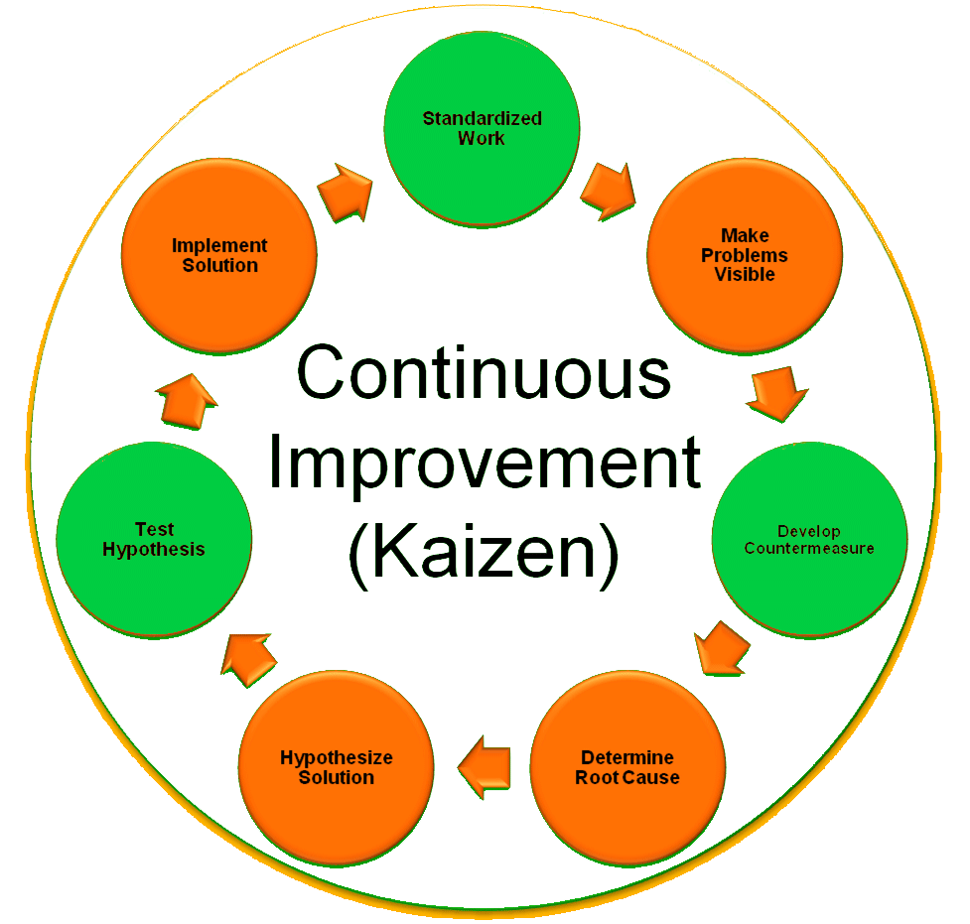

Slide 19
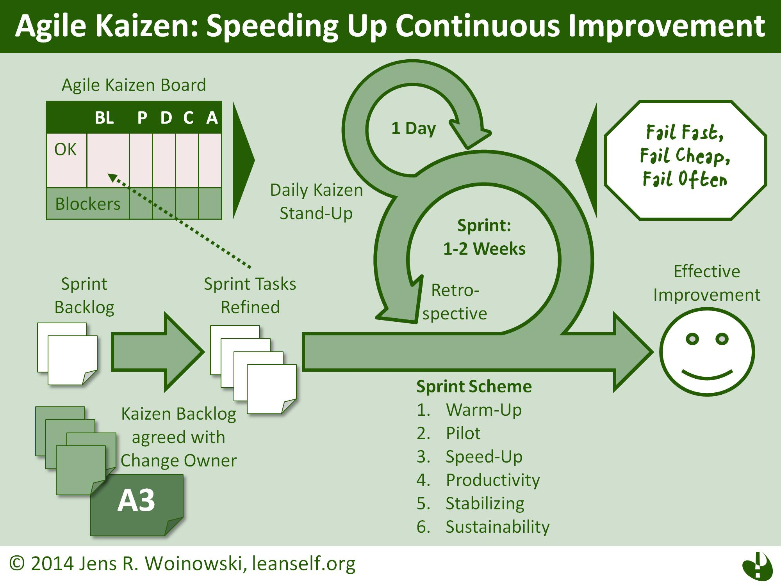

Slide 20
Kaizen Statement
Operations in your organization are likely to be smooth when all functions are streamlined, duties evenly distributed among employees and the management has a sense of direction.

Slide 21
Target Improvement of Individual Workstands
Organize ones responsibilities in a form of task lists segregated by types
Create easy access to heterogeneous data associated with tasks
Interconnect activities between employees by reacting on task events:
Open
Waiting for approval
Closed
Step 1.1
Step 2.1
Step 3.1
Step 1.2
Step 2.2
Step 3.2
Step 1.3
Step 2.3
Step 3.3

Slide 22
Target Small Problems Daily
Look for small ideas which, if possible, can be implemented on the same day.
This is in contrast to traditional models of work improvement, which generally have a long lag between concept development and project implementation. In the traditional model, the time between concept development and project implementation is very long. In the kaizen model, workers mostly look for small ideas and improvements which can be implemented on the same day.

Slide 23
Create a Workflow for Each Problem
Missing Cost Account
Identify Cost Account
Update Olympic
Ticket
Orphaned IIS Account
Locate Parent Account
Update Olympic
Ticket
Pending Closure
Wire Balance to Client
Close Account
Ticket

Slide 24
Identify Relations Between Workflows and Create Interconnection
Orphaned IIS Account
Locate Parent Account
Parent is Closed
Initiate Account Closing
Pending Closure
Wire Balance to Client
Close Account

Slide 25
Identify Root Cause of the Problem
Missing Cost Account
Account is part of a relationship
Cost account is pointing to Parent Root
Parent root is closed
Cost account is now pointing to Closed Account

Slide 26

Develop Solution to Eliminate the Cause
Close account workflow
Close Account
If Used as Cost in Child
Re-point Cost in Child
TERMINATED
Missing Cost Account
TERMINATED

Slide 27
Small Changes = Big Improvement
Improvements Pyramid
BIG
Middle 1
Small 1
Small 2
Middle 2
Small 3

Slide 28
Business Management Methods
Kaizen method
Continuous incremental improvements is an originally Japanese management concept for incremental (gradual, continuous) change (improvement).
Kaizen is actually a way of life philosophy, assuming that every aspect of our life deserves to be constantly improved.
Kaizen philosophy lies behind many Japanese management concepts such as Total Quality Control, Quality Control circles, Small group activities, Labor relations.
Key elements of Kaizen are quality, effort, involvement of all employees, willingness to change, and communication.

Slide 29
Kaizen Points Of Management
Create constancy of purpose for improvement of product and service
Adopt the new philosophy - transformation of companies is needed
Cease dependence on mass inspections (quality must be designed and built into the processes, preventing defects rather than attempting to detect and fix them after they have occurred)
Improve constantly and forever - management and employees must search continuously for ways to improve quality and productivity
Adopt and institute leadership - managers should lead, not supervise
Drive out fear - make employees feel secure enough to express ideas and ask questions
Break down barriers between staff areas - working in teams will solve many problems and will improve quality and productivity
Eliminate slogans, exhortations, and targets for the work force (problems with quality and productivity are caused by the system, not by individuals. Posters and slogans generate frustration and resentment)
Eliminate numerical quotas for the work force and numerical goals for people in management - in order to meet quotas, people will produce defective products and reports
Take action to accomplish the transformation - commitment on the part of both [top] management and employees is required.

Slide 30
Business Management Methods
Kaizen method continuous incremental improvements
Business Process Reengineering method (BPR) is defined as 'the fundamental reconsideration and radical redesign of organizational processes, in order to achieve drastic improvement of current performance in cost, service and speed'. Information technology plays an important enabling role.
When Kaizen is compared to BPR is it clear the Kaizen philosophy is more people-oriented, more easy to implement, requires long-term discipline.
BPR on the other hand is harder, technology-oriented, enables radical change but requires major change management skills.

Slide 31
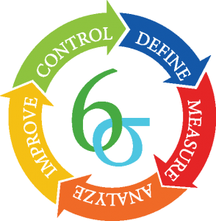
Six Sigma

Slide 32
