Slide 1
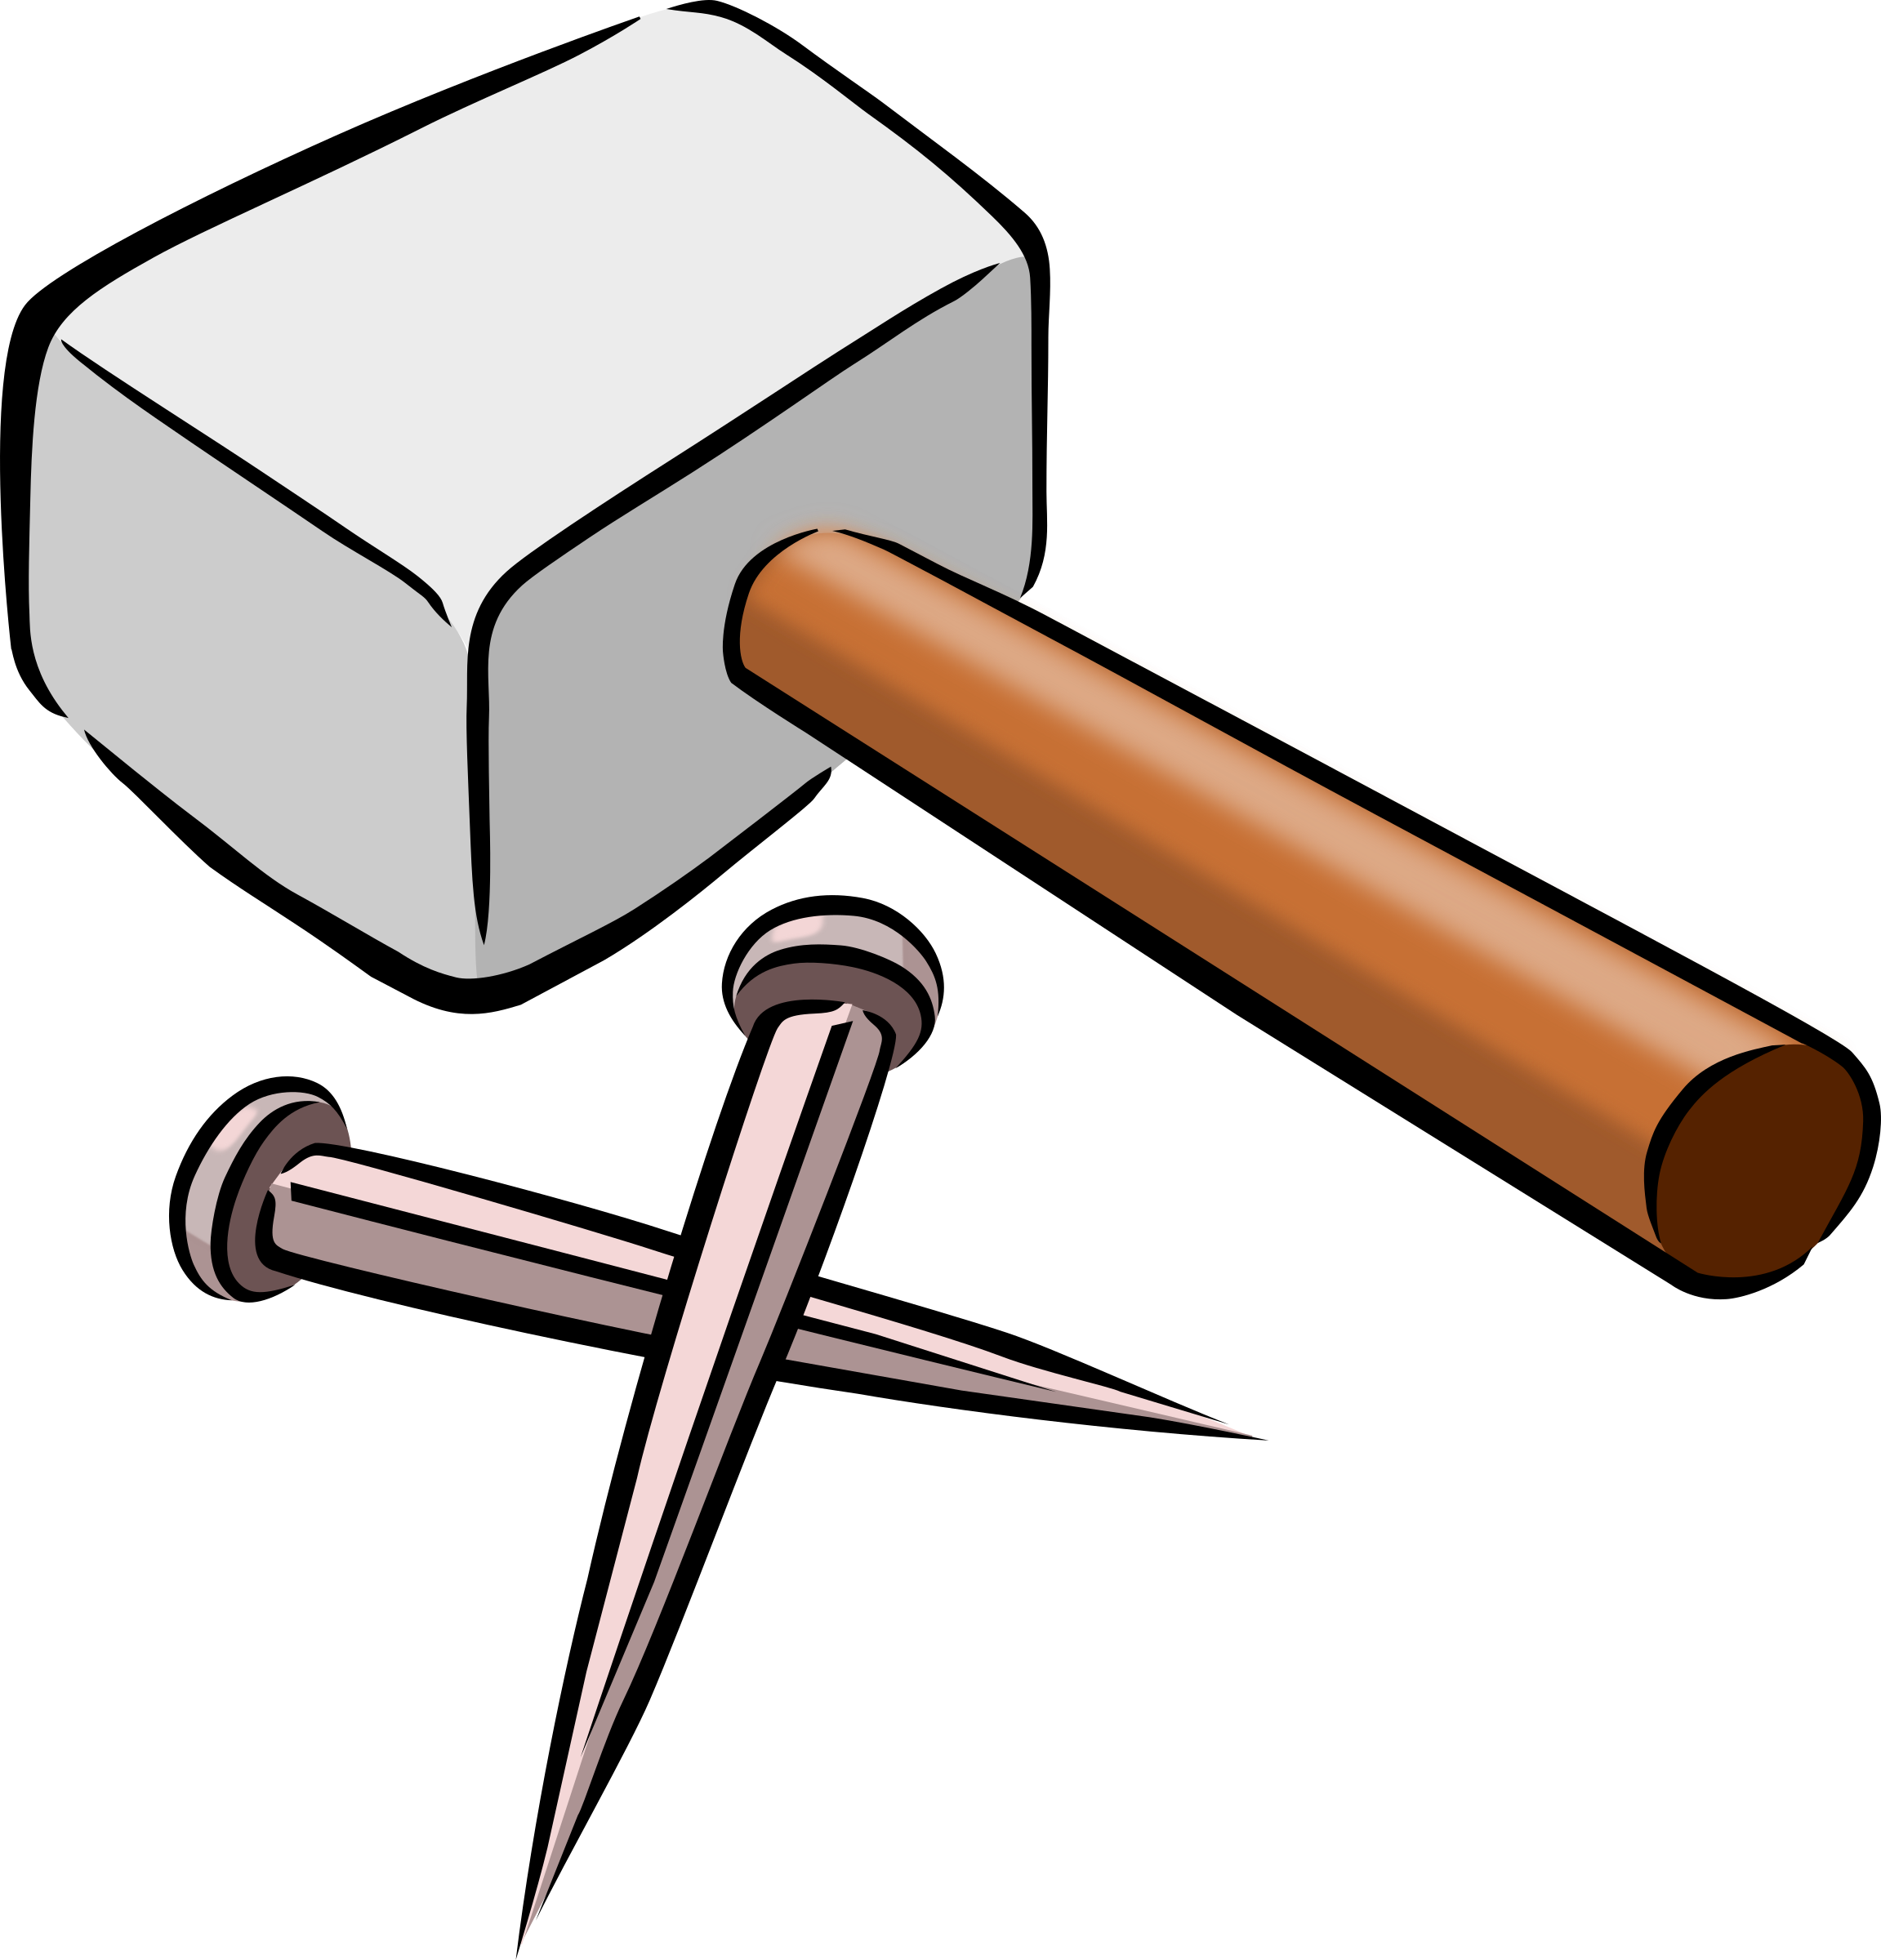
Law of the Hammer
If all you have is a hammer, everything looks like a nail
Is it necessarily bad?
Pros:
Simplicity
Reliability
Uniformity
Cons: Just one
Narrow area of application
Construction
Destruction
Making a point in conversation

Slide 2
Law of the Hummer - Transition
If all you have is a Workflow, everything looks like a Task
Establish the purpose
Write out the steps one-by-one
Assign roles to each step – each step needs to have someone’s name by it or it won’t get done.
Attach to Accountability process (KPI and such)
of the instrument​
Bring nail: Worker 1
Hold nail: Worker 2
Smack nail with hammer: Worker 3
Check nail: Worker 4
Smack again: Worker 3
Done
Law of the instrument​

Slide 3



Challenge
How do we create a Workflow “Hammer” with all the “Pros” of a real Hammer, but without the “Cons”?
Simplicity
Reliability
Uniformity

Slide 4





Way To Simplicity
Use Familiar Tolls already used throughout the company.
No need to learn/adapt new technologies
We already have all necessary in-house experts
For those experts they are “Simple”
No additional cost

Slide 5


Way To Reliability
We pick well established products supported by reliable companies
with optimistic projections for their future.
Yes! Only two! Very Simple!

Slide 6
Missing Link – Uniformity
Now we need an environment that will integrate those seemingly unrelated technologies into well established process of:
Model
Execute
Implement

Slide 7

Enter ICE

Slide 8
ICE - T
(I)dentify the problem
(C)reate Solution
(E)xecute
(T)est

Slide 9
(I)dentify Problem
Clients with missing or inactive RM
Expired W8 form
Missing signature/documentation
List Of New Users
Missing Link in IIS
Order pizza every Thursday for IT

Slide 10


(C)reate Lists Dedicated To Each Problem
[MIS] | => | Clients With Missing RM
[Olympic] | => | Expired W8 Forms
[EDocs] | => | Missing Documentation
[ADP] | => | List of new employees
[Pershing] | => | List Of Orphaned JT1, JT2, JTU, JT9
[Papa John's] | => | List of Early Bird Specials

Slide 11
(E)xecute JIRA Ticket For All Items in All Lists
Accounts without cost account
Account | Reference Date | Account Status | Ticket
5000015 | 2016-09-25 | Open
5000016 | 2016-09-25 | Blocked
Process
Account | Reference Date | Account Status | Ticket
5000015 | 2016-09-25 | Open | DIT-151
5000016 | 2016-09-25 | Blocked | DIT-152
Execute
fixed
Execute
fixed

Slide 12
ICE Is Not Just A Concept
It is a materialized implementation
of a concept outlined above.

Slide 13
ICE Architecture
JIRA - Workflow
JIRA Integration Library
Foundation Library
Configuring, Logging, Testing
Web
Service
Web Client
Block Account
Send Wire
Action Handlers
SMS
Provider
SQL Server
JIRA Event Handling Framework

Slide 14

PART TWO
IS IT NEW?

Slide 15
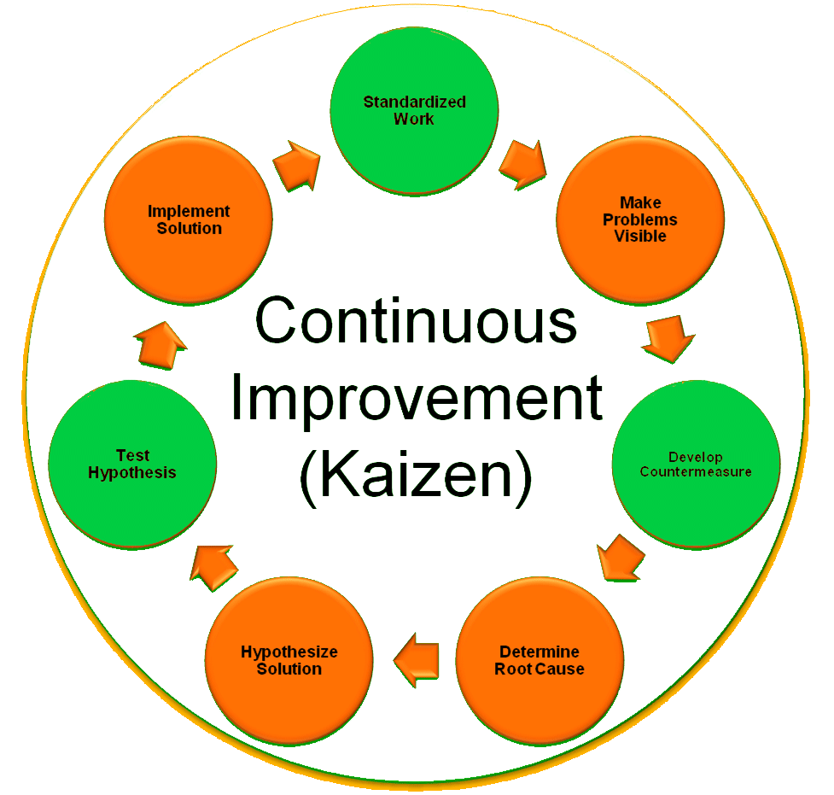

Slide 16
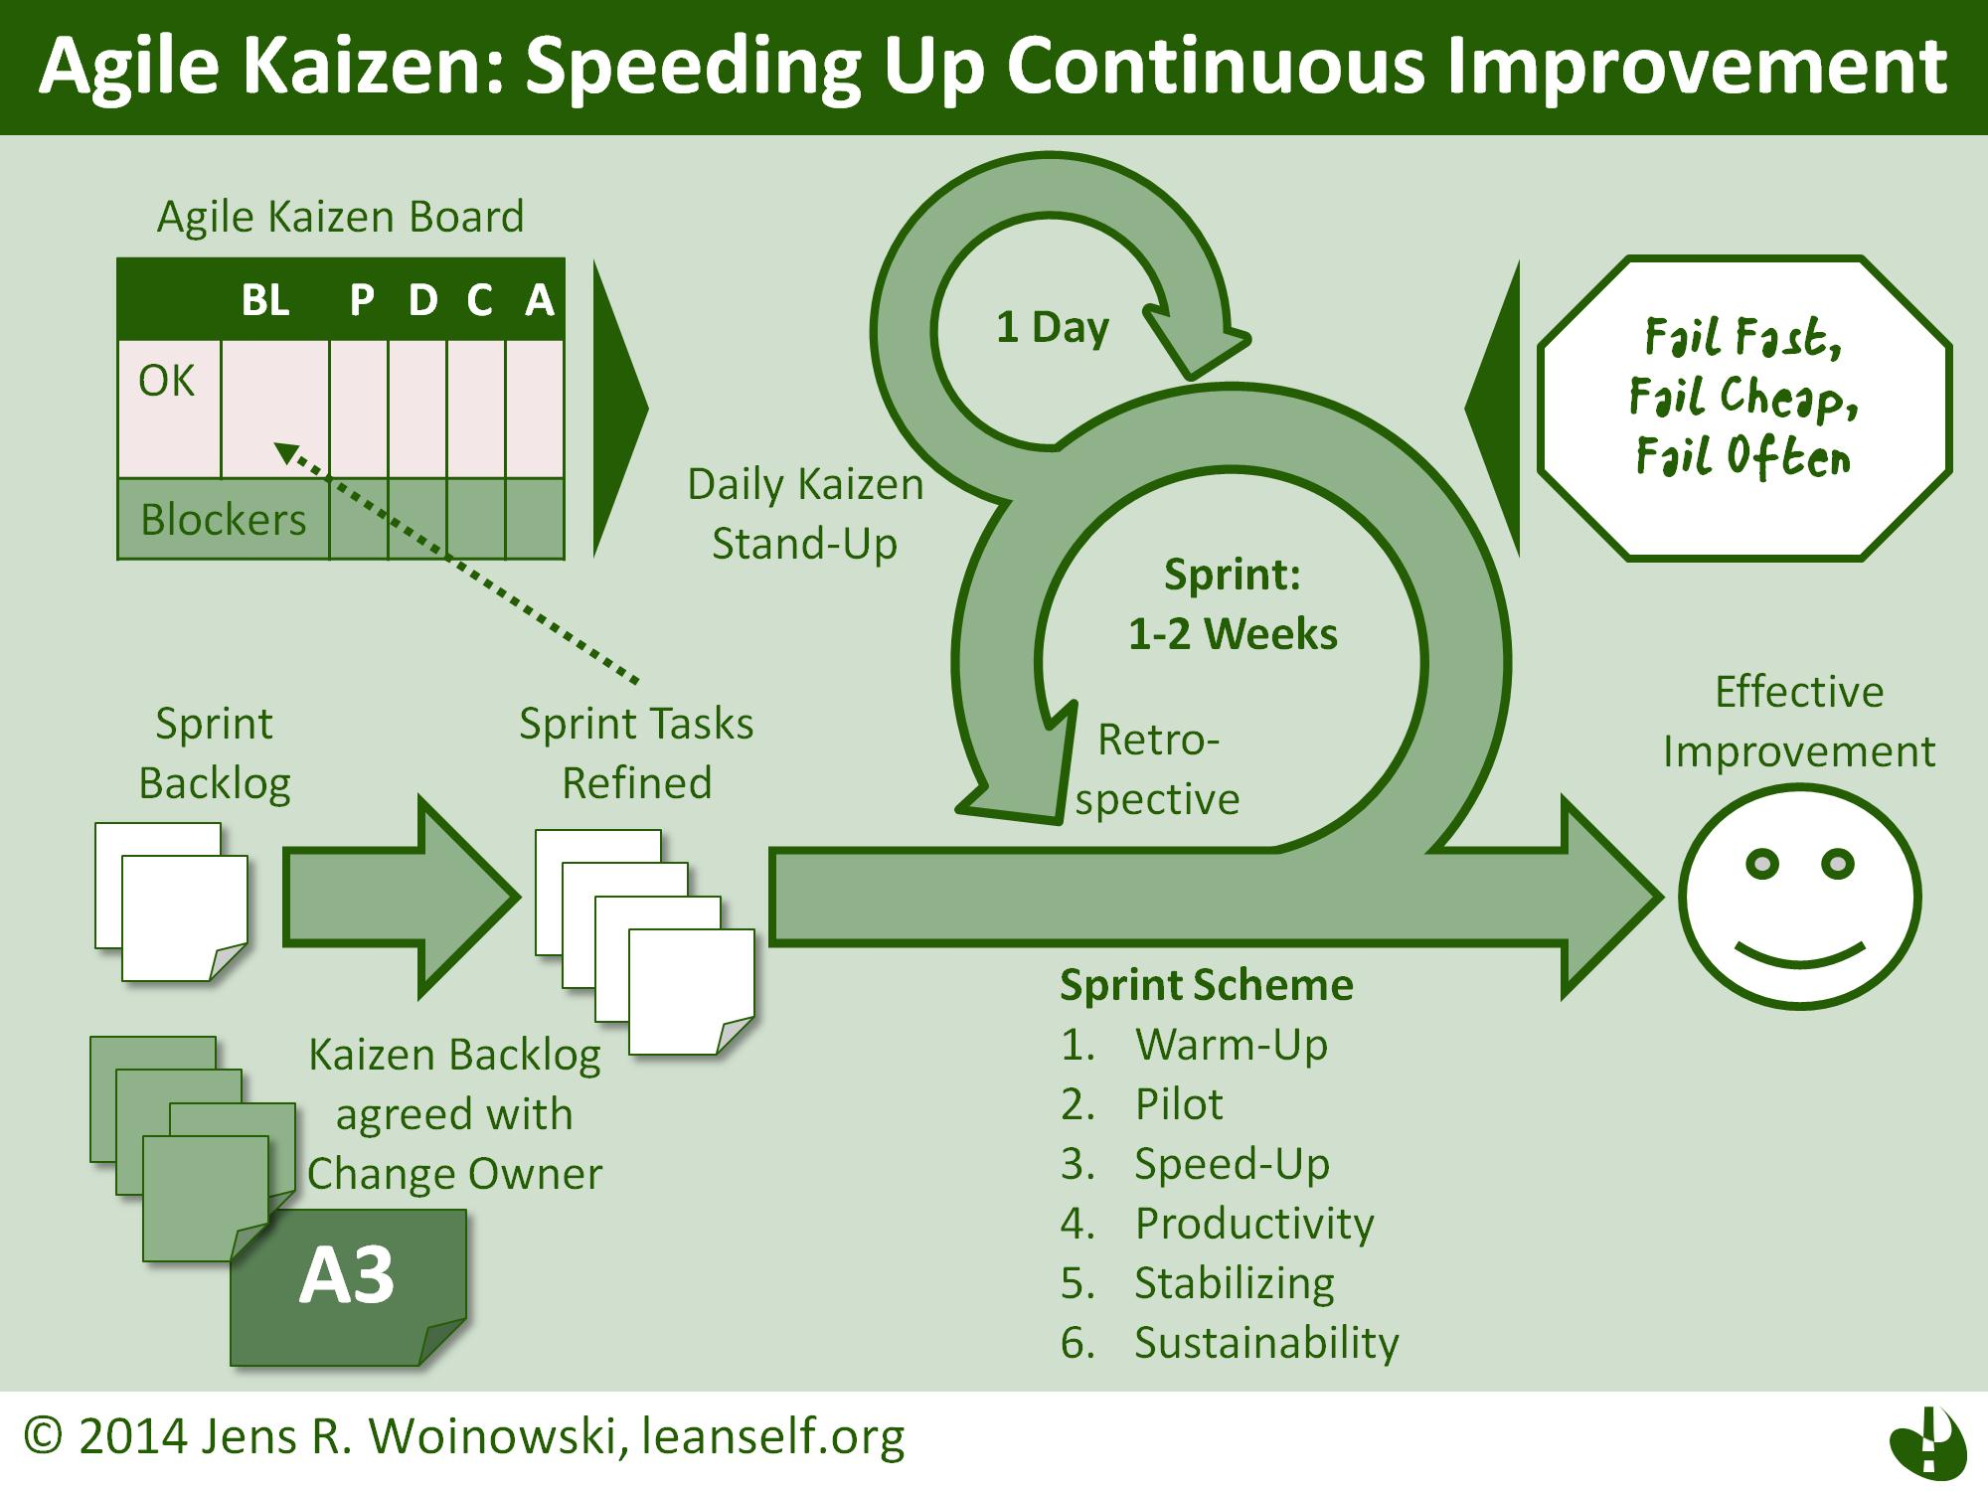

Slide 17
Kaizen Statement
Operations in your organization are likely to be smooth when all functions are streamlined, duties evenly distributed among employees and the management has a sense of direction.

Slide 18
Target Improvement of Individual Workstands
Organize ones responsibilities in a form of task lists segregated by types
Create easy access to heterogeneous data associated with tasks
Interconnect activities between employees by reacting on task events:
Open
Waiting for approval
Closed
Step 1.1
Step 2.1
Step 3.1
Step 1.2
Step 2.2
Step 3.2
Step 1.3
Step 2.3
Step 3.3

Slide 19
Target Small Problems Daily
Look for small ideas which, if possible, can be implemented on the same day.
This is in contrast to traditional models of work improvement, which generally have a long lag between concept development and project implementation. In the traditional model, the time between concept development and project implementation is very long. In the kaizen model, workers mostly look for small ideas and improvements which can be implemented on the same day.

Slide 20
Create a Workflow for Each Problem
Missing Cost Account
Identify Cost Account
Update Olympic
JIRA Ticket
Orphaned IIS Account
Locate Parent Account
Update Olympic
JIRA Ticket
Pending Closure
Wire Balance to Client
Close Account
JIRA Ticket

Slide 21
Identify Relations Between Workflows and Create Interconnection
Orphaned IIS Account
Locate Parent Account
Parent is Closed
Initiate Account Closing
Pending Closure
Wire Balance to Client
Close Account

Slide 22
Identify Root Cause of the Problem
Missing Cost Account
Account is part of a relationship
Cost account is pointing to Parent Root
Parent root is closed
Cost account is now pointing to Closed Account

Slide 23
Develop Solution to Eliminate the Cause
Close account workflow
Close Account
If Used as Cost in Child
Re-point Cost in Child
Missing Cost Account
ELIMINATED
TERMINATED

Slide 24
Small Changes = Big Improvement
Improvements Pyramid
BIG
Middle 1
Small 1
Small 2
Middle 2
Small 3

Slide 25
Business Management Method - Kaizen
Continuous incremental improvements is an originally Japanese management concept for incremental (gradual, continuous) change (improvement).
Kaizen is actually a way of life philosophy, assuming that every aspect of our life deserves to be constantly improved.
Kaizen philosophy lies behind many Japanese management concepts such as Total Quality Control, Quality Control circles, Small group activities, Labor relations.
Key elements of Kaizen are quality, effort, involvement of all employees, willingness to change, and communication.

Slide 26
Kaizen Points Of Management
Create constancy of purpose for improvement of products and services
Adopt the new philosophy - transformation of company is needed
Quality must be designed and built into the processes, preventing defects rather than attempting to detect and fix them after they have occurred
Improve constantly and forever - management and employees must search continuously for ways to improve quality and productivity
Adopt and institute leadership - managers should lead, not supervise
Drive out fear - make employees feel secure enough to express ideas and ask questions
Break down barriers between staff areas - working in teams will solve many problems and will improve quality and productivity
Eliminate slogans, exhortations, and targets for the work force (problems with quality and productivity are caused by the system, not by individuals. Posters and slogans generate frustration and resentment)
Take action to accomplish the transformation - commitment on the part of both [top] management and employees is required.

Slide 27
Alternative Business Management Method - BPR
Business Process Reengineering method (BPR) is defined as 'the fundamental reconsideration and radical redesign of organizational processes, in order to achieve drastic improvement of current performance in cost, service and speed'. Information technology plays an important enabling role.
When Kaizen is compared to BPR is it clear the Kaizen philosophy is more people-oriented, more easy to implement, requires long-term discipline.
BPR on the other hand is harder, technology-oriented, enables radical change but requires major change management skills.
Company should analyze carefully, before choosing a Business Management Method for any improvement.

Slide 28

PART THREE
OUR WAY TO MAKE IT HAPPEN
A concrete Four Step plan to implement KAIZEN approach in ITAU.

Slide 29


