Slide 1
Six Degrees Of Separation
Everything is connected to every other thing, even if it's not visible on the surface.
Math: Assuming everyone knows at least 44 people, and that each of those people knows an entirely new 44 people, and so on, the maths shows that in just six steps everyone could be connected to 44^6, or 7.26 billion people - more than are alive on Earth today.
Account Services
Custody
Documentation
Compliance
Rick Management
Wire Transfer

Slide 2
ICE Mission
Streamlined Business Process
Every Task is accounted for
Assigned to a queue
Execution is measured
Tasks are combined in workflows
Workflows interact with each other

Slide 3
Evolutionary Approach
Minimum Impact on Current Process
Identify the simplest activity preferably not handled by current process (Kaizen)
Activity should have zero or few dependencies on other activities
Communication between involved parties on all levels is the key
Generate a list containing subjects of selected activity in: SQL Server, Access, Excel
Expired KYC
Missing Suitability Profile
Associate new list with designated JIRA - Issue Type as a Unit Of Work (ICE)

Slide 4
Unit Of Work (UoW)
Implemented as JIRA workflow with only two steps:
Start
Done
Serves as initial placeholder for any new activity introduced into ICE

Slide 5
Examples of (UoW)
JIRA: Data Integrity Project
Missing IIS Link: Issue Type
Start
Done
Missing Cost Account: Issue Type
Start
Done

Slide 6
Gain Experience
Leave newly created UoWs to run for a while
Let involved people adjust to new process
Encourage people's input about experience and suggestion
Meanwhile: Identify, research, define next activity and put it on ICE
Week 1
Week 2
Week 3

Slide 7
Expand Unit Of Work
Use gained experience to adjust UoW into more precise workflow
Missing IIS Link
Start
Done
If Root is Closed
Close Account
Else
Update Olympic

Slide 8
Handle Relations
Identify relation to another activity/workflow
Model relation using UoW approach
Iterate Gain Experience step for new UoWs
Close Account
Start
Done
Missing IIS Link
Start
Done
If Root is Closed
Close Account
Else
Update Olympic
Update Olympic
Start
Done

Slide 9
Expand Relations
If related UoW is already represented by an existing process (Notes SR, JIRA, BPM),
re-route Relation accordingly.
Missing IIS Link
Start
Done
If Root is Closed
Close Account
Else
Update Olympic
Close Account
Start
Done
Wire remaining balance
BPM
Wire Transfer
Notes SR
Update Linked IIS

Slide 10


The Continuing Mission
Gradually define flexible, liquid flows of activities in ITAU
Experiment with them
Model
Implement
Relate
Develop test ran on a daily/hourly basis that will ensure operational integrity
Freeze liquid flows into solid metadata-based infrastructure, infused with business rules.
Repeat
Powered by

Slide 11
Kaizen Team
Two permanent members under direct jurisdiction of COO
Operations, Kaizen expert: 1
Technology, ICE expert: 1
Provisional members: 2-5 people
Operational knowledge of current activity: 1-2
Operational knowledge of related activity: 0-1
Knowledge of existing technology involved in current/related activity: 1-2
Tentative members Manager(s) of related department(s)

Slide 12
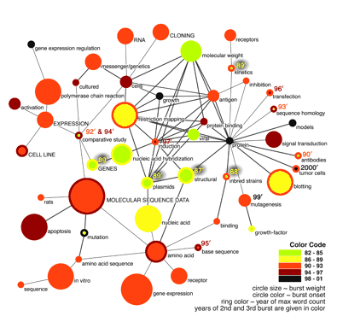
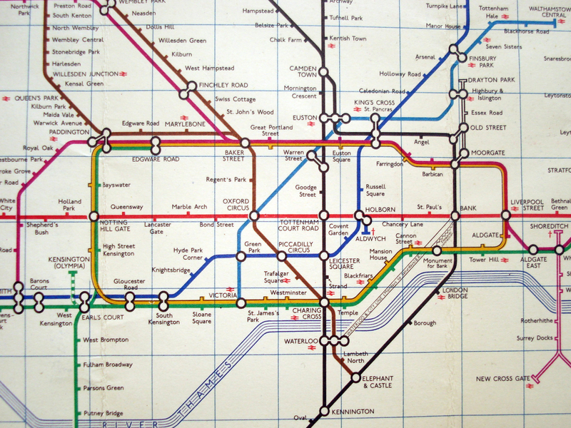
ITAU: WAY TO GO
While taking care of big problems is vital,
those solutions must to be based on solid infrastructure

Slide 13

If you liked this presentation, please

