Slide 1
Six Degrees Of Separation
Assuming everyone knows at least 44 people, and that each of those people knows an entirely new 44 people, and so on, the maths shows that in just six steps everyone could be connected to 44^6, or 7.26 billion people - more than are alive on Earth today.
Account Services
Custody
Documentation
Compliance
Rick Management
Wire Transfer

Slide 2
ICE Ultimate Goal
Streamlined Business Process
Every Task is accounted for
Assigned to a queue
Execution is measured
Tasks are combined in workflows
Workflows interact with each other

Slide 3
Unit Of Work (UoW)
Serves as initial placeholder for an activity introduced into ICE
Implemented as JIRA workflow with two steps:
Start
Done

Slide 4
No Impact on Current Process
Evolutionary Approach
Identify the simplest activity that are not handled by current process
Activity should have zero or few dependencies on others
Assign activity to queue in JIRA as a Unit Of Work
Missing Cost Account
Start
Done
Missing IIS Link
Start
Done

Slide 5
Gain Experience
Leave newly created UoWs to run for a while.
Let people adjust to new process
Encourage people's input about experience and suggestion.
Week 1
Week 2
Week 3

Slide 6
Expand UoWs
Use gained experience to adjust UoWs to more precise work steps
Missing IIS Link
Start
Done
If Root is Closed
Close Account
Else
Update Olympic

Slide 7
Handle Relations
Identify relation to another activity/workflow
Model that relation using UoW approach
Close Account
Start
Done
Missing IIS Link
Start
Done
If Root is Closed
Close Account
Else
Update Olympic
Update Olympic
Start
Done

Slide 8
Expand Relations
If related UoW is already represented by an existing process (Notes SR, JIRA, BPM), re-route
Relation accordingly.
Missing IIS Link
Start
Done
If Root is Closed
Close Account
Else
Update Olympic
Close Account
Start
Done
Wire remaining balance
BPM
Wire Transfer
Notes SR
Update Linked IIS

Slide 9


The Continuing Mission
Gradually define flexible, liquid flows of activities in ITAU
Experiment with them
Model
Implement
Relate
Develop test ran on a daily/hourly basis that will ensure operational integrity
Freeze liquid flows into solid metadata-based infrastructure, infused with business rules.
Repeat
Powered by

Slide 10
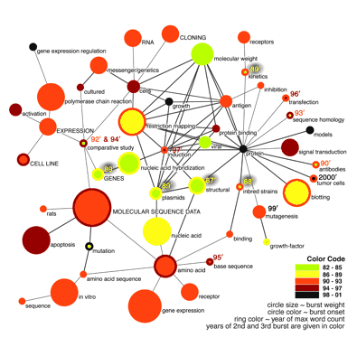
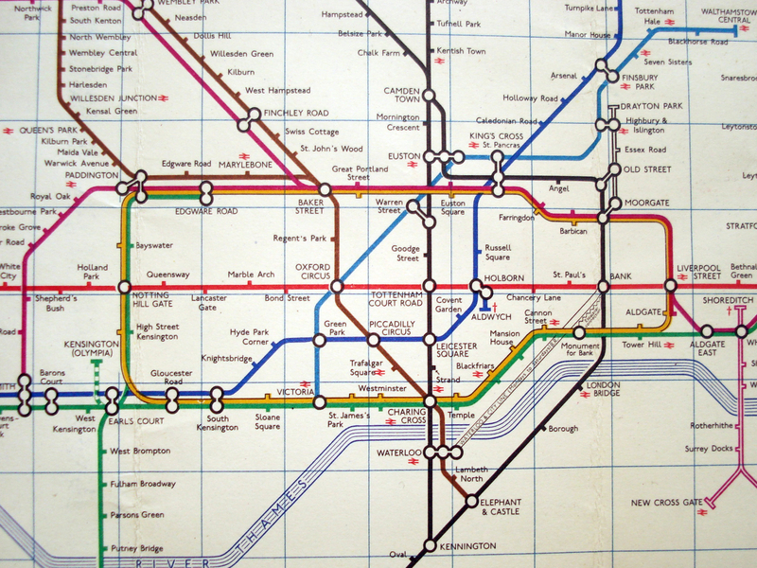
ITAU Universe
While taking care of big problems is vital, those solutions need to be based on solid infrastructure

