Slide 1

Deja Vu

Slide 2
Avalanche Of Problems
Big One
Medium
I don't think of this as a problem
I didn't know about this one
Medium
Only happens so often

Slide 3
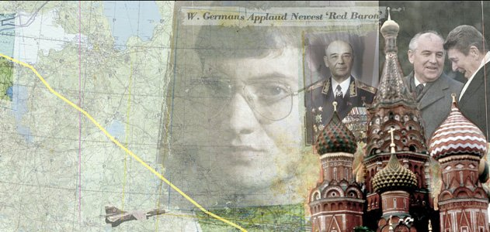
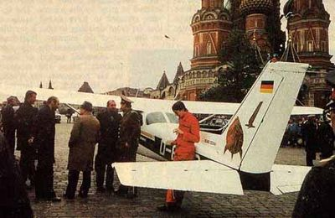
The Notorious Flight Of Mathias Rust
The 19-year-old amateur pilot had flown a single-engine Cessna nearly 550 miles from Helsinki to the center of Moscow—probably the most heavily defended city on the planet—and parked it at the base of St. Basil’s Cathedral

Slide 4
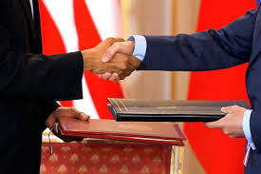

Hero or Criminal?
Two months later, Reagan and Gorbachev agreed to sign a treaty to eliminate intermediate-range nuclear weapons in Europe, and the Supreme Soviet ordered Rust to be released in August 1988 as a goodwill gesture to the West.
At the end of 1987, the police radio code used by law enforcement officers in Moscow was updated to include a code for an aircraft landing

