Slide 1

MBEYA UNIVERSITY OF SCIENCE AND TECHNOLOGY INFORMATION SYSTEMS AND TECHNOLOGY DEPARTMENT Internet Technologies COB 4111
1/3/2022
7A

Slide 2
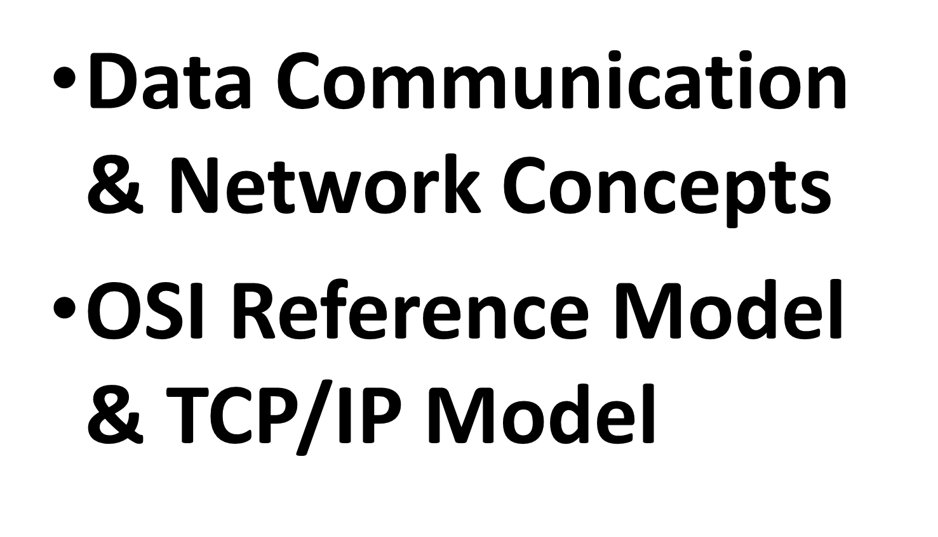
Content
1/3/2022
7A

Slide 3
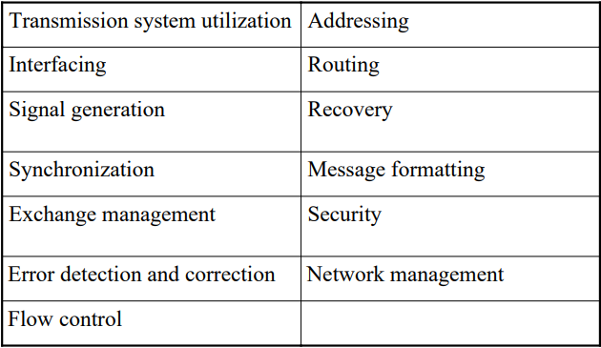
Communications Tasks
1/3/2022
7A

Slide 4
Data Communication
Computer accessing data should be secured and fairly to all.
The need to develop a protocol to set rules to govern all activities during data transmission.
Transmission speed in data communication is an important factor and its principally measured in bit per second (bts).
Modem changed data communication as it allows digital signals of computer to be converted into analogue type signals that can be used by analog circuits such as PSTN.
COB 4111– Internet Technology
MUST
4

Slide 5
Types and source of data
There are three types of signal required to be transmitted: Video, data and Speech.
Video and speech signals are analog in nature
Video signals are in the main found in videophones, video conferencing, multimedia applications, broadcast TV, cable TV, satellite and surveillance systems.
Dependent upon the application, data may be transmitted at very slow speeds of, say, the order of tens of bps or in a very high speed say tens of Gbps.
COB 4111– Internet Technology
MUST
5

Slide 6
Communication models
Initialization and release of a communications link
Synchronization between sending and receiving stations in order to interpret signals correctly
Information exchange protocols to govern communication.
Error control to determine if received signals, or messages, are free from error.
Addressing and routing
Message formatting.
COB 4111– Internet Technology
MUST
6

Slide 7
Communication models Cont.
Source: generates data to be transmitted.
Transmitter: Converts data into transmittable signals.
Transmission System: Carries data
Receiver: Converts received signal into data
Destination: Takes incoming data
COB 4111– Internet Technology
MUST
7

Slide 8
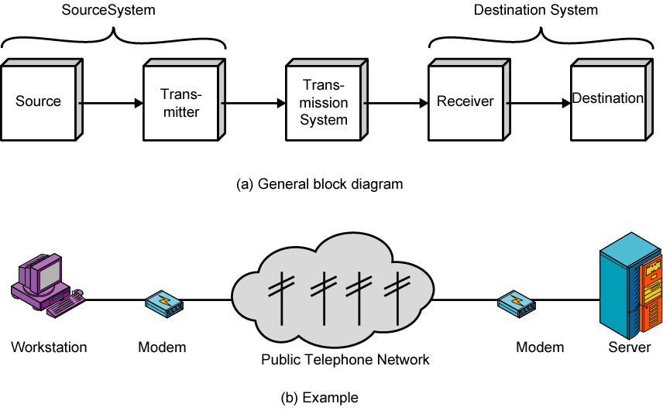
Communication models - Diagram
COB 4111– Internet Technology
MUST
8

Slide 9
Key aspects of networking
Network Applications And Network Programming
email, file transfer, web browsing, voice telephone calls, distributed databases, and audio and video teleconferencing.
Data Communications
Circuit and Packet Switching
Networking Technologies
Internetworking With TCP/IP
Additional Networking Concepts And Technologies
COB 4111– Internet Technology
MUST
9

Slide 10
Wide Area Networks
Large geographical area
Crossing public rights of way
Rely in part on common carrier circuits
Alternative technologies
Circuit switching e.g. telephone network
Packet switching
Frame relay
Asynchronous Transfer Mode (ATM)
COB 4111– Internet Technology
MUST
10

Slide 11
LAN Configurations
Switched
Switched Ethernet
May be single or multiple switches
ATM LAN
Fibre Channel
Wireless
Mobility
Access point installation
COB 4111– Internet Technology
MUST
11

Slide 12
LAN vs MAN vs WAN
LAN | MAN | WAN
Local Area Network | Metropolitan Area Network | Wide Area Network
up to 2 miles(or 2500 meters) | Up to 100 miles(or 200 km) | Unlimited (usually in 1000Km)
High, typically 10, 100 and 1000 Mbps... Sometimes up to 10 Gbps | High, typically 100 Mbps | Slow, about 1.5 Mbps wireless technologies ... Sometimes up to 8 Mbps
Locally installed, twisted pair, fiber optic cable, wireless (e.g. WLAN, Zigbee) | Locally installed and based on common carrier e.g. twisted pair, fiber optic cable etc. | Locally installed and based on common carrier e.g. twisted pair wires, fiber, coaxial cable, wireless including wireless and cellular network based
COB 4111– Internet Technology
MUST
12

Slide 13
Circuit Switching
A dedicated Communication path is required between the two machines/hosts i.e. Phone call
Intermediate links with a logical channel between each physical media
Circuit Switching communication requirements
Connection establishment – before data start transmitting.
Data transfer – in maximum speed
Connection termination
COB 4111– Internet Technology
MUST
13

Slide 14
Limitation of Circuit Switching
Dedicated channel capacity during entire communication
Good for VOICE communication
Inefficient for Huge traffic
Time waste for initial connection establishment
Depend on Point to Point connection
COB 4111– Internet Technology
MUST
14

Slide 15
Packet Switching
Network resource and data transmission is not dedicated.
Data are transmitted in short packets (small blocks –Kbytes) based on the destination address in each packet. When received, packets are reassembled in the proper sequence to make up the message
Each packet contains a header
Packet is being stored at each network node and then forward the packet to the selected route
COB 4111– Internet Technology
MUST
15

Slide 16
Packet Switching Advantages
Link can be shared
Preferable for huge traffic
Attenuation, buffering and data rate is good
Priority is given according to data during transmission
COB 4111– Internet Technology
MUST
16

Slide 17
Frame Relay
packet switching systems have large overheads to compensate for errors
modern systems are more reliable
errors can be caught in end system
Frame Relay provides higher speeds
with most error control overhead removed
COB 4111– Internet Technology
MUST
17

Slide 18
Asynchronous Transfer Mode
evolution of frame relay
fixed packet (called cell) length
with little overhead for error control
anything from 10Mbps to Gbps
constant data rate using packet switching technique with multiple virtual circuits
COB 4111– Internet Technology
MUST
18

Slide 19
Software Defined Network
A network in which the control plane is physically separate from the data plane.
and
A single (logically centralized) control plane controls several forwarding devices.
19

Slide 20





Software Defined Network (SDN)
Control
Program
Control
Program
Control
Program
Global Network Map
Control Plane
Control
Packet
Forwarding
Control
Packet
Forwarding
Control
Control
Packet
Forwarding
Packet
Forwarding
Control
Packet
Forwarding
20
Notes:
Talk about forwarding & control planes

Slide 21
The Networking “Planes”
Data plane: processing and delivery of packets with local forwarding state
Forwarding state + packet header → forwarding decision
Filtering, buffering, scheduling
Control plane: computing the forwarding state in routers
Determines how and where packets are forwarded
Routing, traffic engineering, failure detection/recovery, …
Management plane: configuring and tuning the network
Traffic engineering, ACL config, device provisioning, …
21

Slide 22
Timescales
 | Data | Control | Management
Time-scale | Packet (nsec) | Event (10 msec to sec) | Human (min to hours)
Location | Linecard hardware | Router software | Humans or scripts
22

Slide 23
Transmission medium
The N-layer Service: Layer N provides service N to layer N+1. In order for layer N to fulfil its service to layer N+1, it in turn requests a service from layer N−1.
Peer-to-peer communication protocols whereby any given layer ‘talks’ to its corresponding layer at the distant end.
Encapsulation: When an application has a message to send, data is sent to the application layer which appends an application layer header (H).
COB 4111– Internet Technology
MUST
23

Slide 24
Encapsulation Cont.
The purpose of the header is to include the additional information required for peer-to-peer communication. The resultant header and data are termed a protocol data unit or PDU.
The receiving station performs the reverse operation to encapsulation (known as decapsulation) as headers are stripped off at each layer to separate the respective communications protocols from the data units, the latter being successively passed up through the layers.
COB 4111– Internet Technology
MUST
24

Slide 25
Communication System/modes
Communications systems may operate in either a one-way or a two-way mode.
Simplex operation or broadcast system: a one way communication with no feed back mechanism.
Half-duplex: support two-way communication, but only one direction at a time.
Full-duplex: support simultaneous two way communication by using two separate channels, one for each direction of transmission.
COB 4111– Internet Technology
MUST
25

Slide 26
Transmission media
Guided - wire / optical fibre
Unguided - wireless
Characteristics and quality determined by medium and signal
– in unguided media - bandwidth produced by the antenna is more important
– in guided media - medium is more important
Key concerns are data rate and distance
COB 4111– Internet Technology
MUST
26

Slide 27
Design Factors
Bandwidth
– higher bandwidth gives higher data rate
Transmission impairments
– eg. Attenuation during long distance
Interference
Number of receivers in guided media
– more receivers introduces more attenuation
COB 4111– Internet Technology
MUST
27

Slide 28
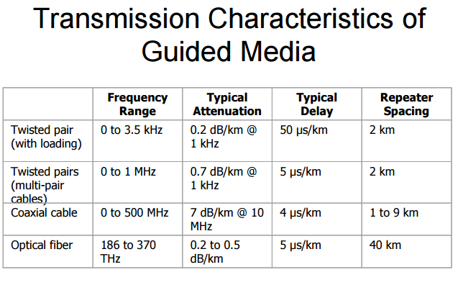
COB 4111– Internet Technology
MUST
28

Slide 29
Transmission media
Media available for transmission of signals are twisted-pair and coaxial-pair metallic conductor and optical fibres. Additionally, signals may be transmitted using radio waves.
Twisted-pair cable is used for baseband communication over relatively short distances, typically in modern LAN installations. Twisted-pair cables are therefore described as unshielded twisted pair (UTP) or shielded twisted pair (STP)
COB 4111– Internet Technology
MUST
29

Slide 30
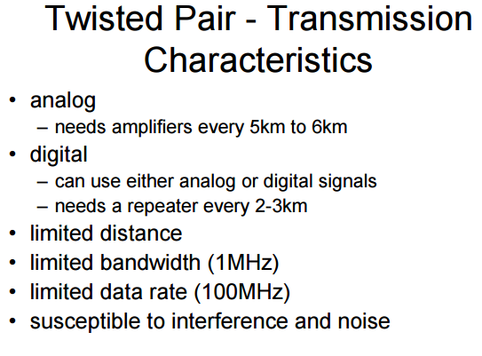
COB 4111– Internet Technology
MUST
30

Slide 31
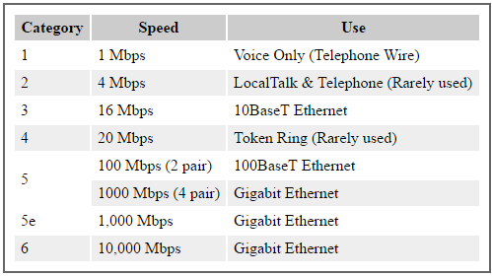
Categories of UTP
COB 4111– Internet Technology
MUST
31

Slide 32
Transmission media Cont.
Coaxial-pair cable: developed to overcome the deficiencies of twisted-pair conductors by enabling much higher frequencies of operation, typically up to hundreds of MHz. Coaxial conductors may support data rates in excess of 100 Mbps
Optical fibre: developed to handle even higher transmission rates with lower losses than are possible with coaxial conductors. Digital transmission is achieved by modulating data onto an optical carrier.
COB 4111– Internet Technology
MUST
32

Slide 33
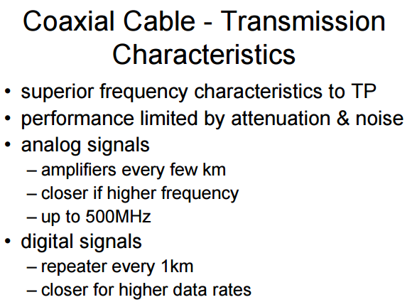
COB 4111– Internet Technology
MUST
33

Slide 34
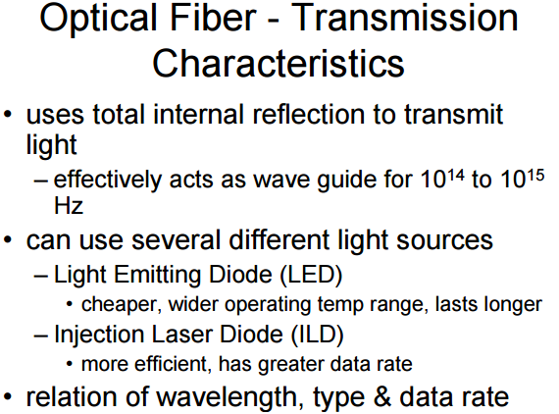
COB 4111– Internet Technology
MUST
34

Slide 35
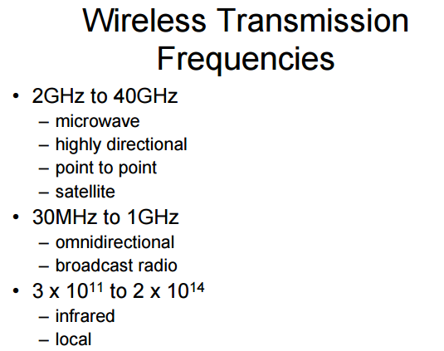
COB 4111– Internet Technology
MUST
35

Slide 36
Standards Organizations
ITU-T (International Telecommunication Union - Telecommunications Sector) - formerly CCITT (International Telegraph and Telephone Consultative Committee), a committee within ITU, a United Nations agency, responsible for X.25, X.21, X.400, X.500, X.700, X.900, etc.
ISO (International Standards Organization): ISO 8073 (connection-oriented transport protocol)
ANSI (American National Standard Institute)
IEEE (Inst. of Electrical and Electronics Engineers): IEEE 802
1/3/2022
7A

Slide 37
Standards Organizations
IETF (Internet Engineering Task Force): TCP/IP, FTP, SNMP
W3C (World-Wide Web Consortium): HTTP, HTML, XML
ATMF (ATM Forum) - ATM related standards
TMF (TeleManagement Forum) - formerly known as NMF, Network Management Forum
1/3/2022
7A

Slide 38
Reference
Data Communications and Computer Networks for Computer Scientists and Engineers BY Michael Duck and Richard Read SECOND EDITION
Computer Networks and Internets by Douglas E. Comer. Fifth edtion
Data and Computer Communications BY William Stallings
COB 4111– Internet Technology
MUST
38

