Slide 1
ETB 3122 ELECTRONIC CIRCUITS
LECTURE #1
Field-Effect Transistor
Chintelele, N
Email: chintelelenoel@gmail.com
Mob: +255718652878

Slide 2
Field Effect Transistors
The field-effect transistor (FET) is a transistor that uses an electric field to control the shape and hence the electrical conductivity of a channel of one type of charge carrier in a semiconductor material.
FETs are also known as unipolar transistors as they involve single-carrier-type operation.
The FET has several forms, but all have high input impedance.

Slide 3
Field Effect Transistors…
• FET can be majority-charge carrier devices, In which
current is carried by majority carriers.
• FET can also be Minority –charge carriers devices in
which current is due to flow of minority.
• The device contain active channel through which charge
carriers , electrons or holes, flows from source to drain.
• FET's conductivity is regulated by a voltage applied to a
terminal (the gate) which is insulated from the device.

Slide 4
Field Effect Transistors…
FET has three terminals which are:
Source (S)- Through which carriers enter the channel
Drain (D) – Through which carriers leaves the
channel
iii. Gate (G)- the terminal that modulates the channel
conductivity

Slide 5
Field Effect Transistors…
The gate permits electrons to flow through or blocks their passage by creating or eliminating a channel between the source and drain.
Electron-flow from the source terminal towards the drain terminal is influenced by the applied voltage.
The FET controls the flow of electrons (or electron holes) from the source to drain by affecting the size and shape of a "conductive channel" created and influenced by voltage (or lack of voltage) applied across the gate and source terminals

Slide 6
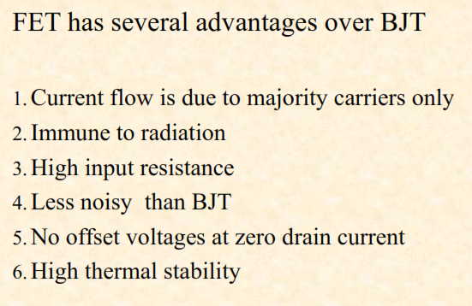
Field Effect Transistors…

Slide 7
FET Biasing
The parameters of FET are the temperature dependent, when temperature increases drain resistance also increases, thus reducing drain current.
The biasing circuits in FET includes:
- Fixed bias Circuits
- Self bias Circuits
- Voltage bias Circuits

Slide 8
FET Biasing…
Fixed Bias Circuits
DC bias of a FET device needs setting of gate-source voltage V_{GS} to give desired drain current I_{D} .
For a JFET, drain current is limited by the saturation current I_{DS}.
Since the FET has such a high input impedance so that no gate current flows and the dc voltage of the gate set by a voltage divider or a fixed battery voltage is not affected or loaded by the FET

Slide 9
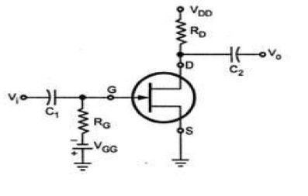
Fixed bias circuit for n-channel circuit
D.C Analysis:
▪For d.c analysis the coupling capacitors are open circuits
▪The current through gate resistor is zero
▪The gate resistor is replaced by short circuit.

Slide 10
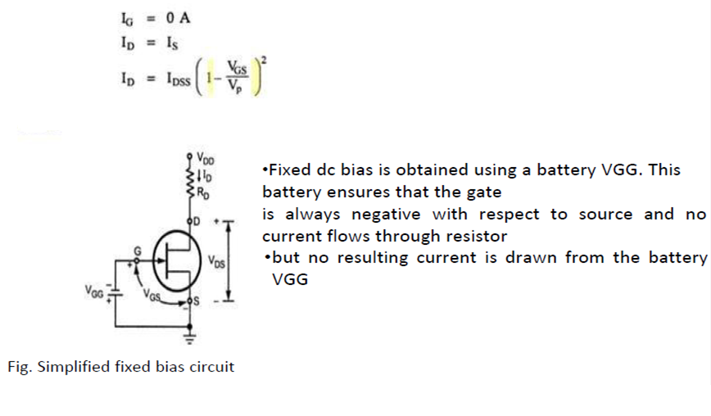
Fixed Bias Circuits…
The relationship which will be used for D.C analysis of all FET amplifiers.

Slide 11
Fixed Bias Circuits…
For D.C analysis we know: I_{G} = 0A
Applying KVL to the input circuit we get:
V_{GS} + V_{GG} = 0
Thus , V_{GS =} ⁻ V_{GG}
Since V_{GG} is a fixed d.c. supply ,this voltage is fixed in magnitude and hence the name fixed bias circuit.

Slide 12
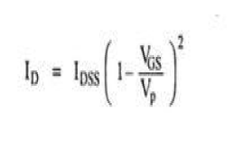
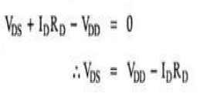
Fixed Bias Circuits…
For a fixed bias circuit the drain current I_{D} is given by
The drain to source voltage output circuit can be obtained by applying KVL

Slide 13
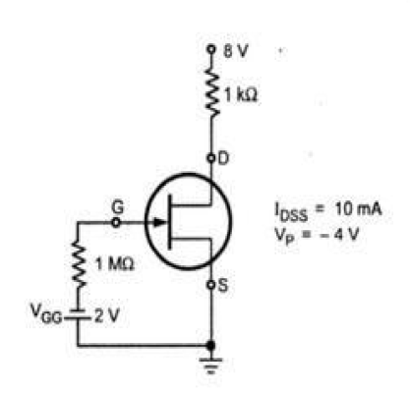

Example 1
For the circuit shown below calculate

Slide 14
Self- bias circuits
It is the most common method for biasing JFET.
The gate source of JFET must be always in reverse biased.
This condition requires a negative V_{GS} for n-channel JFET and positive V_{GS} for P-channel.
R_{G} is necessary only to isolate a.c signal from ground in amplifier applications.
No gate current flows through reverse-biased gate - source.

Slide 15

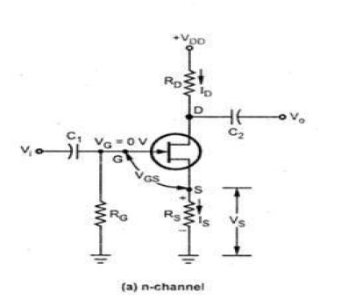
Self- bias circuits…
Hence the gate current is zero, therefore gate voltage will be equal to zero.
With drain current(I_{D}) the voltage across source(S) will be given by:

Slide 16

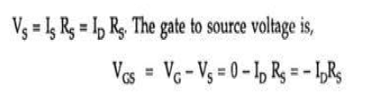
Self- bias circuits…
I_{S} produces a voltage drop across R_{S} and makes the source positive with respect to ground.
Since ,
Then
So voltage drop across source resistor R_{S} provides the biasing voltage V_{GG} .
• No external source is required for biasing and this is the reason
why it is called self-biasing.

Slide 17
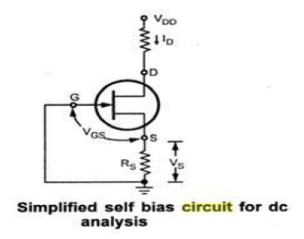
D.C analysis of Self-Biasing Circuit
For d.c analysis we can replace the capacitors by open circuits and R_{G} by short circuits equivalent , since I_{G}=0

Slide 18
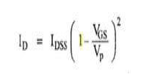

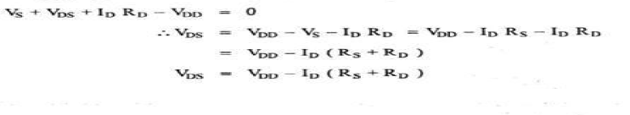
D.C analysis of Self-Biasing Circuit…
We know when I_{G}=0 there is relationship between I_{D} and V_{GS} , which is given by :
-substitute the value of V_{GS} in above equation we get:
-Apply KVL to the output circuit we get

Slide 19
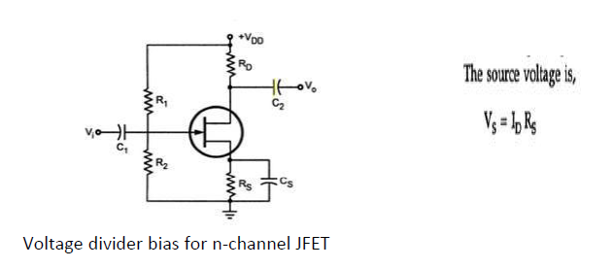
Voltage Divider Bias Circuit
• Voltage at the source of JFET must be more +ve than
the voltage at the gate in order to keep gate-source
junction reverse-bias
• The gate voltage is set by resistor R₁ and R₂

Slide 20

Voltage Divider Bias Circuit…
Gate voltage can be expressed by the following equation by using voltage divider formula.

Slide 21
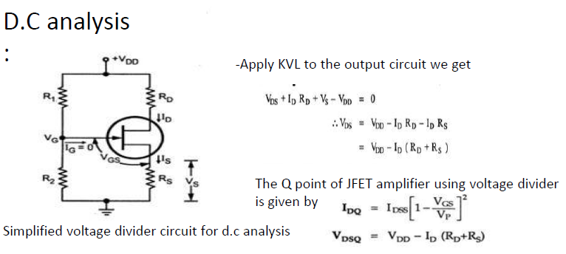
Voltage Divider Bias Circuit…

Slide 22
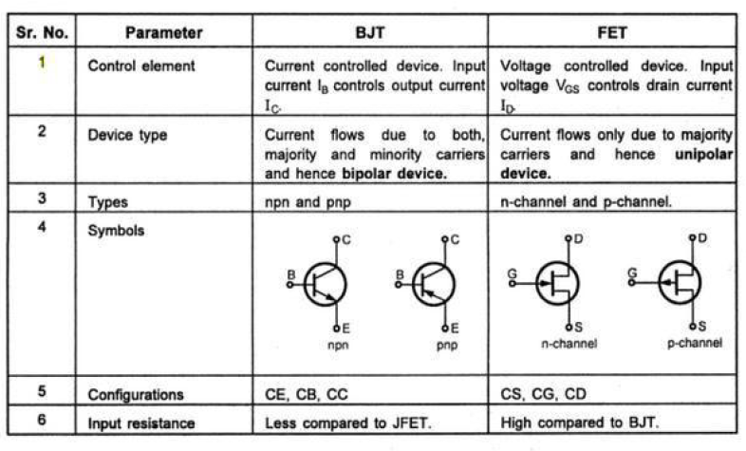
Comparison of BJT and FET

Slide 23
JFET Amplifiers
It provide excellent voltage gain with the added advantage of high input impedance.
For this reason JFET are most preferred over BJT’s for certain types of applications.
There are three basic configuration of JFET Amplifier which are :
▪ Common Source
▪ Common Drain (Source Follower)
▪ Common Gate

Slide 24
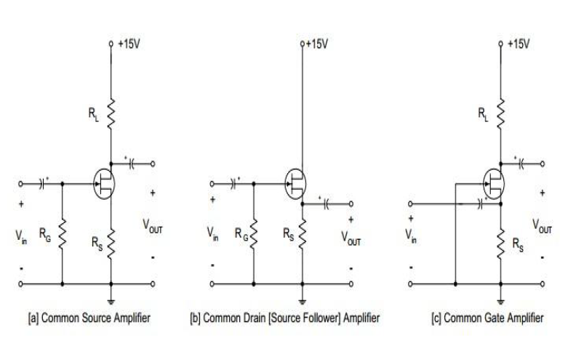
JFET AMPLIFIER CONFIGURATIONS

Slide 25
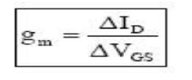

Small signal analysis of JFET amplifiers
The drain to source current of JFET are controlled by gate to source voltage.
The change in the drain current due to change in gate to source voltage can be determined by using the trans-conductance factor G_{m}.
The drain resistance is given by

Slide 26
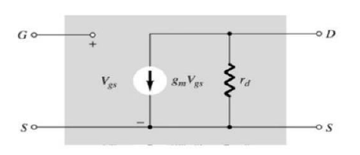
A.C equivalent circuit
•The relationship of ratio of Drain Current and gate source junction is included as current source G_{m}V_{gs} connected from drain to source.
•The input impedance is represented by open circuit at its input terminal,
•Output impedance is represented by r_{d} from drain to source

Slide 27
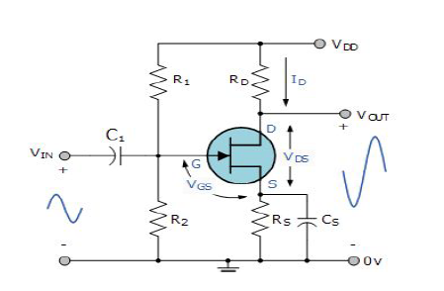
Common Source circuit analysis
The i/p terminals are gate and source
o/p terminals are drain and source
The source terminal is common to both i/p and o/p.

Slide 28
Common Source circuit analysis…
For +ve going input signal there is 180 degree phase shift between input and output.
Increases in V_{s} cause increase in I_{d} and raise the voltage drop across R_{d}
This produces a decrease in V_{d} which is capacitor coupled to the circuit o/p as negative going ac output voltage
As V_{s} increases in +ve direction the o/p voltage
increases in negative direction

Slide 29
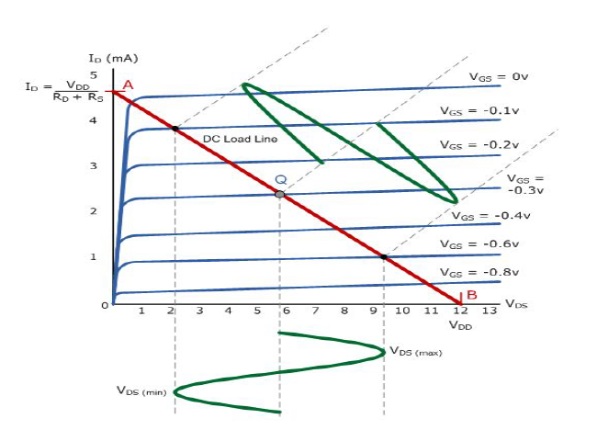
Common Source JFET Amplifier Characteristics Curves

Slide 30
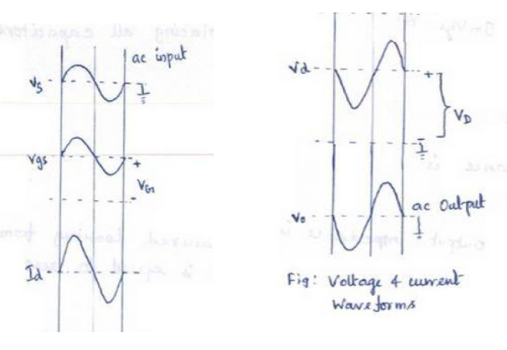
Input and output wave form

Slide 31
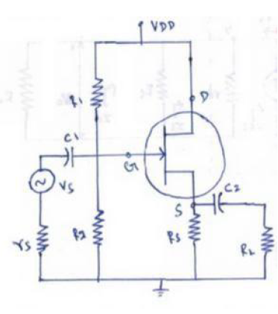
Common Drain Analysis/source follower

Slide 32
Common Drain Analysis/source follower…
The output voltage developed across source resistor.
The external load is capacitor coupled to the source terminal and gate voltage is derived from V_{dd} by means of voltage divider resistor R₁ and R₂
No resistor is connected in series with the drain terminal and no source bypass capacitor employed.

Slide 33
Common Drain Analysis/source follower…
V_{g} is constant and source voltage is V_{s} = V_{g}+V_{gs}
When ac signal is applied to the gate via capacitor c₁
When V_{gs} is constant Vs increase and decrease with V_{g}

Slide 34
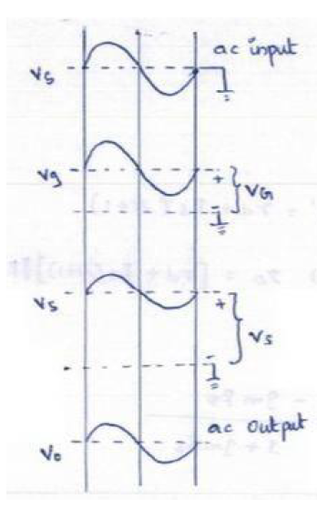
Common Drain Analysis/source follower…

Slide 35
Common Drain Analysis/source follower…
The a.c o/p voltage is closely equal to the a.c i/p
voltage, the circuit have unit gain
V_{o} is slightly smaller than V_{in} because the V_{o} at source terminal follows the signal voltage at gate( source follower )

Slide 36
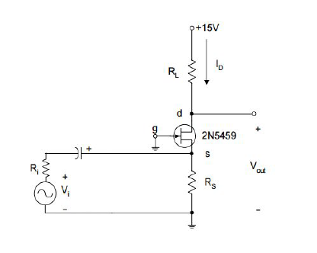
Common Gate amplifier circuit- FET

Slide 37
Common Gate amplifier circuit- FET…
Input is given between source and gate, output is taken between drain and gate.
The gate voltage (V_{in}) is at constant potential.
Thus increase in V_{s} in positive direction cause
increase V_{gs} in negative direction.
The decrease in I_{d} will cause the voltage drop at R_{d}.
Reduction in I_{d} results increases in output voltage(V_{o}).
When V_{s} decreases in opposite direction then
output voltage also decreases in the same direction. Thus there is no phase shift between i/p and o/p.

Slide 38
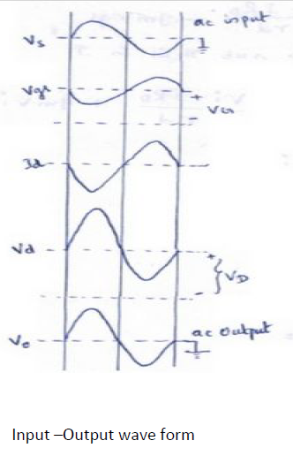
Common Gate amplifier circuit- FET…

Slide 39
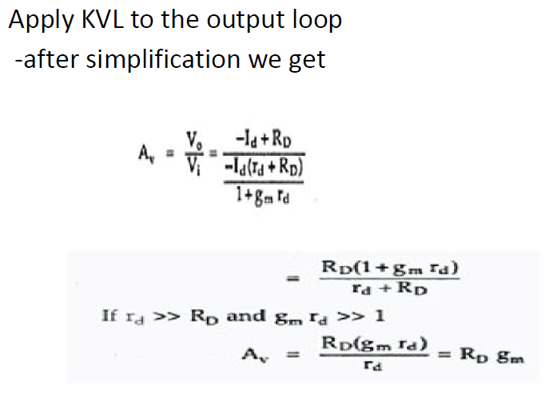
Common Gate amplifier circuit- FET…

Slide 40
END OF LECTURE # 1

