Slide 1
ETB 3122: ELECTRONIC CIRCUITS
Lecture # 2
Chintelele N.Y

Slide 2
METAL-OXIDE SEMICONDUCTOR FIELD EFFECT TRANSISTOR (MOSFET)

Slide 3
Metal-Oxide Semiconductor Field Effect Transistor (MOSFET)
It is a four terminal device used for amplifying or switching electronic signals . Its terminals are:
Source (S)
Drain (D)
Gate (G)
Body(B)

Slide 4
Metal-Oxide Semiconductor Field Effect Transistor (MOSFET)…
The body terminal of MOSFET is often connected to the source terminal , making it three terminal device like other FET
Because these two terminal are normally connected
to each other(short-circuited) internally , only 3
terminals appears in electrical diagram.
MOSFET is common to both digital and analogy
circuit.
A channel can contain electrons (nMOSFET or
nMOS) and holes (pMOSFET or pMOS)

Slide 5
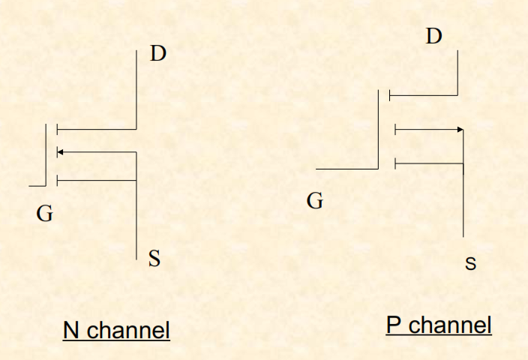
Circuit Symbol of MOSFET

Slide 6
MOSFET AMPLIFIER CONFIGURATIONS
There are three basic configuration of MOSFET Amplifier which are :
▪ Common Source
▪ Common Drain
▪ Common Gate

Slide 7
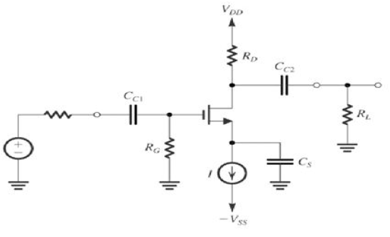
Common Source Configuration-
MOSFET

Slide 8
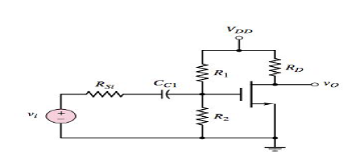
Common source with voltage divider bias

Slide 9
Common source with voltage divider bias…
Transistor is biased at saturation region with resistor R₁ and R₂.
Coupling capacitor act as a short circuit
V_{i} is in series with equivalent source resistance .
Equivalent source resistance is much less than amplifier i/p(input) resistance
The source is at ground potential so there is no body effect.

Slide 10
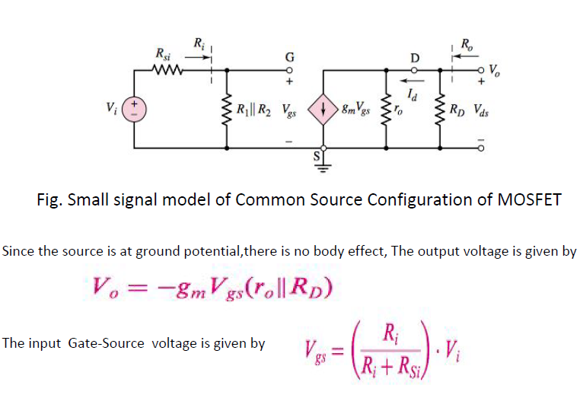
Small signal analysis of MOSFET

Slide 11
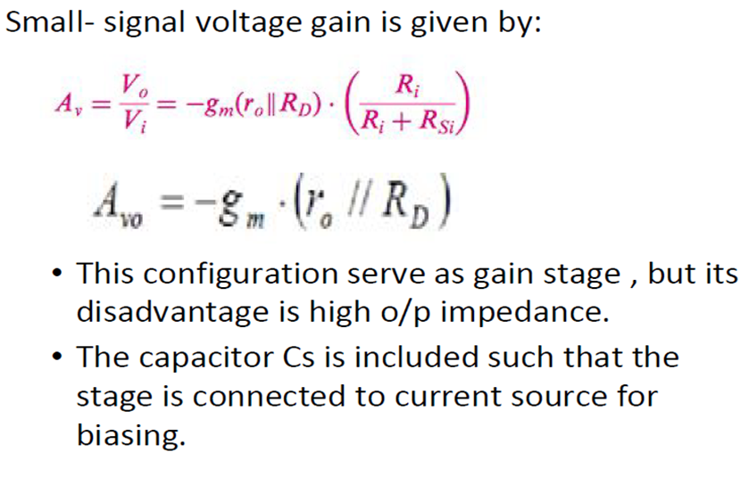
Small signal analysis of MOSFET…

Slide 12
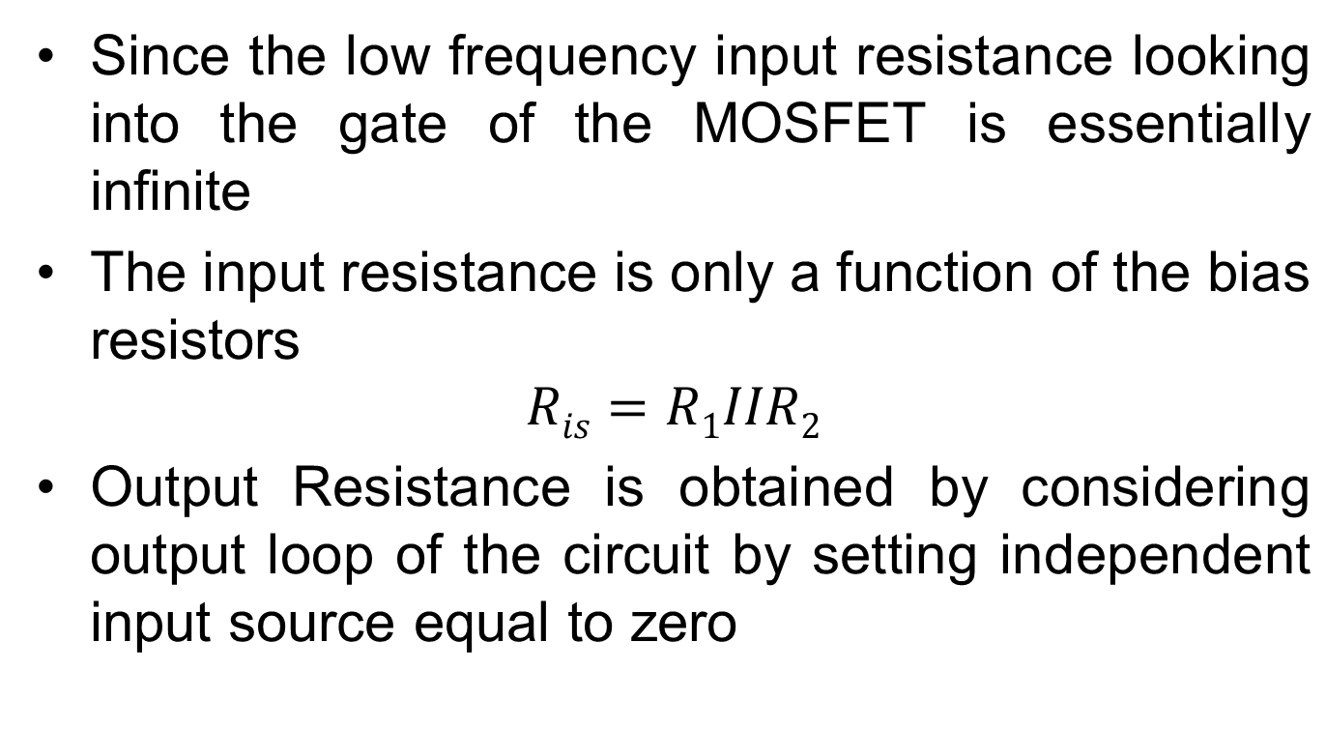

Input and Output Resistance

Slide 13
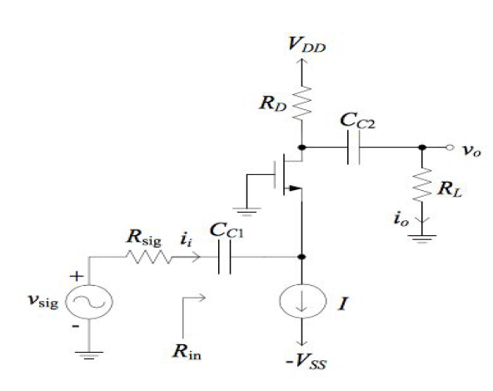
Common Gate configuration -MOSFET

Slide 14
Common Gate configuration –MOSFET…
Input signal is applied to the source terminal, and the gate terminal is grounded.
Circuit is biased with constant current I_{q}
The gate resistor prevent static charge on the gate terminal.
The coupling capacitor Cc₁ couples the signal to the source and coupling capacitor Cc₂ couples the output voltage to the load.

Slide 15
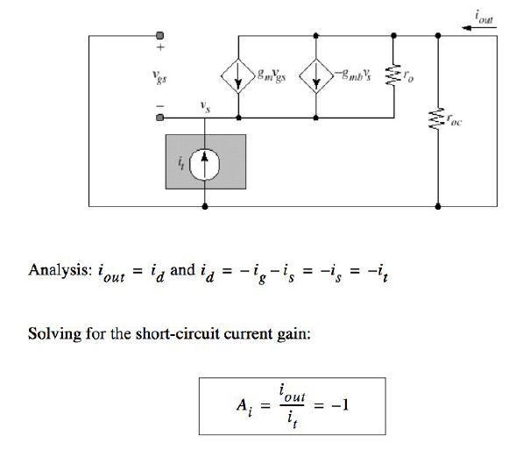
Common-Gate current Gain

Slide 16
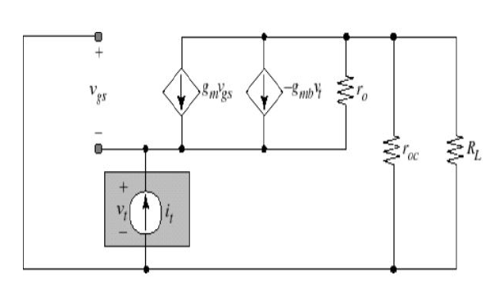
Common-Gate Input Resistance
Apply test current with load resistor present at the output

Slide 17
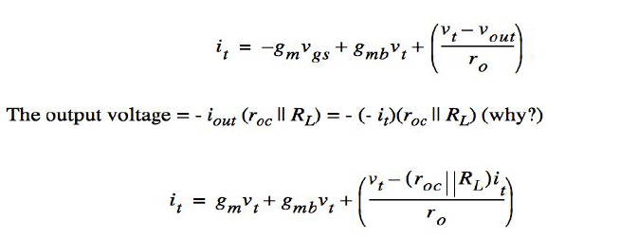
Common-Gate Input Resistance…
Apply KCL to input node.
Add the current at input node and set equal to the test current

Slide 18

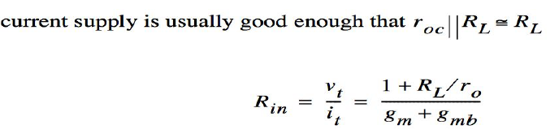
Common-Gate Input Resistance…
Solve for the ratio of the test voltage to test current
Input resistance is the function of load resistance

Slide 19
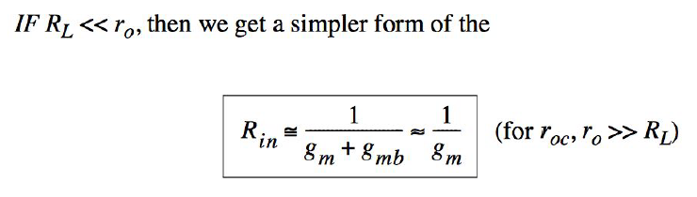
Common-Gate Input Resistance…

Slide 20
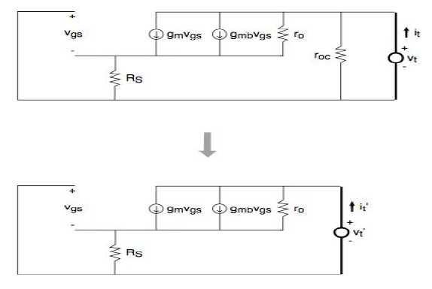
Common-Gate output Resistance
Output resistance is the function of source
resistance

Slide 21


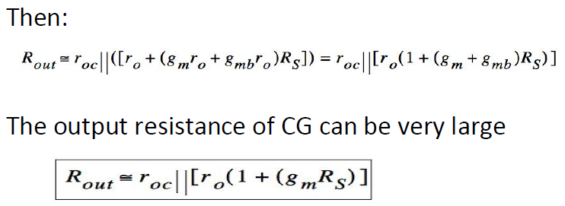
Common-Gate output Resistance…
Apply KCL to the input node

Slide 22
Common-Gate output Resistance…
The signal i/p to gate circuit is current
It has low input impedance compared to CS, low
input resistance is advantage
This amplifier provides gain and is useful when a
specific (low) R_{in} is required.
Another application of the CG configuration is that, it acts as a current buffer (current gain close to unity, small R_{in}, large R_{out}).

Slide 23
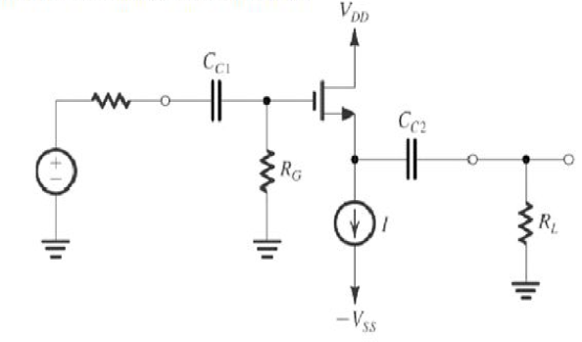
Common Drain Configuration -MOSFET

Slide 24
Common Drain Configuration –MOSFET…
Input is applied to the gate
The output signal is taken from source with respect to ground.
The drain is connected direct to V_{dd}
All signal are grounded at common point
The first order voltage gain is unit(1)
Input resistance is High
Output resistance is low
- Effective voltage buffer stage

Slide 25
Input and output impedance
The i/p resistance to the gate of MOSFET is
essential infinite.
To calculate o/p resistance we set all independent small source equal to zero.
Then apply test voltage to the terminal and
calculate test current.
Set V_{i} = 0, and apply set voltage V_{n}

Slide 26
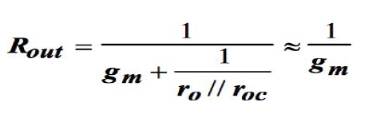
Input and output impedance…
Ro=V_{n}/I_{n}
-Apply KVL at the output terminal we get
For Pmos current direction and voltage polarities
are varied.

Slide 27
SUMMARY
Common-Source amplifier: Good voltage amplifier
- large voltage gain
- High input resistance
- Medium or High output resistance
Common Gate amplifier: Good current buffer
- current gain is unit
- low input resistance
- high output resistance
Common Drain amplifier: Good voltage buffer
- Voltage gain is unit
- High input resistance, Low output resistance

Slide 28
END OF LECTURE # 2

