Slide 1
ETB 3122: ELECTRONIC CIRCUITS
Lecture # 3
Chintelele N.Y

Slide 2
FEEDBACK AMPLIFIERS

Slide 3
Feedback: Is the process where by a portion of the output is returned to the input to form a part of the system excitation.
Feedback plays an important role in almost all electronic circuits.
At Input we have two signals
- Input signal
- Part of the output which fed back to the input
Types: both these signals may be in phase or out of phase
- Positive feedback (Oscillators)
- Negative feedback (Amplifiers)

Slide 4
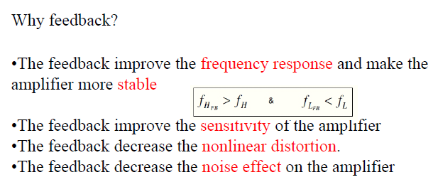

Slide 5
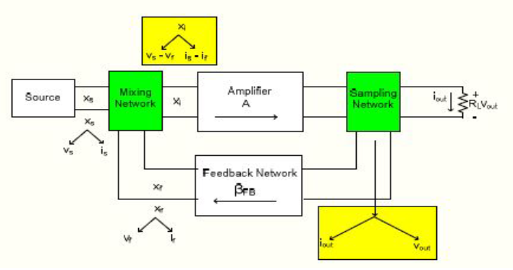
Block diagram of amplifier with feedback

Slide 6
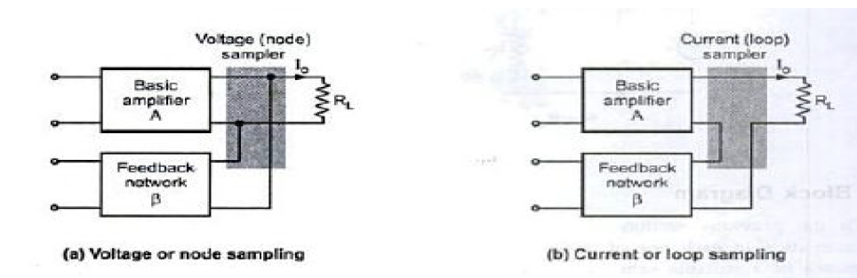
Sampling Network
There are two ways to sample the output, according to the sampling parameter
- Voltage sampling/ node sampling
- Current sampling / loop sampling

Slide 7
Feedback Network
It may consists of resistors ,capacitors and inductors
It is simply resistive configuration
It provides reduced portion of the output as feedback signal to the input mixer network
- It is given by V_{f} = β V_{o}
- Where β is a feedback factor or feedback
ratio
- It lies between 0 and 1

Slide 8
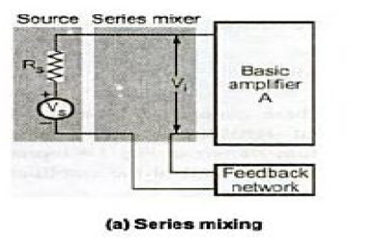
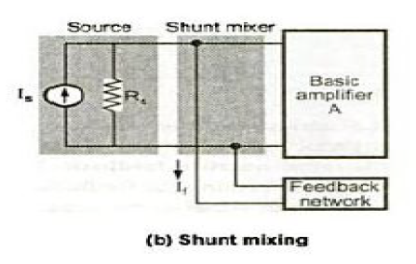
Mixer Network
There are two ways of mixing feedback signal with the input signal
- Series input connection
- Shunt input connection

Slide 9
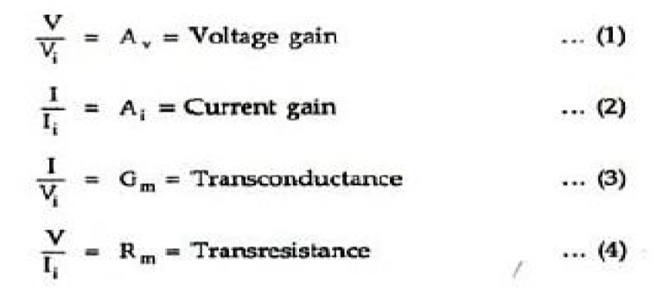
Transfer Ratio or Gain
The ratio of the output signal to the input signal of the basic amplifier is called the gain or transfer ratio of an amplifier

Slide 10
Transfer Ratio or Gain…
The four quantities A_{v}, A_{i} , G_{m} and R_{m} are referred to as transfer gain of the basic amplifier without feedback
We can use symbol A to represent any of these quantities
Transfer gain with feedback is represented by A_{f}
- It is defined as the ratio of the output signal to the input signal of the amplifier with feedback

Slide 11
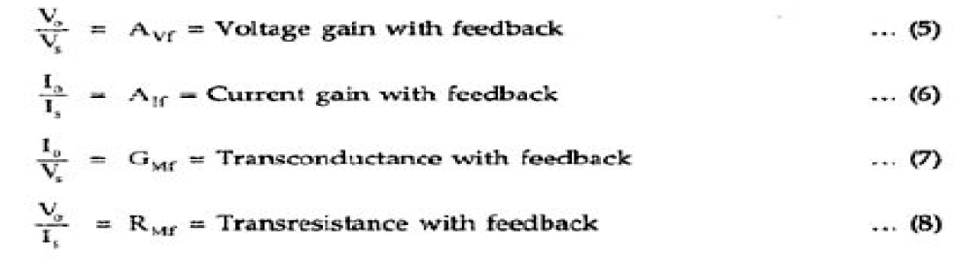
Transfer Ratio or Gain…

Slide 12
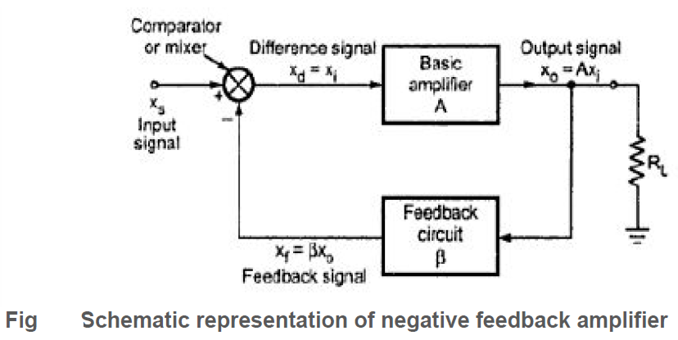
Negative Feedback Amplifier
Input signal and part of the output signal are in out of phase

Slide 13
Advantages of Negative Feedback
Increased Input Impedance
Reduced Output impedance
Gain Stability
Increased Bandwidth
Reduced Nonlinear Distortion
Reduced Noise

Slide 14
Disadvantages of Negative Feedback
All the advantages are obtained at expense of the gain A_{f} with Feedback , which is lowered in comparison with the transfer gain A of an amplifier without feedback by a factor ( 1+Aβ )
A negative feedback amplifier designed for a particular frequency range may break out into oscillations at some high or low frequency

Slide 15
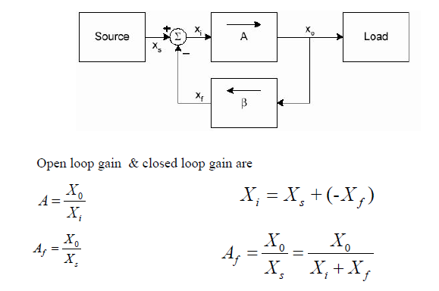
Fig : General Feedback Structure

Slide 16
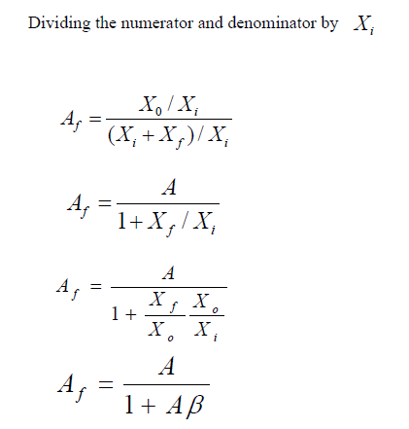

Slide 17
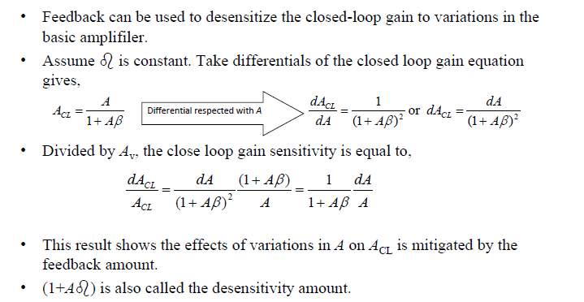
Gain De-sensitivity

Slide 18
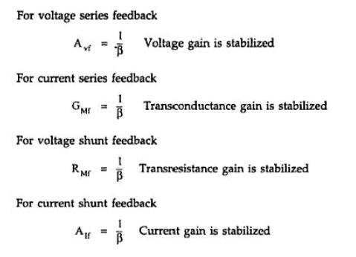
Gain De-sensitivity…

Slide 19
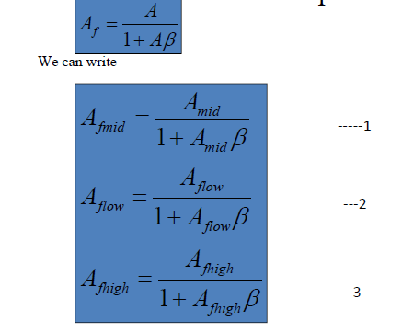
Bandwidth improvement

Slide 20
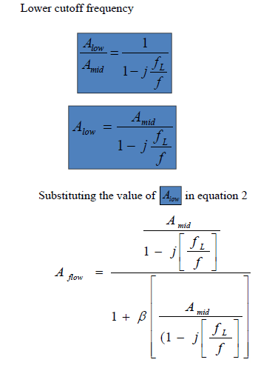
Bandwidth improvement…

Slide 21
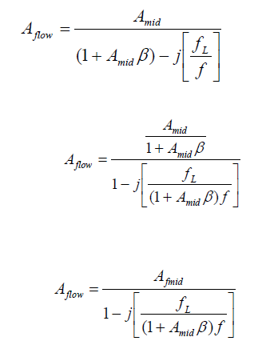
Bandwidth improvement…

Slide 22
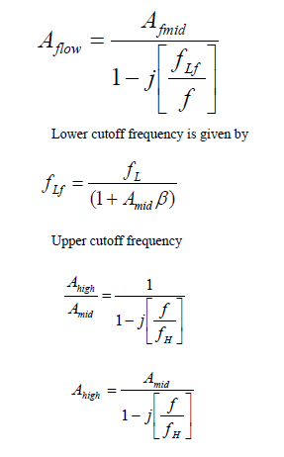
Bandwidth improvement…

Slide 23
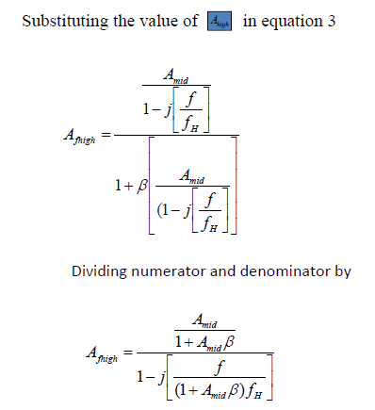
Bandwidth improvement…

Slide 24
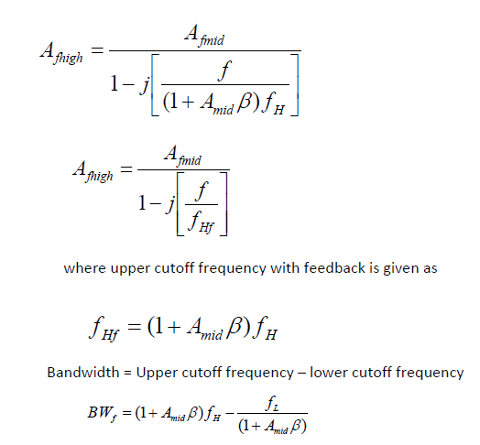
Bandwidth improvement…

Slide 25
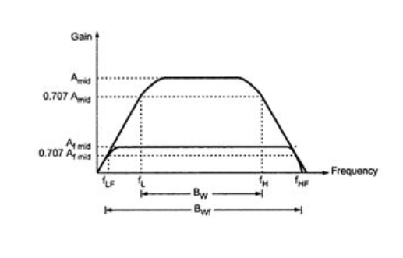
Effect of negative feedback on gain and bandwidth

Slide 26
Basic Feedback Topologies
Depending on the input signal (voltage or current) to be amplified and form of the output (voltage or current), amplifiers can be classified into four categories.
Depending on the amplifier category, one of four types of
feedback structures should be used.
(Type of Feedback) (Type of Sensing)
• Series (Voltage) Shunt (Voltage)
• Series (Voltage) Series (Current)
• Shunt (Current) Shunt (Voltage)
• Shunt (Current) Series (Current)

Slide 27
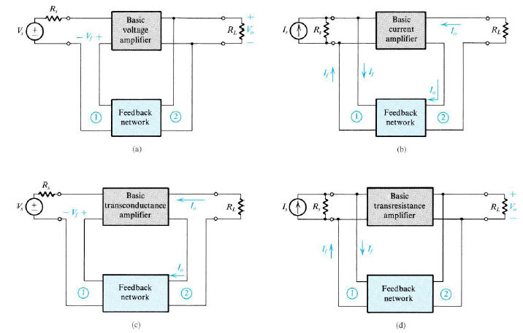
Figure :The four basic feedback topologies: (a) voltage-mixing voltage-sampling (series–shunt) topology; (b) current-mixing current-sampling (shunt–series) topology; (c) voltage-mixing current-sampling (series–series) topology; (d) current-mixing voltage sampling (shunt–shunt) topology

Slide 28
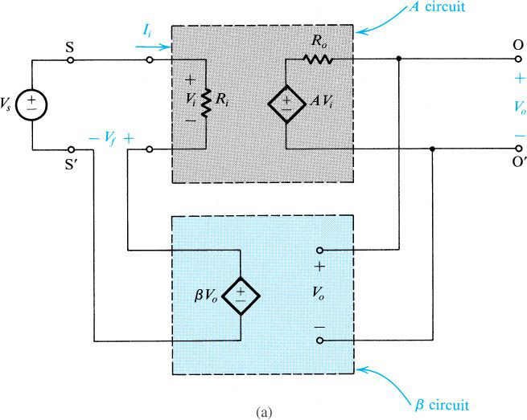
Series–shunt feedback amplifier

Slide 29
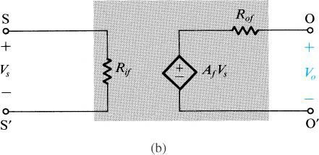
Series–shunt feedback amplifier equivalent circuit.

Slide 30
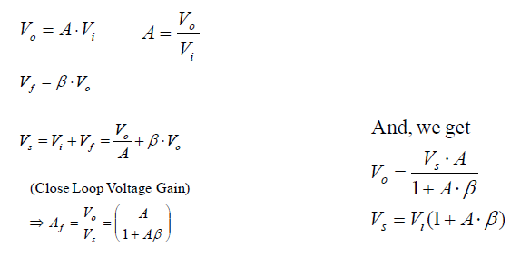
Series–shunt feedback amplifier
Voltage Gain Calculation:

Slide 31
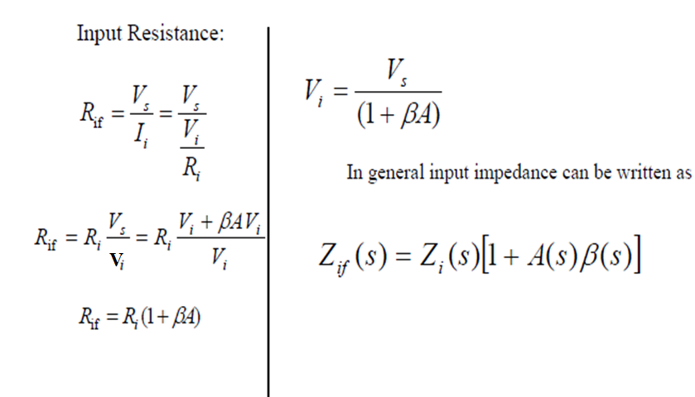
Input Resistance (Series-Shunt)

Slide 32
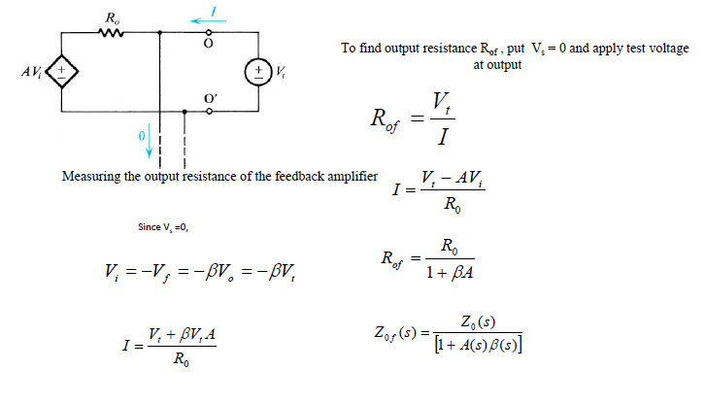
Output Resistance (Series-Shunt)

Slide 33
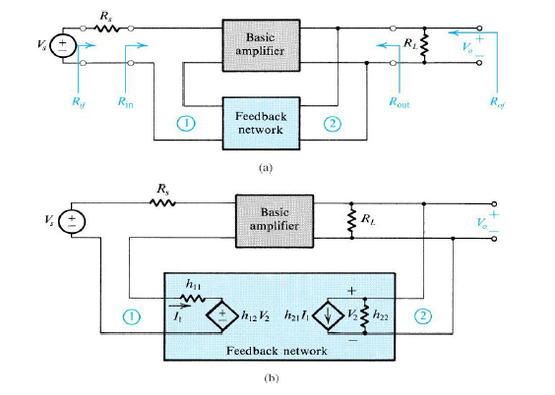
Practical series–shunt feedback amplifier.

Slide 34
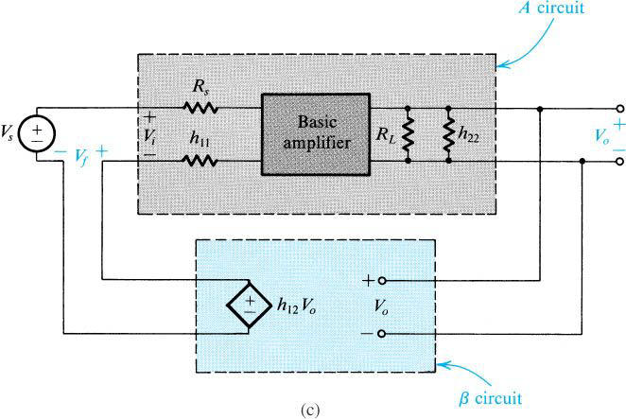
Practical series–shunt feedback amplifier…

Slide 35
Derivation of the A circuit and b circuit for the series–shunt feedback amplifier.
Block diagram of a practical series–shunt feedback amplifier.
The circuit in (a)with the feedback network represented by its h parameters.
The circuit in (b) with h₂₁ neglected.

Slide 36
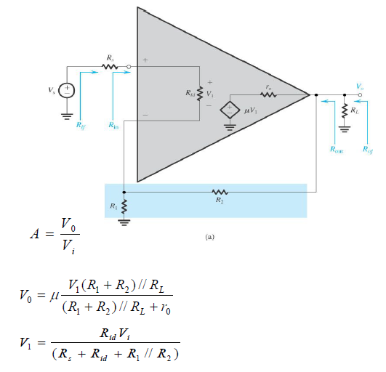
Series–shunt feedback amplifier.

Slide 37
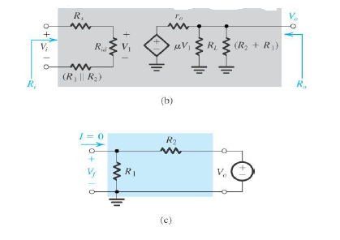
Series–shunt feedback amplifier…

Slide 38
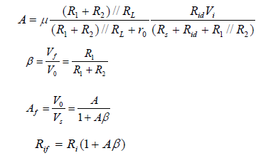
Series–shunt feedback amplifier…

Slide 39
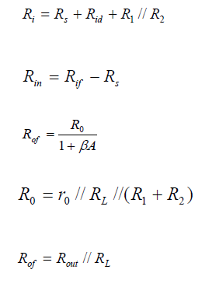
Series–shunt feedback amplifier…

Slide 40
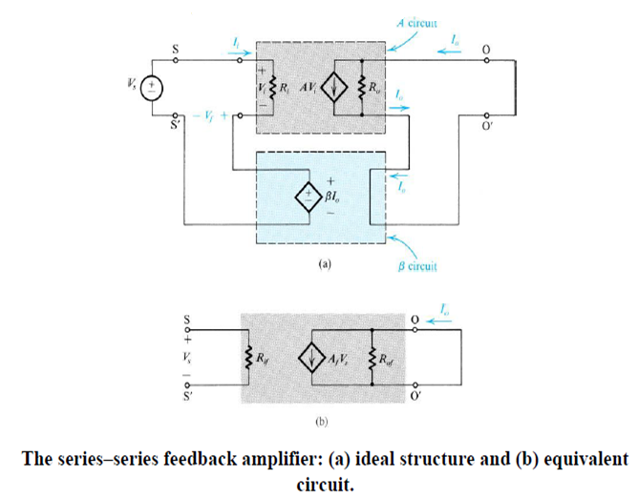
series–series feedback amplifier

Slide 41
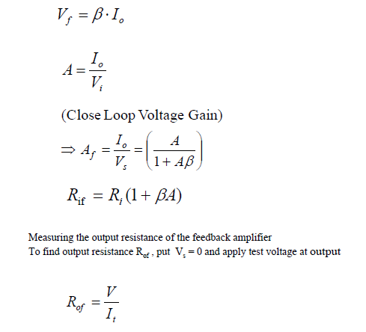
Transconductance gain

Slide 42
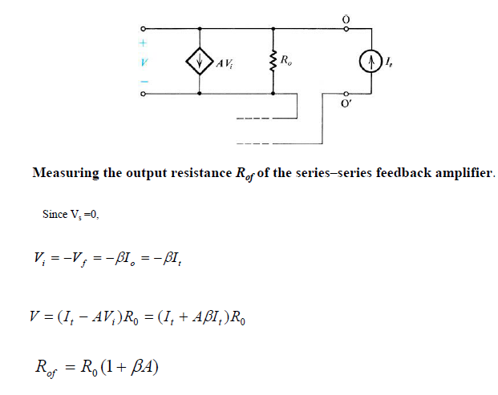
Transconductance gain…

Slide 43
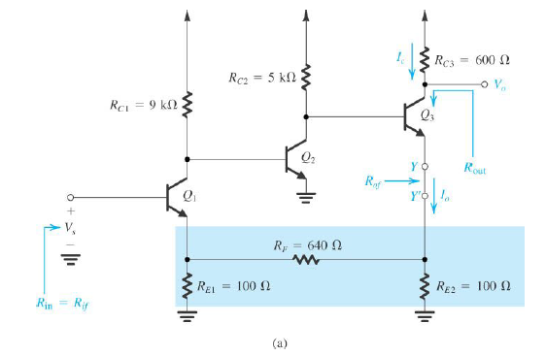
Series series Circuits

Slide 44
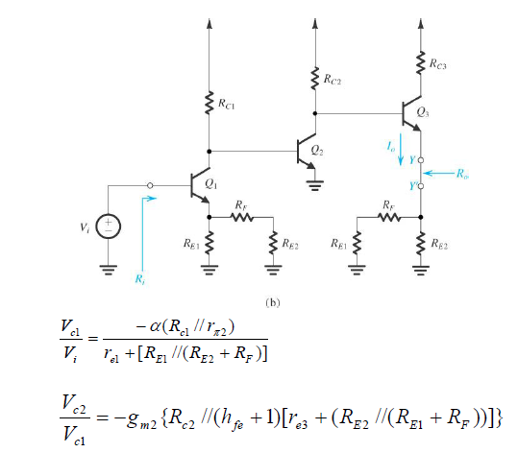
Series series Circuits…

Slide 45
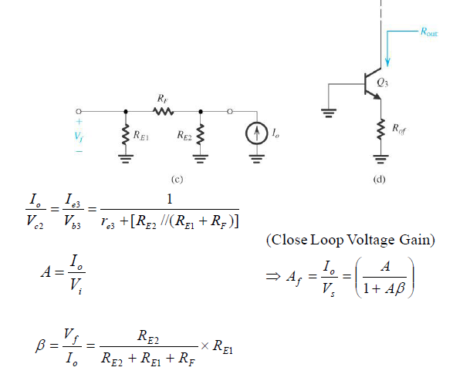
Series series Circuits…

Slide 46
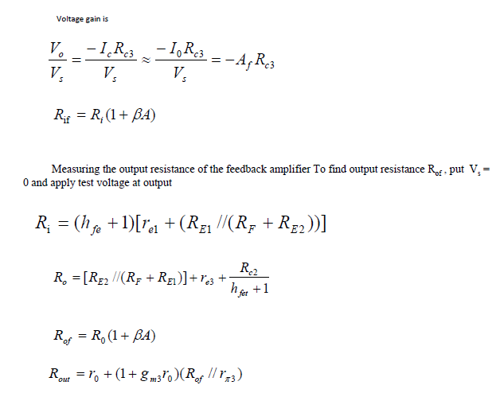
Series series Circuits…

Slide 47
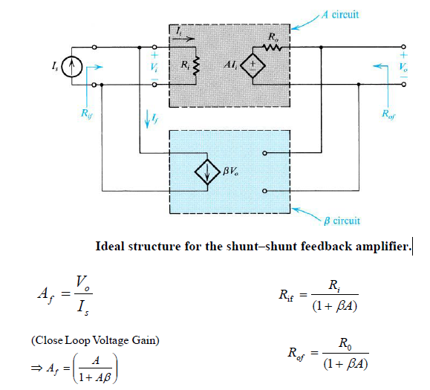
shunt–shunt feedback amplifier.

Slide 48
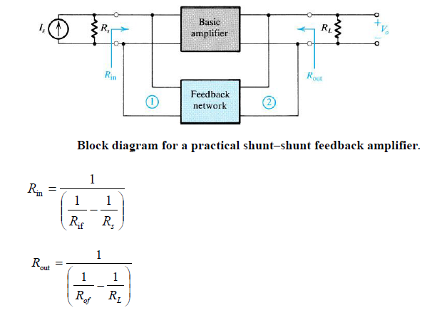
shunt–shunt feedback amplifier..

Slide 49
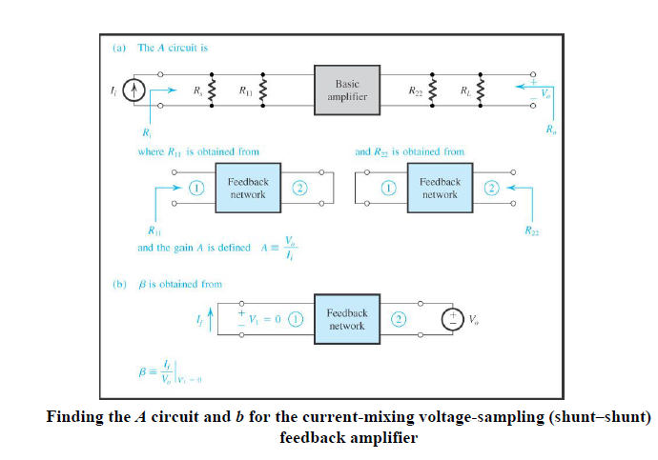

Slide 50
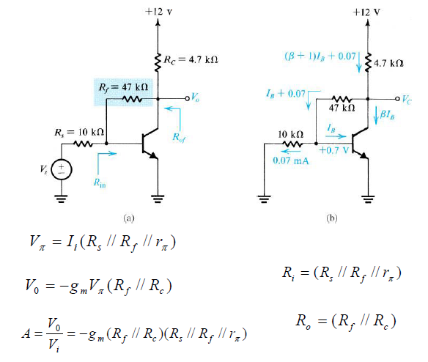
shunt–shunt feedback amplifier…

Slide 51
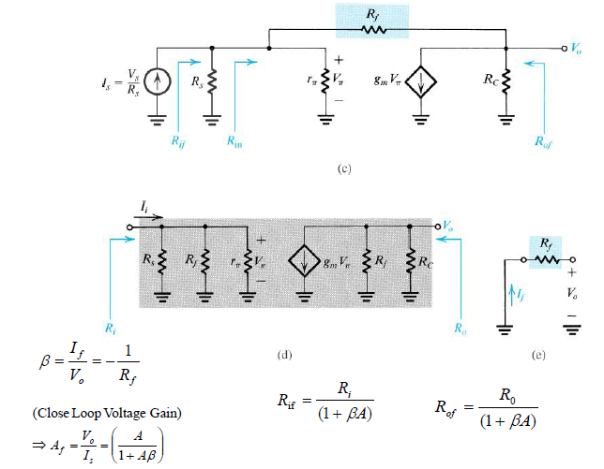
shunt–shunt feedback amplifier…

Slide 52
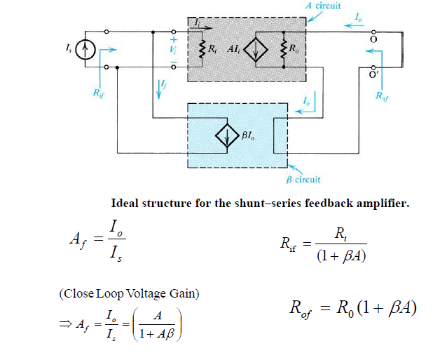
shunt–shunt feedback amplifier…

Slide 53
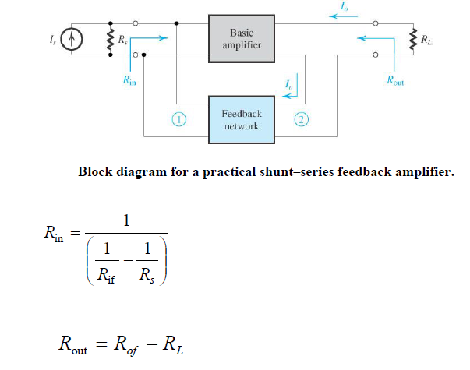
shunt–shunt feedback amplifier…

Slide 54
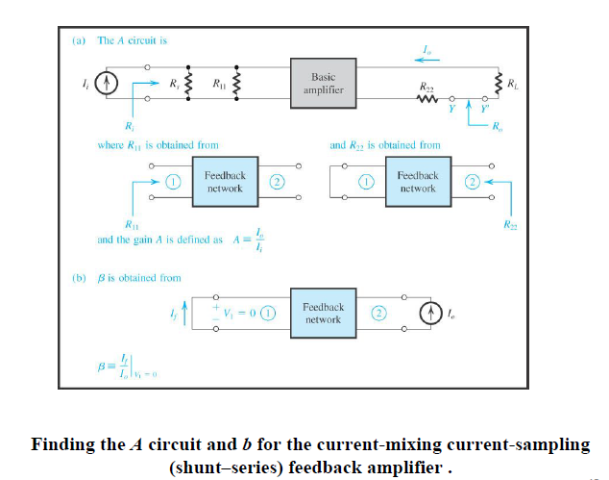

Slide 55
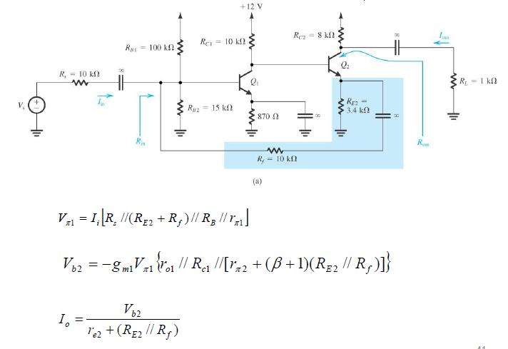
shunt–series) feedback amplifier .

Slide 56
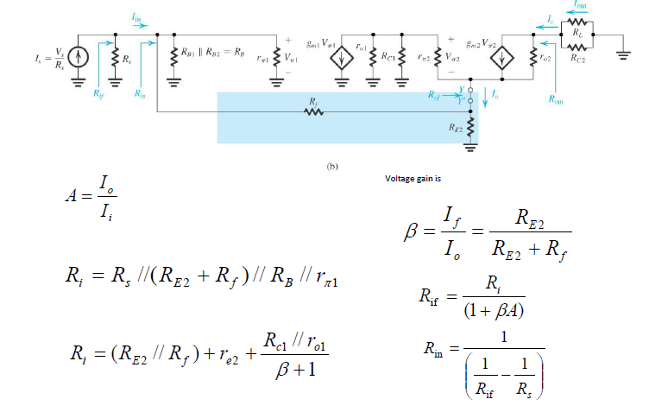

Slide 57
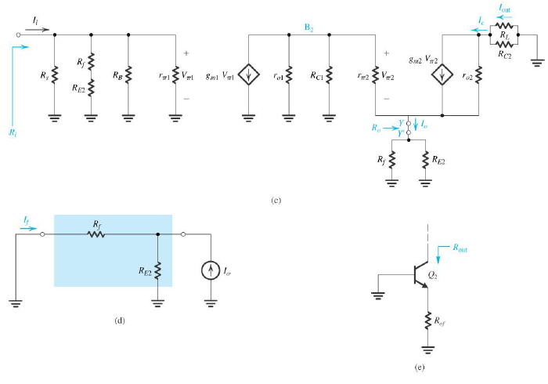

Slide 58
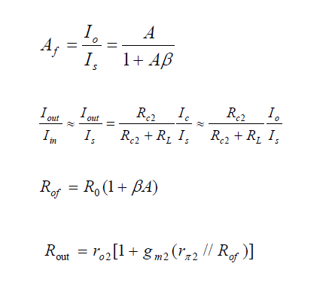
shunt–series) feedback amplifier…

Slide 59


Slide 60
END OF LECTURE # 3

