Slide 1
Operating Systems(COB 3136)
DEPARTMENT COMPUTER ENGINEEERING AND
Facilatot: Aziz Singa

Slide 2
Course objectives
This course practically illustrates the importance of using operating system in computer system, the historical development of the operating system and the fundamental of operating system in connection to the computer system to enable students to work with different environments with computer systems using varieties of operating system

Slide 3
Learning outcomes
Upon completion of the course, students will be able in a position of:
Ability to define the terminologies used in operating systems.
Ability to explain the concepts in designing , and use of operating systems.
Ability to identify problems encountered by users in operating systems.
Ability to use operating system tools efficiently.

Slide 4
Contd…
Ability to work effectively under multiuser operating systems
Ability to install and configure most commonly used operating system

Slide 5
COURSE CONTENT
This module will be conducted through lectures, laboratory work and tutorials
Operating system definition
Historical development of operating systems
Processors, memory, clocks, terminals, disks, network interfaces and i/o devices.
Key mechanisms of operating systems:
Processes, memory management, file system protection and security

Slide 6
REFERENCES
Stallings, w. Operating Systems , 3rd Ed : Prentice Hall

Slide 7
Operating System Overview
Lecture one

Slide 8
What is an operating System?
A program that controls the execution of application programs
An interface between applications and hardware
A program that acts as an intermediary between a user of a computer and the computer hardware

Slide 9
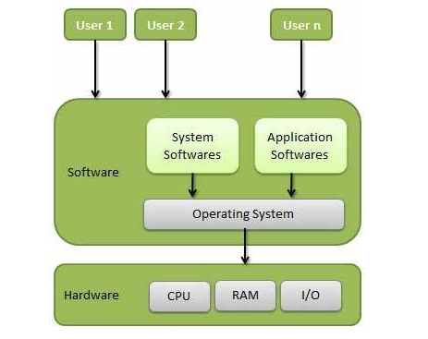
Cont……
An operating system is a program that acts as an interface between the user and the computer hardware and controls the execution of all kinds of programs.

Slide 10
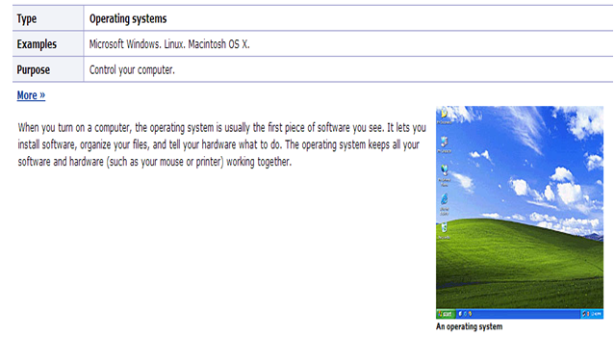
OS contd….

Slide 11
What are the goals of OS?
Operating system goals:
Execute user programs and make solving user problems easier.
Make the computer system convenient to use.
Use the computer hardware in an efficient manner.

Slide 12
Operating System Objectives
Convenience
Makes the computer more convenient to use
Efficiency
-Allows computer system resources to be used in an efficient manner
Ability to evolve
-Permit effective development, testing, and introduction of new system functions without interfering with service

Slide 13
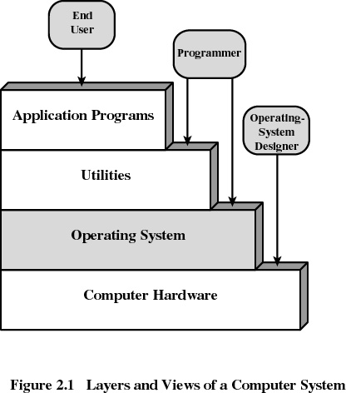
Layers of Computer System

Slide 14
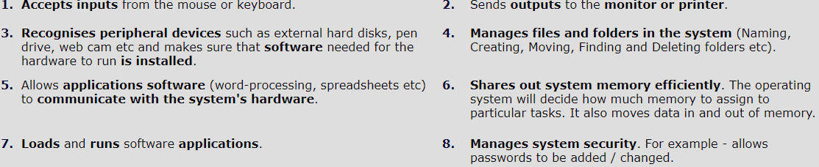
Tasks of the Operating System
Operating systems perform the following function:

Slide 15
Other services provided by OS:
Program development
-Editors and debuggers
Program execution
Access to I/O devices
Controlled access to files
System access

Slide 16
Error detection and response
- internal and external hardware errors
memory error
device failure
-software errors
arithmetic overflow
access forbidden memory locations
Accounting
-collect statistics
-monitor performance
-used to anticipate future enhancements
-used for billing users

Slide 17
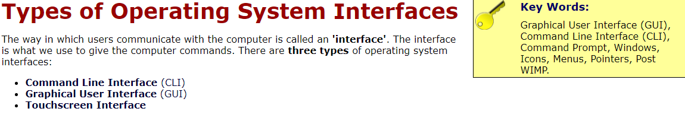

Slide 18
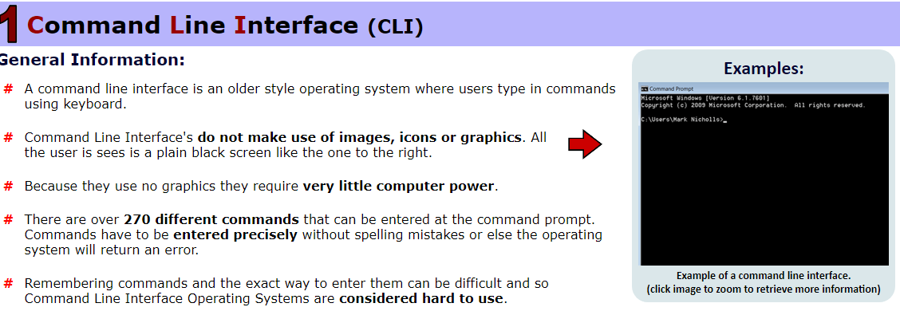

Slide 19
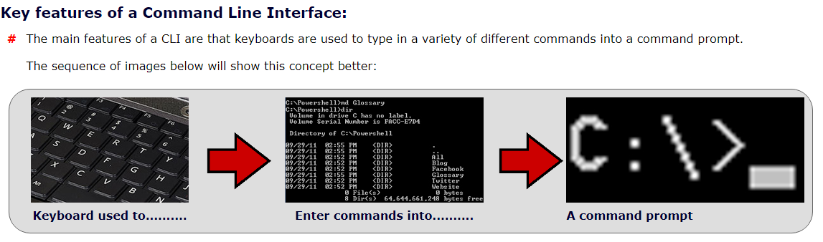

Slide 20
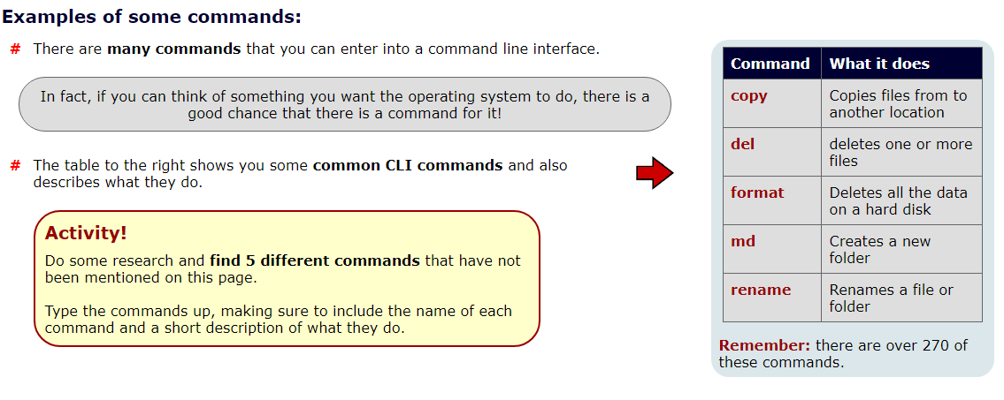

Slide 21
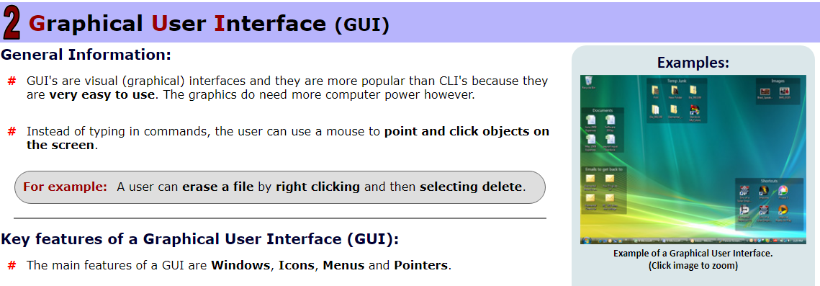

Slide 22
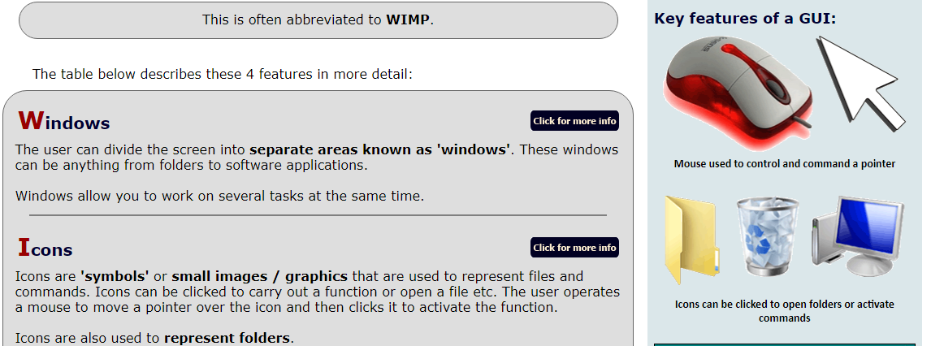

Slide 23
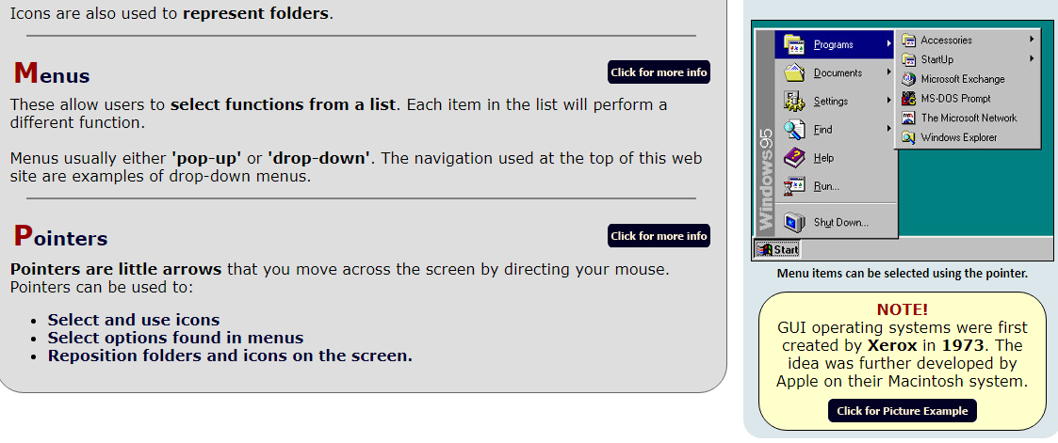

Slide 24
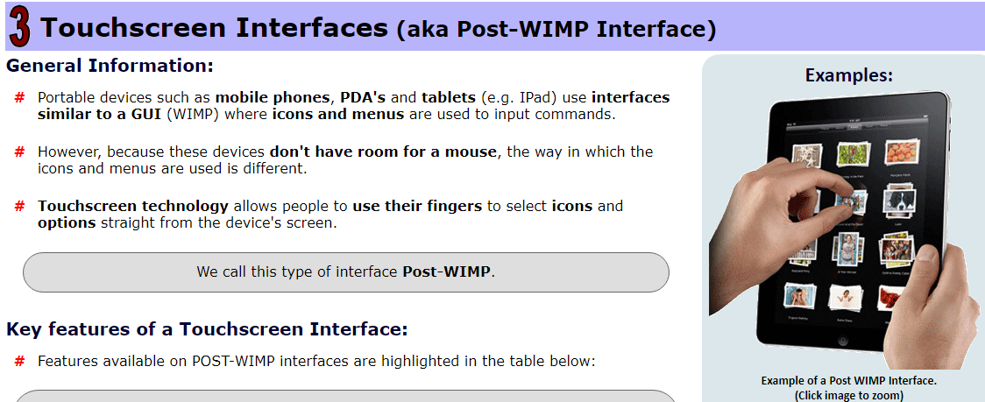

Slide 25
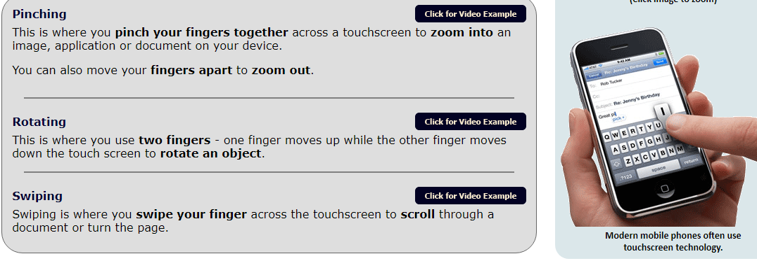

Slide 26
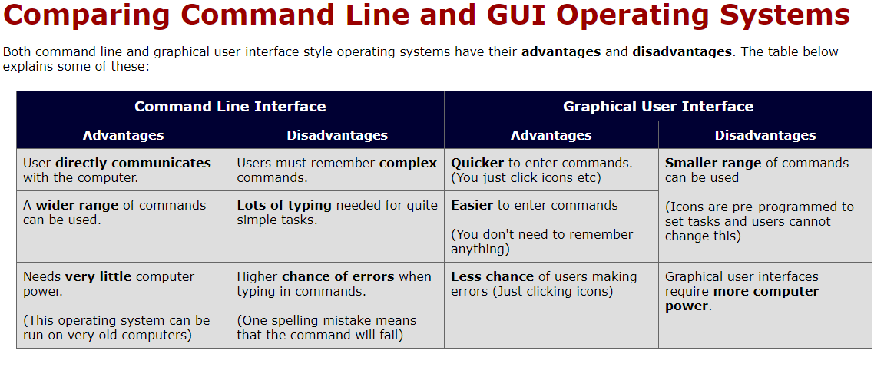

Slide 27
