Slide 1
Revolution of OS
Sub topics to be covered:
-Operating System as a resource manager
-Kernel
-Revolution /History of operating systems

Slide 2
Operating System
Functions same way as ordinary computer software
  It is program that is executed
Operating system relinquishes control of the processor to execute other programs

Slide 3
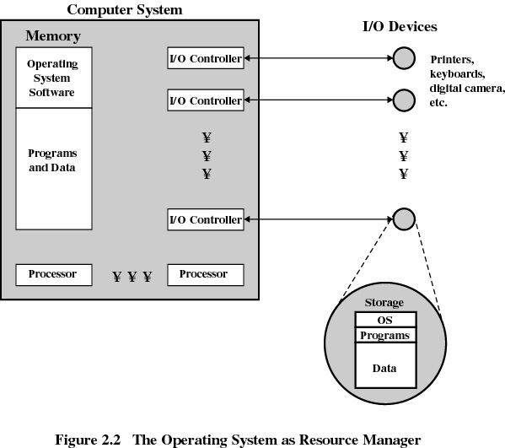

Slide 4
Kernel
Portion of operating system that is in main memory
Contains most-frequently used functions
Also called the nucleus

Slide 5
Evolution of an Operating System
Hardware upgrades and new types of hardware
New services
Fixes

Slide 6
Evolution/History of Operating Systems
Early History: The 1940s and 1950s
Operating systems evolved through several phases
  1940s
    Early computers did not include operating systems
  1950s
    Executed one job at a time
    Included technologies to smooth job-to-job transitions
    Single-stream batch-processing systems
    Programs and data submitted consecutively on tape

Slide 7
The 1960s
1960s
  Still batch-processing systems
  Process multiple jobs at once
    Multiprogramming
  One job could use processor while other jobs used peripheral devices
  Advanced operating systems developed to service multiple interactive users
1964
  IBM announced System/360 family of computers

Slide 8
The 1970s
Primarily multimode timesharing systems
  Supported batch processing, timesharing and real-time applications
  Personal computing only in incipient stages
    Fostered by early developments in microprocessor technology
Department of Defense develops TCP/IP
  Standard communications protocol
  Widely used in military and university settings

Slide 9
Conts…
  Security problems
    Growing volumes of information passed over vulnerable communications lines

Slide 10
The 1980s
1980s
  Decade of personal computers and workstations
  Computing distributed to sites at which it was needed
  Personal computers proved relatively easy to learn and use
    Graphical user interfaces (GUI)
  Transferring information between computers via networks became more economical and practical

Slide 11
The 1980s
Client/server computing model became widespread
  Clients request various services
  Servers perform requested services
Software engineering field continued to evolve
  Major thrust by the United States government aimed at tighter control of Department of Defense software projects

Slide 12
The 1980s
    Realizing code reusability
    Greater degree of abstraction in programming languages
    Multiple threads of instructions that could execute independently

Slide 13
History of the Internet and World Wide Web
Advanced Research Projects Agency (ARPA)
  Department of Defense
  In late 1960s, created and implemented ARPA net
    Grandparent of today’s Internet
    Networked main computer systems of ARPA-funded institutions
    Capable of near-instant communication via e-mail
    Designed to operate without centralized control

Slide 14
History of the Internet and World Wide Web
Transmission Control Protocol/Internet Protocol
  Set of rules for communicating over ARPA Net
  TCP/IP manages communication between applications
  Ensure that messages routed properly from sender to receiver Error-correction
  Later opened to general commercial use

Slide 15
History of the Internet and World Wide Web
World Wide Web (WWW)
  Locate and view multimedia-based documents on almost any subject
  Early development begun in 1989 at CERN by Tim Berners-Lee
  Technology for sharing information via hyperlinked text documents
  Hypertext Markup Language (HTML)
    Defines documents on WWW
  Hypertext Transfer Protocol (HTTP)
    Communications backbone used to transfer documents across WWW

Slide 16
The 1990s
Hardware performance improved exponentially
  Inexpensive processing power and storage
    Execute large, complex programs on personal computers.
    Economical machines for extensive database and processing jobs
    Mainframes rarely necessary
  Shift toward distributed computing rapidly accelerated
    Multiple independent computers performing common task

Slide 17
conts
Operating system support for networking tasks became standard
  Increased productivity and communication
Microsoft Corporation became dominant
  Windows operating systems
    Employed many concepts used in early Macintosh operating systems
    Enabled users to navigate multiple concurrent applications with ease.
Object technology became popular in many areas of computing
  Many applications written in object-oriented programming languages
    For example, C++ or Java
  Object-oriented operating systems (OOOS)
    Objects represent components of the operating system
  Concepts such as inheritance and interfaces
    Exploited/demoralize/broken to create modular operating systems
    Easier to maintain and extend than systems built with previous techniques

Slide 18
Conts….
Most commercial software sold as object code
  The source code not included
  Enables vendors to hide proprietary information and programming techniques
Free and open-source software became increasingly common in the 1990s
  Open-source software distributed with the source code
    Allows individuals to examine and modify software
    Linux operating system and Apache Web server both open-source

Slide 19
Conts….
Richard Stallman launched the GNU project
  Recreate and extend tools for AT&T’s UNIX operating system
  He disagreed with concept of paying for permission to use software

Slide 20
Conts…..
Open Source Initiative (OSI)
  Founded to further benefits of open-source programming
  Facilitates enhancements to software products
    Permits anyone to test, debug and enhance applications
  Increases chance that subtle/ bugs will be caught and fixed
    Crucial for security errors which need to be fixed quickly
  Individuals and corporations can modify the source
    Create custom software to meet needs of certain environment

Slide 21
Virtual Memory
Virtual memory is a feature of an operating system that enables a computer to be able to compensate shortages of physical memory by transferring pages of data from random access memory to disk storage.
Allows programmers to address memory from a logical point of view

Slide 22
This process is done temporarily and is designed to work as a combination of RAM and space on the hard disk.
This means that when RAM runs low, virtual memory can move data from it to a space called a paging file. This process allows for RAM to be freed up so that a computer can complete the task.

Slide 23
This means that when RAM runs low, virtual memory can move data from it to a space called a paging file. This process allows for RAM to be freed up so that a computer c complete the task.
Occasionally a user might be shown a message that says the virtual memory is running low, this means that either more RAM needs to be added, or the size of the paging file needs to be increased.

Slide 24
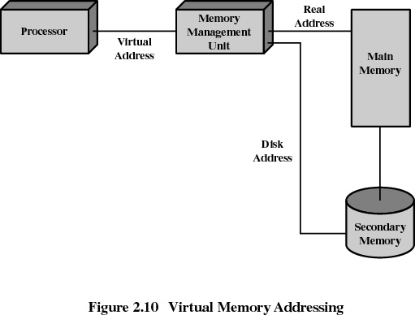
Virtual Memory Addressing

Slide 25
Operating System Design Hierarchy
Level Name Objects Example Operations
13 Shell User programming Statements in shell language
environment
12 User processes User processes Quit, kill, suspend, resume
11 Directories Directories Create, destroy, attach, detach,
search, list
10 Devices External devices, such Open, close,
as printer, displays read, write
and keyboards
9 File system Files Create, destroy, open, close
read, write
8 Communications Pipes Create, destroy, open. close,
read, write

Slide 26
Operating System Design Hierarchy
Level Name Objects Example Operations
7 Virtual Memory Segments, pages Read, write, fetch
6 Local secondary Blocks of data, device Read, write, allocate, free
store channels
5 Primitive processes Primitive process, Suspend, resume, wait, signal
semaphores, ready
list

Slide 27
Operating System Design Hierarchy
Level Name Objects Example Operations
4 Interrupts Interrupt-handling Invoke, mask, unmask, retry
programs
Procedures Procedures, call stack, Mark stack, call, return
display
2 Instruction Set Evaluation stack, micro- Load, store, add, subtract
program interpreter, branch
scalar and array data
1 Electronic circuits Registers, gates, buses, Clear, transfer, activate,
etc. complement

Slide 28
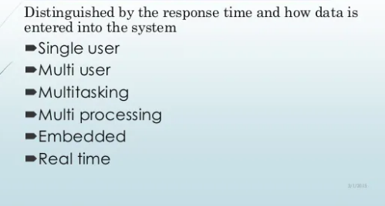
Types of Operating Systems

Slide 29
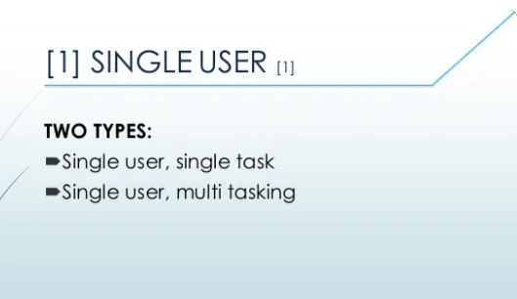

Slide 30
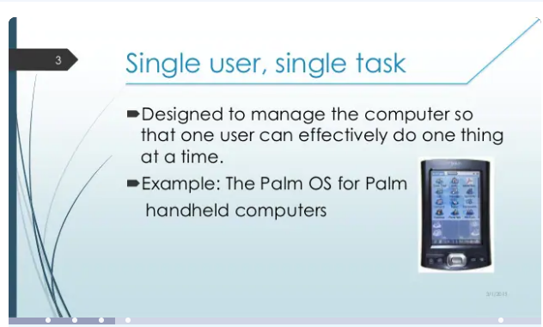

Slide 31
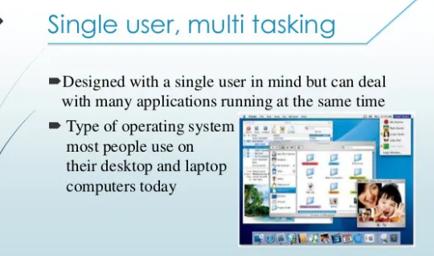

Slide 32
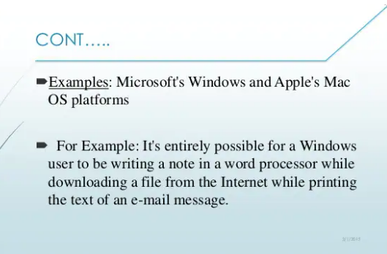

Slide 33
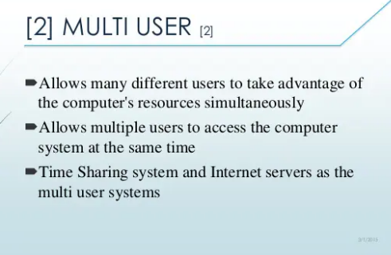

Slide 34
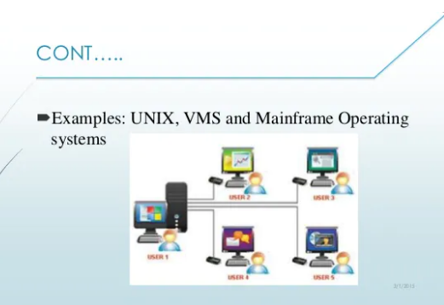

Slide 35
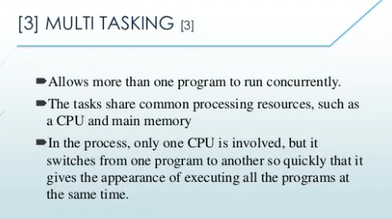

Slide 36
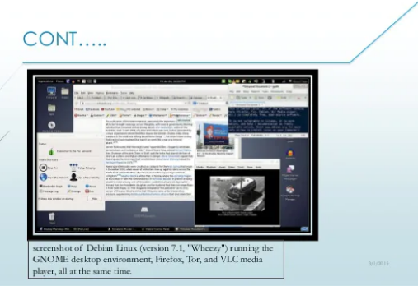

Slide 37
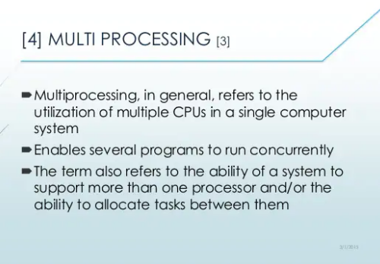

Slide 38
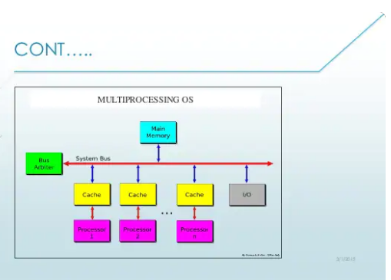

Slide 39
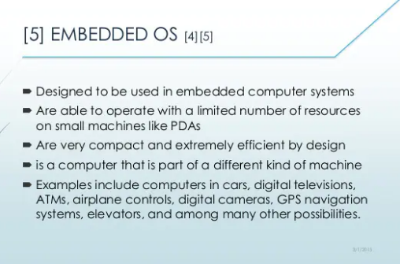

Slide 40
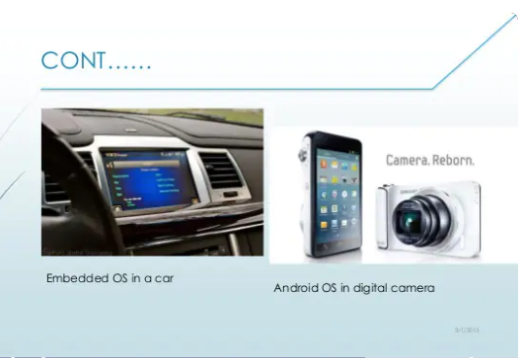

Slide 41
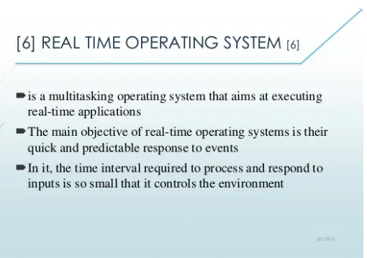

Slide 42
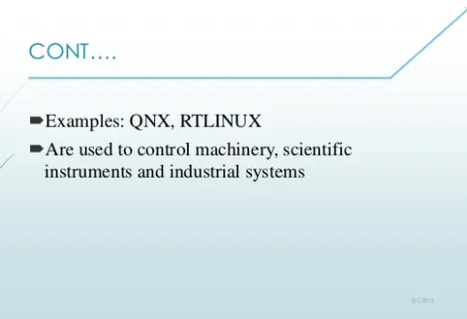

Slide 43
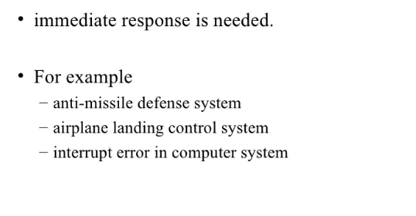

Slide 44
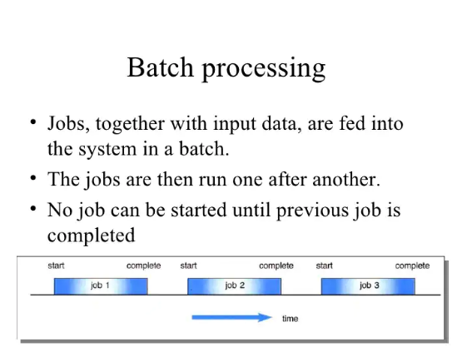

Slide 45
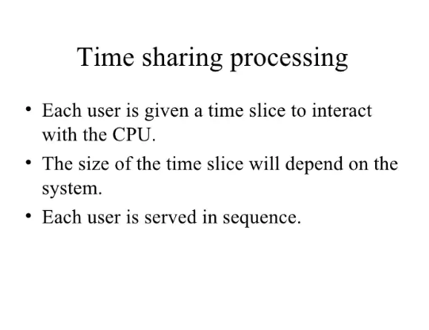

Slide 46
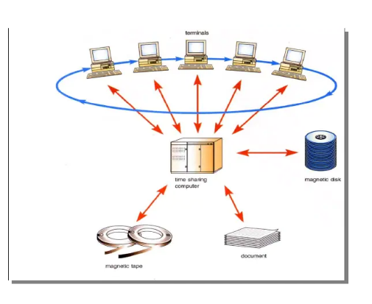

Slide 47
Characteristics of Modern Operating Systems
Microkernel architecture
  assigns only a few essential functions to the kernel
    address space
    interprocess communication (IPC)
    basic scheduling

Slide 48
5 Most Popular Operating Systems
For the most part, the IT industry largely focuses on the top five OSs, including
-Apple macOS
-Microsoft Windows
-Google’s Android OS
- Linux Operating System, and
- Apple iOS

Slide 49
Characteristics of Modern Operating Systems
Multithreading
  process is divided into threads that can run simultaneously
Thread
  dispatchable unit of work
  executes sequentially and is interruptable
Process is a collection of one or more threads

Slide 50
Characteristics of Modern Operating Systems
Symmetric multiprocessing
  there are multiple processors
  these processors share same main memory and I/O facilities
  All processors can perform the same functions

Slide 51
Characteristics of Modern Operating Systems
Distributed operating systems
  provides the illusion of a single main memory and single secondary memory space
  used for distributed file system

Slide 52
Characteristics of Modern Operating Systems
Object-oriented design
  used for adding modular extensions to a small kernel
  enables programmers to customize an operating system without disrupting system integrity

Slide 53
OS Organization
Modified microkernel architecture
  Not a pure microkernel
  Many system functions outside of the microkernel run in kernel mode
Any module can be removed, upgraded, or replaced without rewriting the entire system

Slide 54
Layered Structure
Hardware abstraction layer (HAL)
  Isolates the operating system from platform-specific hardware differences
Microkernel
  Most-used and most fundamental components of the operating system
Device drivers
  Translate user I/O function calls into specific hardware device I/O requests

Slide 55
UNIX
Hardware is surrounded by the operating-system
Operating system is called the kernel
Comes with a number of user services and interfaces
  shell
  C compiler

Slide 56
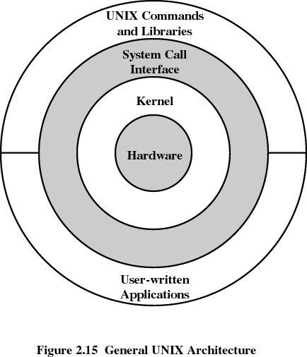
UNIX

Slide 57
Modern UNIX Systems
System V Release 4 (SVR4)
Solaris 2.x
4.4BSD
Linux

