Slide 1
THREADS
Objective:
To be acquainted with:
The definitions of threads

Slide 2
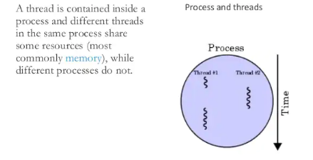
Definitions
Threads Definitions
A thread is a path of execution within a process. A process can contain multiple threads.

Slide 3
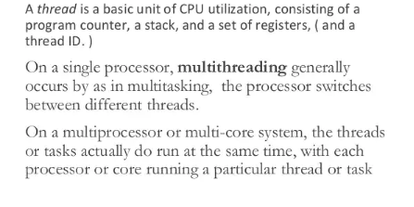
Definitions (cont..)

Slide 4
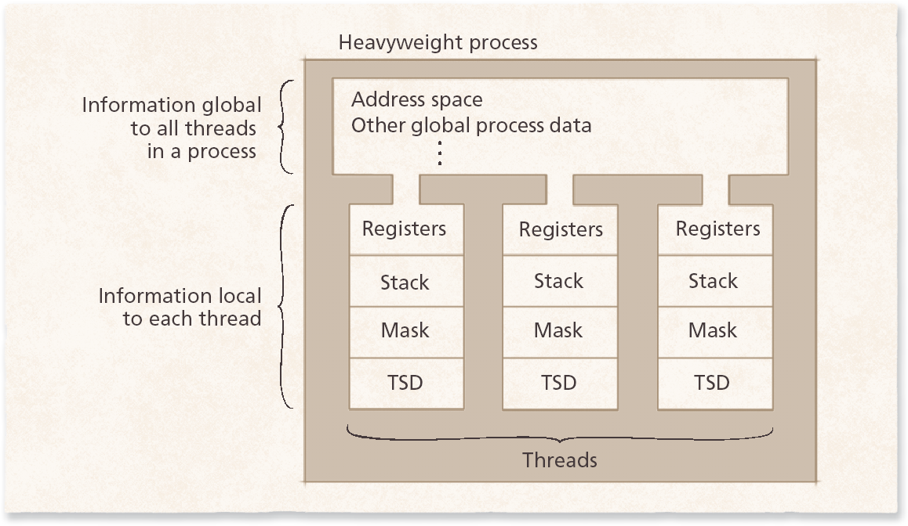
Threads relationship to process

Slide 5
Definitions (cont..)
Why Multithreading?
A thread is also known as lightweight process. The idea is to achieve parallelism by dividing a process into multiple threads. For example, in a browser, multiple tabs can be different threads. MS Word uses multiple threads: one thread to format the text, another thread to process inputs, etc.

Slide 6
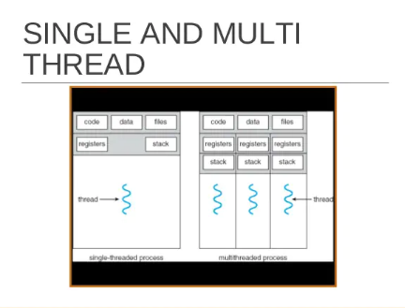
Cont…

Slide 7
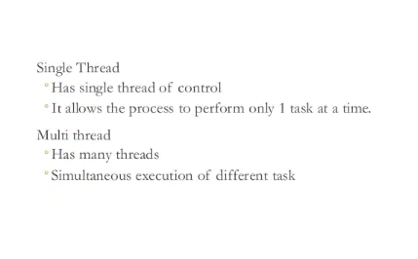
Single Threads and Multi thread

Slide 8
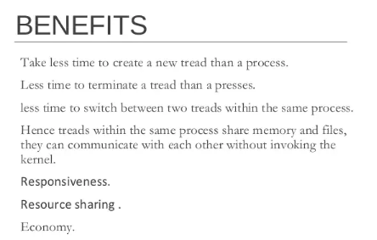

Slide 9
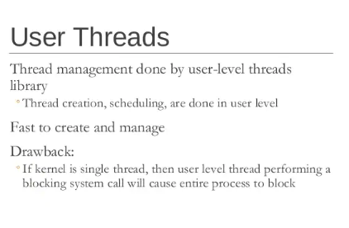
User Threads
.

Slide 10
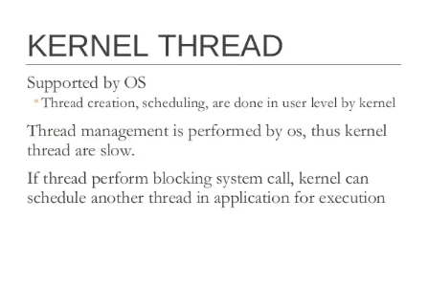

Slide 11
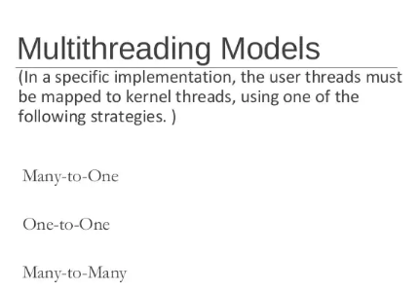

Slide 12
Threading Models
Three most popular threading models
User-level threads
Kernel-level threads
Combination of user- and kernel-level threads

Slide 13
User –Level Threads
User-level threads perform threading operations in user space
Threads are created by runtime libraries that cannot execute privileged instructions or access kernel primitives directly
User-level thread implementation
Many-to-one thread mappings
Operating system maps all threads in a multithreaded process to single execution context
Advantages
User-level libraries can schedule its threads to optimize performance
Synchronization performed outside kernel, avoids context switches
More portable

Slide 14
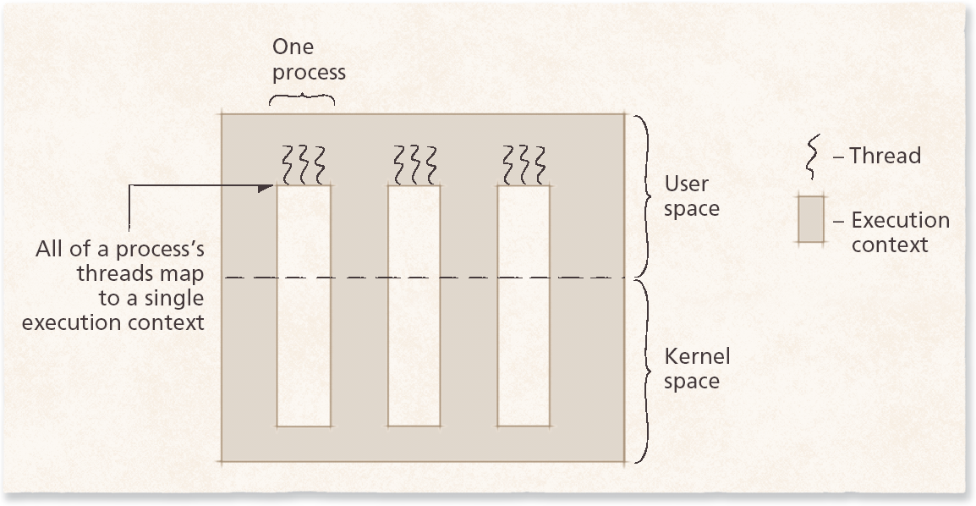
Kernel –Level Threads
Kernel-level threads attempt to address the limitations of user-level threads by mapping each thread to its own execution context
Kernel-level threads provide a one-to-one thread mapping
Advantages: Increased scalability, interactivity, and throughput
Disadvantages: Overhead due to context switching and reduced portability due to OS-specific APIs

Slide 15
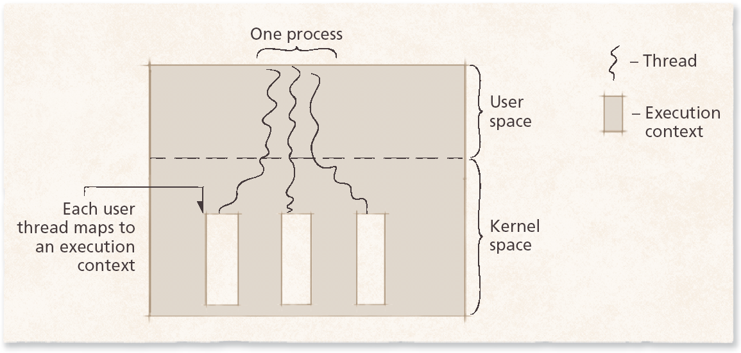
Kernel –Level Threads(cont..)
Kernel-level threads are not always the optimal solution for multithreaded applications

Slide 16
Combining User- and Kernel-level Threads
The combination of user- and kernel-level thread implementation
Many-to-many thread mapping (m-to-n thread mapping)
Number of user and kernel threads need not be equal
Can reduce overhead compared to one-to-one thread mappings by implementing thread pooling
Worker threads
Persistent kernel threads that occupy the thread pool
Improves performance in environments where threads are frequently created and destroyed
Each new thread is executed by a worker thread

Slide 17
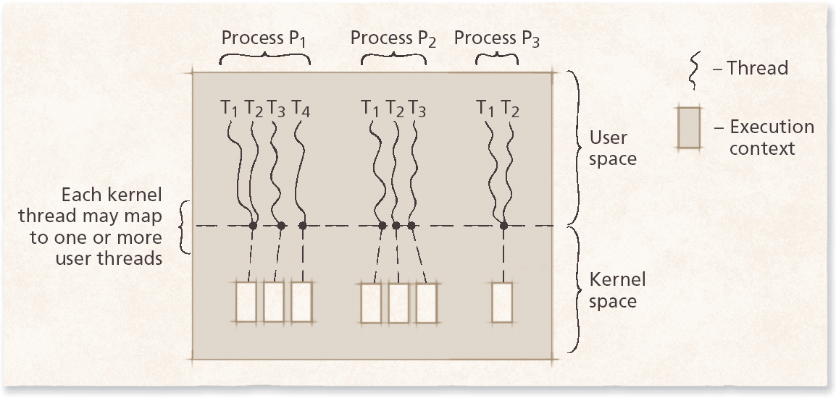
Hybrid threading model
Scheduler activation
Technique that enables user-level library to schedule its threads
Occurs when the operating system calls a user-level threading library that determines if any of its threads need rescheduling

Slide 18
Motivation for Threads
Each thread transitions among a series of discrete thread states
Threads and processes have many operations in common (e.g. create, exit, resume, and suspend)
Thread creation does not require operating system to initialize resources that are shared between parent processes and its threads.
-Reduces overhead of thread creation and termination compared to process creation and termination

Slide 19
Thread States: Life Cycle of a Thread
Thread states
Born state
Ready state
Running state
Dead state
Blocked state
Waiting state
Sleeping state
Sleep interval specifies for how long a thread will sleep

Slide 20
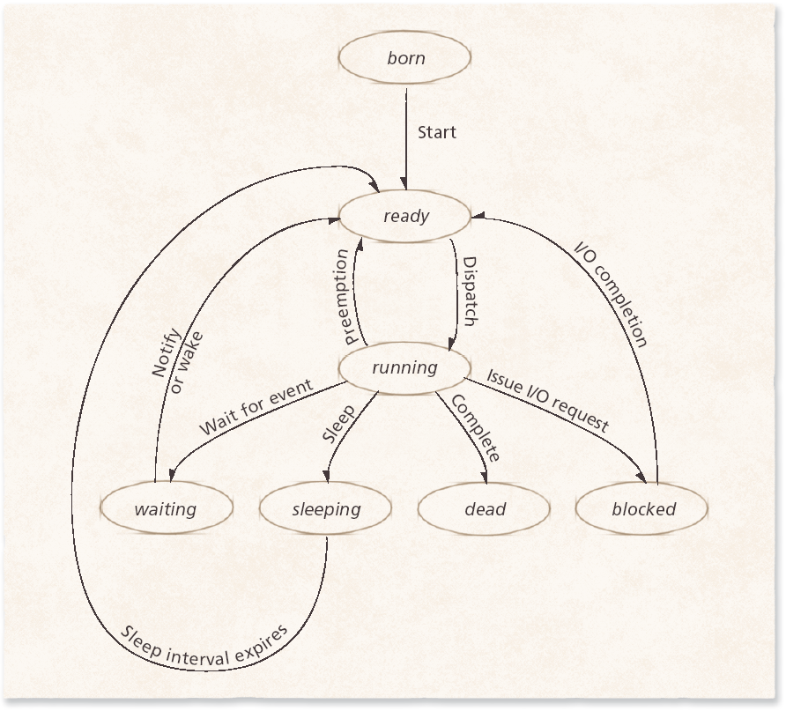
Thread Life Cycle

Slide 21
Thread Operations
Threads and processes have common operations
Create
Exit (terminate)
Suspend
Resume
Sleep
Wake

Slide 22
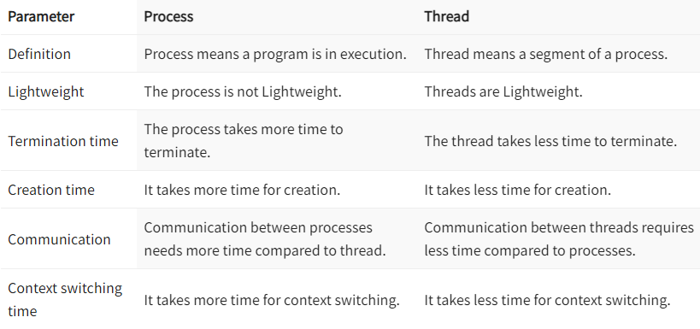
Process VS Thread

Slide 23
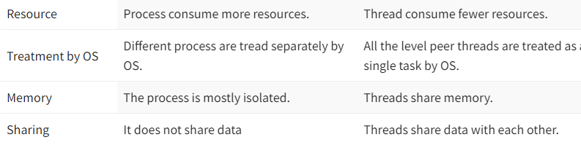
Process Vs Threads

