Slide 1
Processor Scheduling
Outline
Operating System As a Resource Manager
Processor Scheduling
Preemptive vs. Non-preemptive Scheduling
Priorities
Scheduling Objectives
Scheduling Criteria
Scheduling Algorithms
First-Come-First-Served (FCFS) Scheduling
Shortest-Process-First (SPF) Scheduling
Shortest-Remaining-Time (SRT) Scheduling
Round-Robin (RR) Scheduling
Highest-Response-Ratio-Next (HRRN) Scheduling
Fair Share Scheduling
Deadline Scheduling
Real-Time Scheduling

Slide 2
Operating System as a Resource Manager
A computer has many resources (Hardware and Software), which may be required to complete a task. The commonly required resources are Input/Output devices, Memory file storage space, CPU time and so on
The operating system acts as the manager of these resources and allocates them to specific programs and users as necessary for their tasks. Therefore, we can say an operating system is a resource allocator. This is the main features of an operating system.

Slide 3
Operating System as a Resource Manager
Generally, resources sharing in two ways "in time" and "in space". When a resource is a time-sharing resource, first one of the tasks get the resource for some time, then another and so on.
For example, a CPU in the time-sharing system. In the time-sharing system, OS fixes the time slot for the CPU. First one of the processes gets the CPU, when the time slot expires, the CPU switch to the next process in the ready queue. In this example, the CPU is a time resource.

Slide 4
Operating System as a Resource Manager
The other kind of sharing is the "space sharing". In this method, the users share the space of resource. For example, the main memory consisting of several processes at a time, so the process of sharing the resources.
The main difference between "in time" sharing resources and "in space" sharing resources is "in time" resources are not divided into units, whereas "in space" sharing resources are divided into units.

Slide 5
PROCESSOR SCHEDULING
CPU Scheduling in operating system is a fundamental function, almost all computer resources scheduled before use. The CPU is also one of the primary resources. So, CPU scheduling before use. The Scheduling Algorithms determine how the CPU will be allocated to the process.
CPU scheduling in the operating system is the basis of the multi-programmed operating system. The idea of multiprogramming is relatively simple if a process(job) is waiting for an I/O request, then the CPU switches from the process to another through a dispatcher, so the CPU is always busy in multiprogramming.

Slide 6
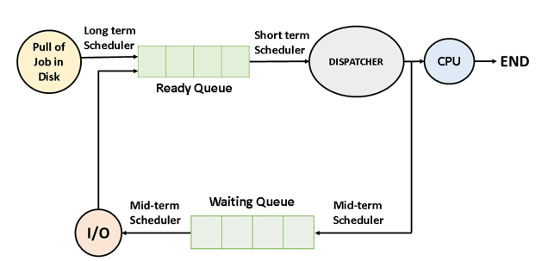
PROCESSOR SCHEDULING
But in a simple computer system, the CPU sits idle until the I/O request granted. By switching the CPU among processes, the OS can make the computer more productive.

Slide 7
CPU SCHEDULER IN OPERATING SYSTEMS
CPU schedulers in operating systems are:
Long-term scheduler
The function of a long-term scheduler is to select the jobs from the pool of jobs and load these jobs into main memory (Ready Queue) of that computer, so the long-term scheduler is also called job-scheduler.
Short-term scheduler
The function of a short-term scheduler is to select a job from the ready queue and gives the control of the CPU to that process with the help of "Dispatcher". That's why the short-term scheduler is also said to be the CPU scheduler.
The method of selecting a process from the ready queue by the short-term scheduler is depending on the scheduling algorithms.

Slide 8
Cont….
Mid-term scheduler
If a process requests an I/O in the middle of execution, then the process removed from the main memory is loaded into the waiting queue. When the I/O operation is completed, then the job moved from waiting queue to ready queue. These two operations are performed by the medium-term scheduler.

Slide 9
DISPATCHER IN OPERATING SYSTEMS
A dispatcher is a module, it connects the CPU to the process selected by the short-term scheduler. The main function of the dispatcher is switching, it means switching the CPU from one process to another process.
Another function of the dispatcher is jumping to the proper location in the user program and ready to start execution. The time taken by the dispatcher to stop one process and start another running is called the Dispatch Latency in OS.
The degree of multiprogramming is dependent on the dispatch latency. If the dispatch latency is increasing, then the degree of multiprogramming decreases.

Slide 10
CPU Scheduling Criteria in OS
Throughput in OS
It means how many jobs are completed by the CPU.
Turnaround Time in OS
The time interval between the submission of the process and the time of the completion is the turnaround time
Turnaround time = Waiting time in the ready queue + executing time + waiting time in waiting queue for I/O.
Waiting Time in OS
Waiting time is the sum of the periods spent waiting by a process in the ready queue.

Slide 11
CPU Scheduling Criteria in OS
Response Time in OS
Response time is the time duration between the submission and the first response.
CPU Utilization in OS
This is the percentage of time that the processor is busy, CPU utilization may range from 0-100%.

Slide 12
TYPES OF CPU SCHEDULING
There are two categories in CPU scheduling:
Preemptive Scheduling
Non-Preemptive Scheduling
Preemptive scheduling
In the preemptive scheduling algorithm, the CPU can release the process even in the middle of the execution. For example, the CPU executing the process P1, in the middle of the execution the CPU receives a request signal from process P2. Then the OS compares the priorities of P1 and P2.

Slide 13
Characteristics of Preemptive Scheduling
  Can be removed from their current processor
  Can lead to improved response times
  Important for interactive environments
  Preempted processes remain in memory

Slide 14
NON-PREEMPTIVE SCHEDULING
In the non-preemptive scheduling, once the CPU assigned to a process, the processor does not release until the completion of that process. The CPU will be assigned to another job only after the previous has finished.
Characteristics of Non-Preemptive Scheduling
  Run until completion or until they yield control of a processor
  Unimportant processes can block important ones indefinitely
  Not suitable for interactive environments

Slide 15
Processor scheduling policy
  Decides which process runs at given time
  Different schedulers will have different goals
    Maximize throughput
    Minimize latency
    Prevent indefinite postponement
    Complete process by given deadline
    Maximize processor utilization

Slide 16
Scheduling Objectives
Different objectives depending on system
  Maximize throughput
  Maximize number of interactive processes receiving acceptable response times
  Minimize resource utilization
  Avoid indefinite postponement
  Enforce priorities
  Minimize overhead
  Ensure predictability

Slide 17
Scheduling Objectives
Several goals common to most schedulers
  Fairness
  Predictability
  Scalability

Slide 18
Scheduling Algorithms
Scheduling algorithms
  Decide when and for how long each process runs
  Make choices about
    Preemptibility
    Priority
    Running time
    Run-time-to-completion
    fairness

Slide 19
First-Come-First-Served (FCFS) Scheduling
FCFS scheduling
  Simplest scheme
  Processes dispatched according to arrival time
  Nonpreemptible
  Rarely used as primary scheduling algorithm

Slide 20
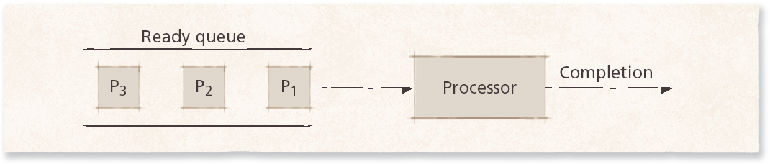
First-Come-First-Served (FCFS) Scheduling
First-come-first-served scheduling.

Slide 21
Shortest-Process-First (SPF) Scheduling
Scheduler selects process with smallest time to finish
  Lower average wait time than FIFO
    Reduces the number of waiting processes
  Potentially large variance in wait times
  Non-preemptive
    Results in slow response times to arriving interactive requests
  Relies on estimates of time-to-completion
    Can be inaccurate or falsified
  Unsuitable for use in modern interactive systems

Slide 22
Shortest-Remaining-Time (SRT) Scheduling
SRT scheduling
  Preemptive version of SPF
  Shorter arriving processes preempt a running process
  Very large variance of response times: long processes wait even longer than under SPF
  Not always optimal
    Short incoming process can preempt a running process that is near completion
    Context-switching overhead can become significant

Slide 23
Round-Robin (RR) Scheduling
Round-robin scheduling
  Based on FCFS
  Processes run only for a limited amount of time called a time slice or quantum
  Preemptible
  Requires the system to maintain several processes in memory to minimize overhead
  Often used as part of more complex algorithms

Slide 24
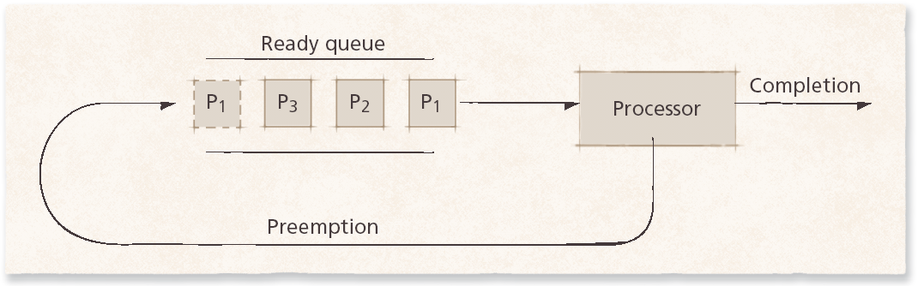
Round-Robin (RR) Scheduling
Round-robin scheduling.

Slide 25
Round-Robin (RR) Scheduling
Selfish round-robin scheduling
  Increases priority as process ages
  Two queues
    Active
    Holding
  Favors older processes to avoids unreasonable delays

Slide 26
Round-Robin (RR) Scheduling
Quantum size
  Determines response time to interactive requests
  Very large quantum size
    Processes run for long periods
    Degenerates to CFFS
  Very small quantum size
    System spends more time context switching than running processes
  Middle-ground
    Long enough for interactive processes to issue I/O request
    Batch processes still get majority of processor time

Slide 27
Highest-Response-Ratio-Next (HRRN) Scheduling
HRRN scheduling
  Improves upon SPF scheduling
  Still non-preemptive
  Considers how long process has been waiting
  Prevents indefinite postponement

Slide 28
Fair Share Scheduling
FSS controls users’ access to system resources
  Some user groups more important than others
  Ensures that less important groups cannot monopolize resources
  Unused resources distributed according to the proportion of resources each group has been allocated
  Groups not meeting resource-utilization goals get higher priority

Slide 29
Deadline Scheduling
Deadline scheduling
  Process must complete by specific time
  Used when results would be useless if not delivered on-time
  Difficult to implement
    Must plan resource requirements in advance
    Incurs significant overhead
    Service provided to other processes can degrade

Slide 30
Real-Time Scheduling
Real-time scheduling
  Related to deadline scheduling
  Processes have timing constraints
  Also encompasses tasks that execute periodically
Two categories
  Soft real-time scheduling
    Does not guarantee that timing constraints will be met
    For example, multimedia playback
  Hard real-time scheduling
    Timing constraints will always be met
    Failure to meet deadline might have catastrophic results
    For example, air traffic control

Slide 31
Real-Time Scheduling
Static real-time scheduling
  Does not adjust priorities over time
  Low overhead
  Suitable for systems where conditions rarely change
    Hard real-time schedulers
  Rate-monotonic (RM) scheduling
    Process priority increases monotonically with the frequency with which it must execute
  Deadline RM scheduling
    Useful for a process that has a deadline that is not equal to its period

Slide 32
Real-Time Scheduling
Dynamic real-time scheduling
  Adjusts priorities in response to changing conditions
  Can incur significant overhead, but must ensure that the overhead does not result in increased missed deadlines
  Priorities are usually based on processes’ deadlines
    Earliest-deadline-first (EDF)
      Preemptive, always dispatch the process with the earliest deadline
    Minimum-laxity-first
      Similar to EDF, but bases priority on laxity, which is based on the process’s deadline and its remaining run-time-to-completion

