Slide 1
Constraint Acquisition: Learning to Learn and to Generalize
Dimos Tsouros
dimos.tsouros@kuleuven.be
05/04/2024

Slide 2
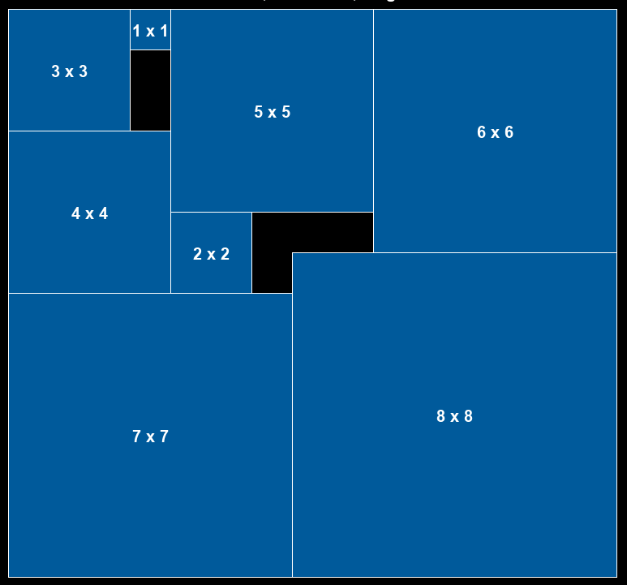
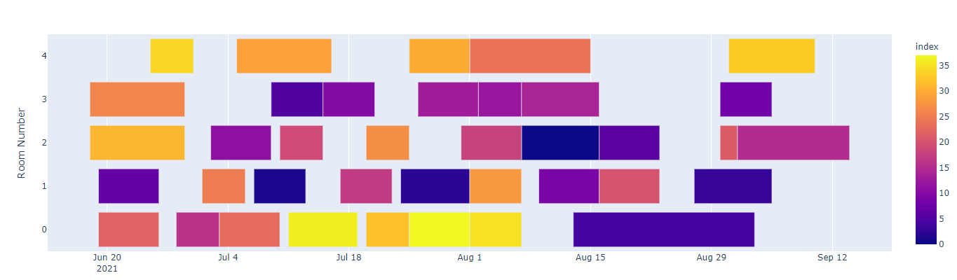
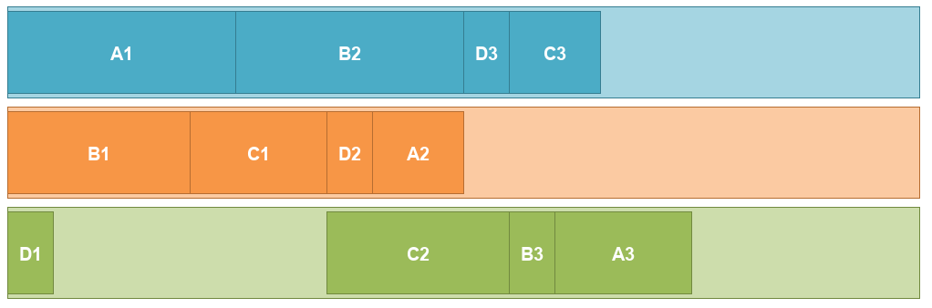
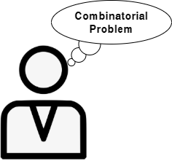

Introduction
Constraint programming (CP)
Solving combinatorial problems in AI
Job-shop scheduling Bin-packing Room assignment
Model + Solve paradigm
Give model
Return solution

Slide 3
Introduction
Model + Solve paradigm
Give model
Return solution
Model as a Constraint Satisfaction Problem:
Set of Variables X
Their Domains D
Set of Constraints C
Example: Exam Timetabling for 8 semesters and 6 courses per semester and 48 available slots
X: { Courses[1,1], Courses[1,2], … Courses[8,6]}
D: D₁ = D₂ = … = {1, …, 48}
Set of Constraints C: {Courses[1,1] != Courses[2,1], Courses[1,1] != Courses[2,2], …, differentDay(Courses[1,1], Courses[1,2]), … }

Slide 4
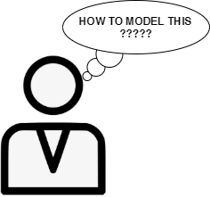


Introduction
Modelling is not always trivial
Requires expertise
Bottleneck for the wider use of CP
Constraint Acquisition
modelling

Slide 5

Introduction (4/4)
Passive acquisition: Using existing data
Examples
CSP Model
(Inter)active acquisition: Interact with the user
Answers
Queries
CSP Model
Constraint Acquisition, C. Bessiere et al., AIJ, 2017

Slide 6

Inputs and Outputs
Γ
Create candidate set
B
Constraint Acquisition system
C_{L}
Vocabulary (X,D)
Examples E
Or
Answers
Queries
Terminology
Vocabulary: (X,D) Variables and domains, given
Γ: Constraint Language, Γ = {r₁, r₂, r₃, …, r_{|Γ|} }
B: Set of candidate constraints, B = {c₁, c₂, c₃, …, c_{|B|}}
C_{L}: Learned constraint set
Goal:
C_{L} is equivalent to the (unknown) target set C_{T}
Constraint Acquisition, C. Bessiere et al., AIJ, 2017

Slide 7
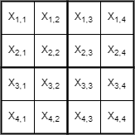
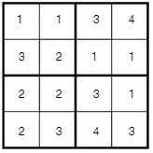
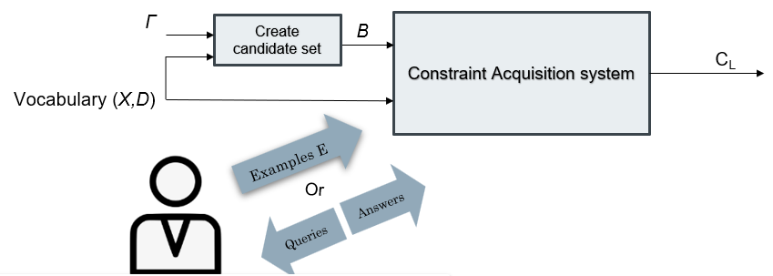
Inputs and Outputs
Running Example: 4x4 Sudoku
X: Variables of the problem, X = {x_{1,1}, x_{1,2}, x_{1,3}, …, x_{4,4} }
D^{X}: Domains of the variables, D^{Xi} = {1, 2, 3, 4}
Γ: Constraint Language, Γ = {═, ≠, ≤, ≥}
B: Set of candidate constraints, B = {x_{1,1} ≠ x_{1,2}, x_{1,1} ═ x_{1,2}, …}
C_{L}: learned constraints, ideally all the ≠ constraints in rows, cols and blocks
The user may not know exactly what constraint relations appear in the model and use many
Problem Formulation
Example e₁

Slide 8
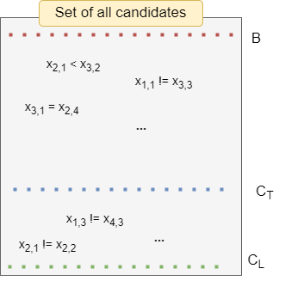
Adapting Candidate Elimination
B: set of (remaining) candidate constraints
C_{T}: target set of constraints
C_{L}: learned set of constraints
Should not be
learned
Should be
learned

Slide 9
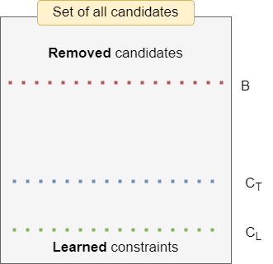
Adapting Candidate Elimination
During the learning process:
Constraints are removed from B
Constraints are added to C_{L}
B: set of (remaining) candidate constraints
C_{T}: target set of constraints
C_{L}: learned set of constraints

Slide 10
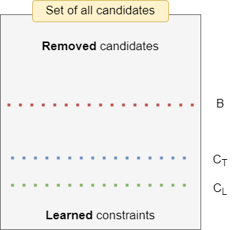
Adapting Candidate Elimination
During the learning process:
Constraints are removed from B
Constraints are added to C_{L}
B: set of (remaining) candidate constraints
C_{T}: target set of constraints
C_{L}: learned set of constraints

Slide 11

Adapting Candidate Elimination
If C_{T} is representable by B the CA system will eventually converge to a C_{L} equivalent to C_{T}

Slide 12
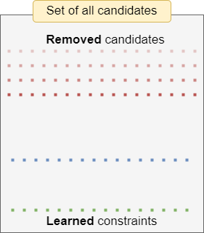

Adapting Candidate Elimination
Examples: Assignments to the variables of the problem
Learning from positive examples (Solutions):
Learning from negative examples (Non-solutions):
- Violated constraints cannot be part of the model
- Otherwise, it could not be a solution
- One (or more) violated constraint is a constraint of the problem
- Otherwise, it would be a solution
Shrinking the bias
Learning Constraints

Slide 13



Passive Acquisition
Labelled examples
CSP Model
Assignment to all variables of the problem, labelled as:
a solution
or a non-solution
Constraint Acquisition, C. Bessiere et al., AIJ, 2017

Slide 14


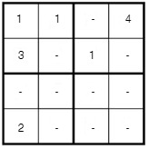
Interactive Constraint Acquisition
Oracle
Unlabelled examples
Labels
CSP Model
Membership query
Partial query
Answer: Negative in both of them
(a constraint is violated)
Learning Constraints through Partial Queries, C. Bessiere et al., AIJ, 2023

Slide 15

Challenges for interactive CA
Minimum number of queries
Minimum waiting time for the user
Too many questions
I need to wait too much for each query
Learning constraint models from data, D Tsouros et al., 2023

Slide 16
Interactive Constraint Acquisition
Learn constraints: zoom in violated constraints’ scopes using partial queries and add them to C_{L}
Update
Version space
No
Learn violated constraints
Example
found
Generate example
Ask query to the user
Answer
Eliminate violated candidates
No example
found
Yes
Converged
Shrink version space: remove violated constraints from B
Learning Constraints through Partial Queries, C. Bessiere et al., AIJ, 2023

Slide 17
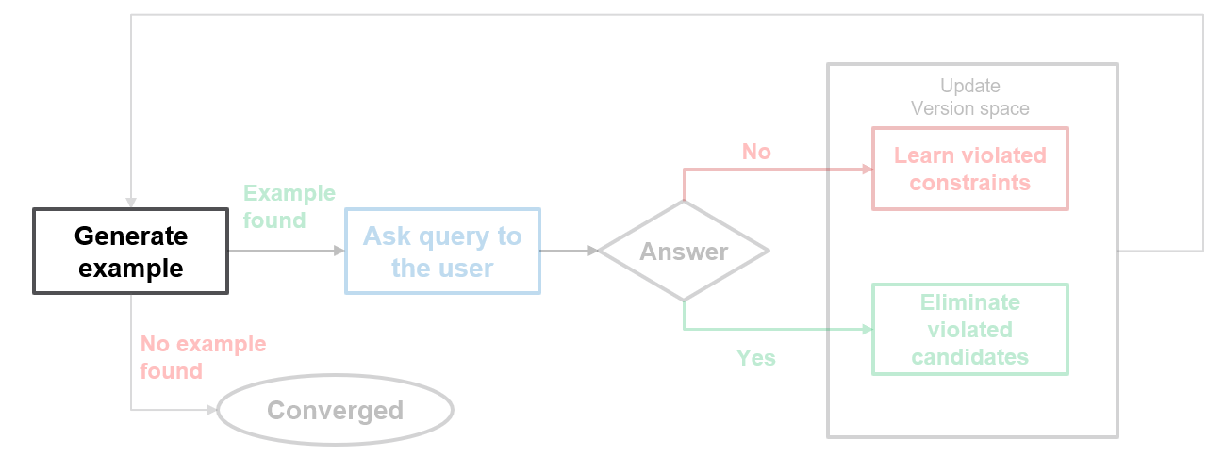
Query generation
Informative query
Quality of query
Generate “informative” examples
Get the maximum amount of information

Slide 18

Query generation
Find an Informative (“irredundant”) query
Not violating any learned constraint in C_{L}
Violating at least one constraint from B
Why??
Find $e∈sol(C_{L}∧\bigvee_{c∈B}{\sim c})$
Learning Constraints through Partial Queries, C. Bessiere et al., AIJ, 2023

Slide 19
What we can learn from examples
Learning from positive examples (Solutions):
Learning from negative examples (Non-solutions):
- Violated constraints cannot be part of the model
- Otherwise, it could not be a solution
- One (or more) violated constraint is a constraint of the problem
- Otherwise, it would be a solution
Shrinking the bias
Learning Constraints
In both cases, we get information only about the violated
candidates and not about the satisfied ones!

Slide 20
Query generation
Informative query
Quality of query
Get the maximum amount of information

Slide 21
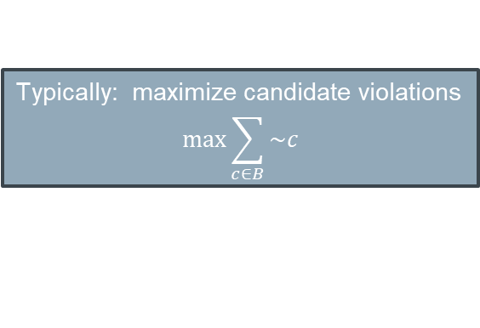
Query generation
Quality of query
Better generated examples lead to faster convergence
More information per query -> less queries needed
Typically: maximize candidate violations
$$max\sum_{c∈B}{\sim c}$$
Not fully aligning with the goal!!
We will discuss this later
Constraint acquisition via partial queries, C. Bessiere et al., IJCAI, 2013

Slide 22

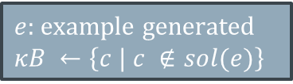
Interactive Constraint Acquisition
What happens after query generation?
Learn constraints: zoom in violated constraints’ scopes using partial queries and add them to C_{L}
Update
Version space
No
Learn violated constraints
Example
found
Generate example
Ask query to the user
Answer
Eliminate violated candidates
No example
found
Yes
Converged
Shrink version space: remove violated constraints from B
$e:$ example generated
$$κB ←\left\{c | c ∉sol(e)\right\}$$
How to find which of the
violated constraint(s) to learn?
$$B ←B ∖κB(e)$$

Slide 23
Learning a constraint
Update
Version space
No
Learn violated constraints
Example
found
Generate example
Ask query to the user
Answer
Eliminate violated candidates
No example
found
Yes
Converged
2-step process:
Find a minimal conflicting scope
Find the constraint
FindScope: exploit partial (sub)queries to find the problematic part of the assignment
FindC: Try different assignments to find the specific constraint in the scope
Learning Constraints through Partial Queries, C. Bessiere et al., AIJ, 2023

Slide 24
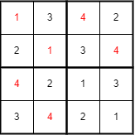
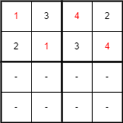
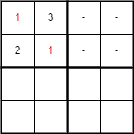
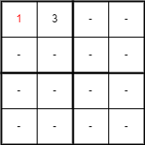
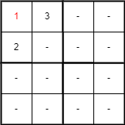
Finding the scope of a constraint
Find a minimal conflicting scope
Find the constraint
Negative
Negative
Negative
Positive
Positive
…

Slide 25
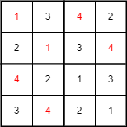
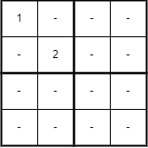
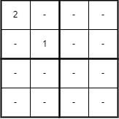

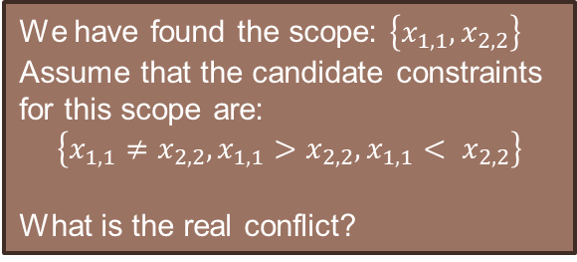
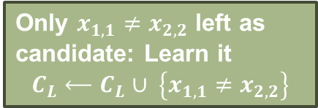

Finding the relation of a constraint
Find a minimal conflicting scope
Find the constraint
We have found the scope: $\left\{x_{1,1},x_{2,2}\right\}$
Assume that the candidate constraints for this scope are:
$$\left\{x_{1,1}≠x_{2,2},x_{1,1}>x_{2,2},x_{1,1}< x_{2,2}\right\}$$
What is the real conflict?
Try different assignments to find the specific constraint in the scope
Positive
Only $x_{1,1}≠x_{2,2}$ left as candidate: Learn it
$$C_{L}⟵C_{L}∪ \left\{x_{1,1}≠x_{2,2}\right\}$$
Positive
Remove $x_{1,1}>x_{2,2}$
Remove $x_{1,1}< x_{2,2}$
Learning Constraints through Partial Queries, C. Bessiere et al., AIJ, 2023

Slide 26
Interactive Constraint Acquisition QuAcq
Learn one violated constraint of the problem
Update
Version space
No
Learn violated constraints
Example
found
Generate example
Ask query to the user
Answer
Eliminate violated candidates
No example
found
Yes
Converged
Shrink version space: remove violated constraints from B
QuAcq:
Learning one violated constraint per generated example
Logarithmic number of queries for each constraint
Learning Constraints through Partial Queries, C. Bessiere et al., AIJ, 2023

Slide 27
Interactive Constraint Acquisition Multiple Acquisition
Learn multiple violated constraints of the problem
Get sub-query not containing
the violated constraint
Update
Version space
No
Learn violated constraints
Example
found
Generate example
Ask query to the user
Answer
Shrink version space: remove violated constraints from B
Eliminate violated candidates
No example
found
Yes
Converged
Multiple Acquisition:
Learn multiple constraints in each loop instance
Don’t generate a new example when a constraint is learnt
- Instead, get an example in a subset of variables not violating the constraint found
Efficient Multiple Constraint Acquisition, D. Tsouros et al., Constraints, 2020

Slide 28
Guiding Interactive Constraint Acquisition

Slide 29
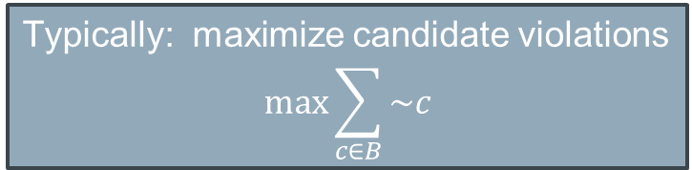
Guiding Query Generation
Quality of query
Better generated examples lead to faster convergence
More information per query -> less queries needed
Not fully aligning with the goal!!
Typically: maximize candidate violations
$$max\sum_{c∈B}{\sim c}$$

Slide 30
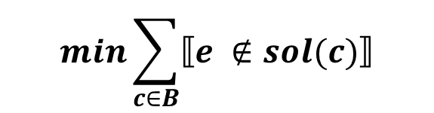
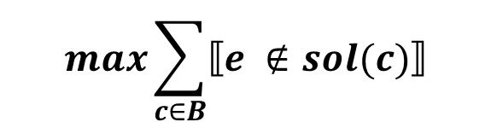
Guiding Query Generation
Better generated examples lead to faster convergence
Positive answers: shrink B fast
Negative answers: Find the conflict fast
The more we have violated the faster B will shrink
The less candidates we have violated, the less queries we need to find the constraint(s)
$$\max{\sum_{c∈B}{⟦e ∉sol(c)⟧}}$$
Opposite objectives based on the (future) answer
$$\min{\sum_{c∈B}{⟦e ∉sol(c)⟧}}$$
Guided Bottom-up Constraint Acquisition, D. Tsouros et al., CP, 2023

Slide 31
Guiding Query Generation
Better generated examples lead to faster convergence
Positive answers: shrink B fast
Negative answers: Find the conflict fast
We cannot know the answer of the user before we ask the query → max violations
The more we have violated the faster B will shrink
The less candidates we have violated, the less queries we need to find the scope (and relation) of the constraint(s)
But what if we can predict if a candidate is a constraint of the problem or not?
$$\max{\sum_{c∈B}{⟦e ∉sol(c)⟧}}$$
Opposite objectives based on the (future) answer
$$\min{\sum_{c∈B}{⟦e ∉sol(c)⟧}}$$

Slide 32
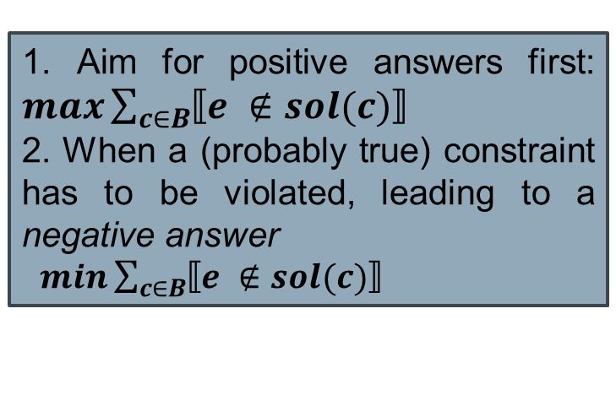
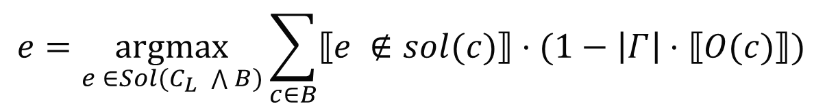

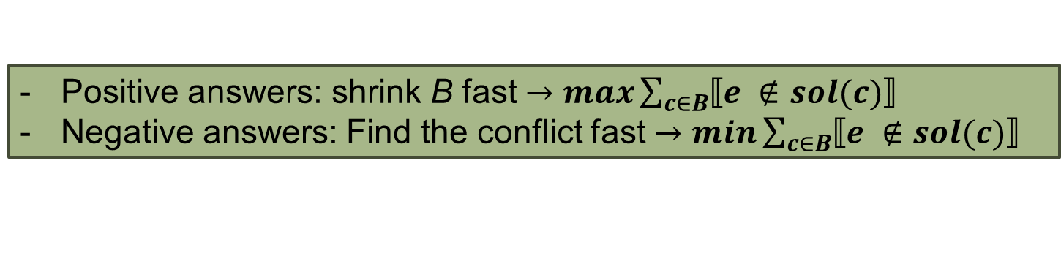
Guiding Query Generation
Positive answers: shrink B fast $→\max{\sum_{c∈B}{⟦e ∉sol(c)⟧}}$
Negative answers: Find the conflict fast $→\min{\sum_{c∈B}{⟦e ∉sol(c)⟧}}$
What if we can predict if a candidate is a constraint of the problem or not?
Use of Oracle $O(c)=(c∈CT)$, to guide query generation based on the prediction of the constraint
$$e=\underset{e ∈Sol(C_{L} \bigwedge{B)}}{argmax}{\sum_{c∈B}{⟦e ∉sol(c)⟧⋅(1−\left|Γ\right|⋅⟦O(c)⟧)} }$$
1. Aim for positive answers first: $\max{\sum_{c∈B}{⟦e ∉sol(c)⟧}}$
2. When a (probably true) constraint has to be violated, leading to a negative answer
$\min{\sum_{c∈B}{⟦e ∉sol(c)⟧}}$
Aim to violate
O(c)
False
Why?
True
Aim to satisfy
Guided Bottom-up Constraint Acquisition, D. Tsouros et al., CP, 2023

Slide 33
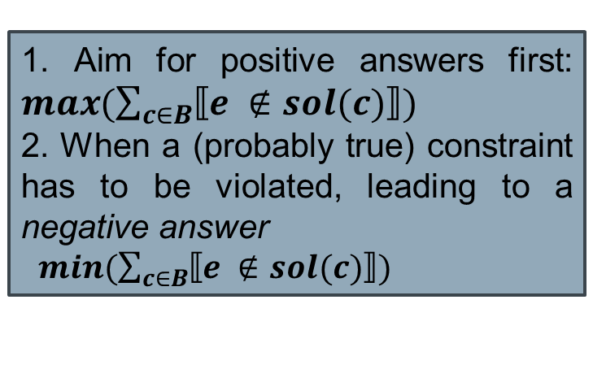

Guiding Query Generation
Positive answers: shrink B fast $→\max{\sum_{c∈B}{⟦e ∉sol(c)⟧}}$
Negative answers: Find the conflict fast $→\min{\sum_{c∈B}{⟦e ∉sol(c)⟧}}$
What if we can predict if a candidate is a constraint of the problem or not?
If the constraint c is violated
Increase objective value by 1
Use of Oracle $O(c)=(c∈CT)$, to guide query generation based on the prediction of the constraint
If it is a constraint predicted to be true: reduce objective value significantly
$$e=\underset{e ∈Sol(C_{L} \bigwedge{B)}}{argmax}{\sum_{c∈B}{⟦e ∉sol(c)⟧⋅(1−\left|Γ\right|⋅⟦O(c)⟧)} }$$
1. Aim for positive answers first: $\max{(\sum_{c∈B}{⟦e ∉sol(c)⟧}})$
2. When a (probably true) constraint has to be violated, leading to a negative answer
$\min{(\sum_{c∈B}{⟦e ∉sol(c)⟧}})$
Aim to violate
O(c)
False
Why?
True
Aim to satisfy
Guided Bottom-up Constraint Acquisition, D. Tsouros et al., CP, 2023

Slide 34
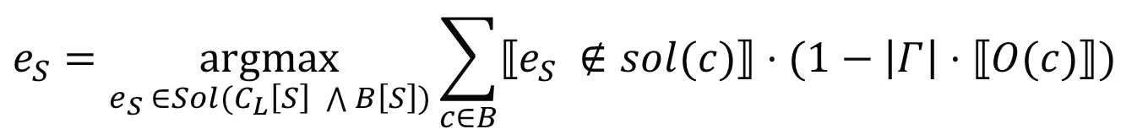
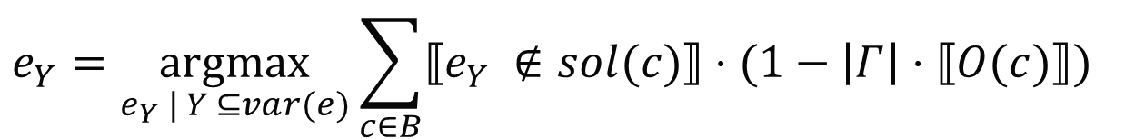
Guiding CA when finding the scope and relation
When finding the scope
Exploit partial (sub)queries to find the conflicting part
How are the removed variable assignments decided???
$$e_{Y}=\underset{e_{Y} | Y ⊆var(e)}{argmax}{\sum_{c∈B}{⟦e_{Y} ∉sol(c)⟧⋅(1−\left|Γ\right|⋅⟦O(c)⟧)} }$$
When finding the relation
Try different assignments to find the specific constraint in the scope
How are the assignments decided???
$$e_{S}=\underset{e_{S} ∈Sol(C_{L}\left[S\right] \bigwedge{B\left[S\right])}}{argmax}{\sum_{c∈B}{⟦e_{S} ∉sol(c)⟧⋅(1−\left|Γ\right|⋅⟦O(c)⟧)} }$$

Slide 35

Do we have an oracle $O\left(c\right)$ to guide CA
The oracle $O\left(c\right)$ “classifies” a candidate as a problem constraint or not
Aim to violate
O(c)
False
It is a prediction problem
True
Aim to satisfy
Use Machine Learning!!
Query
Generation
Learn from user’s answer

Slide 36

Do we have an oracle $O\left(c\right)$ to guide CA
The oracle $O\left(c\right)$ “classifies” a candidate as a problem constraint or not
Aim to violate
O(c)
False
It is a prediction problem
Predictions for constraints not for variable assignments!!
True
Aim to satisfy
Use Machine Learning!!
ML
Query
Generation
Learn from user’s answer
Update Constraint dataset

Slide 37
Using Machine Learning for the prediction
Dataset: Constraint features and class (True or False)
Constructing during the acquisition process
Constraints that we know are part of the problem or not
When a constraint is learned add a positive instance
When a constraint is removed from B add a negative instance
Use both relation and scope features
Relation-based features | Scope-based features
Relation name (string) | Dim[i] same_val (Bool)
Has constant (Bool) | Dim[i] avg (float)
Constant value (int) | Dim[i] distance (int)
Arity (int) | …

Slide 38
Using Machine Learning for the prediction
Dataset: Constraint features and class (True or False)
Constructing during the acquisition process
Constraints that we know are part of the problem or not
When a constraint is learned add a positive instance
When a constraint is removed from B add a negative instance
Use both relation and scope features
Example for constraint
x_{1,1} ≠ x_{1,2} in Sudoku
Relation-based features | Scope-based features
Relation name (string) ≠ | Dim[i] same_val (Bool) True, False
Has constant (Bool) False | Dim[i] avg (float) 1, 1.5
Constant value (int) -1 | Dim[i] distance (int) 0, 1
Arity (int) 2 | …
For the 2 dimensions

Slide 39
Using Machine Learning for the prediction
ID | Name | Type
Basic constraint features
1 | Relation | Categ.
2 | Arity | Int
3 | Has_constant | Bool
4 | Constant | Int
Dimension-indices features
5 | Var_dim_{i}_same | Bool
6 | Var_dim_{i}_max | Int
7 | Var_dim_{i}_min | Int
8 | Var_dim_{i}_avg | Float
9 | Var_dim_{i}_diff | Float
Latent dimension features
10 | Var_latent_dim_{i}_same | Bool
11 | Var_latent_dim_{i}_max | Int
12 | Var_latent_dim_{i}_min | Int
13 | Var_latent_dim_{i}_avg | Float
14 | Var_latent_dim_{i}_diff | Float
Constraint relation features
Features for variables indices in each dimension
e.g. same row, same col …
Look for latent dimensions using the divisors of given dimensions

Slide 40
Latent Dimensions
ID | Name | Type
Basic constraint features
1 | Relation | Categ.
2 | Arity | Int
3 | Has_constant | Bool
4 | Constant | Int
Dimension-indices features
5 | Var_dim_{i}_same | Bool
6 | Var_dim_{i}_max | Int
7 | Var_dim_{i}_min | Int
8 | Var_dim_{i}_avg | Float
9 | Var_dim_{i}_diff | Float
Latent dimension features
10 | Var_latent_dim_{i}_same | Bool
11 | Var_latent_dim_{i}_max | Int
12 | Var_latent_dim_{i}_min | Int
13 | Var_latent_dim_{i}_avg | Float
14 | Var_latent_dim_{i}_diff | Float
Example: Exam Timetabling
Constraints:
All exams must be in a different slot
Exams for courses of same semester must be in different day
Can be modeled as a 2D array with dimensions semesters (s) and courses per semester (cps).
Can also be modeled as a vector of s*cps courses
The pattern of the second constraint can be easily identified on the first case: applies in each row!
In the second case, this dimension is hidden! Need to discover it

Slide 41

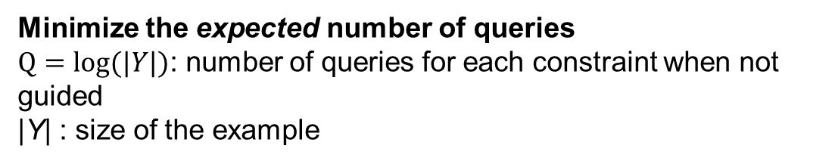
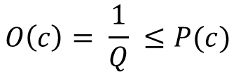
Using Machine Learning in the Oracle
The oracle $O\left(c\right)$ “classifies” a candidate as a problem constraint or not
Use of any classification technique to simulate the Oracle
$$O\left(c\right)=Class(c)$$
classifier.predict()
Use of probabilities?
$$O\left(c\right)= \frac{1}{Q} ≤P(c)$$
classifier.predict_proba()
Minimize the expected number of queries
$Q=log⁡(|Y|)$: number of queries for each constraint when not guided
|Y| : size of the example

Slide 42
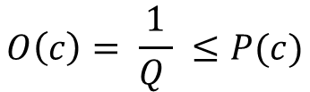
Using Machine Learning in the Oracle
The oracle $O\left(c\right)$ “classifies” a candidate as a problem constraint or not
Use of any classification technique to simulate the Oracle
$$O\left(c\right)=Class(c)$$
classifier.predict()
Use of probabilities?
$$O\left(c\right)= \frac{1}{Q } ≤P(c)$$
classifier.predict_proba()
- Using predicted probabilities instead of class works way better!!
- Assuming that a candidate is a constraint of the problem even if the probability is less than 50% (but above the threshold)
- Threshold defined to minimize number of queries!
Minimize the expected number of queries
$Q=log⁡(|Y|)$: number of queries for each constraint when not guided
|Y| : size of the example

Slide 43
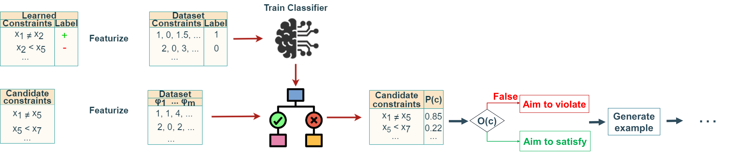
Using Machine Learning in the Oracle
Statistical ML learns the structure implicitly,
query-based learning makes it explicit

Slide 44
Using Machine Learning in the Oracle
Guiding using predictions from ML reduces the querys up to 70%

Slide 45
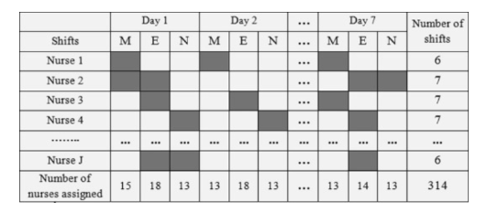
Another Limitation
Most CA methods learn the model only of the given instance of the problem
Nurse rostering problem:
What if the instance changes?
- If the number of nurses changes
If we want to schedule on different timeframe
…
We will need to learn again the constraints for the new instance!!

Slide 46
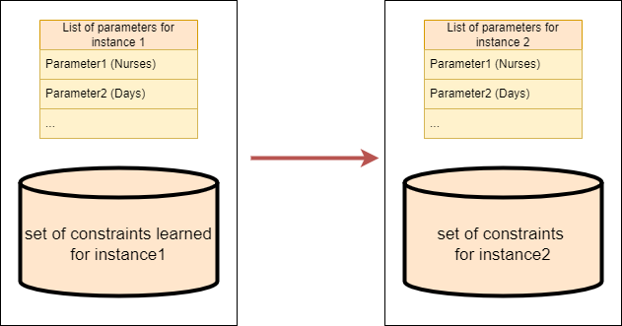
Another Limitation
Most CA methods learn the model only of the given instance of the problem
Can we generalize?
Each instance is defined through a set of parameters (e.g. nurses, number of days for the schedule etc.). Can we generalize the learned constraints to different parameters?

Slide 47
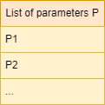
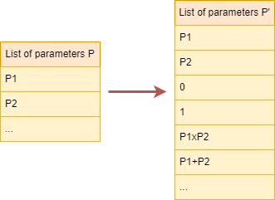
Generalizing learned constraint models
A CSP consists of:
A set of variables X
Their domains D
A set of constraints C
We need to generalize all for a different instance
Based on the set of parameters
1. Extended list of parameters to capture combinations of them

Slide 48
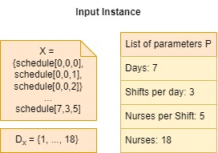
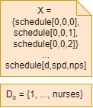
Generalizing learned constraint models
2. Recognize parameters that are affecting the variables and their domains
Replace:
Dimensions of variables matrix
Lower and upper bound of domains
With named parameters that correspond to them
E.g. for Nurse rostering
Generalize

Slide 49
Generalizing learned constraint models
3. Generalize the set of constraints C
Not a simple replacement task!!
But we have already a way to detect patterns in sets of constraints

Slide 50
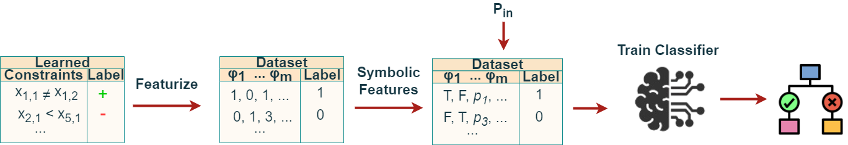
Generalizing learned constraint models
Train a classifier that can recognise which constraints are part of the problem
Create a (parameterized) dataset for the input instance
Replace numeric values with named parameters like before

Slide 51
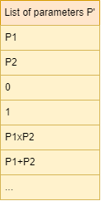
Features
ID | Name | Type
Basic constraint features
1 | Relation | Categ.
2 | Arity | Int
3 | Has_constant | Bool
4 | Constant | Int
Dimension-indices features
5 | Var_dim_{i}_same | Bool
6 | Var_dim_{i}_max | Int
7 | Var_dim_{i}_min | Int
8 | Var_dim_{i}_avg | Float
9 | Var_dim_{i}_diff | Float
Latent dimension features
10 | Var_latent_dim_{i}_same | Bool
11 | Var_latent_dim_{i}_max | Int
12 | Var_latent_dim_{i}_min | Int
13 | Var_latent_dim_{i}_avg | Float
14 | Var_latent_dim_{i}_diff | Float
Replace numeric features (int and float) with named parameters to be able to generalize

Slide 52
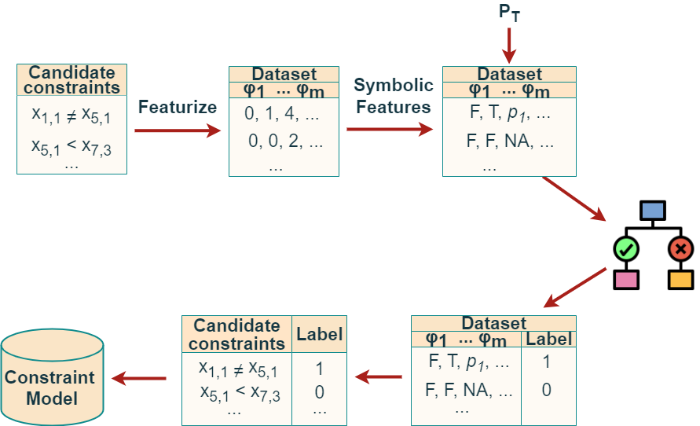
Generalizing learned constraint models
Generate a set of candidates for the new instance
Then classify them to get the true ones

Slide 53
Generalizing learned constraint models
Can capture patterns that can be described with the features (or combinations of them)!
We showed that even with a simple generic feature representation it can work very well

Slide 54
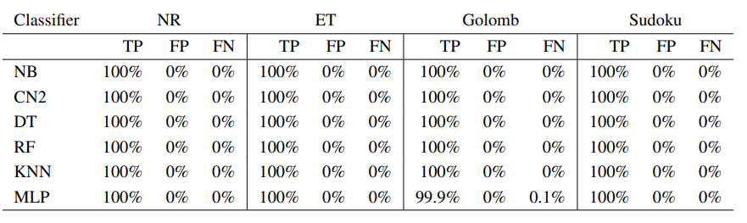
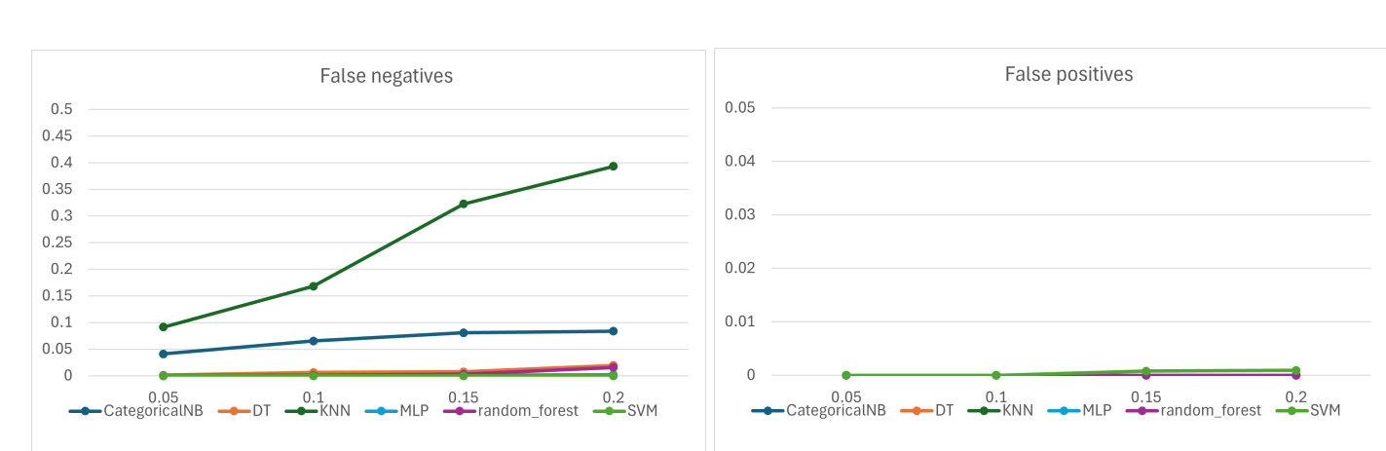
Generalizing learned constraint models
Generalizing with high accuracy in many well-known benchmarks!
Even in the presence of noise (almost 100% accuracy even up to 20% noise)

Slide 55
Open challenges

Slide 56

Challenges
Number of queries
Number of queries needed to converge is still large.
Use also more expressive types of queries
Generalize during learning!
- Based on patterns detected with ML

Slide 57
Challenges
Specific classes of constraints
Global constraints: Exploding the set of candidate constraints
Linear inequalities with constants: Need to consider all possible constants -> Exploding the set of candidate constraints
COUNT
x₁ + 5 < x₂
ALLDIFFERENT
|x₁ + 12| > x₄
CUMULATIVE
SUM
x₁ - x₂ != 238
CIRCUIT

Slide 58

Challenges
Noisy data
Unlike in machine learning, most constraint acquisition techniques still assume the user always (knows how to) answer correctly
Tighter integration with machine learning predictions, to detect when the user may answer wrongly

Slide 59
Conclusions
We discussed:
Passive and interactive constraint acquisition
How to guide constraint acquisition using probabilities for the candidates
Using ML to learn how to learn in interactive constraint acquisition
Using ML to generalize constraint models
Open challenges
- Using ML has great potential on tackling them

