Slide 1




Constraint Modelling with LLMs Using In-Context Learning
Kostis Michailidis, Dimos Tsouros, Tias Guns

Slide 2

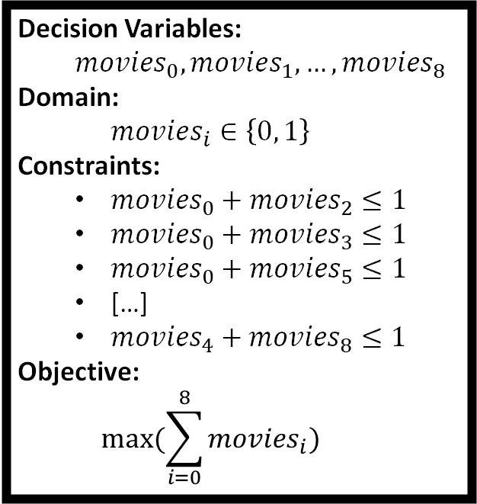
Constraint Modelling: An Example
Context: A popular actor with many offers.
Requirement 1: Only one movie per day.
Requirement 2: Maximize income.
Which movies to choose?
Decision Variables:
$$movies_{0},movies_{1},…, movies_{8}$$
Domain:
$$movi{es}_{i}∈\left\{0, 1\right\}$$
Constraints:
$movies_{0}+movies_{2}≤1$
$movies_{0}+movies_{3}≤1$
$movies_{0}+movies_{5}≤1$
[…]
$movies_{4}+movies_{8}≤1$
Objective:
$$max⁡(\sum_{i=0}^{8}{movies_{i}})$$
 | Movie Title | Start Day | End Day
0 | Tarjan of the Jungle | 4 | 13
1 | The Four Volume Problem | 17 | 27
2 | The President's Algorist | 1 | 10
3 | Steiner's Tree | 12 | 18
4 | Process Terminated | 23 | 30
5 | Halting State | 9 | 16
6 | Programming Challenges | 19 | 25
7 | Discrete Mathematics | 2 | 7
8 | Calculated Bets | 26 | 31
Expert
Source: http://www.hakank.org/minizinc/movie_scheduling.mzn
Source description: Steven S. Skiena's The Algorithm Design Manual

Slide 3
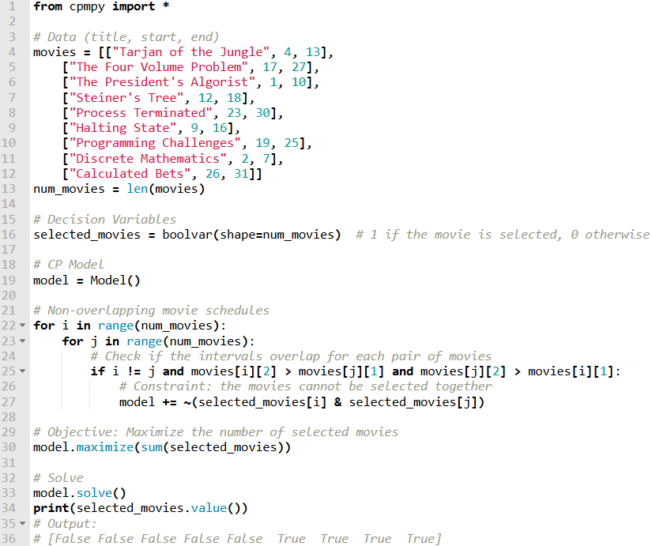
Constraint Modelling: An Example
Context: A popular actor with many offers.
Requirement 1: Only one movie per day.
Requirement 2: Maximize income.
Which movies to choose?
 | Movie Title | Start Day | End Day
0 | Tarjan of the Jungle | 4 | 13
1 | The Four Volume Problem | 17 | 27
2 | The President's Algorist | 1 | 10
3 | Steiner's Tree | 12 | 18
4 | Process Terminated | 23 | 30
5 | Halting State | 9 | 16
6 | Programming Challenges | 19 | 25
7 | Discrete Mathematics | 2 | 7
8 | Calculated Bets | 26 | 31
Expert
Source: http://www.hakank.org/minizinc/movie_scheduling.mzn
Source description: Steven S. Skiena's The Algorithm Design Manual

Slide 4
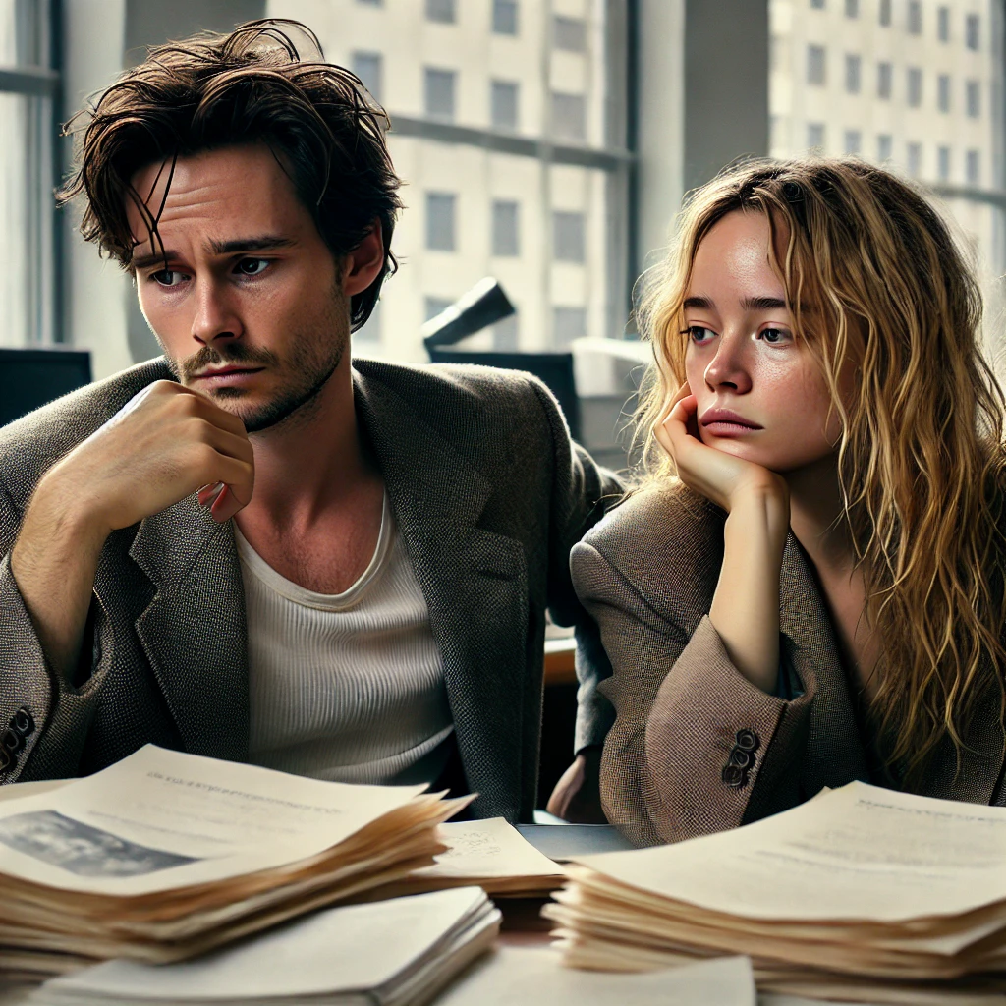

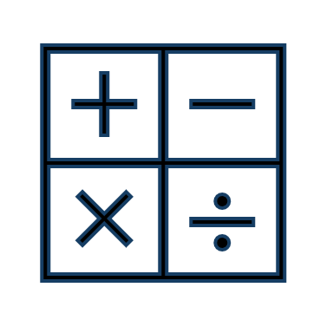

How to decide?
Use CP to solve this combinatorial problem
CP is powerful, but modelling requires expertise in:
Oh no, that’s too difficult!
Domain Knowledge
Mathematical Skills
Solver Formalisms
Image created using OpenAI's ChatGPT.

Slide 5





Making CP More Accessible
Modelling Tools
CPMpy
Constraint Acquisition
Users provide or classify (non-)solutions
From Natural Language
Textual descriptions of combinatorial problems

Slide 6
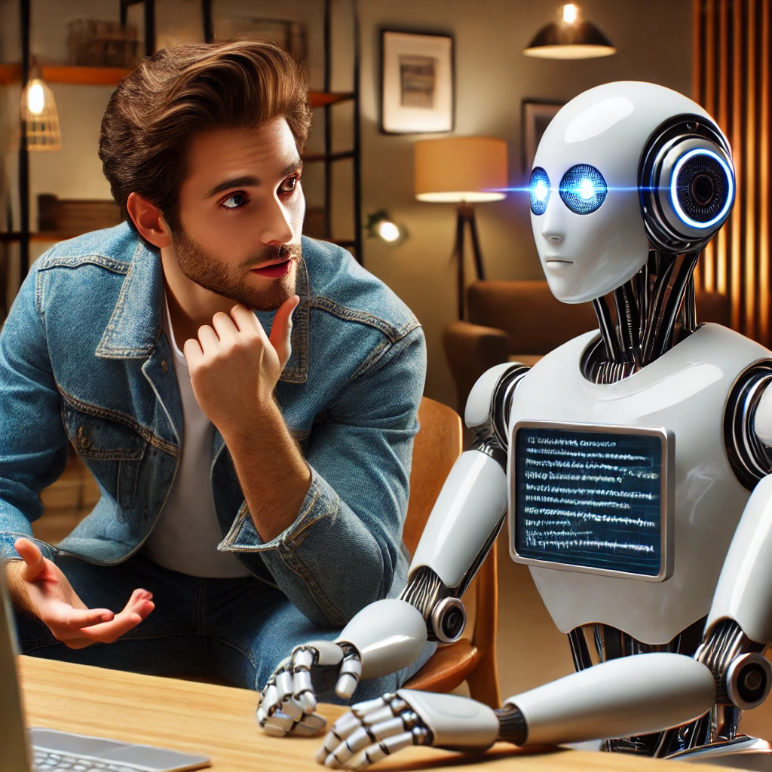
Make a CP model for me, please!
Can
Large Language Models assist in
Constraint Modelling?
Image created using OpenAI's ChatGPT.

Slide 7


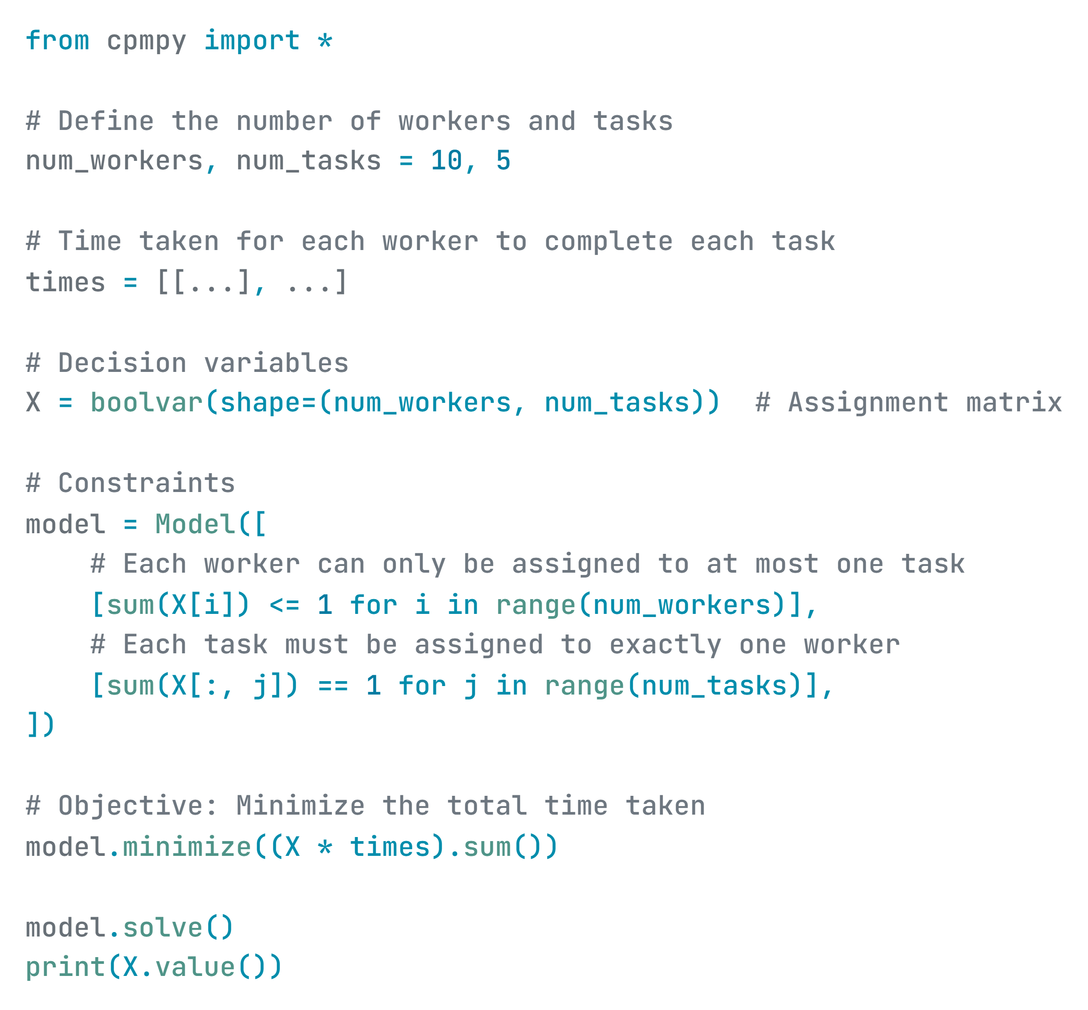


An LLM-based Constraint Programming & Modelling assistant for combinatorial problems given only their natural language description
We’re a team of 10, and we need to complete 5 tasks in the shortest time possible.
Here is an executable model in Python:
Solution Found!

Slide 8
From Natural Language
Textual descriptions of combinatorial problems
Declarative Model Synthesis (SMT-specific)
LGP clues to ASP rules
Constraint Detection with Sequence Labelling
(SVM-HMM)
LGP clues to Prolog constraints
(DistilBERT)
LP problems to formal models
2016
2019
2020
2022
2023
FOL expressions from Logic Grid Puzzle (LGP) clues
Linear Optimization (NL4Opt)
Preliminary work on CP modelling, but lacking systematic evaluation.
Pre-GPT Language Models
Fine-Tuning
Modern LLMs (e.g. GPT-3)
In-Context Learning
Traditional NLP

Slide 9
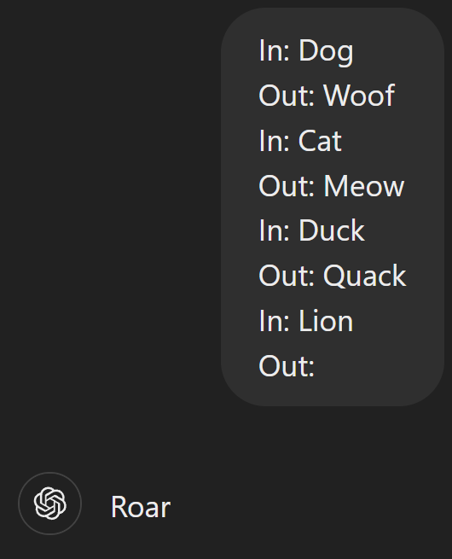
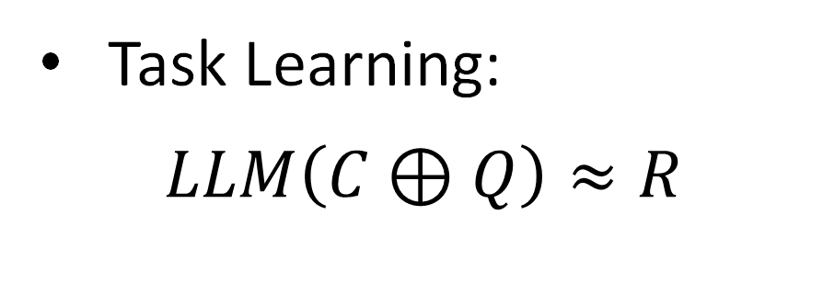
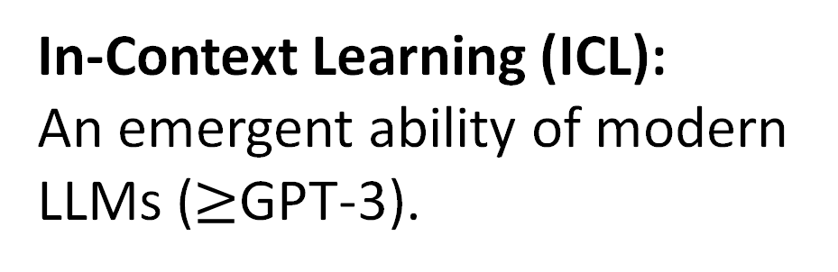
Background: Large Language Models
$$LLM\left(Prompt\right)=Response$$
In-Context Learning (ICL):
An emergent ability of modern LLMs ($≥$GPT-3).
What examples?
How many?
In what order?
Task Learning:
$$LLM\left(C⊕Q\right)≈R$$
https://chatgpt.com/share/431e9c84-1fe4-412e-aa91-1f9f00063e9d

Slide 10




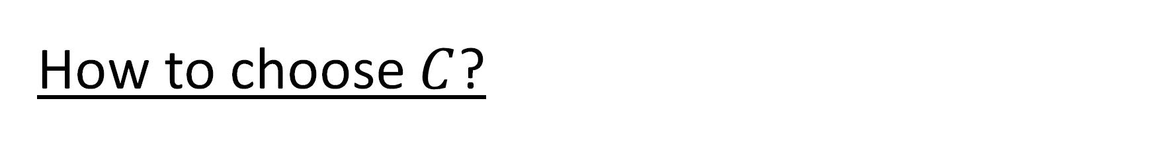


How to choose $C$?
$$C$$
Baseline: Static/Random
Retrieval-Augmented ICL
$${\left\{\left(Q_{j},R_{j}\right)\right\}}_{j=1}^{n}$$
Similarity
Diversity
Recency
$$C$$
$$C$$
$$Q$$

Slide 11


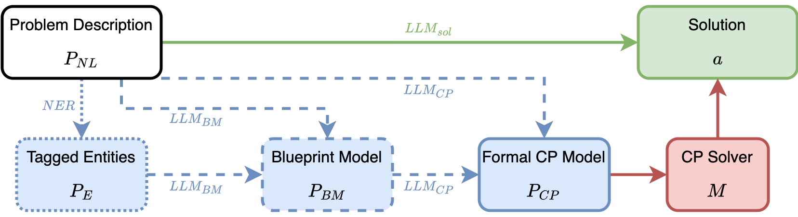

Using LLMs as assistants for solving constraint problems

Slide 12
1. LLMs as solvers

Slide 13
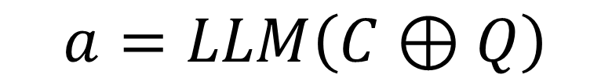

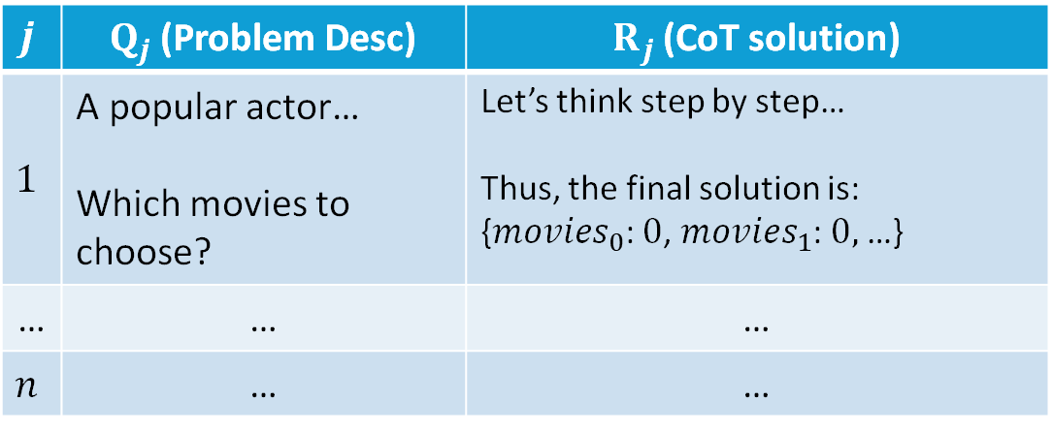
1. LLMs as solvers
Solution generated with Chain-of-Thought
$$j$$ | $Q_{j}$ (Problem Desc) | $R_{j}$ (CoT solution)
$$1$$ | A popular actor… Which movies to choose? | Let’s think step by step… Thus, the final solution is: {$movies_{0}$: $0$, $movies_{1}$: $0,$…}
… | … | …
$$n$$ | … | …
$$a=LLM\left(C⊕Q\right)$$
$${\left\{\left(Q_{j},R_{j}\right)\right\}}_{j=1}^{n}$$

Slide 14
2. LLMs as modellers

Slide 15

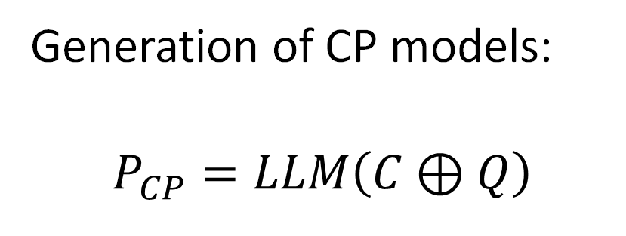
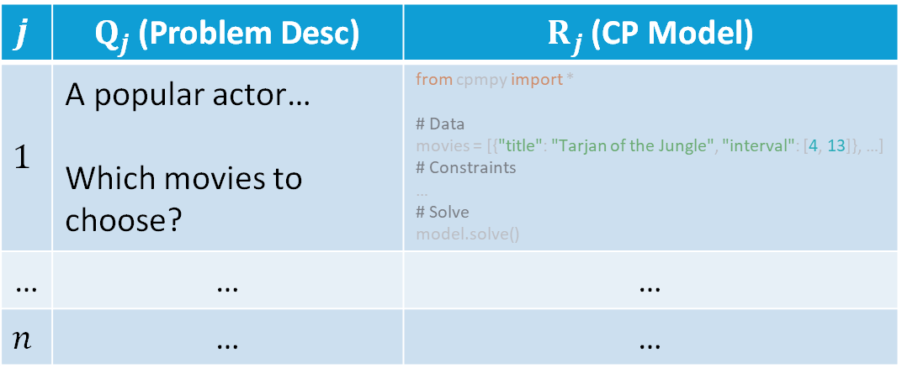

2. LLMs as modellers
$$j$$ | $Q_{j}$ (Problem Desc) | $R_{j}$ (CP Model)
$$1$$ | A popular actor… Which movies to choose? | from cpmpy import * # Data movies = [{"title": "Tarjan of the Jungle", "interval": [4, 13]}, …] # Constraints … # Solve model.solve()
… | … | …
$$n$$ | … | …
Generation of CP models:
$$P_{CP}=LLM\left(C⊕Q\right)$$
$$a=M(P_{CP})$$
$${\left\{\left(Q_{j},R_{j}\right)\right\}}_{j=1}^{n}$$

Slide 16
3. Blueprint Model

Slide 17
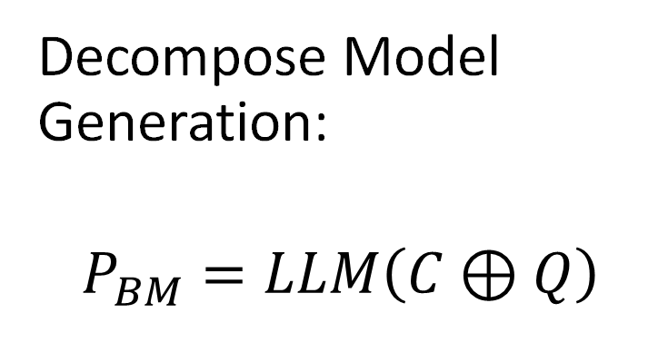

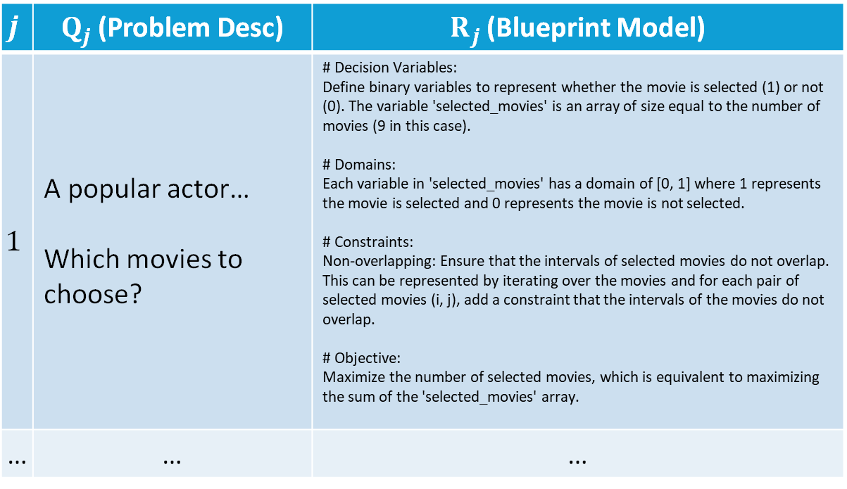
3. Blueprint Model
$$j$$ | $Q_{j}$ (Problem Desc) | $R_{j}$ (Blueprint Model)
$$1$$ | A popular actor… Which movies to choose? | # Decision Variables: Define binary variables to represent whether the movie is selected (1) or not (0). The variable 'selected_movies' is an array of size equal to the number of movies (9 in this case). # Domains: Each variable in 'selected_movies' has a domain of [0, 1] where 1 represents the movie is selected and 0 represents the movie is not selected. # Constraints: Non-overlapping: Ensure that the intervals of selected movies do not overlap. This can be represented by iterating over the movies and for each pair of selected movies (i, j), add a constraint that the intervals of the movies do not overlap. # Objective: Maximize the number of selected movies, which is equivalent to maximizing the sum of the 'selected_movies' array.
… | … | …
Decompose Model Generation:
$$P_{BM}=LLM\left(C⊕Q\right)$$
$${\left\{\left(Q_{j},R_{j}\right)\right\}}_{j=1}^{n}$$

Slide 18

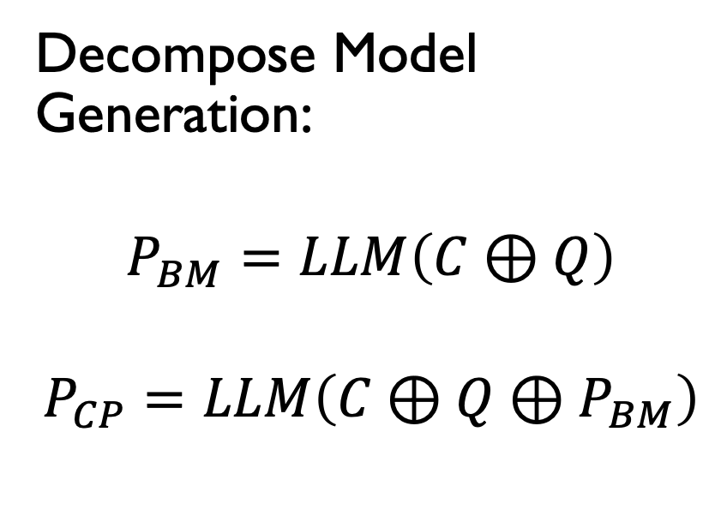

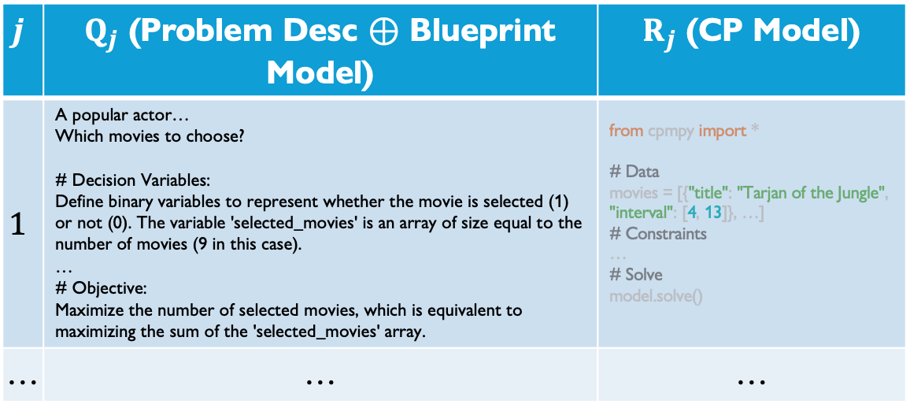
3. Blueprint Model
Decompose Model Generation:
$$P_{BM}=LLM\left(C⊕Q\right)$$
$$P_{CP}=LLM\left(C⊕Q⊕P_{BM}\right)$$
$$j$$ | $Q_{j}$ (Problem Desc $⊕$ Blueprint Model) | $R_{j}$ (CP Model)
$$1$$ | A popular actor… Which movies to choose? # Decision Variables: Define binary variables to represent whether the movie is selected (1) or not (0). The variable 'selected_movies' is an array of size equal to the number of movies (9 in this case). … # Objective: Maximize the number of selected movies, which is equivalent to maximizing the sum of the 'selected_movies' array. | from cpmpy import * # Data movies = [{"title": "Tarjan of the Jungle", "interval": [4, 13]}, …] # Constraints … # Solve model.solve()
… | … | …
$${\left\{\left(Q_{j},R_{j}\right)\right\}}_{j=1}^{n}$$
$$a=M(P_{CP})$$

Slide 19
4. Named Entity Recognition

Slide 20
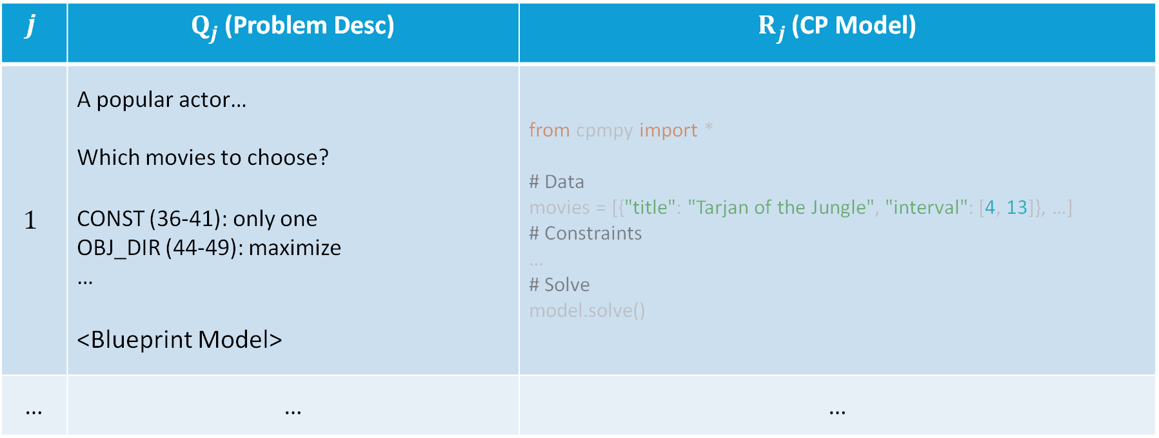

4. Named Entity Recognition
$$j$$ | $Q_{j}$ (Problem Desc) | $R_{j}$ (CP Model)
$$1$$ | A popular actor… Which movies to choose? CONST (36-41): only one OBJ_DIR (44-49): maximize … <Blueprint Model> | from cpmpy import * # Data movies = [{"title": "Tarjan of the Jungle", "interval": [4, 13]}, …] # Constraints … # Solve model.solve()
… | … | …
$${\left\{\left(Q_{j},R_{j}\right)\right\}}_{j=1}^{n}$$

Slide 21
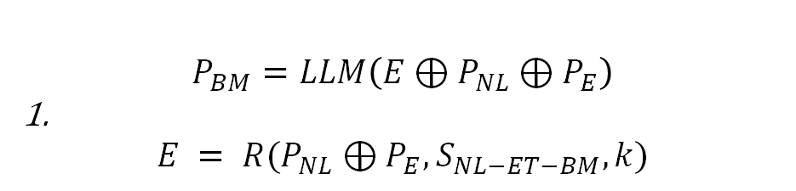

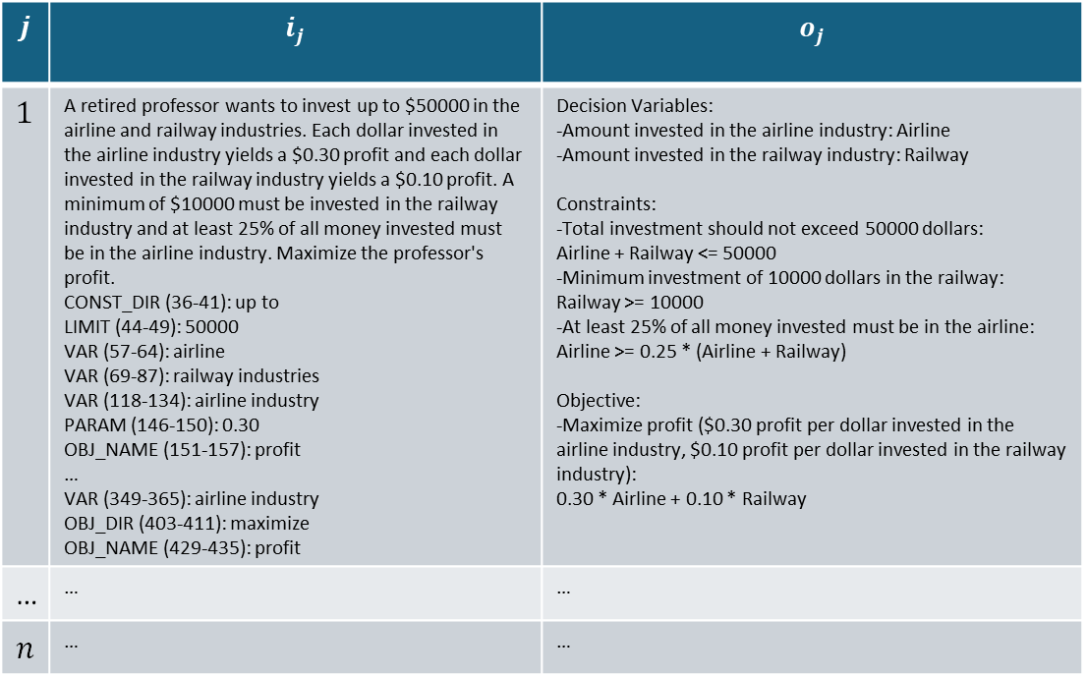
Named Entity Recognition
Identify entities and parameters of the problem:
$$S_{NL−ET−BM}$$
$$j$$ | $$i_{j}$$ | $$o_{j}$$
$$1$$ | A retired professor wants to invest up to $50000 in the airline and railway industries. Each dollar invested in the airline industry yields a $0.30 profit and each dollar invested in the railway industry yields a $0.10 profit. A minimum of $10000 must be invested in the railway industry and at least 25% of all money invested must be in the airline industry. Maximize the professor's profit. CONST_DIR (36-41): up to LIMIT (44-49): 50000 VAR (57-64): airline VAR (69-87): railway industries VAR (118-134): airline industry PARAM (146-150): 0.30 OBJ_NAME (151-157): profit … VAR (349-365): airline industry OBJ_DIR (403-411): maximize OBJ_NAME (429-435): profit | Decision Variables: -Amount invested in the airline industry: Airline -Amount invested in the railway industry: Railway Constraints: -Total investment should not exceed 50000 dollars: Airline + Railway <= 50000 -Minimum investment of 10000 dollars in the railway: Railway >= 10000 -At least 25% of all money invested must be in the airline: Airline >= 0.25 * (Airline + Railway) Objective: -Maximize profit ($0.30 profit per dollar invested in the airline industry, $0.10 profit per dollar invested in the railway industry): 0.30 * Airline + 0.10 * Railway
… | … | …
$$n$$ | … | …
$$P_{BM}=LLM\left(E⊕P_{NL}⊕P_{E}\right)$$
1.
$$E = R(P_{NL}⊕P_{E}, S_{NL−ET−BM}, k)$$

Slide 22


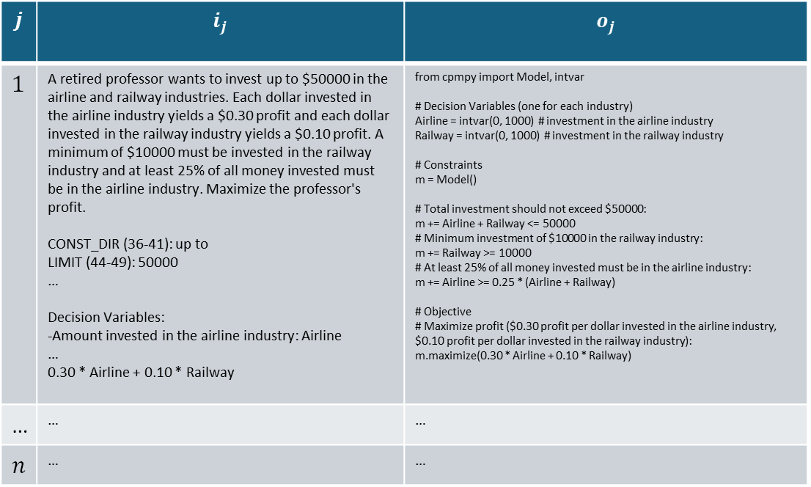
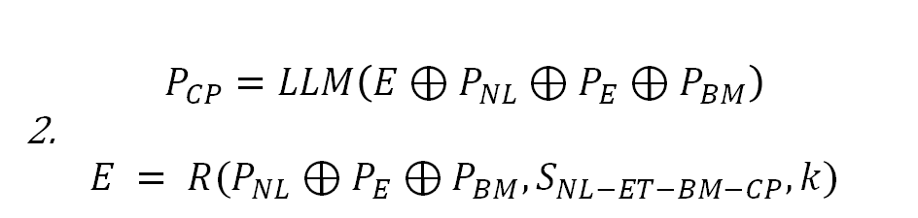
Named Entity Recognition
Identify entities and parameters of the problem:
$$S_{NL−ET−BM−CP}$$
$$j$$ | $$i_{j}$$ | $$o_{j}$$
$$1$$ | A retired professor wants to invest up to $50000 in the airline and railway industries. Each dollar invested in the airline industry yields a $0.30 profit and each dollar invested in the railway industry yields a $0.10 profit. A minimum of $10000 must be invested in the railway industry and at least 25% of all money invested must be in the airline industry. Maximize the professor's profit. CONST_DIR (36-41): up to LIMIT (44-49): 50000 … Decision Variables: -Amount invested in the airline industry: Airline … 0.30 * Airline + 0.10 * Railway | from cpmpy import Model, intvar # Decision Variables (one for each industry) Airline = intvar(0, 1000) # investment in the airline industry Railway = intvar(0, 1000) # investment in the railway industry # Constraints m = Model() # Total investment should not exceed $50000: m += Airline + Railway <= 50000 # Minimum investment of $10000 in the railway industry: m += Railway >= 10000 # At least 25% of all money invested must be in the airline industry: m += Airline >= 0.25 * (Airline + Railway) # Objective # Maximize profit ($0.30 profit per dollar invested in the airline industry, $0.10 profit per dollar invested in the railway industry): m.maximize(0.30 * Airline + 0.10 * Railway)
… | … | …
$$n$$ | … | …
$$P_{BM}=LLM\left(E⊕P_{NL}⊕P_{E}\right)$$
1.
$$E = R(P_{NL}⊕P_{E}, S_{NL−ET−BM}, k)$$
$$P_{CP}=LLM\left(E⊕P_{NL}⊕P_{E}⊕P_{BM}\right)$$
2.
$$E = R(P_{NL}⊕P_{E}⊕P_{BM}, S_{NL−ET−BM−CP}, k)$$
$$a=M(P_{CP})$$

Slide 23
Evaluation Metrics
Declaration Accuracy
Model Accuracy
Solution Accuracy
#Errors: CP Model could not be run

Slide 24
Experiments: Datasets
NL4Opt¹: Linear Optimization Problems
LGPs²: Logic Grid Puzzles described with clues and entities
Mixed (new): 18 diverse problems drawn from a CP Modelling course.
¹ Rindranirina Ramamonjison, Timothy Yu, Raymond Li, Haley Li, Giuseppe Carenini, Bissan Ghaddar, Shiqi He, Mahdi Mostajabdaveh, Amin Banitalebi-Dehkordi, Zirui Zhou, et al. Nl4opt competition: Formulating optimization problems based on their natural language descriptions.
² Arindam Mitra and Chitta Baral. Learning to automatically solve logic grid puzzles.

Slide 25
LLMs as CP solvers? No. LLMs as CP modellers? Possible.
Dataset | Method | Accuracy (%)
NL4Opt | CoT Solving | 11.46
 | CP Modelling | 81.31
LGPs | CoT Solving | 9.36
 | CP Modelling | 57.00
Mixed | CoT Solving | 16.67
 | CP Modelling | 50.00
Static 4-shot ICL, with gpt-3.5-turbo-0125

Slide 26
Intermediate Representations
Configuration: gpt-3.5-turbo-0125, 4-shot static ICL.
Dataset | Method | #Err | Sol. (%) | Decl. (%) | Model (%)
NL4Opt | CP | 7 | 81.31 | 87.81 | 79.24
 | + BM | 8 | 84.43 | 89.93 | 82.01
 | + NER | 8 | 85.47 | 88.60 | 80.62
LGPs | CP | 11 | 57.00 | 80.45 | 55.00
 | + BM | 18 | 58.00 | 70.69 | 58.00
 | + NER | 20 | 54.00 | 67.77 | 50.00
1. Beneficial in small linear problems (NL4Opt)
2. For more complex problems mixed results, noise in the context:
NER: Misclassification of variables.
BM: Larger context, possible to generate errors.
Dataset | #Shots | CP | + BM
Mixed | 2 | 33.33% | 16.67%
 | 4 | 50.00% | 50.00%
 | 8 | 50.00% | 44.44%
 | 12 | 55.56% | 50.00%
Configuration: gpt-3.5-turbo-0125, static ICL, Solution Accuracy.

Slide 27
Retrieval-Augmented ICL? Yes.
Retrieval | LGPs Sol. (%) | LGPs Decl. (%) | NL4Opt Sol. (%) | NL4Opt Decl. (%)
Static | 57.00 | 80.45 | 81.31 | 87.81
Random | 66.00 | 76.75 | 77.16 | 85.60
Similarity | 68.00 | 85.34 | 85.12 | 87.72
R-Similarity | 72.00 | 89.83 | 83.39 | 88.16
Diversity | 66.00 | 83.09 | 84.08 | 87.99
R-Diversity | 74.00 | 87.98 | 83.74 | 87.10
Random w/ Last-Similar | 76.00 | 89.96 | 83.74 | 88.34
Context relevance and diversity improve accuracy.
Recency effect is influential.
CP modelling. Config: gpt-3.5-turbo-0125, R-MMR λ = 0.5.

Slide 28
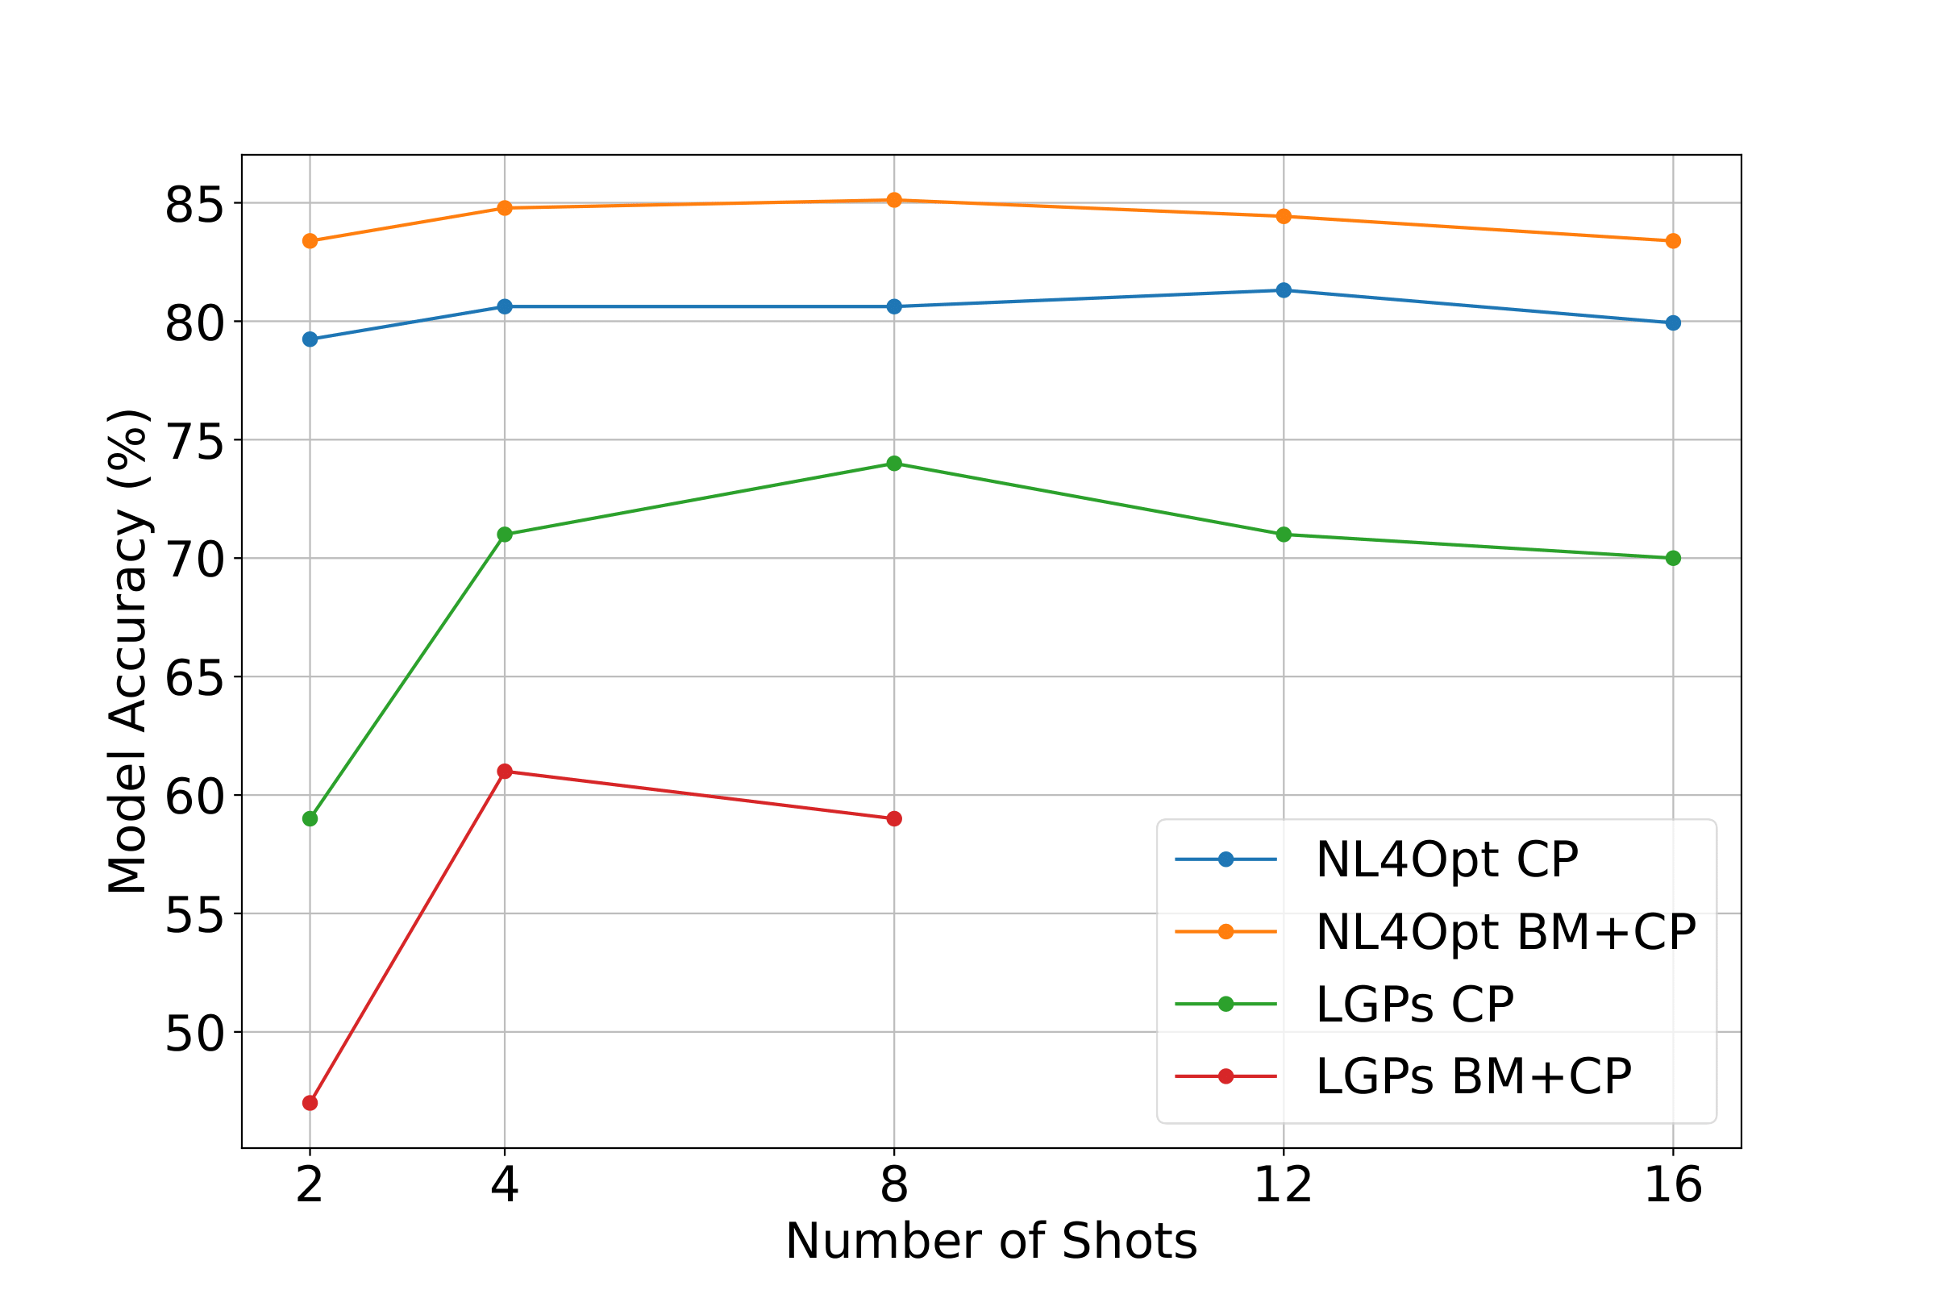
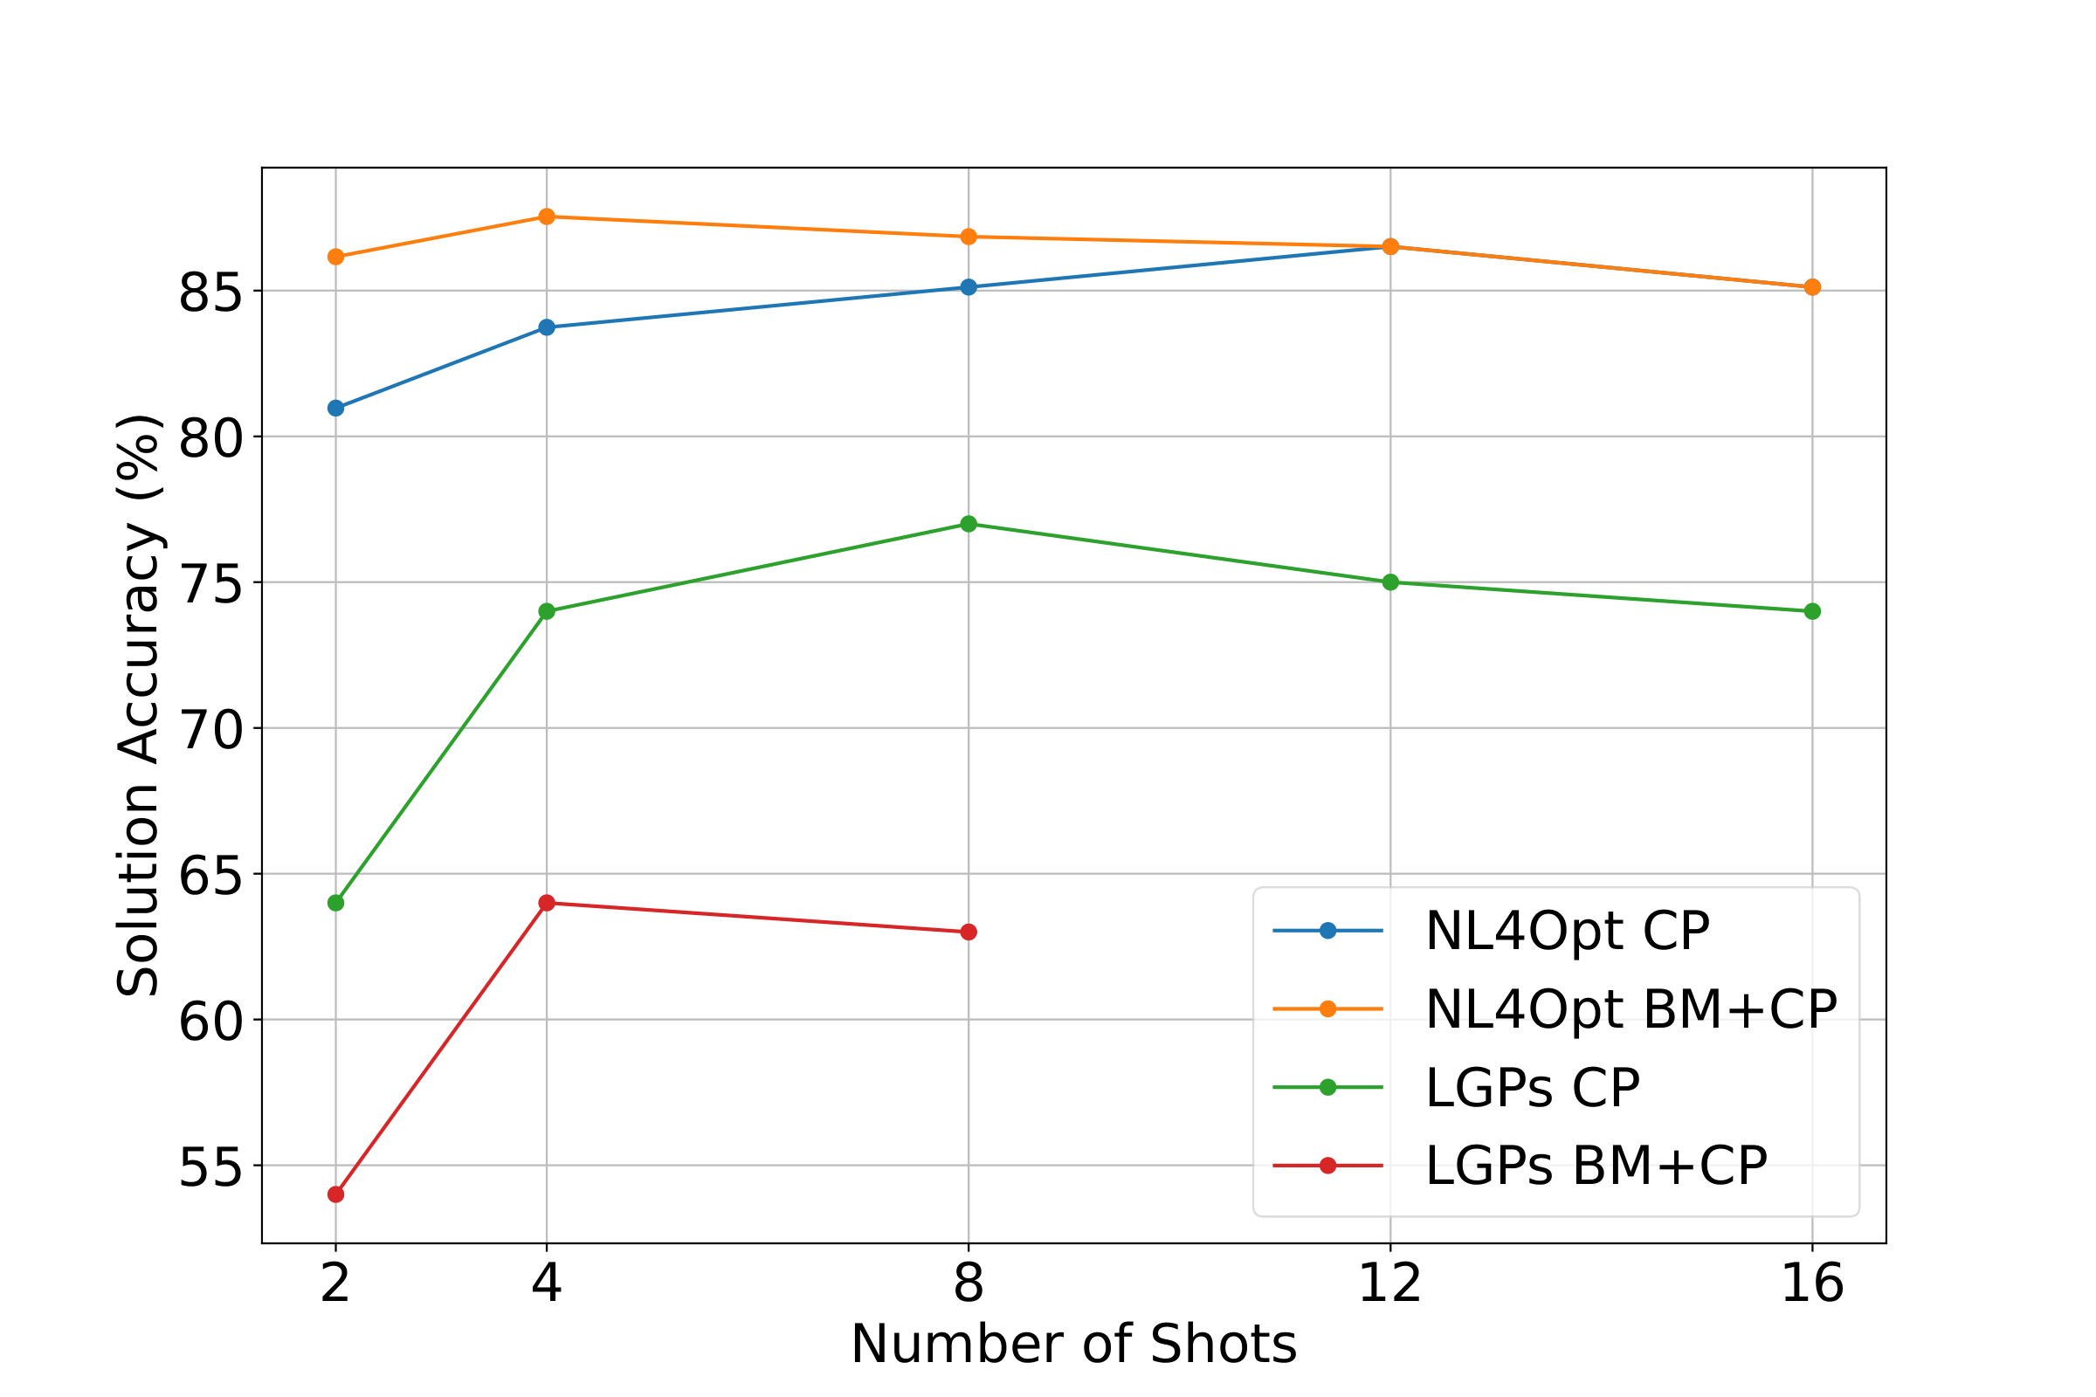
The more examples the better? Not exactly.
Config: gpt-3.5-turbo-0125, R-MMR (λ = 0.5)
Adding in-context examples improves
up to a threshold.

Slide 29
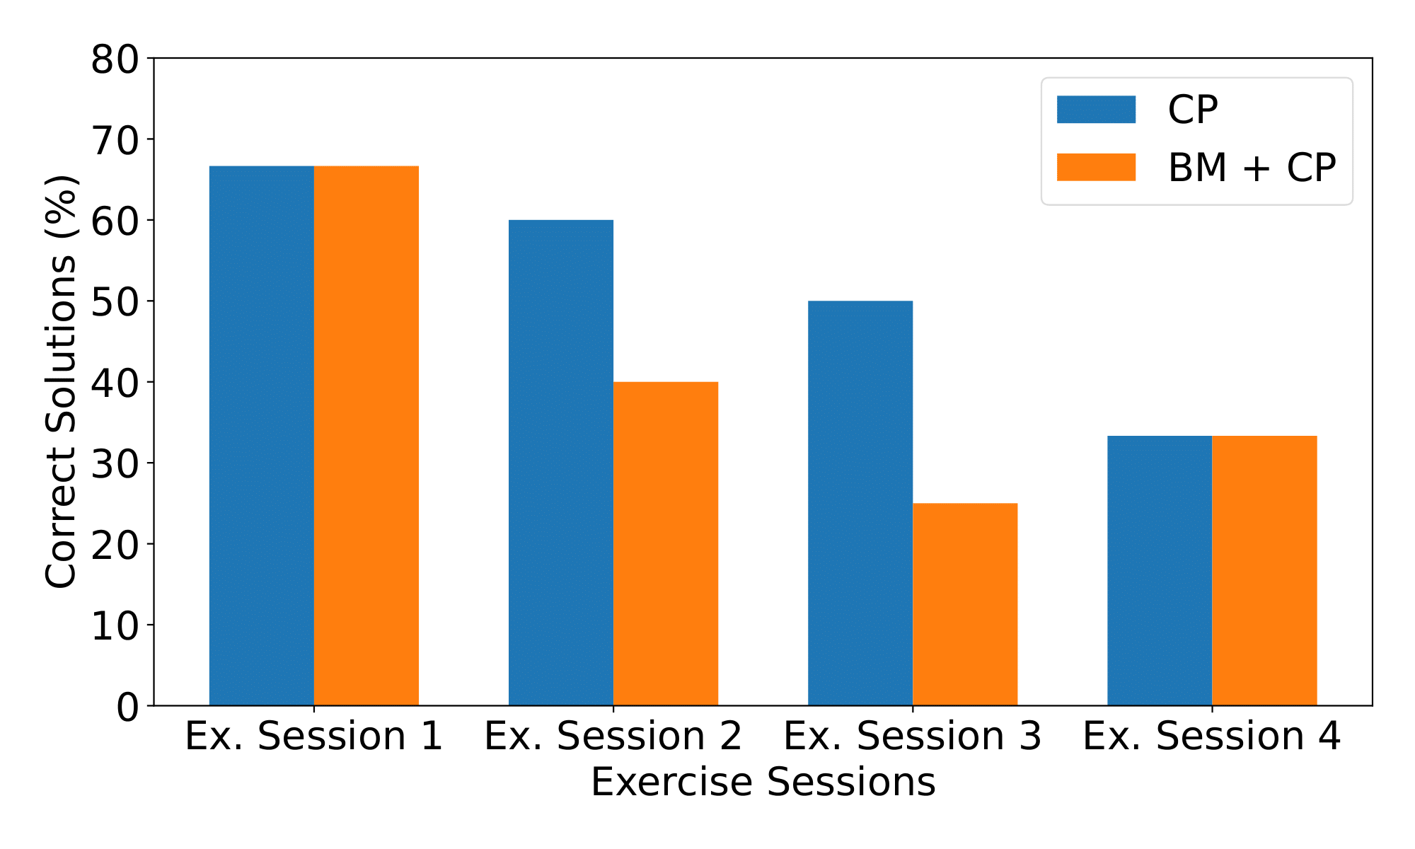
What about more diverse problems?
Config: gpt-3.5-turbo-0125, R-SIM, 12-shot ICL.
Small Dataset: Few examples to retrieve from.
More complex problems harder for LLMs as well.
Evaluation challenges:
Problem: Choice of Decision Variables is free => Model Accuracy.
LIGHTBULB Prompt LLMs to generate code that prints the solution in specific format => Solution Accuracy.

Slide 30



Key Conclusions
LLMs as CP solvers? No LLMs as CP modellers? Possible
Retrieval-Augmented In-Context Learning improves performance
Modelling more complex problems still challenging

Slide 31
Future/Current Work
High-Quality NL-CP dataset.
Beyond ICL: Supervised fine-tuning of LLMs.
Integrate techniques from LLMs coding assistants.
Multi-turn interactive modelling system.

Slide 32

Demo
https://chatopt.cs.kuleuven.be

