Slide 1


Constraint Acquisition – A Tutorial on Learning Constraint Models
Dimos Tsouros
dimos.tsouros@kuleuven.be
05/09/2024

Slide 2
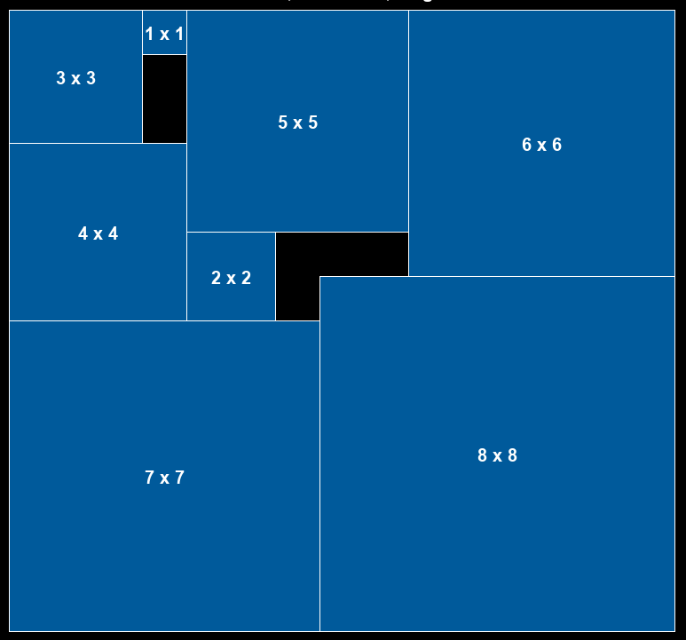
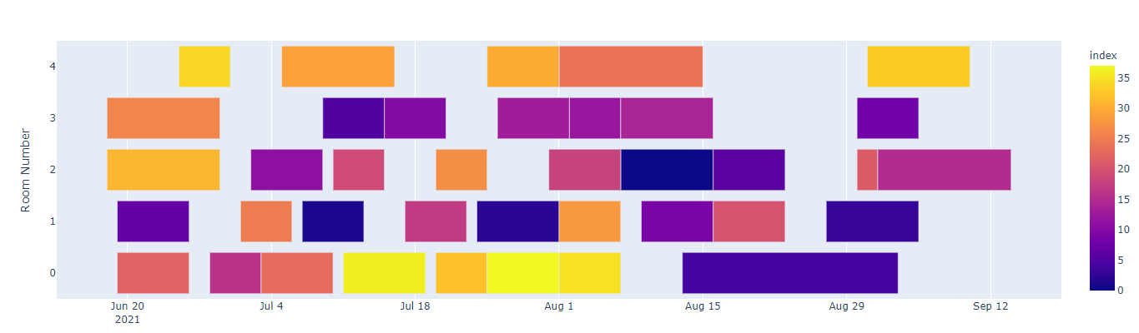
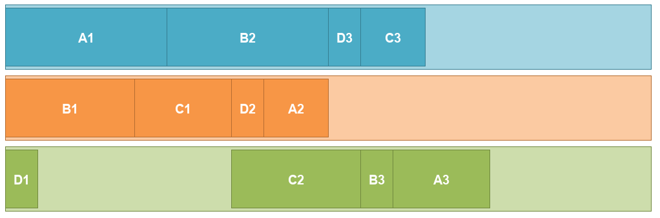
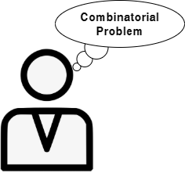

Introduction
Constraint programming (CP)
Solving combinatorial problems in AI
Model + Solve paradigm
Give model
Return solution

Slide 3
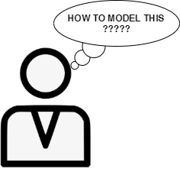


Introduction
Modelling is not always trivial
Requires expertise
Bottleneck for the wider use of CP
Constraint Acquisition
Structure Learning: learn the constraints of the problem, not parameters
modelling

Slide 4

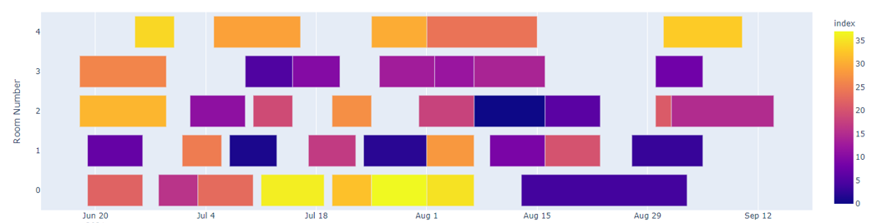
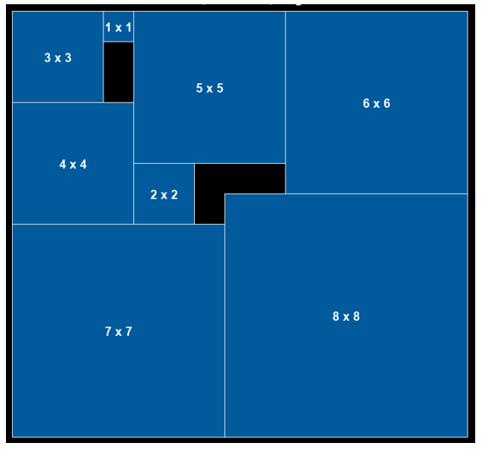
Introduction
modelling
Model
Solve
modelling
Model
Solve

Slide 5

Constraint Acquisition
Passive acquisition: Using existing data
Examples
CSP Model
(Inter)active acquisition: Interact with the user
Answers
Queries
CSP Model
Constraint Acquisition, C. Bessiere et al., AIJ, 2017

Slide 6
Constraint Acquisition
Γ
Create candidate set
B
Constraint Acquisition system
C_{L}
Vocabulary (X,D)
Examples E
Or
Answers
Queries
Terminology
X: Variables, D^{X}: Domains
Γ: Constraint Language: abstract relations
B: Set of candidate constraints (using relations from Γ)
C_{L}: Learned constraint set
Goal:
C_{L} is equivalent to the (unknown) target set C_{T}
Constraint Acquisition, C. Bessiere et al., AIJ, 2017

Slide 7
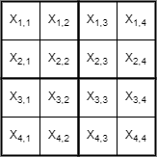
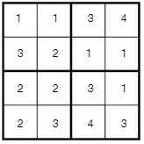
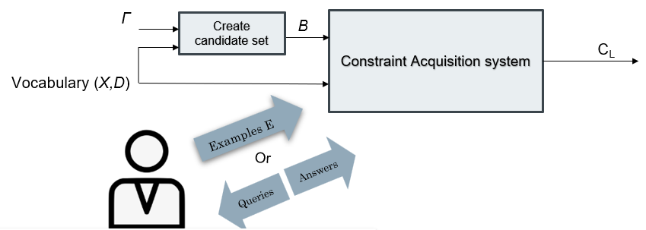
Inputs and Outputs
Running Example: 4x4 Sudoku
X: Variables of the problem, X = {x_{1,1}, x_{1,2}, x_{1,3}, …, x_{4,4} }, domains D = {1, 2, 3, 4}
Γ: Constraint Language, Γ = {═, ≠, ≤, ≥}
B: Set of candidate constraints, B = {x_{1,1} ≠ x_{1,2}, x_{1,1} ═ x_{1,2}, …}
C_{L}: learned constraints, ideally all the ≠ constraints in rows, cols and blocks
The user may not know exactly what constraint relations appear in the model
Problem Formulation
Example e₁

Slide 8
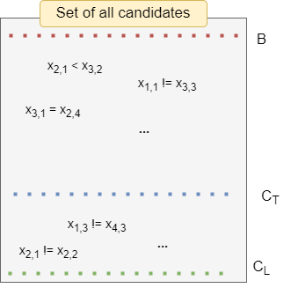
Adapting Candidate Elimination
B: set of (remaining) candidate constraints
C_{T}: target set of constraints
C_{L}: learned set of constraints
Candidates that should
Be excluded
Candidates that should
be acquired

Slide 9
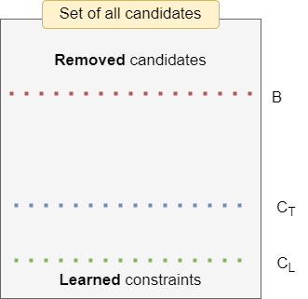
Adapting Candidate Elimination
During the learning process:
Constraints are removed from B
Constraints are added to C_{L}
B: set of (remaining) candidate constraints
C_{T}: target set of constraints
C_{L}: learned set of constraints

Slide 10
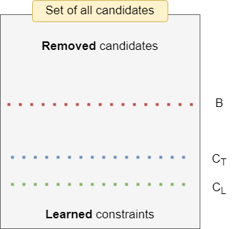
Adapting Candidate Elimination
During the learning process:
Constraints are removed from B
Constraints are added to C_{L}
B: set of (remaining) candidate constraints
C_{T}: target set of constraints
C_{L}: learned set of constraints

Slide 11

Adapting Candidate Elimination
If C_{T} is representable by B the CA system will eventually converge to a C_{L} equivalent to C_{T}

Slide 12
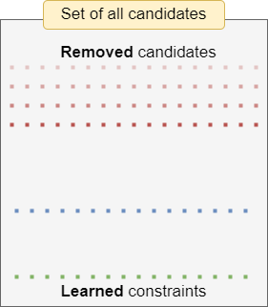

Adapting Candidate Elimination
Examples: Assignments to the variables of the problem
Learning from positive examples (Solutions):
Learning from negative examples (Non-solutions):
- Violated constraints cannot be part of the model
- Otherwise, it could not be a solution
- One (or more) violated constraint is a constraint of the problem
- Otherwise, it would be a solution
Shrinking the bias
Learning Constraints

Slide 13



Passive Acquisition
Labelled examples
CSP Model
Assignment to all variables of the problem, labelled as:
a solution
or a non-solution
Constraint Acquisition, C. Bessiere et al., AIJ, 2017

Slide 14
Passive Acquisition
Version Space Learning
Training Classifiers
Statistical Approaches
Generate and Aggregate
Data Mining
Other
ConAcq
[C. Bessiere et al., AIJ, 2017]
COUNT-CP
[M. Kumar et al., CP, 2022]
MineAcq
[S. Prestwich., CP, 2021]
Approaches
BAYESACQ
EML
[S. Prestwich et al., AMAI, 2021]
[M. Lombardi et al., 2017]
SEQACQ
BAYESACQ
[S. Prestwich., ECAI, 2020]
[S. Prestwich et al., AMAI, 2021]
ModelSeeker
CABSC
LANGUAGE-FREE ACQ
[N. Beldiceanu et al., CP, 2012]
[C. Coulombe et al., CP, 2012]
[C. Bessiere et al., IJCAI, 2023]

Slide 15

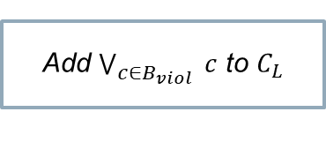




ConAcq – Sat-based version space approach
E
B
$$∀e∈E$$
Test constraints in e
$$B_{viol}$$
$$e∈E_{+}$$
No
Yes
Also from disjunctions in $C_{L}$
Remove $B_{viol}$
Add $\bigvee_{{c∈B}_{viol} }{c}$ to $C_{L}$
Constraint Acquisition, C. Bessiere et al., AIJ, 2017

Slide 16

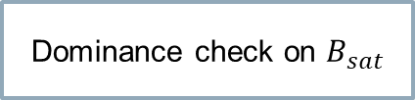

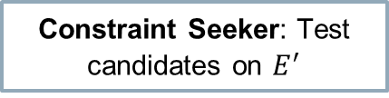




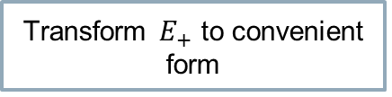
ModelSeeker Learning Global Constraints from data
Domain knowledge on which patterns to apply Γ
Only positive examples
$$Γ$$
$P$: patterns
$$E_{+}$$
Generate candidates
Transform $E_{+}$ to convenient form
$$B$$
$$E^{′}$$
Global Constraints
Actually, a bit more than just a violation test
Constraint Seeker: Test candidates on $E^{′}$
$$B_{sat}$$
Dominance check on $B_{sat}$
A Model Seeker: Extracting Global Constraint Models from Positive Examples, N. Beldiceanu et al., CP, 2012

Slide 17
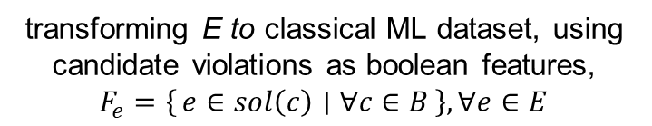
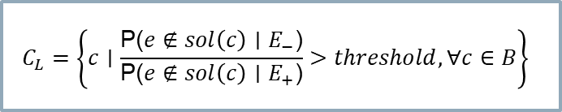

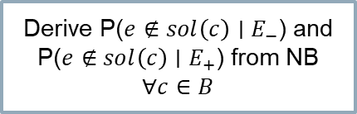
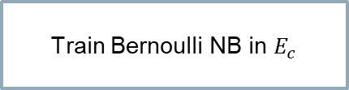
Statistical approaches – BayesAcq
Robust approach: Can handle noise in training set
E
B
transforming E to classical ML dataset, using candidate violations as boolean features,
$F_{e}=\left\{e∈sol\left(c\right) ∣ ∀c∈B\right\}, ∀e∈E$
Create $E_{c}$,
Train Bernoulli NB in $E_{c}$
Derive probabilities for constraints from NB
Derive P($e∉sol\left(c\right)∣E_{−}$) and P($e∉sol\left(c\right)∣E_{+}$) from NB $∀c∈B$
Learn constraints with probability higher than a threshold
$$C_{L}=\left\{c∣\frac{\text{P}\text{(}e∉sol\left(c\right)∣E_{−}\text{)}}{\text{P}\text{(}e∉sol\left(c\right)∣E_{+}\text{)}}>threshold,∀c∈B\right\}$$
Classifier-based constraint acquisition, S. Prestwich et al., AMAI, 2021

Slide 18

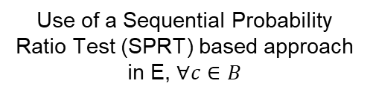
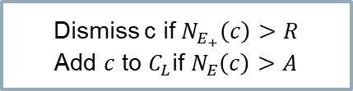
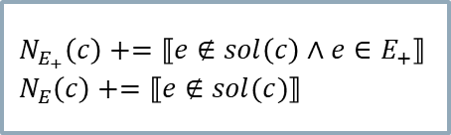
Statistical approaches – SeqAcq
Robust approach: Can handle noise in training set
E
B
{A,R}
$$∀c∈B$$
$$∀e∈E$$
Generate-and-test based approach
learning or removing constraints
based on a statistical test
Not representing the whole set of candidates at the same time
Test the c in e
$$N_{E_{+}}\left(c\right)+=⟦e∉sol\left(c\right)∧e∈E_{+}⟧ \\ N_{E}\left(c\right)+=⟦e∉sol(c)⟧$$
Use of a Sequential Probability Ratio Test (SPRT) based approach in E, $∀c∈B$
Dismiss c if $N_{E_{+}}\left(c\right)>R$
Add $c$ to $C_{L}$if $N_{E}\left(c\right)>A$
Remove from c candidates
Robust Constraint Acquisition by Sequential Analysis, S. Prestwich., ECAI, 2020

Slide 19

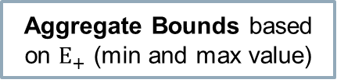
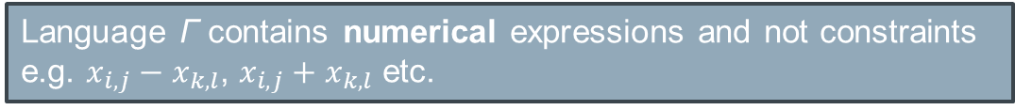


COUNT-CP: Learn using generate and aggregate
Learns constraints of the following form: $lb <= expr <= ub$
Aggregates the bounds of the expressions based on $E_{+}$
Pattern-based grouping like in ModelSeeker
Language Γ contains numerical expressions and not constraints
e.g. $x_{i,j}−x_{k,l}$, $x_{i,j}+x_{k,l}$ etc.
$$∀ expr∈Γ$$
$$Ε_{+}$$
Aggregate Bounds based on $Ε_{+}$ (min and max value)
Generalization to first-order constraints
$$∀ generated expression$$
Express bounds using symbolic expressions
Constraint Filtering
Learning Constraint Programming Models from Data using Generate-and-Aggregate, M. Kumar et al., CP, 2022

Slide 20
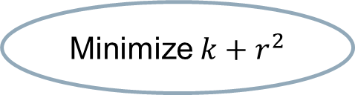
LANGUAGE-FREE ACQ Acquire constraints without knowing the language
Does not need a Language Γ of possible relations
Learning also the relations used (in an extensional form)
k = size of language
r = arity
Model it as a MAX-SAT problem: Try to find a consistent set of constraints
- Agreeing with the examples
- Minimizing the objective(s)
Minimize $k+r^{2}$
Start with k=1, r=1
Solve Weighted MAX-SAT
problem
SAT
Return constraints and language
UNSAT
Increase k or r based on the objective
Learning Constraint Networks over Unknown Constraint Languages, Christian Bessiere, Clément Carbonnel, Areski Himeur, IJCAI, 2023

Slide 21
Passive Constraint Acquisition Small Summary
Labelled examples
CSP Model
We discussed:
Basics of Constraint Acquisition
Passive Constraint Acquisition
Different approaches tackling different cases

Slide 22


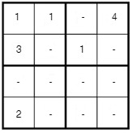
Interactive Constraint Acquisition
Oracle
Unlabelled examples
Labels
CSP Model
Membership query
Partial query
Answer: Negative in both of them
(a constraint is violated)
Learning Constraints through Partial Queries, C. Bessiere et al., AIJ, 2023

Slide 23
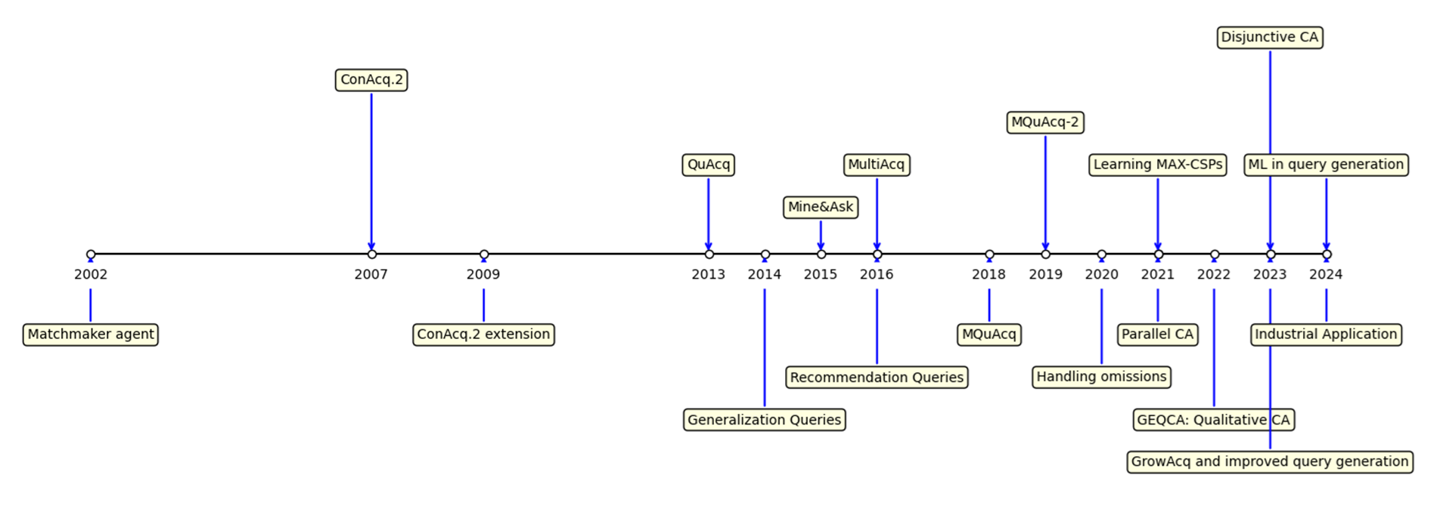


Progress in Interactive CA
PyConA - Python library for Constraint Acquisition
https://github.com/CPMpy/PyConA

Slide 24
Interactive Constraint Acquisition
Learn constraints: zoom in violated constraints’ scopes using partial queries and add them to C_{L}
Update
Version space
No
Learn violated constraints
Example
found
Generate example
Ask query to the user
Answer
Eliminate violated candidates
No example
found
Yes
Converged
Shrink version space: remove violated constraints from B
Learning Constraints through Partial Queries, C. Bessiere et al., AIJ, 2023

Slide 25

Challenges for interactive CA
Minimum number of queries
Minimum waiting time for the user
Too many questions
I need to wait too much for each query
Learning constraint models from data, D Tsouros et al., 2023

Slide 26
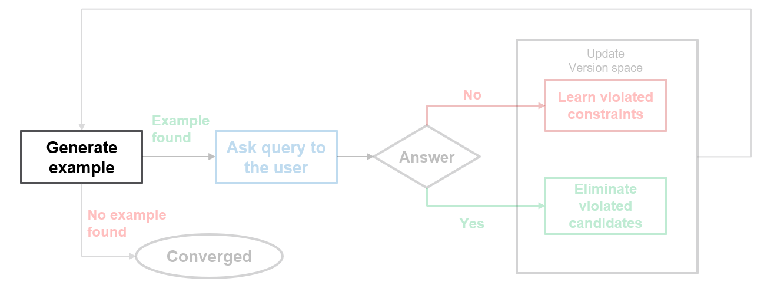
Query generation
Informative query
Quality of query
Convergence
Generate “informative” examples
Get the maximum amount of information

Slide 27

Query generation
Find an Informative (“irredundant”) query
Not violating any learned constraint in C_{L}
Violating at least one constraint from B
Why??
Find $e∈sol(C_{L}∧\bigvee_{c∈B}{\sim c})$
Learning Constraints through Partial Queries, C. Bessiere et al., AIJ, 2023

Slide 28
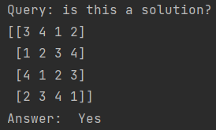
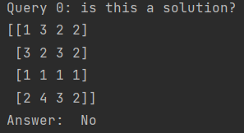
What we can learn from examples
Learning from positive examples (Solutions):
Learning from negative examples (Non-solutions):
- Violated constraints cannot be part of the model
- Otherwise, it could not be a solution
- One (or more) violated constraint is a constraint of the problem
- Otherwise, it would be a solution
Shrinking the bias
Learning Constraints
In both cases, we get information only about the violated candidates and not about the satisfied ones!

Slide 29
Query generation
Informative query
Quality of query
Convergence
Get the maximum amount of information

Slide 30
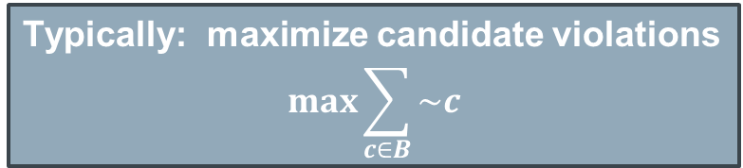
Query generation
Quality of query
Better generated examples lead to faster convergence
More information per query -> less queries needed
Typically: maximize candidate violations
$$max\sum_{c∈B}{\sim c}$$
Not fully aligning with the goal!!
We will discuss this later
Constraint acquisition via partial queries, C. Bessiere et al., IJCAI, 2013

Slide 31
Query generation
Informative query
Quality of query
Convergence
When no informative query exists
Premature converge: if query generation failed but not proven UNSAT

Slide 32
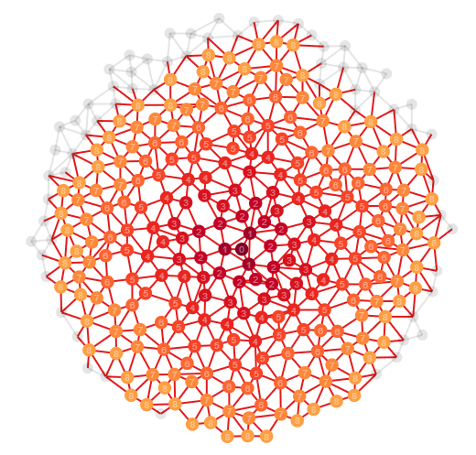
Query generation
Finding an Irredundant query
Finding an informative query is not always easy…
B can be huge!!
B can contain indirectly implied constraints:
indirectly: being implied by combination of constraints from different scopes
Indirect implications are not detected with simple propagation!!

Slide 33
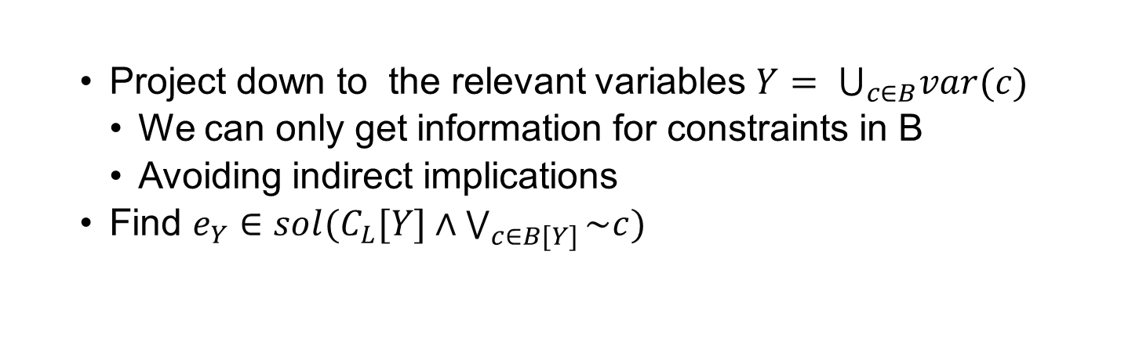
Query generation
Custom solvers
Custom solvers were often employed to deal with this
Looking for$e_{Y}∈sol(C_{L}[Y]∧\bigvee_{c∈B[Y]}{\sim c})$
Looking for 𝑒_𝑌∈𝑠𝑜𝑙(𝐶_𝐿 [𝑌]∧⋁_(𝑐∈𝐵[𝑌])▒〖~𝑐〗)
Custom branching – optional variables
Arbitrary $Y ⊆X$
Arbitrary 𝑌 ⊆𝑋
Projection-based query generation
Project down to the relevant variables $Y= ⋃_{c∈B}var(c)$
We can only get information for constraints in B
Avoiding indirect implications
Find $e_{Y}∈sol(C_{L}[Y]∧\bigvee_{c∈B[Y]}{\sim c})$
Guided Bottom-up Constraint Acquisition, D. Tsouros et al., CP, 2023

Slide 34

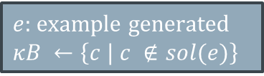
Interactive Constraint Acquisition
What happens after query generation?
Learn constraints: zoom in violated constraints’ scopes using partial queries and add them to C_{L}
Update
Version space
No
Learn violated constraints
Example
found
Generate example
Ask query to the user
Answer
Eliminate violated candidates
No example
found
Yes
Converged
Shrink version space: remove violated constraints from B
$e:$ example generated
$$κB ←\left\{c | c ∉sol(e)\right\}$$
How to find which of the
violated constraint(s) to learn?
$$B ←B ∖κB(e)$$

Slide 35
Learning a constraint
Update
Version space
No
Learn violated constraints
Example
found
Generate example
Ask query to the user
Answer
Eliminate violated candidates
No example
found
Yes
Converged
2-step process:
Find a minimal conflicting scope
Find the constraint
FindScope: exploit partial (sub)queries to find the problematic part of the assignment
FindC: Try different assignments to find the specific constraint in the scope
Learning Constraints through Partial Queries, C. Bessiere et al., AIJ, 2023

Slide 36
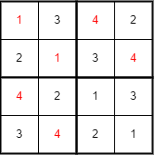
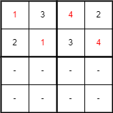
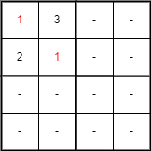
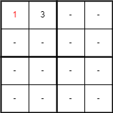
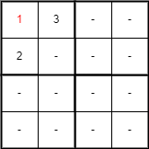
Finding the scope of a constraint
Find a minimal conflicting scope
Find the constraint
Negative
Negative
Negative
Positive
Positive
…

Slide 37
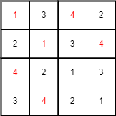
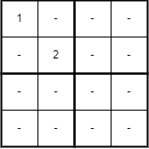
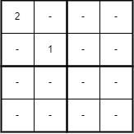

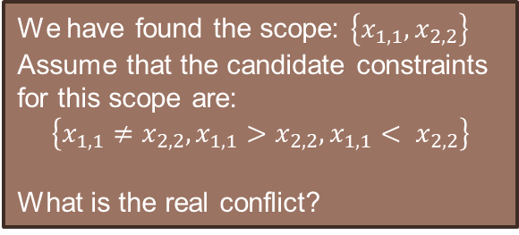
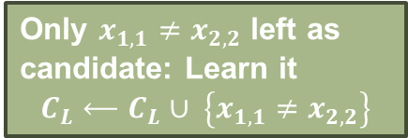

Finding the relation of a constraint
Find a minimal conflicting scope
Find the constraint
We have found the scope: $\left\{x_{1,1},x_{2,2}\right\}$
Assume that the candidate constraints for this scope are:
$$\left\{x_{1,1}≠x_{2,2},x_{1,1}>x_{2,2},x_{1,1}< x_{2,2}\right\}$$
What is the real conflict?
Try different assignments to find the specific constraint in the scope
Positive
Only $x_{1,1}≠x_{2,2}$ left as candidate: Learn it
$$C_{L}⟵C_{L}∪ \left\{x_{1,1}≠x_{2,2}\right\}$$
Positive
Remove $x_{1,1}>x_{2,2}$
Remove $x_{1,1}< x_{2,2}$
Learning Constraints through Partial Queries, C. Bessiere et al., AIJ, 2023

Slide 38
Interactive Constraint Acquisition QuAcq
Learn one violated constraint of the problem
Update
Version space
No
Learn violated constraints
Example
found
Generate example
Ask query to the user
Answer
Eliminate violated candidates
No example
found
Yes
Converged
Shrink version space: remove violated constraints from B
QuAcq:
Learning one violated constraint per generated example
Logarithmic number of queries for each constraint
Learning Constraints through Partial Queries, C. Bessiere et al., AIJ, 2023

Slide 39
Interactive Constraint Acquisition Multiple Acquisition
Learn multiple violated constraints of the problem
Get sub-query not containing
the violated constraint
Update
Version space
No
Learn violated constraints
Example
found
Generate example
Ask query to the user
Answer
Shrink version space: remove violated constraints from B
Eliminate violated candidates
No example
found
Yes
Converged
Multiple Acquisition:
Learn multiple constraints in each loop instance
Don’t generate a new example when a constraint is learnt
- Instead, get an example in a subset of variables not violating the constraint found
Efficient Multiple Constraint Acquisition, D. Tsouros et al., Constraints, 2020

Slide 40
What if the set of candidates is too large??
Can’t store all of it at the same time??
Too slow query generation??

Slide 41








GrowAcq: Growing Acquisition
Start with $Y1 ← ∅$, or a small subset of X
$$∀xi∈X\backslash Y_{1}$$
$$Yi←Yi−1∪\left\{x_{i}\right\}$$
Generate B with $x_{i}$
$$C_{L}\left[Y_{i−1}\right]$$
Bottom-up approach: Using Interactive CA algorithms, on an (incrementally growing) subset of variables
$X$: set of variables
Interactive CA algorithm
$$C_{L}\left[Y_{i}\right]$$
$$Y ⊂X$$
Yes
Need only constraints that newly added variable participates
No
Converged
Guided Bottom-up Constraint Acquisition, D. Tsouros et al., CP, 2023

Slide 42
GrowAcq: Growing Acquisition
Start with $Y1 ← ∅$, or a small subset of X
$$∀xi∈X\backslash Y_{1}$$
$$Yi←Yi−1∪\left\{x_{i}\right\}$$
Generate B with $x_{i}$
$$C_{L}\left[Y_{i−1}\right]$$
Saves time during query generation! We can use more efficiently the time to guide better Constraint Acquisition
Bottom-up approach: Using Interactive CA algorithms, on an (incrementally growing) subset of variables
$X$: set of variables
Interactive CA algorithm
$$C_{L}\left[Y_{i}\right]$$
$$Y ⊂X$$
Yes
Need only constraints that newly added variable participates
No
Converged
Guided Bottom-up Constraint Acquisition, D. Tsouros et al., CP, 2023

Slide 43
Interactive Constraint Acquisition
Small summary
Update
Version space
No
Learn violated constraints
Example
found
Generate example
Ask query to the user
Answer
Eliminate violated candidates
No example
found
Yes
Converged
We discussed:
Interactive CA basics
Query generation
Finding the scope of problem constraints
Finding the relation of the constraints
Growing Acquisition

Slide 44

PyConA
Using the CPMpy modeling library
https://github.com/CPMpy/PyConA
https://github.com/CPMpy/CPMpy
Hands-on on interactive CA Demo: (also in Github: notebooks/CP24 Tutorial Demo.ipynb)
https://colab.research.google.com/github/CPMpy/PyConA/blob/main/notebooks/CP24%20Tutorial%20Demo.ipynb

Slide 45
Prediction-Based Interactive Constraint Acquisition

Slide 46

Guiding Query Generation
Quality of query
Better generated examples lead to faster convergence
More information per query -> less queries needed
Not fully aligning with the goal!!
Typically: maximize candidate violations
$$max\sum_{c∈B}{\sim c}$$

Slide 47
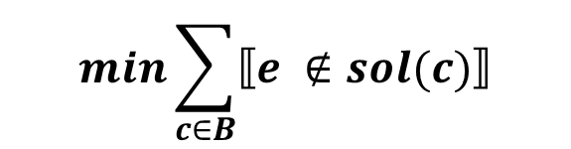
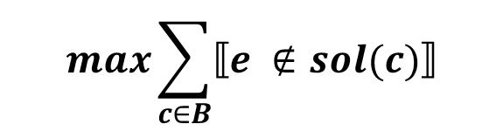
Guiding Query Generation
Better generated examples lead to faster convergence
Positive answers: shrink B fast
Negative answers: Find the conflict fast
The more we have violated the faster B will shrink
The less candidates we have violated, the less queries we need to find the constraint(s)
$$\max{\sum_{c∈B}{⟦e ∉sol(c)⟧}}$$
Opposite objectives based on the (future) answer
$$\min{\sum_{c∈B}{⟦e ∉sol(c)⟧}}$$
Guided Bottom-up Constraint Acquisition, D. Tsouros et al., CP, 2023

Slide 48
Guiding Query Generation
Better generated examples lead to faster convergence
Positive answers: shrink B fast
Negative answers: Find the conflict fast
We cannot know the answer of the user before we ask the query → max violations
The more we have violated the faster B will shrink
The less candidates we have violated, the less queries we need to find the scope (and relation) of the constraint(s)
But what if we can predict if a candidate is a constraint of the problem or not?
$$\max{\sum_{c∈B}{⟦e ∉sol(c)⟧}}$$
Opposite objectives based on the (future) answer
$$\min{\sum_{c∈B}{⟦e ∉sol(c)⟧}}$$

Slide 49




Guiding Query Generation
Positive answers: shrink B fast $→\max{\sum_{c∈B}{⟦e ∉sol(c)⟧}}$
Negative answers: Find the conflict fast $→\min{\sum_{c∈B}{⟦e ∉sol(c)⟧}}$
What if we can predict if a candidate is a constraint of the problem or not?
If the constraint c is violated
Increase objective value by 1
Use of Oracle $O(c)=(c∈C_{T})$, to guide query generation based on the prediction of the constraint
If it is a constraint predicted to be true: reduce objective value significantly
$$e=\underset{e ∈Sol(C_{L} \bigwedge{B)}}{argmax}{\sum_{c∈B}{⟦e ∉sol(c)⟧⋅(1−\left|Γ\right|⋅⟦O(c)⟧)} }$$
1. Aim for positive answers first: $\max{(\sum_{c∈B}{⟦e ∉sol(c)⟧}})$
2. When a (probably true) constraint has to be violated, leading to a negative answer
$\min{(\sum_{c∈B}{⟦e ∉sol(c)⟧}})$
Aim to violate
No
O(c)
Why?
True
Aim to satisfy
Guided Bottom-up Constraint Acquisition, D. Tsouros et al., CP, 2023

Slide 50

Guiding CA when finding the scope
Exploit partial (sub)queries to find the conflicting part
How are the removed variable assignments decided???
Follow the same logic
But the new example is a sub-example of previous one
Instead of deciding variable assignments, decide which variables to keep in the assignment
$$e_{Y}=\underset{e_{Y} | Y ⊆var(e)}{argmax}{\sum_{c∈B}{⟦e_{Y} ∉sol(c)⟧⋅(1−\left|Γ\right|⋅⟦O(c)⟧)} }$$
Aim to violate
No
O(c)
True
Aim to satisfy

Slide 51

Guiding CA when finding the relation
Try different assignments to find the specific constraint in the scope
How are the assignments decided???
Follow the same logic
But the new example has to be an assignment only to the scope S found
$$e_{S}=\underset{e_{S} ∈Sol(C_{L}\left[S\right] \bigwedge{B\left[S\right])}}{argmax}{\sum_{c∈B}{⟦e_{S} ∉sol(c)⟧⋅(1−\left|Γ\right|⋅⟦O(c)⟧)} }$$
Aim to violate
No
O(c)
True
Aim to satisfy

Slide 52

Do we have an oracle $O\left(c\right)$ to guide CA
The oracle $O\left(c\right)$ “classifies” a candidate as a problem constraint or not
Aim to violate
No
O(c)
It is a prediction problem
True
Aim to satisfy
Use Machine Learning!!
ML
Query
Generation
Learn from user’s answer
Update Constraint dataset
Learning to Learn in Interactive Constraint Acquisition, D. Tsouros et al., AAAI, 2024

Slide 53

Do we have an oracle $O\left(c\right)$ to guide CA
The oracle $O\left(c\right)$ “classifies” a candidate as a problem constraint or not
Aim to violate
No
O(c)
It is a prediction problem
Predictions for constraints not for variable assignments!!
True
Aim to satisfy
Use Machine Learning!!
ML
Query
Generation
Learn from user’s answer
Update Constraint dataset
Learning to Learn in Interactive Constraint Acquisition, D. Tsouros et al., AAAI, 2024

Slide 54
Using Machine Learning for the prediction
Dataset: Constraint features and class (True or False)
Constructing during the acquisition process
Constraints that we know are part of the problem or not
When a constraint is learned add a positive instance
When a constraint is removed from B add a negative instance
Use both relation and scope features
Relation-based features | Scope-based features
Relation name (string) | Dim[i] same_val (Bool)
Has constant (Bool) | Dim[i] avg (float)
Constant value (int) | Dim[i] distance (int)
Arity (int) | …
Learning to Learn in Interactive Constraint Acquisition, D. Tsouros et al., AAAI, 2024

Slide 55
Using Machine Learning for the prediction
Dataset: Constraint features and class (True or False)
Constructing during the acquisition process
Constraints that we know are part of the problem or not
When a constraint is learned add a positive instance
When a constraint is removed from B add a negative instance
Use both relation and scope features
Example for constraint
x_{1,1} ≠ x_{1,2} in Sudoku
Relation-based features | Scope-based features
Relation name (string) ≠ | Dim[i] same_val (Bool) True, False
Has constant (Bool) False | Dim[i] avg (float) 1, 1.5
Constant value (int) -1 | Dim[i] distance (int) 0, 1
Arity (int) 2 | …
For the 2 dimensions
Learning to Learn in Interactive Constraint Acquisition, D. Tsouros et al., AAAI, 2024

Slide 56



Using Machine Learning in the Oracle
The oracle $O\left(c\right)$ “classifies” a candidate as a problem constraint or not
Use of any classification technique to simulate the Oracle
$$O\left(c\right)=Class(c)$$
classifier.predict()
Use of probabilities?
$$O\left(c\right)= \frac{1}{expected_queries } ≤P(c)$$
classifier.predict_proba()
Minimize the expected number of queries
$expected_queries$: estimation of number of queries for each constraint when not guided
Learning to Learn in Interactive Constraint Acquisition, D. Tsouros et al., AAAI, 2024

Slide 57
Using Machine Learning in the Oracle
The oracle $O\left(c\right)$ “classifies” a candidate as a problem constraint or not
Use of any classification technique to simulate the Oracle
$$O\left(c\right)=Class(c)$$
classifier.predict()
Use of probabilities?
$$O\left(c\right)= \frac{1}{expected_queries } ≤P(c)$$
classifier.predict_proba()
- Using predicted probabilities instead of class works way better!!
- Assuming that a candidate is a constraint of the problem even if the probability is less than 50% (but above the threshold)
- Threshold defined to minimize number of queries!
Minimize the expected number of queries
$expected_queries$: estimation of number of queries for each constraint when not guided
Learning to Learn in Interactive Constraint Acquisition, D. Tsouros et al., AAAI, 2024

Slide 58

Learning to Learn in Interactive CA
Generate example
Learning to Learn in Interactive Constraint Acquisition, D. Tsouros et al., AAAI, 2024

Slide 59
Back to the demo
Generate example

Slide 60
Other directions in (Interactive) CA

Slide 61


Generalizing Learned Constraint Models
Train a classifier using parameterized features
Classify candidates in the target instance
Generate example
Generalizing Constraint Models in Constraint Acquisition, D. Tsouros et al., PTHG, 2024

Slide 62


LLMAcq
Exploiting LLMs to process user feedback
Accept user feedback after negative answers,
fine-tuned LLMs process the feedback
No candidate constraints
No
Learn violated constraints
Example
found
Generate example
Ask query to the user
Answer
Eliminate violated candidates
Feedback
No example
found
Yes
Converged
Using Large Language Models to Improve Query-based Constraint Acquisition, Mechqrane, Y. et al., IJCAI, 2024

Slide 63
Other types of constraints
Learning Max-CSPs
Acquisition of disjunctive constraints
Similar framework,
Similar framework to ConAcq (no partial queries)
Acquisition of Qualitative constraints
Using qualitative queries
exploits MSSes,
Similar framework to ConAcq (no partial queries)
using preference queries instead, asking if a solution is better than another.

Slide 64
Open challenges in Interactive CA

Slide 65

Challenges
Number of queries
Number of queries needed to converge is still large.
Use also more expressive types of queries
Generalize during learning!

Slide 66
Challenges
Specific classes of constraints
Global constraints: Exploding the set of candidate constraints
Linear inequalities with constants: Need to consider all possible constants -> Exploding the set of candidate constraints
COUNT
x₁ + 5 < x₂
ALLDIFFERENT
|x₁ + 12| > x₄
CUMULATIVE
SUM
x₁ - x₂ != 238
CIRCUIT

Slide 67

Challenges
Noisy data
Unlike in machine learning, most constraint acquisition techniques still assume the user always (knows how to) answer correctly
Tighter integration with modern machine learning techniques

Slide 68
Conclusions
Aim to violate
No
O(c)
ML
Query
Generation
Learn from user’s answer
Update Constraint dataset
True
Aim to satisfy
Significant advancements in interactive CA the last years.
Statistical ML can be successfully be used to capture patterns in constraints!
But still much more are needed.
PyConA – Python library for Constraints Acquisition: Goal to promote research in CA

